Slide 1
VV064: Giving a Presentation
Antonín Zita

Slide 2
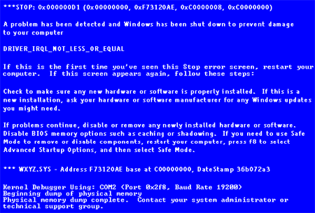
Notes:
all presentations start well before the presenter walks into the room.
Make sure everything works (media, equipment, etc.)
Have backups

Slide 3
Presentations: Before You Start…
Who is your audience?
How many people are in the audience?
What media are you using?
What technology is available?
Is everything properly set up?

Slide 4
Presentations You May Give
Research papers
  seminar/conferences, workshops
Surveys / topic introductions
  tutorials/conferences/class
Discussions / points of view
  seminars, workshops
  panels
Defense of known subject matter
  thesis, proposals
Notes:
Your minimum presentations:
-You are required to give at least one departmental seminar to your peers (other grads) and faculty
-You should try to publish and present at least one paper and/or outside presentation
-You have to give a Thesis Oral, where orals are public.

Slide 5
Presentations You May Give
Audiences
  topic specialists
  area specialists
  computer scientists
  scientists
  academics
  public
experts
lay
Notes:
Audience:
-your talk must be prepare at the right level for your audience.
-A great talk for one audience may bomb with another.
-the audience determines the amount of detail you can get into

Slide 6
Delivering a Bad Presentation
What do you think are some of the features of a bad presentation? Discuss and write down a list.
Watch: https://www.youtube.com/watch?v=ATfY8dvbuFg
Did the presentation include all the items in your list?

Slide 7
Delivering a Good Presentation
What would a good presentation look like?
Watch https://www.youtube.com/watch?v=5utoLhjUuAI
Compare and contrast the good and bad presentation and write down a list of their features.

Slide 8
Good vs. Bad Presentation
- Logical structure
- Clear and to the point
  - Using phrases instead of full sentences
- Good use of visuals
- Speech -> Presentation
- Interaction with the audience (eye contact)
- Practice before
- Fit the time frame
- Incomprehensible
- Too long/short
  - Wordy
- Too many visuals (or not enough)
- Reading the information
- Not audible enough
- Speaking slowly or too fast
- Simply boring

Slide 9
Structure
Introduction 1
Who are you?
What are you going to talk about?
How are you going to talk about it?
Why is it important?
Different time for presentation = different presentation
Notes:
Road map

Slide 10
Structure
Introduction 2
Motivate audience
  Emphasize goal and importance
Background/Terminology
  Provide greater detail
  Contextualize
  Your own motivation

Slide 11
Structure
Main Body
Bring out the facts
What you did and how did you do it
Significance

Slide 12
Structure
Conclusion
Summarize your main points
Purpose
Discuss current work/open problems
Indicate your talk is over

Slide 13
Sources
“Saul Greenberg, University of Calgary, AB, Canada: Grad Tips, http://saul.cpsc.ucalgary.ca/saul/

