Slide 1
Academic Communication Skills in English (DACSE)
Spring Term 2020

Slide 2
DACSE 2020
course instructors
course administration
course introduction

Slide 3
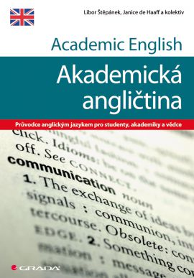
LIBOR ŠTĚPÁNEK (libor.stepanek@cjv.muni.cz)
Masaryk University Language Centre (CJV MU) Komenského nám 2
Education:
MA in English
(MA in History & PhD in Political Science)
Specialization and Research:
Academic Public Speaking
Academic Writing
Creative Approach Language Teaching

Slide 4
course objectives
After completing this course you will be able to:
communicate effectively within the international academic community setting;
be a successful participant of an international conference/meeting;
recognize various organizational patterns found in academic speaking;
adjust communication to different tasks;
write short formal academic texts.

Slide 5
course organisation
4 block sessions
2nd March 2020
3rd March 2020
6th April 2020
7th April 2020
theoretical input combined with diverse practical activities based on individual needs

Slide 6
dates
2nd March 2020
3rd March 2020
6th April 2020
7th April 2020

Slide 7
materials
IS study materials
face-to-face classes
IS (or other) discussion forum
collaborative activities

Slide 8
requirements
Active participation in:
presentations / talks / teaching sessions giving
face-to-face discussions
online discussions
writing assignment

Slide 9
introduction

Slide 10
introduction
peer2peer → class

Slide 11
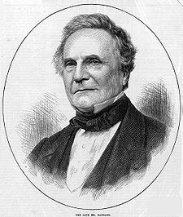
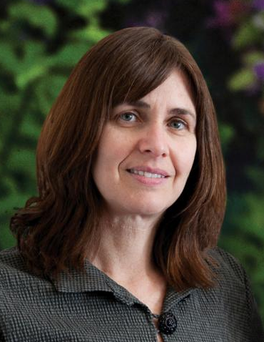
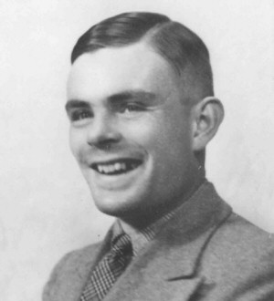
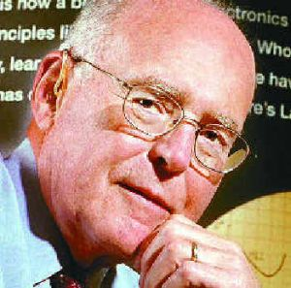
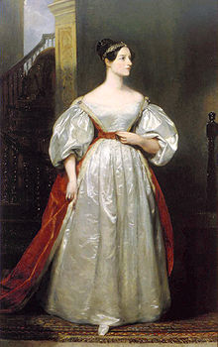
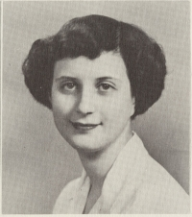
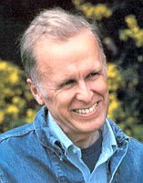
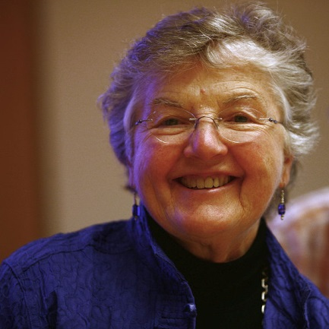
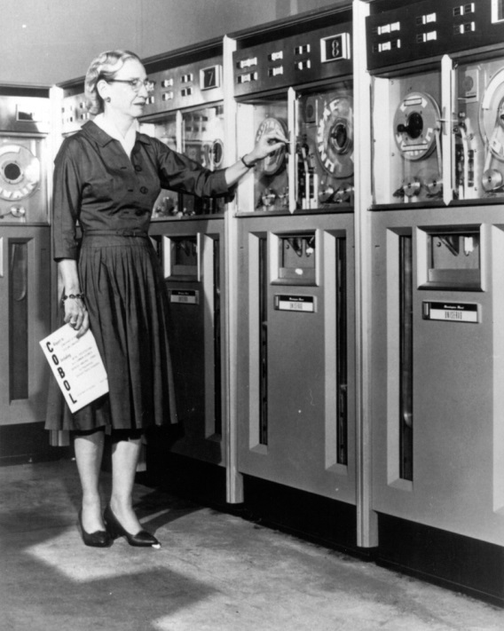
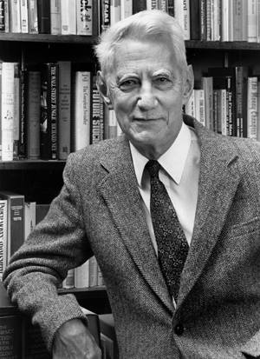
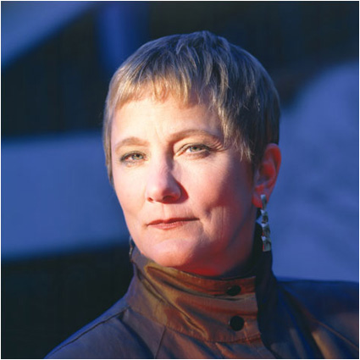
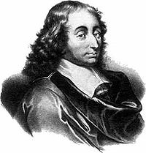

Slide 12
priorities
1.small talk – starting a conversation
2.small talk – finishing a conversation
3.small talk – cultural differences
4.small talk – turn taking
5.after-presentation discussion
6.conference presentation giving
7.panel discussion – presentations
8.panel discussion – chairing
9.panel discussion – turn taking
10.conference slot chairing
11.toast giving
12.lecturing
13.interactive seminar giving
14. academic talk
15.peer-to-peer communication
16. authoritative communication
17. “one of the crowd” communication
18.individual-audience communication
19.adjusting language to your audience
20.instructions giving
21.abstract writing
22.biography writing
23.academic writing style
24.informal emails/letters
25.formal emails/letters
26. interview
27. feedback giving
28. feedback accepting

