Slide 1


Visualization of MR data
Tomáš Pšorn

Slide 2
Takeaways
Visualization of multidimensional data might be domain independent
Visualization of multidimensional data should be domain specific, if needed
We need to have an insight into every step od MR data processing

Slide 3
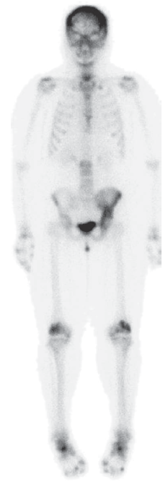
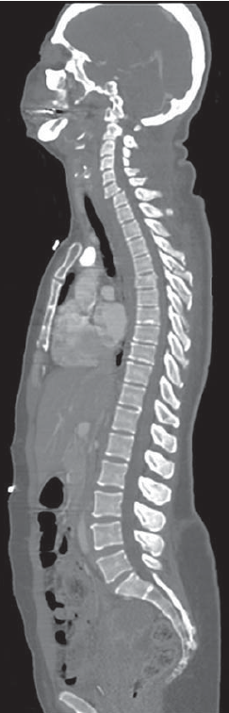
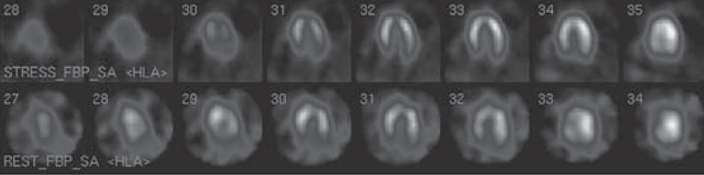
MR in medical imaging context
ultrasound
magnetic resonance imaging
scintigraphy
computed tomography
single-photon emission computed tomography
Prince, Medical Imaging Signals and Systems

Slide 4
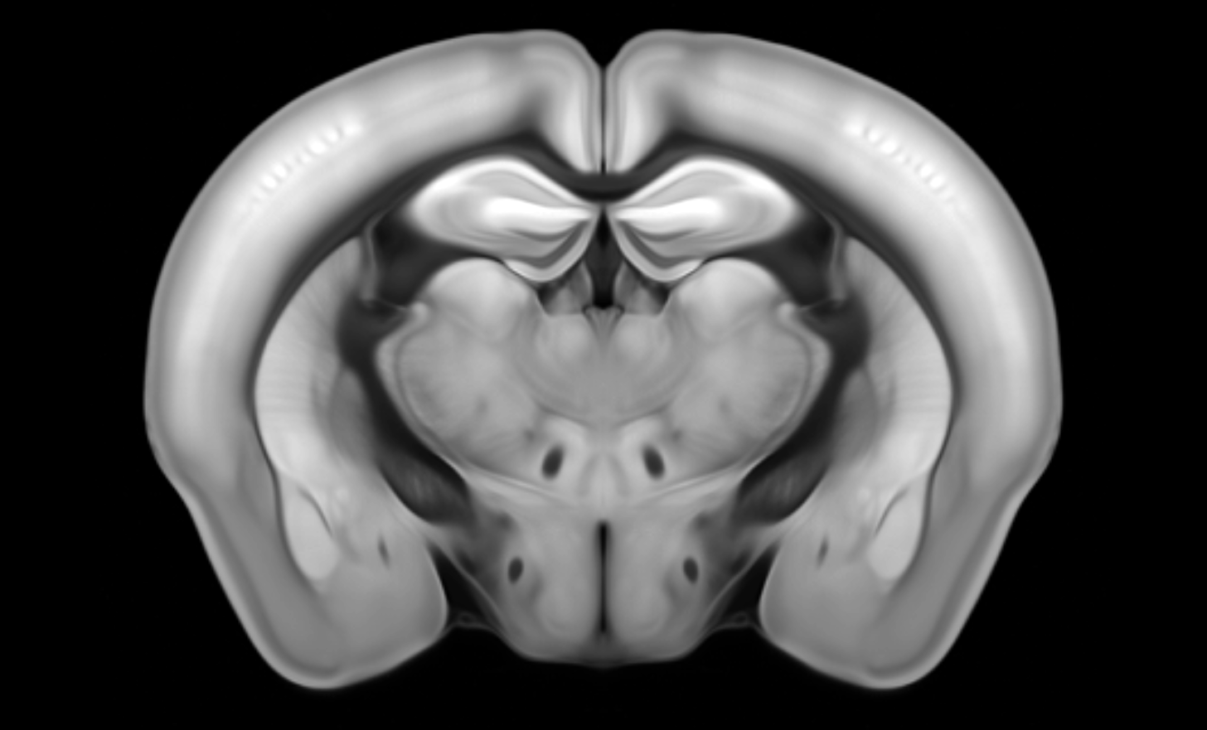
MR in my context
preclinical imaging
clinical imaging
Prince, Medical Imaging Signals and Systems

Slide 5
Features of MR data
Multiple processing stages
Multidimensional matrices
Complex entries
Non-uniformly sampled
Various contrasts encoded within
Certain level of uncertainty

Slide 6
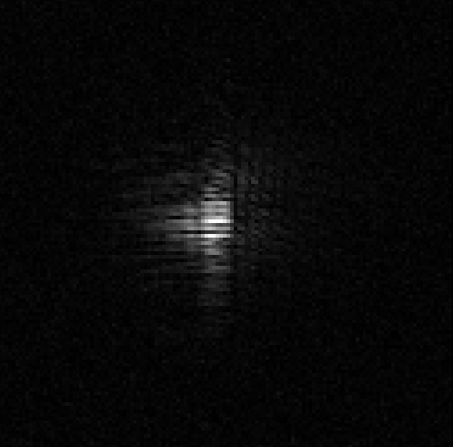

k-space
image
map
measurement
reconstruction
processing
Try to somehow see something.
Visual analysis of specific anatomical features using generic software.
Decoding visually encoded information using method specific software.

Slide 7
Features of MR data
Multiple processing stages
Multidimensional matrices
Complex entries
Non-uniformly sampled
Various contrasts encoded within
Certain level of uncertainty

Slide 8
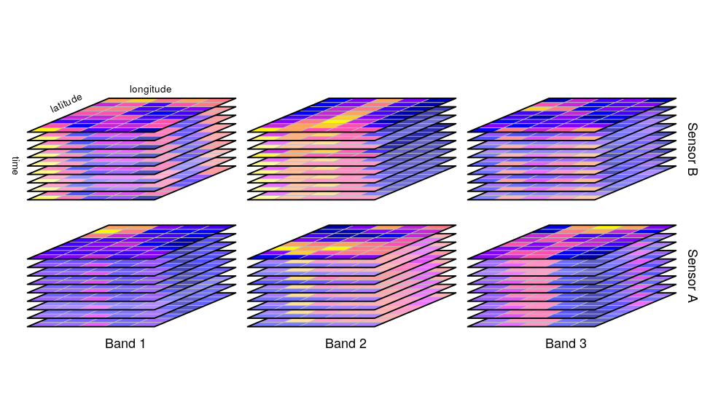
Multidimensional data
r-spatial.github.io/stars

Slide 9
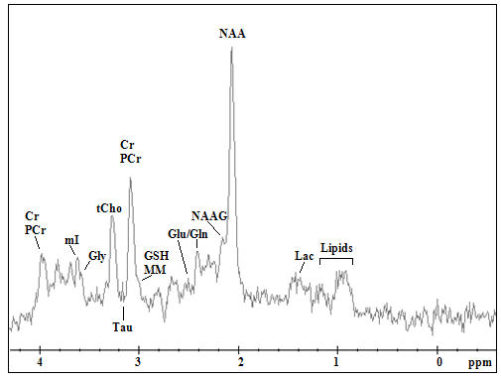
Meaning of MR dimensions
Spatial frequency [1/rad]
Space [mm]
Spectrum [Hz, ppm]
Coil
Time – repetition, echo, inversion
Diffusion
Average
Phase
Contrast
Segment
Kousi, E., et al. Novel Frontiers of Advanced Neuroimaging (2012)

Slide 10
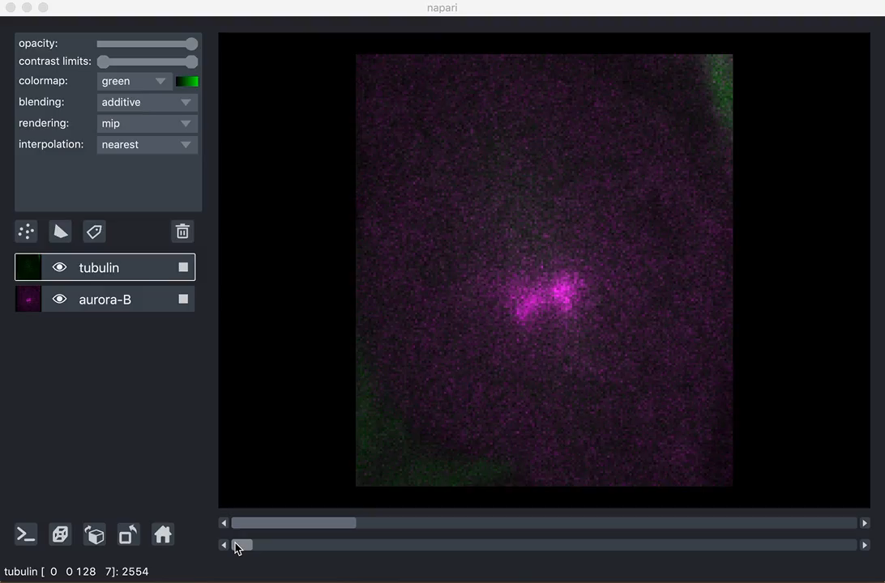
https://ilovesymposia.com/2019/10/24/introducing-napari-a-fast-n-dimensional-image-viewer-in-python/

Slide 11
Features of MR data
Multiple processing stages
Multidimensional matrices
Complex entries
Non-uniformly sampled
Various contrasts encoded within
Certain level of uncertainty

Slide 12

Complex entries
A$e^{iφ}$
The key concept:
Information is encoded in the phase of signal. The encoding is done using spatially and temporarlly varying magnetic field.

Slide 13
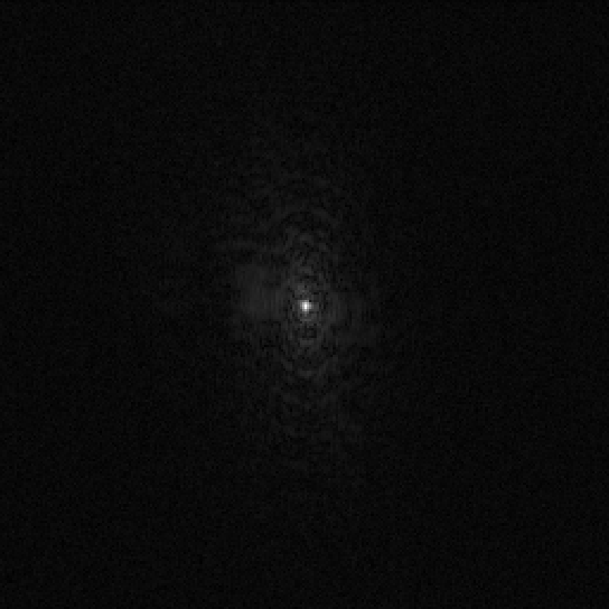
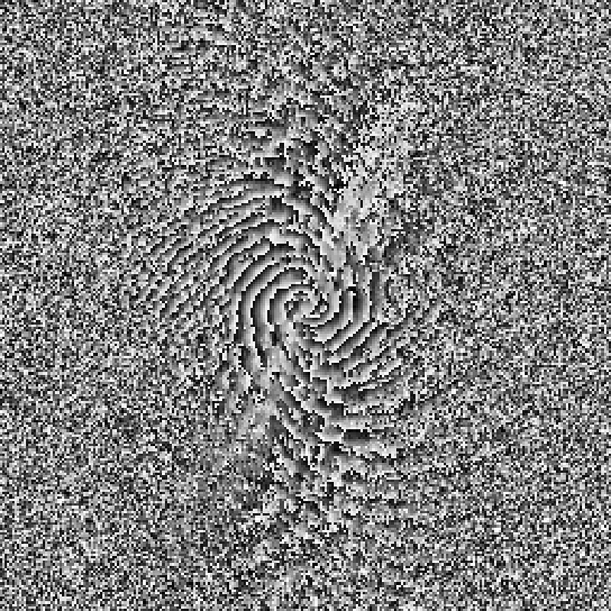
magnitude
phase

Slide 14
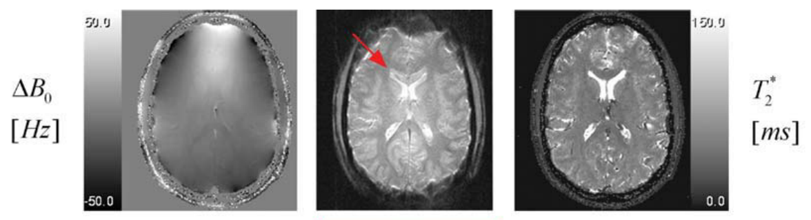
Example of correction
Hetzer, S., et al. Magnetic Resonance in Medicine (2011)

Slide 15
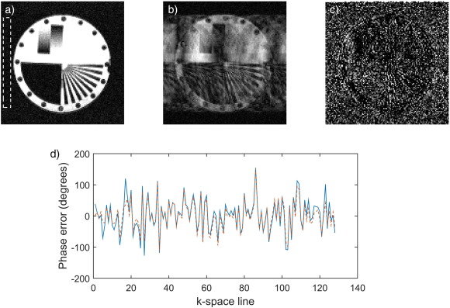
Example of correction
Broche, L. M., et al. Magnetic Resonance Imaging (2017)

Slide 16
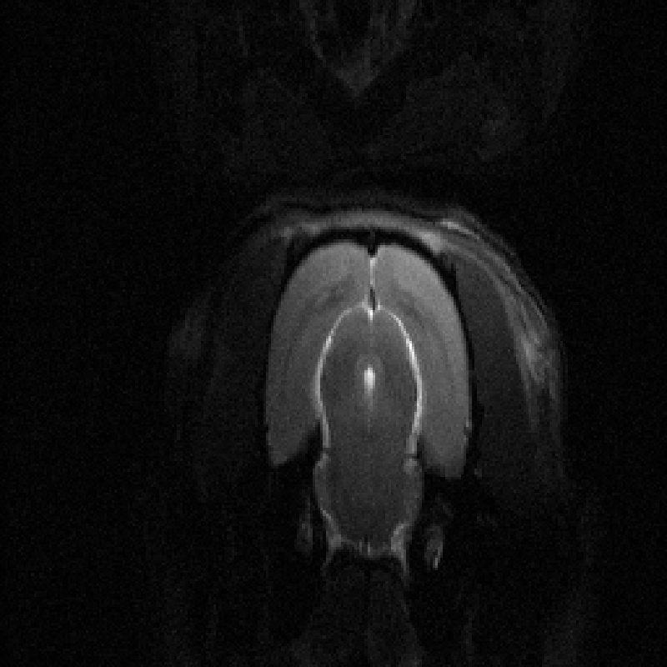
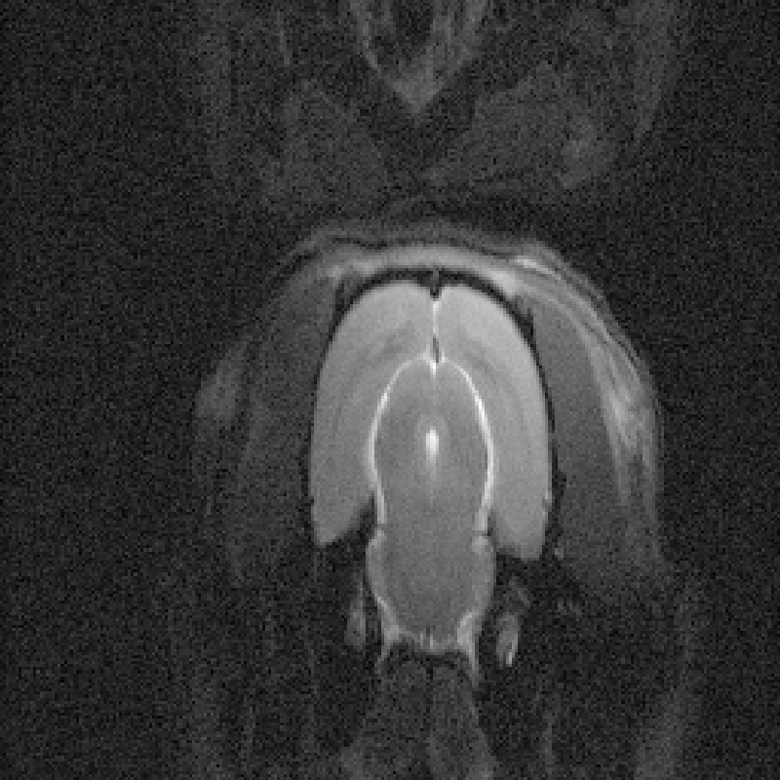
Can we spot the problem?

Slide 17
Features of MR data
Multiple processing stages
Multidimensional matrices
Complex entries
Non-uniformly sampled
Various contrasts encoded within
Certain level of uncertainty

Slide 18
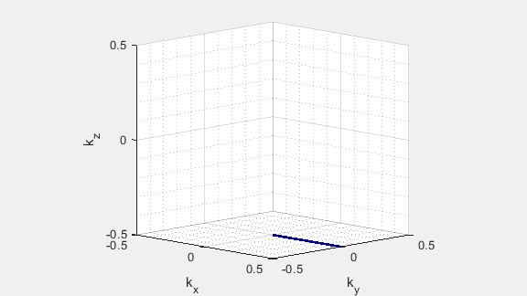
k-space trajectory

Slide 19
Normally you see a nice looking image, which is not what you normally get.
  “Standard“ methods are debugged, anything else is not.
  Data visualisazion infrastructure is the debugger.

Slide 20
Features of MR data
Multiple processing stages
Multidimensional matrices
Complex entries
Non-uniformly sampled
Various contrasts encoded within
Certain level of uncertainty

Slide 21
Susceptibility weighted imaging
SWI

Slide 22
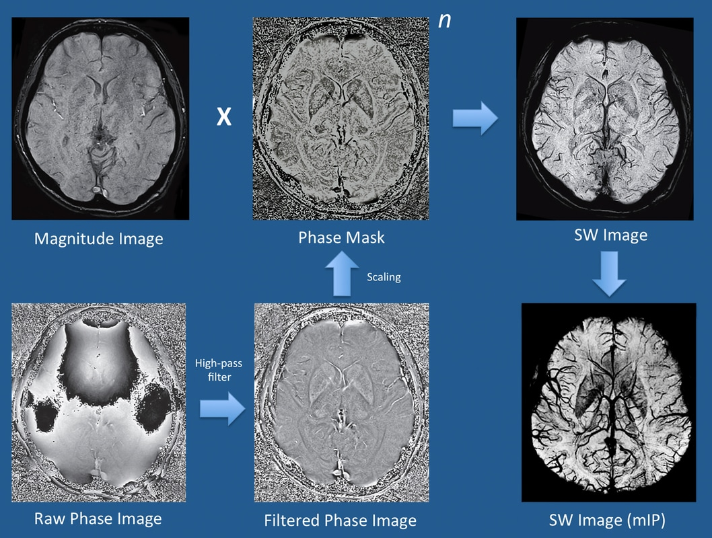
https://mriquestions.com/making-an-sw-image.html

Slide 23
…A simple step to make sure that you always view the images, in the same way, is to look at venous structures and make sure they are of low signal (if bright you should invert the greyscale). Then window the image narrowly such that the image appears a little reminiscent of a dark CT of the brain…
https://radiopaedia.org/articles/susceptibility-weighted-imaging-1
Does a common user know, what it means?
Is it possible to easily perform such a task?

Slide 24

functional MRI
fMRI

Slide 25
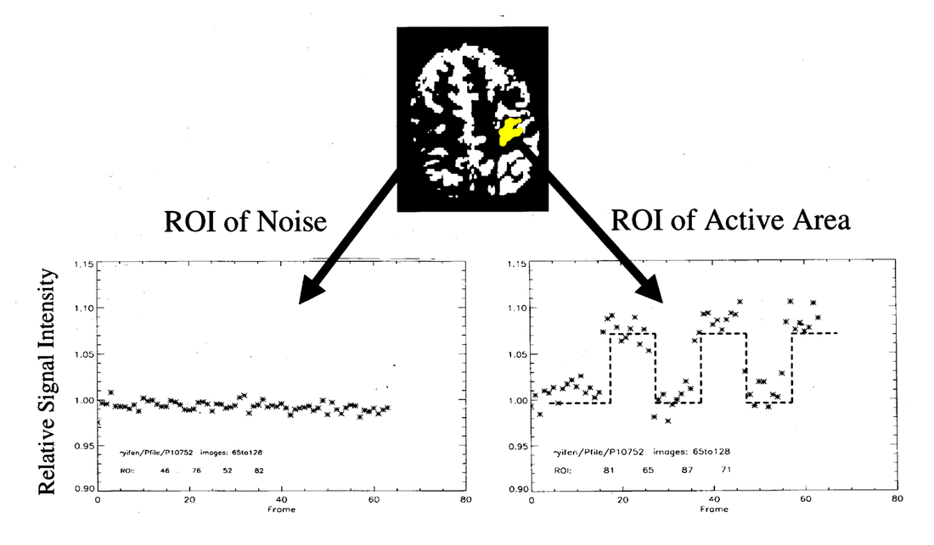
https://mriquestions.com/fmri-paradigm-design.html

Slide 26
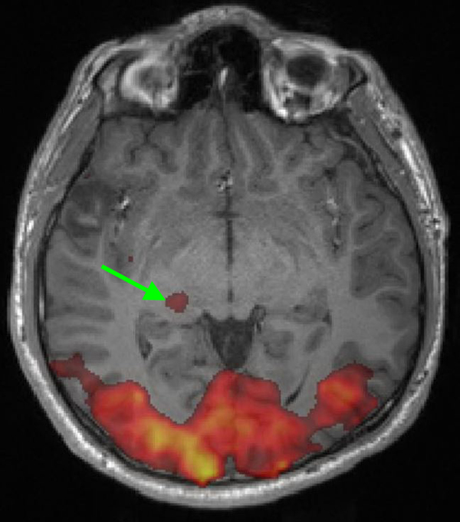
Response to visual stimuli
https://mriquestions.com/visual.html

Slide 27
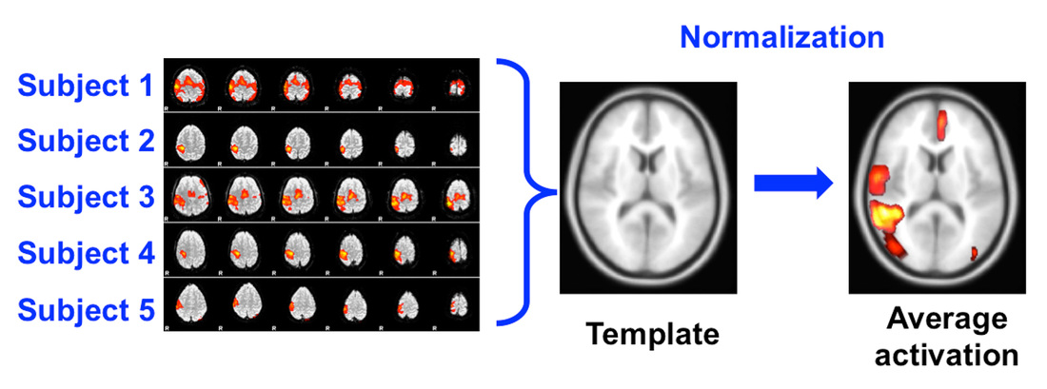
Normalization
https://mriquestions.com/registrationnormalization.html

Slide 28
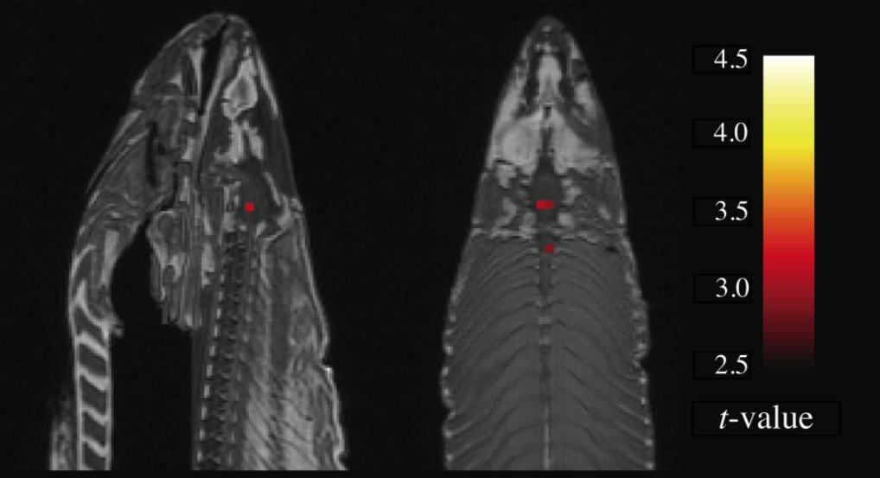
C. M. Bennett et al. J. Serendipitous Unexpected Results (2010)

Slide 29
Diffusion Tensor Imaging
DTI

Slide 30
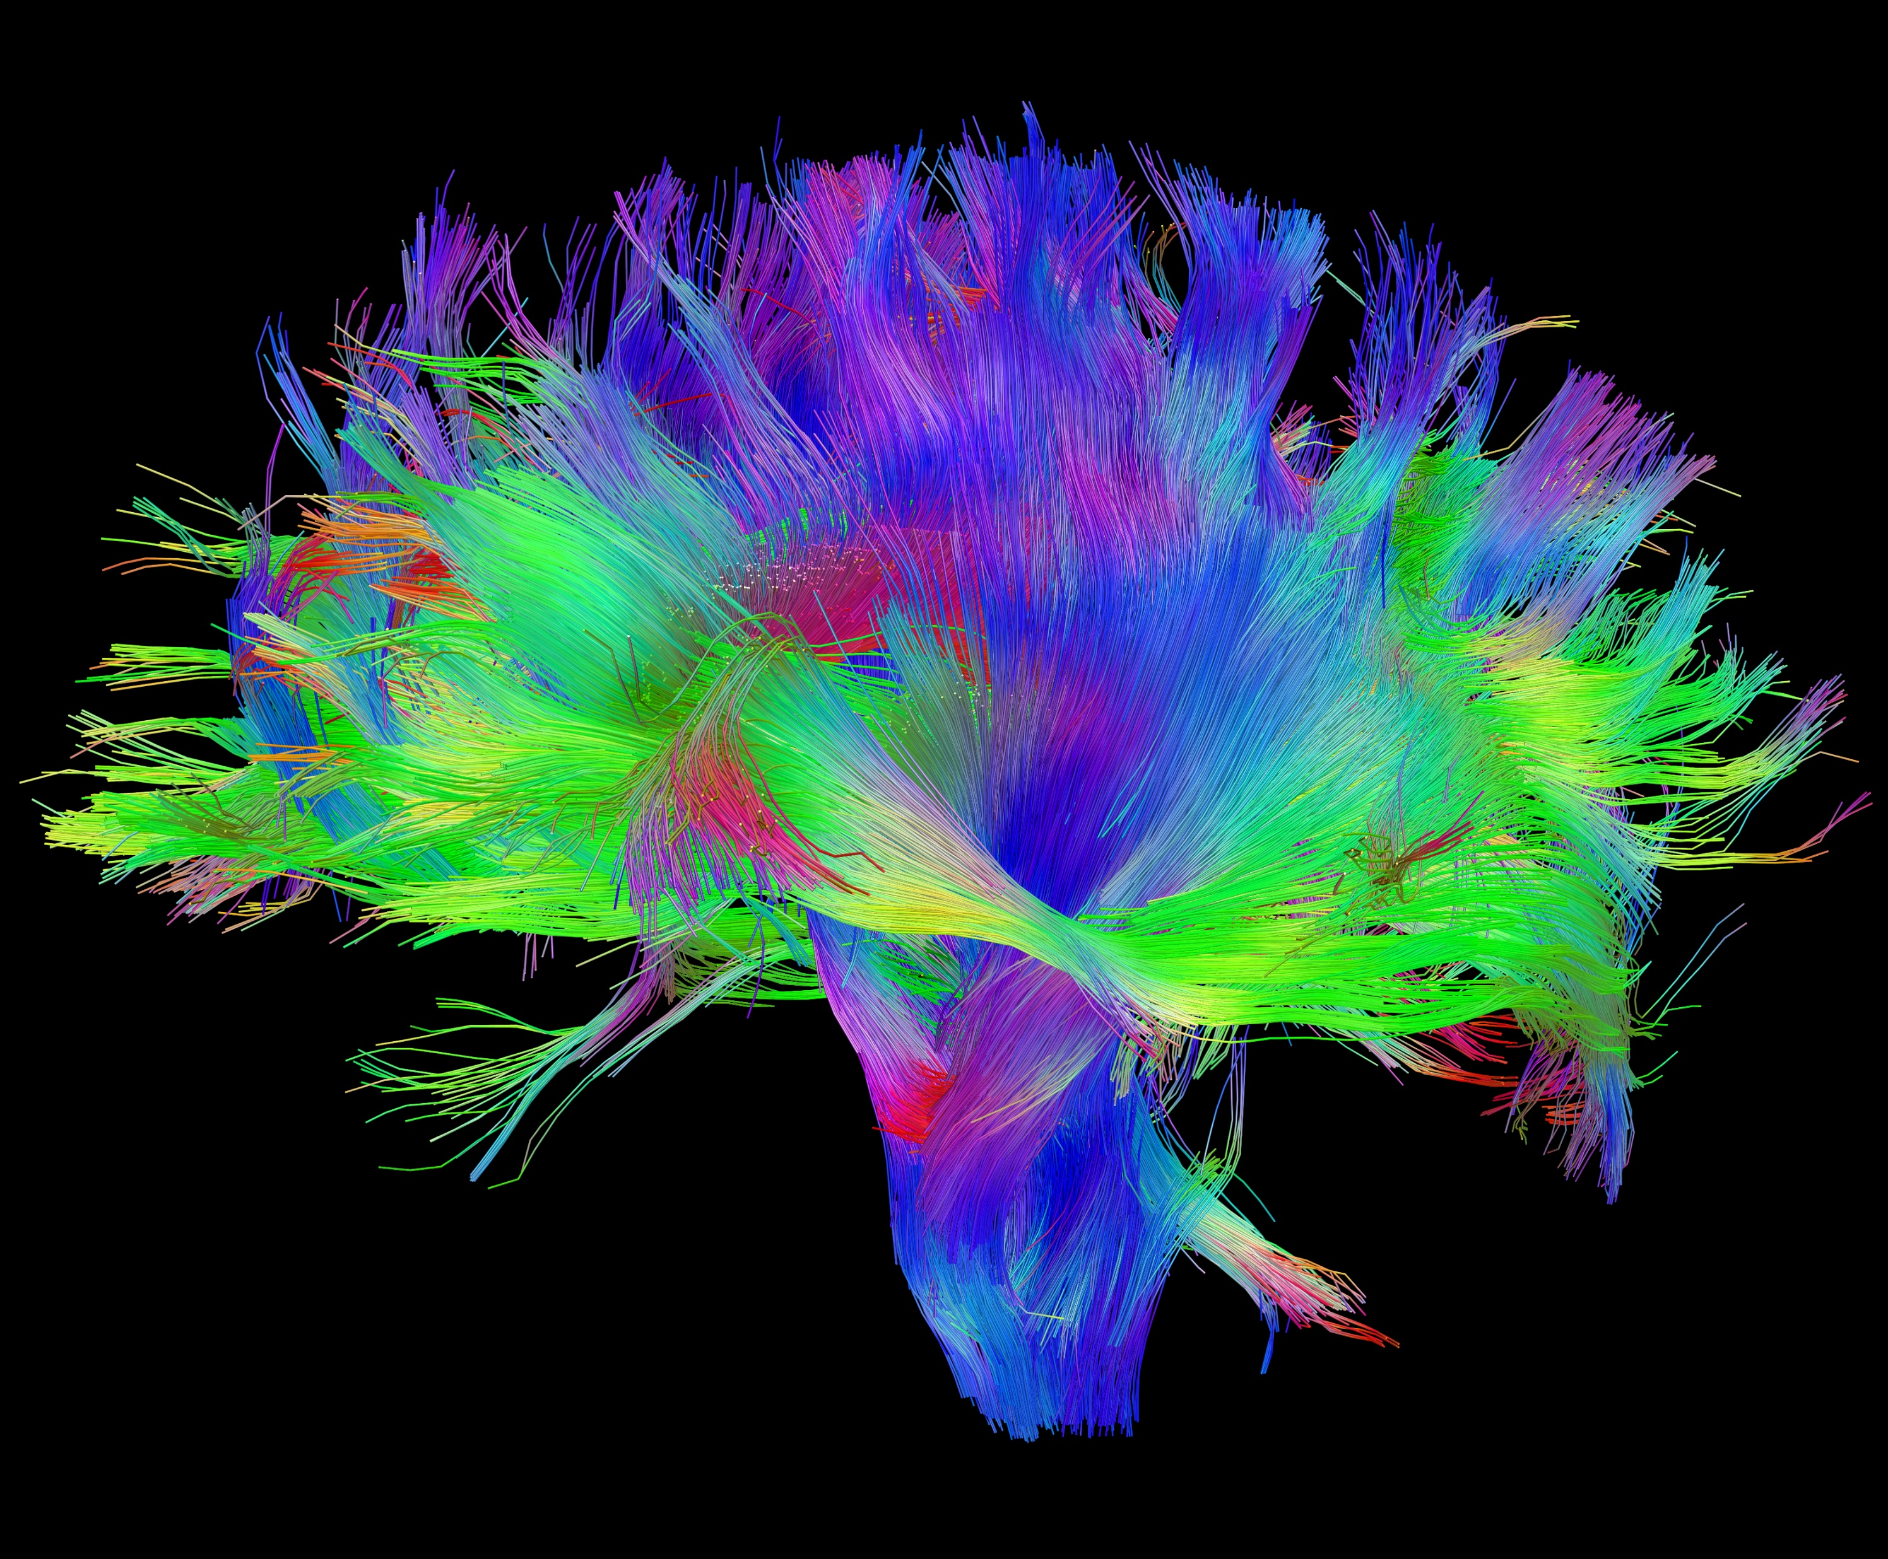
NIH/ The Human Connectome Project

Slide 31
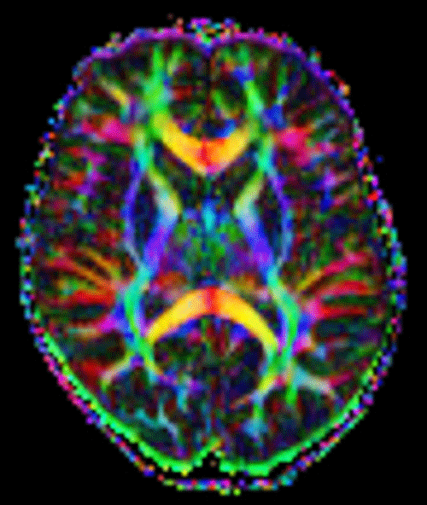

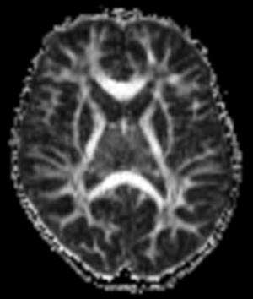
https://mriquestions.com/dti-tensor-imaging.html
NIH/ The Human Connectome Project

Slide 32
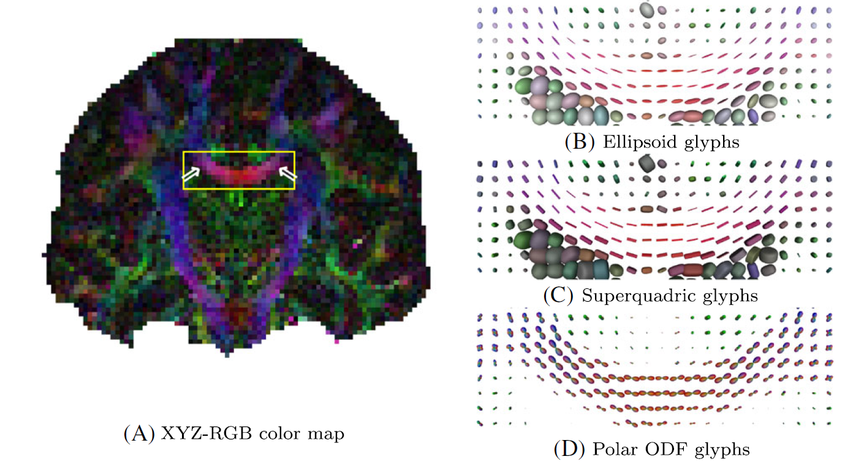
Schultz, T., NMR in Biomedicine (2017)

Slide 33
Magnetic Resonance Spectroscopy
MRS

Slide 34
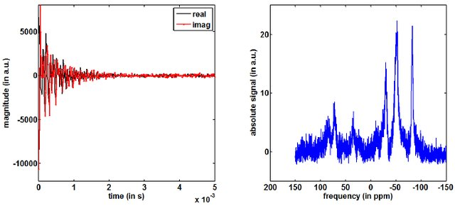
signal
spectrum
Wetterling F., et al., Key Engineering Materials (2013)

Slide 35
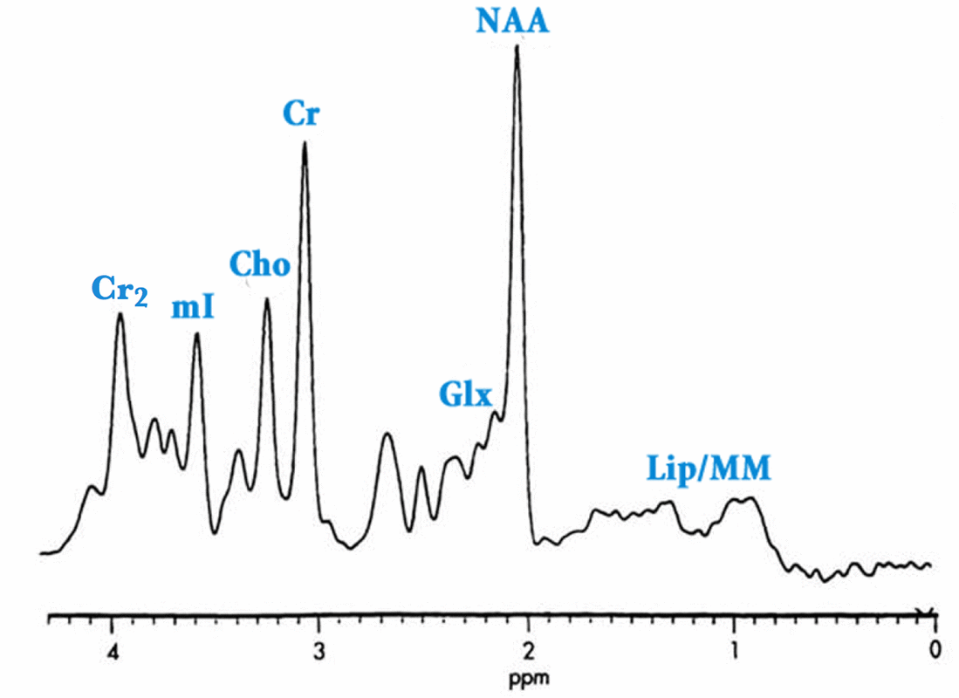
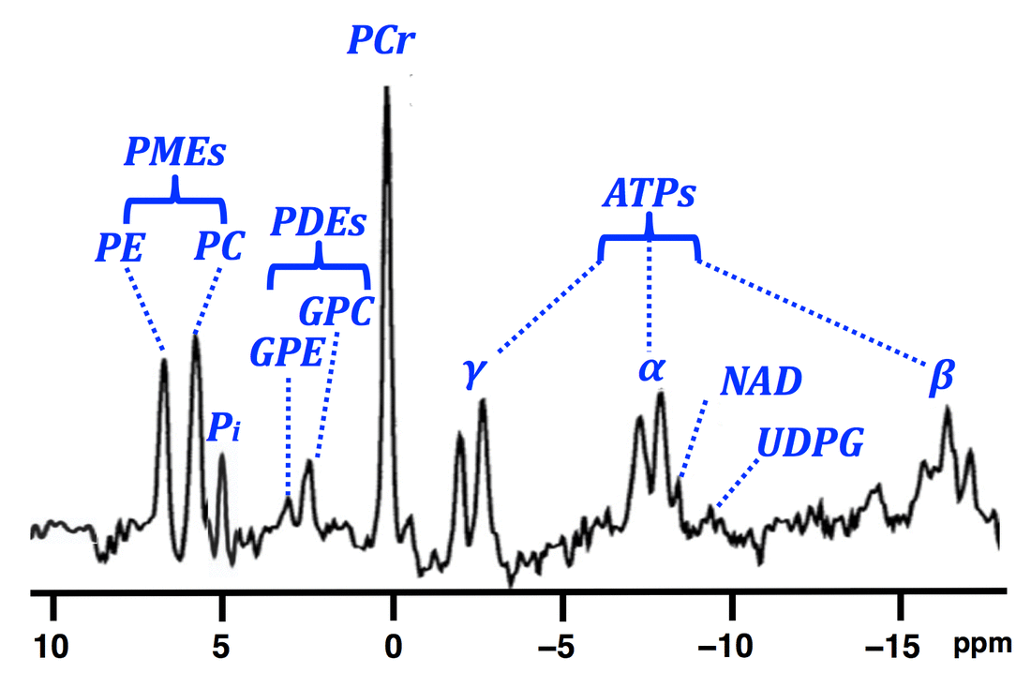
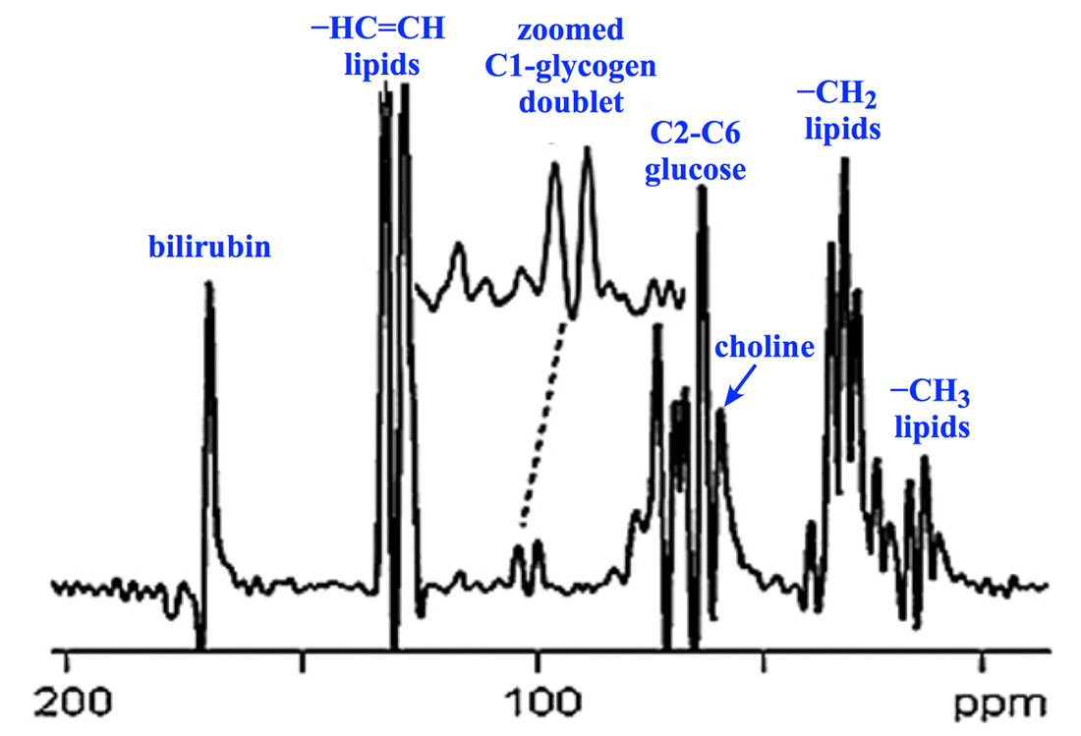
Multi-nuclear spectroscopy
hydrogen
carbon
phosphorus
mriquestions.com

Slide 36
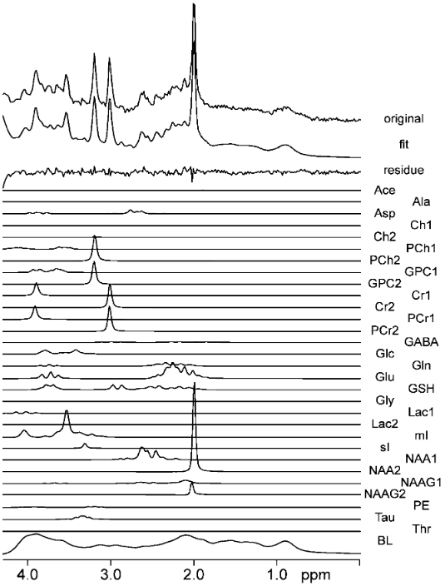
Spectroscopic fitting
Jansen J. F. A, et al., Radiology (2006)

Slide 37
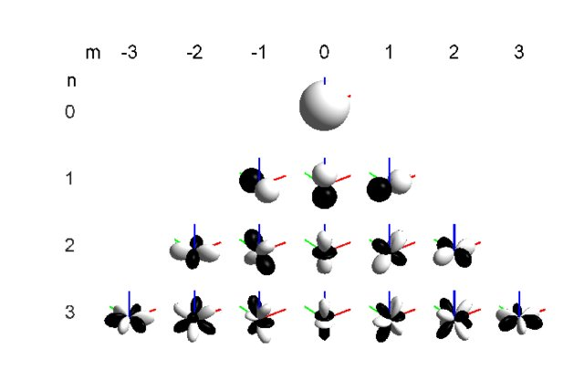
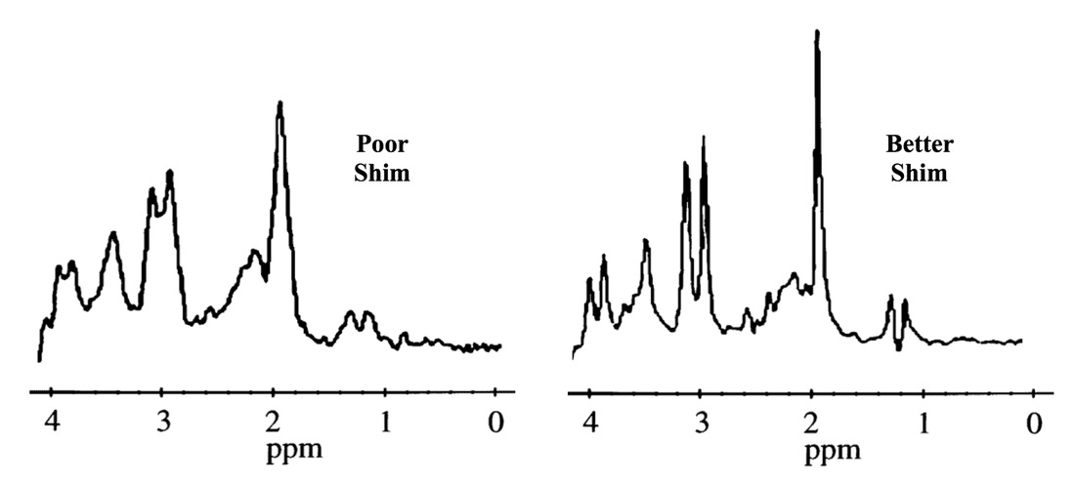
Shimming a.k.a. optimization in 16 dimensional parametric space
https://mriquestions.com/sizeshapes-of-peaks.html
Frank, M., 57th AES Int. Conf. (2015)

Slide 38
Chemical Shift Imaging
CSI

Slide 39
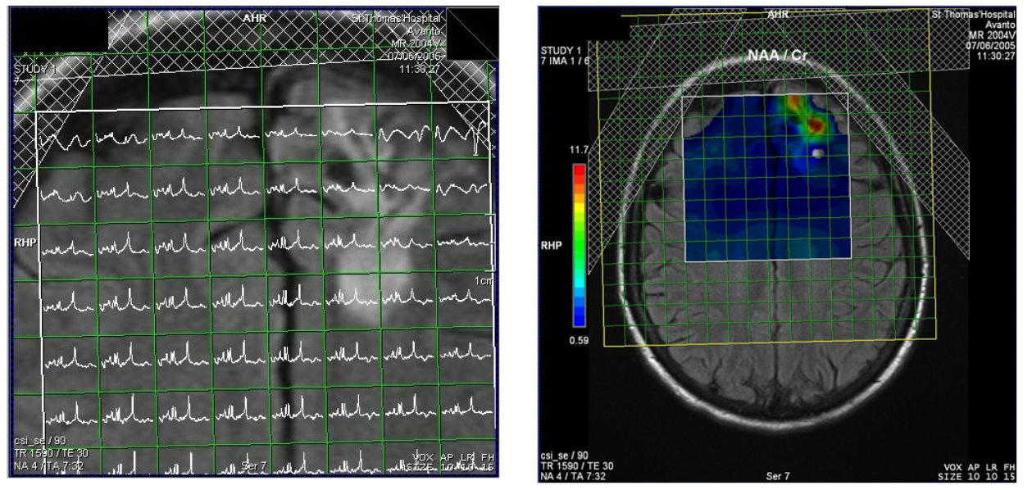
Keevil, S. F., Physics in Medicine and Biology (2006)

Slide 40
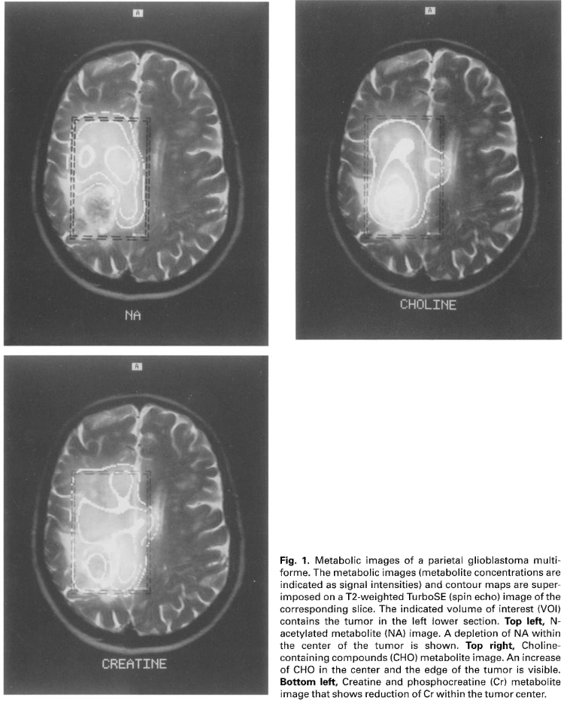
CSI:
a tumor study
Mader, MAGMA 1996

Slide 41
Features of MR data
Multiple processing stages
Multidimensional matrices
Complex entries
Non-uniformly sampled
Various contrasts encoded within
Certain level of uncertainty

Slide 42
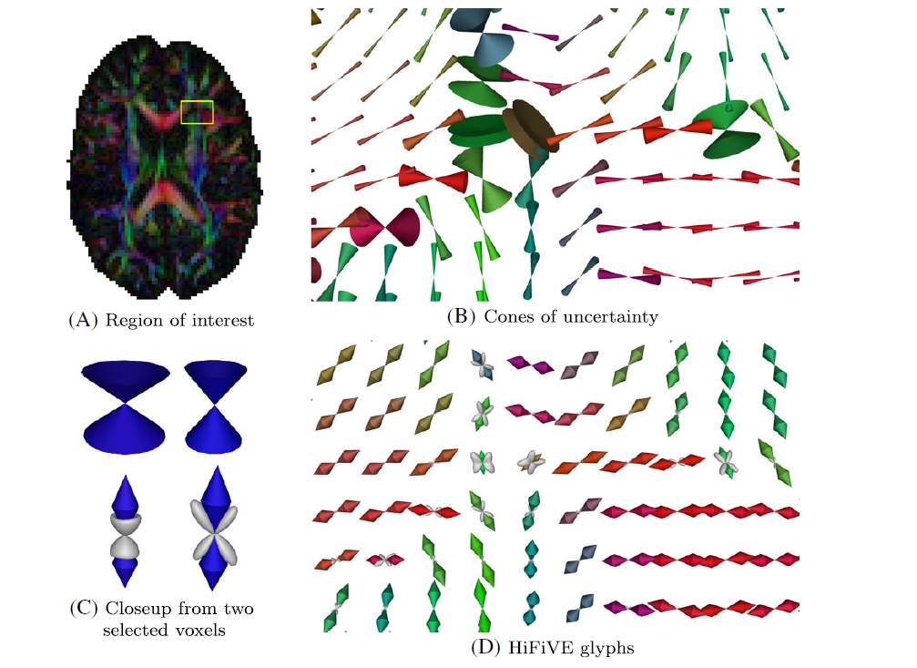
Uncertainty visualization in DTI MRI
Schultz, T., NMR in Biomedicine (2017)

Slide 43
Further reading
Interview with Craig Bennett – the dead salmon guy
A Bug in FMRI Software Could Invalidate 15 Years of Brain Research
Why does the spectroscopy axis run backwards?

Slide 44
Takeaways
Visualization of multidimensional data might be domain independent
Visualization of multidimensional data should be domain specific, if needed
We need to have an insight into every step od MR data processing

