Slide 1


PV204 Security technologies
Trust, trusted element, usage scenarios, side-channel attacks
Petr Švenda svenda@fi.muni.cz @rngsec
Centre for Research on Cryptography and Security, Masaryk University

Slide 2
What is untrusted, trusted and trustworthy
Trusted Element (TE)
Modes of usage of TE
Attacks against trusted element
Protections and testing
Logical attacks
Power analysis
Timing side-channels

Slide 3
Trusted element

Slide 4

What is “Trusted” system (plain language)
Many different notions
System trusted by someone
System that you can’t verify and therefore must trust not to betray you
  If a trusted component fails, security can be violated
System build according to rigorous criteria so you are willing to trust it
…
Why Trust is Bad for Security, D. Gollman, 2006
  http://www.sciencedirect.com/science/journal/15710661/157/3
We need more precise specification of Trust

Slide 5
Untrusted
VS.
Trusted vs.
Trustworthy

Slide 6
Untrusted system
System itself explicitly unable to fulfill specified security policy
Additional layer of protection must be employed
  E.g., Encryption of data before storage
  E.g., Digital signature of email before send over network
  E.g., End-to-end encryption in instant messaging

Slide 7
Trusted system
“…system that is relied upon to a specified extent to enforce a specified security policy. As such, a trusted system is one whose failure may break a specified security policy.” (TCSEC, Orange Book)
Trusted subjects are those excepted from mandatory security policies (Bell LaPadula model)
User must trust (if wants to use the system)
  E.g., you and your bank

Slide 8

Trustworthy system (computer)
“Computer system where software, hardware, and procedures are secure, available and functional and adhere to security practices” (Black's Law Dict.)
User have reasons to trust reasonably
Trustworthiness is subjective
  Limited interface and hardware protections can increase trustworthiness (e.g., append-only log server)
Example: Payment card - Trusted? Trustworthy?
Trusted does not mean automatically Trustworthy

Slide 9
Trusted computing base (TCB)
The set of all hardware, firmware, and/or software components that are critical to its security
The vulnerabilities inside TCB might breach the security properties of the entire system
  E.g., server hardware + virtualization (VM) software
The boundary of TCB is relevant to usage scenario
  TCB for datacentre admin is around HW + VM (to protect against compromise of underlying hardware and services)
  TCB for web server client also contains Apache web server
Very important factor is size and attack surface of TCB
  Bigger size implies more space for bugs and vulnerabilities
https://en.wikipedia.org/wiki/Trusted_computing_base

Slide 10
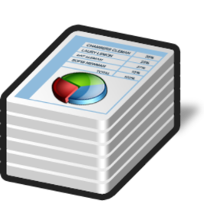




Cryptography on client
Which parts are trusted?
What are threats?
What are attacker models?
What is trusted computing base?

Slide 11
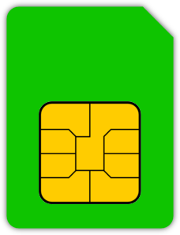
On client, but with secure hardware
Which parts are trusted?
What are threats?
What are attacker models?
What is trusted computing base?
Notes:
Problem: how to get key where is necessary?
- generate on device
- import into device (securely)

Slide 12

Group activity: Make trusted trustworthy
Write 2 different examples of trusted system you regularly use
Write down why exactly it needs to be trusted and with what operations
(5 minutes)
Pick one system and propose 3 changes to make it more trustworthy
(5 minutes)
Combine results found by groups
Notes:
Group activity: Make trusted trustworthy
Took almost 20 minutes
Moderately interesting, but good opportunity to discuss nuances during answers collection

Slide 13


Cryptography in cloud
WS API: JSON
Which parts are trusted?
What are threats?
What are attacker models?
What is trusted computing base?

Slide 14
Trusted element

Slide 15
What exactly can be trusted element (TE)?
Recall: Anything user entity of TE is willing to trust ☺
  Depends on definition of “trust” and definition of “element”
  We will use narrower definition
Trusted element is element (hardware, software or both) in the system intended to increase security level w.r.t. situation without the presence of such element
  By storage of sensitive information (keys, measured values)
  By enforcing integrity of execution of operation (firmware update)
  By performing computation with confidential data (DRM)
  By providing unforged reporting from untrusted environment (TPM)
  …

Slide 16
Typical examples
Payment smart card
  TE for issuing bank
SIM card
  TE for phone carriers
Trusted Platform Module (TPM)
  TE for user as storage of Bitlocker keys, TE for remote entity during attestation
Trusted Execution Environment in mobile/set-top box
  TE for issuer for confidentiality and integrity of code
Hardware Security Module for TLS keys
  TE for web admin
Energy meter
  TE for utility company
Server under control of service provider
  TE for user – private data, TE for provider – business operation
For whom is TE trusted?

Slide 17

Risk management
No system is completely secure (→ risk is present)
Risk management allows to evaluate and eventually take additional protection measures
Example: payment transaction limit
  “My account/card will never be compromised” vs. “Even if compromised, the loss is bounded”
Example: medical database
  central governmental DB vs. doctor’s local DB
Good design practice is to allow for risk management

Slide 18
Trusted element
Modes of usage

Slide 19
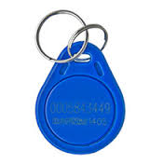



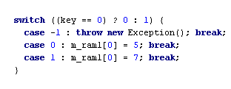
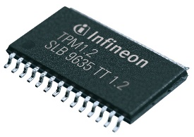
Trusted (hardware) element - modes of usage
Element carries fixed information
Element as a secure carrier
Element as encryption/signing device
Element as programmable device
Element as root of trust (TPM)

Slide 20
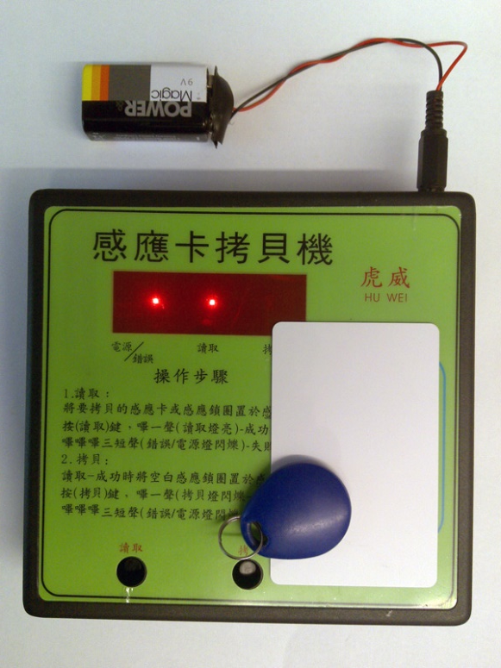

Element carries fixed information
Fixed information ID transmitted, no secure channel
Low cost solution (nothing “smart” needed)
Problem: Attacker can eavesdrop and clone chip
Element is trusted with ID carriage
But is it trustworthy?

Slide 21
Element as a secure carrier
Key(s) stored on a card, loaded to a PC before encryption/signing/authentication, then erased
High speed usage of key possible (>>MB/sec)
Attacker with an access to PC during operation will obtain the key
  key protected for transport, but not during the usage
Element is trusted as confidential key storage,
but cannot perform (or not trusted with) operation

Slide 22
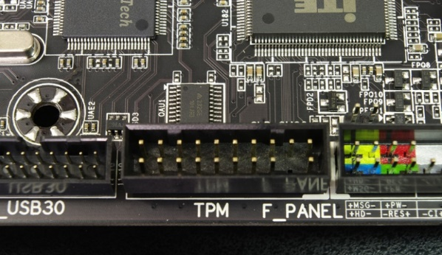
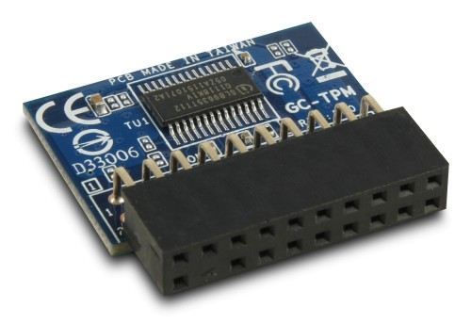
Element as root of trust (TPM)
Secure boot process, remote attestation
Element provides robust storage with integrity
Application can verify before pass control (measured boot)
Computer can authenticate with remote entity…
Element is trusted with integrity of stored values

Slide 23
Element as encryption/signing device
PC just sends data for encryption/signing…
Key never leaves element
  personalized in secure environment
  protected during transport and usage
Attacker must attack the element
  or wait until card is inserted and PIN entered!
Potentially low speed encryption (~kB/sec)
  low communication speed / limited element performance

Slide 24


Element as computational device
PC just sends input for application on smart card
Application code & keys never leave the element
  Element can do complicated programmable actions
  Can open secure channels to other entity
    secure server, trusted time service…
    PC act as a transparent relay only (no access to data)
Attacker must attack the element or input

Slide 25
Trusted element shall be small (TCB) => Not whole system => How to extend desirable security properties from TE to whole system?
The trusted element itself can still be directly attacked
Is secure hardware trusted element a silver bullet?

Slide 26
Attacks against trusted element

Slide 27
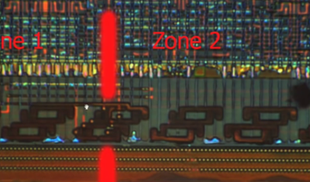
Trusted hardware (TE) is not panacea!
Can be physically attacked
  Christopher Tarnovsky, BlackHat 2010
  Infineon SLE 66 CL PE TPM chip, bus read by tiny probes
  9 months to carry the attack, $200k
  https://youtu.be/w7PT0nrK2BE (great video with details)
Attacked via vulnerable API implementation
  IBM 4758 HSM (Export long key under short DES one)
Provides trusted anchor != trustworthy system
  Weakness can be introduced later
  E.g., bug in newly updated firmware

Slide 28
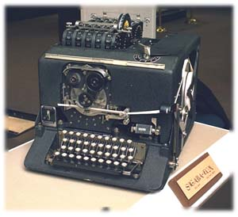
Motivation: Bell’s Model 131-B2 / Sigaba
Encryption device intended for US army, 1943
  Oscilloscope patterns detected during usage
  75 % of plaintexts intercepted from 80 feets
  Protection devised (security perimeter), but forgot after the war
CIA in 1951 – recovery over ¼ mile of power lines
Other countries also discovered the issue
  Russia, Japan…
More research in use of (eavesdropping) and defense against (shielding) → TEMPEST

Slide 29
Common and realizable attacks on Trusted Element
Non-invasive attacks
  API-level attacks
    Incorrectly designed and implemented application
    Malfunctioning application (code bug, faulty generator)
  Communication-level attacks
    Observation and manipulation of communication channel
  Side-channel attacks
    Timing/power/EM/acoustic/cache-usage/error… analysis attacks
Semi-invasive attacks
  Fault induction attacks (power/light/clock glitches…)
Invasive attacks
  Dismantle chip, microprobes…

Slide 30

How to reason about attack and countermeasures?
Where does an attack come from (principle)?
  Understand the principles
Different hypothesis for the attack to be practical
  More ways how to exploit the same weakness
Attack’s countermeasures by cancel of hypothesis
  For every way you are aware of
Costs and benefits of the countermeasures
  Cost of the assets protected
  Cost for an attacker to perform attack
  Cost of a countermeasure
Important: Consider Break Once, Run Everywhere (BORE)

Slide 31
Where are the frequent problems with crypto algs nowadays?
Security mathematical algorithms
  OK, we have very strong ones (AES, SHA-3, RSA…) (but quantum computers)
Implementation of algorithm
  Problems → implementation attacks
Randomness for keys
  Problems → achievable brute-force attacks
Key distribution
  Problems → old keys, untrusted keys, key leakage
Operation security
  Problems → where we are using crypto, key leakage

Slide 32
Non-invasive Logical attacks
Non-invasive attacks

Slide 33
What if faulty Truly Random Number Generator (TRNG)?
Good source of randomness is critical
  TRNG can be weak or malfunctioning
How to inspect TRNG correctness?
  Analysis of TRNG implementation (but usually blackbox)
  Output data can be statistically tested (100MB-8GB stream, NIST STS, Dieharder, TestU01 batteries) http://www.phy.duke.edu/~rgb/General/dieharder.php
  Behaviour in extreme condition (+70/-50° C, radiation…)
    Analyse data stream gathered during extreme conditions
  Simple power analysis of TRNG generation
    Is hidden/unknown operation present?

Slide 34
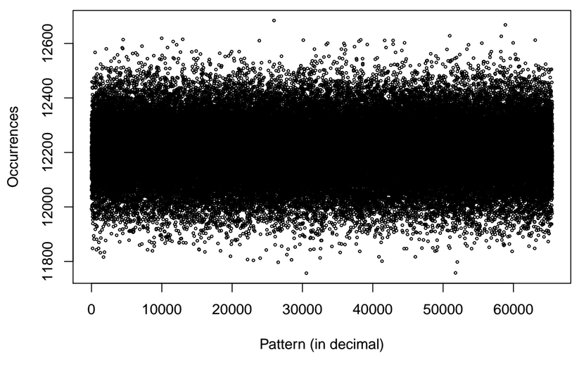
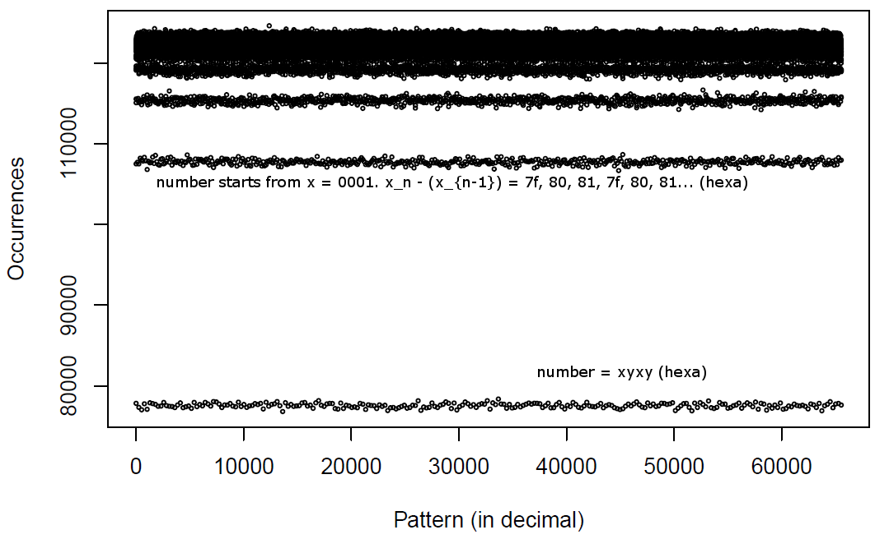
Serial test: Histogram of 16bits patterns
Normal distribution (expected)
Biased distribution (lower entropy)

Slide 35
Algorithmic flaw in Infineon’s RSALib (CVE-2017-15361)
https://roca.crocs.fi.muni.cz
All keys generated by Infineon library are affected
Practical factorization of common lengths 512/1024/2048b
All public keys have unique “fingerprint” (easy to scan for)
  Tool for detection (public since 16th October, try it!)
  https://keychest.net/roca, https://github.com/crocs-muni/roca/
Tool for factorization (made public by Lange&Bernstein)
  Our implementation of factorization tool provided to Infineon in February 2017
  Random 2048b key: 6442450944000000 vCPU years
  Infineon 2048b key: 140 vCPU years
Attack is perfectly parallelizable 1000 cores => 1000x speedup

Slide 36
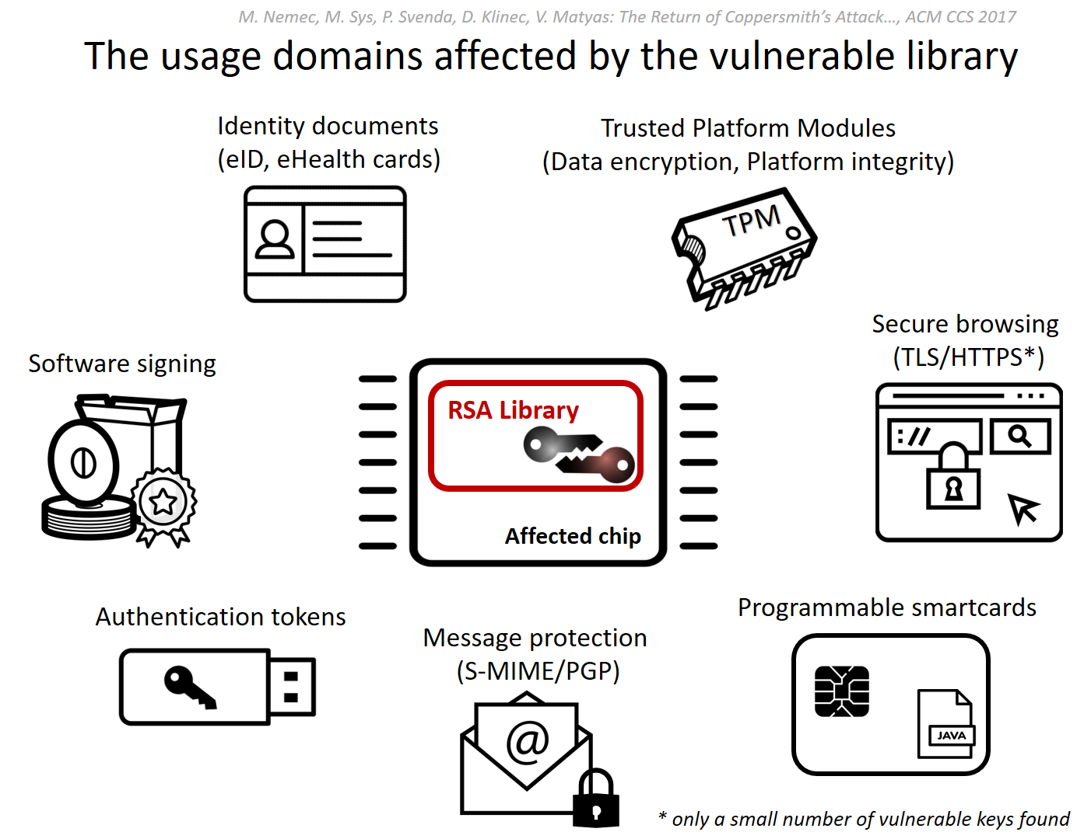
Algorithmic flaw in Infineon’s RSALib (CVE-2017-15361)
https://roca.crocs.fi.muni.cz
25-30% TPMs worldwide, Bitlocker, ChromeOS…
Firmware update available
Austria, Estonia, Slovakia, Spain…
Commit signing,
Application signing
GitHub, Maven…
Very few keys, but all tied to SCADA management
Gemalto .NET
Yubikey 4…
Yubikey 4…

Slide 37
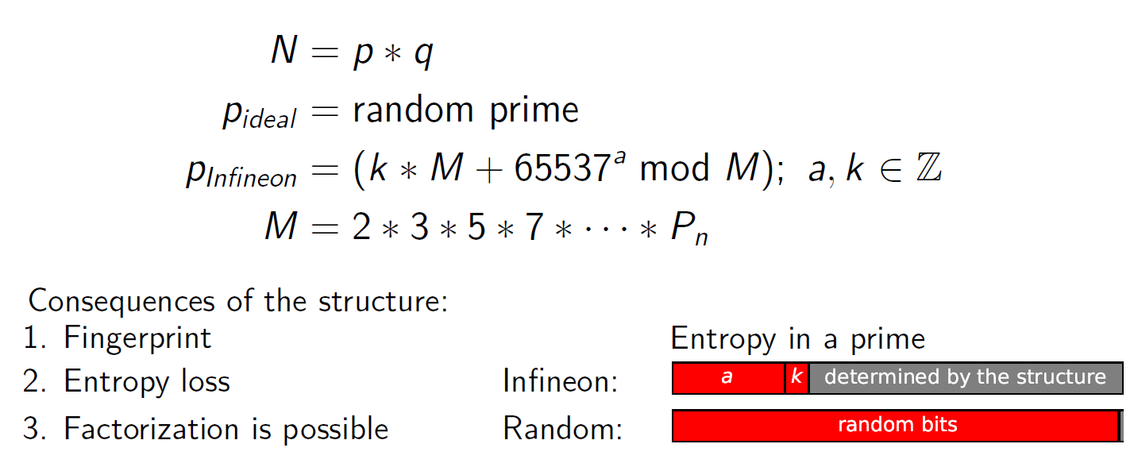
Flawed use of random data to make primes
Special structure of primes to facilitate its faster generation
~310 bits of entropy
for 1024-bit prime
Factorization difficulty
  Random 2048b key: 6442450944000000 vCPU years
  Infineon 2048b key: 140 vCPU years

Slide 38
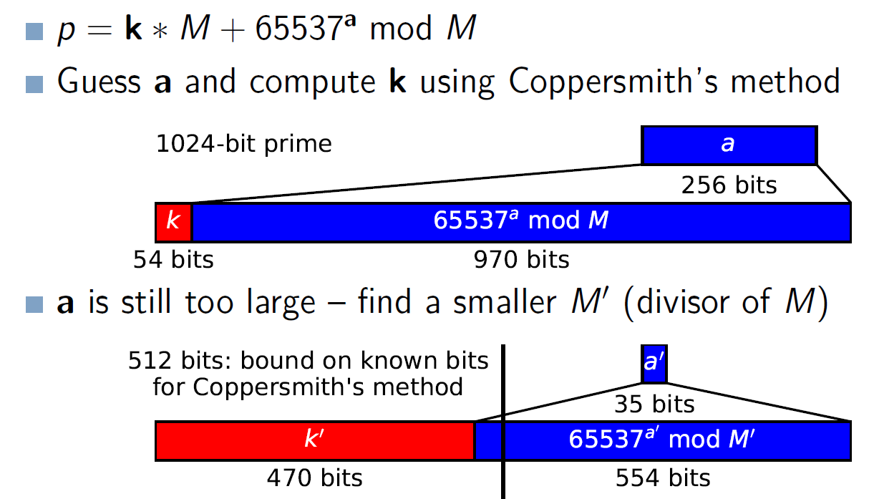
Transformation of prime to make the attack practical

Slide 39
Power analysis
Non-invasive side-channel attacks

Slide 40
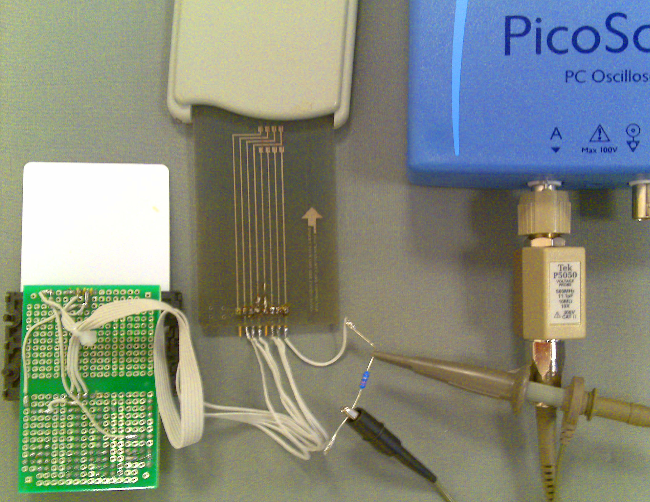
Basic setup for power analysis
Smart card reader
Oscilloscope
Smart card
Inverse card connector
Probe
Resistor
20-80 ohm

Slide 41
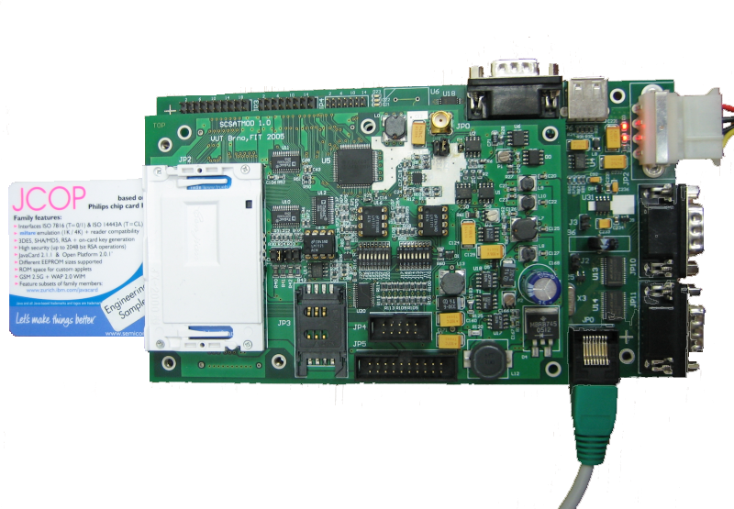
More advanced setup for power analysis
External power supply
Tested smartcard
SCSAT04 measurement board
Ethernet

Slide 42
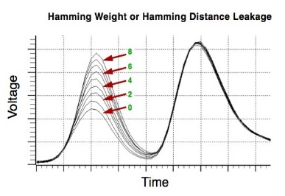
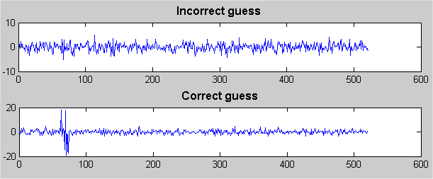
Simple vs. differential power analysis
Simple power analysis
  Direct observation of single / few power traces
  Visible operation => reverse engineering
  Visible patterns => data dependency
Differential power analysis
  Statistical processing of many power traces
  More subtle data dependencies found

Slide 43
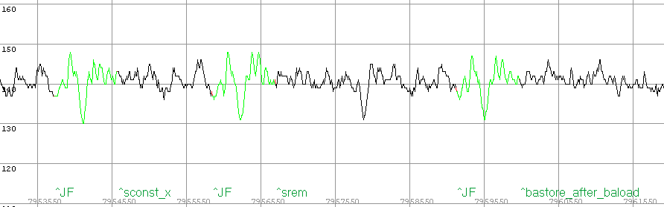
Reverse engineering of JavaCard bytecode
Goal: obtain code back from smart card
  JavaCard defines around 140 bytecode instructions
  JVM fetch instruction and execute it
(bytecode)
getfield_a_this 0;
sconst_0;
baload;
sconst_1;
srem;
bastore;
(source code)
m_ram1[0] = (byte) (m_ram1[0] % 1);
compiler
oscilloscope
(power trace)

Slide 44
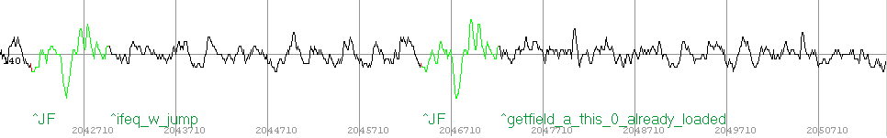
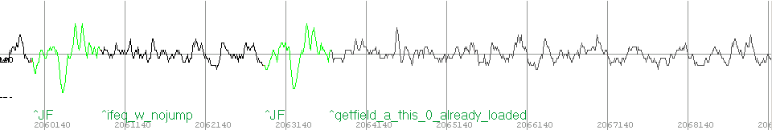
Conditional jumps
(bytecode)
sload_1;
ifeq_w L2;
L1: getfield_a_this 0;
sconst_0;
sconst_0;
bastore;
goto L3;
L2: getfield_a_this 0;
sconst_0;
sconst_1;
bastore;
goto L3;
L3: …
may reveal sensitive info
keys, internal branches, …
(source code)
if (key == 0) m_ram1[0] = 1;
else m_ram1[0] = 0;
oscilloscope
compiler
(power trace, k != 0)
(power trace, k == 0)
Can you use
timing attack?

Slide 45
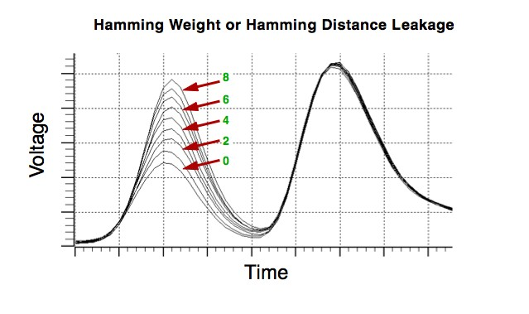
Simple power analysis – data leakage
Data revealed directly when processed
  e.g., Hamming weight of instruction argument
    hamming weight of separate bytes of key (2⁵⁶→ 2³⁸)

Slide 46
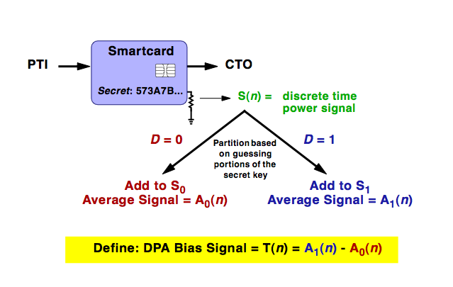
Differential power analysis (DPA)
DPA attack recovers secret key (e.g., AES)
Requires large number of power traces (10²-10⁶)
  Every trace measured on AES key invocation with different input data
Key recovered iteratively
  One recovered byte at the time (KEY_{i} ⊕ INPUT_DATA_{i})
  Guess possible key byte value (0-255), group measurements, compute average, determine match

Slide 47
Differential power analysis
Very Powerful attack on secret values (keys)
  E.g., KEY ⊕ INPUT_DATA
Obtain multiple power traces with (fixed) key usage and variable data
  10³-10⁵ traces with known I/O data => S(n)
  KEY ⊕ KNOWN_DATA
Guess key byte-per-byte
  All possible values of single byte tried (256)
  D = HammWeight(KEY ⊕ KNOWN_DATA > 4)
  Correct guess reveals correlation with traces
  Incorrect guess not
Divide and test approach
  Traces divided into 2 groups
  Groups are averaged A₀,A₁ (noise reduced)
  Subtract group’s averaged signals T(n)
  Significant peaks if guess was correct
No need for knowledge of exact implementation
  big advantage

Slide 48
Tool: DPA simulator
Generate simulated DPA traces
Perform DPA
Can be used to inspect influence of noise, number of traces…
  https://github.com/crocs-muni/PowerTraceSimulator

Slide 49


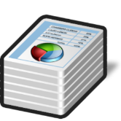
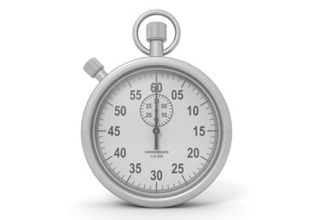

Timing attack: principle
+
→ 57ms
+
→ 49ms

Slide 50
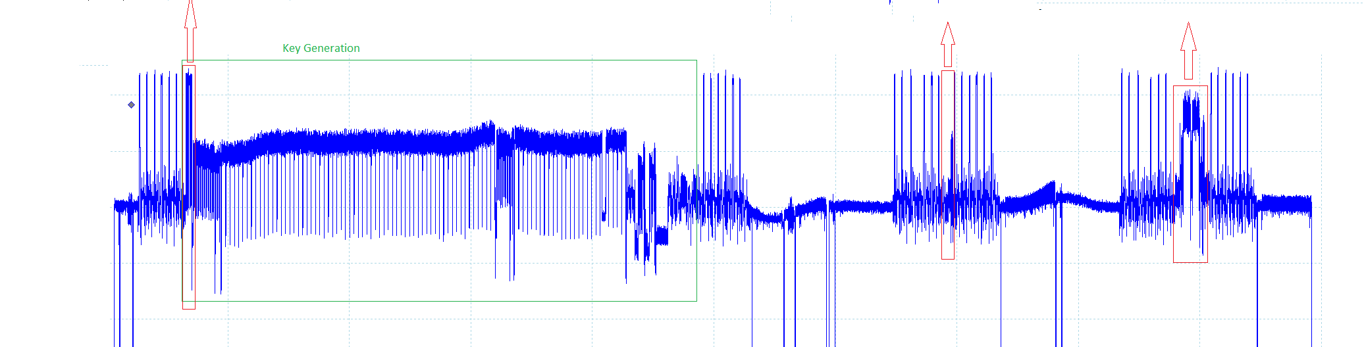
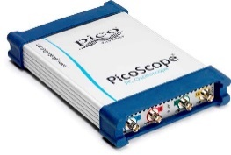
Timing attacks
Execution of crypto algorithm takes different time to process input data with some dependence on secret value (secret/private key, secret operations…)
  Due to performance optimizations (developer, compiler)
  Due to conditional statements (branching)
  Due to cache misses
  Due to operations taking different number of CPU cycles
Measurement techniques
  Start/stop time (aggregated time, local/remote measurement)
  Power/EM trace (very precise if operation can be located)

Slide 51
Naïve modular exponentiation (modexp) (RSA/DH…)
M = C^{d} mod N
M = C * C * C * … * C mod N
Easy, but extremely slow for large d (e.g., >1000s bits for RSA)
  Faster algorithms exist
Is there any dependency
of time on secret value?
d-times

Slide 52
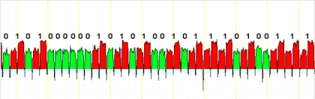
Faster modexp: Square and multiply algorithm
Executed always
// M = C^d mod N
// Square and multiply algorithm
x = C // start with ciphertext
for j = 1 to n { // process all bits of private exponent
x = x*x mod N // shift to next bit by x * x (always)
if (d_j == 1) { // j-th bit of private exponent d
x = x*C mod N // if 1 then multiple by Ciphertext
}
}
return x // plaintext M
How to measure?
  Exact detection from simple power trace
  Extraction from overall time of multiple measurements
Executed only when d_j == 1
Gilbert Goodwill, http://www.embedded.com/print/4408435
Notes:
How to attack:
What if you have debugger?
What if you have just breakpoint inside d_j condition?

Slide 53
Faster and more secure modexp: Montgomery ladder
Computes x^{d} mod N
Create binary expansion of d as d = (d_{k-1}...d₀) with d_{k-1}=1
Be aware: timing leakage still possible via cache side channel, non-constant time CPU instructions, variable k-1…
x₁=x; x₂=x²
for j=k-2 to 0 {
if d_{j}=0
x₂=x₁*x₂; x₁=x₁²
else
x₁=x₁*x₂; x₂=x₂²
x₂=x₂ mod N
x₁=x₁ mod N
}
return x₁
Both branches with the same number and type of operations
(unlike square and multiply on previous slide)

Slide 54
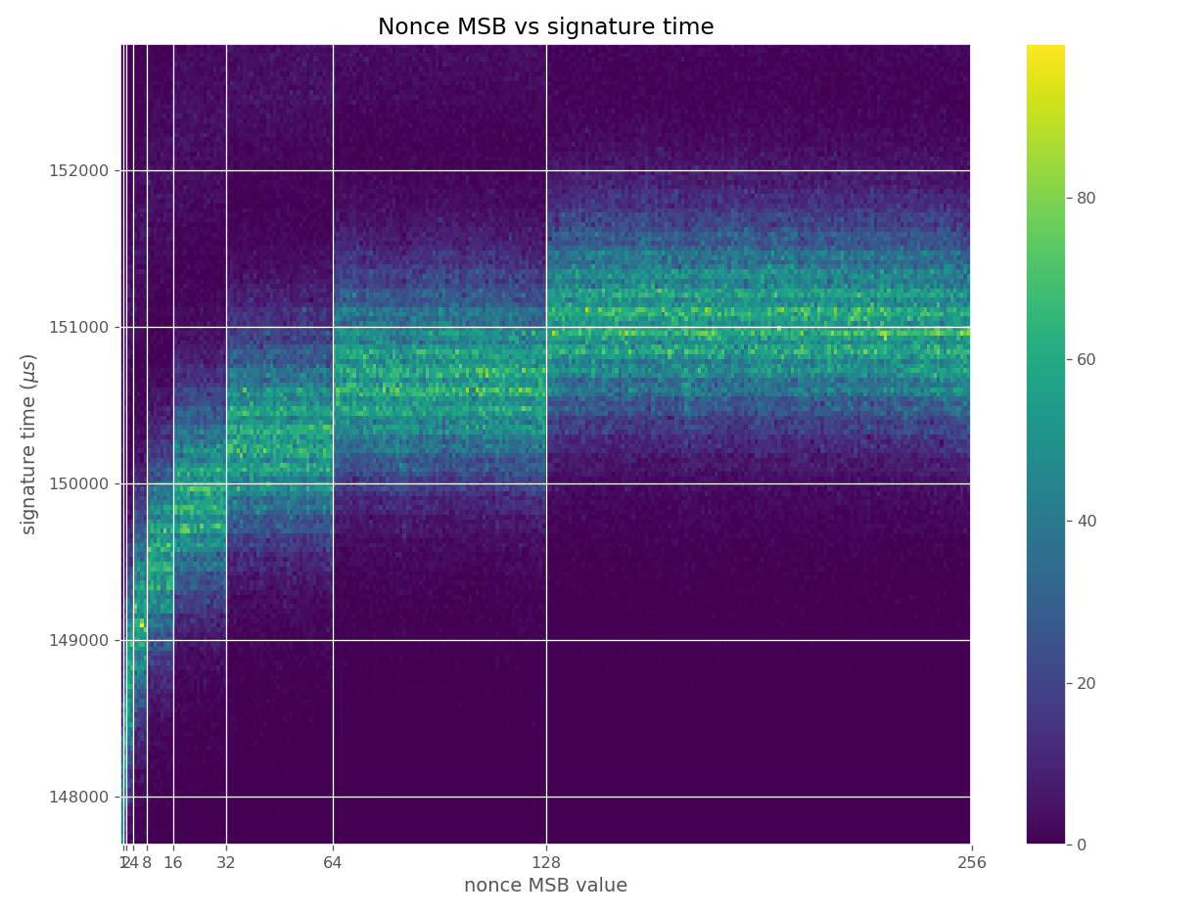
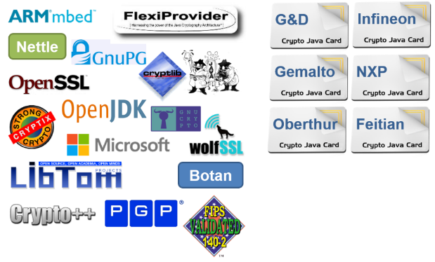
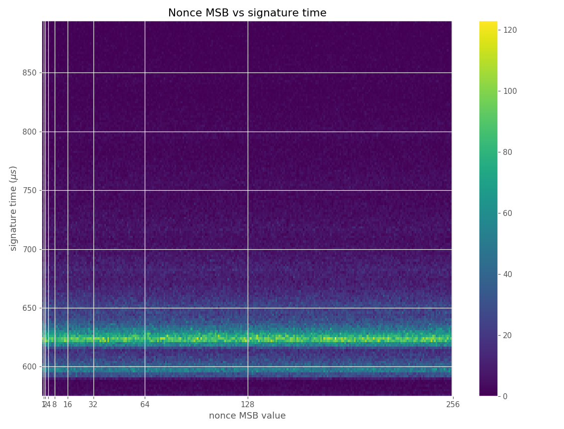

Gather data → Analyse → Bias found → Impact
Run ECC operations → MSB/time → Bias found in ECDSA → CVE-2019-15809
Signature time (µs)
Nonce MSB value
Notes:
Gather data, Analysis, Bias, Impact

Slide 55

https://minerva.crocs.fi.muni.cz/
vulnerability CVE-2019-15809 (10/2019)
Discovered by ECTester (https://github.com/crocs-muni/ECTester)
Athena IDProtect smartcard (CC EAL 4+)
  FIPS140-2 #1711, ANSSI-CC-2012/23
  Inside Secure AT90SC28872 Microcontroller
  (possibly also SafeNet eToken 4300…)
Libgcrypt, wolfSSL, MatrixSSL, Crypto++
SunEC/OpenJDK/Oracle JDK
Small time difference leaking few top bits of nonce
Enough to extract whole ECC private key in 20-30 min
  ~thousands of signatures + lattice-based attack

Slide 56
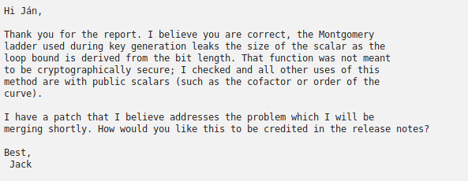
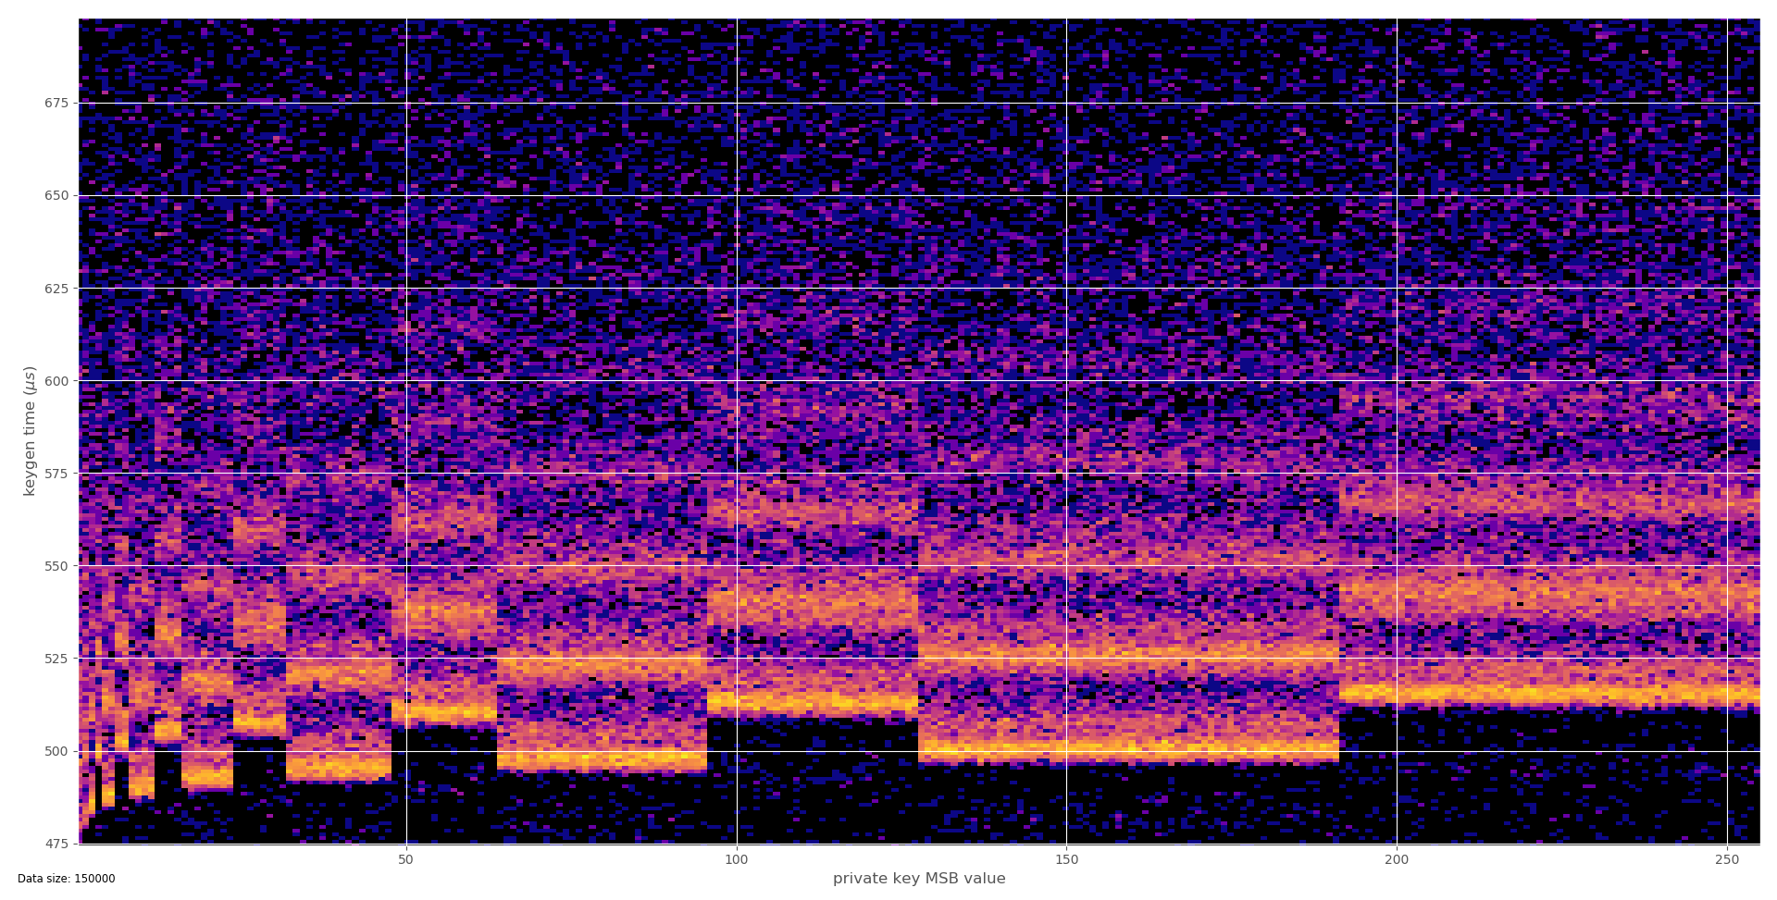
Example: Botan library, ECC, CVE-2018-20187
(Jan Jančár)
Heatmap of private key MSBs to keygen time
Montgomery ladder used, but leakage of exponent size via k
for j=k-2 to 0 do

Slide 57
Example: Remote extraction OpenSSL RSA
Brumley, Boneh, Remote timing attacks are practical
  https://crypto.stanford.edu/~dabo/papers/ssl-timing.pdf
Scenario: OpenSSL-based TLS with RSA on remote server
  Local network, but multiple routers
  Attacker submits multiple ciphertexts and observe processing time (client)
OpenSSL’s RSA CRT implementation
  Square and multiply with sliding windows exponentiation
  Modular multiplication in every step: x*y mod q (Montgomery alg.)
  From timing can be said if normal or Karatsuba was used
    If x and y has unequal size, normal multiplication is used (slower)
    If x and y has equal size, Karatsuba multiplication is used (faster)
Attacker learns bits of prime by adaptively chosen ciphertexts
  About 300k queries needed

Slide 58
Defense introduced by OpenSSL
RSA blinding: RSA_blinding_on()
  https://www.openssl.org/news/secadv_20030317.txt
Decryption without protection: M = c^{d} mod N
Blinding of ciphertext c before decryption
  Generate random value r and compute r^{e} mod N
  Compute blinded ciphertext b = c * r^{e} mod N
  Decrypt b and then divide result by r
    r is removed and only decrypted plaintext remains

Slide 59
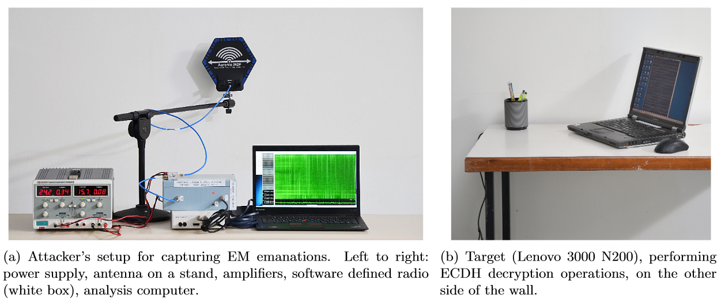
Example: Practical TEMPEST for $3000
ECDH Key-Extraction via Low-Bandwidth Electromagnetic Attacks on PCs
  https://eprint.iacr.org/2016/129.pdf
E-M trace captured (across a wall)

Slide 60
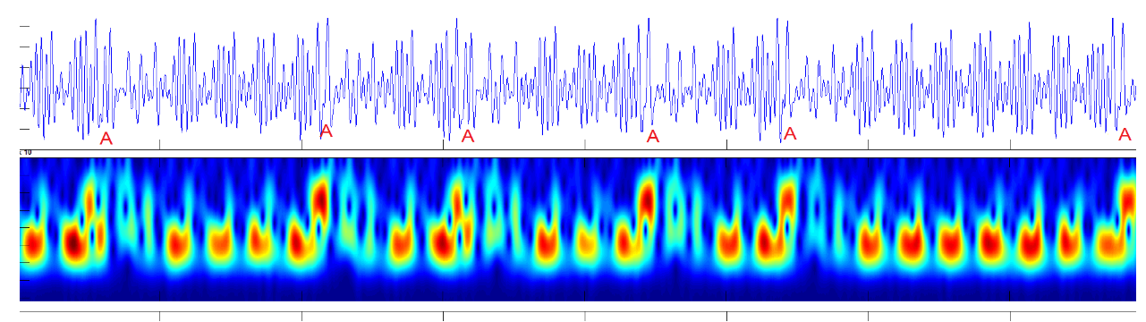
Example: Practical TEMPEST for $3000
ECDH implemented in latest GnuPG's Libgcrypt
Single chosen ciphertext – used operands directly visible

Slide 61
Example: How to evaluate attack severity?
What was the cost?
  Not particularly high: $3000
What was the targeted implementation?
  Widely used implementation: latest GnuPG's Libgcrypt
What were preconditions?
  Local physical presence, but behind the wall
Is it possible to mitigate the attack?
  Yes: fix in library, physical shielding of device, perimeter…
  What is the cost of mitigation?

Slide 62
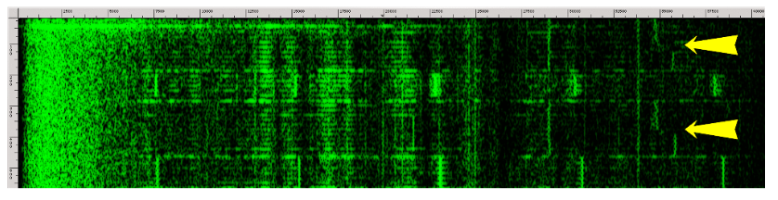
Example: Acoustic side channel in GnuPG
RSA Key Extraction via Low-Bandwidth Acoustic Cryptanalysis
  Insecure RSA computation in GnuPG
  https://www.tau.ac.il/~tromer/papers/acoustic-20131218.pdf
Acoustic emanation used as side-channel
  4096-bit key extracted in one hour
  Acoustic signal picked by mobile phone microphone up to 4 meters away

Slide 63
Example: Cache-timing attack on AES
Attacks not limited to asymmetric cryptography
  Daniel J. Bernstein, http://cr.yp.to/antiforgery/cachetiming-20050414.pdf
Scenario: Operation with secret AES key on remote server
  Key retrieved based on response time variations of table lookups cache hits/misses
  2²⁵ x 600B random packets + 2²⁷ x 400B + one minute brute-force search
Very difficult to write high-speed but constant-time AES
  Problem: table lookups are not constant-time
  Not recognized / required by NIST during AES competition
Cache-time attacks now more relevant due to processes co-location (cloud)

Slide 64
Other types of side-channel attacks
Acoustic emanation
  Keyboard clicks, capacitor noise
  Speech eavesdropping based on high-speed camera
Cache-occupation side-channel
  Cache miss has impact on duration of operation
  Other process can measure own cache hits/misses if cache is shared
  https://github.com/defuse/flush-reload-attacks
  http://software.imdea.org/projects/cacheaudit/
Branch prediction side-channel (Meltdown, Spectre)
  (2 lectures later in semester)

Slide 65
Mitigations

Slide 66
Side-channels mitigation
Don’t use own implementation
  Very hard to prevent side-channels
Don’t do data dependency
  Fixed or completely randomized timings
Be very careful with optimizations
  Data-dependent pre-computed tables
  Data-dependent conditional branches (naïve Montgomery)
Lower layer leakage can be prevented on higher level
  Blinding/masking…
  Don’t use vulnerable constructions (ifeq instruction)
  Implementation secure on higher level can be compromised on lower level

Slide 67
Generic protection techniques
Do not leak
  Constant-time crypto, bitslicing…
Shielding - preventing leakage outside
  Acoustic shielding, noisy environment
Creating additional “noise”
  Parallel software load, noisy power consumption circuits
Compensating for leakage
  Perform inverse computation/storage
Prevent leaking exploitability
  Ciphertext blinding, key regeneration…

Slide 68

Example: NaCl (“salt”) library
Relatively new cryptographic library (2012)
  Designed for usable security and side-channel resistance
  D. Bernstein, T. Lange, P. Schwabe
  https://cr.yp.to/highspeed/coolnacl-20120725.pdf
  Actively developed fork is libsodium https://github.com/jedisct1/libsodium
Designed for usable security (hard to misuse)
  Fixed selection of good algorithms (AE: Poly1305, Sign: EC Curve25519)
  C = crypto_box(m,n,pk,sk), m = crypto_box_open(c,n,pk,sk)
Implemented to have constant-time execution
  No data flow from secrets to load addresses
  No data flow from secrets to branch conditions
  No padding oracles (recall CBC padding oracle in PA193)
  Centralizing randomness and avoiding unnecessary randomness

Slide 69
How to test real implementation?
Be aware of various side-channels
Obtain measurement for given side-channel
  Many times (10³ - 10⁷), compute statistics
  Same input data and key
  Same key and different data
  Different keys and same data…
Compare groups of measured data
  Is difference visible? => potential leakage
  Is distribution uniform? Is distribution normal?
Try to measure again with better precision ☺

Slide 70
Activity: Side-channels (10 minutes)
Power consumption of memory write instruction depends on the Hamming weight of stored byte
Time required to execute inc instruction (a++) is faster than add instruction (a+b)
Temperature of CPU increases with every instruction executed (and CPU is cooled by fan)
For every listed side-channel, argue within the group (Google if necessary):
  Propose an attack(s) based on the particular side-channel
  What is the cost of required equipment?
  What are possible options to mitigate the attack?
Order given side-channels by
  Seriousness with respect to security impact
  Difficulty to systematically mitigate the side-channel leakage

Slide 71
Conclusions

Slide 72
Morale
Preventing implementation attacks is extra difficult
  Naïve code is often vulnerable
    Not aware of existing problems/attacks
  Optimized code is often vulnerable
    Time/power/acoustic… dependency on secret data
    Dangerous optimizations (Infineon primes)
Use well-known libraries instead of own code
  And follow security advisories and patch quickly
Security / mitigations are complex issues
  Underlying hardware can leak information as well
  Try to prevent large number of queries

Slide 73
Mandatory reading
Constant-time crypto: https://bearssl.org/constanttime.html
Focus on:
  What can cause cryptographic implementation to be non-constant?
  Is there any impact by compiler?
  How is bitslicing technique improving situation?
  What particular techniques are used by BearSSL?

Slide 74
Optional reading
G. Goodwill, Defending against side-channel attacks
  http://www.embedded.com/print/4408435
  http://www.embedded.com/print/4409695
Focus on:
  What side channels are inspected?
  What step in executed operation is misused for attack?
  What are proposed defenses?

Slide 75
Optional reading
Why Trust is Bad for Security, D. Gollman, 2006
  http://www.sciencedirect.com/science/journal/15710661/157/3
Focus on:
  Which definition of Trust Gollman uses?
  Why Gollman claims that Trust is bad for security?

Slide 76
Conclusions
Trusted element is secure anchor in a system
  Understand why it is trusted and for whom
Trusted element can be attacked
  Non-invasive, semi-invasive, invasive methods
Side-channel attacks are very powerful techniques
  Attacks against particular implementation of algorithm
  Attack possible even when algorithm is secure (e.g., AES)
Use well-know libraries instead own implementation

Slide 78
Semi-invasive attacks

Slide 79
Semi-invasive attacks
“Physical” manipulation (but card still working)
Micro probes placed on the bus
  After removing epoxy layer
Fault induction
  liquid nitrogen, power glitches, light flashes…
  modify memory (RAM, EEPROM), e.g., PIN counter
  modify instruction, e.g., conditional jump

Slide 80
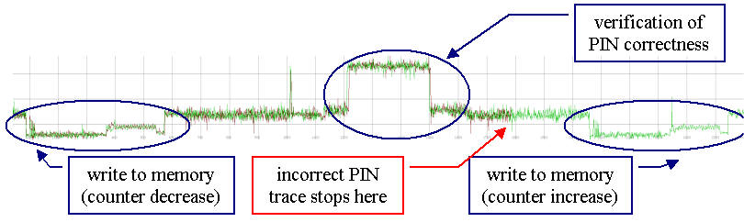
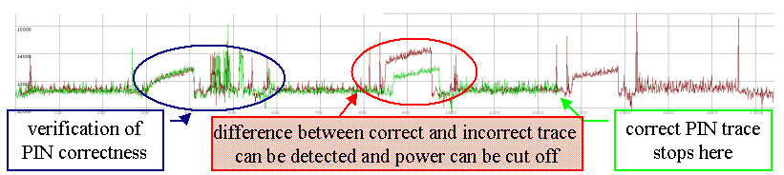
PIN verification procedure
[Decrease counter, verify, increase] - correct
[Verify, decrease/increase]

Slide 81
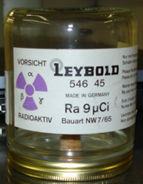

Fault induction
Attacker can induce bit faults in memory locations
  power glitch, flash light, radiation...
  harder to induce targeted then random fault
Protection with shadow variable
  every variable has shadow counterpart
  shadow variable contains inverse value
  consistency is checked every read/write to memory
Robust protection, but cumbersome for developer
01011010
10100101
01011010
01010101
a
a_inv
if (a != ~a_inv) Exception();
a = 0x55;
a_inv = ~0x55;
01010000
if (a != ~a_inv) Exception();
a = 0x13;
10100101
10101010

