Slide 1
Black-box analysis of malware
Vít Bukač
CROCS, Faculty of Informatics, Masaryk University
Supervisor IT Security, CIRT, Honeywell Global Security
PV204 Security Technologies

Slide 2
Black-box analysis of malware – Outline
Lecture
Incident response
Malware
Black-box principle
Tools
Automatic sandbox analysis
Hands-on lab
Analysis of provided malware samples

Slide 3
Analyzing intrusions

Slide 4
Cyber Incident Response
Cyber Incident Response
“A well-organized effort by which an organization handles a cyberattack, including analysis, containment, remediation and reduction of future risks.”
Good incident response results in:
Lower costs of ongoing cyber incidents
Fewer future incidents
Cyber Kill Chain
Each incident goes through certain phases
Each phase can only continue if all previous phases completed successfully
Collecting information about each phase helps detect/prevent future incidents

Slide 5
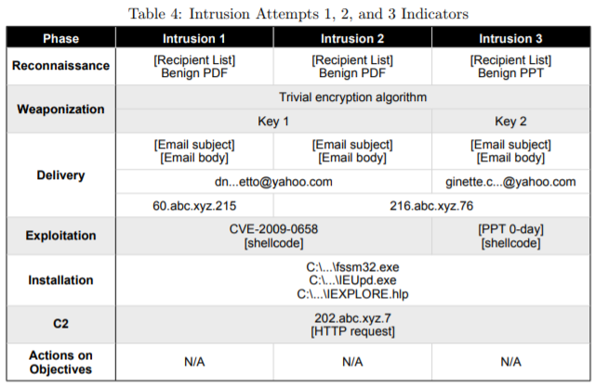
Cyber Kill Chain
M Hutchins, Eric & J Cloppert, Michael & M Amin, Rohan. (2011). Intelligence-Driven Computer Network Defense Informed by Analysis of Adversary Campaigns and Intrusion Kill Chains. Leading Issues in Information Warfare & Security Research.

Slide 6
MITRE ATT&CK Framework
Globally accessible knowledge base of adversary tactics and techniques based on real-world observations.
Good learning point about advanced attackers
Likely will replace kill chain
https://attack.mitre.org/

Slide 7
Malware

Slide 8
Malware definition
“Malware, short for malicious software, is an umbrella term used to refer to a variety of forms of hostile or intrusive software, including computer viruses, worms, Trojan horses, ransomware, spyware, adware, scareware, and other intentionally harmful programs. It can take the form of executable code, scripts, active content, and other software. Malware is defined by its malicious intent, acting against the requirements of the computer user — and so does not include software that causes unintentional harm due to some deficiency.”

Slide 9
Malware types
Trojan
Fake AV
Backdoor
Remote Access Tool (RAT)
Dropper
Downloader
Information stealer
Keylogger
Ransomware
Coinminer
Sniffer
Virus
Worm
Spyware
Adware
Botnet

Slide 10
Malware infection vectors
Email
Link
Attachment
Link + document download
Malicious website
Drive-by download
USB
Cracked software
Worms

Slide 11
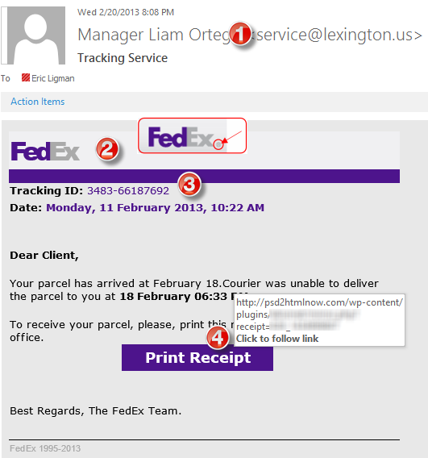
Infection vector – Phishing
Subject
“Account blocked”
“Package to be delivered”
“Expiring subscription”
“Invoice” / “Receipt” / “Parchment”
Signs
Unexpected sender address (1)
Graphic errors (2)
Erroneous info (3)
Links to unexpected URL (4)
Links to same URL
Generic salutation
Use of threats, sense of urgency

Slide 12
Infection vector – Drive-by download

Slide 13
Example – Zeus infection
Notes:
User access fake Facebook page from phishing link
Webpage asks to update Flash Player
If the user refuses to install malicious flash player, Blackhole exploit kit is attempted instead
Computer exploited
Initial callback to Smoke Loader
Downloads Zeus banker trojan
Downloads config file
User accesses one of UK banks
Zeus monitors and reports about these activities
C&C server instructs the bot to steal money
Zeus makes the transaction
Money is sent to a money mule in UK
Zeus logs successful transaction, new recipient and money volume
Money mule takes the money and sends them to cybercrime gang

Slide 14
Black box malware analysis

Slide 15
Motivation – Ask the right questions
What is the scope of compromise? What are 2nd stage callbacks?
Communication between local file server and an unknown IP address in China has been observed. What process is responsible for the communication?
Malware is creating temporary files. Where are these files located?
Malware executable is created again after system reboot. How is it possible and what is causing it?
A new type of malware has been spreading through internal network. How to quickly assess the malware capabilities? What is its purpose? Is it based on any well-known tool?

Slide 16
Black box malware analysis
Dynamic analysis – file is executed
Analysis without internal knowledge
Observable inputs
Observable outputs
Quick, simple
Common monitoring tools
Collected indicators about
Filenames, process names, process parent/child relationships, temporal relationships, domain names, IP addresses, registry keys, persistence methods, cleanup operations etc.
Can be highly automated

Slide 17
Black box malware analysis – Principle
Prepare analysis environment
Create snapshot
Run monitoring tools
Run malware
Collect and observe interactions between malware and VM
Restore snapshot
Repeat 3-6 as needed

Slide 18
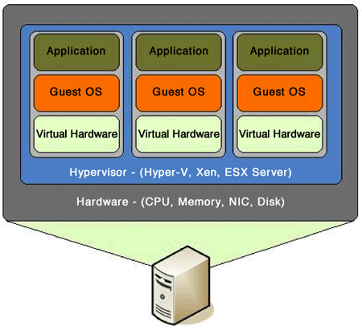
Analysis environment
Virtual Machine
Limited/no connectivity
Virtualized services (DNS, HTTP,…)
Several VMs for various host types
Software
Monitoring tools
Often exploited applications
Risks
VM isolation breach
Malware inactivity in VM

Slide 19
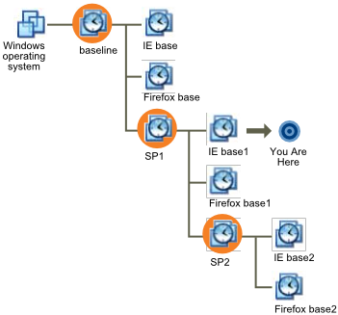
Virtual machine snapshot
Snapshots
Saved state of VM
Disk state, memory state
Quick restoration of previous state

Slide 20
Tools

Slide 21
Network analysis
Capturing sent/received packets
Protocol dissection
Promiscuous mode
Tools
Tcpdump, Wireshark, NetworkMiner
Indicators
Domain names, IP addresses, protocols, ports, HTTP parameters
Q&A
Who is this program communicating with? What reputation does the partner have? What data is exchanged? Is it encrypted or obfuscated?

Slide 22
Network analysis – What to look for
New established connections – HTTP 80/8080
Direct calls for domains without DNS lookup
Random domain names (e.g., rpxiodffd.biz)
Suspicious domain names (e.g., gooogle.org)
Similarly looking domain names (e.g., osinstall.biz, swinstall.biz, swinstall.com)
Outgoing portscans
Ping/DNS request for well known services
Connection availability test
Be aware of background OS/processes activities!

Slide 23
Example – Wireshark

Slide 24
File system
Observing file accesses and modifications
Background file manipulation
Tools
Procmon, Handle
Indicators
File names, folder names, order of actions, compromise spread through local system
Q&A
Where is malware copied after the initial infection? What filenames are used? Where is the collected data stored?

Slide 25
File system – What to look for
New file names & folders
New created files and folders
Batch files (.cmd, .bat, .vbs, .ps1)
Known favorite malware file names (e.g., 1.exe, test.exe, new.exe)
Known file names in uncommon folders (e.g., C:\Temp\svchost.exe)
Recycler
Modifications of system files
Temporary storage files, encrypted archives

Slide 26
Example – Procmon

Slide 27
Registry
Regedit
Windows built-in registry editor
RegRipper
Extracts relevant forensic artifacts from registry
Autoruns
Lists all programs set to start after system boot

Slide 28
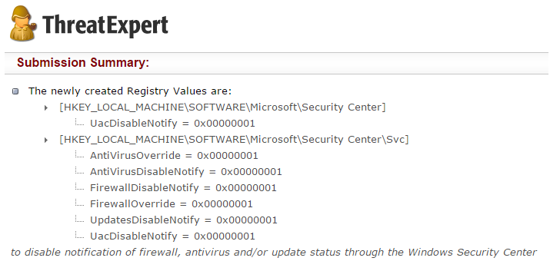
Registry – What to look for
Well-known locations
Autorun locations
Task scheduler
Changes tracking
Keywords fulltext search
Filenames
Processes
Domain names

Slide 29
Registry – Regedit

Slide 30
Processes
Observing initial system compromise
Processes parent/child relationships
Tools
Process Explorer, Procmon
Indicators
Process names, order of execution, dropper activity
Q&A
What processes are run after malware binary is executed? Are batch files involved? Are there watcher processes?

Slide 31
Processes – What to look for
Order of executables
Initial malware
Dropper/downloader
Persistence executable
Final malware
Command line interpreters
cmd.exe
Powershell
Cscript, wscript

Slide 32
Example – Process Explorer

Slide 33
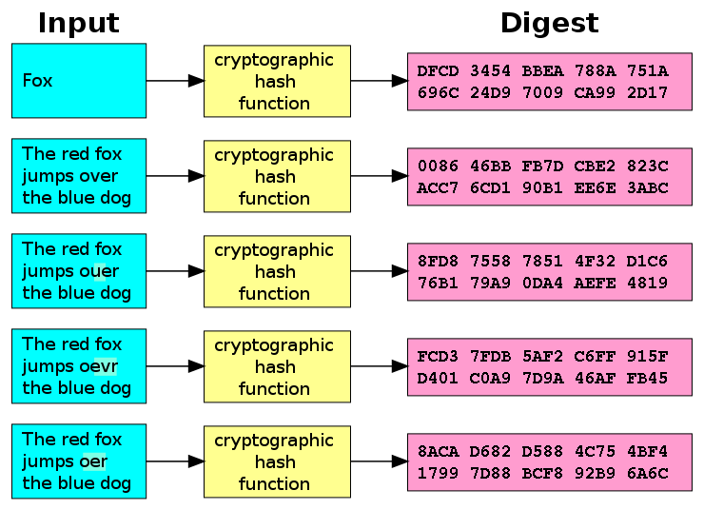
Executable file analysis
Cryptographic hash
Hash function which is considered practically impossible to invert
Unique identification of file
Counter: Polymorphism
MD5, SHA1
Fuzzy hash
Context triggered piecewise hash
Families of files
ssdeep
Strings

Slide 34
Example – Strings
server.exe
AppData
4bcce4de98bcdb4d29f66c0fe1ffe002
hackerhani.no-ip.biz
Software\Microsoft\Windows\CurrentVersion\Run
Software\
yy-MM-dd
??-??-??
Microsoft
Windows
SystemDrive
netsh firewall delete allowedprogram "
Software
cmd.exe /c ping 0 -n 2 & del "
SEE_MASK_NOZONECHECKS
netsh firewall add allowedprogram "
Domain name
Persistence registry key
Commands to be executed
MD5: 5d347384ea978a96bc842ad9f29e95f2

Slide 35
Analysis

Slide 36
Black box analysis – indicator interpretation
Network analysis – domain & IP verification, processes communicating
Hash comparison
Collisions, same-hash files
Behavior analysis
System processes, created processes, persistence
File manipulation

Slide 37
Document analysis – Quick insight
EXIF information
File metadata
Document sandboxing
Document interpretation ambiguity
Practical examples
Double extensions, different content in different viewers, code block obfuscation & hiding

Slide 38
Automated sandbox analysis

Slide 39
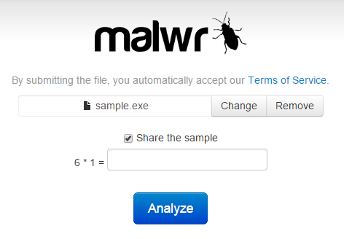
Automated sandboxing
Automated
Execute malware in sandbox
Wait a few seconds
Receive summary report
Investigate report
Non-interactive
Known tools
Cuckoo, Norman, Anubis etc.

Slide 40
Cuckoo sandbox
Open source malware analysis system
Can analyze
Windows executables, DLLs, PDF documents, URLs, HTML files, PHP scripts, Visual Basic scripts, ZIP archives, Python files, etc.
Modular, scriptable
Full memory dump (for Volatility Framework)
Django web interface
Mongo (NoSQL) database

Slide 41
Cuckoo – Architecture

Slide 42
Cuckoo – GUI

Slide 43
Internet sandbox services
Public service
OpSEC issues
Huge comparison database
Exact match by hash
Similarity search by keywords
Malwr.com (public Cuckoo sandbox)
VirusTotal.com
ThreatExpert.com
Hybrid-Analysis.com

Slide 44
Operational security (OpSec)
Advanced attackers monitor victim’s actions
Unique indicators visible on Google?
Attacker host monitoring for incoming traffic
Keywords search in mails, PDFs…
Basics of OpSec
“Think before you act” mentality
Limited information sharing
Trace removal
PassiveTotal.org

Slide 45
OpSec – Basic rules
No ping
No DNS lookup
No accessing to suspicious domains
No premature remediation steps (reboot, antivirus scan, OS reinstall)
No upload of samples
No indicator validation on external sources
NOT EVEN through 3rd parties

Slide 46
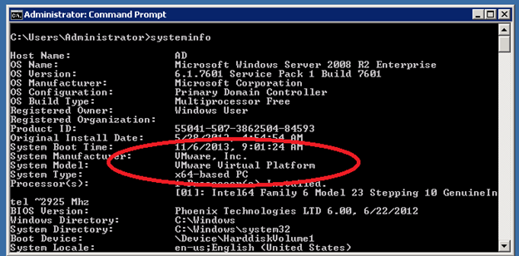
Anti-sandbox techniques
Continuous development – sandbox vs. anti-sandbox
Malware inactive in analysis environment
Tools presence detection (Wireshark, etc.)
Virtualization detection
Registry (key existence, key value)
File system (file existence, drivers)
Processes (syscall response)
Human presence detection
Mouse movement
Keyboard activity
File artefacts

Slide 47
Lab

Slide 48
Lab – Overview
Hands-on experience of manual black-box analysis
Guided analysis of selected malware samples
Tools
Wireshark – Network activity
Process Monitor – File system activity, process creation
Autoruns – Persistence
Regshot – Registry changes
Process explorer – Process map

Slide 49
Lab – Samples
2-3 samples from different malware families
Commodity malware – Zeus, ZeroAccess, Generic Trojans,…
Students will execute samples in virtual environment
Provided simple analysis virtual machine (Windows)
Indicators collected – network, files, persistence
Discussion about interpretation of facts
Homework
2 samples for analysis independently
Write a cohesive report and present key information to the reader

