Slide 1
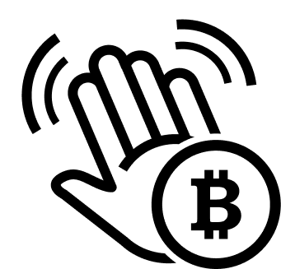
Hello Bitcoin
A friendly introduction to Bitcoin
http://hellobitco.in @hello_bitcoin hello-bitcoin

Slide 2
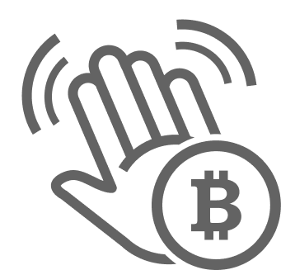
Let’s talk about money.

Slide 3
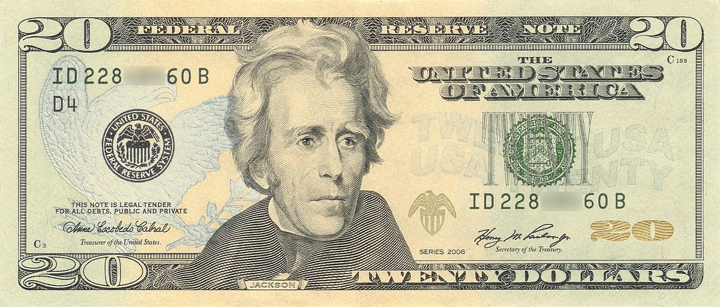
Notes:
We all like money, right?
It is a representation of our work, our efforts. We produce and we receive money that allows us to obtain other things we want at a future date.

Slide 4
Money has evolved, since forever.

Slide 5
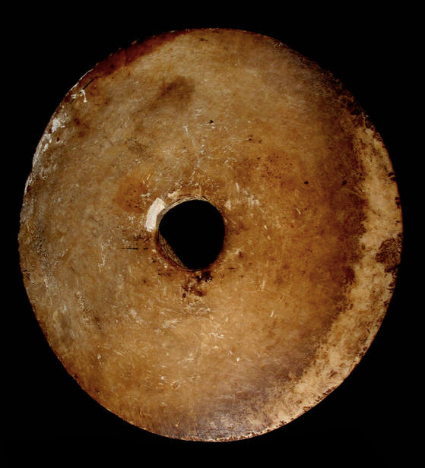
Notes:
Rai stones, used in Micronesia 500AD - present day.

Slide 6
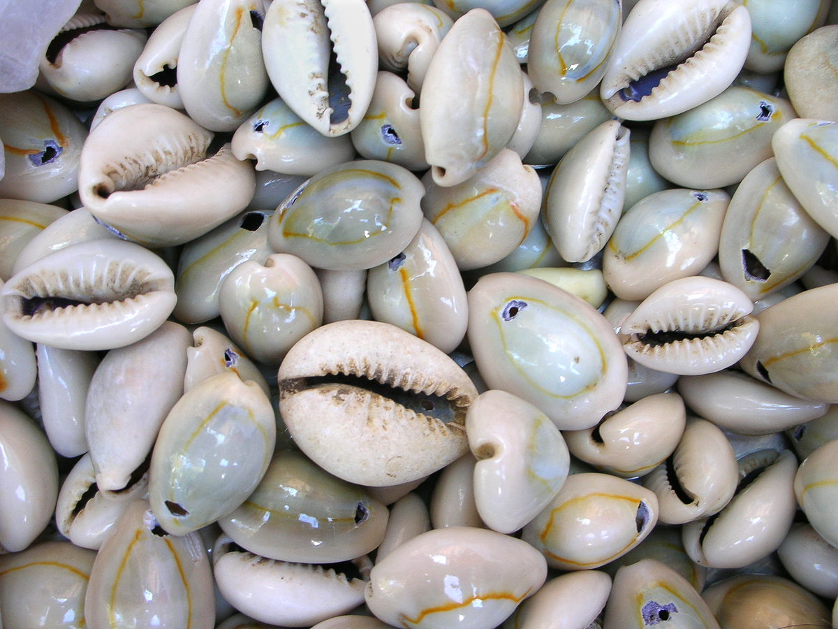
Notes:
Cowrie Shell Money. Some shell money in use up until late 1800s

Slide 7
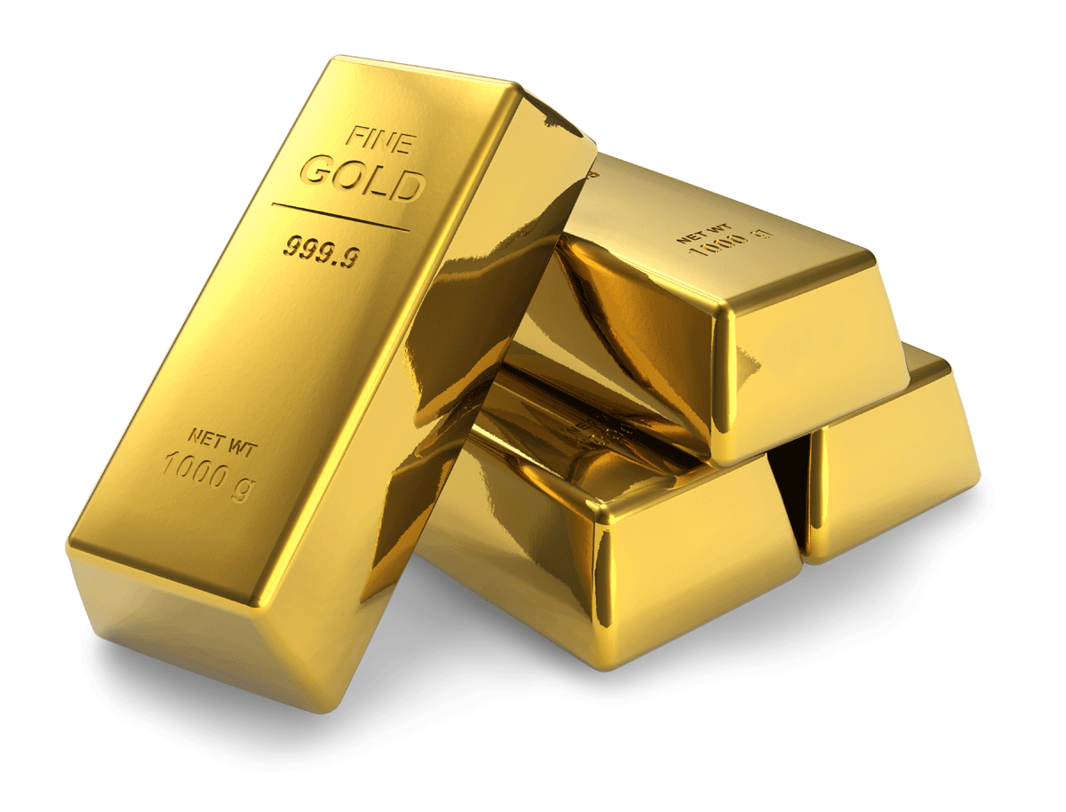
Notes:
Gold: still used today. Notably as store of wealth for nation states.

Slide 8
What makes good money? Bad money?
Notes:
Properties of good money:
Durable: doesn’t perish
Portable: easy to transport
Fungible: one is interchangeable with another
Verifiable: easy to check authenticity
Divisible: support exchange of small amounts
Scarce: can’t be abundant or easy to produce lots** flag here that this is a big problem with fiat currency
It is common to find things that have one or some of these properties. It is rare to find something that has them ALL.
Source: https://medium.com/@vijayboyapati/the-bullish-case-for-bitcoin-6ecc8bdecc1

Slide 9
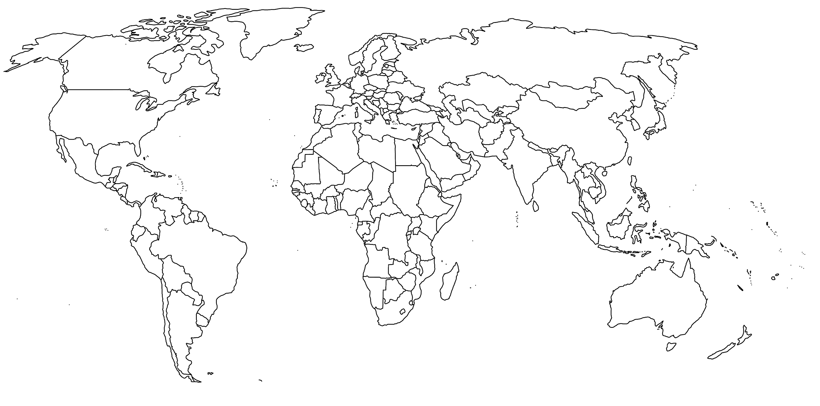
How does where you live change your view?
Notes:
Does where you live in the world maybe change your answers?
4B people live under authoritarian regimes
Source for 4B number: Human Rights Foundation
https://hrf.org/research_posts/political-regime-map/

Slide 10
Imagine...

Slide 11
Needing protection against runaway inflation
Notes:
Sugar

Slide 12
Having a check against government overreach

Slide 13
Not having good options to save without risk (1/2)
Notes:
Savings, CDs, bonds, etc. don’t beat inflation
Plumber…

Slide 14
Not having good options to save without risk (2/2)
Notes:
Resulting in many people either
losing purchasing power over time
Taking risks with stocks or other risky assets they’re uncomfortable with or not well prepared to be financially disciplined and make mistakes (eg buy high sell low)

Slide 15
Trying to escape with any savings you have

Slide 16
Reaching those lacking access to banking

Slide 17
Allowing funds to flow without judgment

Slide 18
Being powerless to avoid a financial data trail
Notes:
Also sf https://www.sfchronicle.com/business/article/Cashless-SF-stores-now-must-take-cash-14371473.php
Also nyc https://qz.com/1790745/new-york-banning-cashless-stores-wont-fix-citys-deeper-problem/

Slide 19
Main problem with money today: the abuse of trust.
Notes:
Abuse of trust is the theme that binds the examples (headlines) we walked through earlier.

Slide 20
When money went digital—even more trust required.
Notes:
1) $20 bill hand to merchant at farmer's market
2) but when going digital...i can send a photo to you and arik, the same copy, and it is what i want to happen. you can easily copy digital things. great!
3) except, money. what if i send the same $20 digitally to you and arik. did i just create money out of thin air? did one of you not receive it?
4) hence, with digital money, trusted 3rd parties have been REQUIRED

Slide 21
Less trust ➝ more privacy.
➝ more fairness.
➝ more freedom.
Notes:
This is the genius / main achievement of Bitcoin.

Slide 22
Can we make better money?

Slide 23
Goals for today
Appreciate why Bitcoin is interesting
Learn the basics about how it works
Q&A and conversation
Not an investment pitch

Slide 24
About your host: [Your Firstname Here]
A few bullet points
about your tech experience
and Bitcoin journey
Still learning
Heard about it
Know about it
(Buy some?)
Contribute to it
You are ~ here
I am ~ here

Slide 25
Bitcoin: innovating at the money layer.
Notes:
And not the payment layer as has been the case with fintech for a generation

Slide 26
What is Bitcoin?
Bitcoin is a new form of p2p digital money that is:
Self-sovereign
Scarce
Open to all
The big idea: eliminates the need to trust anyone.
Notes:
P2p = “peer to peer” - mention that this is the opposite of client <-> server model, example: music sharing
Trust. Who is the “anyone” we trust today? Banks, government, policy makers.
Another way to think of Bitcoin: as better version of physical cash, for the Internet age (with added benefits, eg. no inflation)
Will come back to dive into each of these properties in more detail later.

Slide 27
How did this even become possible?

Slide 28
The history of Bitcoin
In the past decade…
- Wild price volatility
- Lots of scams
- Many tech improvements
- Civil war
- Bitcoin “dies” many times
- 1000 new cryptos bloom
- Resilience to attacks
Dec 12 2010:
Satoshi disappears
Today
- Total settled: ~$7T
- Market cap: ~$150B
- Daily volume: ~$1B
- Hash power: ~120EH
- Developers: 1000+
- Up-time: 99.98%
May 22 2010:
2 pizzas sold for 10K BTC
Jan 12 2009:
2nd user joins network
Jan 3 2009:
First bitcoins “minted”
Oct 31 2008:
Satoshi Nakamoto publishes Bitcoin whitepaper

Slide 29
The mystery of Satoshi
Who is Satoshi Nakamoto? He? She? They? No one knows.
Has remained anonymous despite worldwide attention.
Lack of a leader is a huge benefit to Bitcoin.
Satoshi’s coins have never moved (~$6B)
Many impostors: beware!

Slide 30
To appreciate Bitcoin, let’s look under the hood.

Slide 31
What does it mean to “have some bitcoin”?
Ownership is controlling the private key that allows you (and only you) to transfer bitcoin stored at some public address on a shared ledger.
Bitcoin Public Ledger
Public address | Amount
bc1qar0srrr7xfkvy5l643lydnw9r | 5 BTC
1F1tAaz5x1HUXrCNLbtMD | 26,000 BTC
3P3QsMVK89JBNqZQv5zMA | 0.28 BTC
Private Key
5Kb8kLf9zgWQnogidDA76MzPL6TsZZY36hWXMssSzNydYXYB9KF
Custody options
Fun fact:
You can have a fraction of bitcoin!
Each bitcoin is composed of 100M satoshis.
Risk vs UX tradeoffs
Notes:
If you’re unfamiliar with what a ledger is, just think of this as a simple spreadsheet tracking ownership of coins.
2^256 > atoms in universe
Similar to a $20, if it blows away in the wind, you lose the money. If your priv key is written on a piece of paper that blows away...so there are different custody options

Slide 32
What happens when you send bitcoin?
1
First, have some bitcoin.
E.g. You control the private keys to some amount of bitcoin.
Amount to send:
3 BTC
To:
3wdpspso3i2
SEND

Slide 33
What happens when you send bitcoin?
2
Generate a transaction.
A digital signature is created using your private key that proves ownership of the coin, allowing them to be transferred.
Amount to send:
3 BTC
Transaction
To:
Digital Signature
Recipient Address
3wdpspso3i2
Cryptography!
Private Key
Amount
Fee
SEND
Only known to you
Authorizes tx without revealing private key

Slide 34
What happens when you send bitcoin?
3
Broadcast the transaction.
The transaction is sent to the p2p bitcoin network.
Amount to send:
3 BTC
To:
3wdpspso3i2
SEND

Slide 35
What happens next does not require trust…
Notes:
Again, not a client/server architecture…compare to Venmo, Cash app, etc.

Slide 36
P2P nodes propagate new transactions
A node is a computer running bitcoin software.
Run by:
Node
Node
Node
Node
Transaction
Node
Node
Node
Every node has its own copy of the ledger
Node
Node
Node
Run by:
Node
Node
Fun fact:
There are estimated to be more than 50,000 nodes on the bitcoin network.
Run by:

Slide 37
BUT—how does the system maintain integrity?
Need good solutions to many important questions:
How do nodes agree on a single version of the ledger?
What prevents double spending and counterfeit coins?
What prevents modifying history?
Notes:
1. should speak to permissionless entry. anyone can come/go at any point in time, and should not be disadvantaged in any way based on any factor (time entered, amount of hash rate, etc.).
2. randomness is a really hard concept and difficult to produce uniform randomness. it is critical for #1. PoW is a system to create that randomness and create a FAIR SYSTEM.
3. because this is the only method to print money, it is EXTREMELY IMPORTANT to be fair, neutral, and permissionless.

Slide 38
Mining is the solution to these problems
Notes:
Ask audience, who has heard of bitcoin mining?

Slide 39
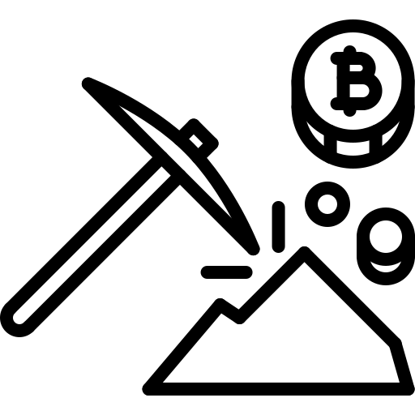
First, a few definitions
Blocks
Miners
Proof of Work
A set of transactions that are added to the public ledger.
Miners are special Bitcoin nodes that create blocks.
PoW is a process that makes it expensive to create blocks but cheap to verify them.

Slide 40
Miners settle transactions on the blockchain
Proof-of-Work
Tx queue
Miners choose txs based on fees
Miner A
mining...
Miner B
mining...
Miner C
mining...
New txs arrive
Link prev block
New
block!
Reward
Tx Fees
Public ledger aka “blockchain”
New BTC
Block of previous txs
Block of previous txs
Block of previous txs
Block of previous txs
Block of latest transactions
~40m ago
~30m ago
~20m ago
~10m ago
Notes:
Critical voiceover:
A block is valid if all bitcoin protocol rules which include
Preventing double spending, by ordering transactions in time [explicitly refer to this addressing question #2]
Preventing the creation of counterfeit bitcoin [explicitly refer to this addressing question #4]
The new block must link back to previous blocks ensuring the same history of transactions is used [explicitly refer to this addressing question #3]

Slide 41
The cost of mining a block: illustrated
This sequence is currently executed 120 quintillion times every second by miners
Including a link to the previous block in the hash ensures the integrity of the blockchain.
Only way to find a block is by hashing LOTS and LOTS of times—this is the “proof of work”.
Inputs
Previous block
Hashing function
Y
Transactions
SHA-256
Output hash
Match?
New block!
Runs on ASIC hardware
Example: 00000000000000001e8d6829a8a21adc5
Random #
N
Is the output less than some target threshold?
Generate new random #
Notes:
This is what makes it expensive
And makes it hard to undo past work
And creates game theory to accept others’ work
Difficulty
Supply schedule maintained regardless of # miners
Why do miners spend money to produce new blocks?
Each new block mints new bitcoin which the miner receives as compensation.
Also, each transaction attaches a fee that goes to the miner as a reward.
fingerprint; wildly diff output hash; google doc add period ex.
120 quintillion = 120 million trillion hashes per second
By far the biggest “supercomputer” in existence

Slide 42
Nodes verify the validity of newly mined blocks
Game theory suggests that miners begin mining next block immediately
Node
Node
Node
Miner
Once verified, nodes add block to their copy of the ledger and relay it
Node
Node
Node
Miner
New block found!
Send for verification
Miner
Node
Blocks are valid if they:
1. Obey protocol rules
2. Meet PoW requirements
Critical that verification remain a decentralized process to keep miners honest
Notes:
Game theory then suggests that each miner accepts the block and begins attempting to produce the next valid block with a new set of transactions
The odds of finding a new block doesn’t change for a miner, so it isn’t like they’re “starting over from the beginning” … in fact each hash they do is starting over from the beginning
If a miner were to ignore a new valid block, and continue attempting to build off of the block they had been, this would create a fork, but the rest of the network would reject their new block once broadcast because it would represent a “shorter chain”
Similarly, each node in the network verifies the new block is valid and accepts it [explicitly refer to this addressing question #1]
To emphasize the importance bitcoin puts on allowing anyone to participate, it is possible to run a bitcoin node on a $100 Android phone and audit the entire history of 600k blocks and 500m transactions.

Slide 43
Miners settle transactions on the blockchain
Proof-of-Work
Tx queue
Miners choose txs based on fees
Miner A
mining...
Miner B
mining...
Miner C
mining...
New txs arrive
Link prev block
New
block!
Reward
Tx Fees
Public ledger aka “blockchain”
New BTC
Block of previous txs
Block of previous txs
Block of previous txs
Block of previous txs
Block of latest transactions
~40m ago
~30m ago
~20m ago
~10m ago
Increasing immutability
“Accumulated work” protects txs, avoids double spends
Notes:
RECAP
Highlight: block reward, increasing immutability of the ledger

Slide 44
Mining maintains system integrity
✓
How do nodes agree on a single version of the ledger?
Game theory. Nodes accept longest chain.
✓
What prevents double spending and counterfeit coins?
Rules defining a valid block and game theory.
✓
What prevents modifying history?
Cost to redo PoW + competing with honest chain.
Notes:
single version of ledger ... because each node accepts the longest chain of valid blocks as the valid version of history
double spending and counterfeit ... to do so would be creation of an invalid block, which miners would reject because they don't want to mine (and spend money) building off of a block they anticipate the rest of the network rejecting. similarly, non-mining nodes would reject as (a) it isn't in their self-interest (only the double spenders) (b) game theory suggests majority will reject
modifying history ... to go back and modify a transaction from, say, last week, would necessitate re-mining 1000+ blocks, which would cost a LOT of money, and, you'd be racing against the rest of the network which would continue to build onto the "valid" chain

Slide 45
Let’s zoom out again.

Slide 46
Bitcoin is a new form of p2p digital money that is:
Self-sovereign
Scarce
Open to all

Slide 47
Self-sovereign: Bitcoin obeys only its own rules
Game theory determines and balances behaviour of ecosystem actors
No person/group can control Bitcoin
Decentralization provides security against corruption or capture
Changes to Bitcoin require massive consensus and backwards compatibility
Miners
Nodes
Devs
Social Consensus (Schelling Point)
User Keys
Businesses
Warning
Bitcoin Cash (BCH) is a non-consensus fork away from Bitcoin (BTC)
Even though promoted on bitcoin.com — this is not real Bitcoin. Beware!
Notes:
Important hisory: all attempts at ecash prior to bitcoin were shut down, example:
https://en.wikipedia.org/wiki/Liberty_dollar_(private_currency)
RE: Bitcoin Cash - mere fact that bitcoin.com can be captured by a scam, is testament to the unprecendented freedom of Bitcoin.
RE: Scams in general - lots of greed and misinformation out there. Education and vigilance is important!

Slide 48
Bitcoin is a new form of p2p digital money that is:
Self-sovereign
Scarce
Open to all

Slide 49
Digital scarcity: only 21M bitcoins will ever exist (!)
This fixed monetary policy cannot be changed—it is apolitical.
Total BTC
Fun facts
Current block reward: 12.5 BTC
85% of all bitcoins have already been mined
Up to 4M bitcoins may be lost
Impossible for every existing millionaire to own a whole bitcoin
0.28 BTC is sufficient to be in the top 1% of holders
21M
The 21M supply cap is enforced by code, verifiability and social consensus.
T
2009
2140
Every 4 years the “block reward” to miners drops by half.
The last new bitcoin will be issued in the year 2140.

Slide 50
Bitcoin is a new form of p2p digital money that is:
Self-sovereign
Scarce
Open to all

Slide 51
Permission is not required to participate in Bitcoin
Anyone can receive or send bitcoin.
Anyone can mine bitcoin.
Anyone can verify bitcoin.
Anyone can improve bitcoin.
No one can block a bitcoin transaction.
No one can seize (or freeze) your bitcoin wealth.
No one required to guarantee property rights.
No one can devalue your bitcoin.
Notes:
you don't have to apply for an account, fax in forms to some institution, etc. you just need to pick a number!

Slide 52
So what is the end game?

Slide 53
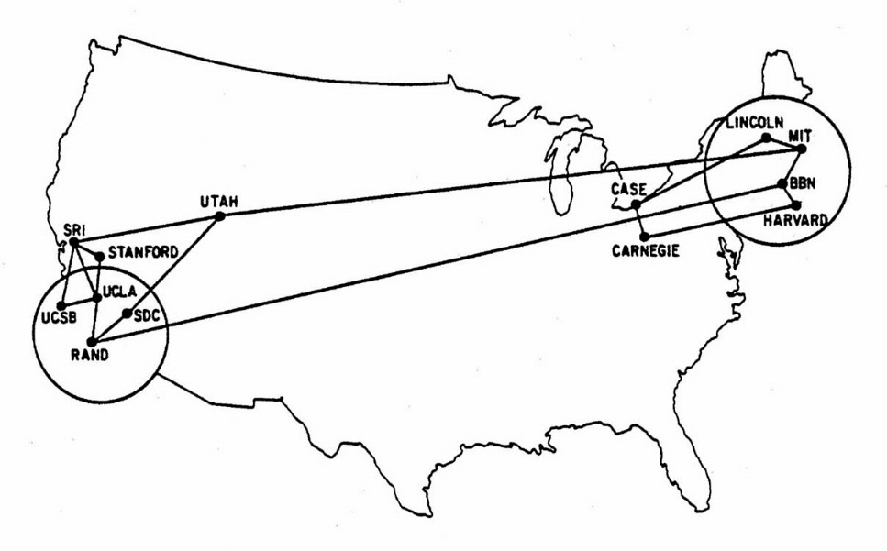
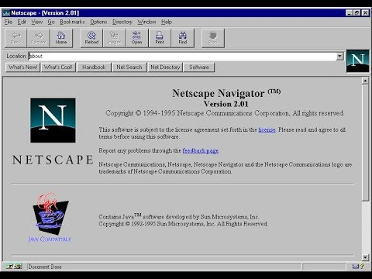
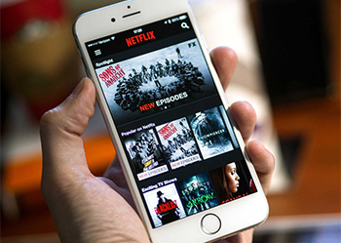
New protocols take time to mature
1970
1995
2020
Notes:
Speak to big areas that still need a lot of improvement: UX. Scaling. Security. Privacy. Volatility. Tax regulation.

Slide 54
A small probability of a massive shift
That shift: the complete re-invention of global finance.
Bitcoin as new store of value (e.g. better version of gold)
Bitcoin as global currency and unit of account
Savings-oriented economy vs. consumption-oriented.
Huge implications for nation states and central banking.

Slide 55
What do you think money will look like in 30 years?

Slide 56
Thank you.
http://hellobitco.in @hello_bitcoin hello-bitcoin

Slide 57
Additional resources to keep learning:
The Bullish Case for Bitcoin
The Little Bitcoin Book
Bitcoin Information & Resources

Slide 58
Appendix: Additional Q&A

Slide 59
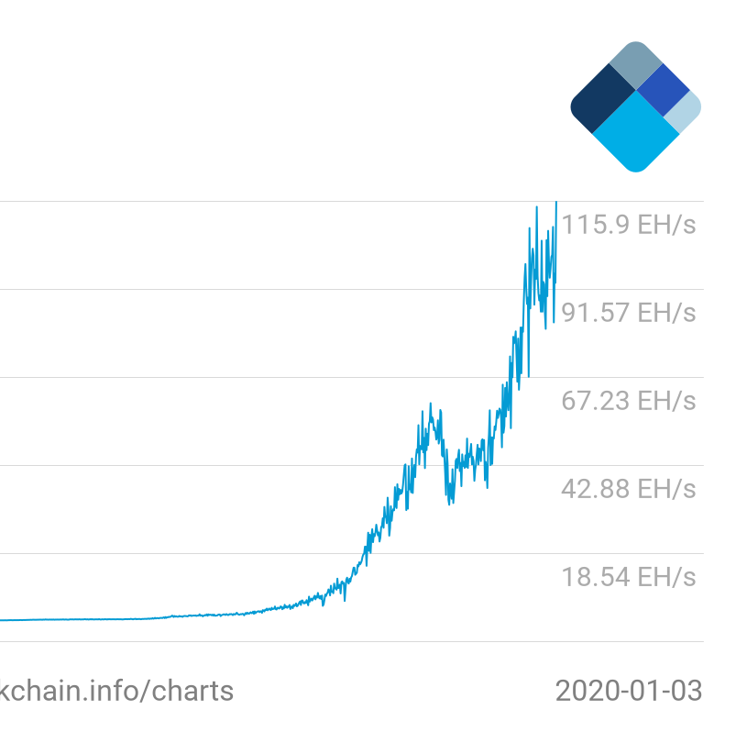
Does Bitcoin waste energy? (1/2)
Reframe: Do you value what Bitcoin grants us?
The energy cost of mining is what makes bitcoin secure against tampering.
Bitcoin Network Hashrate
More energy consumed
A more secure network
More enshrined freedoms
There is no other known way to create high-security, p2p digital money.

Slide 60
Does Bitcoin waste energy? (2/2)
Also, zoom out to consider:
Counterfactuals
Efficiency
Renewables
How much energy does the global financial system consume today?
Bitcoin transforms energy at the source—avoiding transmission losses.
New renewables projects now become economically feasible, driving investment.

Slide 61
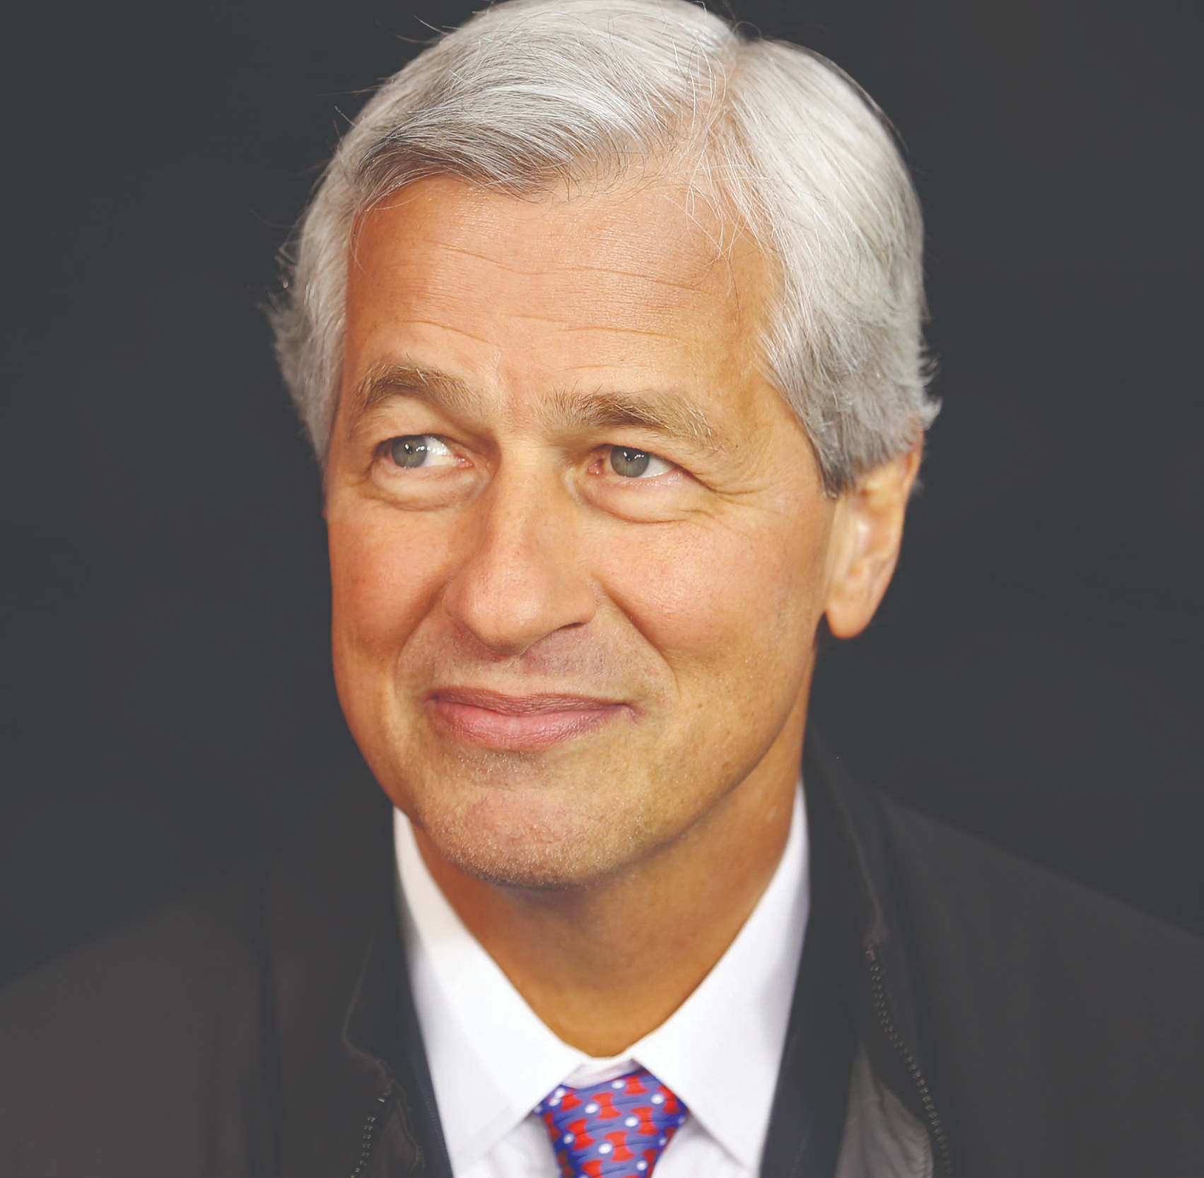
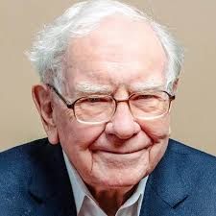
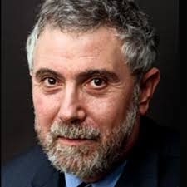
“Bitcoin is only for criminals” (1/3)
What does the old guard think?
“
Bitcoin is a fraud. It’s worse than tulip bulbs.
“
Bitcoin is rat poison squared.
“
Bitcoin is evil.

Slide 62
“Bitcoin is only for criminals” (2/3)
Crime is eternal.
Bitcoin is neutral.
Is the ‘cure’ worse than the disease?
1
2
Illicit activity <=1% of bitcoin txs
Counterfactual: USD?
New protocols enable good and bad uses:
Cell phone networks?
Internet?
Encrypted comms?
Digital regulated finance centralizes power dangerously
Human judgment subject to corruption, politics, error
Examples: HK protesters, Wikileaks, Iranian citizens
Adds friction to growth and innovation

Slide 63
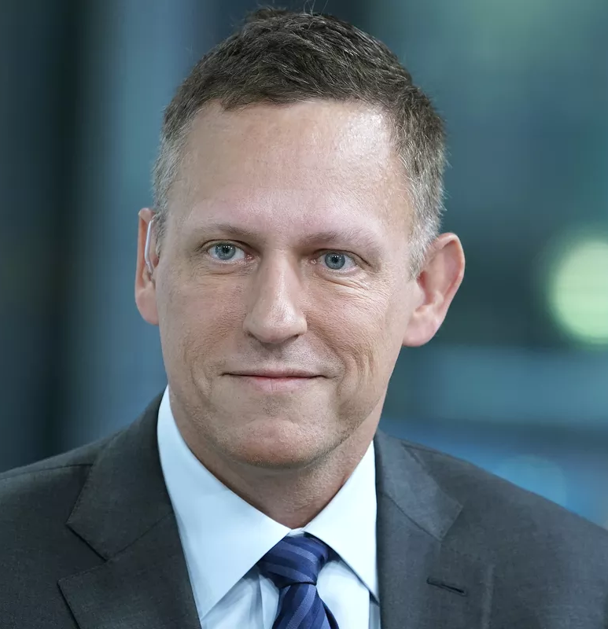
“Bitcoin is only for criminals” (3/3)
What do tech leaders think?
“
Bitcoin is resilient. Bitcoin is principled. Bitcoin is native to internet ideals.
“
Bitcoin is a remarkable cryptographic achievement and the ability to create something that is not duplicable in the digital world has enormous value.
“
I do think Bitcoin is the first [encrypted money] that has the potential to do something like change the world.

Slide 64
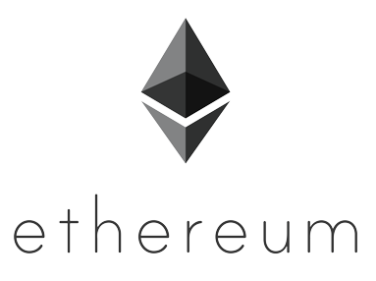
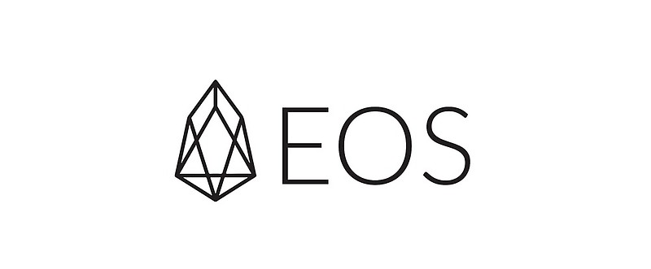
“What about other cryptocurrencies?”
Bitcoin gave rise to many competing cryptocurrencies (aka altcoins) that tweak its design parameters.
Critically, unlike almost all altcoins, Bitcoin has no leader or company behind it.
No other coin aims to become money or approach Bitcoin’s level of security, liquidity, infrastructure and branding.
The fact Bitcoin was first is definitionally unique and hardens the social consensus.
+
countless
others

Slide 65
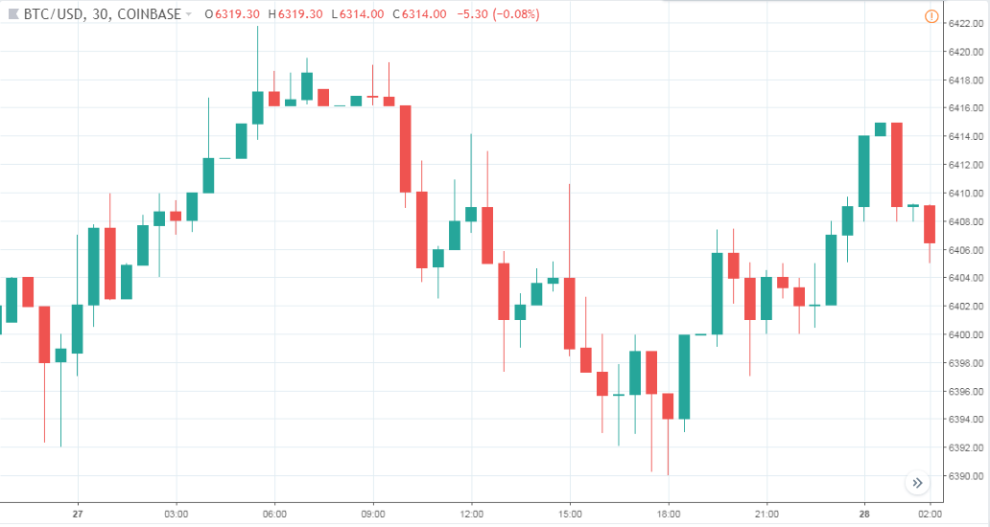
“Bitcoin is too volatile”
BTC is definitely volatile!
Volatility will decrease over time
Few people own bitcoin today.
In time, more people will own bitcoin.
Fixed supply. More demand. Higher price.
Less upside, fewer speculators.
Lower volatility.
Trading BTC is high risk

Slide 66
“When can I buy a coffee at Starbucks”
Cheap & instant bitcoin transactions will come via new layers.
It will take time for the application layer to see massive adoption by consumers & merchants.
POS Terminal
User Wallet
Other apps
Layer 2 Lightning Network (i.e. payment channels) will allow for near-instant, infinitely scalable transactions that are cheaper and more private than “on chain”. In development!
Layer 1 blockchain will remain slow & costly in order to preserve security and decentralization.
Bitcoin public ledger

Slide 67
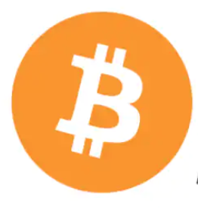
“How private is Bitcoin?”
All transactions publicly visible on blockchain but pseudonymously (i.e. public address)
Bitcoin public ledger
Chain analysis aims to track the flow of funds over time, btc can become “tainted”.
Fiat <> BTC on/off-ramps (typically 3rd party exchanges) often require user identity to abide by KYC regulations. Beware!
Onramp
Offramp
“Mixing” and other techniques (R&D) can help improve btc fungibility and transaction privacy.
Bitcoin transactions
Fun fact: Lightning Network transactions are more private than on-chain transactions.

Slide 68
“Why not do something useful with PoW”
PoW mining has a singular useful purpose: securing Bitcoin.
Any "useful" work done outside of that purpose does not contribute to security (e.g. comes at the expense of security).
Bitcoin Network Hashrate

Slide 69
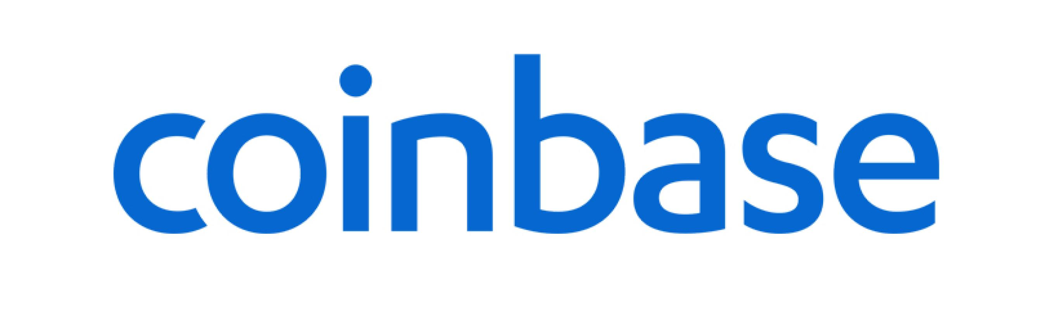
“How do I buy bitcoin?” (1/2)
Step 1: Buy BTC with fiat currency on a reputable site.
Established in 2012, good UX for new users, strong security record.
Mobile app from Square. Nice/easy for buying small amounts.
Can verify existence of your bitcoin on the blockchain.
New Bitcoin-only startup, supports recurring buys (DCA).

Slide 70
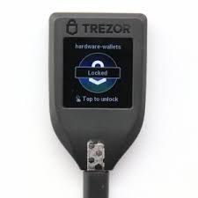
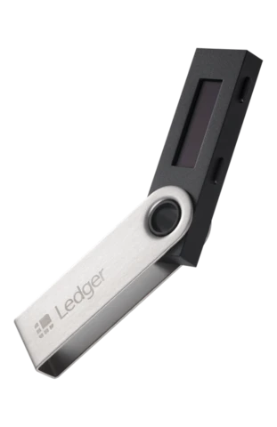
“How do I buy bitcoin?” (2/2)
Step 2: Take custody of your private keys.
Trezor Model T — probably best user experience.
Ledger Nano X — very good, slightly clunky user input.
Blockstream Green — free mobile wallet with 2-factor auth.
Casa Keymaster Multisig Wallet — distributed private keys.

