Slide 1



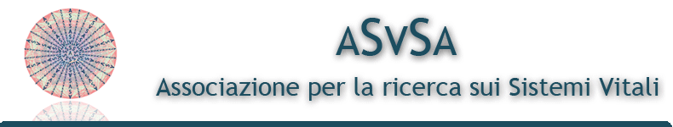
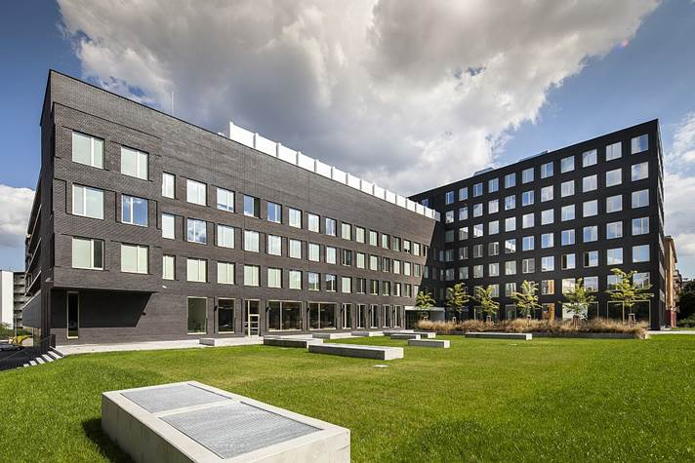
Marketing Strategy
in Service Business
- margrimaldi@unisa.it -

Slide 2




Programme
Marketing and Service Marketing: origins, evolutions & trends
Service Theories: from S-D logic & Service Science to service ecosystems & service systems
Many-to-Many Marketing
Marketing plan
Value co-creation
Unconventional marketing
Case studies
Examples

Slide 3


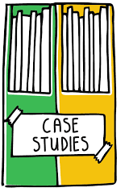
Agenda: Lesson 2
Service theories:
Service-Dominant Logic
Service Science
New organizational frameworks:
    Service ecosystems
    (Smart) service systems
Case studies and examples
from research projects

Slide 4
2.1
Service- Dominant logic
4

Slide 5
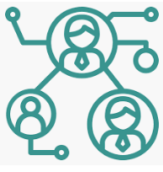

Service-based & Systems perspective: The key theories
Service- dominant logic (SDL)
Service Science, Management, Engineering and Design (SSMED)
Vargo & Lusch (2004)
Maglio & Spohrer (2008)
Theory that introduces the transition from a manufacturing logic to a new
service-based conceptualization of value creation process.
Multidisciplinary research stream (computer science, management, sociology…) which proposes a practical approach to the study of service systems, with a focus on service design and evaluation.

Slide 6
The Story of S-D Logic

Slide 7
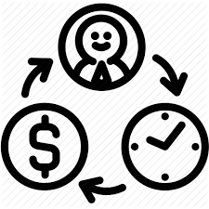
S-D logic: main insights and originality
S-D logic draws inspiration from the fundamentals of network theories and from the general revolution of Service Marketing (Grönroos, 2000; Gummesson, 2004) and focuses on the analysis of:
new value «generation» processes
modern (entrepreneurial) interactions
new “networked” modalities for resources integration
The goal is to advance a broader perspective that can meet current market’s requirements and can reflect the reality of contemporary service exchanges.

Slide 8
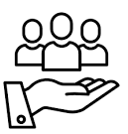
Service- dominant Logic (SDL)
The founders: Stephen L. Vargo & Robert F. Lusch
Aim: to overcome the old manifacturing logic and introduce a new perspective centred on service which emphasizes the relational nature of delivery and the authonomy of service as the basis of exchange.
SERVICE
New definition→ platform to exchange products
VALUE
Redefinition of value exchange process in order to propose the concept of value co- creation and to higlight the preeminence of customer’s role
ORGANIZATIONAL MODEL
Proposition of a new (multi-stakeholder) organizational layout to foster value co- creation

Slide 9
Goods-services Continuum

Slide 10
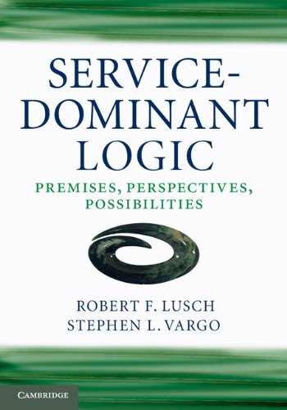
S-D logic mindset
Service-Dominant (S-D) Logic is a mindset for a unified understanding of the purpose and nature of organizations, markets and society which are engaged in the exchange of service, intended as the application of competencies (knowledge and skills) for the benefit of a party.
Formalization of the overcoming of product-orientation and proposition of a service-for-service view in which customers are not intended anymore as «passive» receivers of service but as actors who contribute actively to production and creation of joint value.
https://www.youtube.com/watch?v=Rp78Aefaz5I

Slide 11
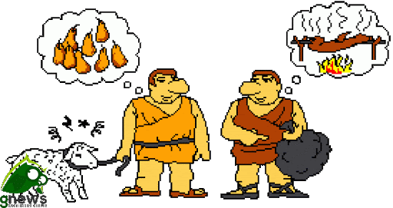
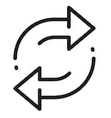
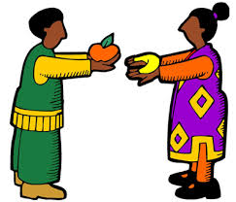
It’s all about service!
Even the oldest method of exchange like barter can be conceptualized as direct service-for-service exchange, in which each actor provides other actors with reciprocal service provision.
The producer-consumer distinction is trivial and should be overcome since each party clearly and directly provides other parties with benefits.

Slide 12
Originality and innovative insights:
Purpose of Exchange
Vargo and Lusch use the singular word «Service» to explain the goal to produce a benefit for a recipient and not as a simple unit of services (G-D logic).
Even when a customer buys a physical product, he is buying the service directly connected to it.
Many concepts (value co-production/co-creation, value propositions and experiences) are not totally new.
Rather, S-D logic captures the shift in contemporary marketing thought, in which marketing is seen as a facilitator of ongoing processes of voluntary exchange through collaborative, value-creating relationships among actors (individuals and organizations for example).

Slide 13


The evolution of S-D Logic
2004
FP1- FP8
Service
Users-Providers
Value
Resource Integration
Co-creation
In-exchange
vs In-use
2008
FP9- FP10
Value- in- context
Service
ecosystems
2016
FP11
Institutions

Slide 14

Axioms, Foundational Premises and Concepts of S-D Logic
The ten foundational premises (FPs, 2004-2008) lay the foundations of a framework for the service-centered mindset.
The different shades of VALUE
Over time, thanks to the diffusion of the theory in service research, different research streams have been proposed that emphasize different key dimensions of value co-creation processes: cultural, social, knowledge-based, innovation opportunities. Thus, value-in-context and institutions are proposed to consider the social nature of exchanges.
«To be consistent with the emerging narrative»
Vargo and Lusch realized that some of the original FPs could be derived from others and group the 11 statements into 5 more general propositions (AXIOMS)

Slide 15
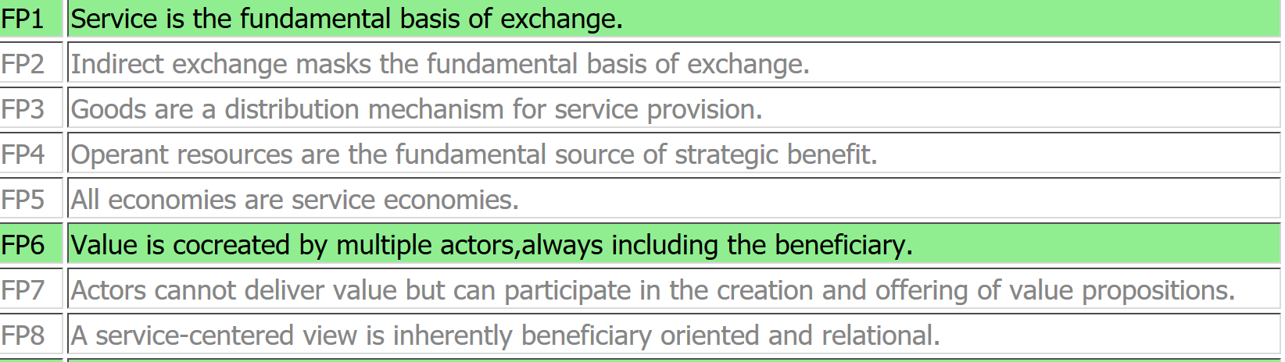
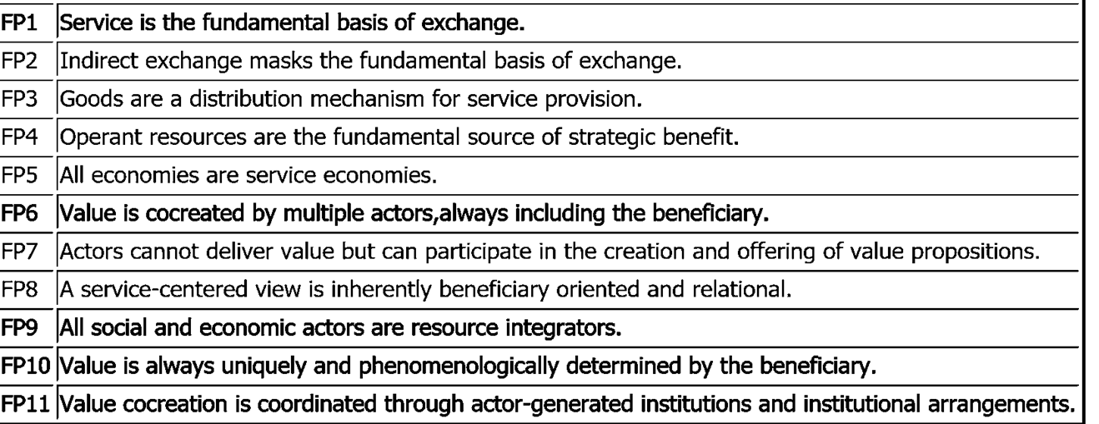
Axioms & Foundational Premises
AXIOM 1
AXIOM 2
AXIOM 3
AXIOM 4
AXIOM 5
Vargo Stephen, L., & Lusch Robert, F. (2004). Evolving to a new dominant logic for marketing. Journal of marketing, 68(1), 1-17.
Vargo, S. L., & Lusch, R. F. (2008). Service-dominant logic: continuing the evolution. Journal of the Academy of marketing Science, 36(1), 1-10.
Vargo, S. L., & Lusch, R. F. (2016). Institutions and axioms: an extension and update of service-dominant logic. Journal of the Academy of marketing Science, 44(1), 5-23.

Slide 16
S-D logic: FPs

Slide 17

Foundational Premises
11 foundational premises (FP): Synthesis of Vargo and Lusch’s theses that explain step by step the logic passages that lead to the elaboration of SDL framework and to the patchwork of the emerging dominant logic.
FP 1- FP5
SERVICE
11 Foundational premises
FP
FP 6- FP10
VALUE
FP11
ORGANIZATIONAL MODEL

Slide 18

FP1- FP5: Products and service, between manufacturing model and service logic
FP1
Service is the basis of all exchange
“Service for service”
FP2
Indirect exchange masks the fundamental unit of exchange
Goods as means for service
FP3
Goods Are Distribution Mechanisms for Service Provision
Service as overarching
FP4
Knowledge Is the Fundamental Source of Competitive Advantage
Operand and operant resources
FP5
All economies are service economies
Service dominates every kind of offering
Vargo S. L., Lusch R.F. (2004), Evolving to a new dominant logic for marketing, Journal of marketing, 68(1), pp. 1-17.
Vargo S. L., Lusch R. F. (2008), Service-dominant logic: continuing the evolution, Journal of the Academy of marketing Science, 36(1), pp. 1-10.

Slide 19
FP1: Service is the basis of all exchange
The first assumption represents the real SDL manifesto and remarks the transition from a traditional idea of exchange (Good- dominant logic) to a new service- centred perspective.
SERVICES
SERVICE
intangible units of output realized in a standardized way from producers and without the intervention of customers
The fundamental unit of exchange
The application of specialized skill(s) and knowledge for the benefit of other parties
Goods and service are not anymore strictly separated: not only service are not «dominated» by products but the two concepts converge.

Slide 20



FP1: Service is the basis of all exchange
New role of customer→ from passive receiver to active participant in the process of service delivery engaged in business activities.
Overcoming of the dichotomy proposed by Normann (2001) which defines providers as value creators and customers as value destroyers
New conception of exchange→ not anymore centered on physical goods but on a set of skills and immaterial elements whose value should be negotiated and co- produced
New aim of service delivery→ Beyond economic utility, towards the achievement of benefits for all the participants and the generation of new intangible resources.

Slide 21

FP2: Indirect exchange masks the fundamental unit of exchange
“Service for service”→ overthrowing of the role of goods and service
From service as a particular kind of products
From SERVICE (only intangible) ≠ PRODUCTS (only tangible)
To products as a tool to service delivery
It is the service underlying goods which represents and enhances the value of products
(Vargo & Lusch, 2004)

Slide 22
FP3: Goods are distribution mechanisms for service provision
Aim of service exchange:
to transform the tacit knowledge involved in service design and production into something exchangeable;
to provide the service related to goods
Even if the offering is tangible, the benefits deriving from the exchange should necessarily be conceived in terms of service.
Even though consumers concretely buy physical goods, they purchase the service related to it.
Goods are key levers and tools for the concretion, actualization and experiencing of service.

Slide 23


FP4: Knowledge is the fundamental Source of Competitive advantage
In line with Resource-based view (RBV, Penrose, 1959; Hamel & Prahalad, 1989) knowledge has a key role in the acquisition competitive advantage
OPERAND RESOURCES
Natural or economic resources usually tangible and static which require some alterations to assume value.
They represent the distrIbution mechanisms of service.
OPERANT RESOURCES
Human knowledge and skills, cultural and social resources usually intangible and dynamic which act on operand resources to create value and competitive advantage.
The sinergy deriving from user’s, provider’s(and each member’s) personal resources gives birth to a unique result, superior to the simple sum of the single individual contributions.

Slide 24
FP5: All economies are service economies
Service is the common denominator of all the economies and takes place in every kind of offering
Service is based on intangible activities which normally, but not necessarily, take place in the interactions between the customers and service employees and/or provider systems, which are provided as solutions to customer problems (Gronröos, 1990)
Goods are one of the resources that support co- creation process
Customers do not buy goods or service, but offerings that release service which in turn create value (Gummesson, 1995)
Holistic vision→ Service as a set of activities (including the use of products) creating new relationships and new configurations of elements.

Slide 25
FP6-FP10: The value of exchange, from a m to a collaborative view
FP6
The customer is always a co-producer
Value co-creation
Value-in-exchange
FP7
The enterprise can only make value propositions
Value does not lie in product
Consumer as strategic resource
FP8
A service-centered view is customer oriented and relational
Multi- level vision
Bidirectional communicative flux
FP9
Organizations exist to integrate and transform microspecialized competences into complex services that are demanded in the marketplace
A2A- collaborative optics
FP10
Value is always uniquely and phenomenologically determined by the beneficiary
Value- in- context

Slide 26

FP6: The customer is always a co-producer
From
to : the provision of a priceless experience, strictly connected to the service
value-in-exchange
value-in-use
Customer is always a co-producer, an active part of the system who gives a key contribution in terms of knowledge, skills and creativity.
VALUE CO-CREATION
process in which products, service and experience are jointly developed by companies and by their stakeholders.
Consumers are engaged in all the phases of the process: design, personalization of the offering, delivery and production

Slide 27
FP6: The customer is always a co-creator of value
Value co- creation differs from co- production which represents only part of it.
Co-creation
Co- creation
Co- production
co-production
Customer’s practice realization of value proposition in order to obtain value-in-use
Customers’ participation in the development of value propositions and in service design in order to provide a more efficient service.
Users are always value co- creators but they not necessarily are co- producers
Users contribute to service delivery both through:
their emotional engagement and previous experience;
the release of operand (financial capital) and operant (psychological and social factors) resources.

Slide 28

FP7: The enterprise can only make value propositions
Consumers/Users
from target who should be "hit" by a given offering to competitive resource leading to sustainable competitive advantage.
Providers
Users
Value proposition suggestions in line with the specific resources owned.
Subjective and context- dependent perception and possible acceptance
of the value proposition proposed by providers.
Durable and bidirectional relationship based on trust

Slide 29
FP8: A service-centered view is customer oriented and relational
SDL is customer-oriented and based on a relational view.
The resource exchange between users and providers is based on bidirectional relationships and on informational symmetry.
Providers are not anymore in a leading position.
Customers participate in all the phases of service delivery (pre-, during and post)
Stakeholder theory (Donaldson and Preston, 1995): engagement in all business strategies and tactics of all the stakeholder (affected and affecting the conduct of organization), such as consumers, other companies, institutions, associations, etc.

Slide 30

FP9: Organizations integrate and transform competencies into complex services
Organizations: micro and macro competencies integrators transforming the specialized skills provided by stakeholders into efficient services.
Resources integration
set of procedures, tasks, mechanisms, activities and interactions supporting co- creation
point of contact for the interaction between the two parties
A2A (“actors to actors”) logic
All the economic actors involved in value exchange are resource integrators in a network approach and carry out actions aimed at achieving mutual benefits for everyone

Slide 31
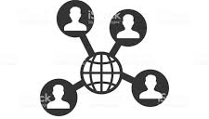
Resource integration
The definition of value co- creation is strictly related to resource exchange and to customer’s social network
McColl-Kennedy et al. (2012) define value co- creation as a: benefit realized from integration of resources through activities and interactions with collaborators in the customer’s service network
So, customers integrate resources from sources other than the firm. Social networks affect the way in which they use operand resources.

Slide 32
Resource integration
Vargo and Lusch categorize the kind of resources (2011) and the competencies (2014) implemented by users in value co- creation process.
Resources
Competencies
KIND
SOURCES
ABSORPTIVE
Individual experience
Actor’s ability to understand the context, to absorb and learn new knowledge from other members of the system, to remove any kind of resistance to collaboration.
INTERNAL
PRIVATE
Friends and family
PUBLIC
Associations, corporations, P.A. officials
ADAPTIVE
Capability to adapt to the variable complexity of the context and to improve the process through cross- functional teamwork.
MARKET- FACING
Other suppliers or economic actors

Slide 33
FP10: Value is always uniquely and phenomenologically determined by the beneficiary
The final determination of value is always established by beneficiaries: value, in fact, is negotiated during the provision, in- use, starting from a specific subjective point of view and from a specific context.
Value-in-context (Vargo et al., 2008)
consumers do not obtain value «simply» by buying a product, but from its use, transformation and consumption and from the integration and sharing of resources and benefits with other members of the network.
Final aim of the process: improvement of the general well-being of all the actors of the network and acquisition of the capability to adapt to the environment.

Slide 34

FP11: Institutions and
institutional arrangements
Two main enablers and coordination mechanisms of value co-creation (strictly interconnected):
INSTITUTIONS
INSTITUTIONAL ARRANGEMENTS
rules, norms, meanings, symbols, practices and agreement that govern actor’s collaboration
interdependent assemblages of institutions: essential facilitators for value co-creation in markets and society
The two enablers permit to perform activities and exchange in a «natural» and «coordinated» way in line with the rules determined a priori.
“Humans create institutions to coordinate their behaviours " (Barile et al., 2016).

Slide 35
S-D logic: Axioms

Slide 36
S-D Logic Axiom n.1
A1
Service is the fundamental basis of exchange
The application of operant resources (knowledge and skills), «service», is the basis for all exchange.
Service is exchanged for service
1. Goods are devices to provide service
2. All companies are service companies
3. All economies are service economies.

Slide 37
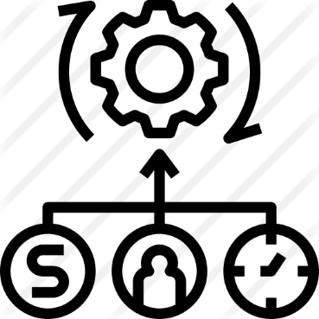
Innovative contributions:
Knowledge and Resources
S-D Logic is focused on the importance of the intangible resources, in particular of the knowledge as a strategic resource – not just a competitive factor (FP4).
Tangible resources, often inert (operand resources) need intangible and more dynamic activities (operant resources), relevant to them, in order to be usable and useful.

Slide 38
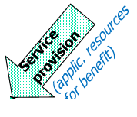
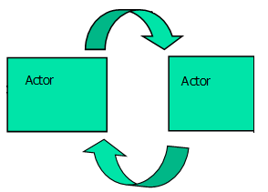
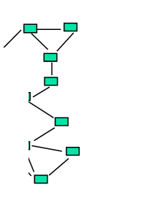
A1 (FP1): Service is the fundamental basis for exchange

Slide 39
S-D Logic Axiom n.2
A2
Value is always co-created by multiple actors, including the beneficiary
Value co-creation is interactional and combinational
Value is always co-created by actors’ interactions, both directly and through the goods.
[Ex. A physician providing a patient with service co-creates value with him, a drug is seen as a device to facilitate service delivery and value co-creation]

Slide 40
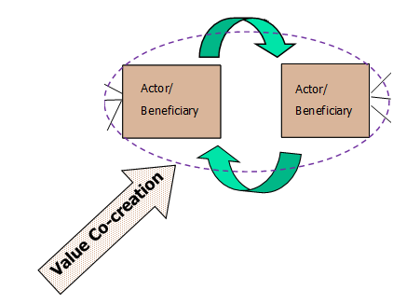
A2 (FP6): Value is always cocreated by multiplie actos, including the beneficiary

Slide 41
S-D Logic Axiom n.3
A3
All economic and social actors are resource integrators
The context of value co-creation is networks of networks (resource integrators)
Resources come from a variety of sources:
private sources (ex. themselves, friends, family)
market sources (so by other actors, through barter or economic exchange)
public sources (collective access from community and government sources)

Slide 42
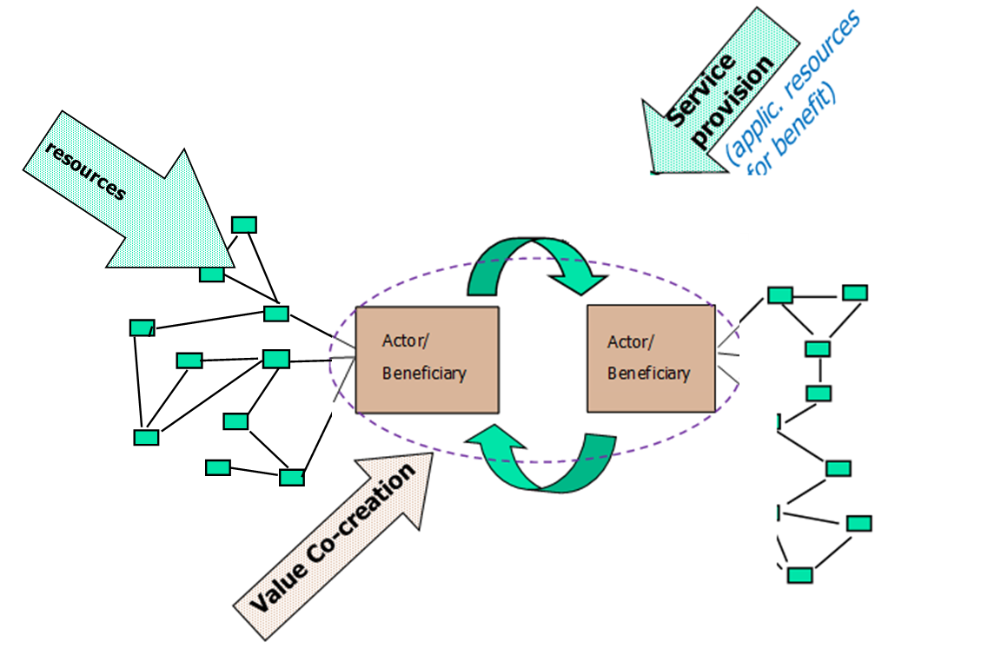
A3 (FP9): All social and economic actors are resource integrators

Slide 43
S-D Logic Axiom n.4
A4
Value is always uniquely and phenomenologically determined by the beneficiary
Value is idyosincratic, experiential, contextual and meaning laden
Not only actors are co-creators, but they are the only ones who can determine the value, which is always perceived and “negotiated” based on the context in which the subjects act.

Slide 44

S-D Logic Axiom n.5
A5
Value cocreation is coordinated through actor-generated institutions and institutional arrangements
Institutions provide the glue for value cocreation through service-for-service exchange
Institutions: humanly devised rules, norms, and beliefs that enable and constrain action and make social life predictable and meaningful
Institutional arrangements: higher-order sets of interrelated institutions
Institutionalization
new practices (routinized activities)
for market evolution
legitimization of
old practices

Slide 45
Service Ecosystems
Starting from the «social shift» of SDL (11 FP), Vargo and Lusch proposes a new conceptualization of networks based on the transcending and systems perspective of service
Value co-creation involves complex networks of actors and supply chains (rather than dyads)
THEN, new multi-actor models are required to reread the mechanisms for competitive advantage
“relatively self-contained, self-adjusting system[s] of resource-integrating actors connected by shared institutional logics and mutual value creation through service exchange”
Lusch and Vargo (2014, p. 161)
45

Slide 46




Service Ecosystems: main dimensions
Coordination mechanisms for exchanges based on preexisting shared rules (socially and commonly accepted) that act as enablers of resource integration
INSTITUTIONS
RESOURCE INTEGRATION
Exchange of resources occurring in the multiple interactions between actors (from pre-delivery, design to post-delivery)
TECHNOLOGY
IT and ICTs based platforms that make exchanges more efficient and accelerate innovation
VALUE PROPOSITION
Set of common values that guide the attainment of shared purposes for each actor
https://www.youtube.com/watch?v=Az6D6vzfFrU
46

Slide 47
Case studies on
Service Ecosystems

Slide 48
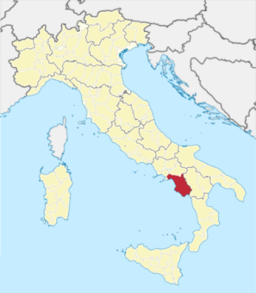


Case study 1: Tourism
Qualitative approach
Exploratory Case Study: B&B Sector
  informal nature and the synergistic exchange between system’s actors
  Analysis of «Bouganville B&B»
Semi-structured interviews:
  face-to-face interviews with b&b owner
  to explore the relationship between b&b owner and customers and identify the existence of elements that forster VCC
Duration: about 20 min
Conducted in informal style and colloquial settings (at b&b)
Recorded and transcribed
Interview Track based on theory
48

Slide 49


Tourism Ecosystem
PROVIDERS
E
M
E
R
G
E
N
C
E
USERS
New Value Genereted
Value proposition
Resource integration
Technology
Institutions
Value proposition
Resource integration
Technology
Institutions
New Value Genereted
VALUE CO-CREATION
INNOVATION
New resource and resource integration
New interactions modalities
New institutions
New value
49

Slide 50



CO-EVOLUTION AND VIABILITY
E
M
E
R
G
E
N
C
E
The best stay ever
Material, information, logistic, experiential, cultural resources
Ota, Metasearch, site, instant messaging, social network
Formal and informal rules
Guests
B&B host
The best stay ever
Previous experiences, cultural, comments and suggestions spontaneous or asked
Ota, Metasearch, site, instant messagging, social network
Formal and informal rules
VALUE
VALUE
VALUE CO-CREATION
INNOVATION
New knowledge (culturales), new experiences, new habits
New interactions modalities through the strategic integration of ICTs (pre, during, post)
New rituals:
Photo, Welcome apretif, breakfast with tipical sweet
50

Slide 51

Main Insights
emerging inputs and outcomes (new value) can foster value co-creation and innovation
Value Co-Creation
Innovation
Co-evolution
Viability
outputs can act as a basis for the constant renewal of values and innovation that leads to co-evolution and viability over time
51

Slide 52

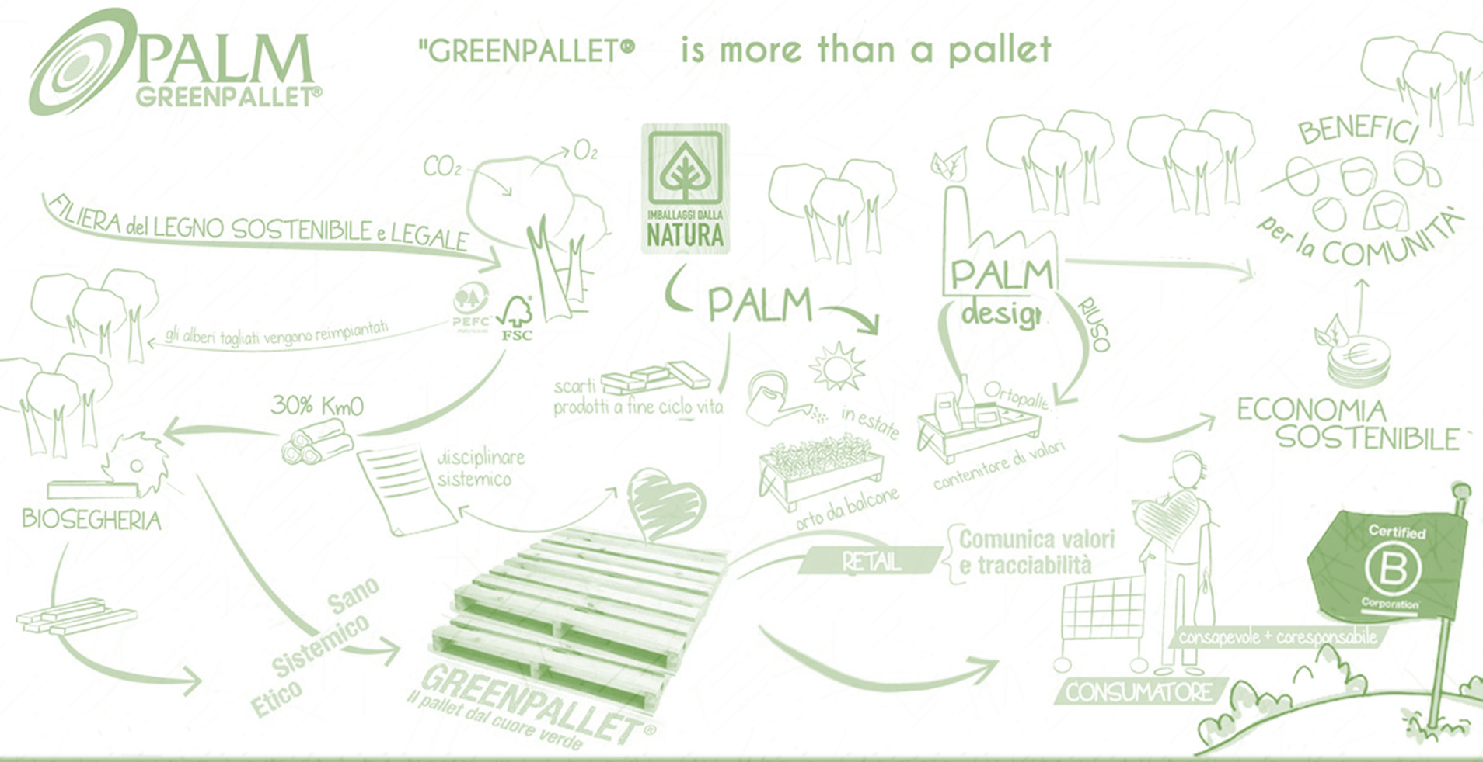
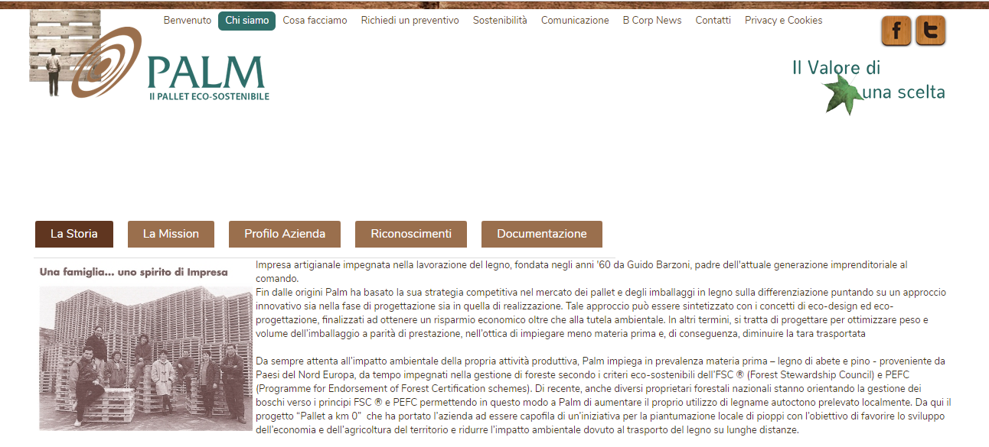
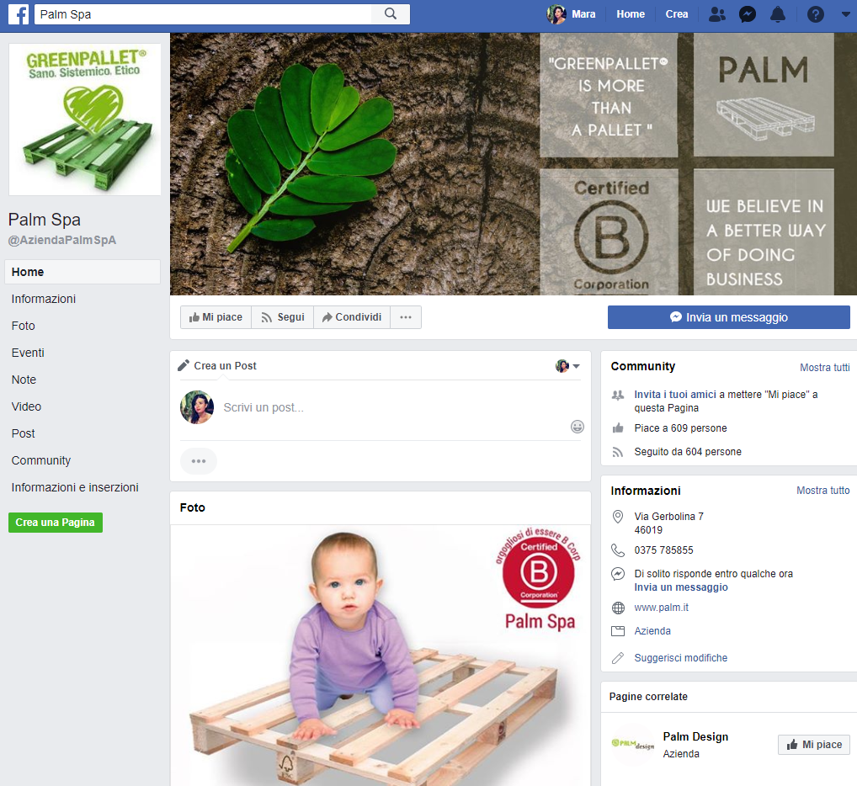
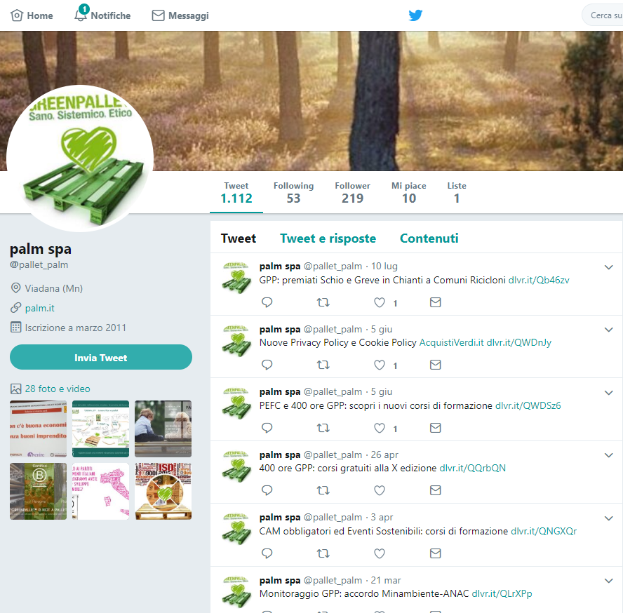
Case study 2: Green Pallet
Method
Qualitative
Idiographic approach (underlying dimensions)
Exploratory stage
Technique
Case study based on content analysis
The case
Multi-stakeholder network
Sustainable innovation practices
Units of analysis
Website (report, codes)
Social networks page
Macro-areas for analysis sheet
Different strategies for value co-creation and innovation
ICTs role
Different innovation outcomes
For each stage of co-created innovation
52

Slide 53
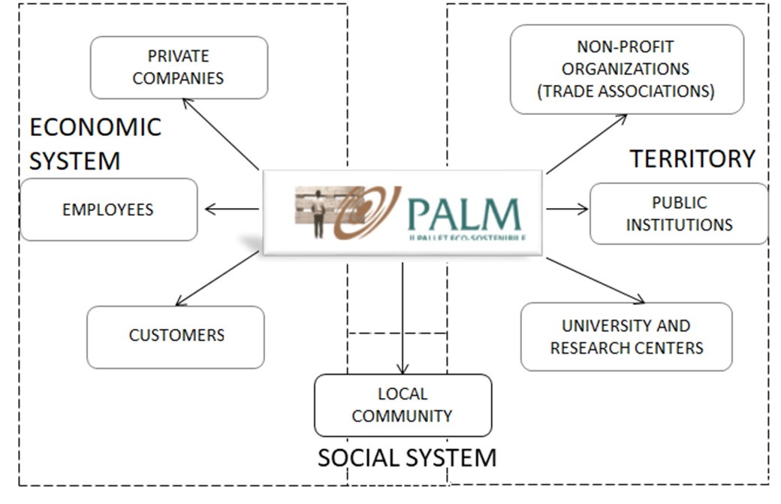
Reinterpreting “Palm” as an ecosystem
MICRO
Co-created innovation
strategies
ICTs role
Innovation outcome
MESO
MACRO
53

Slide 54
Strategic innovation management in ecosystems
Co-development
Multi-leveled approach
MESO
Engagement/ Experience
Shared goals
Different steps of co-created innovation
Different contexts
Different technologies
Different innovation outcomes
TECHNOLOGY
MACRO
MICRO
Co-design
in use
in context
Co-evaluation
Value propositions
VALUE CO-CREATION
Cohesive Culture
INNOVATION
META
Creation of new value, service process, product
Co-learning
Renewal of innovation outcomes
Creativity
Co-evolution
54

Slide 55


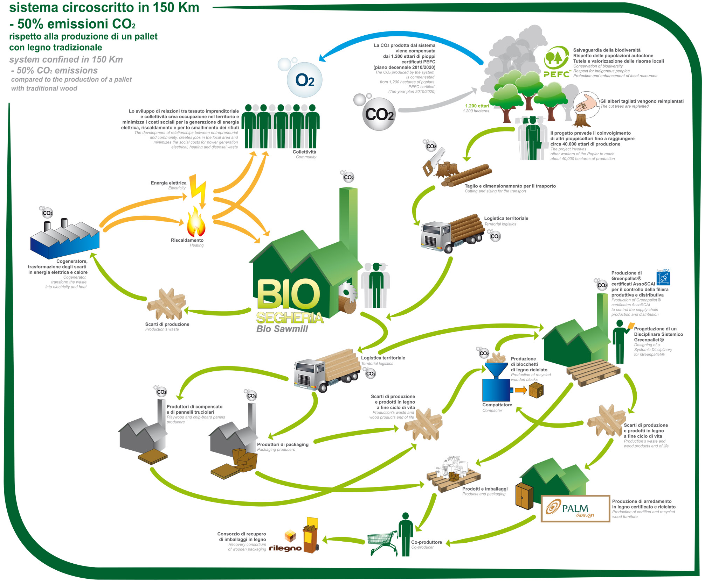

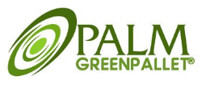


Different innovation in Palm ecosystem
MESO
Co-development
Shared Goals
ECONOMIC SUSTAINABILITY
Engagement
Experience
SOCIAL RESPONSIBILITY
RQ1
MICRO
Co-design
TECHNOLOGY INNOVATION
  PROCESS-SERVICE
  INNOVATION
Co-evaluation
Common value propositions
Externalization
culture
MACRO
Cohesive
Culture
VALUE CO-CREATION
SOCIAL INNOVATION
Co-learning
RQ2
Co-evolution
creativity
ENVIRONMENTAL SUSTAINABILITY
META
Renewal of value
55

Slide 56
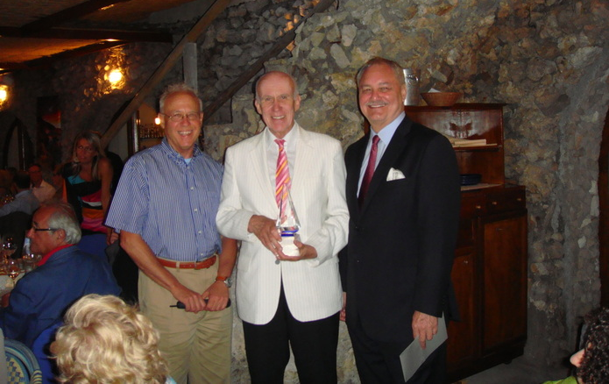
Gummesson receiving the S-D Logic Award at the 2011 Naples Forum on Service.
(left to right: Dr. Robert F. Lusch, Dr. Evert Gummesson, Dr. Stephen L. Vargo)

Slide 57
Key References
The foundations
Vargo S.L., Lusch R.F., Evolving to a new dominant logic for marketing, in Journal of marketing, vol. 68, n. 1, 2004, pp. 1-17.
Vargo, S. L., Lusch, R. F. (2008). Service-dominant logic: continuing the evolution. Journal of the Academy of marketing Science, 36(1), 1-10.
The development
Vargo, S. L., Wieland, H., Akaka, M. A. (2015). Innovation through institutionalization: A service ecosystems perspective. Industrial Marketing Management, 44, 63-72.
Vargo, S. L., & Lusch, R. F. (2016). Institutions and axioms: an extension and update of service-dominant logic. Journal of the Academy of marketing Science, 44(1), 5-23.
The different shades of SDL
Edvardsson, B., Tronvoll, B., & Gruber, T. (2011). Expanding understanding of service exchange and value co-creation: a social construction approach. Journal of the academy of marketing science, 39(2), 327-339.
Nambisan, S., & Baron, R. A. (2013). Entrepreneurship in innovation ecosystems: Entrepreneurs’ self–regulatory processes and their implications for new venture success. Entrepreneurship theory and practice, 37(5), 1071-1097
The research agenda
Vargo, S. L., & Lusch, R. F. (2017). Service-dominant logic 2025. International Journal of Research in Marketing, 34(1), 46-67.
Barile, S., Lusch, R., Reynoso, J., Saviano, M., & Spohrer, J. (2016). Systems, networks, and ecosystems in service research. Journal of Service Management.
57

Slide 58
2.2
Service Science

Slide 59


Service Science
Service Science management, engineering and design (SSMED)
Multidisciplinary research stream that studies the implications emerging from the new management approach to services
Unifying framework for service design, delivery and evaluation that aims at developing the capabiliteis required by service economy;
Introduced after company’s shift from a good-logic to a service centered perspective
The founders: Spohrer and Maglio (2008)
Aim: to combine and to apply computer science, operational research, industrial engineering, management and social sciences to find the most appropriate organizational model to support the emergence of value

Slide 60

Service Systems
Service systems are value-creation networks composed of (Bryson et al. 2004; Maglio et al. 2006):
People
Organizations
Technology
Shared information
promote real-time relationships and accelerate up co-learning processes in many fields (e.g. smart services in the energy sector, transport, etc.).
come from systematic methods, continuous learning, data collection, innovation, social responsibility and network governance, and all the operations that benefit from the application of new technologies.

Slide 61
(1) Service Systems: definition
Service systems: value-co-creation configuration of people, technology, value propositions connecting internal and external service systems, and shared information able to create and deliver value to providers, users and other interested entities, through service.
Spohrer, Maglio, Bailey and Gruhl (2007)
The aim of service system is to use its own resources and the resources exchanged with other actors to improve its own and other’s well-being
Service
systems

Slide 62
(2) Service Systems: definition
value-co-creation configurations,
resources integrators,
knowledge-based,
capable of enabling connections and interaction,
with the aim of reaching desired outcomes,
simply, always, an operative application,
any number of elements, interconnections, attributes, and stakeholders interacting in a co-productive relationship.
… a Service System is basically composed of heterogeneous entities, interacting with each other with specific purposes
1
2
3
4
5
6
7

Slide 63
The different definitions
«A service system is any number of elements, interconnections, attributes and stakeholders interacting in a co-productive relationship that create value, in which the principal interactions take place at the interface between the provider and the customer»
Spohrer, Vargo, Maglio and Caswell, 2008
«A service system primarily relates to customer-provider interactions as well as open system with it being capable of improving its own state and the one of another system though acquiring, sharing, or applying resources, with the aim of creating a basis for systematic service innovation»
Golinelli, 2008
«Service systems can be represented as real networks, in which the same entities combine their strengths through direct and indirect connectivity, as they are oriented toward enduring competitiveness and daily interactions with other external interdependent service systems»
Polese, 2009

Slide 64

Service Systems: origins
The concept derives from systemic vision and network theory (Richardson, 1972; Normann and Ramirez, 1993; Castells, 1996; Capra, 2002)
System
entity emerging from a specific structure (organzational-physical equipment) thanks to interactions among all system’s members (Barile, 2013).
Aim: survival through the acquisition (and the exchange) of knowledge from the other systems situated in the context which leads to the creation of new knowledge.
Since value co- creation is centred on knowledge exchange to acquire mutual benefits, system is the most adequate configuration for companies aiming at acquiring sustainable competitive advantage.

Slide 65

From Systems Theory
SYSTEM
“complex of interacting elements” (Von Bertalaffy, 1956)
“an entity that is adaptable for the purpose of surviving in its changing environment” (Beer, 1975);
“entity which is a coherent whole” (Ng, Maull and Yip, 2009)
Actors & connections
Composed of many part (Parsons, 1965), boundaries, connections and different relationship with relevant stakeholders based on the sharing of critical and influential capabilities
sub-systems focus on the analysis of relationships among its own internal components while supra-systems focus on the connections between the analysis unit and other influencing systemic entities in their context (Golinelli, 2005)
SUB-SYSTEMS
Supra-systems

Slide 66

Service Systems
Today, service systems represent an emerging issue in economic research, all-encompassing many specific topics (innovation, smart cities and communities) and even quality, traditionally related to technologies and processes
Main References:
Alter, S. (2008)
Spohrer, J., Vargo, S.L., Maglio, P.P, Caswell, N. (2008)
Reinterpretation of service design, service supply and fruition, in which multiple active actors synergistically participate in the value co-creation process, which is characterized by resource-sharing and common finality.
66

Slide 67
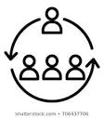

(1) Service Systems: ORGANIZATIONS
Organizations: interconnected systems entities
sharing the same value system.
A Service system is composed of a network of organizations carrying out integrations of multiple resources in order to achieve reciprocal benefits for all the stakeholders.
Every member of the system has its own interests and pursues specific aims. Thus, managers should seek to harmonize the differing needs of each subject in an attempt to satisfy the stakeholder’s demands and, at the same, the well-being of the system.
Individual objectives
System’s
Goal

Slide 68

(2) Service Systems: PEOPLE
Human factor is essential to balance the
needs of all the stakeholders.
Knowledge is the real added value to foster value co- creation, since this process is grounded of the exchange of internal and external (contextual) competencies and resources
In a market based on intangibilities, service delivery does not represent only economic exchange, but can be undesrtood as the result of the integration of the specialized skills of each member.
Customers can help firm to improve service starting from service design, by sharing their capabilities andcreativity.

Slide 69

(3) Service Systems: TECHNOLOGY
ICTs: opportunities for providers and consumers to exchange resources, fostering the sharing of value propositions at intra- and inter-organizational level
The diffusion of new technologies and platforms (community, forum, blog, social network) can enhance the interactions among stakeholders, with an increase in stakeholder engagement.
Users can make comments and judge service quality, providing organizations with suggestions on the improvement of the offering.
The more the social and relational capital grow, the more the knowledge exchanged intensifies.

Slide 70

(4) Service Systems: INFORMATION
Through technology and ICTs co- creators can constantly share flows of information, increase their knoweldge, strenghten relationships and modify their behaviors to pursue common goals.
The possibility to transfer every kind of information in real time permits users to play a predominant role in business decision- making and service improvement
The combination of the 4 elements of service systems (organizations, people, technologies and information) allows to create value through the implementation of a networked system in which companies, institutions, organizations and users share a systematic flux of information and know-how, which can be managed in an efficient way thanks to technology

Slide 71
Main Suppliers
Suppliers
Stakeholder
Individuals
Enterprise
Stakeholder
Individuals
Enablers
Clients
Service System as Value Network
Organizations
Technology
Shared Information
People

Slide 72

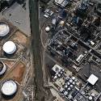



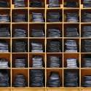


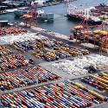




Complex Service Systems
as the base of a Smarter Planet…
iterative, interactive, instrumented, interconnected, intelligent
S.M.A.R.T.: Specific, Measurable, Agreed, Realistic and Timely
(More measurement data, More networks, More learning and adaptation)
Complex Service Systems, as smarter systems improve quality of life,
creating more opportunities for win-win interactions:
resulting in measurable resource access & value-cocreation for multiple stakeholders.
Smart traffic systems
Intelligent oil field technologies
Smart food systems
Smart healthcare
Smart energy grids
Smart retail
72
Smart water management
Smart supply chains
Smart countries
Smart
weather
Smart regions
Smart cities
Source: www.ibm.com/think
72

Slide 73

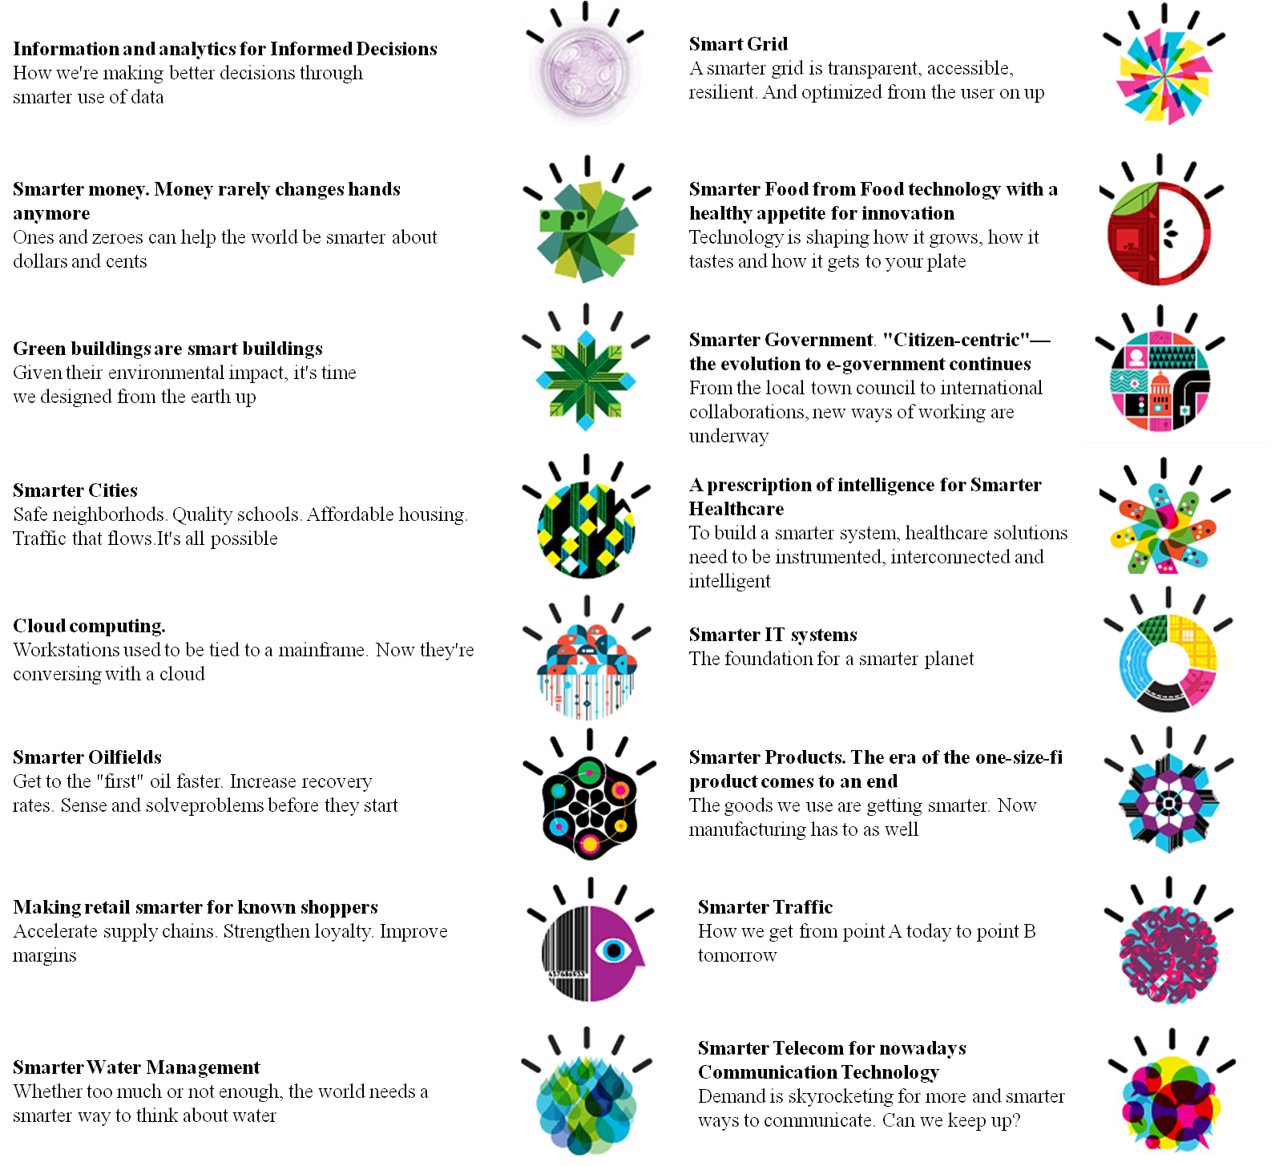


Smarter Planet
Iterative, interactive, instrumented, interconnected, intelligent
(More measurement data, More networks, More learning and adaptation)
Smarter Food
Smarter Products
Making retail smarter
73

Slide 74
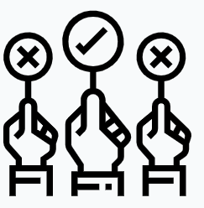
Service Science vs S-D logic
Similarities with SDL
Relational approach to business
Focus on resources (RBV)
Many-to-many logics to business behaviour
Differences with SDL
Practical approach
Technological- Informational focus
Smart vision on planet
Measurement of service and systematic search for innovation and continuous improvement
Spohrer, J., Anderson, L., Pass, N., Ager, T. (2008)
Spohrer, J. Maglio, P.P., Bailey, J., Gruhl, D. (2007)
Vargo, S.L., Lusch, R.F., Wessels, G. (2008)

Slide 75
Case studies on
Service systems

Slide 76
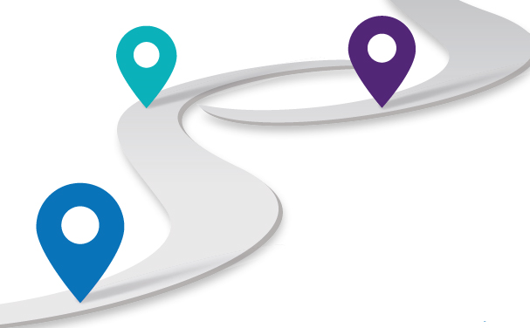
Case study 1: Service Journey
J O U R N E Y
DATA
Research & collection
DATA
Selection
Integrated Architecture
PRE
TP
TP
T
E
C
H
N
O
L
O
G
Y
TP
T
E
C
H
N
O
L
O
G
Y
Experience
Experience
Organizations
People
DATA
ATTITUDE
MOTIVATIONS
EXPECTATIONS
PERCEPTION & EVALUATION
Shared information
Re-use & Storage
COMPUTING
Skills
VALUE
Encounter
INFORMATION
DATA Integration
DATA Recombination
POST
TP
Process
management
TP
PURCHASE/BUSINESS DECISIONS
KNOWLEDGE
RESHAPING
OPINIONS
TP
Neslin et al., 2006
Verhoef et al., 2007
Voorhees et al., 2017
DATA Interpretation
76

Slide 77
Touchpoints & Multi-channel strategies
Touchpoints
Rating services In-Store or during E-commerce transactions
Instant Messaging applications
Research techniques
Simulations, scenario-based analysis
during
1
3
1
2
Touchpoints
pre
Research & Collection
Sharing & Integration
Selection
pre
Touchpoints
Planned Communication (Social network)
Reviews on the service
Recommendation Systems
Metasearch
E-Booking
User’s Needs Identification
Prediction and enhancement of Willingness to Engage
DATA
Alignment/Misalignment and Internalization of Value Propositions
Extraction of User’s Feedback on service
Recall Communication
Exchange of experience, knowledge, culture, «sentiment»
Organizations
Shaping experience
People
Value Propositions
Supervision of The Degree of
Involvement
Skills Enhancement
Analysis
People
Cloud Computing Systems
Order management
Search, evaluate & Compare Services
Willingness to Share
Organizations
Shared information
Organizations
Touchpoints
Creation of a common set of Values
Idea proposition for service improvement/creation of
new Service
Post-Delivery Services
(e-commerce)
New value
Touchpoints
People
To extract Knowledge
Feedback’s Analysis and Management
Word-of-Mouth
Analytics
Organizations
5
People
Constant regeneration and renewal of Value- Services- Process
KNOWLEDGE
Transformation
Analytics
Datawarehouse & Database
Cloud computing
Sentiment analysis, Text Mining for Users Profiling
Machine Learning, Cognitive computing & Fuzzy Logic
VALUE
during
Organizations
6
Touchpoints
post
Re-use & Storage
Living Labs
Open Platforms (Crowdsourcing, co-Design)
INFORMATION
4
Recombination
Recombination
post
post
77

Slide 78


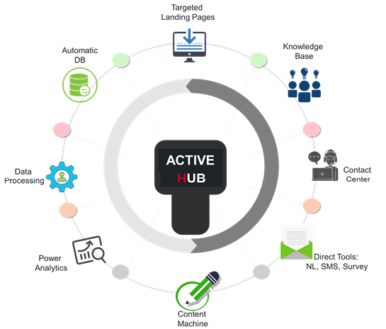




The Case
CREATION OF NEW TOUCHPOINTS
TO ACQUIRE
[lists, contents,
on-line campaign]
TO ENGAGE
INTERCONNECTION OF CHANNELS
INTERACTIONS
HUMAN CONTACT
TO RETAIN
[Voice – in/out bound,
post sales, etc.]
[lMailing –
DEM – Social –
CRM – Nurturing]
[In Bound – customer care, web Contact center ]
Experience PERSONALIZATION
TO RAISE AWARWENESS
78
KNOWLEDGE
Content Management e gestione campagne di nurturing: newsletter, sms, sondaggi

Slide 79

Smart Home: Analysis of the Journey
INFORMATIONAL RESEARCH
COMPOSITIONAL RESEARCH
BRANDED
RESEARCH
EXPERT
RESEARCH
First approach to research
Basic need
Generic informational sources
Mix online-offline
Query on use, consumption & performance.
Informative posts
for users with a given need
First identification of the kind of product they may be interested in
Users not satisfied with a brand or in search for a brand not yet tested.
Online search for users with an advanced state of knowledge, looking for specific products for their needs.
TYPOLOGY
QUERY
Remote hermosthat Prices
Best smart thermosthat
How to set thermosthat by remote…
Home temperature control with the position of the tenants
Smart thermostat Tado ...
Remote thermostat app
Remote Control Programmable Smart thermostat with applications
Waste reduction
79
Notes:
ì

Slide 80

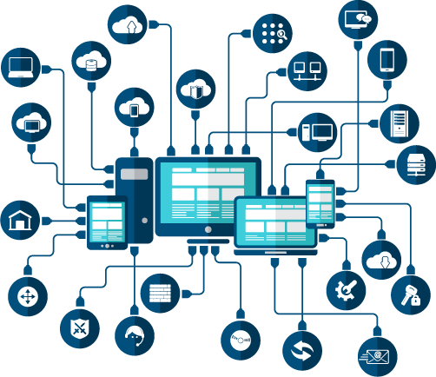
Case study 2: Technological cluster for Aerospace
4.0 Industry & Smart technologies
Smart
Service Systems
Service
Systems
Increased
connectivity
& Information sharing
Data collection & analysis
Knowledge co-creation
INNOVATION OPPORTUNITIES
80

Slide 81
From service systems….
Spohrer et al. (2007, 2008)
technology
organizations
shared information
people
communication
things
t
e
c
h
n
o
l
o
g
y
t
e
c
h
n
o
l
o
g
y
things
technology
organizations
people
connection
shared information
connection
value co-creation
things
things
data collection
data collection
computation
value co-creation
…to smart service systems
Lim et al. (2016)
Lim and maglio (2019)
81

Slide 82
Reinterpreting service systems
..thanks to the proliferation of technological channels (things) that compose an integrated infrastructure in which information is exchanged and shared in an immediate and transparent way (communication)…
P2
Integrated architecture
P1
P3
DATA
The interactions organizations-people (connection) are strengthened and intensified…
Continuous
improvement
COMMUNICATION
..and which fosters
continuous data collection & incorporation, resources combination…
Organizations
Things
People
CONNECTION
T
E
C
H
N
O
L
O
G
Y
Shared information
T
E
C
H
N
O
L
O
G
Y
Things
Things
Things
Data collection
Data collection
COMPUTATION
P5
KNOWLEDGE
P4
…“accumulated” new value and knowledge can enhance continuous improvement.
…that, through the application of analytics (computation), facilitate the transformation of information into knowledge, and new value…
82

Slide 83




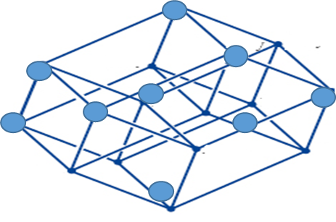


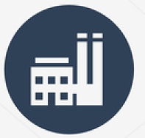

National cluster for aerospace technology
sub-system 4
sub-system 1
Complementary suppliers
B2S
Public Administration
B2B
Universities
S2S
Spin-off
Sub-suppliers
Regional clusters
Lombardia
DTA
Lazio
Accademic Spin-off
Umbria
Sardinia
Suppliers
Abruzzo
DAC
Campania
Non-profit organizations
Aerospace industry
Basilicata
DTA
Apulia
Emilia Romagna
Research Centers
C2C
S2S
Mobility industry
Citizens
Users
B2C
sub-system 2
sub-system 3
83

Slide 84



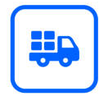
Stakeholders Mapping
Systems
Structure
Complementary suppliers
Sub-suppliers
Spin-off
R
O
L
E
S
A
C
T
O
R
S
Suppliers
Resources
Data analysis
Technology tools
Improved Knowledge & Skills
84

Slide 85




Structural analysis
Activities
1) new co-created solutions for supply chain competitiveness (sub-suppliers);
2) smart maintenance for the digitalization of supply chain (complementary suppliers).
A
C
T
O
R
S
Resources
Financial & material
Technological & informational
Technology tools
E-manufacturing, e-procurement and Digitalization of supply chain through:
Internet of things, augmented reality, wearable devices;
Integrated Management systems: SOA web-based architecture based on learning based algorithms.
85

Slide 86
Systems analysis
Representative brokers
Improved Knowledge & Skills
Complementary suppliers
productive and process competencies;
technological, managerial and relational skills.
Sub-suppliers
R
O
L
E
S
Spin-off
BRIDGE
Suppliers
STAR
Coordinator Broker
Data analysis
Integrated methodology and data orientation based on real time data analysis and feedback for prompt execution of actions and problem solving
Technology tools
86

Slide 87
THANK YOU.
Questions? Comments?
Mara Grimaldi
margrimaldi@unisa.it

