Slide 1




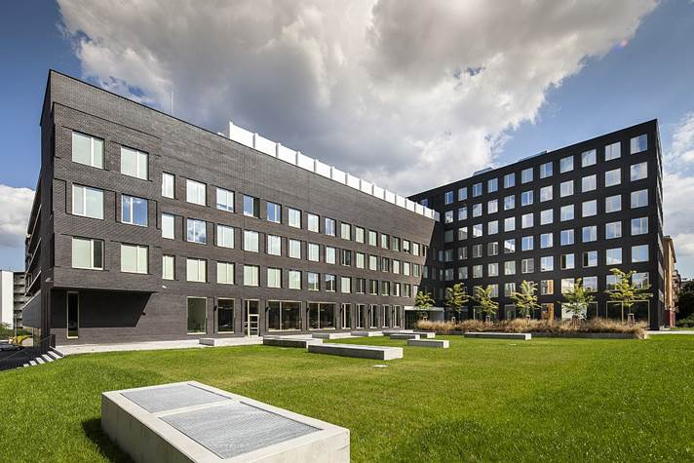
Marketing Strategy
in Service Business
- margrimaldi@unisa.it -

Slide 2




Programme
Marketing and Service Marketing: origins, evolutions & trends
Service Theories: from S-D logic & Service Science to service ecosystems & service systems
Marketing Plan
Many-to-Many Marketing
Value co-creation
Unconventional marketing
Case studies
Examples

Slide 3



Agenda: Lesson 3
The Marketing Plan:
    Strategic marketing
STP
    Operational marketing
4Ps
Examples: different strategies for different tactics
Exercise

Slide 4
3.1
The Marketing Plan

Slide 5
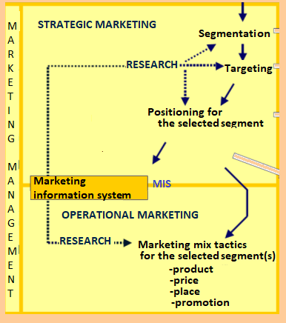
Marketing Management
What ?
Which value?
Value proposition
For Whom ?
Creating value
S
E
L
E
C
T
I
O
N
Consumers
gap
Segments
Selection of different «levels» of benefits
required by users
gap
s1
s2
s3
Target
gap
st
HOW?
gap
Can be value translated into
products for the selected targets?
gap
THROUGH?
Which kind of marketing mix
Value can be spread and take shape?

Slide 6
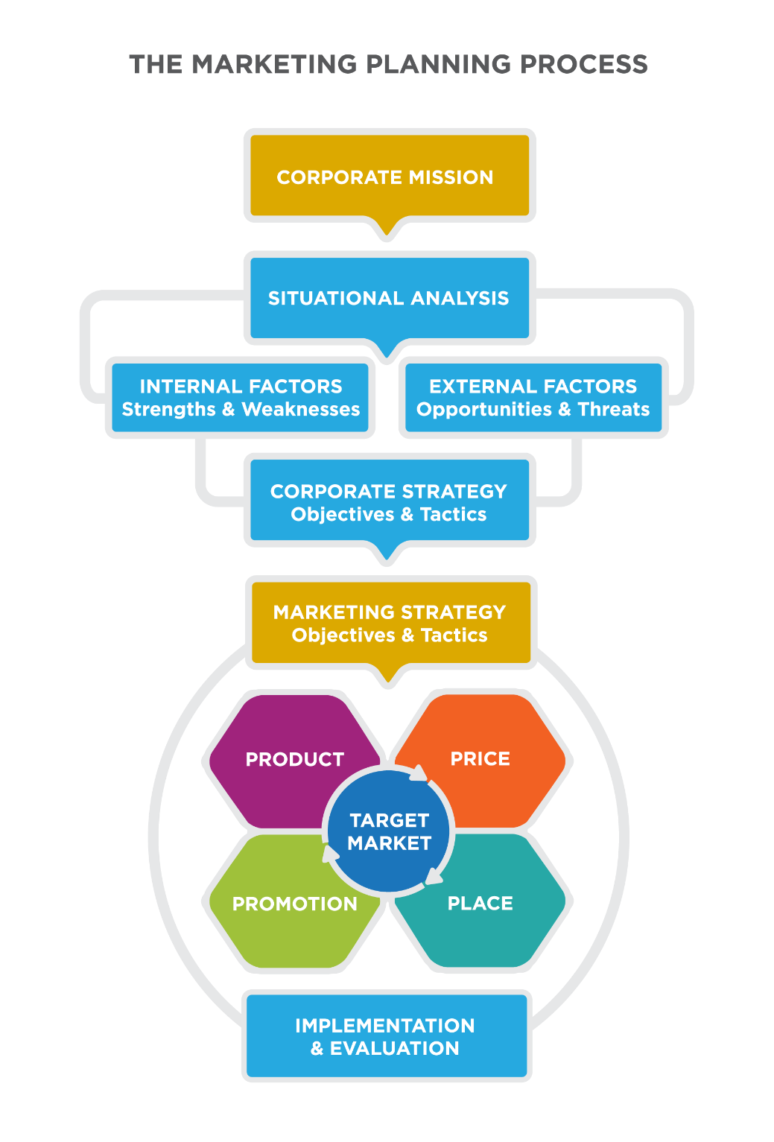
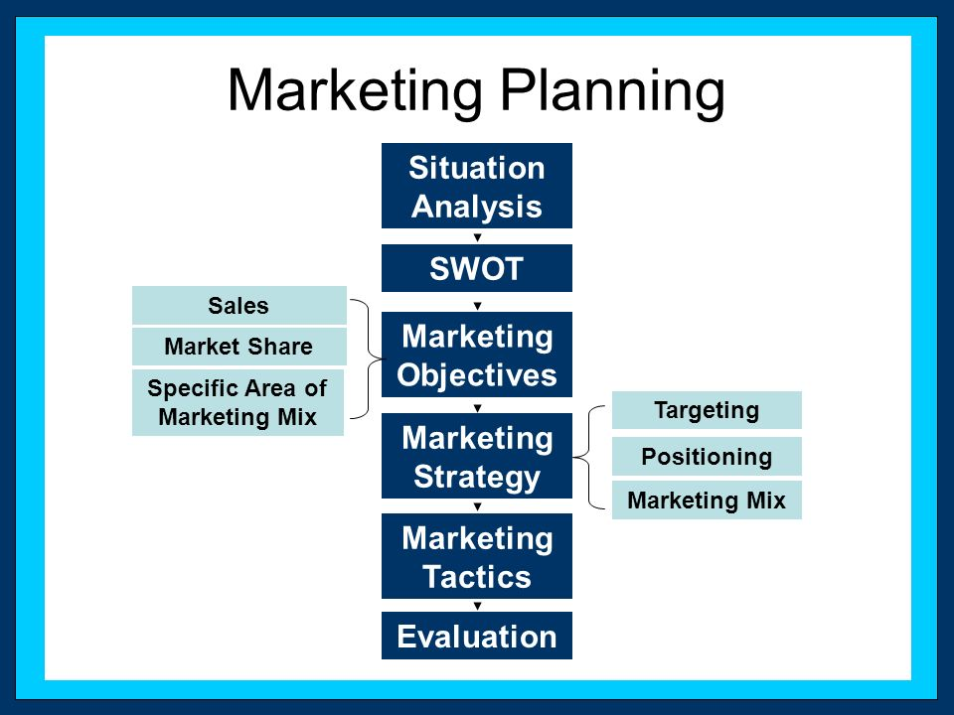
Marketing Planning
Systematic, structured process that involves:
RESEARCH
Research and analysis of current and future market and business situation
Development and Diffusion of firm’s objectives, strategies and programs,
…
Segmenting
Targeting
Implementing, evaluating and controlling marketing activities.
Positioning
Marketing mix
Control

Slide 7
A mission statement is a short description of organization’s raison d’être, of its overall goal and of the objectives for the future (VISION).
…
Segmenting
Targeting
Positioning
Marketing mix
Control

Slide 8
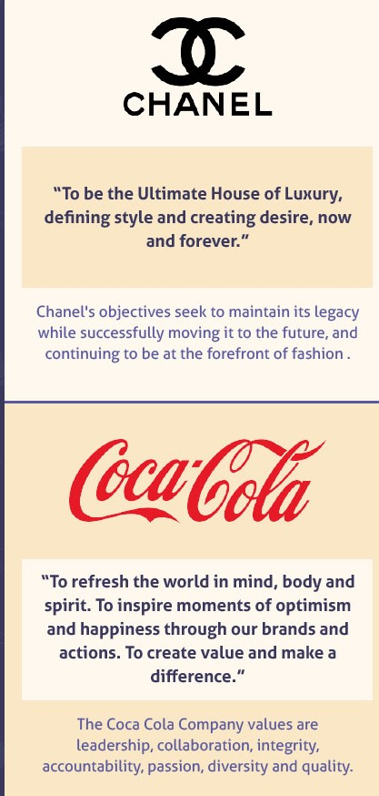
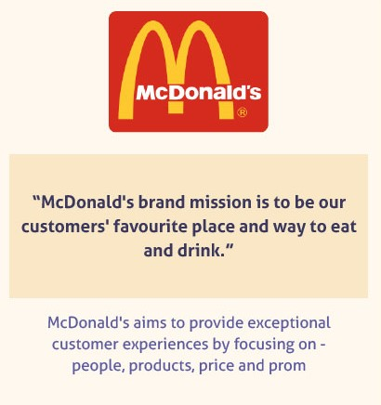


Examples of mission statements

Slide 9
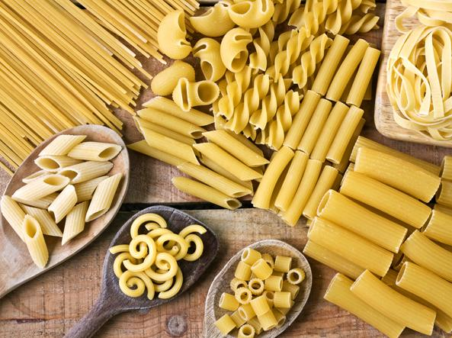

Example: PASTA Market
Healthy
Environmental friendly
Culture and Lifestyle
Traditions and Habits
Joy

Slide 10
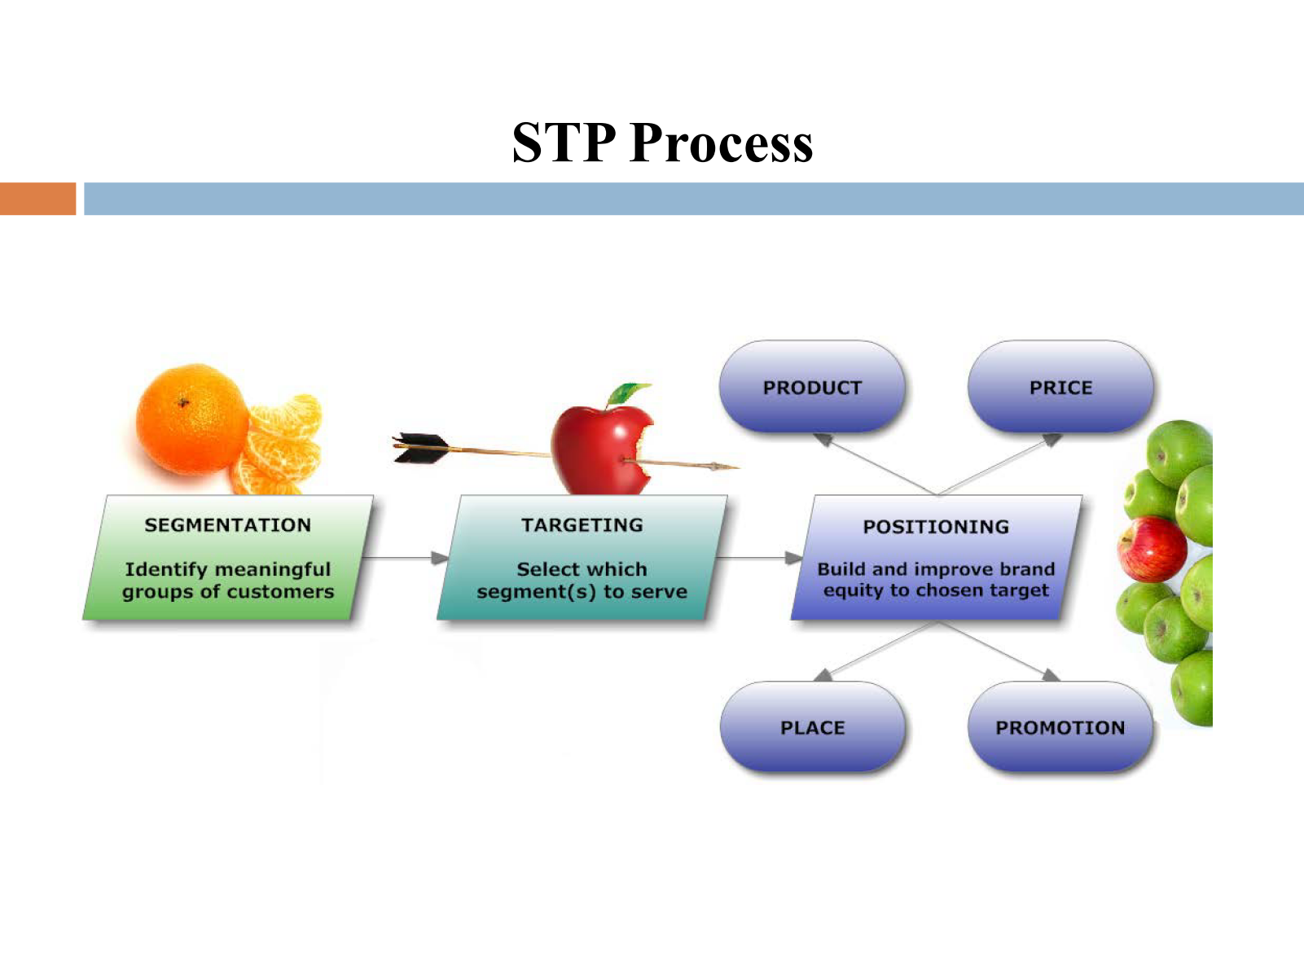
Strategic and Operational Marketing
Strategic marketing
Operational marketing
MARKETING MIX & the 4 Ps
Marketing Managers
To guide business process in the short and in the long run based on users’ expectations and competitor’s actions.

Slide 11
Corporate Strategy: A strategy that determines the means for the use of resources in the various functional areas to reach the organization’s goals.
…
Segmenting
Targeting
Positioning
Marketing mix
Control

Slide 12

"The marketing strategy lays out target markets and the value proposition that will be offered based on an analysis of the best market opportunities." (Kotler & Keller)
Development and maintenance of strategic alignment between:
…
Segmenting
Targeting
Market opportunities/competitor’s behaviors.
Positioning
Marketing mix
Goals/organization’s capabilites
Control

Slide 13
3.1.1
Strategic Marketing

Slide 14

Strategic Marketing
Tools and techniques required for the analysis, measurement and selection of dynamic scenario and potential targets forvalue proposition.
AIMS
  To decrease errors;
  To identify the targets interested in the offering (or potentially intereseted);
  To codify strategic guidelines to create or establish/consolidate the reputation and awareness of the offering

Slide 15
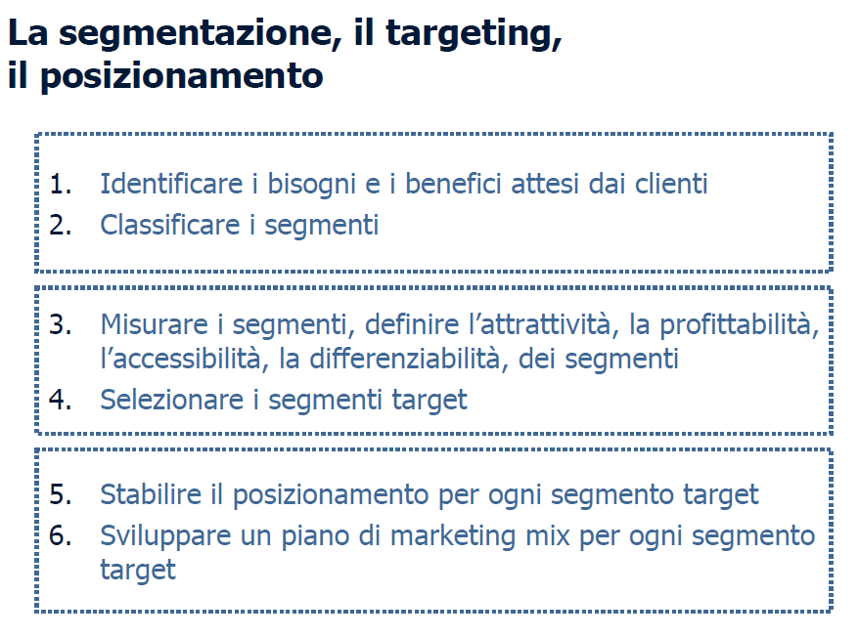


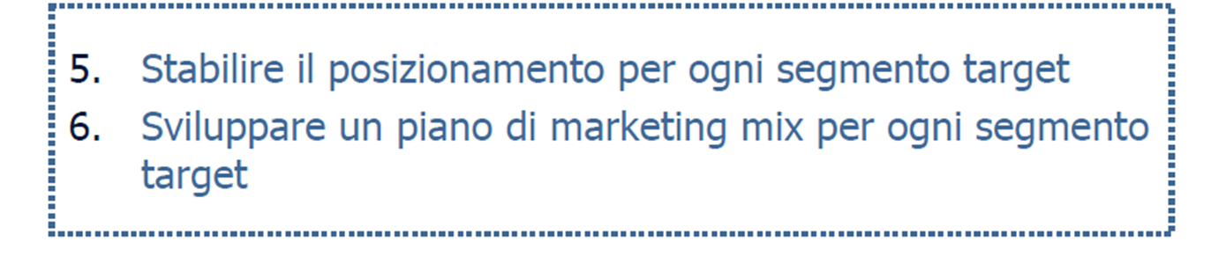

STP- segmentation, targeting, positioning
S
To identify customer’sexpected needs and benefits
To classify segments
3. To measure segments’ attractiveness, profitability, accessibility and differences
4. To select target segments
T
P
5. To establish the positioning for each target
6. To develop a marketing mix plan for each target

Slide 16
STP: (1) segmentation
1
2
3
4
Select
& study a market
Choose
bases
for
segmen-tation
Select
segmentation variables
Profile
and
analyze
segments
Marketing, Il Marketing Strategico – Capitolo 4, fpolese@unisa.it

Slide 17
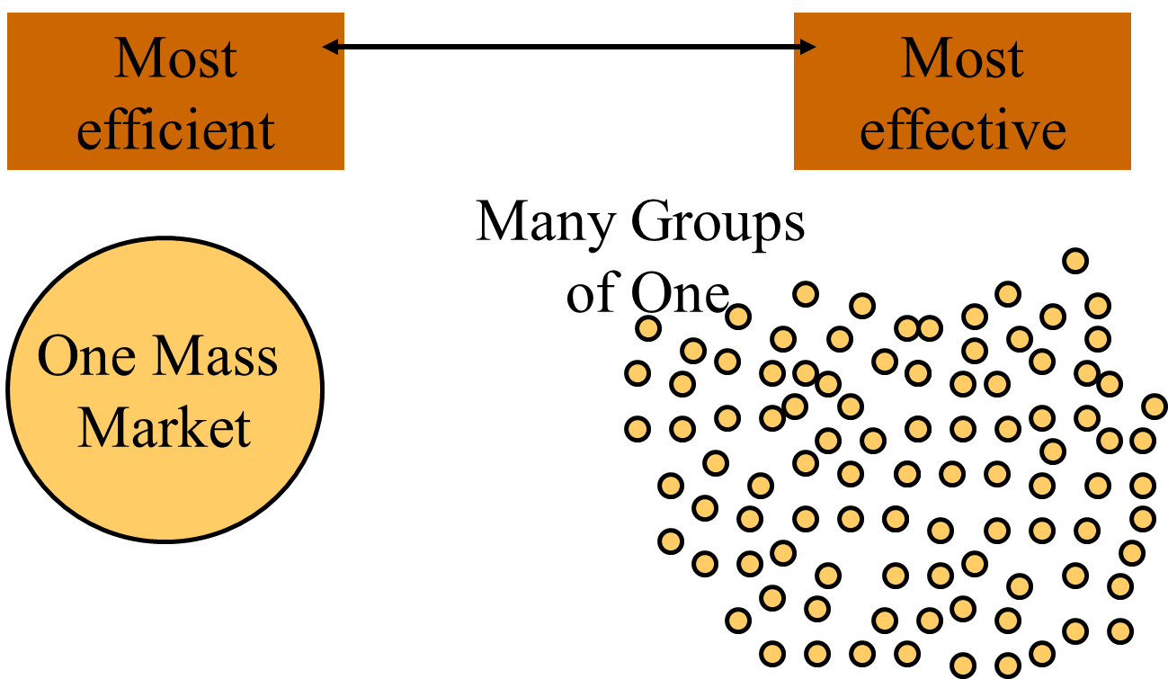
Segmentation
S
Definition: Division of the total market into smaller, relatively homogeneous groups
Why?
Levels: Mass, Segment, and Niche

Slide 18
Example: PASTA Market
TRADITIONALISTS
POST-MODERNISTS
Heavy consumers
Culture of food and meals consumption as «rituals»
Medium interest in product quality
High Price sensitivity
HEALTHY CONSUMERS
Light users
Low familiarity with cooking and «processed» food
Low interest in product quality
Medium Price sensitivity
Heavy consumers of organic, lactose-free and gluten-free food
Specific requirements on organoleptic properties of products
Low Price sensitivity

Slide 19
The importance of segmentation
Market
Marketers
Decision makers
Markets have a variety of product needs and preferences.
Marketers can better define customer needs
Decision makers can define objectives and allocate resources more accurately.

Slide 20
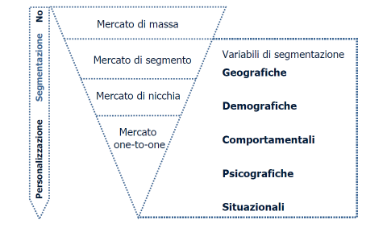
Segmentation Criteria
Mass Market
SEGMENTATION VARIABLES
Segmentated Market
Segmentation
Geographic
Niche Market
Demographic
One-to-one Market
Behavioural
Personalization
Psychographic
Situational

Slide 21
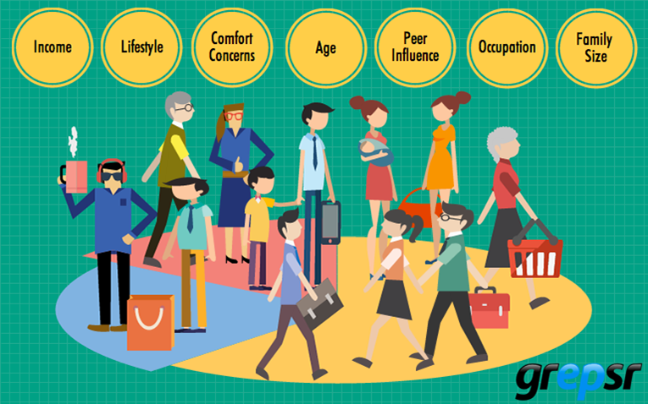
Segmentation Criteria
Behavioural
Psychographic
Situational
Demographic

Slide 22
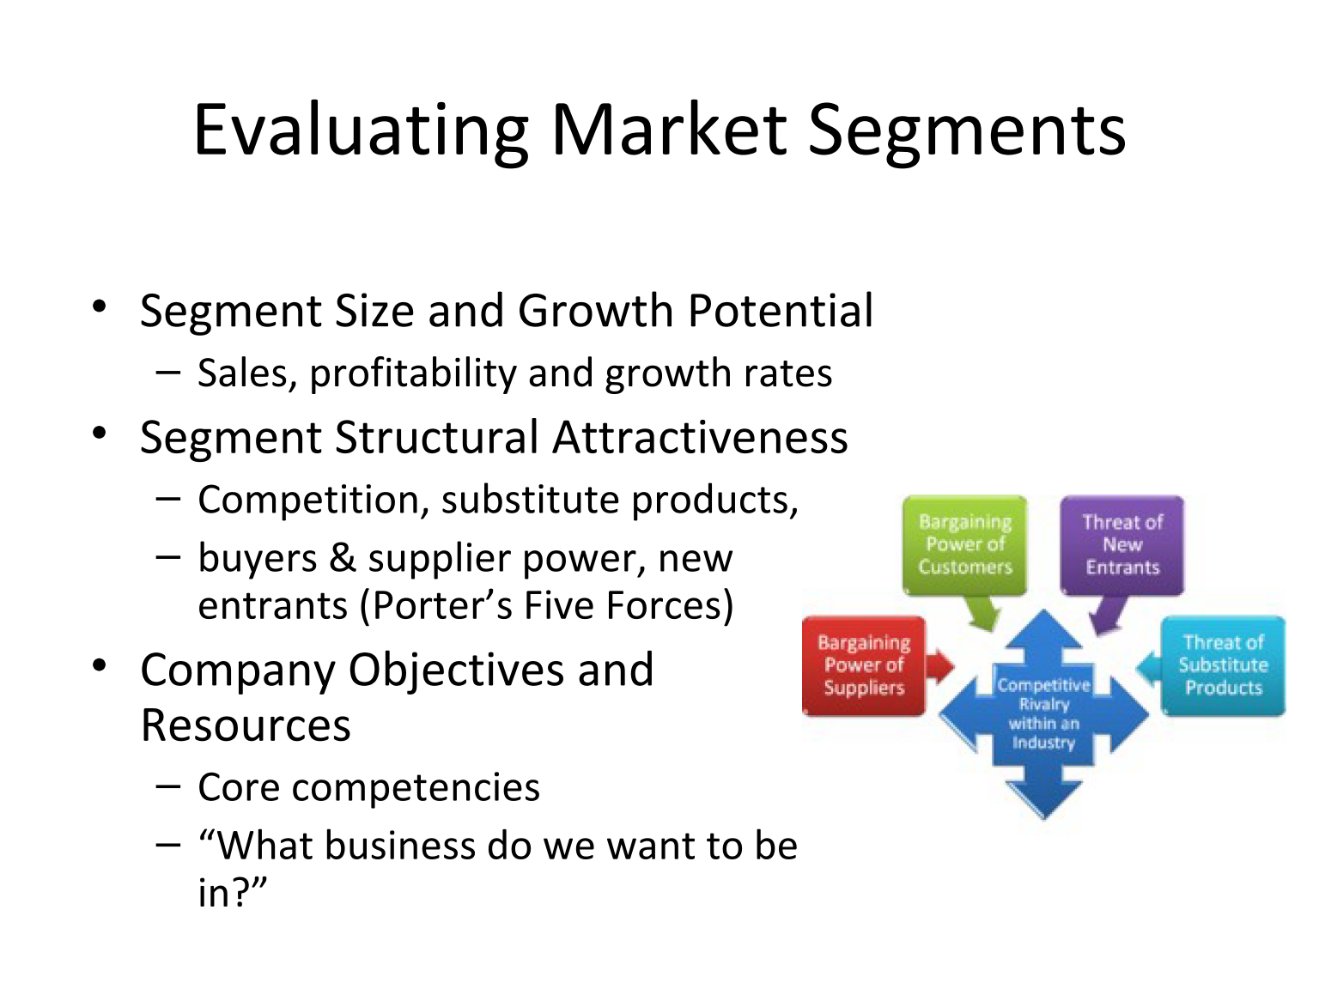

Segments: main characteristics
QUANTITY
QUALITY
STRATEGY

Slide 23
STP: (2) TARGETING
1
2
3
Define the market(s)
Select
the needs for each segment
Select and define
the most suitable target(s)
Marketing, Il Marketing Strategico – Capitolo 4, fpolese@unisa.it

Slide 24
(2)Targeting
Selection of one or more segments
becoming
Targets to “deliver” :
value propositions
offering design
strategies and tactics

Slide 25
Targeting as a process
Process that identifies potential markets by analyzing the marketing opportunities arising from the different segments.
This complex decision should balance:
GOALS
RESOURCES
EFFECTIVENESS
EFFICIENCY
At the end of the process, firms can choose a target market, that is the set of customers with homogeneous needs and features that companies aim at «striking»: the target.

Slide 26
Targeting: identification of market(s)
RESEARCH: how does the external environment look like?
SEGMENTATIONS: How many and which segments are in the market?
TARGETING: Among the different segments, for whom should firms create value?
After the analysis of external environment and after segmentation, companies use the quantitative and qualitative information obtained from data to evaluate and decide the segments/targets to whom offering can be delivered through focused marketing actions.

Slide 27

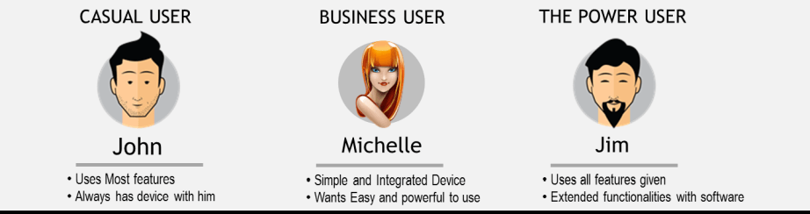

Slide 28
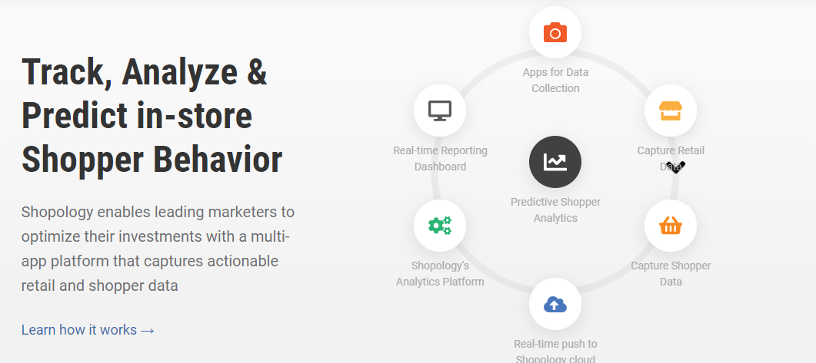
Shopology & Customer Journey

Slide 29


Targeting: Main steps
COMPETITOR ANALYIS
  Matrix Attractiveness/Competitiveness
  Swot Analysis
MARKET COVERAGE

Slide 30


(1)Targeting: competitor analysis
Competitor Analysis
After the identification of the segments that help the definition of the markets, firms should evlauate the trade-off:
Segments/ Investements required to satisfy the segments
Businesses should relate the efforts that can be sustained and the potential outcomes to be achieved.

Slide 31
(1) Competitor Analysis
To define how many and which segments should be selected through an assessment of segment(s) attractiveness based on firm’s capabilities to employ resources to satisfy it/them.
Two main factors affect the decision:
External
Internal
Contextual factors that surround business’ activities, for instance the time period in which resources should be available.
Medium & Long-term goals related to volumes of production and sales, market penentration and (perspective) profits
31

Slide 32

(1) Competitor Analysis
Potential Limitations
CURRENT
The presence of a large number of competitors, already active in the identified segment (or potentially entering), can limit or damage the entry or permanence of the company in the chosen segment
The consolidated bargaining power of customers and suppliers can make the market segment less profitable for the company
FUTURE
32

Slide 33
Matrix Attractiveness-Competitiveness
EXOGENOUS FACTORS
Segment Attractiveness
Threats/ Opportuntities
Low
Medium
High
1
2
3
High
ENDOGENOUS FACTORS
4
5
6
Strengths/ Weaknesses
Medium
7
8
9
Low
Capability to satisfy the segment(s)
33

Slide 34
Example:
Target Attractiveness
POST-MODERNISTS
Undifferentiated tastes, no special requirements in terms of quality or brand
HEALTHY CONSUMERS
Required components/ recipes/ organoleptic features
TRADITIONALISTS
Brand awareness, Italian Culture, loyalty
 | Post-modernists | Healthy Consumers | Traditionalists
DEMAND | 50 | 50 | 50
OFFERING | 50 | 50 | 50
*
*
*
ATTRACTIVENESS | 1 | 3 | 4
100
300
400
34

Slide 35
Example: Matrix Attractiveness-competitiveness
EXOGENOUS FACTORS
Segment Attractiveness
Threats/ Opportuntities
Low
Medium
High
1
2
3
TRADITIONALISTS
High
ENDOGENOUS FACTORS
4
5
6
Strengths/ Weaknesses
HEALTHY CONSUMERS
Medium
POST-MODERNISTS
7
8
9
Low
Capability to satisfy the segment(s)
500
100
140
350
370
35

Slide 36

Example: PASTA Market
Italian Families
TRADITIONALISTS
POST-MODERNISTS
Heavy consumers
Culture of food and meals consumption as «rituals»
Medium interest in product quality
High Price sensitivity
Traditional Products
Strengthening of Mediterranean Culture
New Storytelling Campaign
…
Green eaters
HEALTHY CONSUMERS
Light user
Low familiarity with cooking and «processed» food
Low interest in product quality
Medium Price sensitivity
Heavy consumers of organic, lactose-free and gluten-free food
Specific requirements on organoleptic properties of products
Low Price sensitivity
Green Lines
Broadening of the assortment
New packagings
….
36

Slide 37
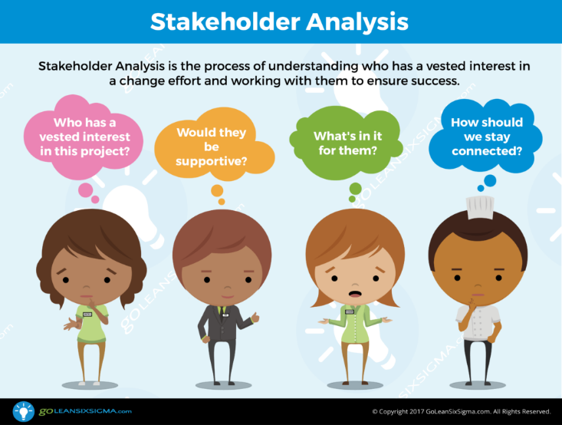
Stakeholder Analysis
Stakeholder Analysis is the process of understanding who has a vested interest in a change effort and working with them to ensure success

Slide 38
SWOT Analysis
S
w
Qualities that separate your firm from competitors
Internal resources (skills, knowledge, staff)
Tangible assets: intellectual-capital property, technologies
Things your company lacks
Things your competitors do better than you
Resource limitations
Unclear unique selling proposition
O
T
Emerging competitors
Changing enviornmental conditions (law, regulation)
Changing customer’s attitude toward the company (need)
Negative Press/Media coverage
Underserved markets
Few competitors in your area
Emerging needs for your product-service
Press/media coverage of your company

Slide 39
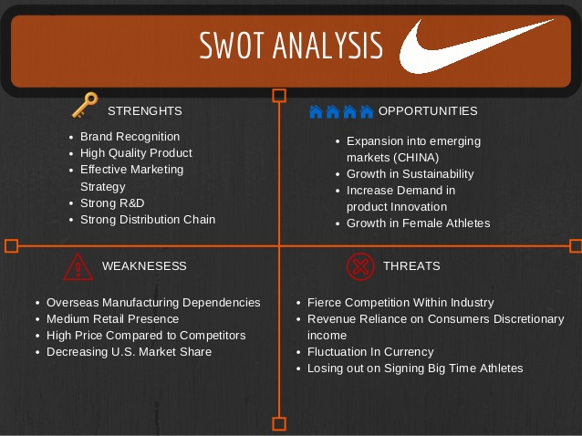

SWOT Analysis: Example

Slide 40


(2) Market Coverage
Market “portion” reached through marketing activity or campaign, or, in relation to sales, through employees and salesforce (market share).
After the step of analysis, firms should assess the possible opportunities deriving from it and identify the possibility to competitive advantage
Undifferentiated marketing strategies
Differentiated marketing strategies
  Concentrated marketing strategies
40

Slide 41


(2) Market Coverage: Main factors
The kind of product/service offered and the degree of homogeneity or specialization of needs;
The stage of the product in its lifecycle of the product ( in the phase of decisions);
The resources owned.
The current situation in the target market and the potential future evolution (e.g. from homogeneity of needs to the emergence of differences);
The analysis of competition, the level of dynamism and the past strategic decisions of competitors (for comparison, contrast or inspiration).
41

Slide 42
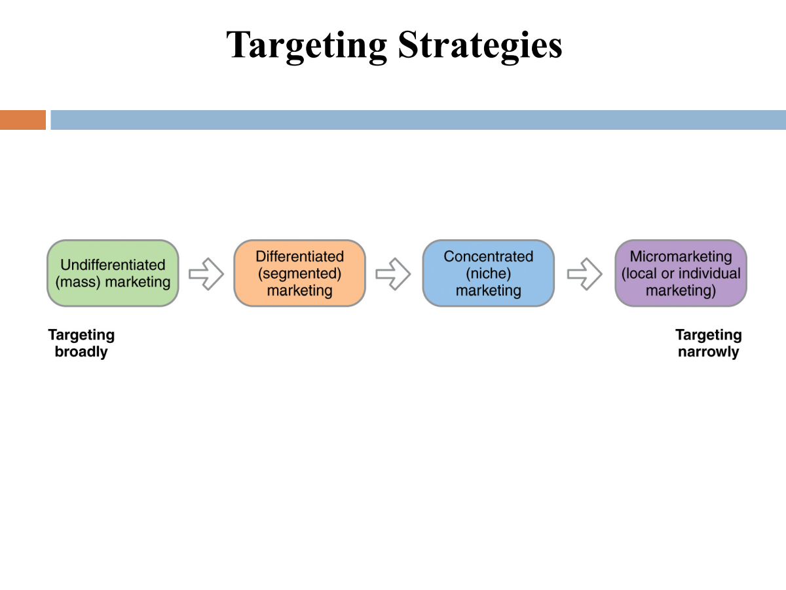
Market Coverage: Different Targeting, Different Strategies

Slide 43


(1) Undifferentiated marketing
To ignore segmentation opportunities

Slide 44
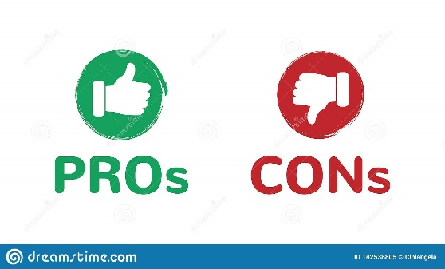
(1) Undifferentiated marketing
Pros
  Possibilities to exploit the advantages economies of scale in production and selling;
  Lower costs (e.g. for communication, single marketing mix)
  To maintain leadership
Cons
  Complexity of markets and evolution of consumers’ needs and degree of satisfaction;
  Difficulties in the coverage of small segments with specific needs.

Slide 45
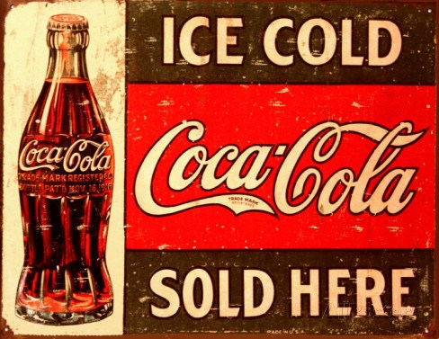
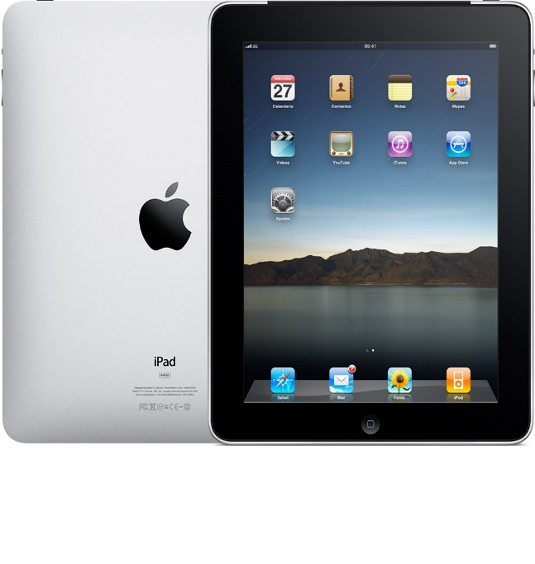
(1) Undifferentiated marketing
The brand is too strong to identify the entire market and/or the segment in consumer’s mind. The brand embodies the whole market.
Apple Ipad in Tablet market
(2010)
Coca-Cola

Slide 46
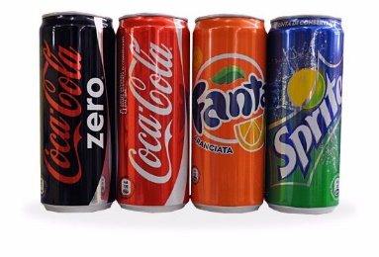


(2) Differentiated (Segmented) marketing
Target several segments and design separate offers for each
Coca- Cola (Coke, Sprite, Coca Zero/ Diet, Fanta, etc)
Procter & Gamble (Tide, Cheer, Gain, Dreft, etc.)
Toyota (Aygo, Yaris, Corolla, Prius, Camry, etc.)

Slide 47
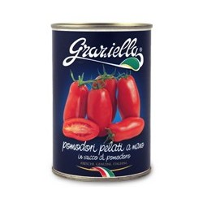
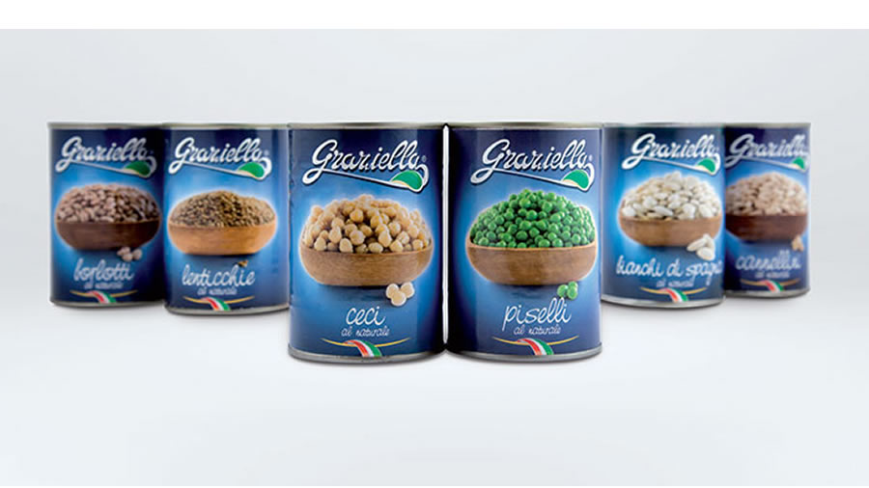
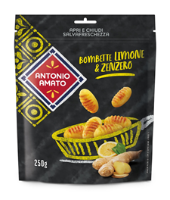
(2) Differentiated marketing

Slide 48
(2) Differentiated marketing
Pros
  Possibilities to boost the overall selling opportunities;
  Possibility to maintain market share.
Cons
  Higher costs for production, distribution and communication;
  Criticalities in the definition of strategic choices of control. (BRAND PORTFOLIO)

Slide 49
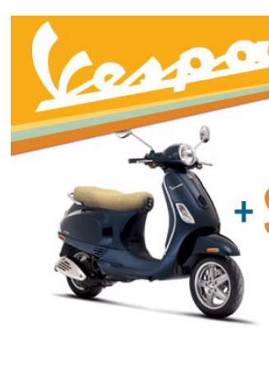
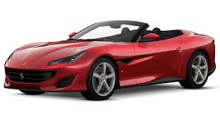


(3) Concentrated and Niche marketing
Target one or a couple of small segments with very specialized interests
Status symbol
Luxury Goods
Specific
needs

Slide 50
(3) Concentrated and Niche marketing
Pros
  Possibilities to acquire economies of scale and learning economy through the focus on a specific segment;
  Specialization of products (and competencies).
Cons
  Risk of the unexpected inability to survive in the market due to iperspecialization. The success of the firm depends only on a specific segment or product-service. The risk of business is not fragmented.

Slide 51
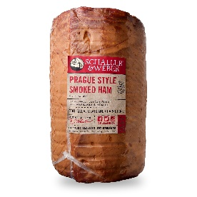
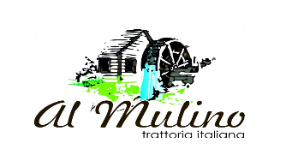


(4) Micro-Marketing/Personalized marketing
Hypercompetition and the rapid evolution of contemporary customer’s tastes lead businesses to adopt more and more focused programmes and solutions:
Micro- marketing:
Small group of consumers selected based on common features such as localization (single point of sales, restaurants, typical products);
Personalized/ Taylored Marketing
Satisfaction of the needs of a single consumer (individual or consumer group).
- Loyalty and personalize relationships over time

Slide 52
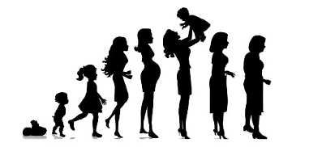
Everyone is much more than
a customer
Customer Lifetime value
Life stage defines a person’s major concern
52

Slide 53
STP: (3) POSITIONING
1
2
3
Define the most relevant features of the offering
Estabish how consumers should perceive the offering
“Position” the offering into the market
Marketing, Il Marketing Strategico – Capitolo 4, fpolese@unisa.it

Slide 54
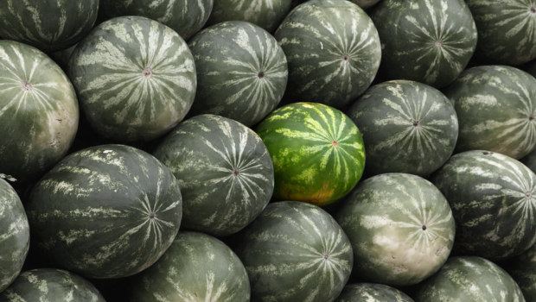
The definition of Positioning
“the building of a product image in order to give a brand, in the evaluation of consumers, a favorable place, differentiated from competitor’s position» (Ries and Trout, 1991)over
Positioning defines the way in which a brand or a firm are perceived by potential consumers as different from competitors

Slide 55

Positioning
Positioning is a tool for the analysis employed by firms to define the optimal strategy to attain competitive advantage
Main goals:
Favorable perception of potential buyers;
Brand Awareness (reputation, notoriety)

Slide 56

Positioning Strategies
Stabilization of current positioning of the product, brand or firm in consumer’s mind;
Research and achievement of a new positioning based on new attributes not yet used or promoted as new value for consumers;
Repositioning in relation to competitor’s offerings, that involves a process of shifting of positioning from an old to a new location in potential consumer’s mind

Slide 57

The Repositioning
A change of positioning is necessary when market conditions change. Usually, repositioning is performed for two reasons:
To challenge new competitors;
To enhance the capability to address users’ needs and preferences.
N.B.= the repositioning should be carried out without creating confusion in the perception of customers, by adopting a coherent and reliable communication strategy consistent with the previous image of the brand.

Slide 58

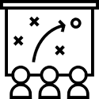
Positioning: Analysis and Strategies
Positioning involves two different moments:
.
Analytic plan
focus the attention on the identification of the benefits of the product perceivable by the consumer with respect to the expected benefits and assessment of the ability to satisfy them by the competitor’s offering
  Research for a satisfactory place for the offering and for the brand by identifying the tools (marketing policies) to occupy and defend the positioning from competitors' actions
Strategic plan

Slide 59


Positioning
The main activity is the identification of required benefits:
Functional benefits
Strictly connected with product’s attributes; referred indirectly to the brand
Referred to product’s and consumer’s value and to brand’s ability to put users in relations with the others and with their reference group
Symbolic benefits

Slide 60
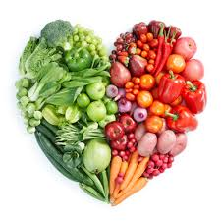
Example: Pasta Market
Functional benefits
Complete nutrition
Taste
Digestibility
Symbolic Benefits
Health and physical well-being (weight, fitness)
Helthy way of life
Conviviality

Slide 61
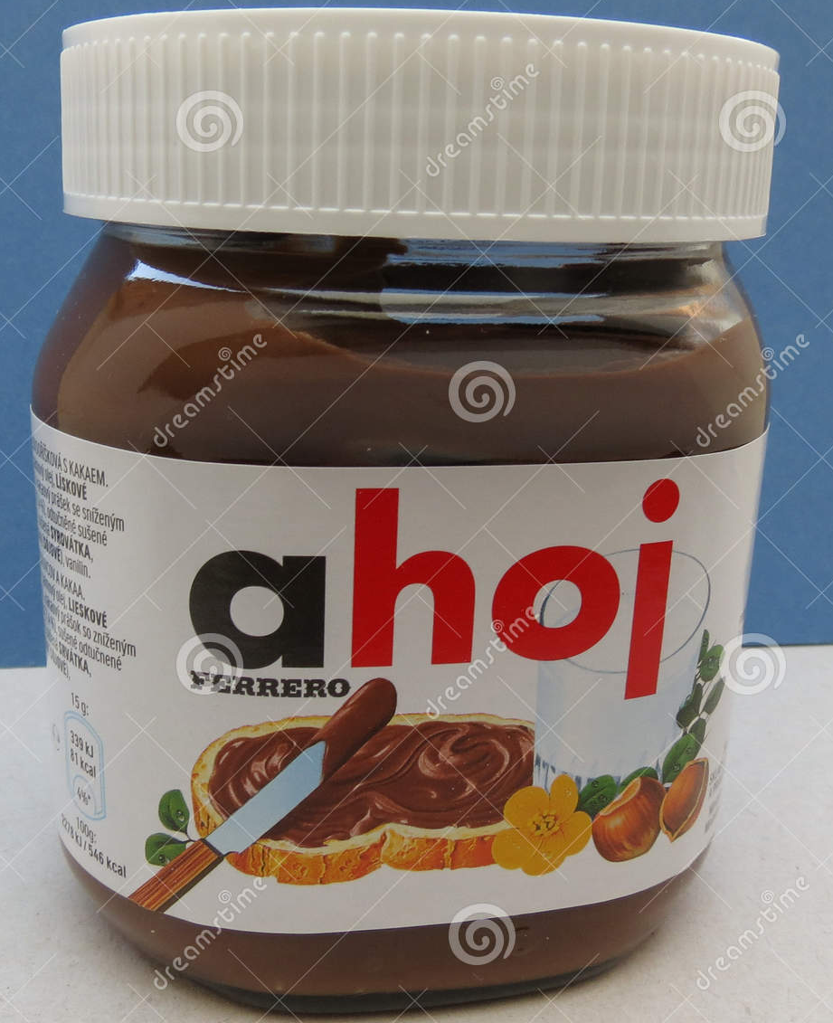
Example: Positioning
Functional benefits of the brand «Nutella»:
  Nutritional properties
Symbolic beneficts of the brand «Nutella»:
  Emotional/hedonistic: delight for taste
  Sentimental: childhood memories

Slide 62

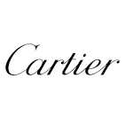
Example: Positioning
Functional benefits of the brands «Bulgari and Cartier»:
- Quality of raw materials (stones, emerald, metals etc.)
Symbolic benefits of the brands «Bulgari and Cartier»:
  Exclusivity
  Refinement
  Status symbol

Slide 63
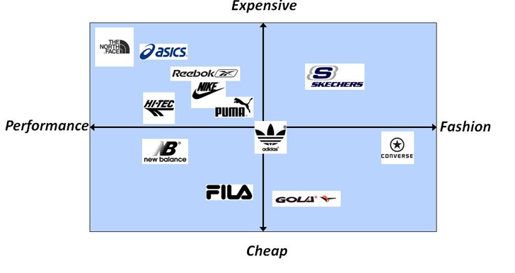
Perceptual Positioning Maps
Display consumer’s perceptions through a visual picture of how customers perceive their brand versus the competing products or services on relevant buying dimensions
Example: atletic footwear

Slide 64
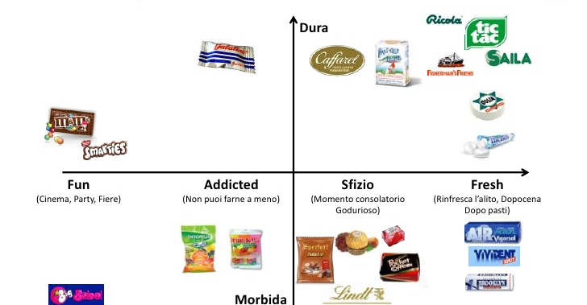
Example: Candy sector
HARD
Whim
Cinema, Party
Not be able to do without
Consolatory
After lunch/ dinner
SOFT

Slide 65



Marketing management steps: a synthesis
7. To define the marketing mix for each target
6. To define the positioning for each target
5. To analyze the current positioning of products and competitors in customer’s mind
POSITIONING
4. To select the segment(s)/ target(s)
3. To measure segment’s attractiveness
TARGETING
2. To profile segments
SEGMENTATION
1. To identify the bases to segment the market

Slide 66
Criteria for Positioning
Main features to differentiate a product (the brand) in the perception of buyers:
Physical attributes of the product
Symbolic attributes of the product
Benefits offered
Price
Contrast to a competitor
Association with a class of products
Identification with a class of users
Identification with an opinion leader
Appropriateness for given occasions of use
Image of the manufacturer or country of origin

Slide 67
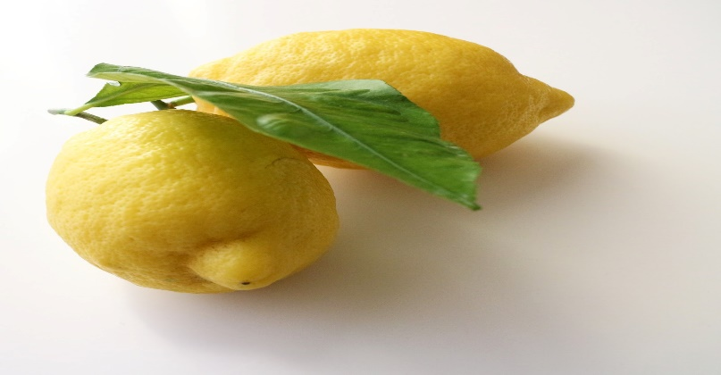
Positioning
1. Physical attributes: to emphasize the main (inner characteristics) features that affect performance
Intense perfume; tapered shape; juicy pulp; absence of seeds.
Rich of vitamin C and essential oils. Delicious, natural, suitable for the preparation of fresh recipes
Food companies can stress the colors, the appearance, the freshness of their goods

Slide 68
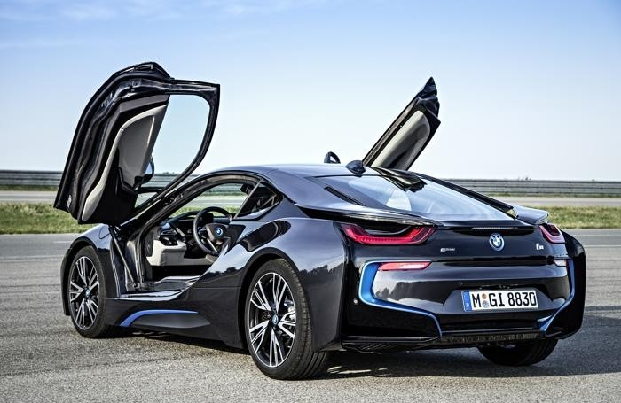
Positioning
2. Symbolic attributes
To adopt a given (dynamic, exclusive, sporty, adventurous) lifestyle

Slide 69
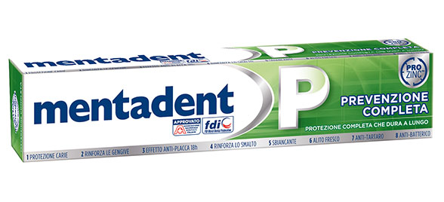
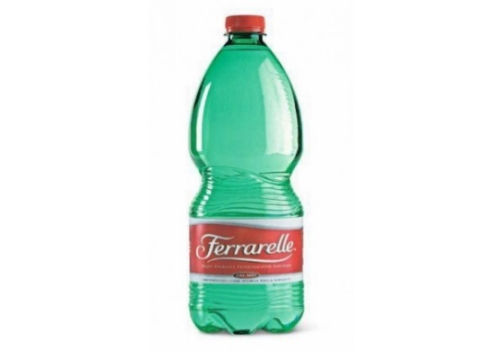
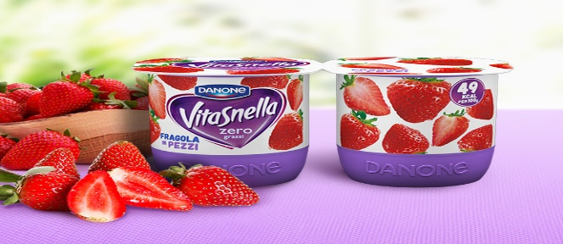
Positioning
3. Offered benefits
Anti bacterial; Anti plaque; It protects caries; Helps and strengthens the enamel; Helps protect the gums; Effective on the tongue; Acts in hard-to-reach areas; It guarantees long lasting freshness.
Ferrarelle lights up your vitality because it envelops the well-being of 100% effervescence, perfectly balanced, with a unique and full taste.
Creamy, rich in taste and fat-free, many pieces of fruit.

Slide 70
Positioning
4. Price
Price lower than competitors’ services. Focus on basic features and essential characteristics.
performance

Slide 71

Positioning
5. Opposition to a competitor
A drink created to challenge Coca-Cola, the «hystorical» competitor.
At the beginning, Pepsi aims at curing stomach pains.
performance

Slide 72
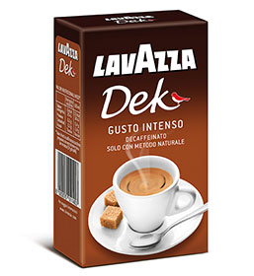
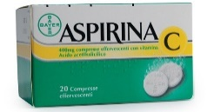
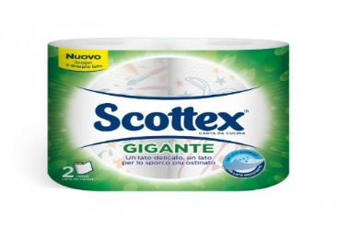
Posizionamento
6. Association with a category of products
… Decaffeinated coffee…
… Analgesics…
… Roll kitchen paper…

Slide 73
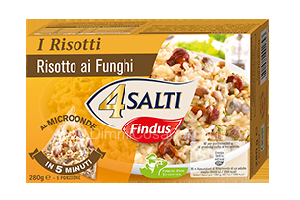
Posizionamento
7. Identification with a segment of users
«Dishes as good as homemade… Ready meals»
Users: Singles, mothers

Slide 74

Posizionamento
8. Identification with leaders or celebrities
The «personality» of celebrities are associated with brand’s and product’s personality (elegance, exclusivity, refinement)

Slide 75
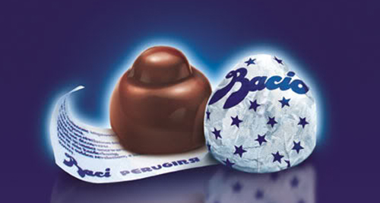
Positioning
9. Suitability for given occasions of use
On San Valentines Day one candy one chocolate candy out of three is «Perugina»

Slide 76
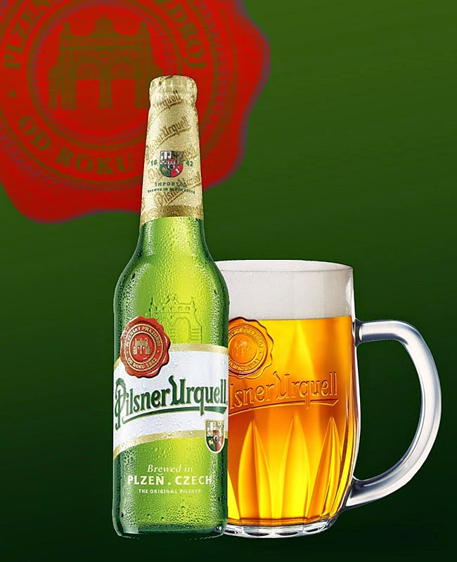
Positioning
10. Image of Producer (brand) and Country of Origin Effect
… the focus is not (only) on the features of goods, but on feelings and sense of belonging…promotion of citizenship

Slide 77

Positioning Map
Positioning Maps is a tool that represents graphically the positioning or perception of each group of competing products in respect of two specific product characteristics
AIMS:
understand the perception of and the existence of correspondence between consumer preferences and offer positioning
compare the positioning of competing products
identify any ideal free positions

Slide 78
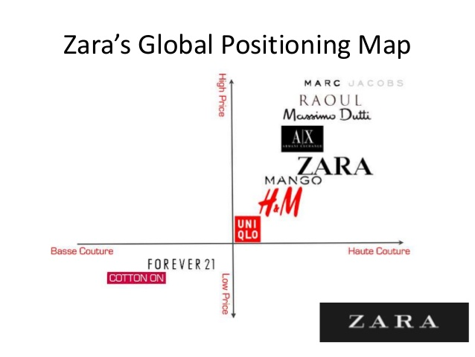



Positioning Map: Fashion
HIGH PRICE
BASSE COUTURE
HAUTE COUTURE
LOW PRICE

Slide 79

Positioning Map: Cars
HIGH PRICE
LOW QUALITY
HIGH QUALITY
LOW PRICE
79

Slide 80









Positioning Map:
Pasta Market
HIGH QUALITY
LOW PRICE
Gap in the market
(Offering blank)
HIGH PRICE
LOW QUALITY
80

Slide 81

Framework your business: Abell’s Matrix

Slide 82

3.1.2
Operational Marketing & The 4 Ps
82

Slide 83
Marketing Mix
Marketing Mix is the set of decisions that concern the kind of product, the kind of packaging, the price, the place, the communication that are the marketing variables controllable by firms, the 4 Ps.
PRODUCT
PRICE
PROMOTION
PLACE
N.B.= marketing mix decisions should comply with a «dual coherence» between:
Internal (between the different single «Ps»);
External (coherent with positioning and corporate image).

Slide 84

(1) Product
A product is everything that can be offered to consumers to satisfy their needs. It can be a physical object and can invovle people, places, institutions, ideas. Products should comply with firm’s proposal to satisfy the need of buyers.
Basic attributes
Ingredients, components, raw materials, shape
(service: equipment, structures for delivery)
Secondary attributes
Packaging, visual identity, brand, accessories
It depends on market and product’s vision and strategies

Slide 85


Assortment
Lines, types of products, variations and versions constitute the assortment, measured according to two dimensions:
BREADTH: number of the product lines
DEPTH
DEPTH: number of variations and of different versions of each product for each line
BREADTH

Slide 86




Example:
Pasta Market

Slide 87



The Brand
It is a name, a symbol, a picture, a logo or a combination of these elements to identify products and services of one or more suppliers to distinguish them from competitors’ products.
To be effective, brand should have the following features:
- Originality
Ease of pronunciation
Memorability
To be translatable in other languages, coherence with the product
Manufacturer brand
Retail brand
Producers
Distributors

Slide 88




The main goals of branding
• Identification of producers
• Awareness, notoriety and esteem
• Association with the level of quality of the product
• Differentiation from other products (or from different products of the same company but characterized by a different marketing mix);
Protection and rights;
• Possibility for the customer to make comparisons with other products;
• Impact on consumer’s behaviors;
• Opportunity to retain customers.

Slide 89



Three main tools
Product Lifecycle
BCG Matrix
General Electric Matrix

Slide 90



Different targeting, different products
commodity or convenience goods: mass consumers goods (water, pasta, bread and food sector in general) highly replaceable and low price
shopping goods: products devoted to customers with medium spending capacity and that requires careful evaluation (professional services, travels, services not easily replaceable)
luxury goods (exclusive cars, haute couture fashion): targeted at market niches or at consumers with high spending capacity

Slide 91

(1) Product Lifecycle
Revitalization
DEMAND
Introduction
Decline
Maturity
Growth
TIME

Slide 92


Product Lifecycle
Introduction
Slow sales growth and negative economic results due to the huge expenses.
Development
Rapid market acceptance, with improved profits
Maturity
Product acceptance by potential buyers which leads to stabilization of sales and profits.
Decline
High decrease in sales and profits.
Revitalization
Sales development deriving from changes:
in the offer (new uses of product, quality improvements, expansion of the range, introduction of accessories, etc.;
In the demand (new needs satisfied with the product, new market segments, new channels, new consumer habits, new trends in users’ needs).

Slide 93





Product Lifecycle: Implications
DEMAND
Introduction
Decline
Maturity
Introduction
Development
Maturity
Decline
Low
Rising
Stable
Descending
Growth
High
Medium
Low
Low
TIME
Negative
Rising
High
Decreasing
Innovators
Early Adopters
Majority
Laters
Few
Increasing
Stable
Reduction

Slide 94

(2) BCG Matrix
Star
Question Mark
Cash cow
Dog

Slide 95



(1+2) BCG Matrix & Product Lifecycle

Slide 96








BCG Matrix: an application
Mac
Books
iMacs
HomePods
Apple Tv
96

Slide 97

General Electric Matrix
HIGH
Area of Investment
MEDIUM
Attractiveness
Attractiveness
Attractiveness
Area of Disinvestment
LOW
HIGH
MEDIUM
LOW
Competitiveness

Slide 98


(2) Price
It is the “measure” of the main effort and sacrifice sustained by consumers to satisfy their needs.
N. B. It is the “P” more influenced by external factors (competition in the sector) and that depends on the company's ability to manage the other three variables.
There are no standard procedures to settle prices, but there are three different orientations that price policies:
Profit-oriented goals;
Sales-oriented goals;
Objectives oriented towards risk reduction.

Slide 99


New product’s Price
Price decisions are based on the long-term, since they refer to the phase of introduction and can influence the price throughout the entire lifecycle. There are two main strategies:
Penetration Pricing
Skimming Pricing
Proposal of a price lower than competitor’s products
Proposal of a price higher than competitors’ products

Slide 100
New product’s Price
SKIMMING POLICY
PENETRATION POLICY
Price higher than market’s expectations
High unit contribution margin;
Low number of early consumers.
Suitable products: innovative
Price lower than market’s expectations
High volumes of sales;
Reduced contribution margin;
High number of early consumers.
Suitable product: goods not differentiated from technical viewpoint, with higher competition and consumers with high price sensitivity.
The firm can keep on establishing high prices
The firm can choose to reduce prices when attractive segments lose their potential and can be re-targeted at broader segment
Over time, price is stable but contribution margin increases, since high volumes can produce economies of scale
- Unit costs + profit

Slide 101




Example:
Pasta Market
0,67 €
0,95 €
1,19 €
1,80 €

Slide 102

(3) Place: Distribution
Distribution channels are a «set of institutions that perform the complex activities needed to deliver and transfer the product, with the related property right, from producers to consumers»
The main activities of distribution are:
Deposit at the end of the production process;
Transport;
Collection of to support transactions with customers;
Promotion and information communication with the customer;
Selection, assembly, packaging and adaptation of the product in the final phase of delivery to the customer;
Negotiation of the conditions of sale;
Execution of after-sales services (assistance, guarantee, maintenance);
Acquisition and management of the financial resources necessary to carry out the activities.

Slide 103
The composition of Channels
Distribution channels permit firms to reach their market.
The decisions related to distribution concern the definition of the activities that organizations carry out directly and indirectly.
Direct channel
Indirect channel
Activities are managed without engaging external actors
Producers reach consumers directly.
(e.g. selling on catalogue, by phone, through emai)
Some activities are entrusted to third parties.
Every stakeholder engaged in one of the activities performs a different step of distribution channel. The more individuals are engaged, the more the number of intermediate phases in the channel increases.

Slide 104




Distribution Channels
DIRECT CHANNEL
Producer
Consumer
SHORT INDIRECT CHANNEL
Producer
Retailer
Consumer
LONG INDIRECT CHANNEL
Producer
Stockist
Retailer
Consumer
Producer
Stockist
Agent
Retailer
Consumer

Slide 105
Example:
Pasta Market
SHORT INDIRECT CHANNEL
Producer
Retailer
Consumer
Large-scale distribution
Retailers for commodity goods
Traditional point of sales
Hypermarket: more than 2,5 m²
Supermarket: from 400 m² too 2.500 m²
                less than 100 m²

Slide 106

(4) Promotion: Communication
Context of Sender
Context of Receiver
Encoding
Decoding
Sender
Message
Receiver
Sender
Channel
Message
Code
Code
NOISE
Response
The source/ sender (a firm or an organization) develops an encoded message (e.g. an advertising campaign) and send it through a given means of communication (television, press, front-office employees, sales staff etc. ) to the recipients (target-market).

Slide 107




Communication Strategy
1. Selection of Receiver
2. Selection of communication goals
3. Development of strategic planning
4. Budgeting
5. Selection of communication mix levers
6. Development of the message
7. Selection of media
8. Programming times and modalities of action
9. Definition of the standards for performance monitoring
10. Evaluation of effectiveness

Slide 108

1. Selection of Receivers
In the target market
Other receivers-stakeholders
existing consumers
potential consumers
acquired consumers
competitor’s consumers
(with different roles in the buying process)
suppliers
shareholders
employees
Salespersons
intermediaries
public institutions
public opinion

Slide 109

2. Selection of Communication Goals
Depending on TARGET:
• Encourage the demand
• To inform the market
• Persuade consumers to buy (to guide users’actions by indicating addresses, phone number, etc.)
• Reassure buyers
• To create or to strengthen the image of a brand/ product
• To boost the institutional image of a brand
To enhance the effectiveness of strategies, goals should be:
• measurable
• based on market research
• addressed to a defined target
• realistic
• coherent with marketing plan
• supervised periodically

Slide 110

3.Development of Communication Plan (Strategy)
Main goals related to the total strategy
Integrated set of communication forms for each stakeholders
Selection of the concept (creative idea) that should guide the content of the message
Selection of communication means and vehicles for each target

Slide 111
4. Budgeting
Based on:
• marketing plan objective;
• economic conditions of the market;
• product category;
• life cycle of the product;
• distribution channels;
• experience of competitors
Budget size is calculated arbitrarily as:
•% on sales
• in relation to corporate objectives
• similarly to the investments of competitors.
P.S: Often the size of the budget is a fixed constraint.

Slide 112
5.Development of Communication Mix Strategy
• Advertising
• Sales Promotion
• Public Relations
• Sales persons (front-office employees)
6. Development of the Message
Content based on:
target and marketing goals (tone of voice)
brand strategies (reputation, image, identity…repositioning)
stage of product’s lifecycle

Slide 113
7. Selection of Media
Based on:
The kind of product
The features of market
The characteristics of communication
Forms (advertising, sales promotion, P.R., salesperson)
General means (television or press)
Specific measurable vehicles (newspaper, radio channel, television channel, websites)
8. Programming of times and modalities
9. Definition of standards for performance monitoring
10. Evaluation of effectiveness

Slide 114




Communication Mix
The set of forms (means, instruments) through which businesses can realize communication
Advertising
Sales Promotion
Public relations
Sales person

Slide 115

Communication Mix: main criteria
The nature of product
The analysis of target market (size of market and geographical location)
Phase of the product’s lifecycle
Channel strategies:
  pull (targeted at final consumers)
  push (targeted at retailers, and/or at sales personnel)

Slide 116

Communication Mix Wheel

Slide 117

Communication Mix Levers
Communication Mix Lever | Man features of communication | Pros | Cons
ADVERTISING | •Mass communication(high size market). •Impersonal •For commodity goods in the phase of introduction •Targeted at consumers. | •Standard and measurable message | •Absence of direct feedback •High general costs
SALES PROMOTION | •Mass communication •Impersonal •Targeted at consumers and retailers •For product revitalization in the phase of maturity or decline or to enhance users’ loyalty | •Standard message •Rapid effectiveness | •Nonconstant message •Absence of direct feedback

Slide 118

Communication Mix Levers
Communication Mix Lever | Man features of communication | Pros | Cons
Public relations | •Mass communication. •Impersonal. •Srengthen brand image. | •No direct costs • Reliability of message | •No direct feedback •Not controllable/ measurable message
Salespersons | •Focused one-to-one communication •Personal •Usually for manufacturing goods •Targeted mainly at consumers (retailers, too) | • “Taylored” message for consumers •Direct feedback | •High costs per contact.

Slide 119
Communication Mix: example
FORMS | MEANS | VEHICLES | Timing
ADVERTISING | TELEVISION | Česká televize: ČT1, ČT2, ČT Sport, ČT Déčko Nova Živé vysílání Prima Video Tv Noe Idnes | Prime time, day time
 | PRESS | Cesky Noviny, Hospodarske Noviny, Lidové Noviny, Mlada Fronta Dnes, Prager Zeitung Respekt, Tyden, Reflex | Daily newspapers Magazine and specialized magazine (cars, cooking, music)
 | RADIO | HitRadioCity Brno Free Radio 107 Europa 2, Express Radio | Prime time, day time
 | Billboards and posters | ------- | One month, etc.
 | WEB (Banner, sponsored ads) | Official website Blog | One-three months
 | SOCIAL NETWORKS | Facebook Youtube Instagram Linkedin Twitter Pinterest | Planned posts (Three times a week/ one time a day) Content: texts, videos, pictures, tweets and hashtag)

Slide 120
Communication Mix: example
FORMS | MEANS | VEHICLES | Timing
SALES PROMOTION | TELEVISION | Česká televize Etc. | Prime time, day time
 | PRESS | See previous slide | Daily newspapers or specialized magazines
 | RADIO | See previous slide | Prime time, day time
 | Telephone advertising
 | WEB (Banner, sponsored ads) | E-mail Google sponsored link | One month-three months
 | SOCIAL NETWORKS | Facebook | Three times a week, etc
PUBLIC RELATIONS | • MEETINGS, FAIRS, EXHIBITIONS, TRADE SHOWS WORKSHOPS, PRESS CONFERENCES WORKSHOPS AND COURSES IN SCHOOLS AND UNIVERSITIES AWARD AND CONTEST (e.g. innovathon, contest for students) SPONSORED EVENTS (e.g. football games, marathon, music live shows) | Name of the events and organizers City/cities in which the event takes place | Date and planning of the event Duration of the event

Slide 121
Communication Mix: example
FORMS | MEANS | VEHICLES | Content
SALESPERSON AND DIRECT SELLING | EMPLOYEES | Monobrand stores Front-office employees in direct points of sales Assistance in E-commerce websites Assistance in Livechat Customer care & call centers Stands in trade shows | Kind of skills and competencies of the employees

Slide 122

Age Breakdown (Social media users)

Slide 123


Media Planning
Brand strategic objectives Brand personality
Real communication and visual signals: Brand Identity
FIT
Off-line←→On-line
To enhance the exposure to brand’s messages;
To raise traffic on official «traditional» media (website, online and offline stores, blogs, social networks, applications, magazines, brochures, etc..);
To encourage and monitor (?) Word-of-mouth.

Slide 124

Media Planning
Goals: DESIRED EFFECTS
WHY?
Content: Tone of voice
WHAT?
Receivers/Stakeholders: TARGET
TO WHOM?
Communication mix: FORMS- MEANS- VEHICLES
HOW?
Geographic context
WHERE?
Timing
WHEN?
Which results?
To check performances: measurement

Slide 125

Media Planning: off-line vs on-line
Goals
Content
Target
Payed media
OWNED MEDIA
Communication Forms (beyond «classical» ads)
Means: digitals (applications, mobile devices, etc)
Vehicles: links, banners, etc
EARNED MEDIA

Slide 126

Social Media Plan
The intensity and the extensiveness can vary based on the kind of platform selected and on the target

Slide 127











Example: Pasta Market
FORMS: ADVERTISING
MEANS
press
television
radio
Web
Official website
Banners Food blog
Banners Food App
Banners Streaming TV
Sponsored Ads on Social network
Specialized Newspapers- Channel
VEHICLES
Social media
CHAT SPOT
ITALY RESISTS
https://www.youtube.com/watch?v=VoDiFxiJf7U
https://www.youtube.com/watch?v=848kapapk8I
ADOPTION
https://www.youtube.com/watch?v=lz7pzn2nXQw

Slide 128
THANK YOU.
Questions? Comments?
Mara Grimaldi margrimaldi@unisa.it

