Slide 1

CSS[3] Fundamentals
PV219, Spring 2020

Slide 2
Agenda
History
What is New
Basics (Syntax, Shorthand, Box Model)
Selectors
Examples

Slide 3
History
CSS initially released in December 1996
CSS2 which was released in 1998 became a recommendation June 7th 2011
CSS3 was published in June 1999

Slide 4
What is New in CSS3
2D Transforms
Backgrounds & Borders
Color
Values and Units
Selectors
Web Fonts
Media Queries
Namespaces
3D Transforms
Animations
Gradient
CSS Exclusions (Floats)
Flexible Box (“Flexbox”) Layout
Grid Layout
Multi-column Layout
Region
SVG Filter Effects
Text Shadow
Transitions

Slide 5
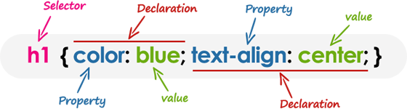
Basics – Syntax
A CSS stylesheet consists of a set of rules that are interpreted by the web browser and then applied to the corresponding elements such as paragraphs, headings, etc. in the document.
A CSS rule have two main parts, a selector and one or more declarations:

Slide 6
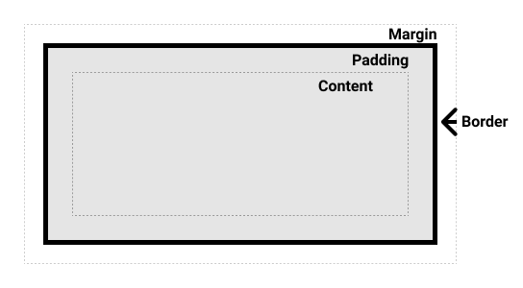
Basics – Shorthand
#container {
margin-top: 0;
margin-right: 5px;
margin-bottom: 6px;
margin-left: 5px;
padding-top: 20px;
padding-right: 10px;
padding-bottom: 30px;
padding-left: 12px;
}
vs.
#container {
padding: 20px 10px 30px 12px;
margin: 0px 5px 6px 5px;
}
0
20
5
12
10
30
5
6

Slide 7
Basics – Others
CSS property names and many values are not case-sensitive. Whereas, CSS selectors are usually case-sensitive, for instance, the class selector .maincontent is not the same as .mainContent.
A CSS comment begins with /*, and ends with */
CSS units are:
  cm, mm, Q, in, pc, pt, px (absolute)
  [r]em, ex, ch, re, lh, vw, vh, vmin, vmax (relative)

Slide 8
Basic – Box Model
The full CSS box model applies to block boxes; inline boxes only use some of the behavior defined in the box model. The model defines how the different parts of a box – margin, border, padding, and content – work together to create a box that you can see on the page.

Slide 9
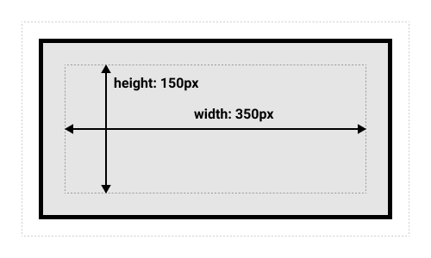
Basic – Box Model
.box { width: 350px; height: 150px; margin: 10px; padding: 25px; border: 5px solid black; }
Final dimension: width = 410px, height = 210px

Slide 10
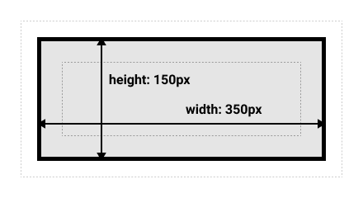
Basic – Box Model
.box { box-sizing: border-box; }
Final dimension: width = 350px, height = 150px

Slide 11
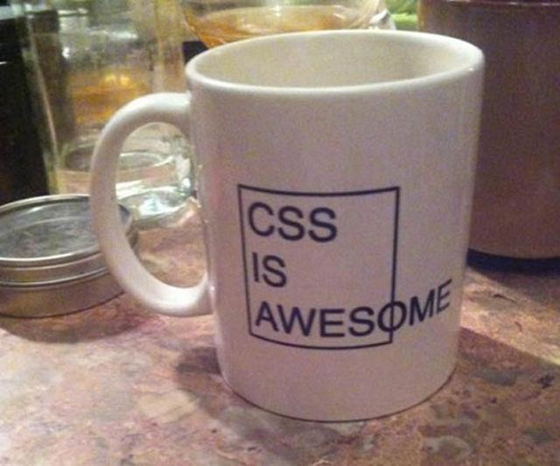

Slide 12
Selectors
A CSS selector is a pattern to match the elements on a web page. The style rules associated with that selector will be applied to the elements that match the selector pattern.

Slide 13
Universal Selector
The universal selector, denoted by an asterisk (*), matches every single element on the page. It may be omitted if other conditions exist on the element.
* { margin: 0; padding: 0; }
Note: It is recommended not to use the universal selector too often in a production environment, since this selector matches every element on a web page that puts too much of unnecessary pressure on the browsers. Use element type or class selector instead.

Slide 14
Element Type Selectors
An element type selector matches all instance of the element in the document with the corresponding element type name. Let's try out an example to see how it actually works:
p { color: blue; }

Slide 15
Id Selectors
The id selector is used to define style rules for a single or unique element.
The id selector is defined with a hash sign (#) immediately followed by the id value.
#error { color: red; }
Note: The value of an id attribute must be unique within a given document — meaning no two elements in your HTML document can share the same id value.

Slide 16
Class Selectors
The class selectors can be used to select any HTML element that has a class attribute. All the elements having that class will be formatted according to the defined rule.
The class selector is defined with a period sign (.) immediately followed by the class value.
.blue { color: blue; }
p.blue { color: blue; }

Slide 17
Descendant Selectors
You can use these selectors when you need to select an element that is the descendant of another element, for example, if you want to target only those anchors that are contained within an unordered list, rather than targeting all anchor elements.
ul.menu li a { text-decoration: none; }
h1 em { color: green; }

Slide 18
Child Selectors
A child selector is used to select only those elements that are the direct children of some element.
A child selector is made up of two or more selectors separated by a greater than symbol (>). You can use this selector, for instance, to select the first level of list elements inside a nested list that has more than one level.
ul > li { list-style: square; }
ul > li ol { list-style: none; }

Slide 19
Adjacent Sibling Selectors
The adjacent sibling selectors can be used to select sibling elements (i.e. elements at the same level). This selector has the syntax like: E1 + E2, where E2 is the target of the selector.
h1 + p { color: blue; font-size: 18px; }
ul.task + p { color: #f0f; text-indent: 30px; }

Slide 20
General Sibling Selectors
The general sibling selector is similar to the adjacent sibling selector (E1 + E2), but it is less strict. A general sibling selector is made up of two simple selectors separated by the tilde (∼) character. It can be written like: E1 ∼ E2, where E2 is the target of the selector.
h1 ∼ p { color: blue; font-size: 18px; }
ul.task ∼ p { color: #f0f; text-indent: 30px; }

Slide 21
Attributes Selectors
The CSS attribute selectors provides an easy and powerful way to apply the styles on HTML elements based on the presence of a particular attribute or attribute value.
[title] { color: blue; }
abbr[title] { color: red; }
input[type="submit"] { border: 1px solid green; }
[class~="warning"],
[class*="error"]
[lang|=en],
a[href^="http://"],
a[href$=".pdf"] { color: green; }

Slide 22
Pseudo-classes Selectors
The pseudo-classes allow you to style the dynamic states of an element such as hover, active and focus state, as well as elements that are existing in the document tree but can't be targeted via the use of other selectors without adding any IDs or classes to them. A pseudo-class starts with a colon (:).
a:visited { text-decoration: none; }
ol li:first-child { border-top: none; }
table tr:nth-child(2n) td { background: #eee; }
q.red:lang(cs) { quotes: "~" "~"; }

Slide 23
List of Pseudo-classes
:link
:visited
:hover
:active
:focus
:enabled
:disabled
:checked
:indeterminate
:target
:default
:valid
:invalid
:in-range
:out-of-range
:required
:optional
:read-only
:read-write

Slide 24
Pseudo-elements Selectors
The pseudo-elements allow you to style the elements or parts of the elements without adding any IDs or classes to them. Such elements aren’t explicitly defined by a position in the document tree. A pseudo-element starts with a double-colon (::).
h1::before { content: url("images/marker.gif"); }
p.article::first-letter { font-size: 2em; }

Slide 25
Examples

Slide 26
Border Radius
#container {
border-radius: 5px 10px 10px 10px / 10px 10px 5px 5px;
border-radius: 5px 10px / 10px;
border-radius: 10px;
}

Slide 27
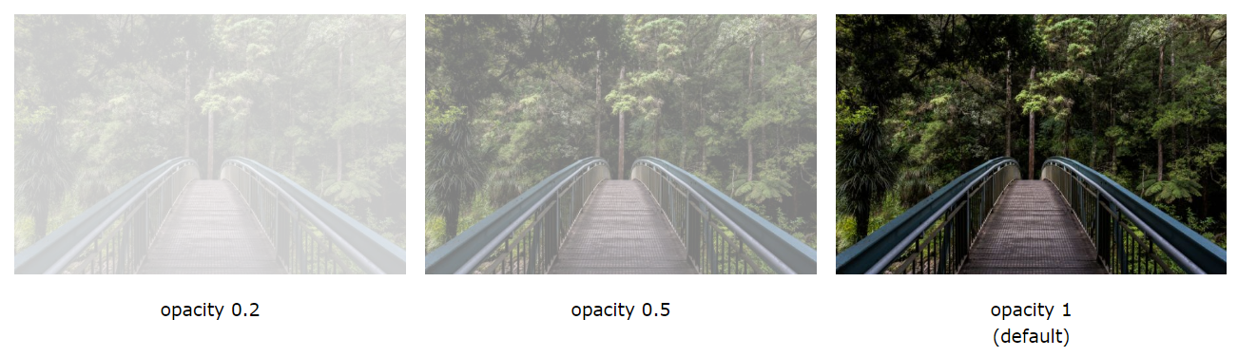
Opacity
The opacity property sets the opacity level for an element. The opacity-level describes the transparency-level, where 1 is not transparent at all, 0.5 is 50% see-through, and 0 is completely transparent.
div.first { opacity: 0.2; }
div.second { background: rgba(76, 175, 80, 0.5); }

Slide 28

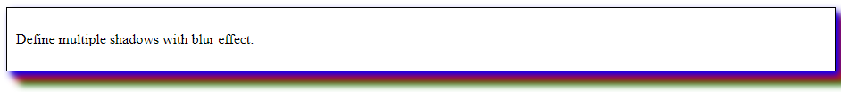
Shadows
h1 {
text-shadow: 2px 2px 8px #ff0000;
}
#container {
box-shadow: 5px 5px 8px blue,
10px 10px 8px red,
15px 15px 8px green;
}

Slide 29
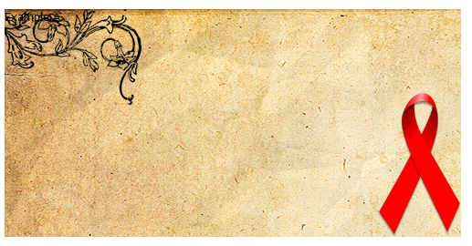
Multiple Background Images
#example {
width: 500px;
height: 250px;
background-image: url("decoration.png"), url("ribbon.png"),
url("old_paper.jpg");
background-repeat: no-repeat;
background-position: left top, right bottom, left top;
}

Slide 30
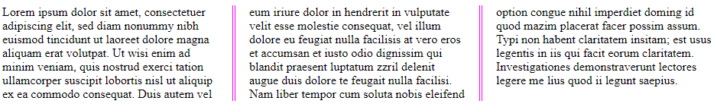
Multi-column Layout
The column-count property specifies the number of columns an element should be divided into.
.newspaper {
column-count: 3;
column-gap: 40px;
column-rule: 4px double #ff00ff;
}

Slide 31
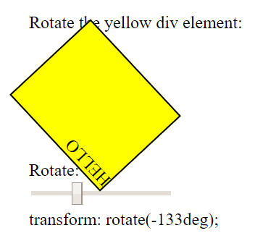
Transform
The transform property applies a 2D or 3D transformation to an element. This property allows you to rotate, scale, move, skew, etc., elements.
div.a {
transform: rotate(20deg);
}
div.b {
transform: skewY(20deg);
}
div.c {
transform: scaleY(1.5);
}

Slide 32


Transition
When an <input type="text"> gets focus, gradually change the width from 100px to 250px:
input[type=text] {
width: 100px;
transition: width .35s ease-in-out;
}
input[type=text]:focus {
width: 250px;
}

Slide 33
Media Query
The Media Queries Module specifies methods to enable web developers to scope a style sheet to a set of precise device capabilities.
Media types:
Desktop browser, screen, print, braille
Mobile browser
Tablet
Television
Game console
Examples: https://mediaqueri.es/

Slide 34
Media Query
@media screen and (max-width: 600px) {
body {
font-size: 80%;
}
}
@media screen and (min-width: 320px) and (max-width: 480px) {}
@media not print and (max-width: 600px) {}
Media properties are:
min/max-width, min/max-height, device-width, device-height, orientation, aspect-ratio, device-aspect-ratio, color, color-index, monochrome, resolution

Slide 35
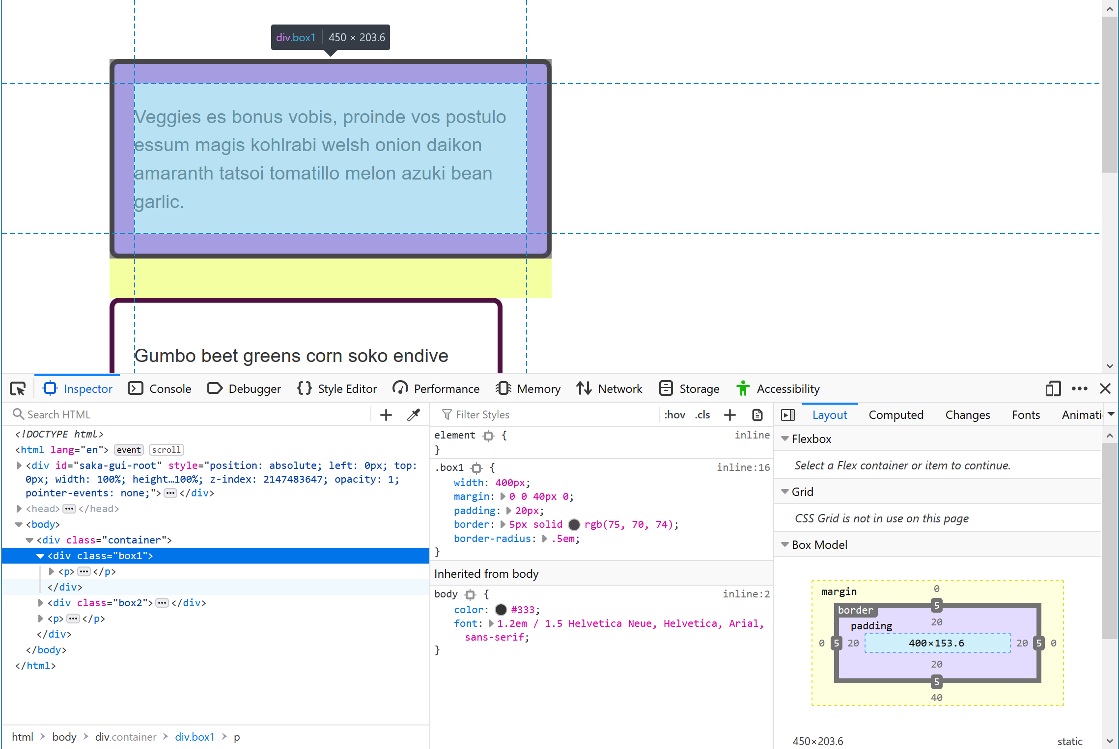
Debugging CSS

Slide 36
References and Tools
https://www.w3.org/Style/CSS/specs.en.html
https://css3test.com/
https://css3generator.com/
http://css3pie.com/
https://flukeout.github.io/
https://flexboxfroggy.com/
https://cssgridgarden.com/

