Slide 1
Academic Communication Skills in English (DACSE)
Spring Term 2021

Slide 2
DACSE 2021
course instructor
course administration
course introduction

Slide 3
LIBOR ŠTĚPÁNEK (libor.stepanek@cjv.muni.cz)
Masaryk University Language Centre (CJV MU) Komenského nám 2
Education:
MA in English
(MA in History & PhD in Political Science)
Specialization and Research:
Academic Skills in English
Academic Public Speaking
Academic Writing

Slide 4
course objectives
After completing this course you will be able to:
communicate effectively within the international academic community setting;
be a successful participant of an international conference/meeting;
recognize various organizational patterns found in academic speaking;
adjust communication to different tasks;
write short formal academic texts.

Slide 5
course organisation
4 block sessions
Monday 22 March 9:30-13:15 (synchronously) Zoom
Tuesday 23 March 9:30-13:15 (synchronously) Zoom
Monday 19 April 9:30-13:15 (synchronously) Zoom
Tuesday 20 April 9:30-13:15 (synchronously) Zoom
theoretical input combined with diverse practical activities based on individual needs

Slide 6
materials
IS study materials
synchronous classes
IS (or other) discussion forum
collaborative activities

Slide 7
requirements
Active participation in:
presentations / talks / teaching sessions giving
synchronous (Zoom) discussions
online asynchronous discussions
writing assignments

Slide 8
introduction

Slide 9
introduction
peer2peer → class

Slide 10
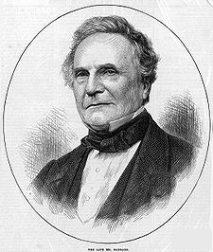
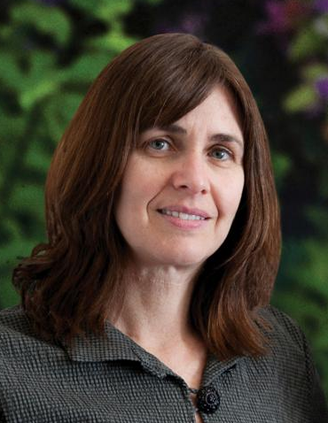
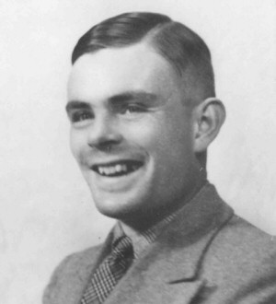
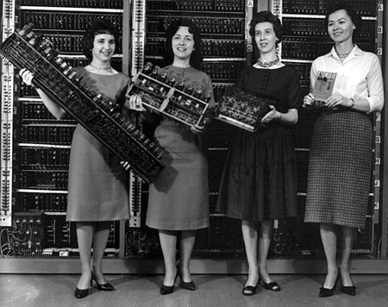
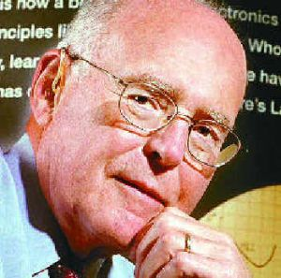
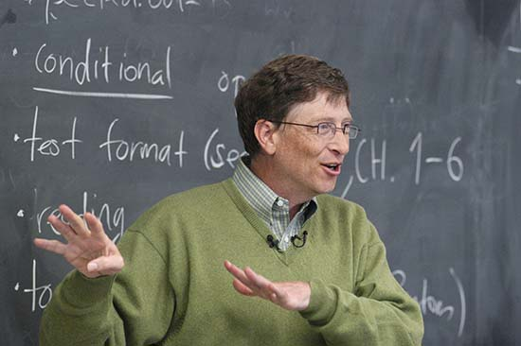
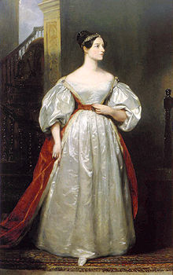
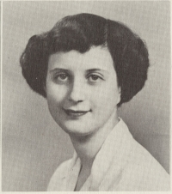
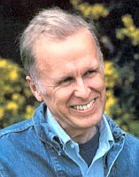
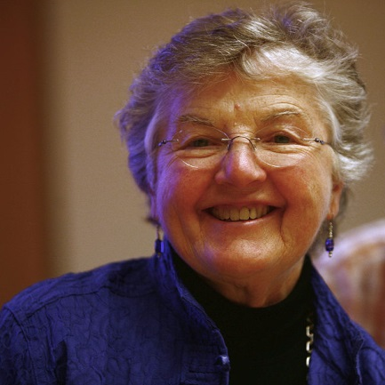
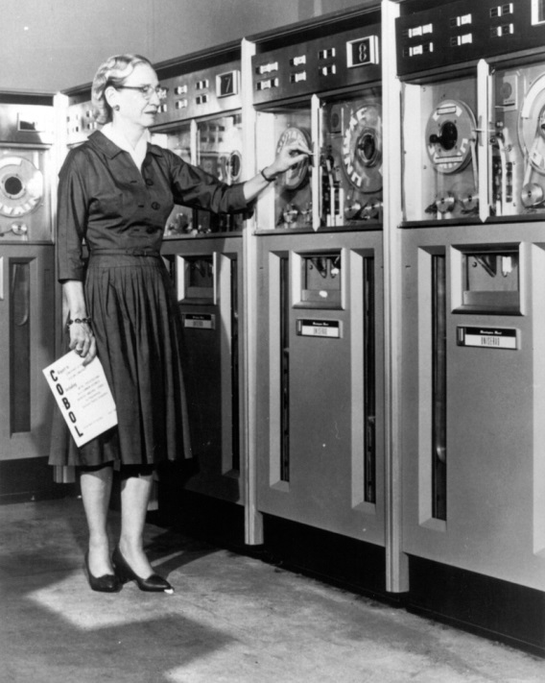
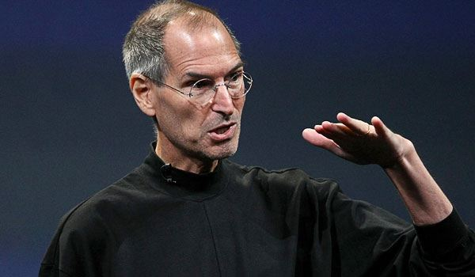
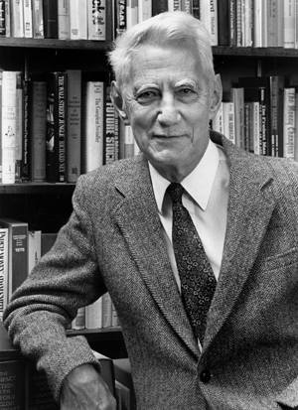
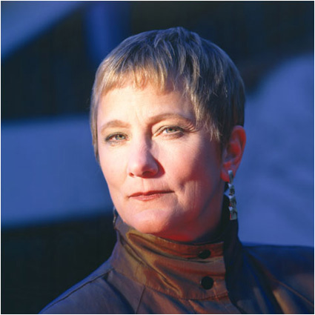
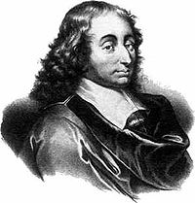

Slide 11
priorities
1.small talk – starting a conversation
2.small talk – finishing a conversation
3.small talk – cultural differences
4.small talk – turn taking
5.after-presentation discussion
6.conference presentation giving
7.panel discussion – presentations
8.panel discussion – chairing
9.panel discussion – turn taking
10.conference slot chairing
11.toast giving
12.lecturing
13.interactive seminar giving
14. academic talk
15.peer-to-peer communication
16. authoritative communication
17. “one of the crowd” communication
18.individual-audience communication
19.adjusting language to your audience
20.instructions giving
21.abstract writing
22.biography writing
23.academic writing style
24.informal emails/letters
25.formal emails/letters
26. interview
27. feedback giving
28. feedback accepting
29. in-front-of-the-camera communication
30. other preference

