Slide 1
Gaps in Quality of Service
Josef Spurný
PA181 Services - Systems, Modelling and Execution

Slide 2
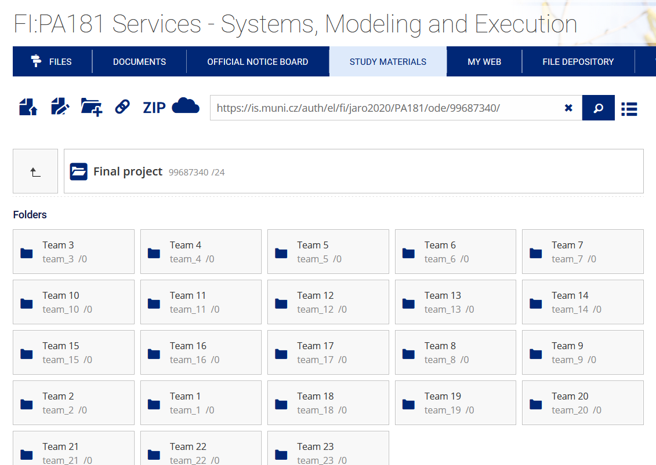
Course information
The exam will be online.
the deadline for submitting the whole project is 23rd of June 2020
the project topic, you could make changes, but let me know first by email.
for pa181, we will have a live session on the 20th of May from 11:00-12:00 and email communication is always welcome

Slide 3
Learning objectives
Re-cap the SERVQUAL model
Understand the gaps in quality of service
Understand how to improve quality of service

Slide 4
Service Quality
Reliability
Responsive-ness
Empathy
Tangibles
Assurance
SERVQUAL

Slide 5
SERVQUAL Attributes
RELIABILITY
EMPATHY
Providing service as promised
Dependability in handling customers’ service problems
Performing services right the first time
Providing services at the promised time
Maintaining error-free records
Giving customers individual attention
Employees who deal with customers in a caring fashion
Having the customer’s best interest at heart
Employees who understand the needs of their customers
Convenient business hours
RESPONSIVENESS
Keeping customers informed as to when services will be performed
Prompt service to customers
Willingness to help customers
Readiness to respond to customers’ requests
TANGIBLES
Modern equipment
Visually appealing facilities
Employees who have a neat, professional appearance
Visually appealing materials associated with the service
ASSURANCE
Employees who instill confidence in customers
Making customers feel safe in their transactions
Employees who are consistently courteous
Employees who have the knowledge to answer customer questions
4-5

Slide 6
Word of
mouth
Personal
needs
Past
experience
Service Quality
Dimensions
Reliability
Responsiveness
Assurance
Empathy
Tangibles
Expected
service
Service Quality Assessment
1. Expectations exceeded
ES<PS (Quality surprise)
2. Expectations met
ES~PS (Satisfactory quality)
3. Expectations not met
ES>PS (Unacceptable quality)
Perceived
service

Slide 7
Conceptual Model of Service Quality
CUSTOMER
Word-of-mouth
Communications
Personal Needs
Past experience
Expected Service
Gap 5
Perceived Service
PROVIDER
Service
Delivery
External
Communications
To Customers
Gap 4
Gap 3
Gap 1
Service Quality
Specs
Gap 2
Management
Perceptions of
Customer Expectations

Slide 8
What are the Servqual Gaps?
Gap 1: The difference between management perceptions of what customers expect and what customers really expect
Gap 2: The difference between management perceptions and service quality specifications - the standards gap

Slide 9
What are the Servqual Gaps?
Gap 3: The difference between service quality specifications and actual service delivery - are standards consistently met?
Gap 4: The difference between service delivery and what is communicated externally - are promises made consistently fulfilled?

Slide 10
What are the Servqual Gaps?
Gap 5: The difference between what customers expect of a service and what they actually receive
  expectations are made up of past experience, word-of-mouth and needs/wants of customers
  measurement is on the basis of two sets of statements in groups according to the five key service dimensions

Slide 12
Problems with Gaps in Service Quality
Gap1: Market research gap
  Management may not understand how customers formulate their expectations from past experience, advertising, communication with friends
    Improve market research
    Foster better communication between employees and its frontline employees
    Reduce the number of levels of management that distance the customer
Gap 2: Design gap
  Management is unable to formulate target level of service to meet customer expectations and translate them to specifications
    Setting goals and standardizing service delivery tasks can close the gap

Slide 13
Problems with Gaps in Service Quality
Gap 3: Conformance gap
  Actual delivery of service cannot meet the specifications set by management
    Lack of teamwork
    Poor employee selection
    Inadequate training
    Inappropriate job design
Gap 4: Communication gap
  Discrepancy between service delivery and external communication
    Exaggerated promises in advertising
    Lack of information provided to contact personnel to give customers

Slide 14
Problems with Gaps in Service Quality
Gap 5: Customer expectations and perceptions gap
  Customer satisfaction depends on minimizing the four gaps that are associated with service delivery

Slide 15
Conclusion
Understand the gaps in quality of service
User the gap model to improve service quality

