Slide 1
Quality of Service
Josef Spurný
PA181 Services - Systems, Modelling and Execution

Slide 2

How good your service is?
When there is some service, how good this service is?

Slide 3
Learning Objectives
Recognize the importance of service quality
Describe the five dimensions of service quality
Develop a service measurement survey

Slide 4
Why is Service Quality Important?
SQ positively correlates with organization‘s financial performance
Dissatisfied customers are likely to share their experience with more than 3 other people
Six times more people hear about negative service experience than hear about positive one
Customers‘ service expectations are constantly rising, while their tolerance for poor service is declining

Slide 5
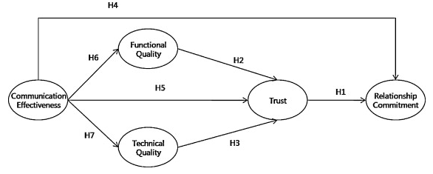
Why is IT Service Quality Important?
Customers often lack specialized knowledge; therefore, it is not easy for them to assess IT service quality, even after delivery
communication with a customer is essential! (T-Shaped profile)
IT Service Quality is a mediating factor between communication and buildup of trust with the customer
Source: Park, Lee, Lee & Truex (2012). Exploring the impact of communication effectiveness on service quality, trust and relationship commitment in IT services. International Journal of Information Management

Slide 6
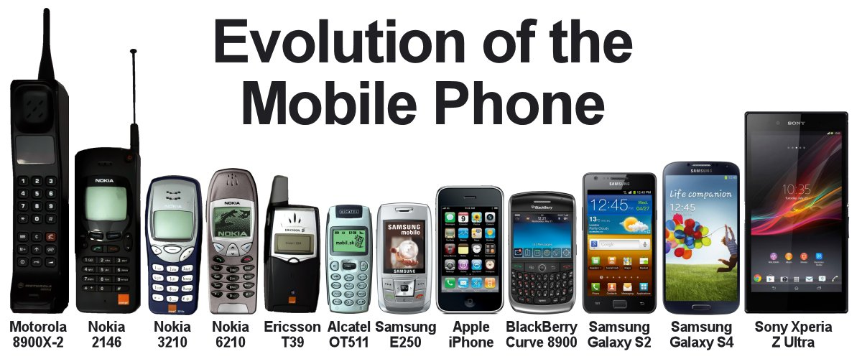
Comparison in real life

Slide 7
Comparison in real life
3rd Party Authority
=
Objective comparison
Own comparison criteria
=
marketing / persuasion

Slide 8
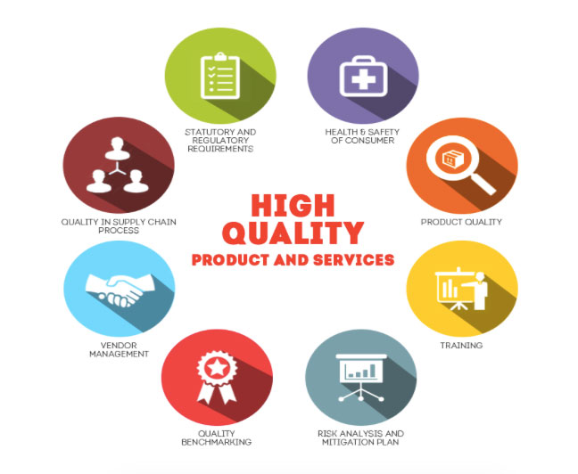
Service Quality or Quality of Service

Slide 9
Scope of Service Quality
View quality from five perspectives
  Content – are standard procedures being followed?
  Process – is the sequence of events in the service process appropriate?
  Structure – are the physical facilities and organizational design adequate for the service?
  Outcome – what change in the status has the service effected? Is the consumer satisfied?
  Impact – what is the long-range effect of the service on the consumer?

Slide 10
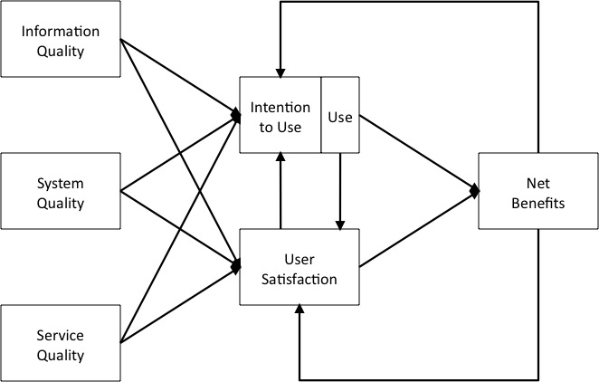
Position of Service Quality
Information Systems Success Theory, DeLone and McLean (2002)
Data quality – format, accuracy, reliability, completeness…
SW engineering
[Focus of this lecture]

Slide 11

Evaluation of Service Quality
Metrics/Criteria/Dimensions

Slide 12
SERVQUAL: The Five Key Service Dimensions
Dimension | No. of Items in Questionnaire | Definition
Reliability | 5 | The ability to perform the promised service dependably and accurately
Assurance | 5 | The knowledge and courtesy of employees and their ability to convey trust and confidence
Tangibles | 4 | The appearance of physical facilities, equipment, personnel and communication materials
Empathy | 5 | The provision of caring, individualized attention to customer
Responsiveness | 4 | The willingness to help customers and to provide prompt service
Source: Based on Parasuraman, A, Ziethaml, V. and Berry, L.L., "SERVQUAL: A Multiple- Item Scale for Measuring Consumer Perceptions of Service Quality' Journal of Retailing, Vol. 62, no. 1, 1988

Slide 13
Service Quality
Reliability
Responsive-ness
Empathy
Tangibles
Assurance
SERVQUAL Model

Slide 14
Dimensions of Service Quality
Reliability:
  Perform promised service dependably and accurately.
  Example: receive mail at same time each day.
Assurance:
  Ability to convey trust and confidence.
  Give a feeling that customer’s best interest is in your heart
  Example: being polite and showing respect for customer.

Slide 15
Dimensions of Service Quality
Tangibles:
  Physical facilities and facilitating goods.
  Example: cleanliness.
Empathy:
  Ability to be approachable, caring, understanding and relating with customer needs.
  Example: being a good listener.
Responsiveness:
  Willingness to help customers promptly.
  Example: avoid keeping customers waiting for no apparent reason.
  Quick recovery, if service failure occurs

Slide 16
SERVQUAL Attributes
RELIABILITY
EMPATHY
Providing service as promised
Dependability in handling customers’ service problems
Performing services right the first time
Providing services at the promised time
Maintaining error-free records
Giving customers individual attention
Employees who deal with customers in a caring fashion
Having the customer’s best interest at heart
Employees who understand the needs of their customers
Convenient business hours
RESPONSIVENESS
Keeping customers informed as to when services will be performed
Prompt service to customers
Willingness to help customers
Readiness to respond to customers’ requests
TANGIBLES
Modern equipment
Visually appealing facilities
Employees who have a neat, professional appearance
Visually appealing materials associated with the service
ASSURANCE
Employees who instill confidence in customers
Making customers feel safe in their transactions
Employees who are consistently courteous
Employees who have the knowledge to answer customer questions

Slide 17
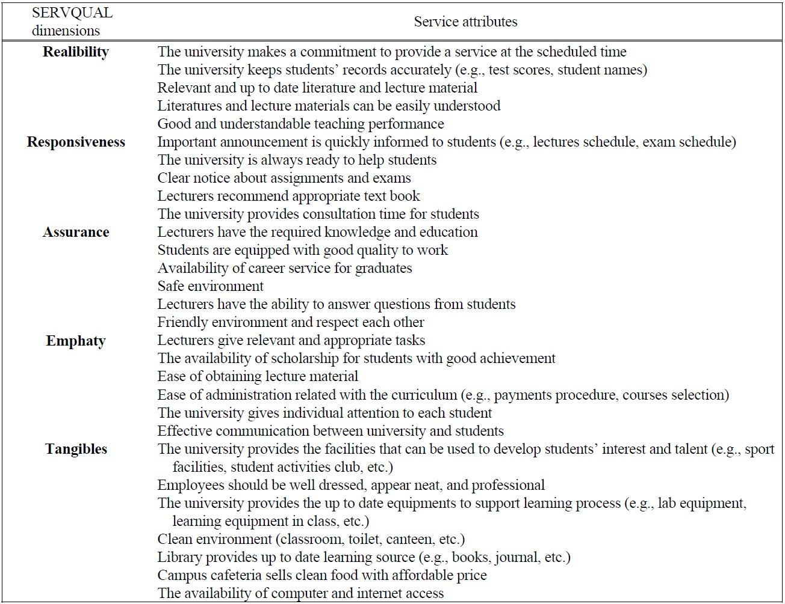
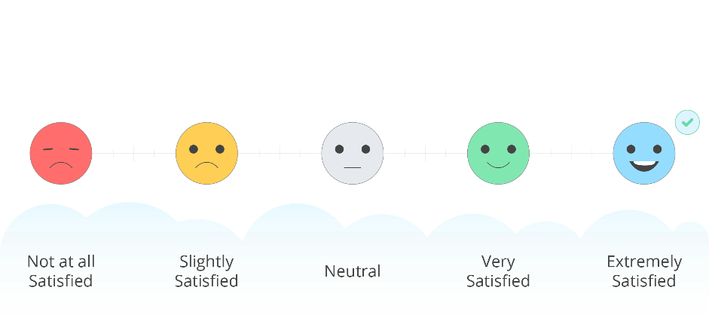
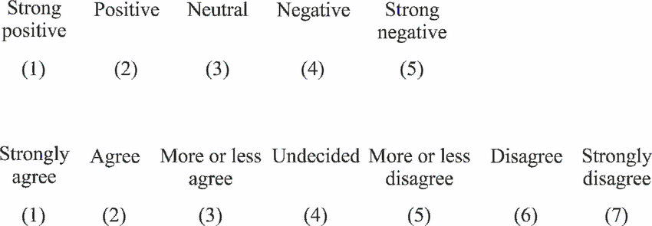
SERVQUAL Example for University Services
Likert scale

Slide 18
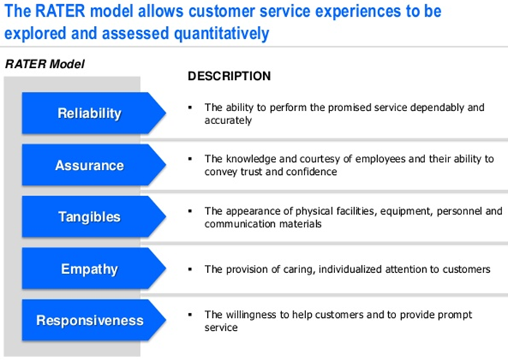
RATER – Tool for SERVQUAL

Slide 19
Remarks for Service Quality
We can assess service quality from the customer’s perspective
We can track customer expectations and perceptions over time and the discrepancies between them
We can compare a set of Servqual scores against those of competitors or best practice examples

