Slide 1
Service Quality Management
Josef SPurný
PA181 Services - Systems, Modelling and Execution

Slide 2
Learning objectives
Understand Service Quality Management
Cost of Service Quality Optimization
Model the Service Value Chain + Example

Slide 3
Service Quality
Reliability
Responsive-ness
Empathy
Tangibles
Assurance
SERVQUAL

Slide 5
Why Service Quality Management?
Reasons for service quality becoming a first priority for most organizations:
Competition – Today’s market demand high quality services at low cost. Having `high quality’ reputation is not enough! Internal cost of maintaining the reputation should be low.
Changing customer – The new customer is not only establishing priority based on volume but is more demanding about the “quality service.”
Changing product mix – The shift:
low volume/high price high volume/low price
has resulted in a need to reduce the internal cost of poor quality.

Slide 6
Why Service Quality Management?
Product complexity – As services have become more complex, the reliability requirements for suppliers of components have become more demanding.
Higher levels of customer satisfaction – Higher customers expectations are getting increased by competition.

Slide 7
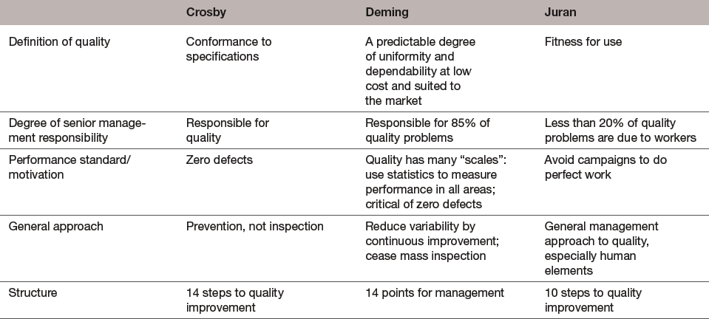
Three Quality Management Gurus
Source: Modified from John S. Oakland, Total Quality Management (London: Heinemann Professional Publishing Ltd., 1989), pp. 291–92.

Slide 8
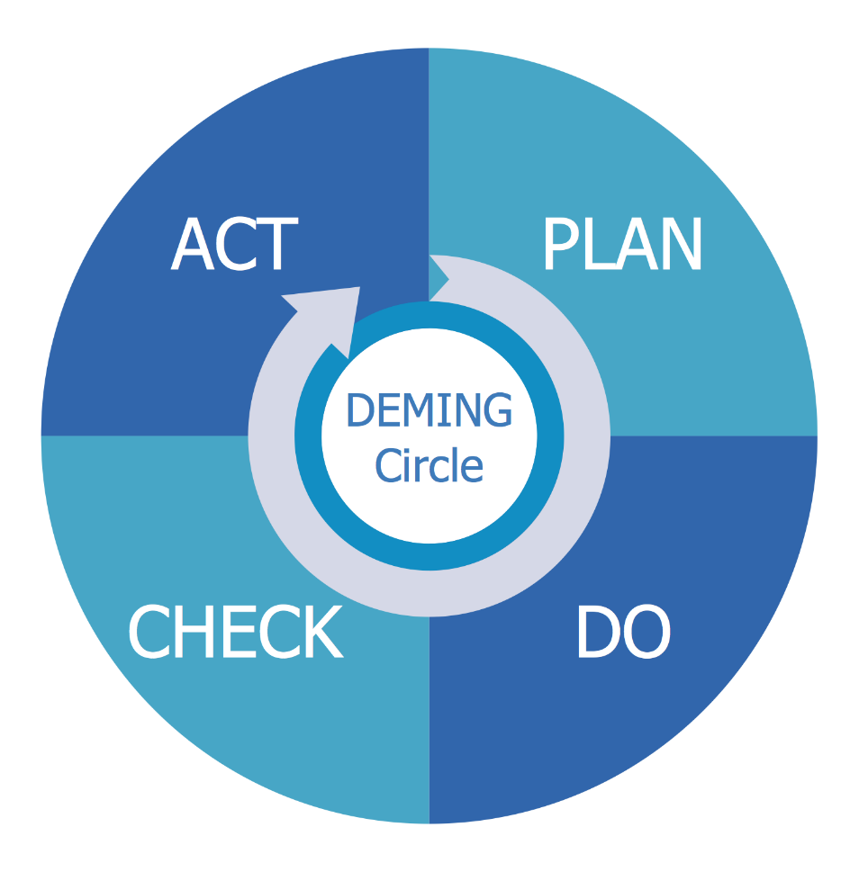
Deming PDCA Circle

Slide 9
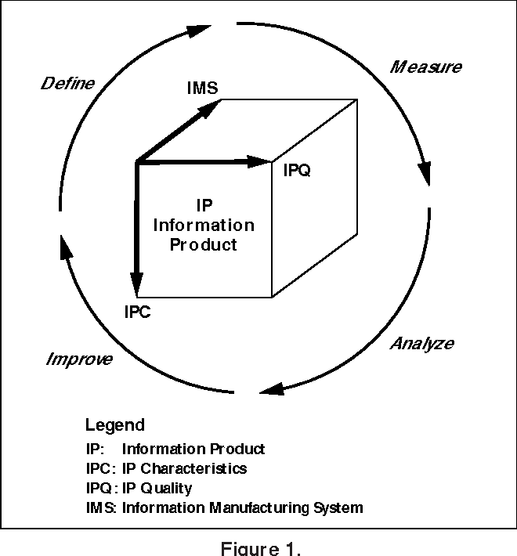
Total data quality management

Slide 10
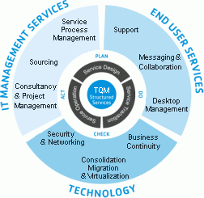
Total Service Quality Management
We can easily adapt the quality management to service quality management

Slide 11
Cost of Service Quality

Slide 12
The Cost of Quality
Cost of Quality
  Framework for identifying quality components that are related to producing both high quality services and low quality components, with the goal of minimizing the total cost of quality.
  Costs of poor quality:
    Detection/appraisal costs
    Internal failure costs
    External failure costs

Slide 13
Cost of Service Quality
Category | Definition | Example
Prevention | Costs associated with preventing defects. | Training, early reviews, quality planning, tools, process improvement initiatives.
Detection/ appraisal | Costs associated with analyzing and testing the product to ensure it conforms to specifications. | Inspections, testing, audits, quality control.
Internal Failure | Costs associated with fixing defects found prior to release. | Repair, retesting, updating documentation.
External Failure | Costs associated with fixing defects found after release. | Technical support, defect reporting and tracking, field updates, loss of future sales.

Slide 14
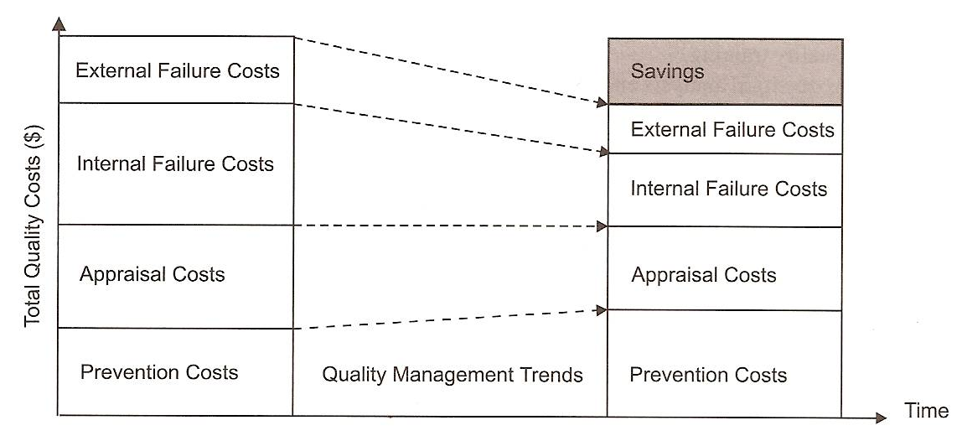
Cost Management of Service Quality
Quality Cost Management shows how increased Prevention Costs reduce the Total Quality Costs.
+
satisfied early adopters

Slide 15
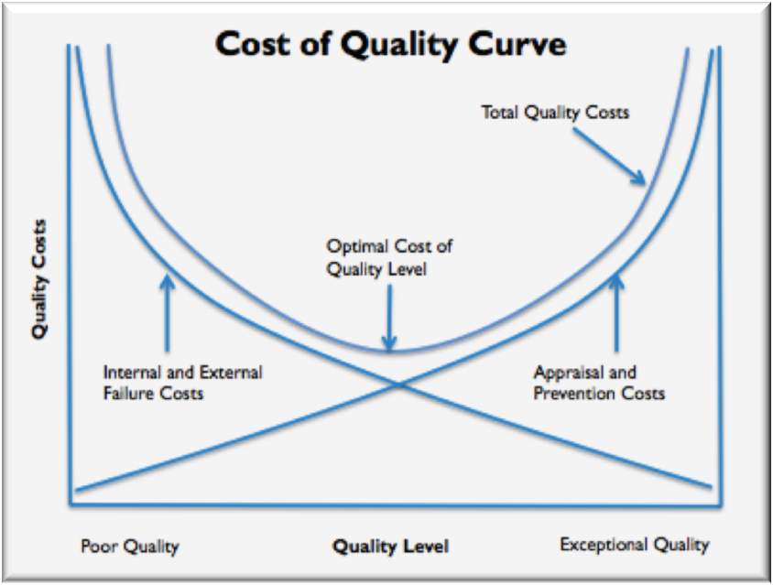
Optimization for Cost of Service Quality

Slide 16
Service value chain

Slide 17
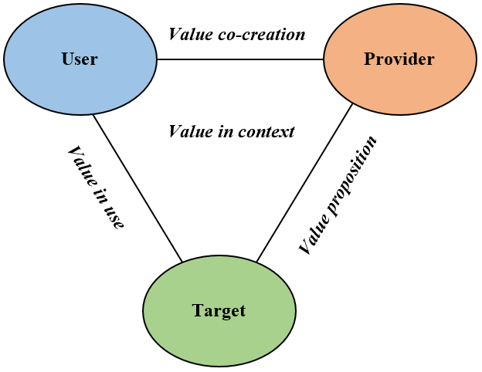
Service Unit Model

Slide 18
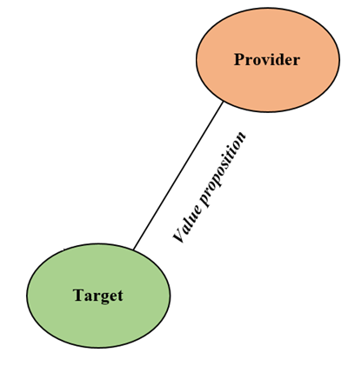
Provider’s perspective
The provider offers the solutions to the users’ needs by combining its knowledge, resources, competences, and capabilities.
The concept of ‘value proposition’ in terms of provider’s proposals to market based on their knowledge, competences, and capabilities.

Slide 19
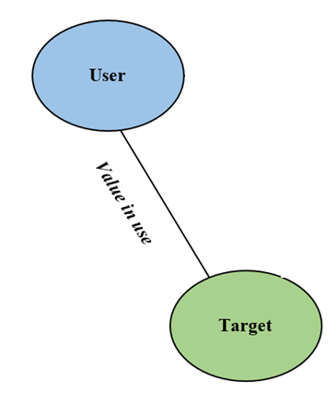
User’s perspective
From user’s perspective, users evaluate the solutions to their requirements based on their perceived utility, emotional state, past experience, and memories.
This perspective analyses the ways in which users define their needs.

Slide 20
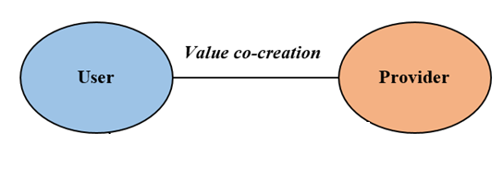
Provider-user relational perspective
The relationship between service providers and users
The concept of ‘value co-creation’ underling that “value is ultimately derived with the participation of, and determined by, the beneficiary (often, the customer) through use (often called ‘consumption’) in the process of acquisition, usage, and disposal”

Slide 21
Contextual perspective
Value is influenced by contextual and social dynamics.
The concept of ‘value in context’ stated that the “value creation being understood in the context of a larger value-configuration space” (Vargo 2008).

Slide 22
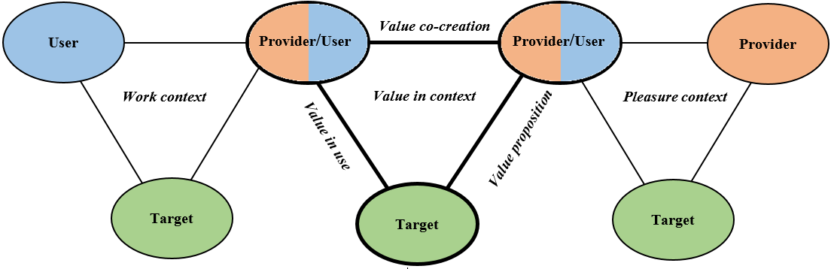
Value Process Model

Slide 23
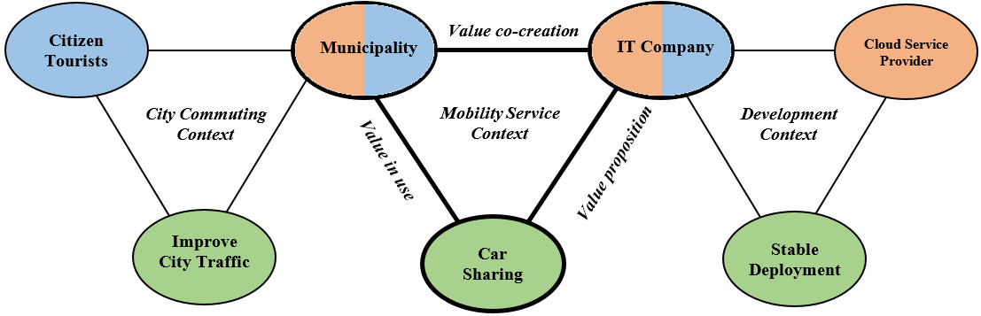
Service Value Chain - Example

