Slide 1
TypeScript vs JavaScript
PB138 Moderní značkovací jazyky
Duben 2021
Tomáš Pitner

Slide 2
TypeScript – Motivation
JavaScript – was a decent simple language for manipulation with objects in web pages
Eventually, it became a universal language for both client & server side (Node.js), for general scripting, for defining queries and views in NoSQL databases
1,500,000+ projects at npmjs.com

Slide 3
JavaScript – dynamic weak typing
Issues with weak and dynamic typing
Urgent need for a static type system emerged

Slide 4
JS – dynamic typing
JS is a dynamically typed language
Objects behavior is determined in runtime – objects offer & behave according to what they have in runtime not by declaration
Type checking in runtime
JS does not (did not) have classes
Generaly about language typing, see https://medium.com/android-news/magic-lies-here-statically-typed-vs-dynamically-typed-languages-d151c7f95e2b

Slide 5
JS – weak typing
JS is a weakly typed language – opposite of strong typing where more or less allowing only those automatic type conversions that do not lose information), one can refer to the process as Strongly typed, if not, as Weakly typed.

Slide 6
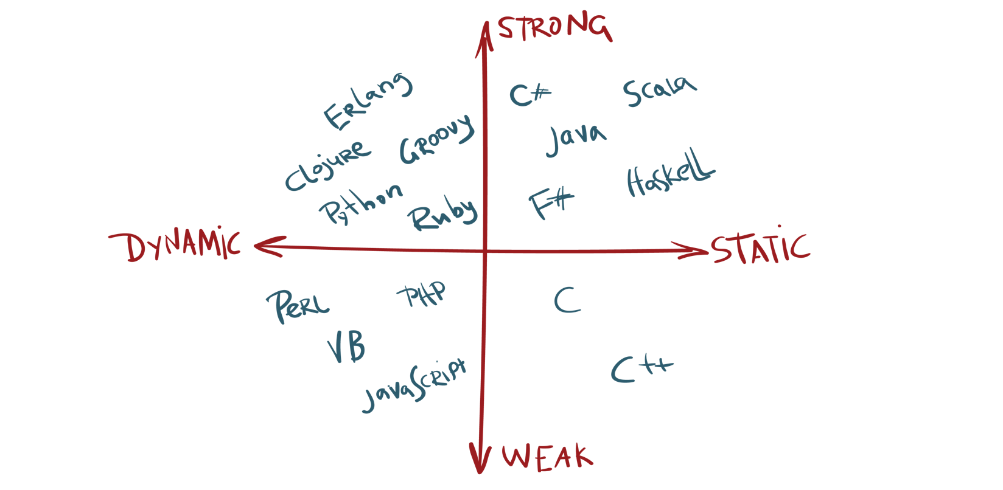
Typing in Languages

Slide 7
Java, Python vs PHP
Java – strong static typing
String temp = “Hello World!”;
temp = 10; // error in compile time
Python – strong dynamic typing
temp = “Hello World!”
temp = temp + 10; // error in RT

Slide 8
Java, Python vs PHP
PHP – weak dynamic typing
$temp = “Hello World!”;
$temp = $temp + 10; // no error as type coercion occurs in RT

Slide 9
JS – issues with typing
Type coersion (enforcement) – type must be converted in order to do certain operation
  Ie. String concatenation in JS
  var value1 = “5“; // string
  var value2 = 9; // number
  let sum = value1 + value2; // must be all strings
  // result: sum = „59“

Slide 10
JS – issues with typing
Type conversion – in static languages does not loose information while in dynamic may loose information
May be done implicitly (more error prone) or explicitly (more under control, done consiously)
  // implicit
  let a = 5 + 2.0;
  // 2.0 (floating) is converted to 2 (integer)
  // explicit
  sum = Number(value1) + value2; // both numbers
  // result: sum = 14

Slide 11
JS vs TS (strong typing)
Absurd expressions still evaluate in JS (but not TS):
  // JS: coerces [] to 0 (array length)
  console.log(4 / []); // gives Infinity (as 4/0)
  // TS: checks types and produces error:
  console.log(4 / []);
The right-hand side of an arithmetic operation must be of type 'any', 'number', 'bigint' or an enum type.

Slide 12
TS = Static Types over JS
The type system in TypeScript has different levels of strictness when working with a codebase:
A type-system based only on inference with JavaScript code
Incremental typing in JavaScript via JSDoc
Using // @ts-check in a JavaScript file
TypeScript code
TypeScript with strict enabled

Slide 13
TypeScript
very popular open-source language maintained and developed by Microsoft
superset of JavaScript
static type definitions
kind of arguments & returned values from functions
exact structure of objects
see https://nodejs.dev

Slide 14
Example – type definition
type User = {
name: string;
age: number;
};
function isAdult(user: User): boolean {
return user.age >= 18;
}
const justine: User = {
name: 'Justine‘,
age: 23
};
const isJustineAnAdult: boolean = isAdult(justine);

Slide 15
Example – type definition
type User = {
name: string;
age: number;
};
function isAdult(user: User): boolean {
return user.age >= 18;
}
const justine: User = {
name: 'Justine‘,
age: 23
};
const isJustineAnAdult: boolean = isAdult(justine);

