Slide 1
PA181 – Service Systems, Modeling and Execution
Business and Service Models

Slide 2
Business Model Canvas for Service Science
- for project in IBM Services -

Slide 3
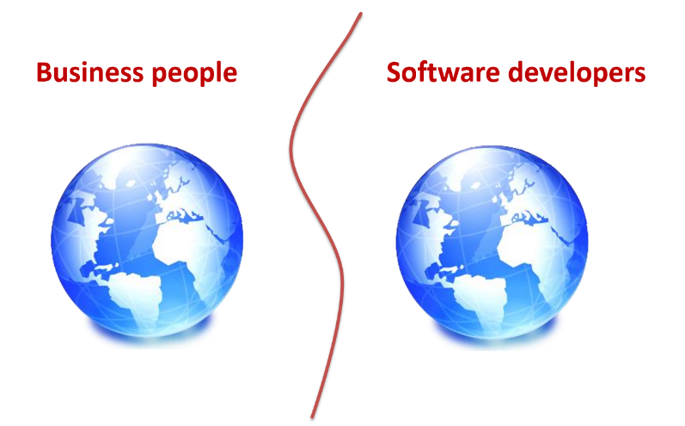
Two different planets

Slide 4
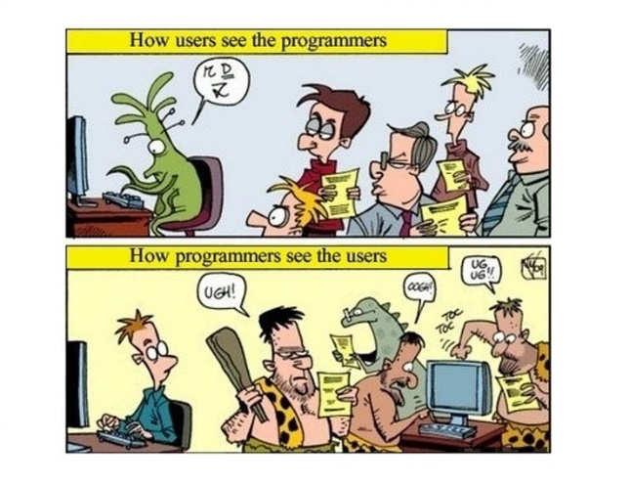

Slide 5
Business Model versus Business Plan
Business Model
Business Plan
A single diagram of your business
A document investors make you write that they don’t read

Slide 6






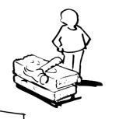


Business Model Canvas – Template
Key Partners | Key Activities | Value Propositions Write directly to the canvas… Or use the post-it™ note …or both |  | Customer Relationships | Customer Segments
 | Key Resources |  |  | Channels
Cost Structure |  |  | Revenue Streams
http://www.businessmodelgeneration.com

Slide 7

Business Model Canvas -
Key Partners | Key Activities | Value Propositions |  | Customer Relationships | Customer Segments
 | Key Resources |  |  | Channels
Cost Structure |  |  | Revenue Streams
Social & Environmental Cost |  |  | Social & Environmental Benefit
http://www.businessmodelgeneration.com

Slide 8
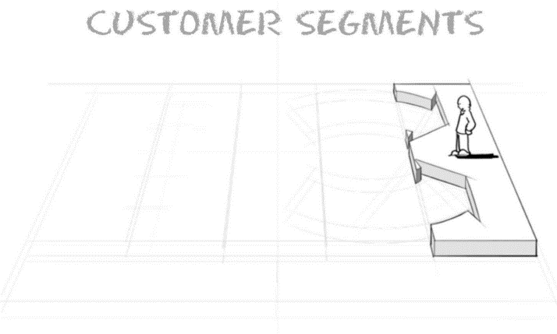

Slide 9
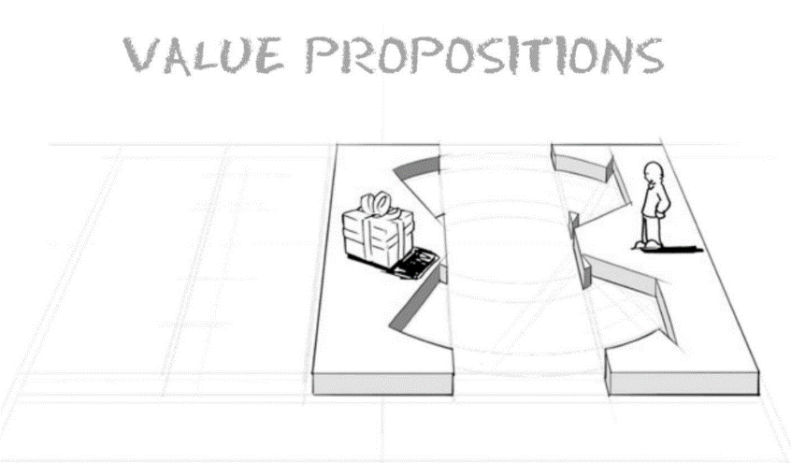

Slide 10
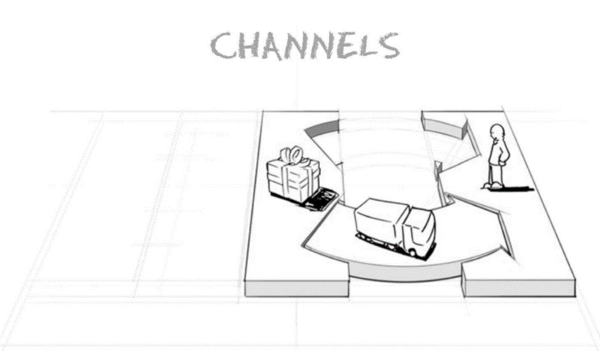

Slide 11
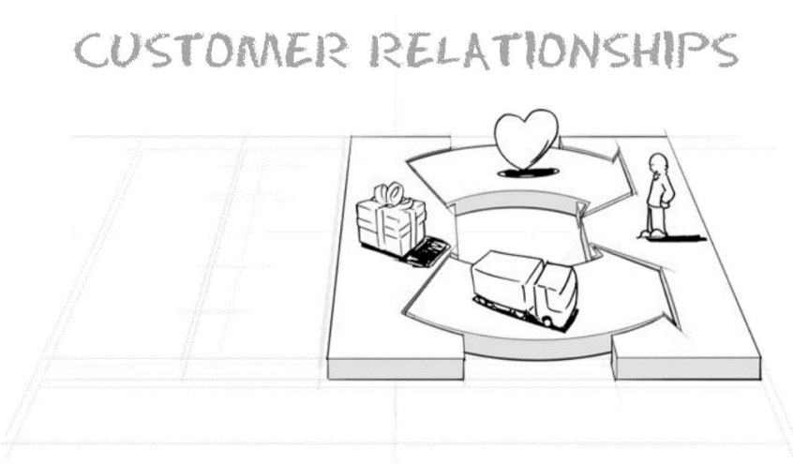

Slide 12
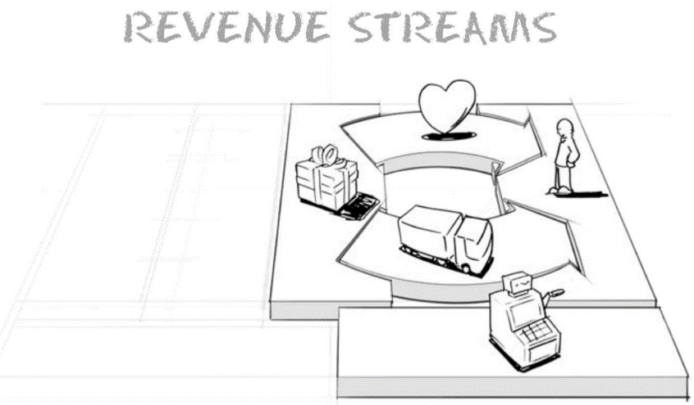

Slide 13
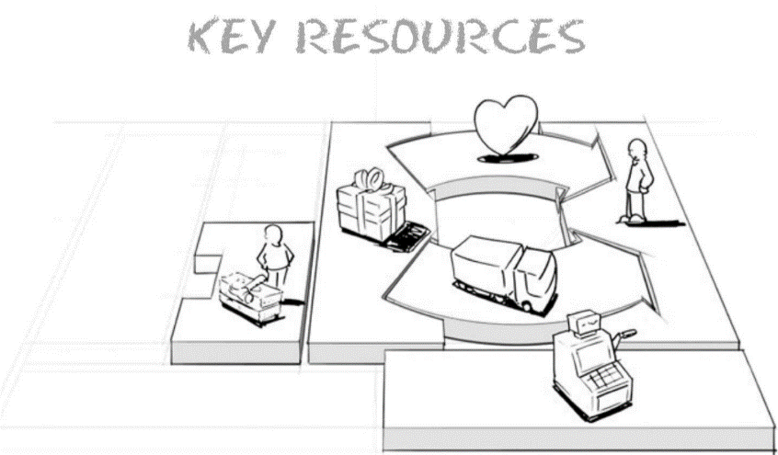

Slide 14
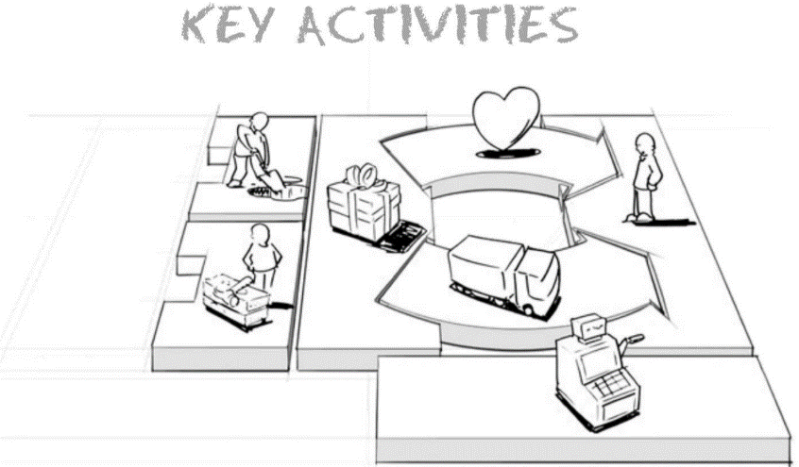

Slide 15
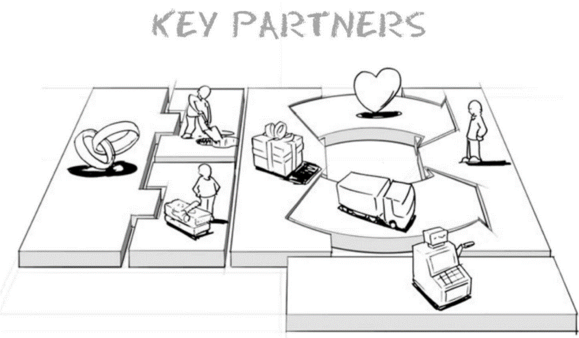

Slide 16
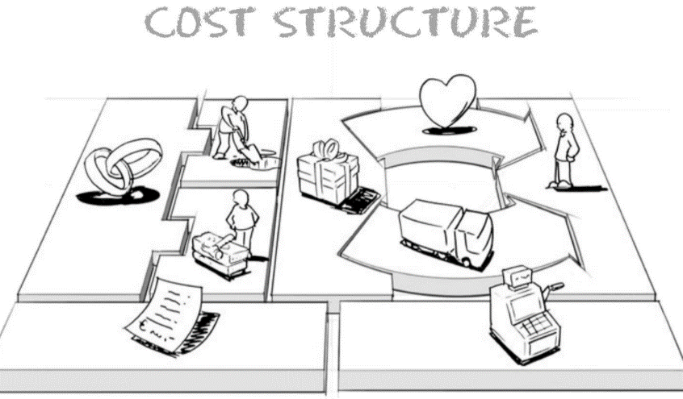

Slide 17
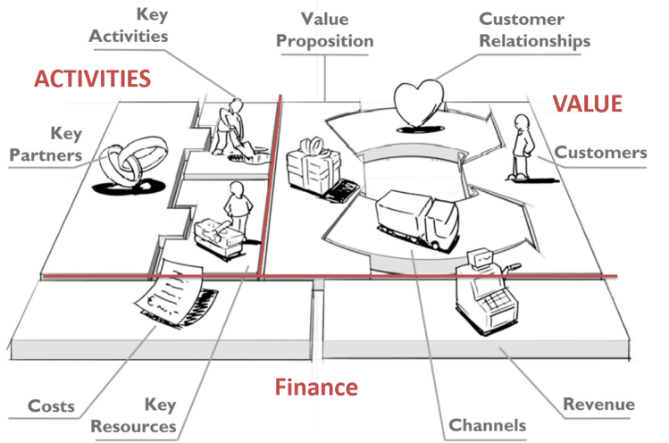

Slide 18
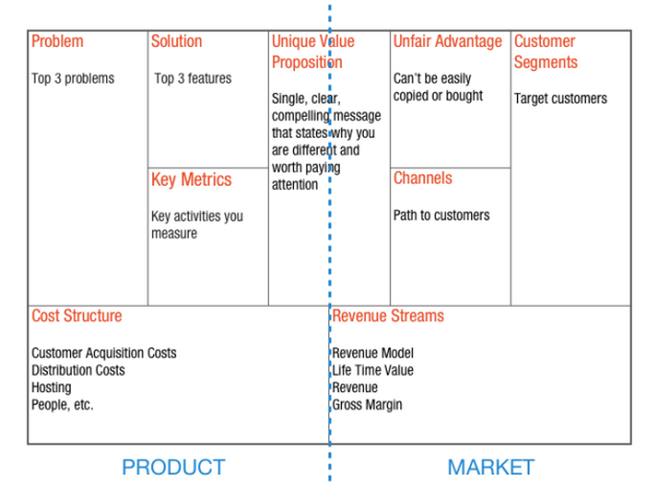
Business Model – Lean Canvas

Slide 19
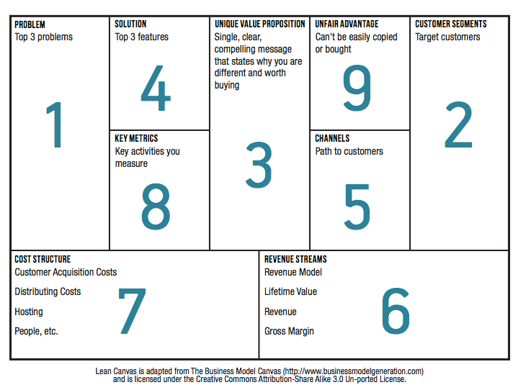
The prescribed order

Slide 20
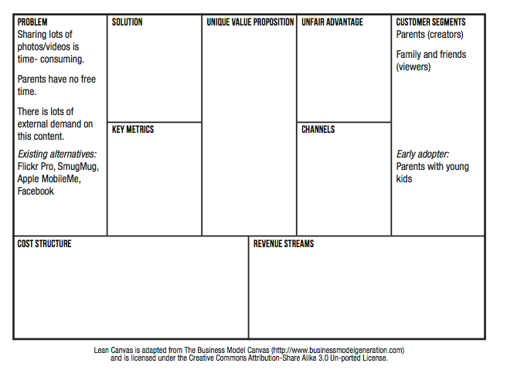
Problem and Customer Segments

Slide 21
Unique Value Proposition
Some Tips on how to craft a UVP
Be different, but make sure your difference matters
Target early adopters
Focus on finished story benefits
Example resume building service
A feature - “professionally designed templates”
Benefit – “eye catching resume that stands out”
Finished story benefit – “landing your dream job”
Pick your words carefully and own them
Performance – BMW
Design – Audi
Prestige – Mercedes
Picking a few key words that you consistently use also drives your search engine optimization (SEO) ranking
Answer what, who and why
Study other good UVP’s
Unique Value Proposition
Why you are different and worth buying/getting attention

Slide 22
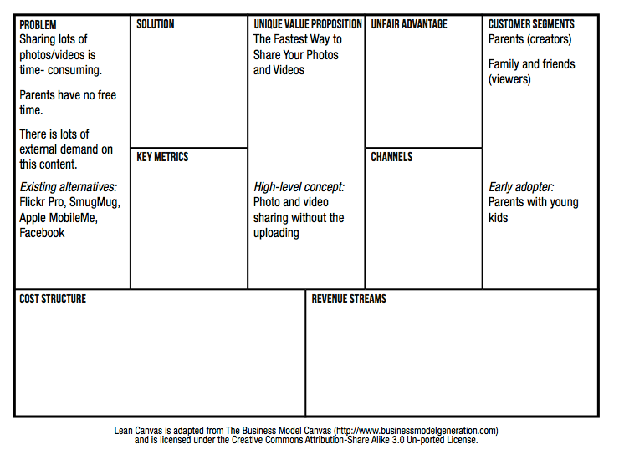
Unique Value Proposition

Slide 23
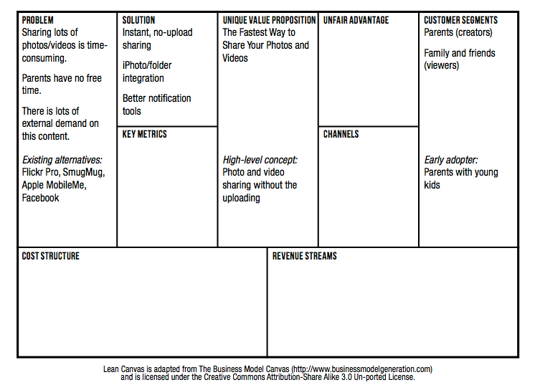
Solution

Slide 24
Channels
Freer versus Paid
Inbound versus outbound
Examples inbound channels
Blogs
SEO
Ebooks
White papers
Examples of outbound channels
Print/TV ads
Trade shows
Cold calling
Direct versus automated
Direct versus indirect
Retention before referral

Slide 25
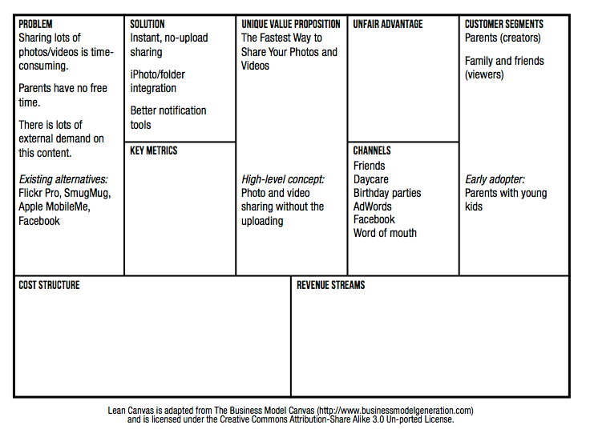
Channels

Slide 26
Revenue Streams and Cost Structure
Revenue Streams
If you intend to charge for your product you should charge from day one.
Price is part of the product
Price defines your customers
Getting paid is the first form of validation
Cost structure
It’s hard to calculate into the future. Instead, focus on the present
What will it cost you to interview 30 – 50 customers?
What will it cost you to build and launch your MVP?
What will your ongoing burn rate look like in terms of both fixed and variable costs?

Slide 27
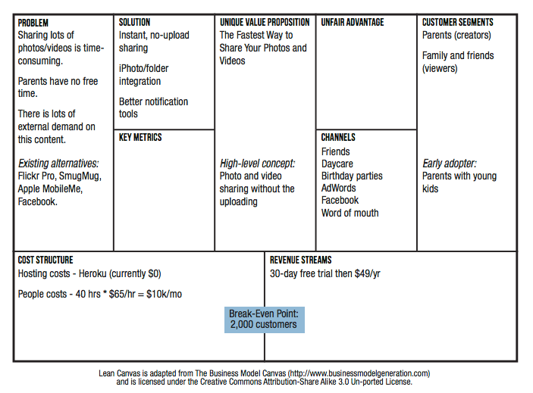
Revenue Streams and Cost Structure

Slide 28
Key Metrics
Find the key number that tells you how your business is doing in real time, before you get the sales report
How do users find you?
Aqusition
Activation
Retention
Revenue
Referral
Do users have a great
first experience?
Do users come back?
How do you make money?
Do users tell others?

Slide 29
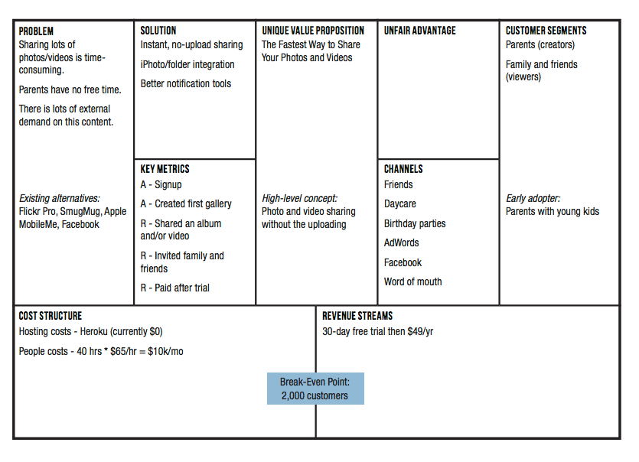
Key Metrics

Slide 30
Unfair Advantage
A real unfair advantage is something that cannot be easily copied or bought
How can/will you make yourself different and make your difference matter
Some examples
Insider information
The right “expert” endorsements
A dream team
Personal authority
Large network effects
Community
Existing customers
SEO ranking

Slide 31
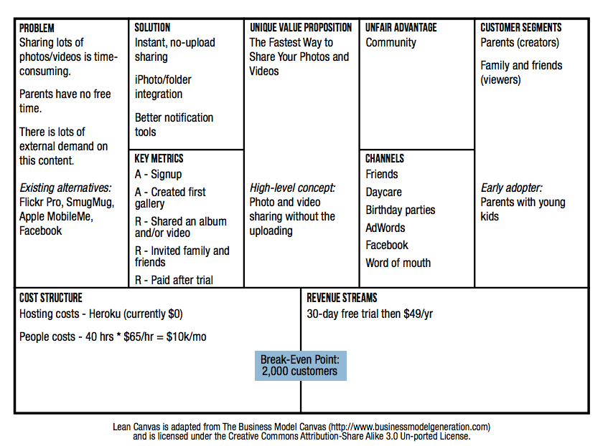
Unfair Advantage

Slide 32
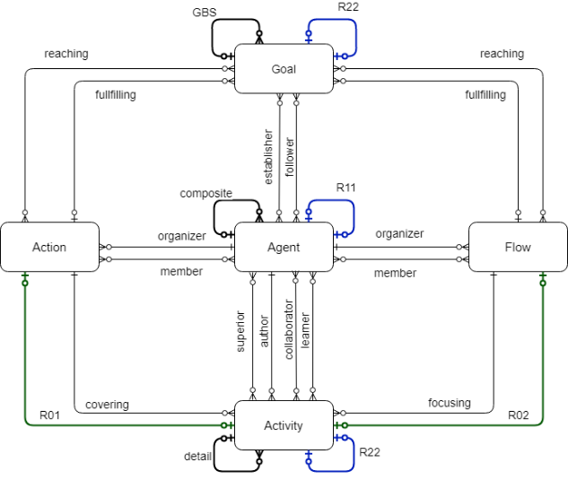
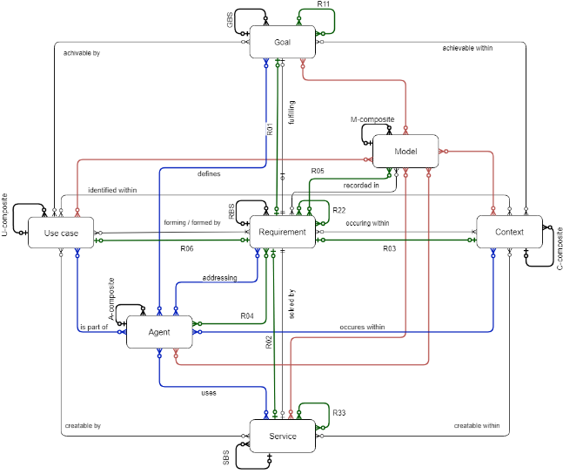
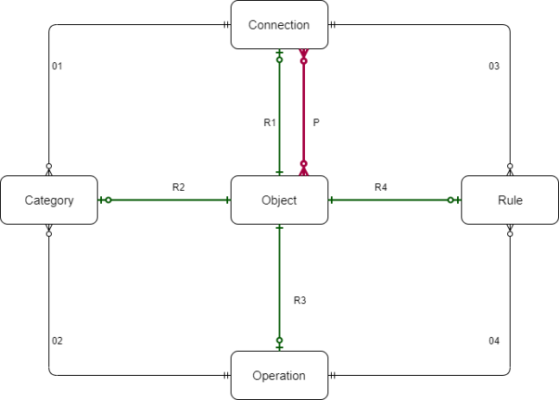
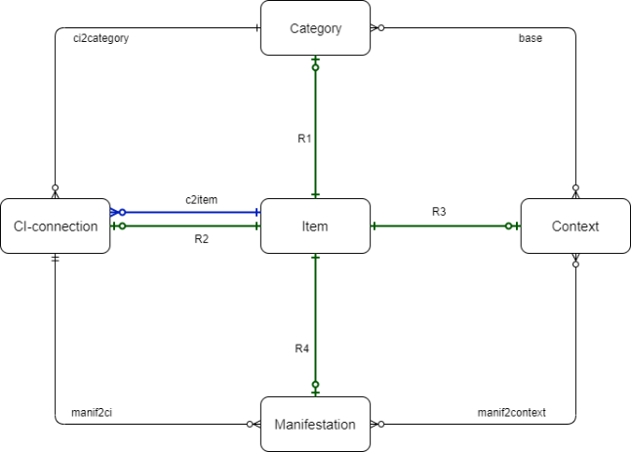
Model of 4-diamonds
Diamond of Attention Focusing
Diamond of Cognitive Elements
Diamond of Agent- Team Organization
Diamond of Predictive Behaviour
See
Recognize
Organize
Do
Stanicek, Z: SSME Manuscript, http://is.muni.cz/el/1433/jaro2013/PV202/um/SSMEstar_manuscript.pdf (2009)
WALLETZKY, L., L. CARRUBBO a M. GE, 2019. Exploring complex service design: Understanding the Diamonds of Context. In: Naples Forum on Service. 2019 Salerno.
WALLETZKÝ, L., L. CARUBBO a M. GE, 2019. Modelling Service Design and Complexity for Multi-contextual Applications in Smart Cities. In: 23rd International Conference on System Theory, Control and Computing. Bucharest: ICSTCC, s. 101-106.

Slide 33
Smart Service Canvas
Actors
Resources
Institutional arrangement
Co-creation
Goals
What goal is fulfilled by a service?
Are there any sub-goals that need to be taken into the account? Are they part of the main goal GBS ?
Who is the establisher of the goal? Who is the follower?
Requirements
What requirements are important for service design?
What goals are they born from?
Are all requirements in the same context?
Agents
What groups of stakeholders are involved into service?
Are there any special groups of agents that must be mentioned?
What is their role in the GBS/ Actions/ Flows?
Value co-creation
How the value is co-created?
How does each agent contribute on the value co-creation?
How the service is linked to other services?
What is its role in the value co-creation chain?
Contexts
In what contexts is the service able to provide a value? Which context is the main one?
Are there any contexts influenced by the service? How?
Is the service sustainable in all contexts?
Endowment
What resources are necessary to create and maintain the service?
What are the necessary inputs from other services?
Use-cases
Are there any practical applications of the similar service?
How they are designed?
What aspects can we use?
Value proposition
How is the value proposition formulated?
Who are addressing and addressed agents?
How is their response evaluated?
Actions
What necessary actions must be done to create/ maintain/ cooperate on the service?
Are there any actions that take part in other context? And how?
Flows
What flows are affected/newly defined by the service?
In what contexts do they appear and how?
Activities
What activities do the actions and flow contain?
What roles do they play in other contexts?
Measures (KPI)
What are defined indicators to monitor quality and the level of value provided?
How is the innovation level monitored?
Are the effects of the service monitored in all contexts?

Slide 34
Case Study
The application of immuni (ITALY)
First, the value of current application is analyzed
Second, the design of „an ideal application“ is suggested with the examples of the value

Slide 35


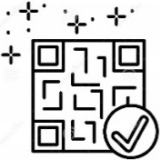

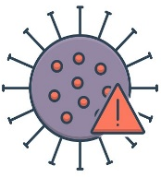






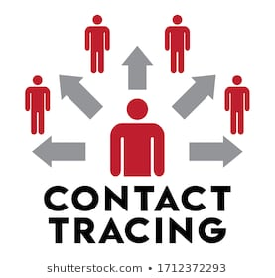


Application Immuni
Public App store
(for free)
1. Few downloads can tackle the final aim
WHERE IS VALUE?
2. Not using the App (even if installed) reduces the solution’s validity
3. Not ‘engaged’ people doesn’t help enough
Local Area Alert (not in Italy)
3
QR check-in (not in Italy)
1
Risky contacts
(tested positive person)
Warning with notifications
2
Data privacy guaranted
Population reached (activated)
Automatic tracking (contact tracing)
Call for competent local support
Anonymous
users
16.1
27%
Infection trends monitoring
(in Millions)
(on the total)

Slide 36
Goals
Requirements
Agents
Value co-creation
To monitor a spread of covid-19.
To prevent covid-19 infection.
To help people to get oriented.
To protect non-infected people​
To enable normal life
To inform about the contacts ​
To provide information about current situation ​
Inhabitants
Medical institutions
Sanitary stations
PARTIALLY-CHECKED
PARTIALLY-CHECKED
CHECKED
MISSED
Contexts
Endowment
Use-cases
Value proposition
Medical – the key is to prevent the congestion of hospitals
Social – people need to understand why the must be isolated
Information about test results
  Are All Covid -19 applications
To be informed about the possible infection
To know what to do
PARTIALLY-CHECKED
PARTIALLY-CHECKED
PARTIALLY-CHECKED
CHECKED
Actions
Flows
Activities
Measures (MPI)
Send warning – this actions happens if the user is infected. The users who were in contact with him/her will be warned. ​
To monitor surrounding ​
To receive positive test information ​
Detect all close devices ​
Send information to sanitary station ​
Receive information about positive contacts​
No of installations ​
No. of informed users ​
PARTIALLY-CHECKED
PARTIALLY-CHECKED
PARTIALLY-CHECKED
PARTIALLY-CHECKED

Slide 37
Goals
Requirements
Agents
Value co-creation
To monitor a spread of covid-19.
To prevent covid-19 infection.
To help people to get oriented.
To protect non-infected people​
To enable normal life
To inform about the contacts ​
To provide information about current situation ​
Inhabitants
Medical institutions
Sanitary stations
The interaction based on information sharing (the confirmation about healthy status)​
The control on the vaccination and testing
To link to register of tests and vaccination​
Business entities – will use the app to confirm the person health status
PARTIALLY-CHECKED
PARTIALLY-CHECKED
MISSED
CHECKED
CHECKED
CHECKED
CHECKED
Contexts
Endowment
Use-cases
Value proposition
Medical – the key is to prevent the congestion of hospitals
Social – people need to understand why the must be isolated
Information about test results
  Are All Covid -19 applications
To be informed about the possible infection
To know what to do
Information about the vaccinations
Control of private data
To get proper date and place for tests and vaccination​
Economic – to enable economy to run
PARTIALLY-CHECKED
PARTIALLY-CHECKED
PARTIALLY-CHECKED
CHECKED
CHECKED
CHECKED
CHECKED
Actions
Flows
Activities
Measures (MPI)
Send warning – this actions happens if the user is infected. The users who were in contact with him/her will be warned. ​
To monitor surrounding ​
To receive positive test information ​
Detect all close devices ​
Send information to sanitary station ​
Receive information about positive contacts​
No of installations ​
No. of informed users ​
To monitor the validity of test and vaccination
No. of tests linked with app​
No of vaccinations linked with app​
No. of questions​
Get the status – get the current health status from register​
Connect to register – connect to the register of test and vaccination​
Get the information about new test or vaccination
PARTIALLY-CHECKED
PARTIALLY-CHECKED
PARTIALLY-CHECKED
PARTIALLY-CHECKED
CHECKED
CHECKED
CHECKED
CHECKED

Slide 38
Conclusion
Business model vs Business plan
Business model Canvas
Business model Lean Canvas
Smart Service Canvas

