Slide 1
Smart Service
Leonard Walletzký
PA181 Services - Systems, Modelling and Execution

Slide 2
Smart Service and Smart City
"A Smart City is a city well performing built on the ‘smart’ combination of endowments and activities of self-decisive, independent and aware citizens.” Giffinger et al. 2007
“Smart city is defined by IBM as the use of information and communication technology to sense, analyze and integrate the key information of core systems in running cities.” IBM
“Smart City is the product of Digital City combined with the Internet of Things.” Su et al. 2011
“Concept of a Smart City where citizens, objects, utilities, etc., connect in a seamless manner using ubiquitous technologies, so as to significantly enhance the living experience in 21st century urban environments.” Northstream
...

Slide 3
Smart Service
Personalization
User-centered
Ubiquitous services
Dynamic UX
Prediction
Machine Learning
Data mining, Big Data
AI
Based on
Open data
Other available data sources
Multicontextual view

Slide 4
How can the data help in multicontextual view?
Can data be Smart? Or Wise?
We have a plenty of data in the cities, but are we using them properly?
What is the role of multidisciplinarity in the data management?
How do we know we are using right data in the right time?

Slide 5
First we need to explore data management of the cities
The cities are not taking care of their data
They do not know what to collect, where to collect and how to collect
What are key aspects of data management?

Slide 6
Main insights
shift focus from the objective and quantitative management of data to the subjective and qualitative understanding of problems
process through which decision makers find solutions to new problems
more information are useful to solve new problems, only in the case in which the decision maker has the capability to correctly manage and interpret them
Without this, incoming units of information do not help to solve the problem and increase the variety generating entropy and chaos.
Carayannis, Elias & Giudice, Manlio & Saviano, Marialuisa & Caputo, Francesco. (2018). Beyond Big Data: From smart to wise knowledge management.

Slide 7
4C model
decision in condition of chaos/complexity is made on the basis of what the decision maker ‘feels’ to do: essentially, he/she decides guided by his/her emotions and strong beliefs not by the information collected and processed as in problem solving contexts.

Slide 8
What can we learn?
The interpretation for data usage
There is a difference to use a data to make a decision (problem solving)
Only if we have relevant information schemas
Or make a decision and find the data that support it (decision making)
Decision maker is using the emotions to find solution, after that we can find data to support or verify its effectiveness

Slide 9
Interpretation schemas
• Information units represent the ‘structural’ composition of knowledge in terms of the total amount of data held by the system.
• Interpretation schemes represent the system’s organization of information variety.
• Categorical values represent the system’s values and strong beliefs that affect the personality and identity of the system over the time.

Slide 10
taxonomy of knowledge management approaches

Slide 11
Conclusions
Data collected as for example Open Data are basic, essential part for the city development
Without skills of decision makers to interpret them to solve the problem or use them to support their decisions the data are purposeless
However, to understand the data complexity and their usage, we must increase the data collected and the entropy
Only by this pressure (4C) it is possible to increase the probability of the finding the right solution

Slide 12

Examples of data portals
Brno - https://data.brno.cz/en/
Prague – http://opendata.praha.eu/
European Data portal - https://www.europeandataportal.eu/en
Rome - https://dati.comune.roma.it/
Naples - http://www.comune.napoli.it/opendata

Slide 13
Important project info
The project consists of two parts: demo and report
If the project is done by a group of students, in your project report, please write down who did what.
The demo should be developed and deployed on IBM Bluemix platform (IBM Cloud)
The demo should be functioning, and we can try the demo.

Slide 14
Structure of the project report
You don‘t need 100% follow this structure, feel free to add something that suit your project
Project title
Scenario
Modelling – model the Scenario
Service used from IBM Cloud
Application with Link and snapshots, and also despription of your application
Report Summary and who did what!
business model (Canvas or Lean Canvas)
Smart Service Canvas (mentioning all important contexts)
the problem you would like to solve
introduction for each service
What data / datasets you need for solution

Slide 15
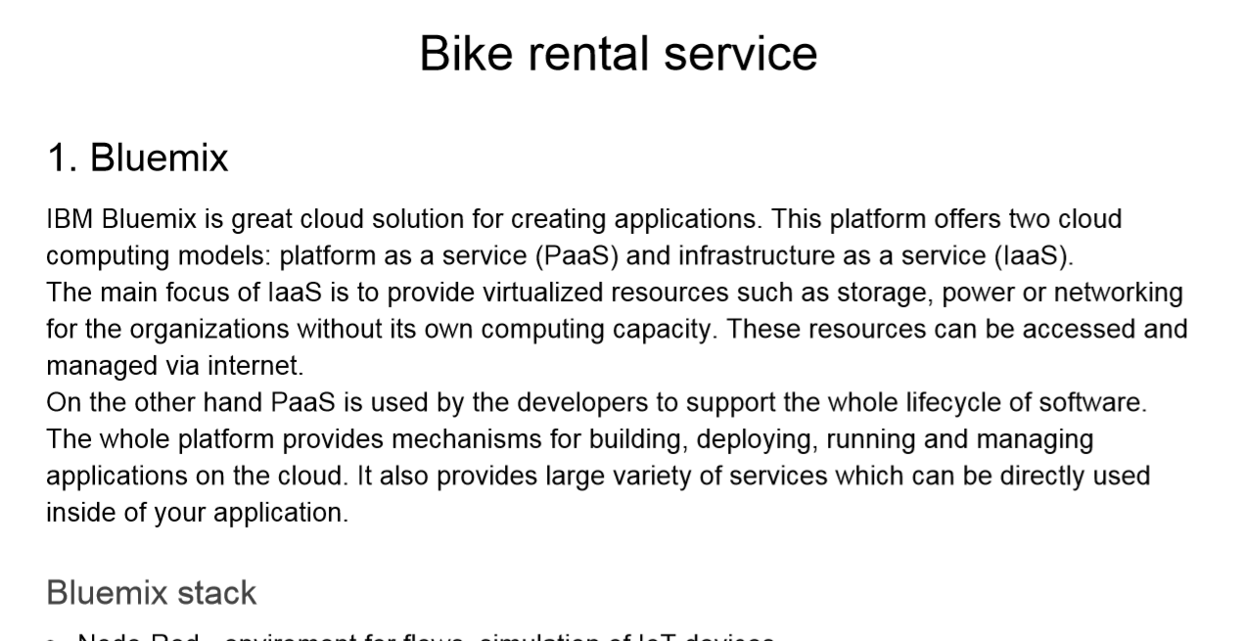
Example project 1
Example

Slide 16
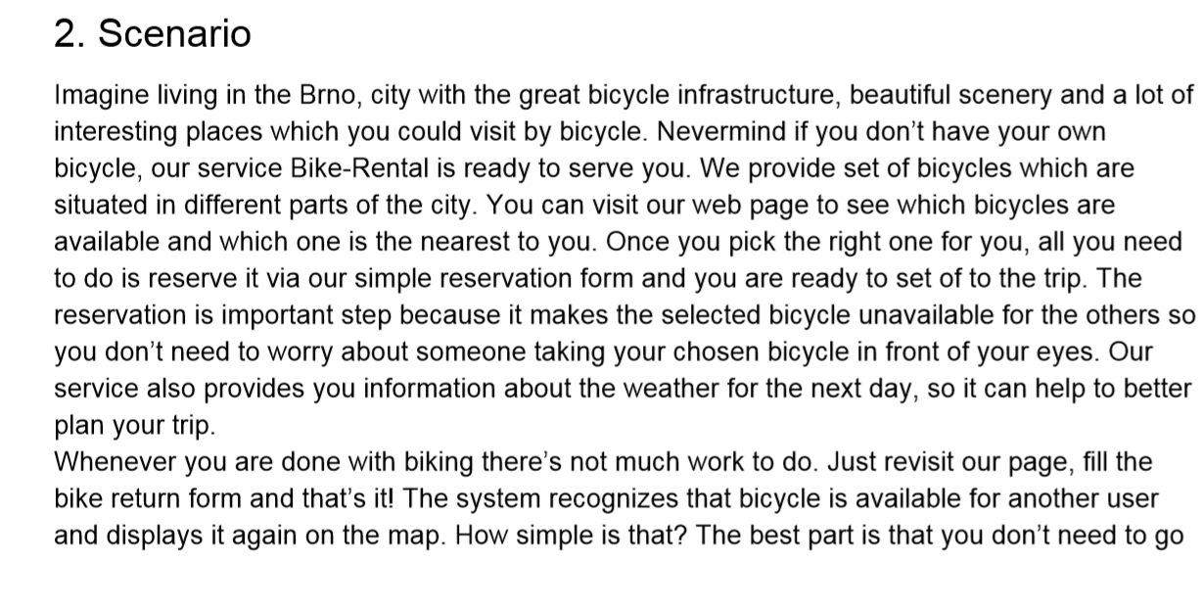
Example

Slide 17
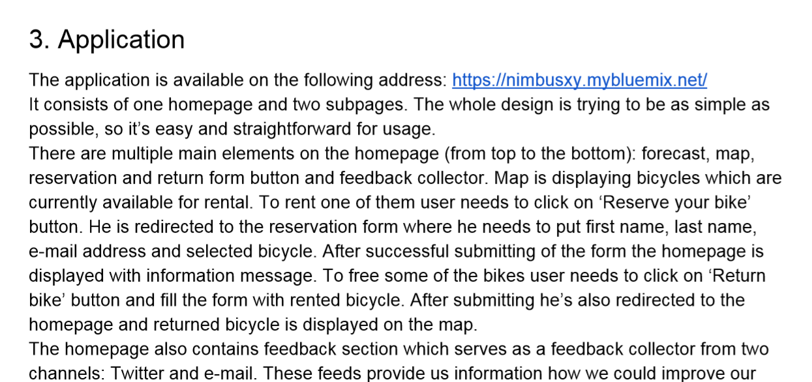
Example

Slide 18
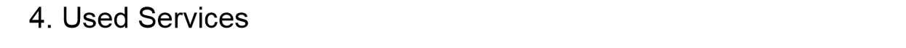
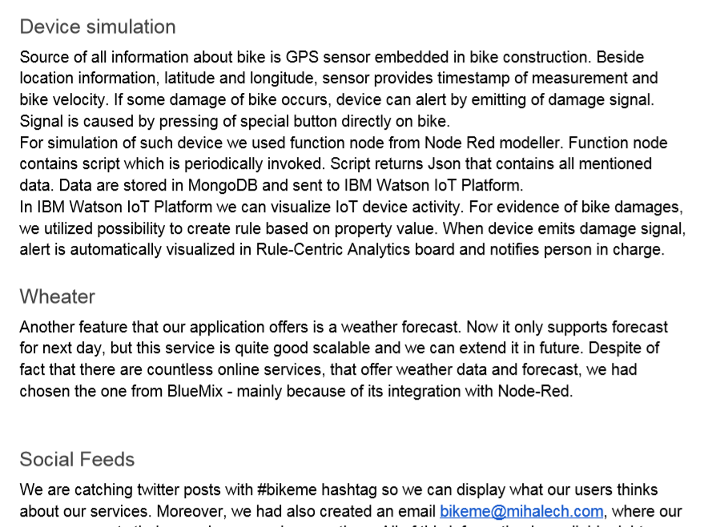
Example

Slide 19
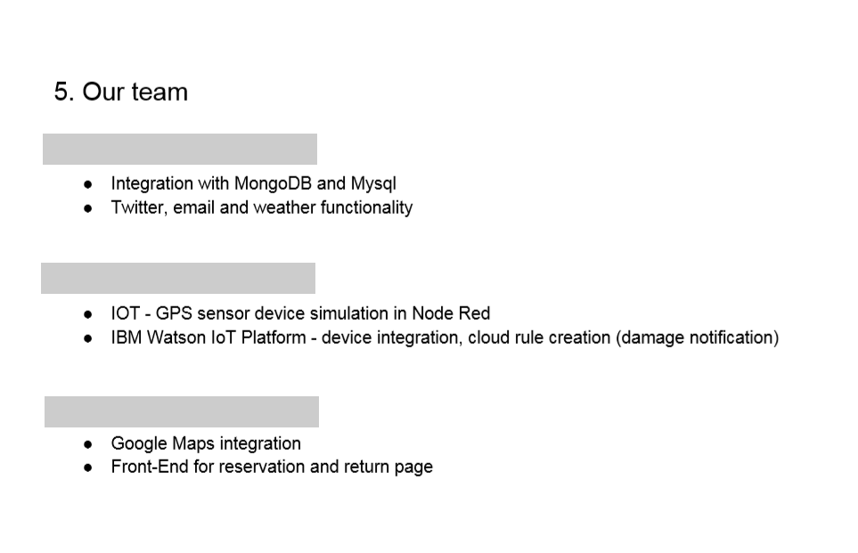
Example

Slide 20
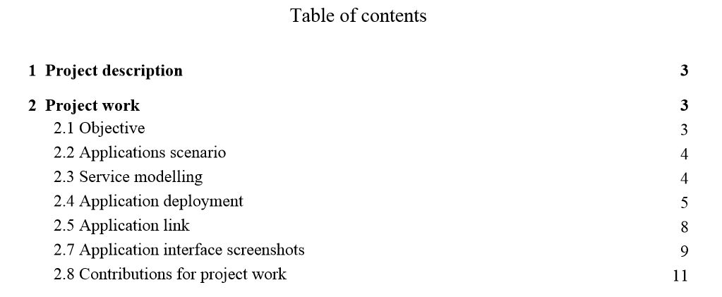
Example project 2
Example

Slide 21
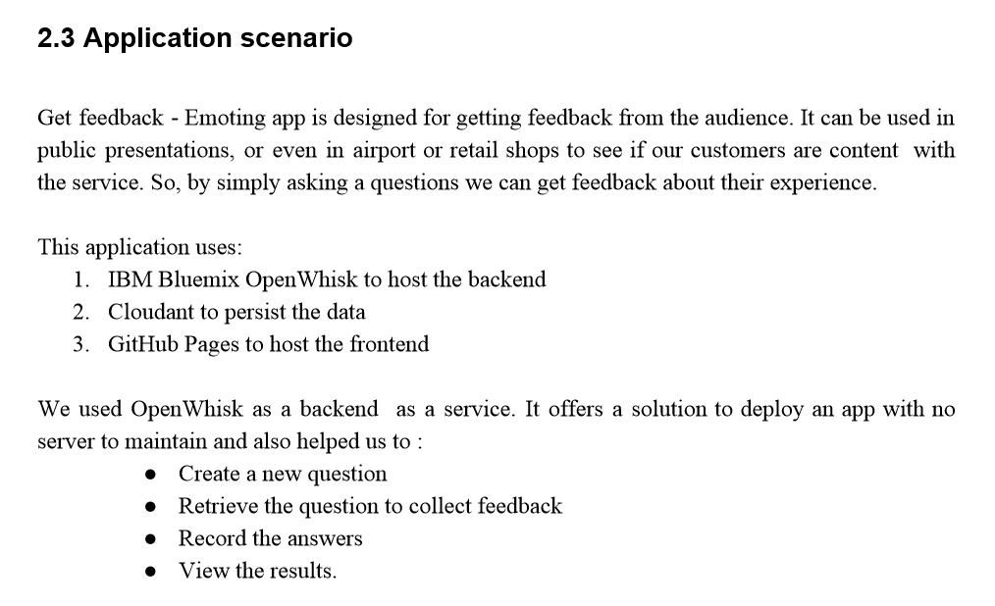
Example

Slide 22
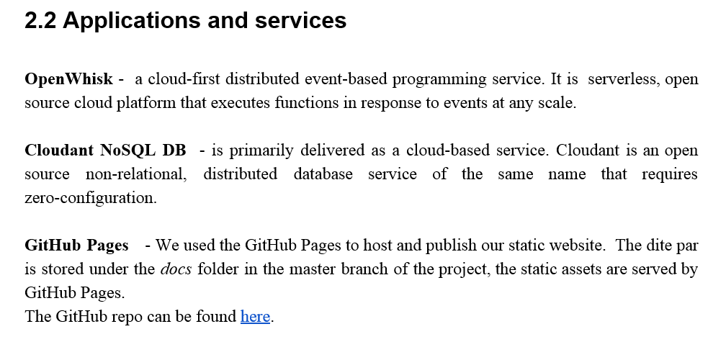
Example

Slide 23
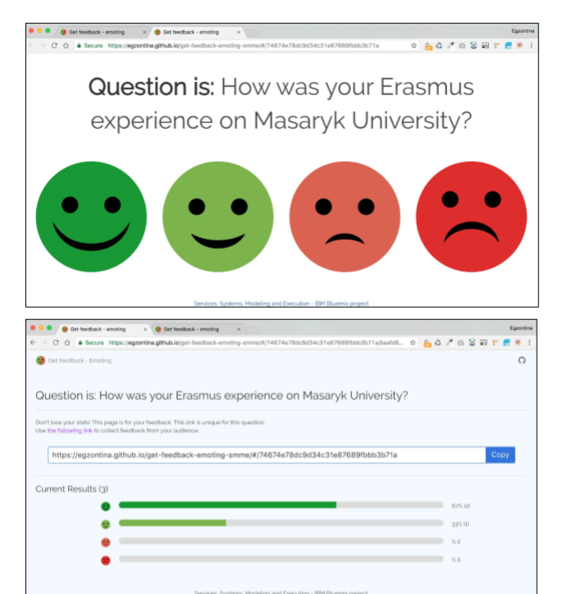
Snapshots
Example
You could also include application Snapshots to the report

Slide 24
IBM Presentations
The dates will be announced this week:
One date for earlier closing (state exam) – please, notify me if you belong to this group – end of May / beginning of June
The second date for others – second half of June

