Slide 1
Building
Pyramid of Culture

Slide 2
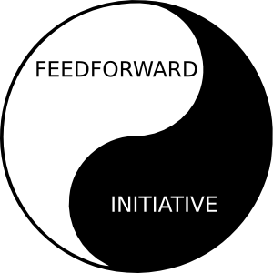


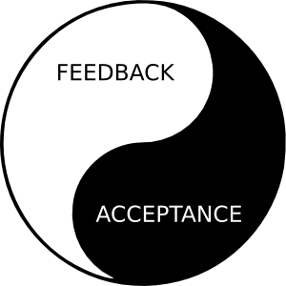
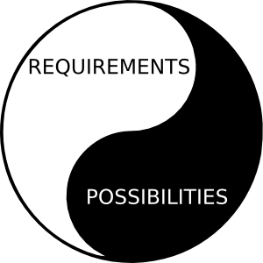
Strategy: Theory of vitality
crisis
Stability
Effectivity
Usefulness
Dynamics
Integration
Synergetization
Habilitation
Motivation
Orientation
Definition
eqi.
activity
stability
acceptation
structures
resources
processes
tasks
products
needs
subjects
(C) J. Plamínek

Slide 3
