Slide 1
Similarity Search for Multimedia Data
Pavel Zezula
DISA FI Masaryk University
Brno, Czech Republic

Slide 2
Outline of the talk
Similarity in our lives
Principles of metric similarity search technology
  effectiveness – metric similarity features
  efficiency – indexing structure
Examples of multimedia applications:
  Image search and annotation
  Processing streams of similarity queries
  Searching in motion capture data
  Accessing protein databases
Future research directions

Slide 3
Similarity in the Real-Life quotations from the social psychology literature
Any event in the history of organism is, in a sense, unique.
Recognition, learning, and judgment presuppose an ability to categorize stimuli and classify situations by similarity.
Similarity (proximity, resemblance, communality, representativeness, psychological distance, ...) is fundamental to theories of perception, learning, judgment, etc.
Similarity is subjective and context-dependent

Slide 4
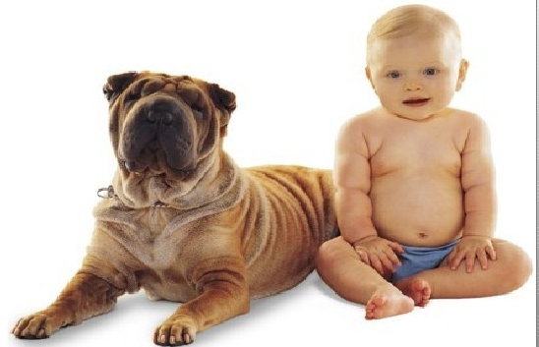
Real-life Similarity
Are they similar?

Slide 5
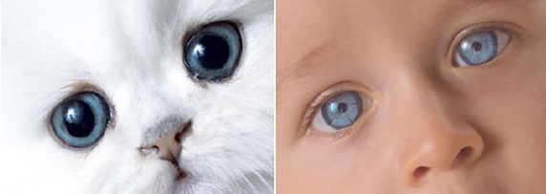
Real-life Similarity
Are they similar?

Slide 6
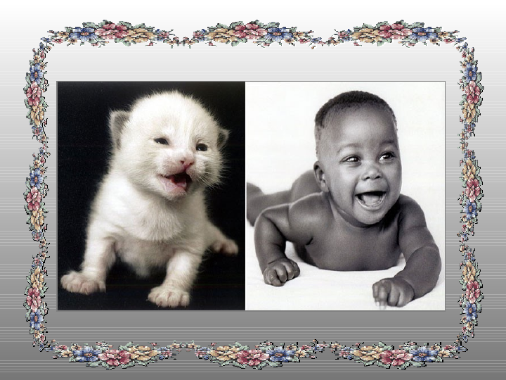
Real-life Similarity
Are they similar?

Slide 7
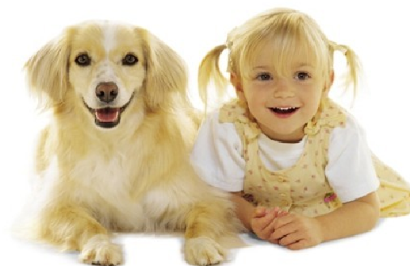
Real-life Similarity
Are they similar?

Slide 8
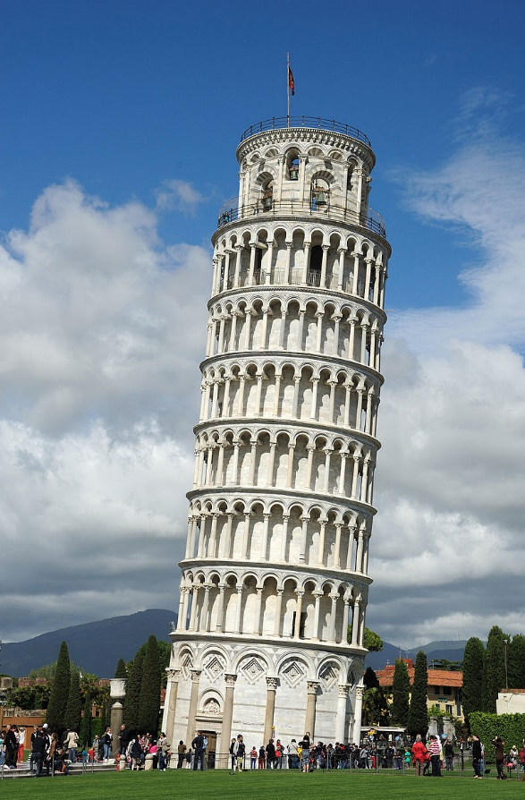
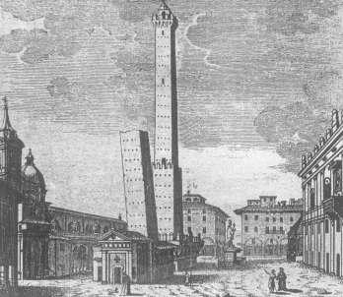
Prototypicality or Centrality not symmetric

Slide 9
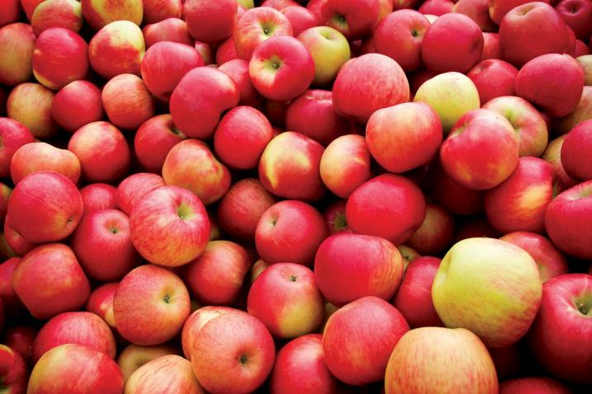
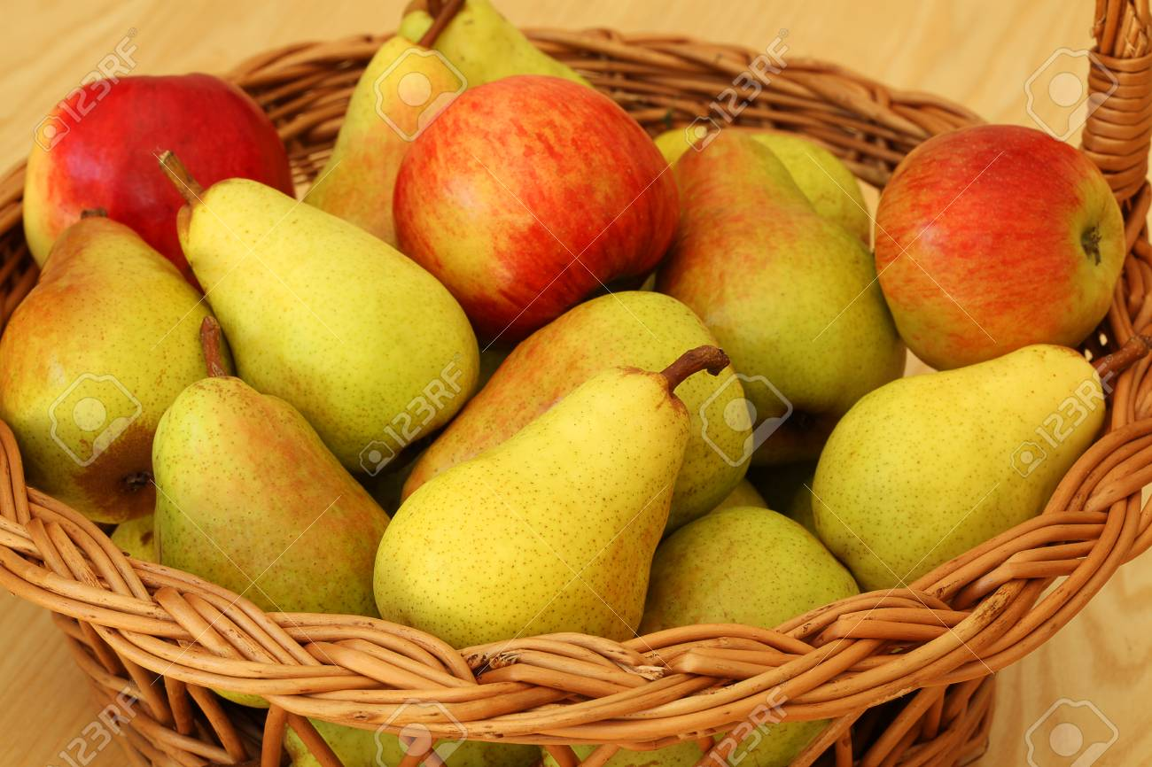
Context/Data/Environment Dependent circumstances alter similarities

Slide 10
We learned from School
GEOMETRY:
Two polygons are similar to each other, if:
  Their corresponding angles are congruent
    ∠A = ∠E; ∠B = ∠F; ∠C = ∠G; ∠D = ∠H, and
  The lengths of their corresponding sides are proportional
    AB/EF = BC/FG = CD/GH = DA/HE
D
C
H
G
A
B
E
F

Slide 11
Similarity & Geometry
If one polygon is similar to a second polygon, and the second polygon is similar to the third polygon, the first polygon is also similar to the third polygon.
In any case:
Two geometric figures are either similar or they are not similar at all

Slide 12
Contemporary Networked Media
The digital data view
Almost everything that we see, read, hear, write, measure, or observe can be digital.
Users autonomously contribute to production of global media and the growth is exponential.
Sites like Flickr, YouTube, Facebook host user contributed content for a variety of events.
The elements of networked media are related by numerous multi-facet links of similarity.
Majority of current data is unstructured
possibly only structured on display

Slide 13
Challenge
Networked media database is getting close to the human “fact-bases”
  the gap between physical and digital world has blurred
Similarity data management is needed to connect, search, filter, merge, relate, rank, cluster, classify, identify, or categorize objects across various collections.
WHY?
It is the similarity which is in the world revealing.

Slide 14
Iterative and Interactive
Nature of Contemporary Searching
When we search, our next actions are reactions to the stimuli of previous search results
What we find is changing what we seek
In any case, search must be:
fast, simple, and relevant

Slide 15
Metric Space:
A Geometric Model of Similarity
Metric space: M = (D,d)
  D – domain
  distance function d(x,y)
    ∀x,y,z ∈ D
    d(x,y) > 0 - non-negativity
    d(x,y) = 0 ⇔ x = y - identity
    d(x,y) = d(y,x) - symmetry
    d(x,y) ≤ d(x,z) + d(z,y) - triangle inequality

Slide 16
Examples of Distance Functions
L_{p} Minkovski distance (for vectors)
    L₁ – city-block distance
    L₂ – Euclidean distance
    L∞ – infinity
Edit distance (for strings)
    minimal number of insertions, deletions and substitutions
    d(‘application’, ‘applet’) = 6
Jaccard’s coefficient (for sets A,B)

Slide 17

Examples of Distance Functions
Mahalanobis distance
  for vectors with correlated dimensions
Hausdorff distance
  for sets with elements related by another distance
Earth movers distance
  primarily for histograms (sets of weighted features)
and many others

Slide 18
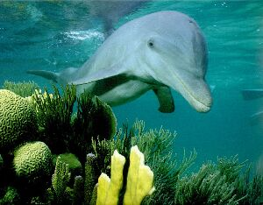
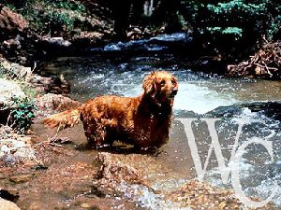
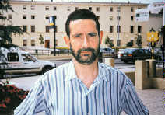
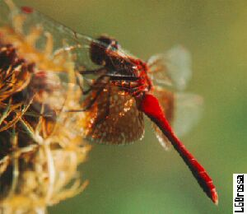
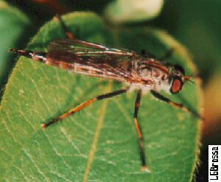
Content-Based Search
Content-based search in images
Image base
similar?

Slide 19
Extracting Features
Extracting features
Image level
B
Feature level
R
G

Slide 20
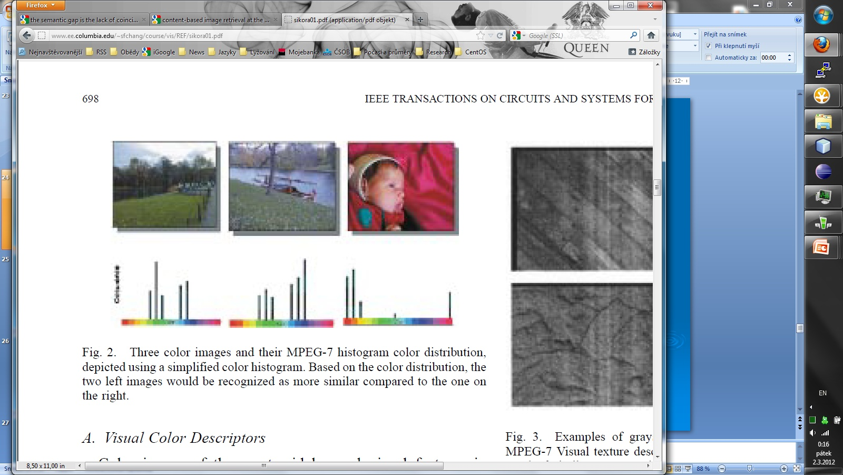
MPEG-7
Multimedia Content Descriptors Standard ~ 2000
Global feature descriptors:
  Color, shape, texture, …
  One high-dimensional vector per image and feature
  Minkovski distance used

Slide 21
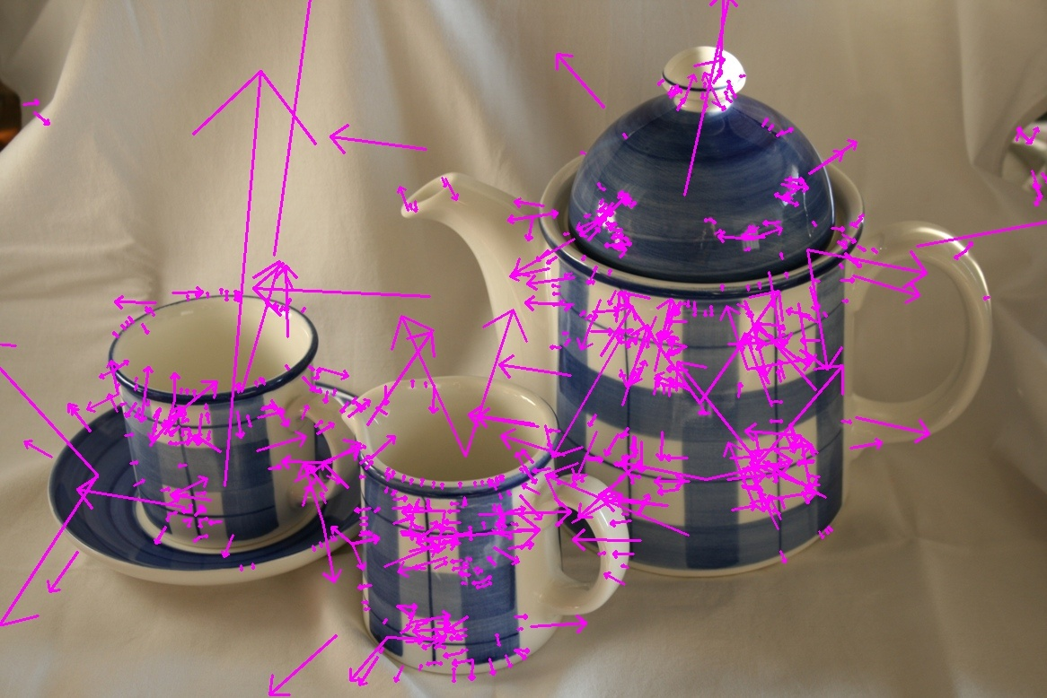
Visual Similarity
Local feature descriptors – SIFT, SURF, etc.
Invariant to image scaling, small viewpoint change, rotation, noise, illumination

Slide 22
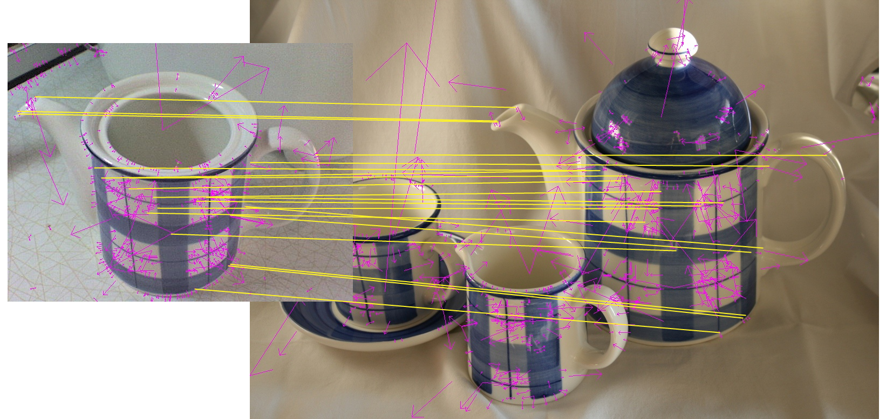
Visual Similarity - finding coresspondence

Slide 23
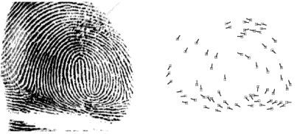
Biometrics: Fingerprint
Minutiae detection:
  Detect ridges (endings and branching)
  Represented as a sequence of minutiae
    P=( (r₁,e₁,θ₁), …, (r_{m},e_{m},θ_{m}) )
    Point in polar coordinates (r,e) and direction θ
Matching of two sequences:
  Align input sequence with database one
  Compute weighted edit distance
    w_{ins,del}=620
    w_{repl}=[0;26] - depending on similarity of two minutiae
Notes:
Points in the sequence are ordered in an increasing order of radial angle (e).

Slide 24
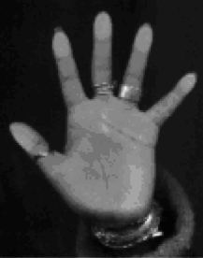
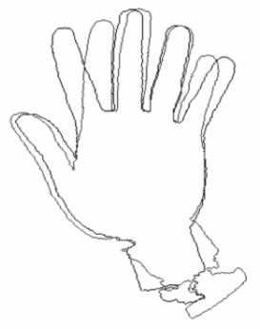
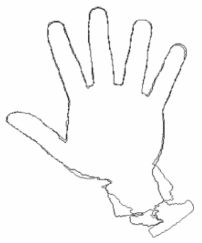
Biometrics: Hand Recognition
Hand image analysis
  Contour extraction, global registration
    Rotation, translation, normalization
  Finger registration
  Contour represented as a set of pixels
  F={f₁,…,f_{NF}}
Matching: modified Hausdorff distance
Notes:
|| f-g || = Euclidean distance between pixel positions of f and g

Slide 25
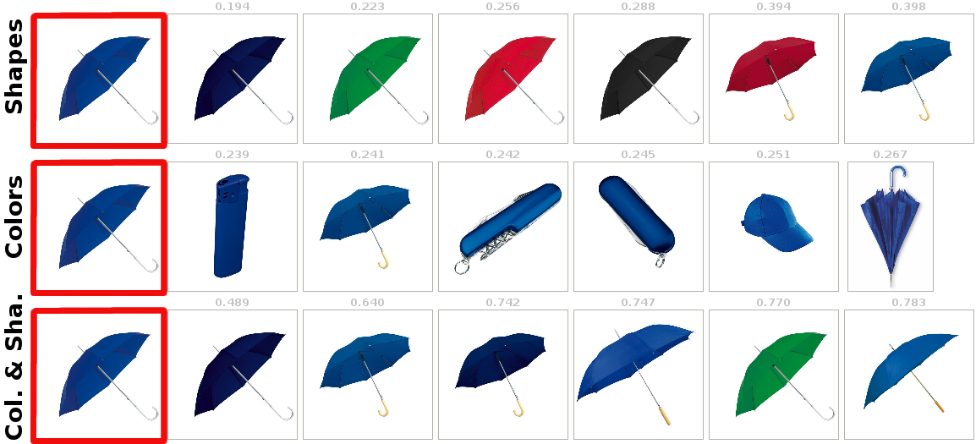
Multiple Visual Aspects

Slide 26
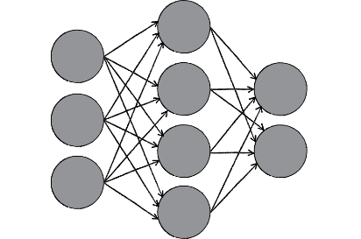
Contemporary Approaches to
Feature Extraction
Neural networks technology
  Convolutional Neural Networks (CNN)
  Recurrent Neural Networks (RNN)
Training data
Training (Fine-tuning)
Neural network model
Classified
dataset
Data split
Validation data
Validation

Slide 27
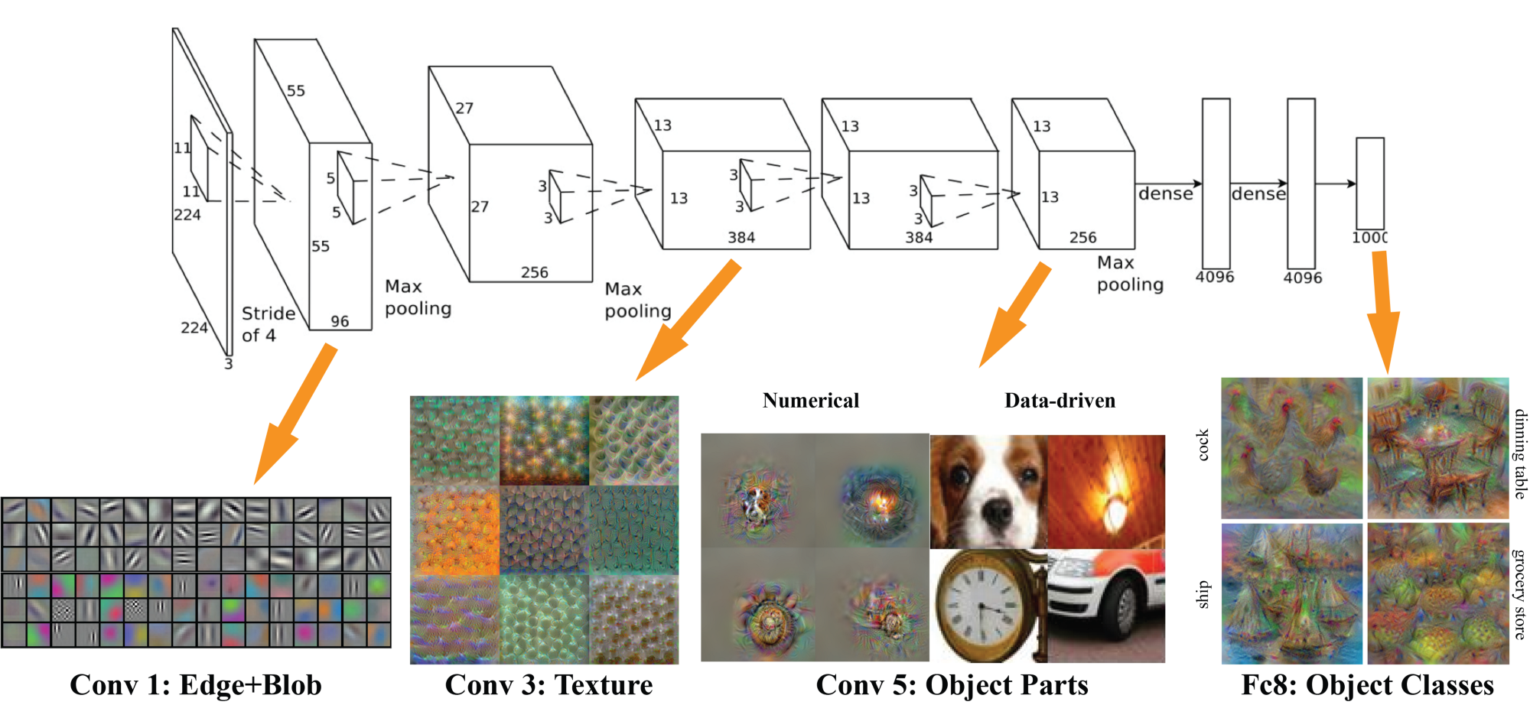
Convolutional Neural Networks
Convolutional Neural Network (CNN) – AlexNet
The last layer with 1,000 output categories
Output of any layer can be used as a feature
Notes:
It contains 5 convolutional layers and 3 fully connected layers. Relu is applied after very convolutional and fully connected layer. Dropout is applied before the first and the second fully connected year.
Convolutional layer is a feature detector that automatically learns to filter out not needed information from an input by using convolutional kernel.
Pooling layers compute the max or average value of a particular feature over a region of the input data (downsizing of input images) and also help to detect objects in some unusual places and reduce memory size.
The network has 62.3 million parameters (and 650,000 neurons), and needs 1.1 billion computation units in a forward pass. We can also see convolution layers, which accounts for 6% of all the parameters, consumes 95% of the computation. It takes five to six days to train on two GTX 580 3GB GPUs.
The network uses Relu instead of Tanh to add non-linearity. It accelerates the speed by 6 times at the same accuracy.

Slide 28
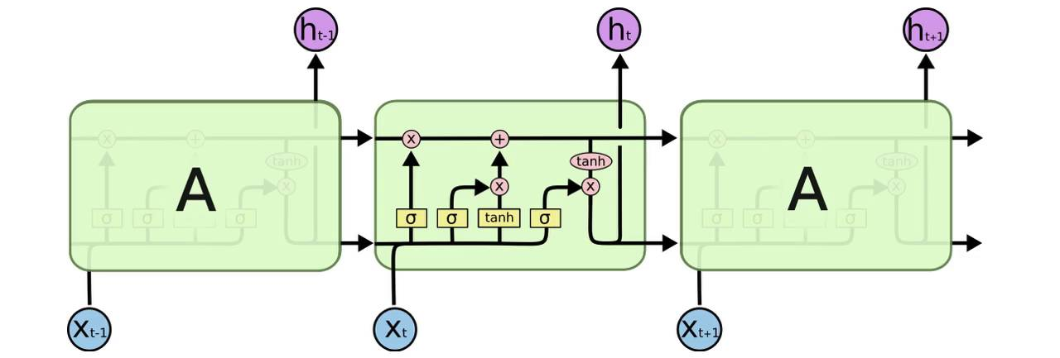
Recurrent Neural Networks
Recurrent neural networks (RNN)
Long-Short Term Memory (LSTM) networks:
  Learn when data should be remembered and when they should be thrown away
  Well-suited to learn from experience to classify, process and predict time series when there are very long time lags of unknown size between important events
Notes:
Provide operations for reading, writing and resetting

Slide 29
Deep Learning Summary
It is no magic! Just statistics in a black box, but exceptional effective at learning patterns, provided powerful computational infrastructure can be applied - GPU cards
Can be used not only for classification but is also able to provide content preserving feature vectors.
When calibrated by an Lp distance good quality similarity estimates can be obtained.
Notes:
Machines that learn to represent the world from experience

Slide 30
Similarity Search Problem
For X ⊆D in metric space M,
pre-process X so that the similarity queries
are executed efficiently.
Implementation problems:
  How to partition the data to reduce search space
  How to ask questions - definition of queries
  - How to execute queries – to achieve performance
The challenge:
  In metric space, no total ordering exists!

Slide 31
Basic Partitioning Principles
Given a set X ⊆ D in M=(D,d), basic partitioning principles have been defined:
  Ball partitioning
  Generalized hyper-plane partitioning
Note:
  Some special cases, such as Euclidian or Supermetric spaces are more tractable

Slide 32
Ball Partitioning
Inner set: { x ∈ X | d(p,x) ≤ d_{m} }
Outer set: { x ∈ X | d(p,x) > d_{m} }
d_{m}
p

Slide 33
Generalized Hyper-plane
{ x ∈ X | d(p₁,x) ≤ d(p₂,x) }
{ x ∈ X | d(p₁,x) > d(p₂,x) }
p₂
p₁

Slide 34
Similarity Range Query
range query
  R(q,r) = { x ∈ X | d(q,x) ≤ r }
… all museums up to 2km from my hotel …
r
q

Slide 35
Nearest Neighbor Query
the nearest neighbor query
  NN(q) = x
  x ∈ X, ∀y ∈ X, d(q,x) ≤ d(q,y)
k-nearest neighbor query
  k-NN(q,k) = A
  A ⊆ X, |A| = k
  ∀x ∈ A, y ∈ X – A, d(q,x) ≤ d(q,y)
… five closest museums to my hotel …
k=5
q

Slide 36
Reverse Nearest Neighbor
… all hotels with a specific museum as a nearest cultural heritage cite …

Slide 37
Example of 2-RNN
Objects o₄, o₅, and o₆ have q between their two nearest neighbor.
o₄
o₁
o₂
q
o₃
o₅
o₆

Slide 38
Similarity Joins
similarity join of two data sets
similarity self join ⬄ X = Y
…pairs of hotels and museums
which are five minutes walk apart …
μ

Slide 39
Pivot Filtering
Idea:
Given R(q,r) use triangle inequality for pruning
All distances between objects and a pivot p are known
Prune object o ∈ X if any holds
  d(p,o) < d(p,q) – r
  d(p,o) > d(p,q) + r
r
p
q
Notes:
Generalized concept of the object-pivot constraint.

Slide 40
Pivot Filtering (cont.)
Filtering with two pivots
  Only Objects in the dark blue
  region have to be checked.
  Effectiveness is improved
  using more pivots.
o₂
r
p₁
q
o₃
p₂
o₁

Slide 41
Pivot Filtering (summary)
Given a metric space M=(D,d) and a set of pivots
P = { p₁, p₂, p₃,…, p_{n} }. We define a mapping function Ψ: (D,d) → (R^{n},L∞) as follows:
Ψ(o) = (d(o,p₁), …, d(o,p_{n}))
Then, we can bound the distance d(q,o) from below:
L∞(Ψ(o), Ψ(q)) ≤ d(q,o)

Slide 42
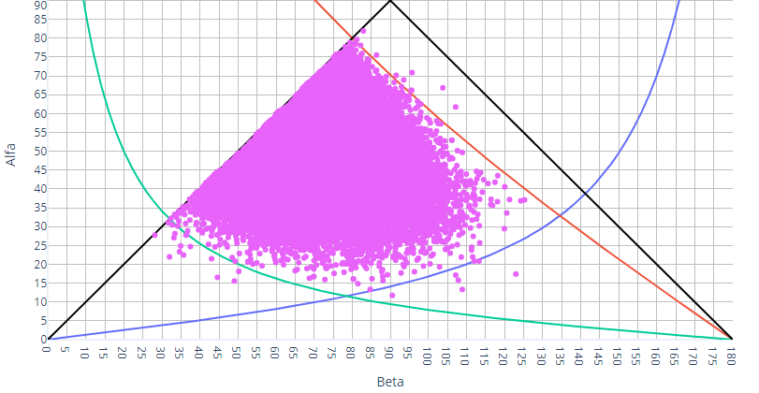
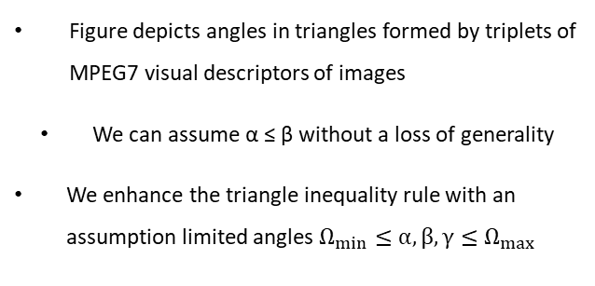
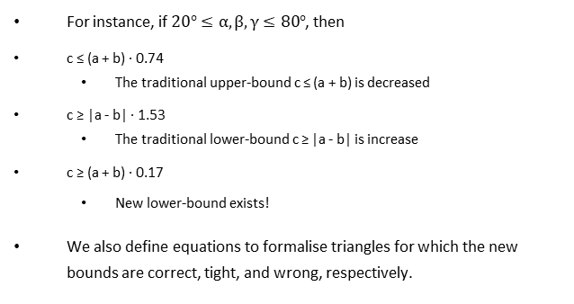
Angles formed by triplets of descriptors
Any 3 metric objects can be isometrically embedded into 2D Euclidean space to form the triangle
Angles within triangles are defined (by the Cosine rule)
Angles formed by real-life descriptors are from limited range
Figure depicts angles in triangles formed by triplets of MPEG7 visual descriptors of images
We can assume α ≤ β without a loss of generality
We enhance the triangle inequality rule with an assumption limited angles $Ω_{min}≤α, β, γ≤Ω_{max}$
For instance, if $20°≤α, β, γ≤80°$, then
c ≤ (a + b) ∙ 0.74
  The traditional upper-bound c ≤ (a + b) is decreased
c ≥ |a - b| ∙ 1.53
  The traditional lower-bound c ≥ |a - b| is increase
c ≥ (a + b) ∙ 0.17
  New lower-bound exists!
We also define equations to formalise triangles for which the new bounds are correct, tight, and wrong, respectively.

Slide 43
The M-tree [Ciaccia, Patella, Zezula, VLDB 1997]
1) Paged organization
2) Dynamic
3) Suitable for arbitrary metric spaces
4) I/O and CPU optimization
  - computing d can be time-consuming

Slide 44
The M-tree Idea
Metric: L₂ (Euclidean)
C
A B
A
E
B
C D E F
F
D
Depending on the metric, the “shape” of index regions changes
L₁ (city-block)
L∞ (max-metric)
weighted-Euclidean
quadratic form

Slide 45
M-tree: Example
o₅
o₁₀
o₁₁
o₂
o₃
o₇
o₈
o₁
Covering radius
o₆
o₄
o₉
Distance to parent
Distance to parent
Distance to parent
o₁
4.5
-.-
o₂
6.9
-.-
o₁
1.4
0.0
o₁₀
1.2
3.3
o₇
1.3
3.8
o₂
2.9
0.0
o₄
1.6
5.3
o₁
0.0
o₆
1.4
o₁₀
0.0
o₃
1.2
o₂
0.0
o₈
2.9
Distance to parent
o₇
0.0
o₅
1.3
o₁₁
1.0
o₄
0.0
o₉
1.6
Leaf entries

Slide 46
M-tree: Range Search
Given R(q,r):
Traverse the tree in a depth-first manner
In an internal node, for each entry ⟨p,r^{c},d(p,p^{p}),ptr⟩
  Prune the subtree if |d(q,p^{p}) – d(p,p^{p})| – r^{c} > r
  Application of the pivot-pivot constraint
r
p^{p}
q
p^{p}
p
r^{c}
p
r
r^{c}
q

Slide 47
M-tree: Range Search (cont.)
If not discarded, compute d(q,p) and
  Prune the subtree if d(q,p) – r^{c} > r
  Application of the range-pivot constraint
All non-pruned entries are searched recursively.
r^{c}
r
q
p

Slide 48
D-Index [Dohnal, Gennaro, Zezula, MTA 2002]
4 separable buckets at the first level
2 separable buckets at the second level
exclusion bucket of the whole structure

Slide 49
D-index: Insertion

Slide 50
D-index: Range Search
r
r
q
q
r
r
q
q
r
q
r
q

Slide 51
Pivot Permutation Approach
Assume a set n of pivots {p₁, p₂, ... p_{n}}
Given object x in X, order the pivots according to d(x, p_{i})
Let ∏_{x} be a permutation on the set of pivot indexes {1, … , n} such that ∏_{x}(j) is index of the j-th closest pivot from x
  e.g., ∏_{x}(1) is the index of the closest pivot to x
  p_{∏x(j)} is the j-th closets pivot from x
∏_{x} is denoted as Pivot Permutation (PP) with respect to x.

Slide 52
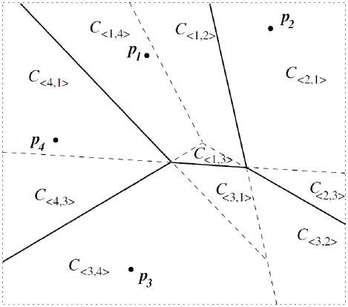
Pivot Permutation Approach
Can be seen as a recursive Voronoi partitioning to level l
Cell C_{(i1, … il)} contains objects x for which:
∏_{x}(1) = i₁, ∏_{x} (2) = i₂, … , ∏_{x} (l)=i_{l}

Slide 53
Metric Sketches for
Fast Searching and Filtering
Transformation of any metric space (D,d) to the Hamming space
  Each descriptor o is transformed into a bit-string sketch of length λ. Hamming distance evaluates the number of different bits – very efficient, hardware instruction
Sketches compared by the Hamming distance should approximate similarity relationships of the original metric
Typical sketch length is 32 – 320 bits

Slide 54
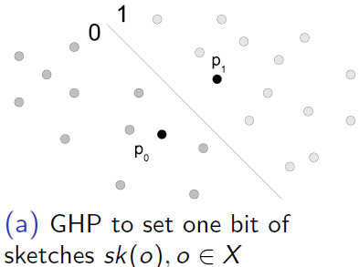
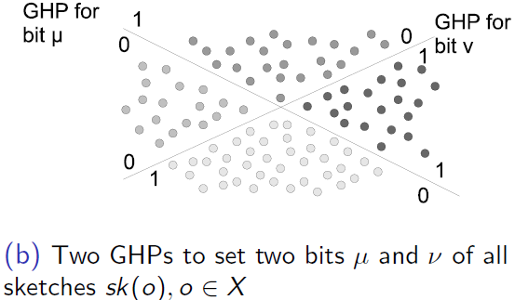
Sketching Transformation
GHP to set one bit of sk(o)
GHP to set bits μ and ν of sk(o)

Slide 55
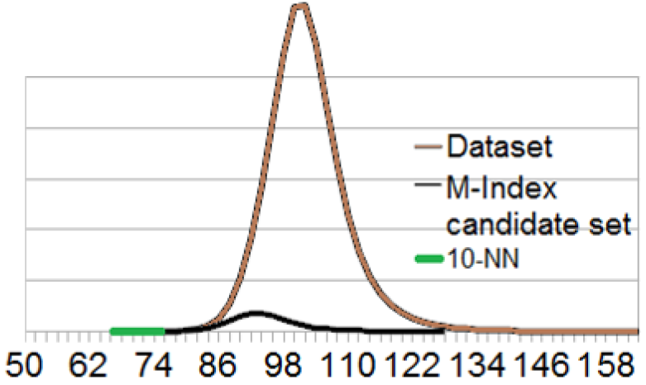
Properties and Application
Good sketches (choosing pivots):
  Balanced split
  Low correlation
Application – even better for filtering than searching

Slide 56


Textbooks on
Metric Searching technology
Hanan Samet
Foundation of Multidimensional and
Metric Data Structures
Morgan Kaufmann, 2006
P. Zezula, G. Amato, V. Dohnal, and M. Batko
Similarity Search: The Metric Space Approach
Springer, 2005
Teaching material: http://www.nmis.isti.cnr.it/amato/similarity-search-book/

Slide 57



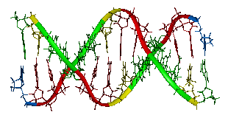
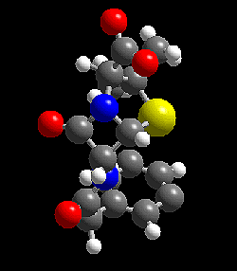

Infrastructure Independence: MESSIF
Metric Similarity Search Implementation Framework
Performance statistics
Distributed index structures
Centralized index structures
Metric space (D,d)
Operations
Storage
Communication
Net
Vectors
  L_{p} and quadratic form
Strings
  (weighted) edit and
  protein sequence
Insert, delete,
range query,
k-NN query,
Incremental k-NN
Volatile memory
Persistent memory

Slide 58
Similarity Search Demos
20M images: http://disa.fi.muni.cz/demos/profiset-decaf/
Fashion: http://disa.fi.muni.cz/twenga/
Image annotation: Image annotation: http://disa.fi.muni.cz/annotation-ui/
Fingerprints: http://disa.fi.muni.cz/fingerprints/
Time series: http://disa.fi.muni.cz/subseq/
Multi-modal person ident.: http://disa.fi.muni.cz/mmpi

Slide 59
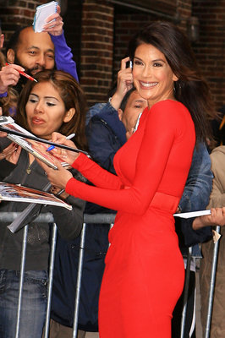




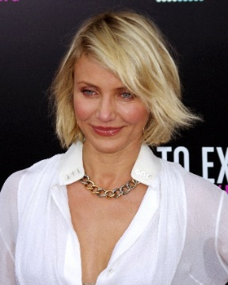






Similarity Search in Collections of Faces
<13.9, 9.5, -6.0, 712.1, …>
<17.9, 12.1, -9.1, 692.0, …>
<8.8, 7.7, -3.5, 570.8, …>
<14.4, 8.2, -8.4, 704.0, …>
<10.1, 5.8, 40.6, 99.6, …>
Merge of detected faces
<5.4, 1.2, -60.4, 88.0, …>
<45.1, 64.8, 90.6, 78.6, …>
Face detection with several technologies
Face description with several technologies
Features indexing by one technique
Fused features saving
Preprocessing
Face Detection
Features Extraction
Retrieval
Index
Fused features DB
Candidate
faces
Candidates
filtering
<13.9, 9.5, -6.0, 712.1, …>
<10.6, 78.9, -45.6, 101.3, …>
0.12
0.17
0.18
0.23
Query image

Slide 60
Fused Face Detection and Face Matching
Fused face detection:
  Faces detected by more technologies are taken into account
  Showcase: 3 technologies, compliance of at least two:
Fused face matching:
  Characteristic features from more technologies are available for each face
  Similarity of two faces evaluated by each technology is normalized into interval [0, 1]
  Normalized value expresses a probability that faces belong to the same person
  Highest probability is used to determine the similarity of faces
Software name | OpenCV | Luxand | Verilook | Compliance of at least 2
Recall / precision (%) | 55 / 89 | 64 / 83 | 73 / 83 | 64 / 96

Slide 61









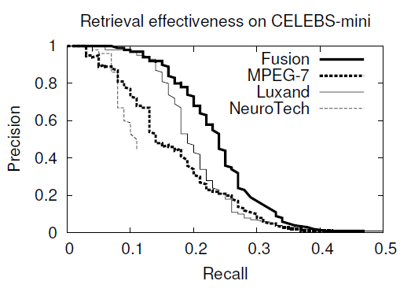
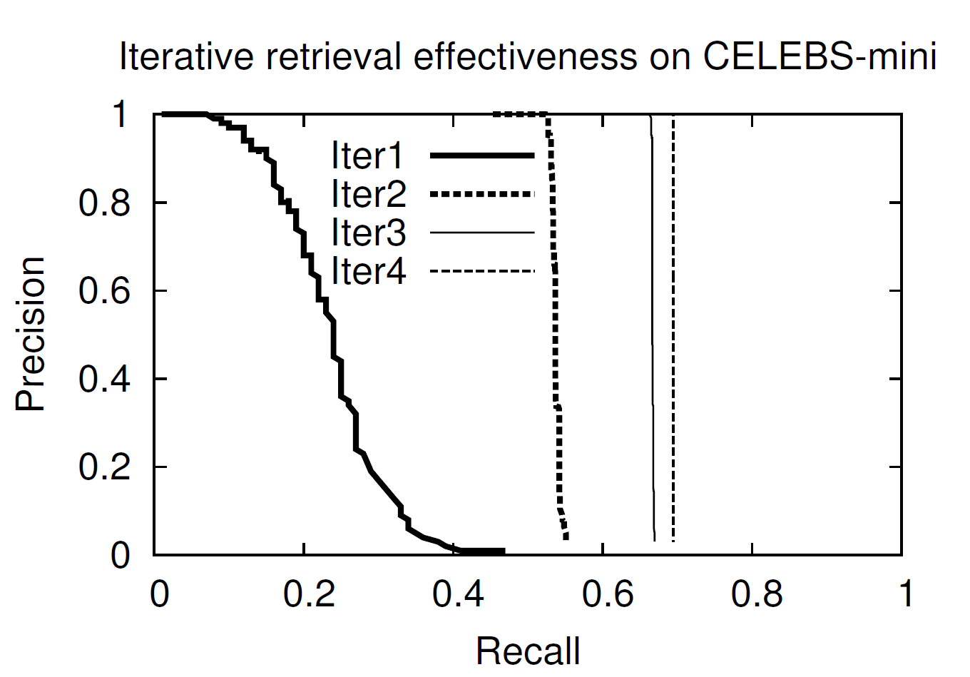
Face Matching Results, Relevance Feedback
User may improve results by marking correctly found faces in several iterations:
1st iteration
query
2nd iteration
query

Slide 62
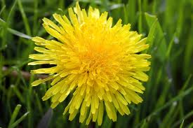
Search-based Image Annotation
Keyword-based image retrieval
  Popular and intuitive
  Needs pictures with text metadata
  Manual annotation is expensive
?
Need for automatic image annotation
We already have a strong tool – the similarity search
  For any input image, we can retrieve visually similar images
  Metadata of the similar images can be used to describe the original image
Search-based image annotation

Slide 63
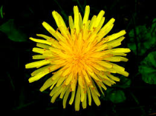


Search-based annotation principles
Annotated image collection
Similar annotated images
d = 0.2
d = 0.5
d = 0.6
?
Content-based
image retrieval
Yellow, bloom, pretty
Meadow, outdoors, dandelion
Mary’s garden, summer
Final candidate keywords
with probabilities
Semantic resources
Candidate
keyword
processing
Plant 0.3
Flower 0.3
Garden 0.15
Sun 0.05
Human 0.1
Park 0.1

Slide 64
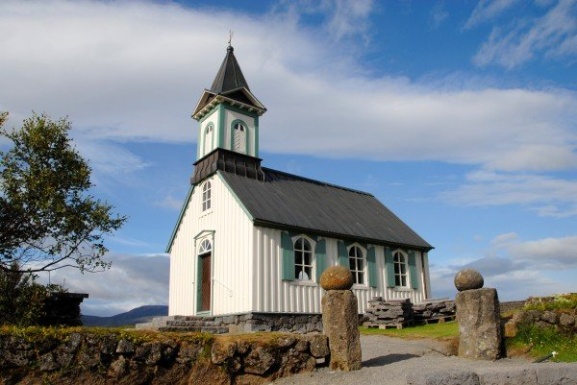
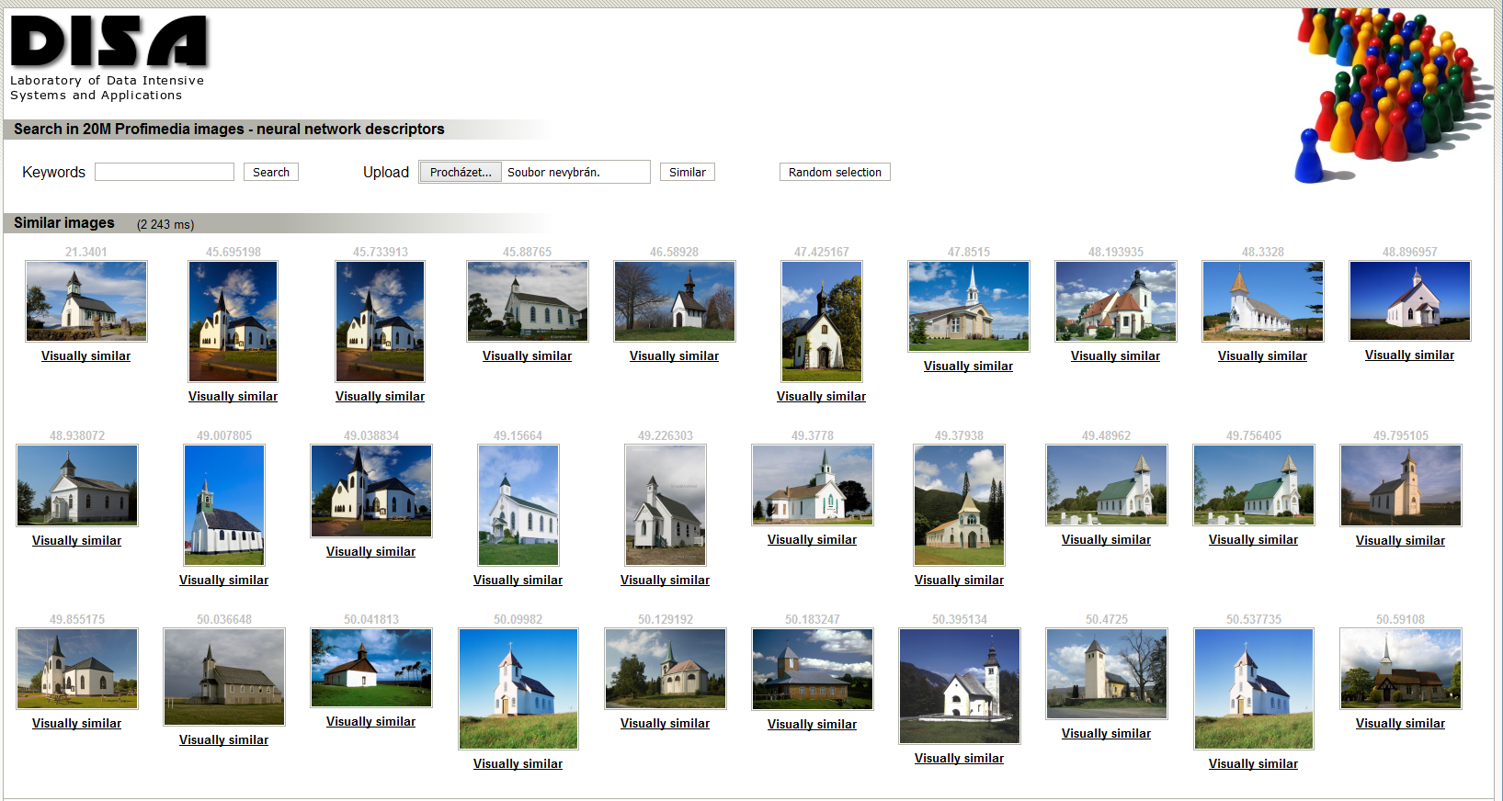
Example
Retrieve 100 similar images from Profiset
Merge their keywords, compute frequencies
Build the semantic network using WordNet
Compute the ConceptRank
Apply postprocessing & return 20 most probable keywords
Candidate keywords after CBIR
church, architecture, travel, europe, building, religion, germany, buildings, north, churches, christianity, america, religious, exterior, st, historic, world, tourism, united, usa, …
Semantic network
4 relationships: hypernym (dog → animal), hyponym (animal → dog), meronym (leaf → tree), holonym (tree → leaf)
270 network nodes, 471 edges
ConceptRank scores
building (2.53), structure (2.41), LANDSCAPE (2.10), BUILDINGS (1.87), OBJECT (1.84), NATURE (1.78), place_of_worship (1.75), church (1.74), Europe (1.68), religion (1.64), continent (1.51), …
Final keywords
building, structure, church, religion, continent, group, travel, island, sky, architecture, tower, person, belief, locations, chapel, christianity, tourism, regions, country, district

Slide 65
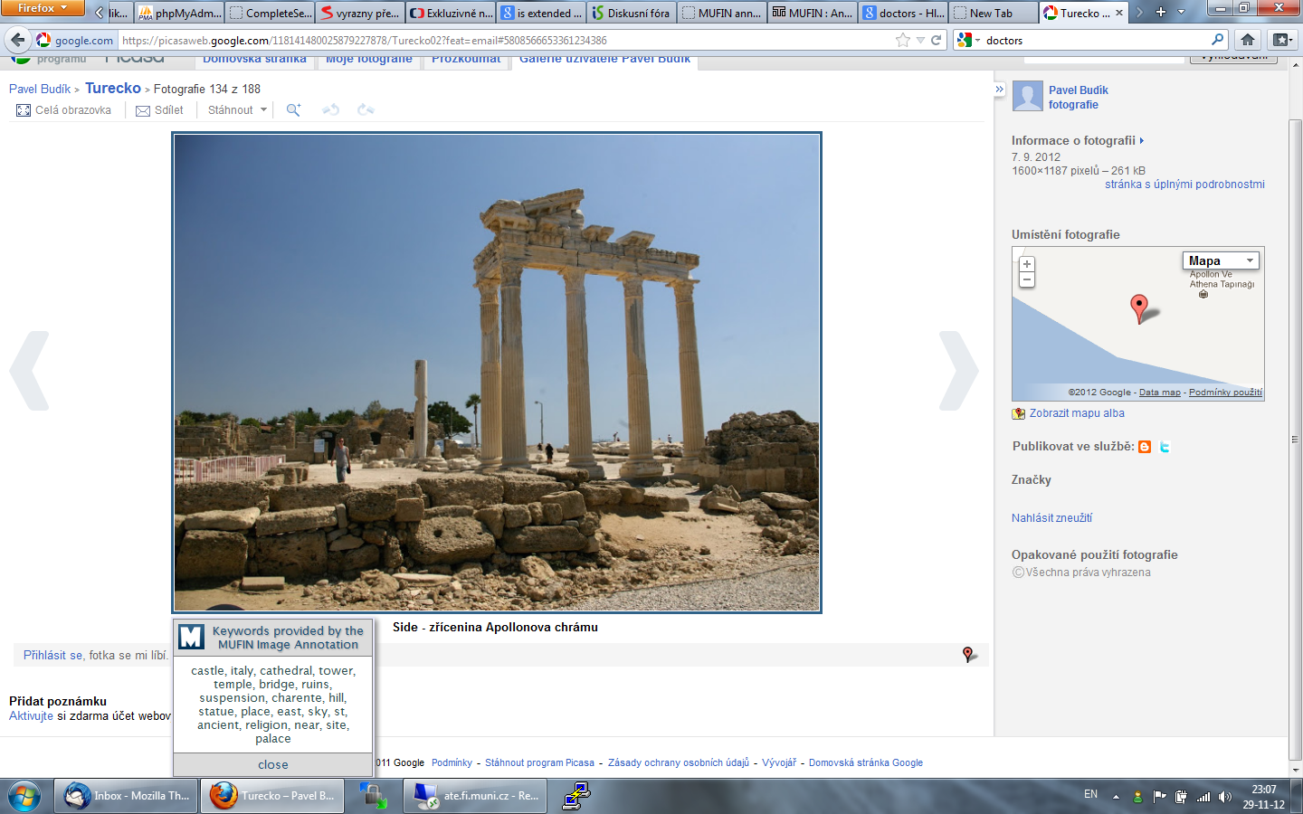
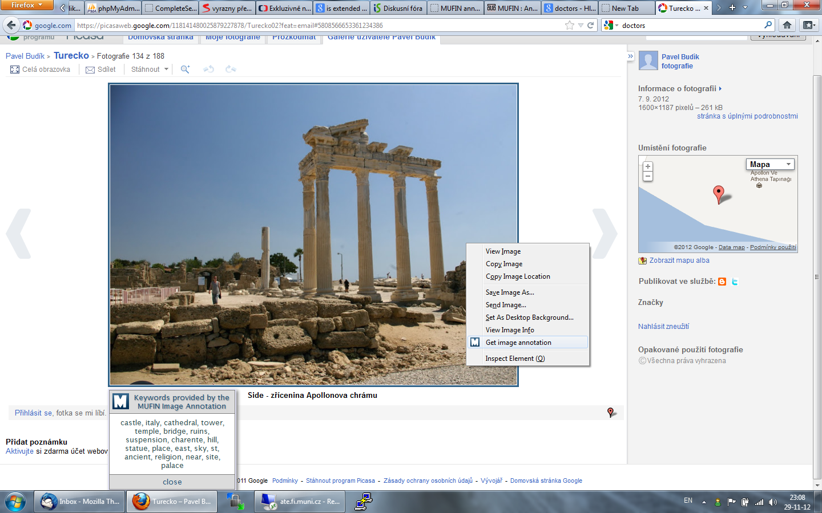

Annotations in use
Participation in the ImageCLEF 2014 Scalable Annotation Challenge
  2nd place, mean average precision of annotation approx. 60 %
Web demo & Mozilla addon
Image annotation: http://disa.fi.muni.cz/annotation-ui/

Slide 66
Similarity Search in Streams
Two basic approaches to explore data:
  Store, pre-process and search later, database processing
  Process (filter) continuously, stream processing
Examples of stream processing applications:
  Surveillance camera and event detection
  Mail stream and spam filter
  Publish/subscribe applications

Slide 67
Stream Processing Scenarios
Stream: potentially infinite sequence of data items (d₁, d₂, …) – tuples, images, frames, etc.
Basic scenarios:
  Data items processed immediately, possible data item skipping
  → minimize delay - e.g., event detection
  Process everything as fast as possible, delay possible to maximize throughput - our focus
Motivating examples with similarity searching
  Image annotation – annotate a stream of images collected by a web crawler
  Publish/subscribe applications – categorize a stream of documents by similarity searching

Slide 68

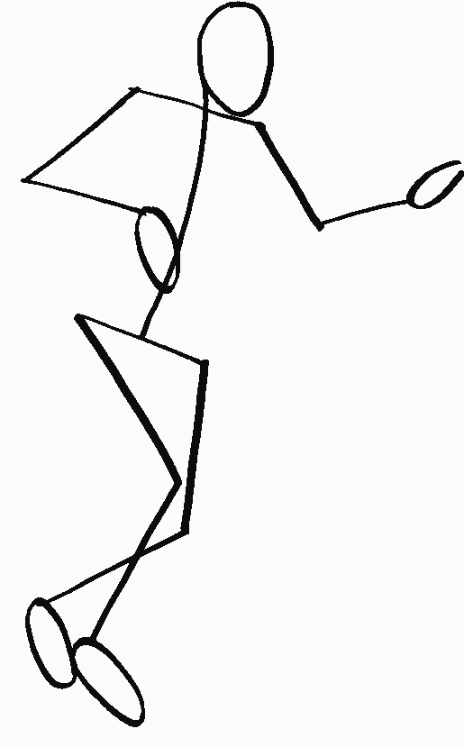

Processing Streams of Query Objects
Typical large-scale similarity search approach:
  partitioned data stored on a disk
  partition reads from a disk form the bottleneck
Idea: similar queries need similar sets of partitions → save accesses
Buffer: memory used for reordering (clustering) queries
Cache: memory containing previously read data partitions
Stream
Metric index
Buffer
Result
Query
Query
Cache
Disk

Slide 69
Experiment Results
100,000 processed 10-NN queries
DB: 1 mil. MPEG-7 descriptors
Buffer capacity: 8,000 queries
Cache size: 40,000 objects (4% of the DB)
100,000 processed 10-NN queries
DB: 10 mil. MPEG-7 descriptors
Buffer capacity: 10,000 queries
Cache size: 90,000 objects (0.9% of the DB)

Slide 70
Continuous kNN Join
Task: efficiently evaluate kNN join at any time
Challenge: efficient join computation having a lot of query objects and a lot of stream objects in the time window
General approach: update the join result continuously
Problem: a lot of time-consuming metric distance computations
Approximation technique proposal
  Sketch-based filter
  Hamming distances
Time window
Future
Past
Users‘ preferences
(query objects)
3NN join

Slide 71
Continuous kNN Join
Task: efficiently evaluate kNN join at any time
Challenge: efficient join computation having a lot of query objects and a lot of stream objects in the time window
General approach: update the join result continuously
Problem: a lot of time-consuming metric distance computations
Approximation technique proposal
  Sketch-based filter
  Hamming distances
Time window
Future
Past
Users‘ preferences
(query objects)
3NN join
?

Slide 72
Continuous kNN Join
Task: efficiently evaluate kNN join at any time
Challenge: efficient join computation having a lot of query objects and a lot of stream objects in the time window
General approach: update the join result continuously
Problem: a lot of time-consuming metric distance computations
Approximation technique proposal
  Sketch-based filter
  Hamming distances
Time window
Future
Past
Users‘ preferences
(query objects)
3NN join

Slide 73
Experiments
  Dataset: Caffe descriptors (4,096 dimensional vectors)
  1 step: process a new stream object, delete the oldest stream object
  Each experiment: 1,000 steps
  10-NN join
  200,000 stream objects in the time window
  Sketch-based approach vs. no sketches:
    sketches nearly 13 times faster, almost precise results (less than 0.5% missed objects)

Slide 74
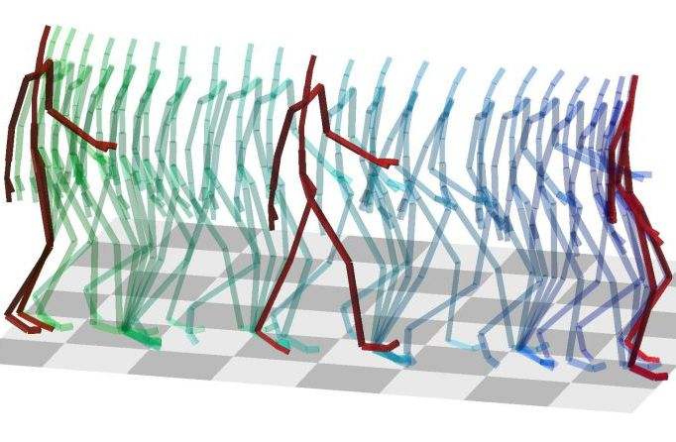
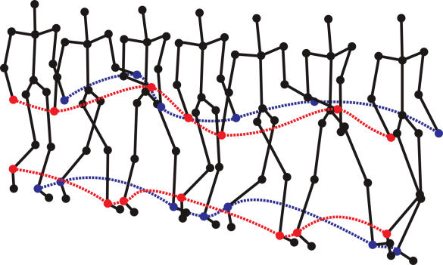
What Is Mocap
  Digital representation is depicted by series of coordinates of body joints in space-time.
    Complex multi-dimensional spatio-temporal data (3D space, 31 joints, 120 frames per second).
    Visualized by simplified human skeleton (stick figure), coordinates of joints stored as float numbers.
    1 minute of such motion data ≈ 669,600 float numbers.

Slide 75
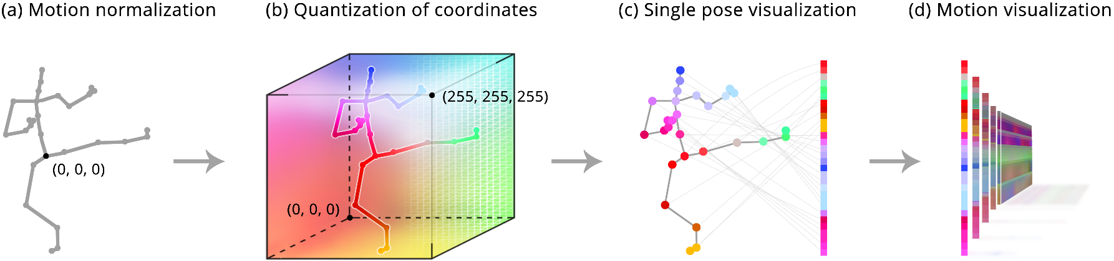
Our Approach – Motion Images
Every single-frame joint configuration is normalized (by centering and rotating), then transformed into a RGB stripe image while fully preserving skeleton configuration.
Notes:
We focus on body joints, not volumetric model nor skeleton bones
Why normalziation is important

Slide 76





Motion Images + Caffe
d = 13.17
d = 10.1
1) Effective transformation
from (dynamic) motion capture data into (static) images.
2) Extract fixed-size feature vector
using content-based image descriptors.
3) Index for fast and scalable search
1)
2)
<0, 0, 4.56, 0, 7.88, …>
3)
d = 14.2
d = 1.1
Motion
Motion Image
(hop-one-leg)
4096-dim
Caffe vector
Nearest neighbors

Slide 77
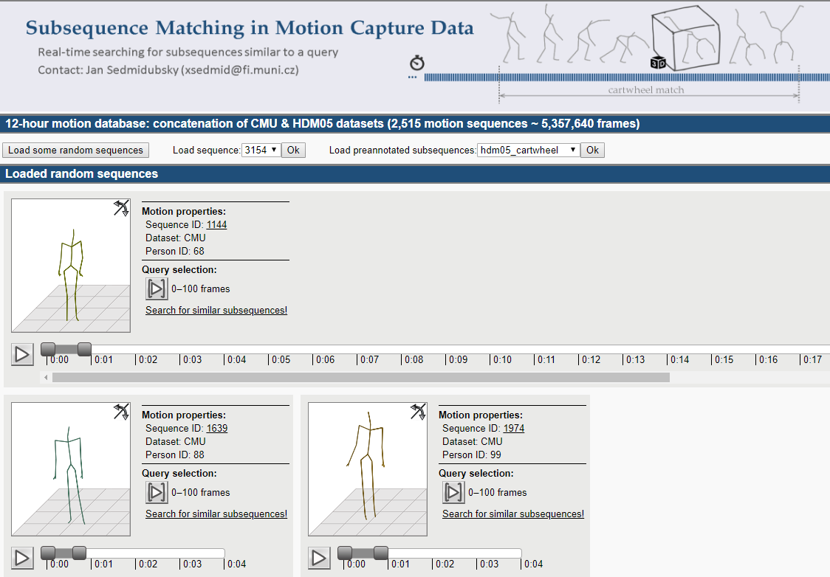
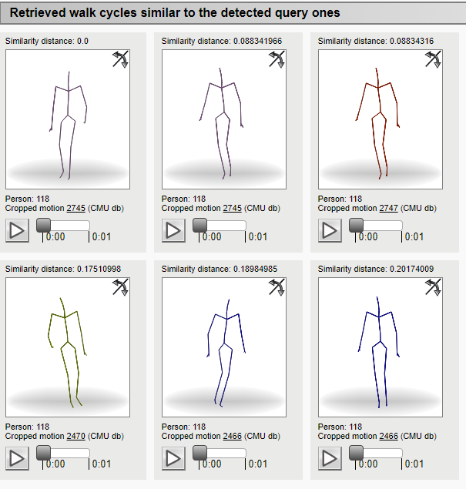
Demos
Subsequence search demo
http://disa.fi.muni.cz/mocap-demo/
Action recognition demo
http://disa.fi.muni.cz/mocap-action-recognition/
Gait recognition demo
http://disa.fi.muni.cz/mmpi

Slide 78
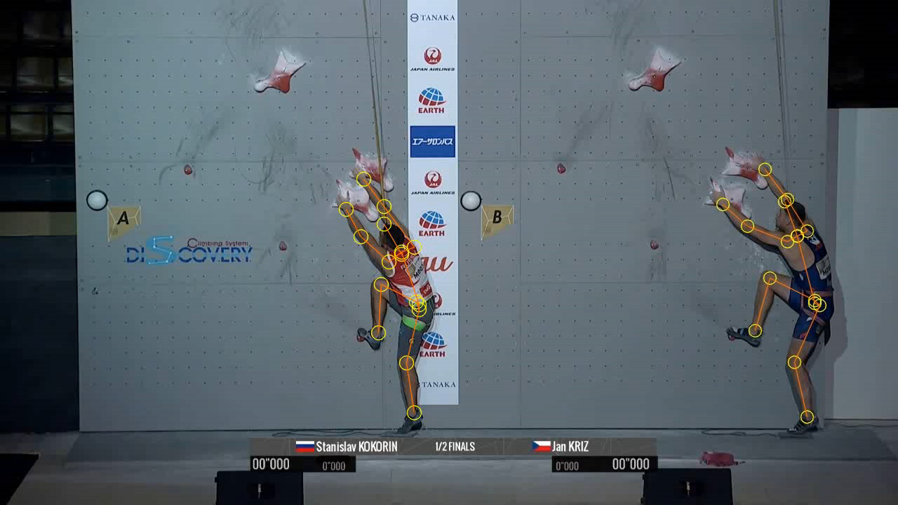
Speed Climbing
Olympic sport in Tokyo 2021
Speed climbing in numbers
15 m vertical wall
5° overhang
20 big hand holds, 11 small foot holds (standardized layout)
5.48 s world record (≈ 10 km/h)
Speed climbing is suitable for computer-aided motion analysis based on 2D skeleton sequences

Slide 79

Application: Speed Climbing Analysis
Performance comparison of two climbers (or with world record)
Notes:
Green chart – time advantage (who is winning)
Blue chart – speed difference (who is faster)
Color clusters – biggest delay points where hands and feet stayed for longer time

Slide 80
Similarity Search in Protein Chains
Each protein consists of 1 or more subparts – protein chains
Approx. 500,000 chains are known – Protein Data Bank (PDB)
3D models of protein chains are used
to define their pairwise similarity
  Similarity evaluation time strongly depends
  on the size of compared chains
  Model of a protein chain: balls ≈ atoms, sticks ≈ bonds between atoms. Green ribbon ≈ simplification of the main atoms

Slide 81
Challenges
Very high variation in similarity evaluation time
  ranging from 1 ms to 42 minutes
The similarity measure violates the metric postulates
  Symmetry and triangle inequality are slightly violated
Difficult distribution of similarities
  Curse of dimensionality – not many close objects, most pairs have similar distance
Implementation objective: minimise the number of similarity comparisons

Slide 82
Implementation
3-phase search application
  returning query results after each search phase
  https://similar-pdb.cerit-sc.cz/
  Our engine visualises the search progress
    Users can decide not to wait for the results of next phase(s)
Mic, Raček, Křenek, Zezula: Similarity Search for an Extreme Application: Experience and Implementation, Proceedeing of the SISAP 2021, 15 p.
 | Similarity comparisons with the query chain | Searching median accuracy (30 NN) | Median (and maximum) searching time per query
Current PDB search engine | Hundreds of thousand | 100 % | 3 min (4 hours)
1st phase | 61 (fixed) | 47 % | 0.18 s (4 s)
2nd phase | 61 (reused) + 428 (fixed) | 67 % | 1.1 s (12 minutes)
3rd phase | 489 (reused) + 23 fixed + 190 (for median query chain) | 100 % | 2.5 s (1 h 4 min)

Slide 83












SISAP Conferences
SISAP (Similarity Search and Applications)
International conference series (http://sisap.org/)
2009
Prague
Czechia
2011
Lipari
Italy
2013
A Coruña
Spain
2015
Glasgow
UK
2017
Munich
Germany
2019
Newark NJ
USA
2008
Cancun
Mexico
2010
Instanbul
Turkey
2012
Toronto
Canada
2014
Los Cabos
Mexico
2016
Tokyo
Japan
2018
Lima
Peru

Slide 84



DISA at Masaryk University
Laboratory of
Data Intensive Systems and Applications
http://disa.fi.muni.cz

Slide 85
Challenges in Similarity Data Processing
State of the art:
  metric dependent partitioning - possibly adapting to data volume
Future data needs:
  Context dependent metric functions
    Data dependent
      Distance dependent on density of neighbors – surroundings
      Significantly varied computational costs for different object pairs
    Time dependent
      Distance changing in time
    User dependent
      Subjective measures
      More rich similarity models – distance density, set theoretic, …
  Implied performance appeals
    High dist. comp. cost → dimensional reduction, quantization, sketches, learned indices
    Adaptive, incremental metric partitioning

