Slide 1
Barokní malířství

Slide 2
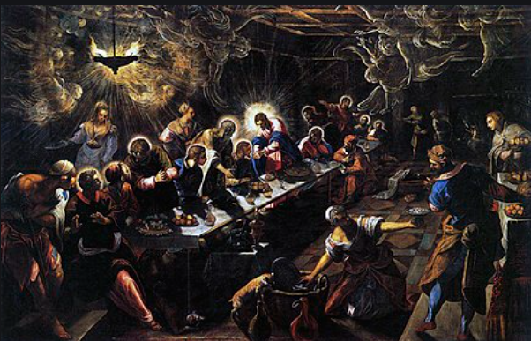
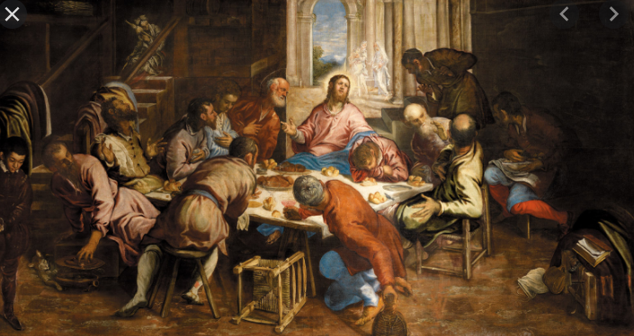
Manýrismus-Tintoreto-El Ereco

Slide 3
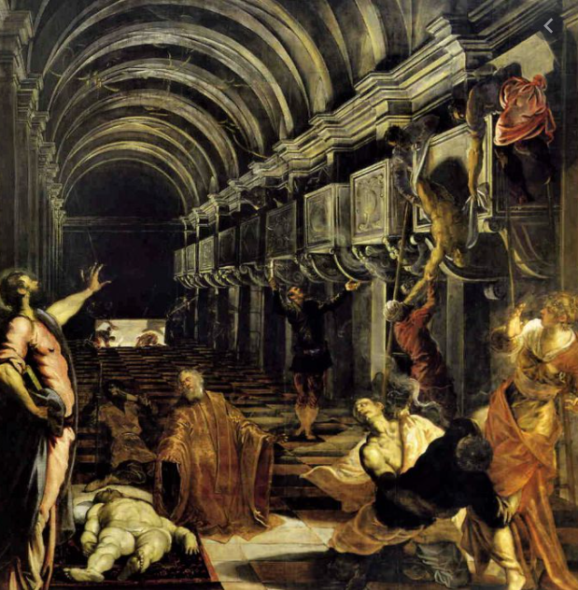

Slide 4
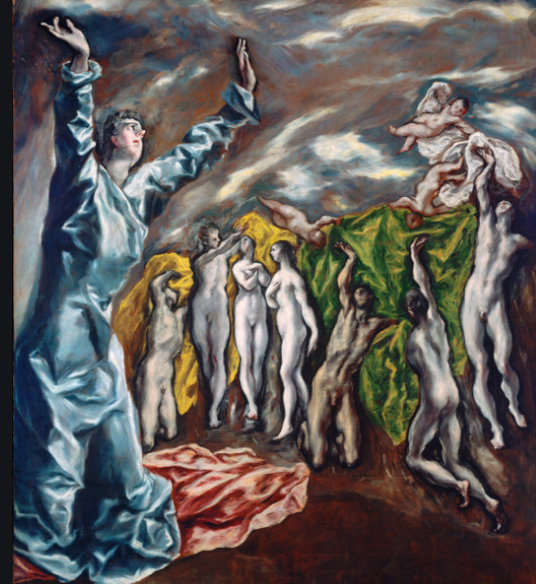
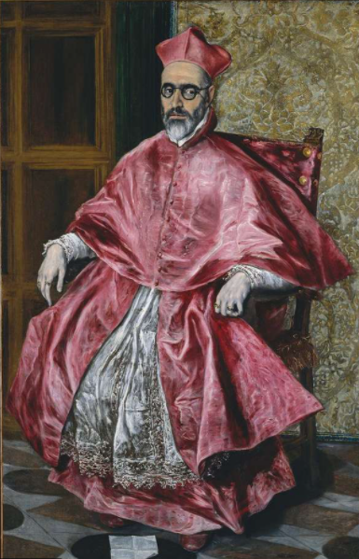

Slide 5
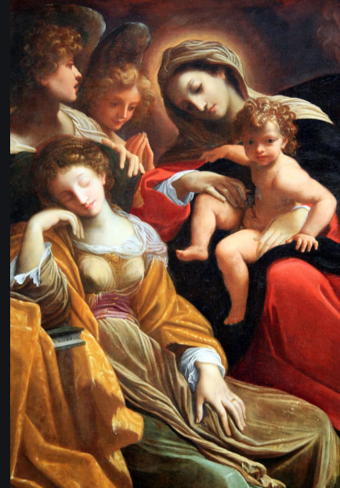
Annibale Carracci

Slide 6
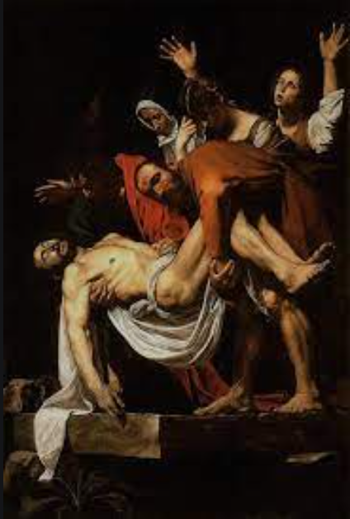
Caravaggio

Slide 7
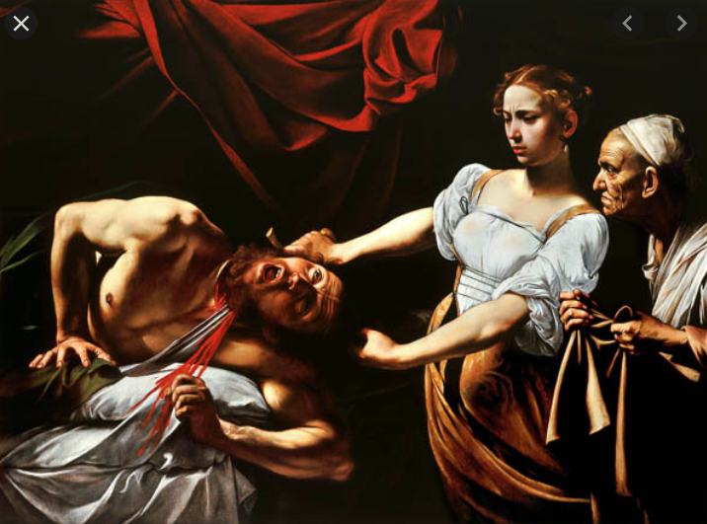

Slide 8
Guido Reni

Slide 9
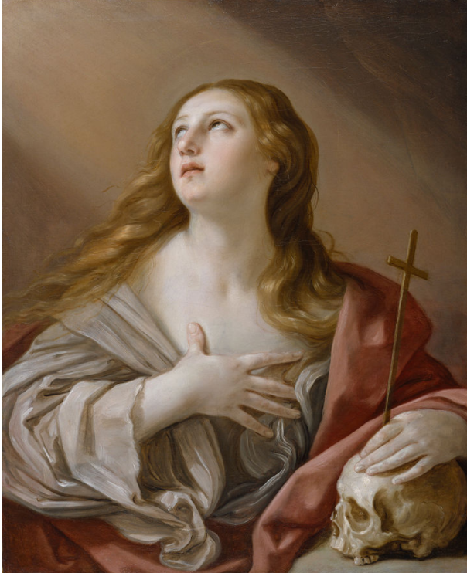

Slide 10
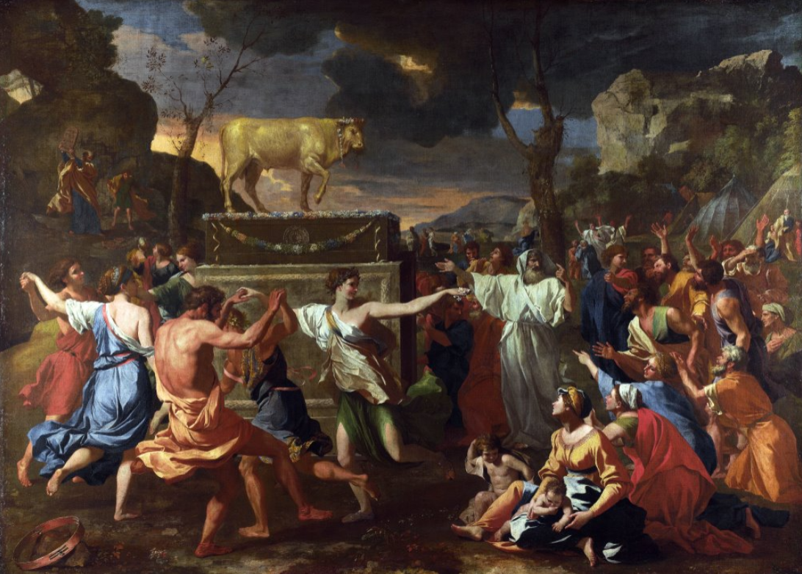
Nicolas Poussin

Slide 11
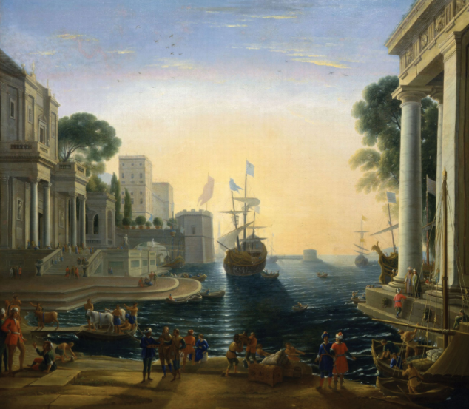
Claude Lorrain

Slide 12
Petr Pavel Rubens https://theculturetrip.com/europe/belgium/articles/10-artworks-by-rubens-you-should-know/

Slide 13
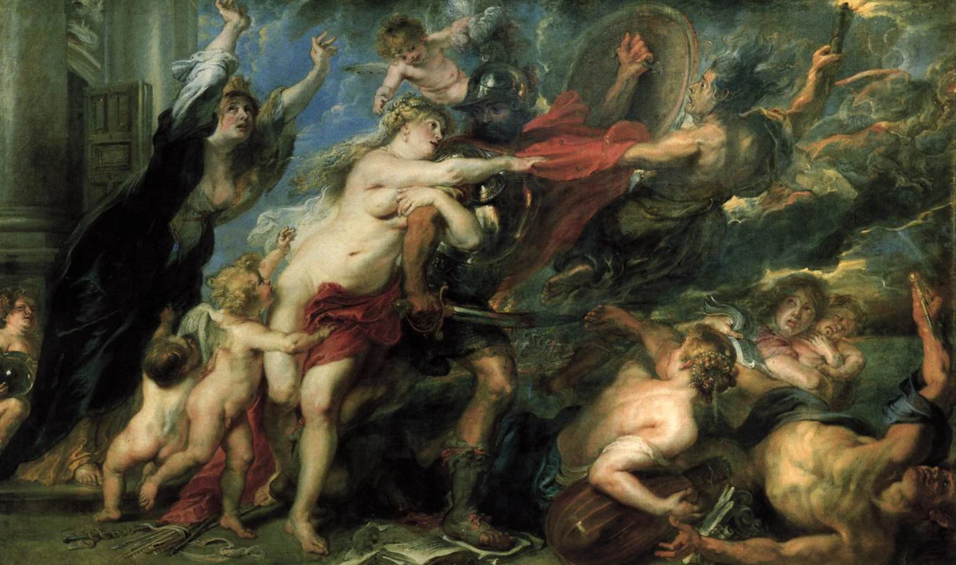

Slide 14
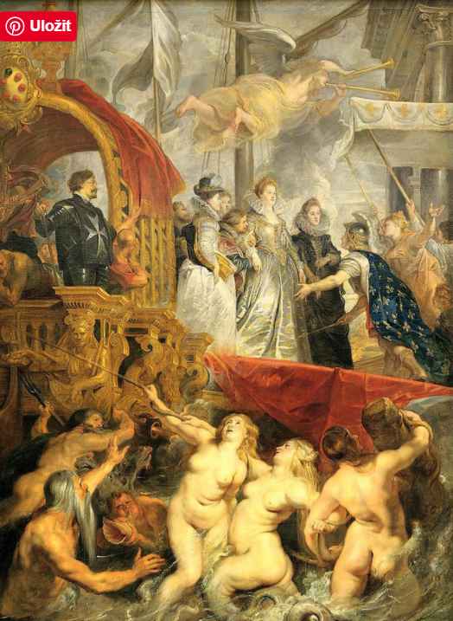

Slide 15
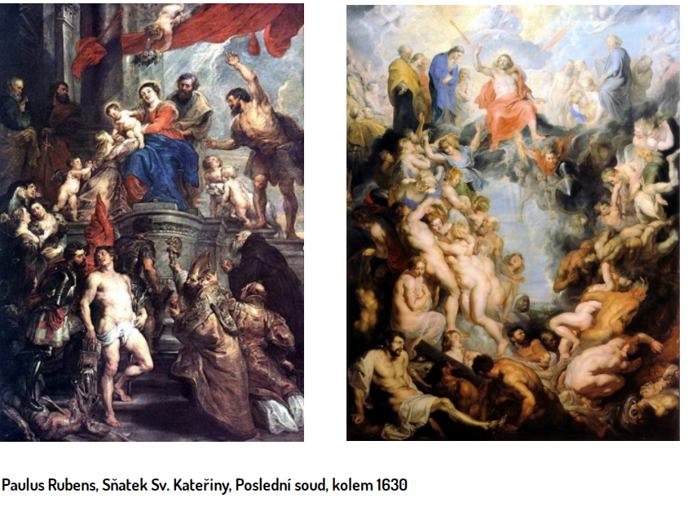

Slide 16
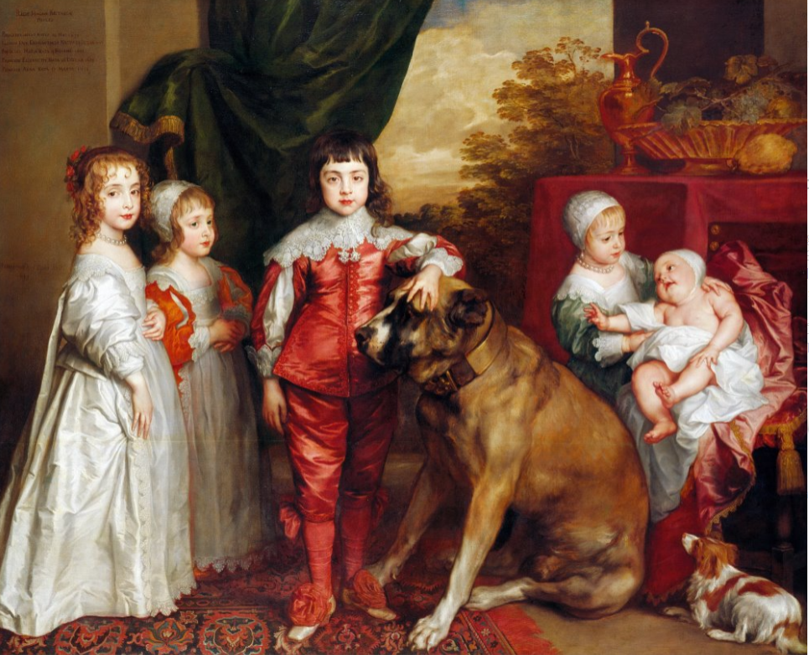
Anthonis van Dyck

Slide 17
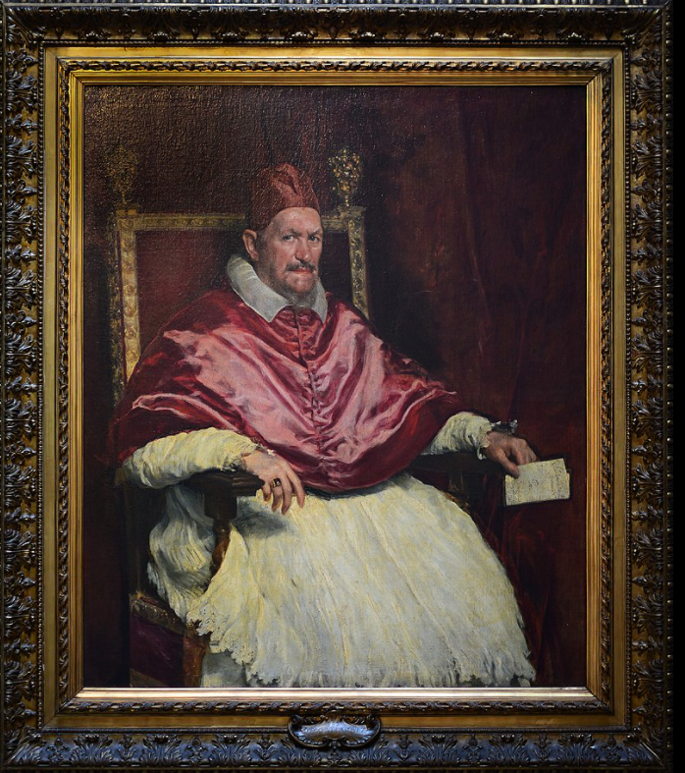
Velazques

Slide 18
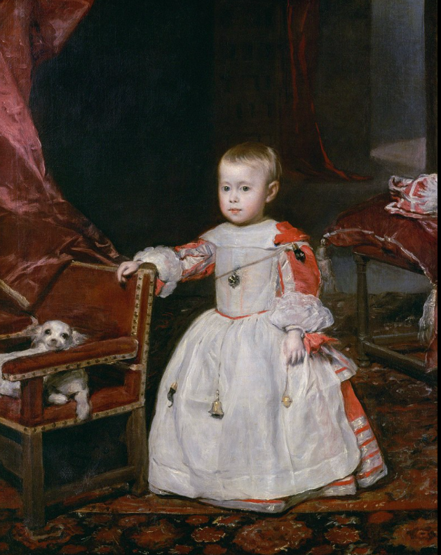

Slide 19
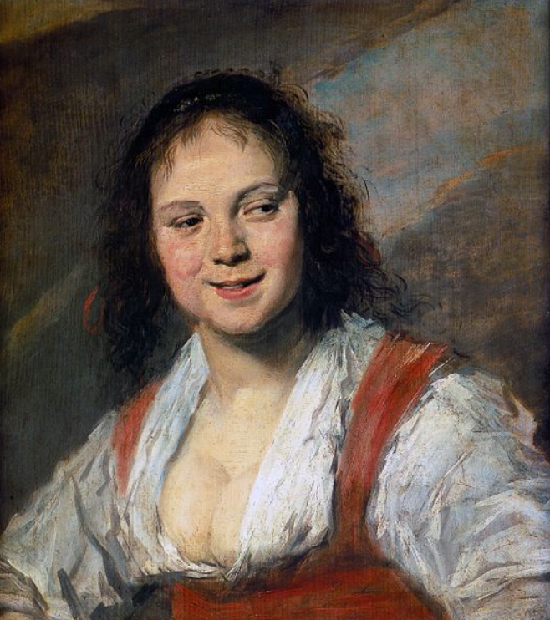
Franz Hals

Slide 20
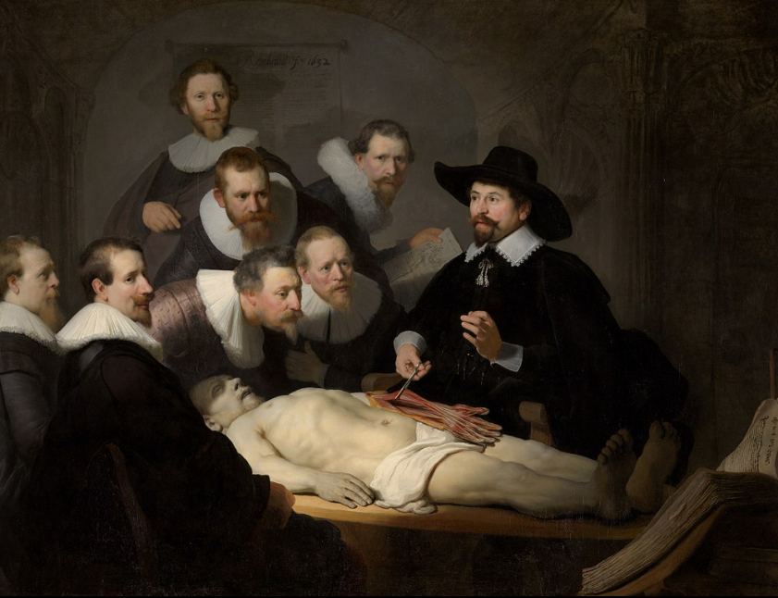
Rembrant

Slide 22
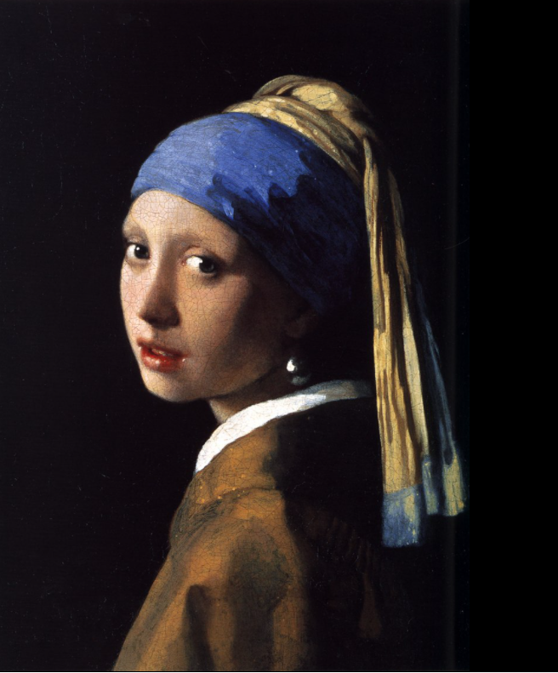
Jan Vermeer https://cs.wikipedia.org/wiki/Jan_Vermeer

Slide 23
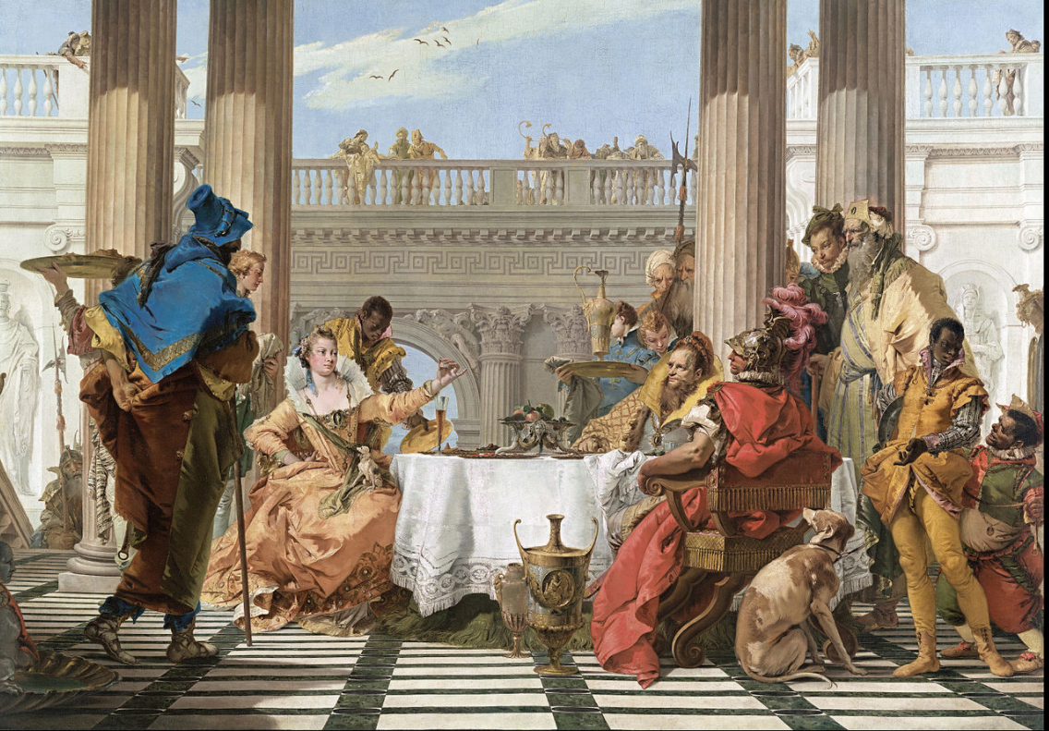
Giovanni Battista Tiepolo

