Slide 1
Evening Drawing
Week 1: Basics
Helena Lukášová, Hana Pokojná

Slide 2
Welcome
Some topics we will explore in the next few months:
Basics (line of action, gravity, intuitive drawing)
Proportions (body)
Portraits and profiles
Surface anatomy
Lightning
More…

Slide 3
Materials
Paper
Charcoal: natural or manufactured
Graphite
Kneaded eraser (putty rubber)
Masking tape (paper)
Fixing spray, can also be hairspray)
Places to shop:
INDIGES, Štefánikova 19a, 602 00 Brno-střed,
https://www.provytvarniky.cz/kontakt
Výtvarné potřeby CREATIVE, Husova 255, 602 00 Brno-střed,
https://www.art-creative.cz/
KOH-I-NOOR HARDTMUTH Trade a.s., Kobližná 27/5 and Masarykova 427/31, 602 00
Brno-střed, https://www.koh-i-noor.cz/
v obchodním domě Vágner na České v nejvyšším patře

Slide 4
Intuitive Measurements
Sometimes we get too preoccupied with details, however, the first step is blocking out the general shapes and movements
Great start is intuitive measurement -> practice through drawing movement and short poses
Focus on capturing the ‘action’, often in the folds and angular areas such as knees, elbows…

Slide 5
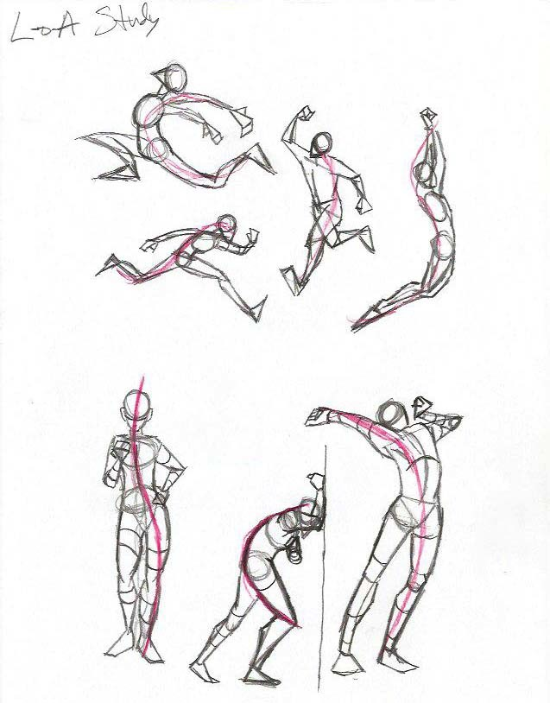
The Line of Action
Drawn with gesture, starting with head, going through body (down the spine) into one of the lower limbs
On the right is an example of the Line of action in a figure (Andrew Capps, Artstation)

Slide 6
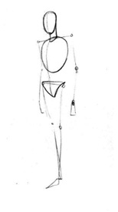
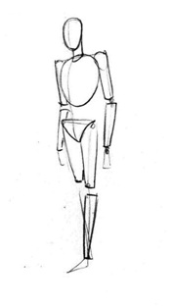
Human Figure Basics
Add basic geometric shapes for main body parts
- head, torso, knees, shoulders (no details!!!)
You will be adding ‘meat on the bones’, still in simple shapes (cylinders) onto this sketch
Afterwards, connect shapes with curves
Read More + Source: http://www.kokuyocamlin.com/blog/the-basics-of-human-figure-drawing.html

Slide 7
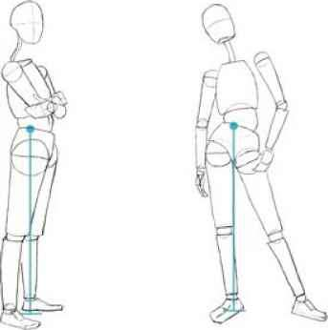
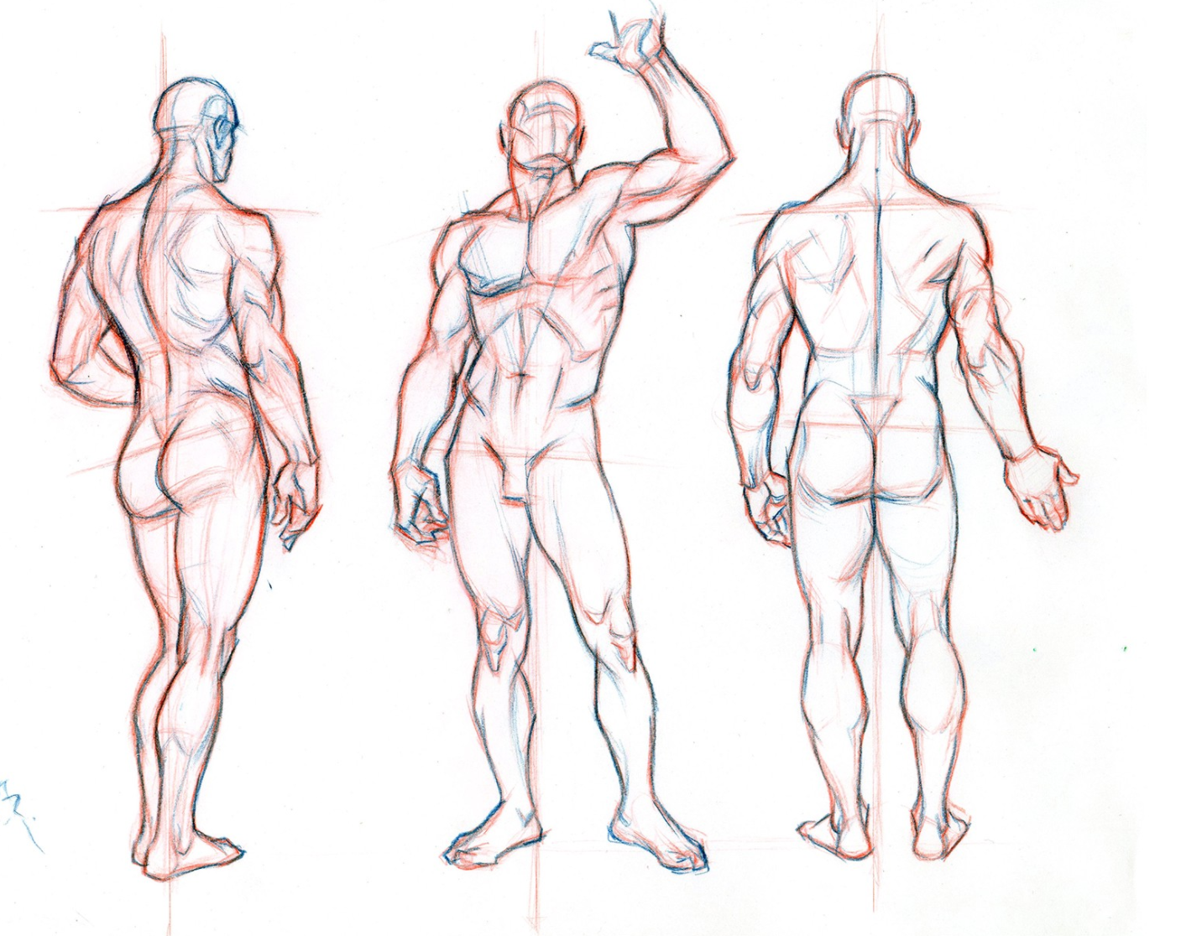
Gravity and Balance
Gravity makes the drawing ‘look right’
Tip: chin is above the heel that carries the weight of the body
Sources + further reading: https://www.joshuanava.biz/human-figure/weight-balance-movement.html
https://medium.com/@GetScriba/beginner-s-guide-importance-of-proper-body-proportions-and-how-to-get-them-right-31d94d2f75c7

Slide 8
Practice
If you fancy practising life-drawing outside of class
Get someone to pose for you
Draw people in public
There are MANY statues around Brno who don’t move ;}
Website that has life-drawing photo materials:
https://line-of-action.com/

