Slide 1
Evening Drawing
Week 8: Portraits, moods and character
Helena Lukášová, Hana Pokojná

Slide 2
Not accurate but not a caricature
You can create a portrait to capture the character of the person, or the mood
Doesn’t need to be super anatomically accurate
Not a funny/ satirical caricature either

Slide 3
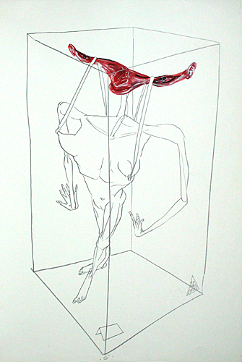
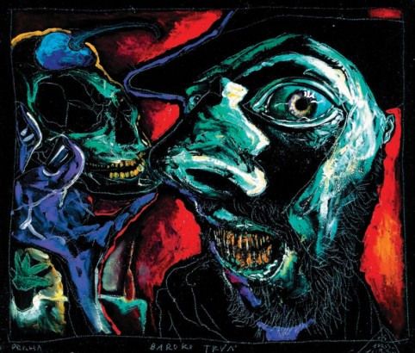
Emphasis on the important parts
Boris Jirku

Slide 4
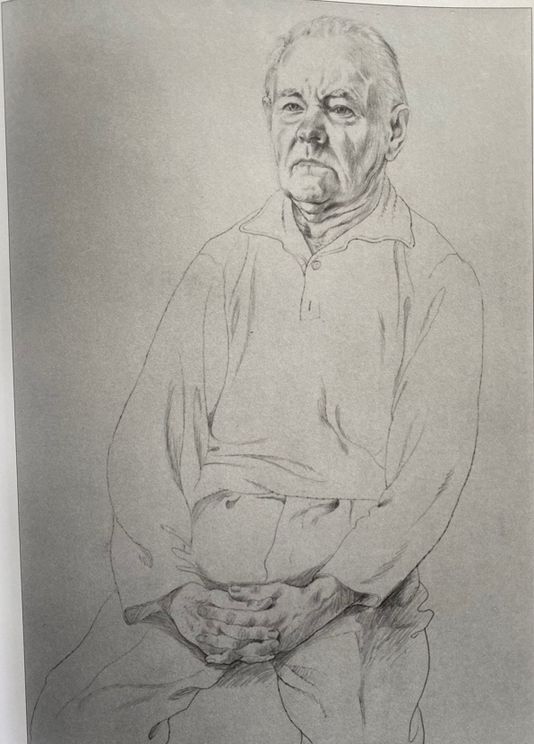
Portrait of the father by J. Veskerna (1983(

Slide 5
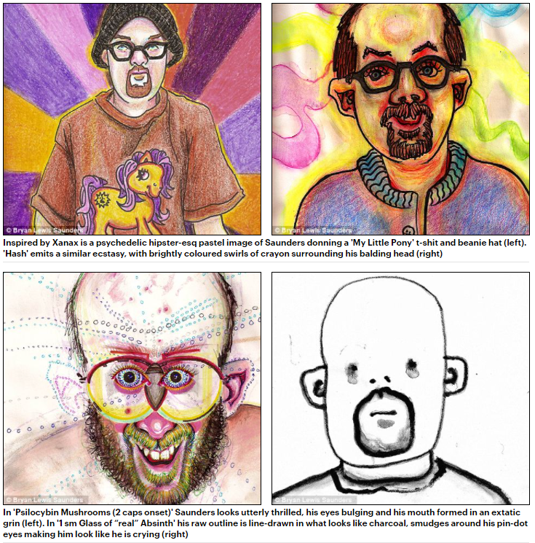
Different mental states
Bryan Lewis drew a series of self-portraits on drugs

Slide 6
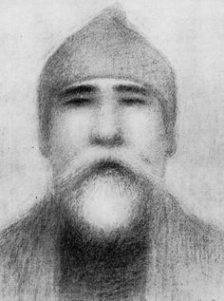
Jan Zrzavý (1965)

Slide 7
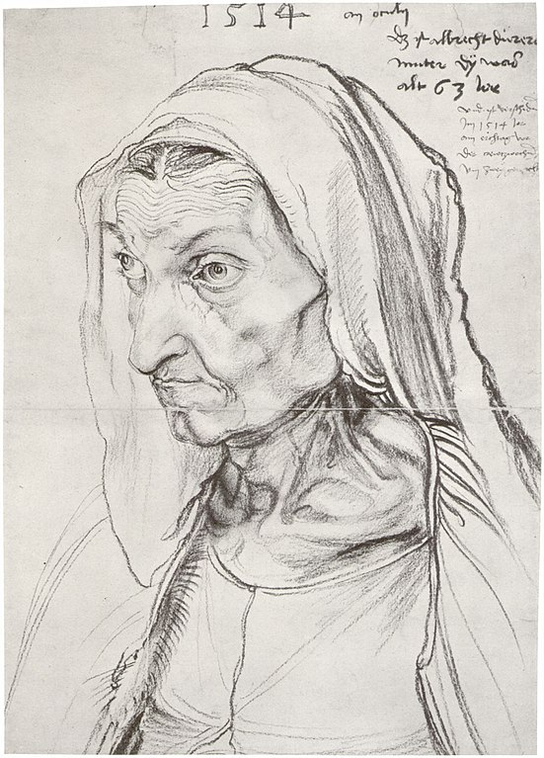
Albrech Durrer, portrait of mother

Slide 8
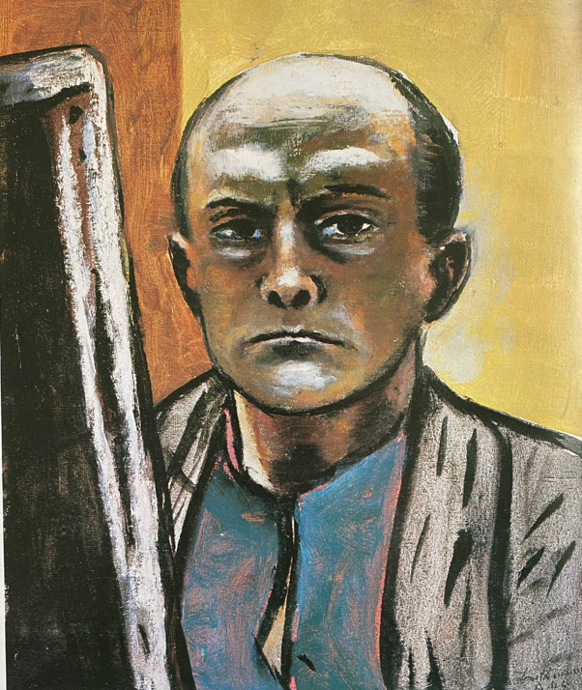
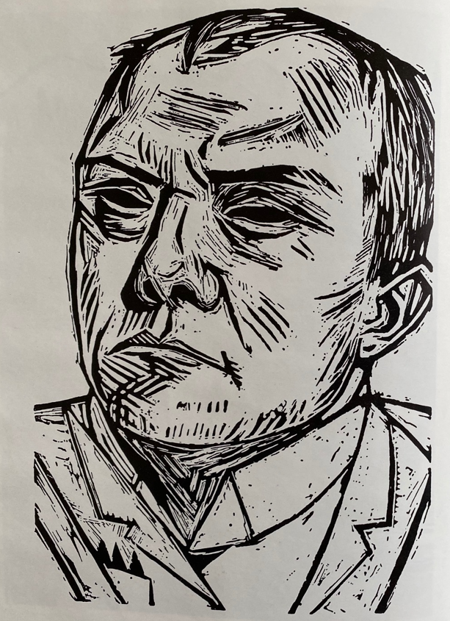
Beckmann

Slide 9
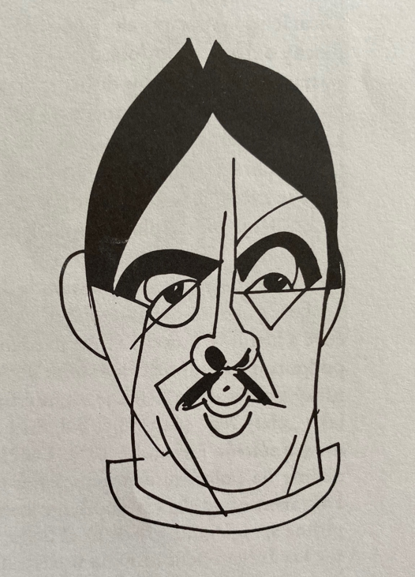
Simplicity
Caricature portrait of F Tuchy by Rada

Slide 10
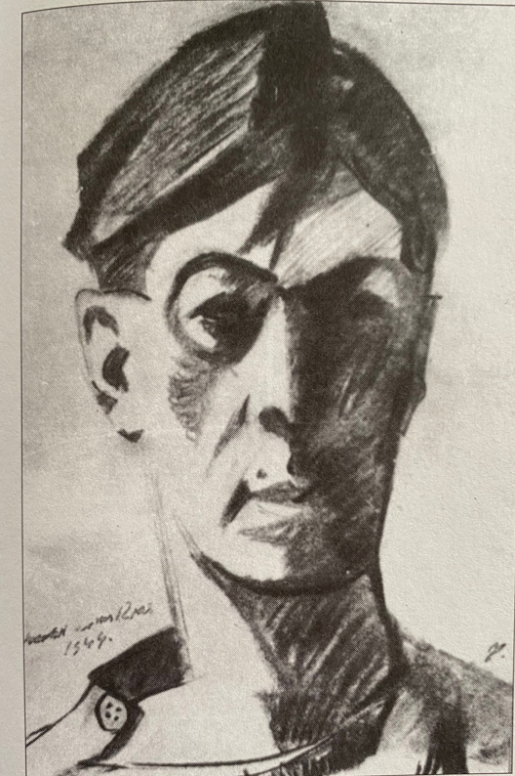
Angles and negative spaces
F Tichy self-portrait

