Slide 1
PA181 – Service Systems, Modeling and Execution
Introduction

Slide 2
New teachers
Leonard Walletzký
Josef Spurný
Zuzana Schwarzová
Lectures
Lectures
Administration
Organization of the projests
IBM cooperation

Slide 3
Content of the course
Theoretical background
4 diamond model
Quality of services
IBM Bluemix
Framework introduction
Business model
Service model and execution
Case studies and examples
Canvas
Lean canvas
Smart Services
Service complexity
Social informatics

Slide 4
Final project
Group project of 2 – 3 students
Assigment will be specified in the middle of semmester
After introduction to theory and IBM cloud
The presentation of the project during examination period
The best 5 projects will be awarded by Kyndryl

Slide 5
What is service?
services are processes, performances, or experiences that one person or organization does for the benefit of another
In all cases, service involves deployment of knowledge, skills, and competences that one person or organization has for the benefit of another, often done as a single, customized job
Lusch & Vargo
PA181 – Service Systems, Modelling and Execution

Slide 6
What is the complexity?
Complexity characterizes the behavior of a system or model whose components interact in multiple ways and follow local rules, meaning there is no reasonable higher instruction to define the various possible interactions
https://www.intercom.com/blog/the-hidden-cost-of-design-complexity/

Slide 7
What are complex services?
Services acting in complex environment
There is not clear way how to define the process of service provision
The final value depends on
Response of customer
The resources currently used
Interaction with other entities in the environment
All services became more complex

Slide 8
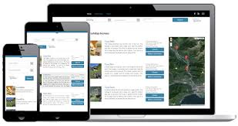
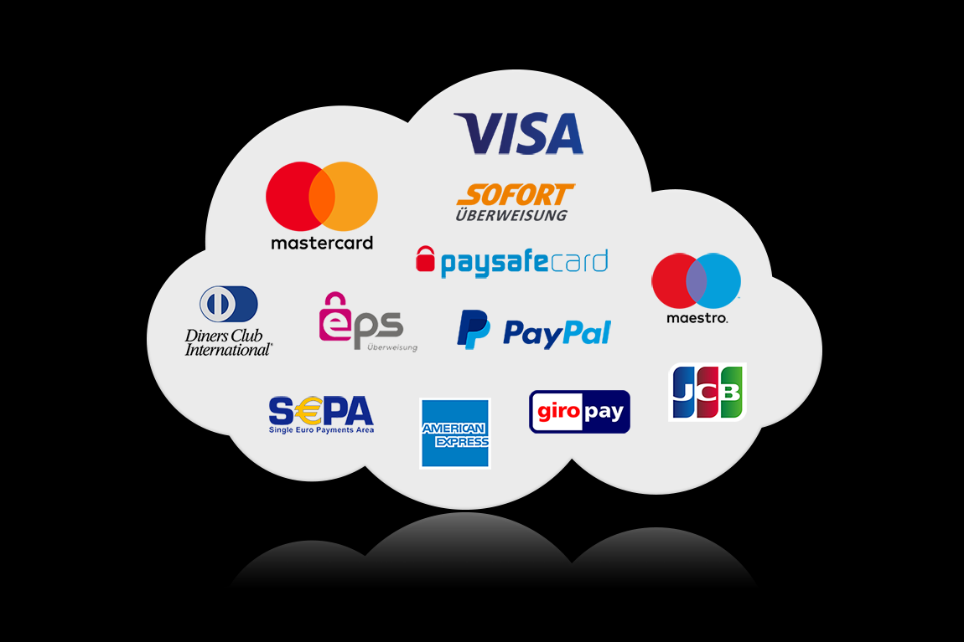
Example: Hairdresser and knowledge
1960
How to use scissors and other cutting staff
2018
he basic trends in haircutting
Know the basic of marketing (how to impress the new customers and keep the present ones)
Know the basic of taxation and bookkeeping
How to get online actual data of newest trends
How to work with sophisticated software to simulate examples of the hair cutting
How to work with on-line banking to pay the bills and get the payment for services

Slide 9
Teaching in the environment of Complex services
New curriculum
How to turn proposal into application
Less theory, more practice
Focus to other skills
Multidisciplinarity
To understand marketing, management etc.
Social skills
To present and communicate
To understand people from other domains

Slide 10
Social skills as key factor
To understand people from other domains is the main factor of success in multidisciplinary teams
One word or phrase can have more, mostly different meaning
IT
Set of data
File stored in cloud
Law
Legal manuscript
Legal consequences
Doctor
Medical content
Treatment, medicine, pills
Size, type
Laws, paragraphs

Slide 11
What if the context understanding fails?
E-Prescription has very clear value
But if it is not described properly to all stakeholders, it is refused
Physicians took e-prescription as example of the state dictate
They have more important duties than learn new technology with no relation to medicine

Slide 12
Immuni: the contact tracking in Italy

Slide 13
Smart City – example of service complexity
Correct definition of Smart City
Role of ICT in Smart City Structure
Role and design of Services within the Smart City
Notes:
Napsal bych "úloha a návrh služeb". Ty dva poslední body jsou jasné, ale proč ten první? Zdůvodnit.

Slide 14
Definition of Smart City
Why do we need „correct“ definition of Smart City?
Many cities claim to be smart
Obviously, the implementation of ICT plays key role in city „smartness“
Smart City Council definition:
A smart city is one that has digital technology embedded across all city functions
But just usage of ICT does not mean the city is smart
The usage of ICT should have been used in a way to improve city efficiency, usability and sustainability
Notes:
Tady zase jsme u toho, co nám má přinést správná definice. Abycom měli z čeho vycházet v daším přístupu k práci na SC? Podle toho co je tady a na dalším slajdu uvedené, tak jde o roli IT v SC. Ta první definice je sice pro IT jasná ale ignruje vše ostatní, co hraje roli v SC, což ty vlastně říkáš. A tedy ty další definice jsou lepší

Slide 15
Possible definitions
The use of smart computing technologies to make the critical infrastructure components and services of a city – which includes city administration, education, healthcare, public safety, real estate, transportation and utilities – more intelligent, interconnected and efficient
Where Smart Computing means: A new generation of integrated hardware, software, and network technologies that provide IT systems with real-time awareness of the real world and advanced analytics to help people make more intelligent decisions about alternatives and actions that will optimize business processes and business balance sheet results
Smart City is the set of services, using ICT in non-trivial way that enables city management and whole society to meet the challenges of city development with the aim to improve its efficiency, habitation and sustainability, to bring its citizens the highest value possible, formulated in understandable value proposition.
WASHBURN, Doug; SINDHU, Usman; BALAOURAS, Stephanie; DINES, Rachel A; HAYES, Nicholas M; NELSON, Lauren E. Helping CIOs Understand "Smart City" Initiatives. 2010.
Notes:
V slovním doprovodu bych zdůraznil, že SC je služba ICT je nástroj té služby a že, definice určuje cíle té služby

Slide 16
Main research questions
Do the Smart City Services have any structure?
How to design and realize Smart City services in the most efficient and complex way?
What competencies and knowledge are necessary to understand complexity of services?
What are necessary inputs, implementation processes, limits, forms of financing and other constrains to create valuable structure of services within Smart City?
How to formulate the rules to create effective, flexible and complex Smart City, fulfilling the requests of administration, citizens and other related stakeholders?
Notes:
Tady bych to úplně přeoral.Unás v moha konkrétních dílčich ípřípadech SC docela funguj. Research je jak navrhovat a realizovat maximálně efektivní a komplexní SC!!!. Ty struktury nechápu. Aby se splnil ten můj požadavek, tak je třeba znat všechny charakteristické atributy SC, vstupní požadavky, jejich zadavatele, omezující podmínnky, implementační postupy, formy financování a já nevím co ještě. Jestli toto nazýváš strukturou, tak budiš, ale posluchačům by bylo lepší to neservírovat detailně, taky to má hlubší dopad. Pak bych teprve uvedl otázku kompetencí a znalostí. I když nevím, , co jsou ty kompetence. Já bych řekl znalpsti a donednosti.A jako poslední bod bych uvedl na základě získaných a vyhodnoceých informací vytvořit pravidla pro realizaci efektivního , modifikovatelého a kompexního SC, splňujícího požadavky samospravy a vyvarujícího se možným omezením nedostatkům.

Slide 17
Smart City Services
There are many different services, used in Smart City, with different role and customers
Traffic control
Route optimization
Waste services
We can find there many IT services, but in the basic level, we can recognize two main elements
Software
Hardware
How they are related or connected? What tasks do they really fulfill?
Is there any methodology we can use?
Notes:
Těch služeb je fůra , tak bych řekl, Např... Místo triviálního HW a SW bych uvedl otázky k řešení: jakou funkci plní ICT služby při realizaci SC služeb, jak jsou využívány ICT komponenty, jaké jsou impomentační postupy, je jejich využití (nasazení) optimální, nedají se lépe využít, jaké již existující postupy by se daly využít přizískání odpovědí na tyto otázky?

Slide 18
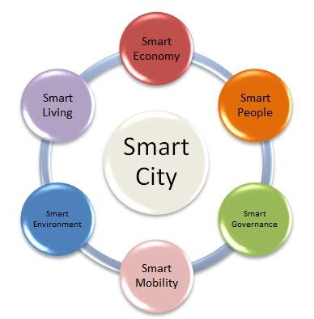
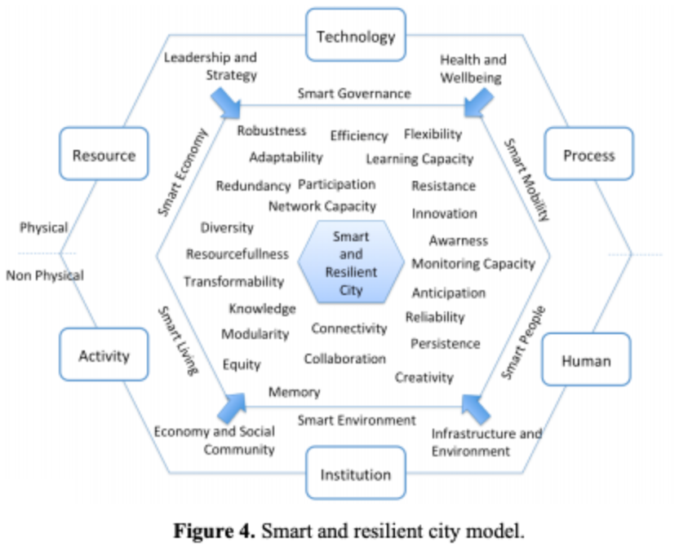
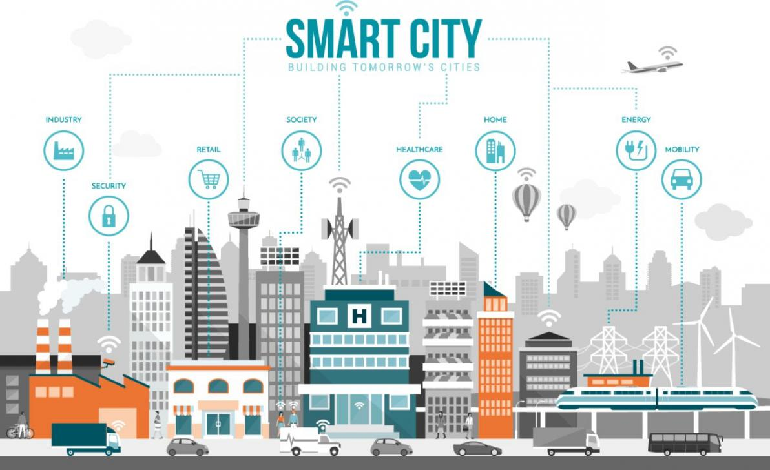
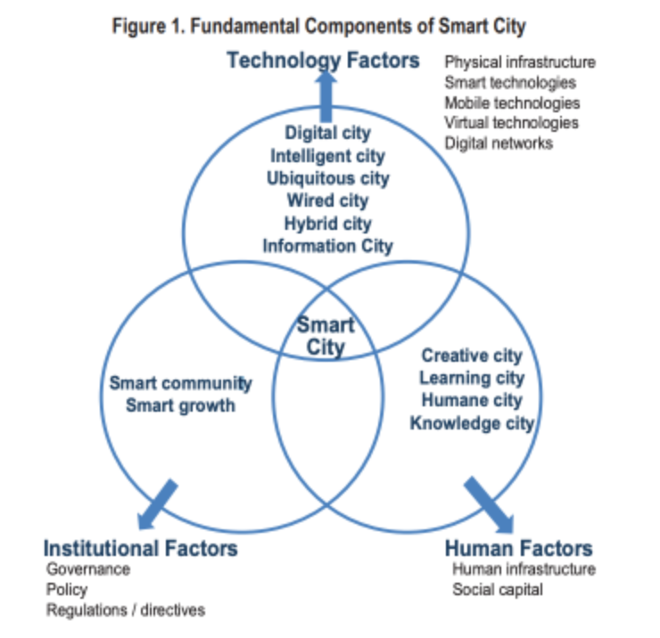
How do we model Smart City?

Slide 19
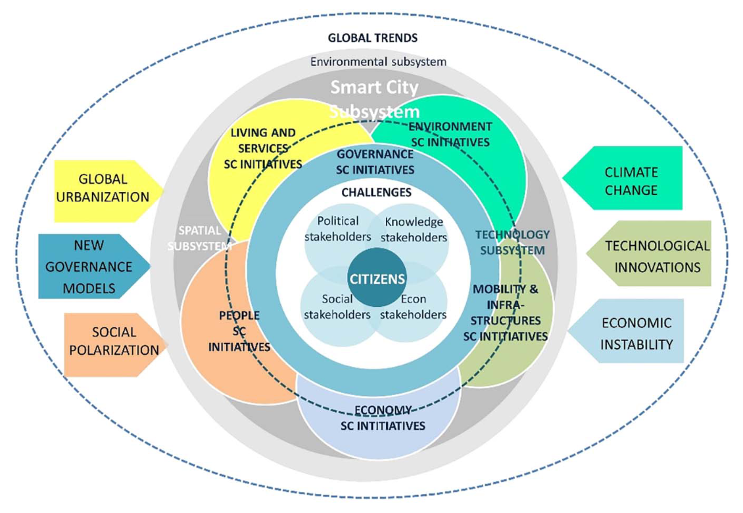
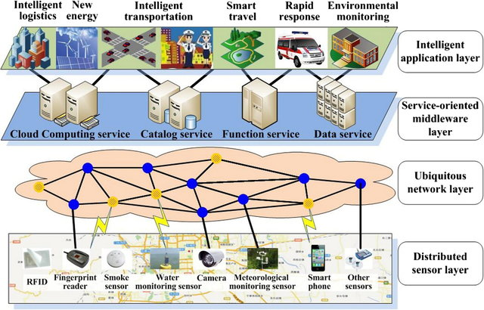
How do we model Smart Cities?

Slide 20
Service Science inspiration
The key element of all services is:
Value – usefulness or utility for the receiver of the service
Value proposition – description of the value in the language of receiver
Based on this we divided the Smart City services to the layers depending on their value proposition.
Do they serve for final user (citizen, administration) or are they just „inputs“ for other services?
IT services
Supporting services
Smart services
Smart features
Notes:
Můj první dotaz by byl – jak se odvodilo těch 5 vrstev value a value proposition

Slide 21
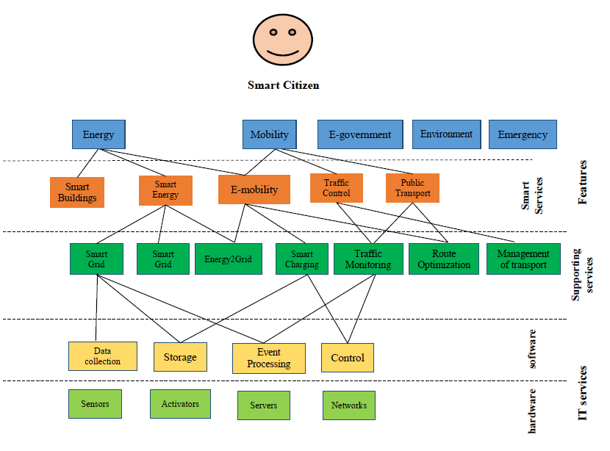
Layer model of Smart City
Walletzky L., Buhnova B., Carrubbo L. (2018) Value-Driven Conceptualization of Services in the Smart City: A Layered Approach. In: Barile S., Pellicano M., Polese F. (eds) Social Dynamics in a Systems Perspective. New Economic Windows. Springer, Cham
Notes:
Předpolkádám, že je nějaký oslí můstek s předchozím slajdem.

Slide 22
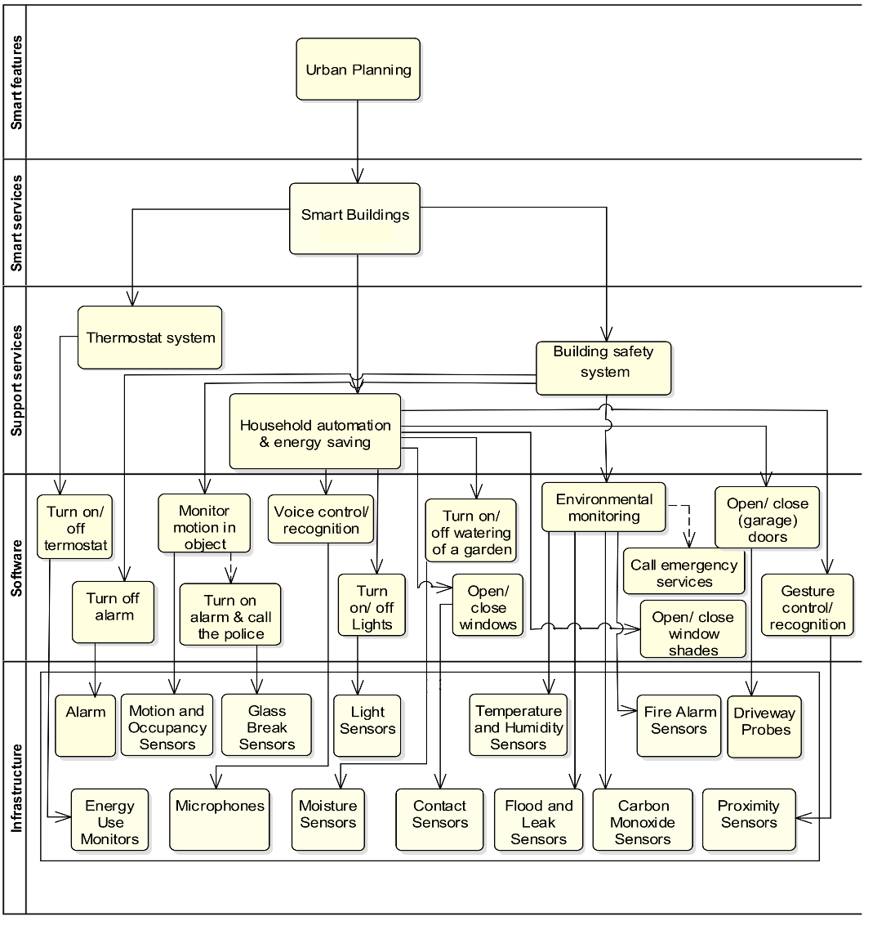
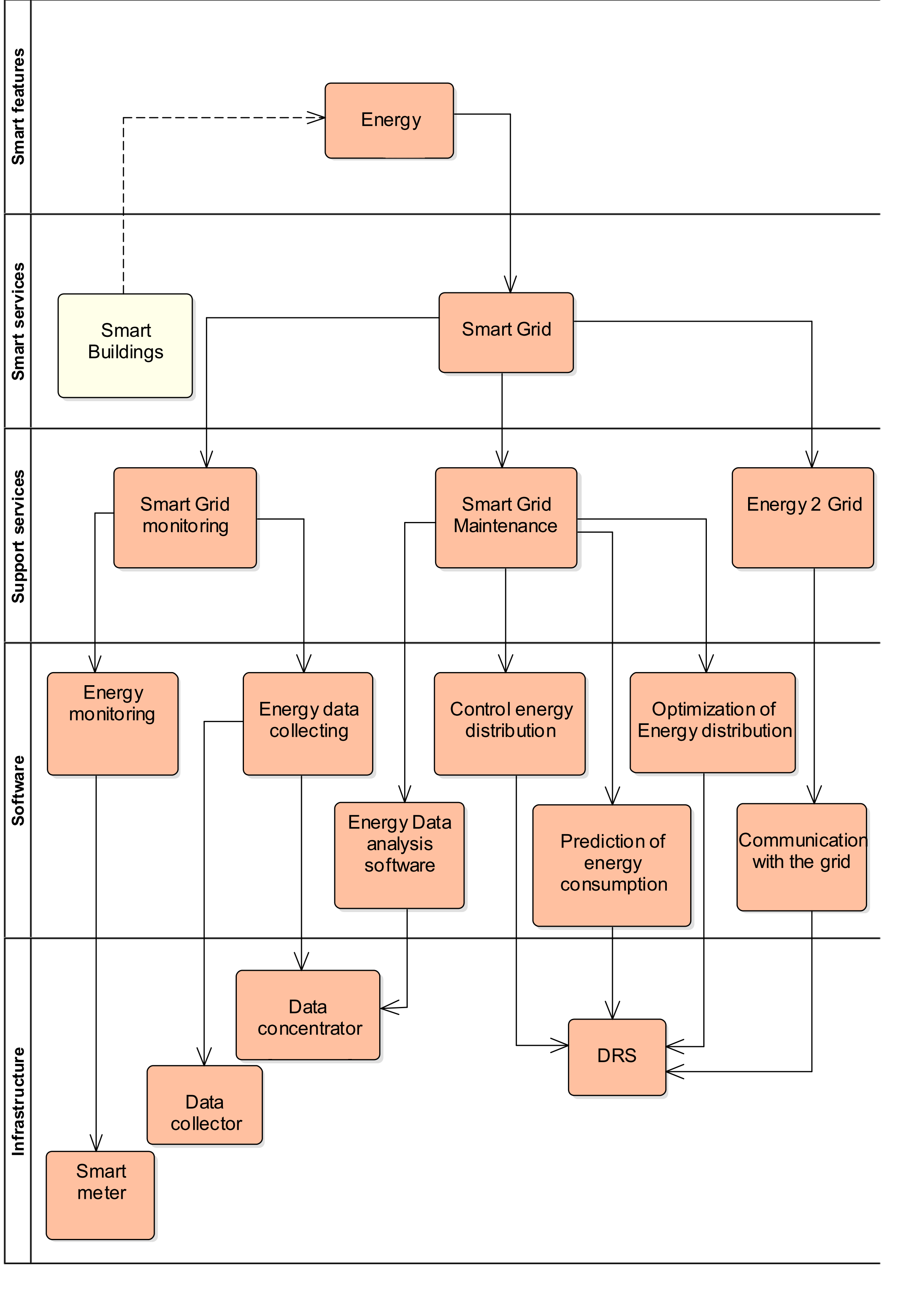
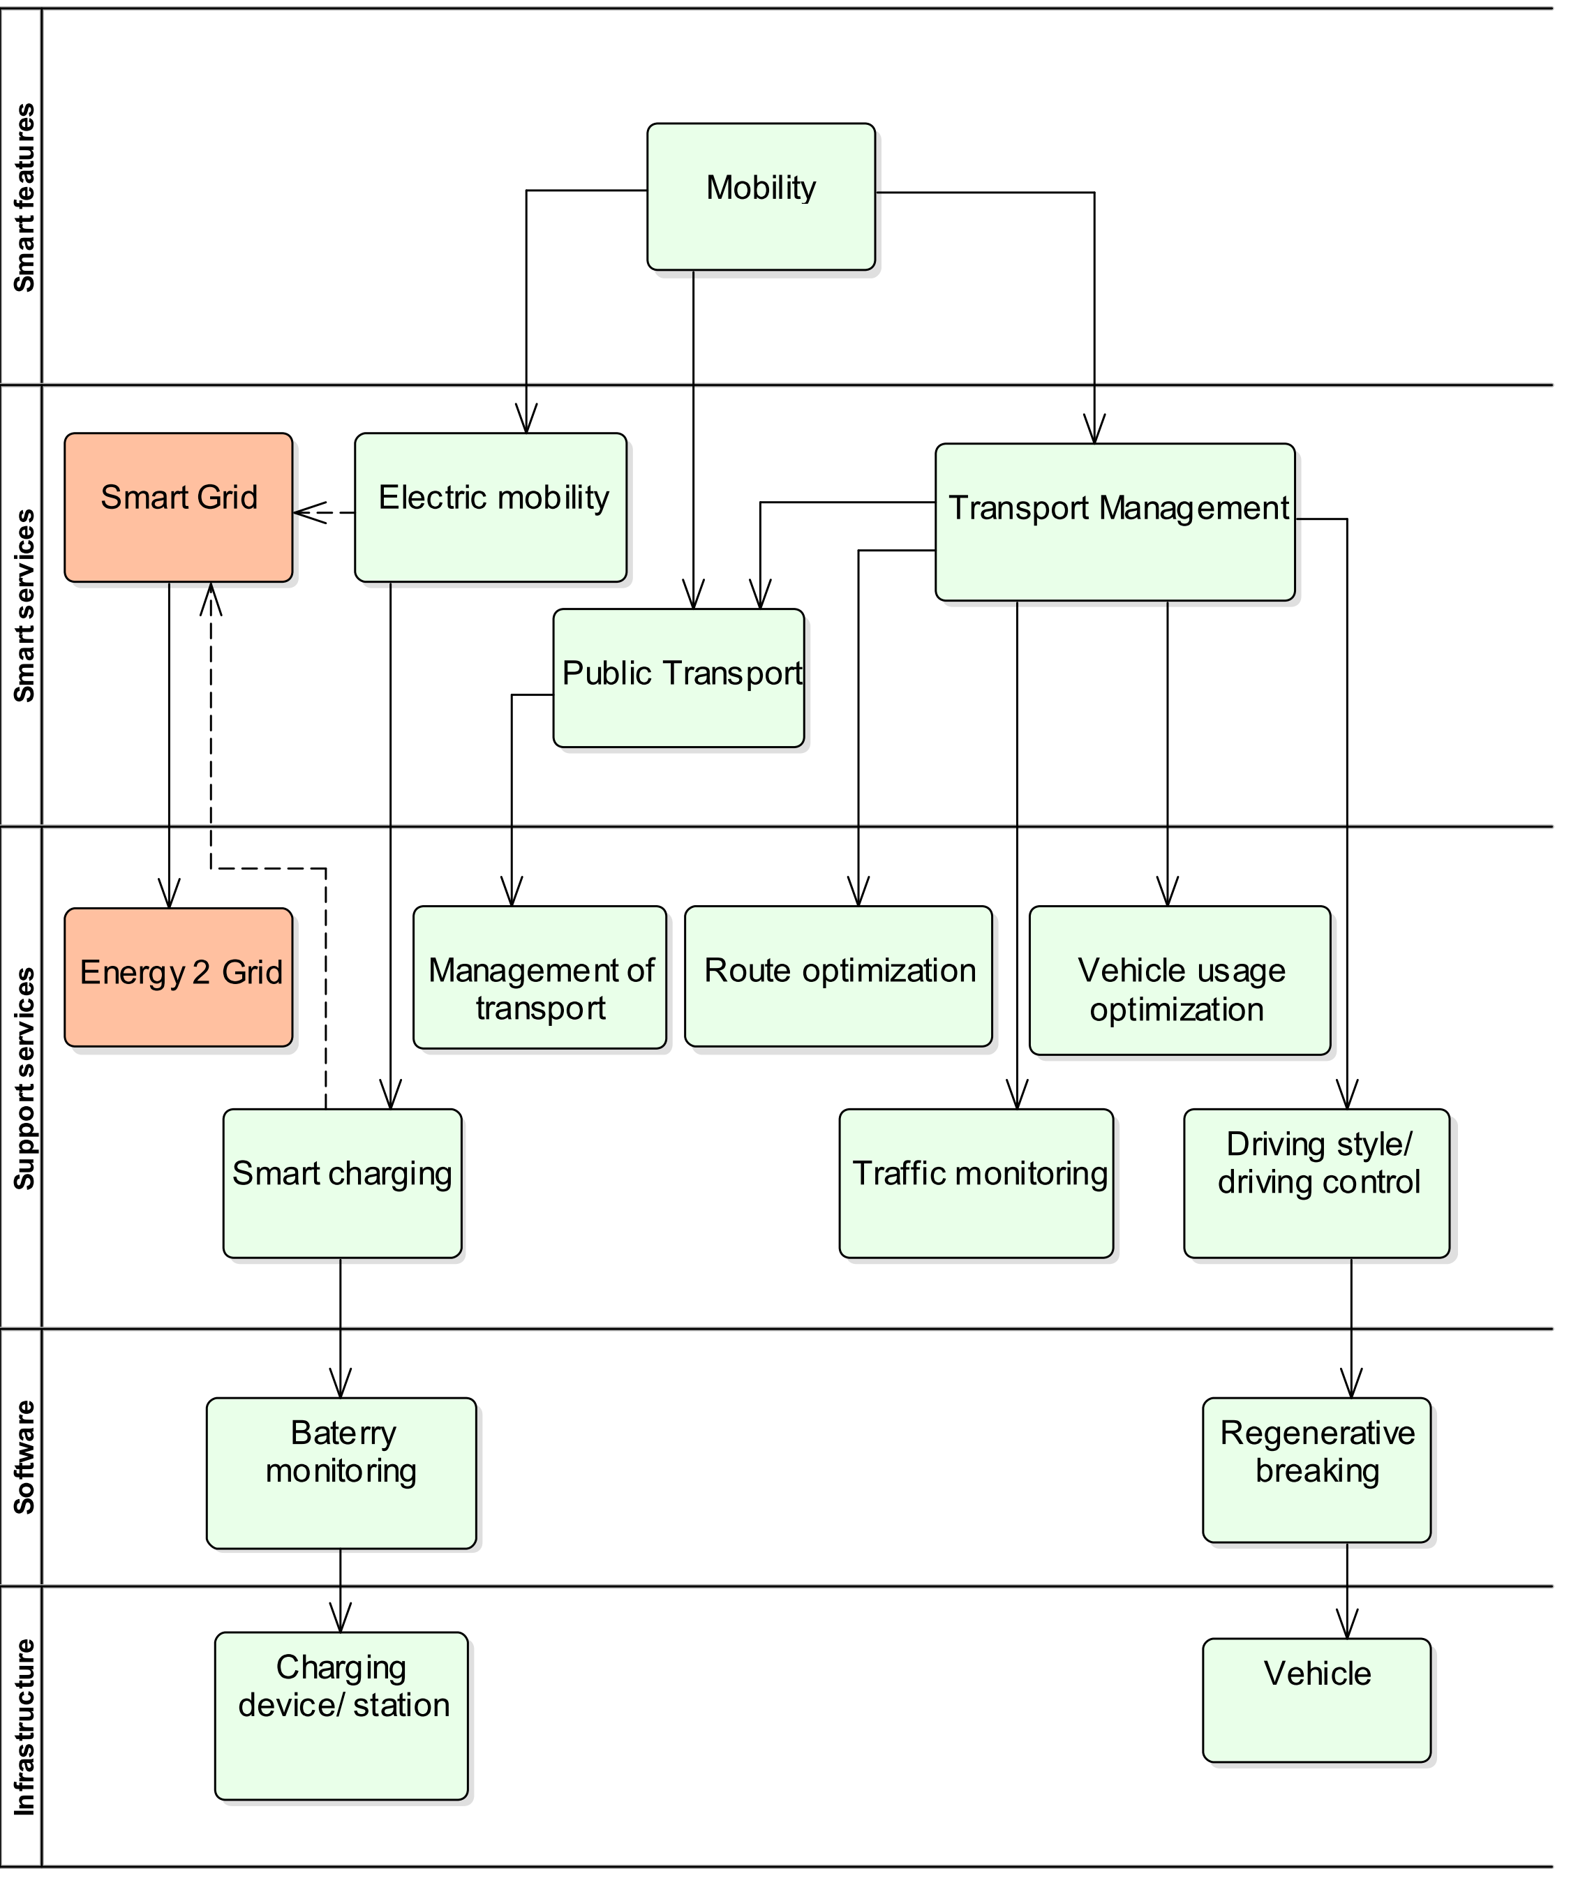
Detailed Layer analysis
Urban planning
Smart Energy
Mobility

Slide 23
Breaking idea
All models are trying to model multicontextual environment as one context
Context is the facets of a situation, fictional or non-fictional, that inspire feelings, thoughts and beliefs of groups and individuals. It is the background information that allows people to make informed decisions. (https://www.studiobinder.com/blog/what-is-context-definition/)
Any change, modification or enlargement means redefinition of the model
We need to find a way how context can be part of the model

Slide 24
Conclusion
Service and its role
Value proposition and its meaning
Serivice complexity
Smart City as examle

