Slide 1
Smart City and Complexity
How to understand complexity of Services
© Leonard Walletzký 2023

Slide 2
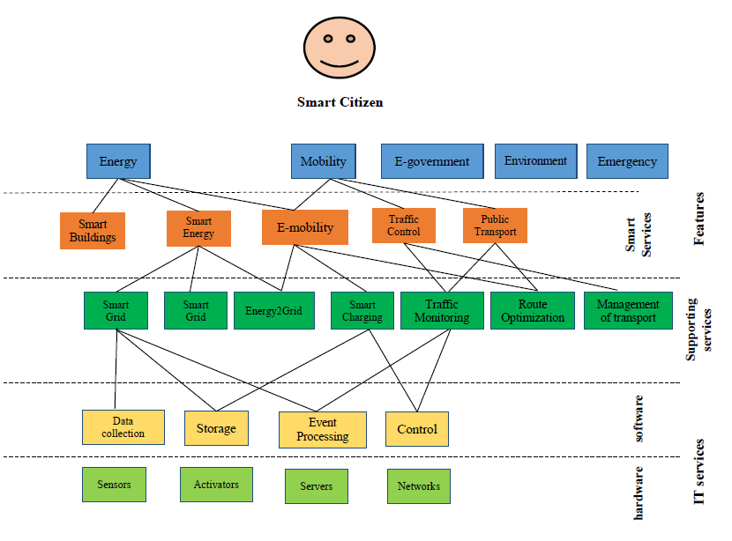
Layer model of Smart City
Walletzky L., Buhnova B., Carrubbo L. (2018) Value-Driven Conceptualization of Services in the Smart City: A Layered Approach. In: Barile S., Pellicano M., Polese F. (eds) Social Dynamics in a Systems Perspective. New Economic Windows. Springer, Cham
Notes:
Předpolkádám, že je nějaký oslí můstek s předchozím slajdem.

Slide 3
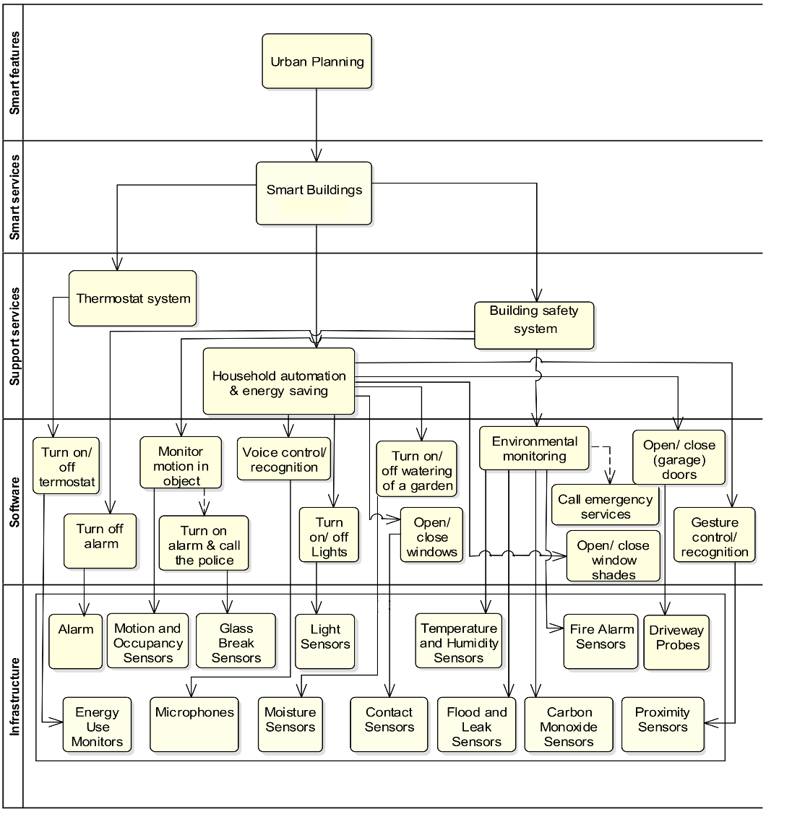
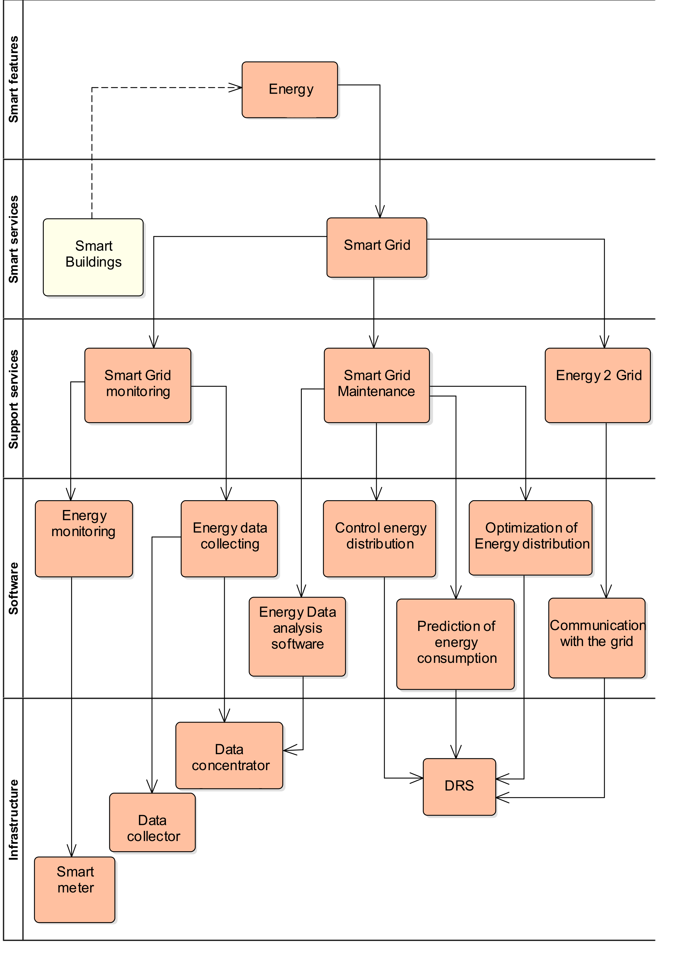
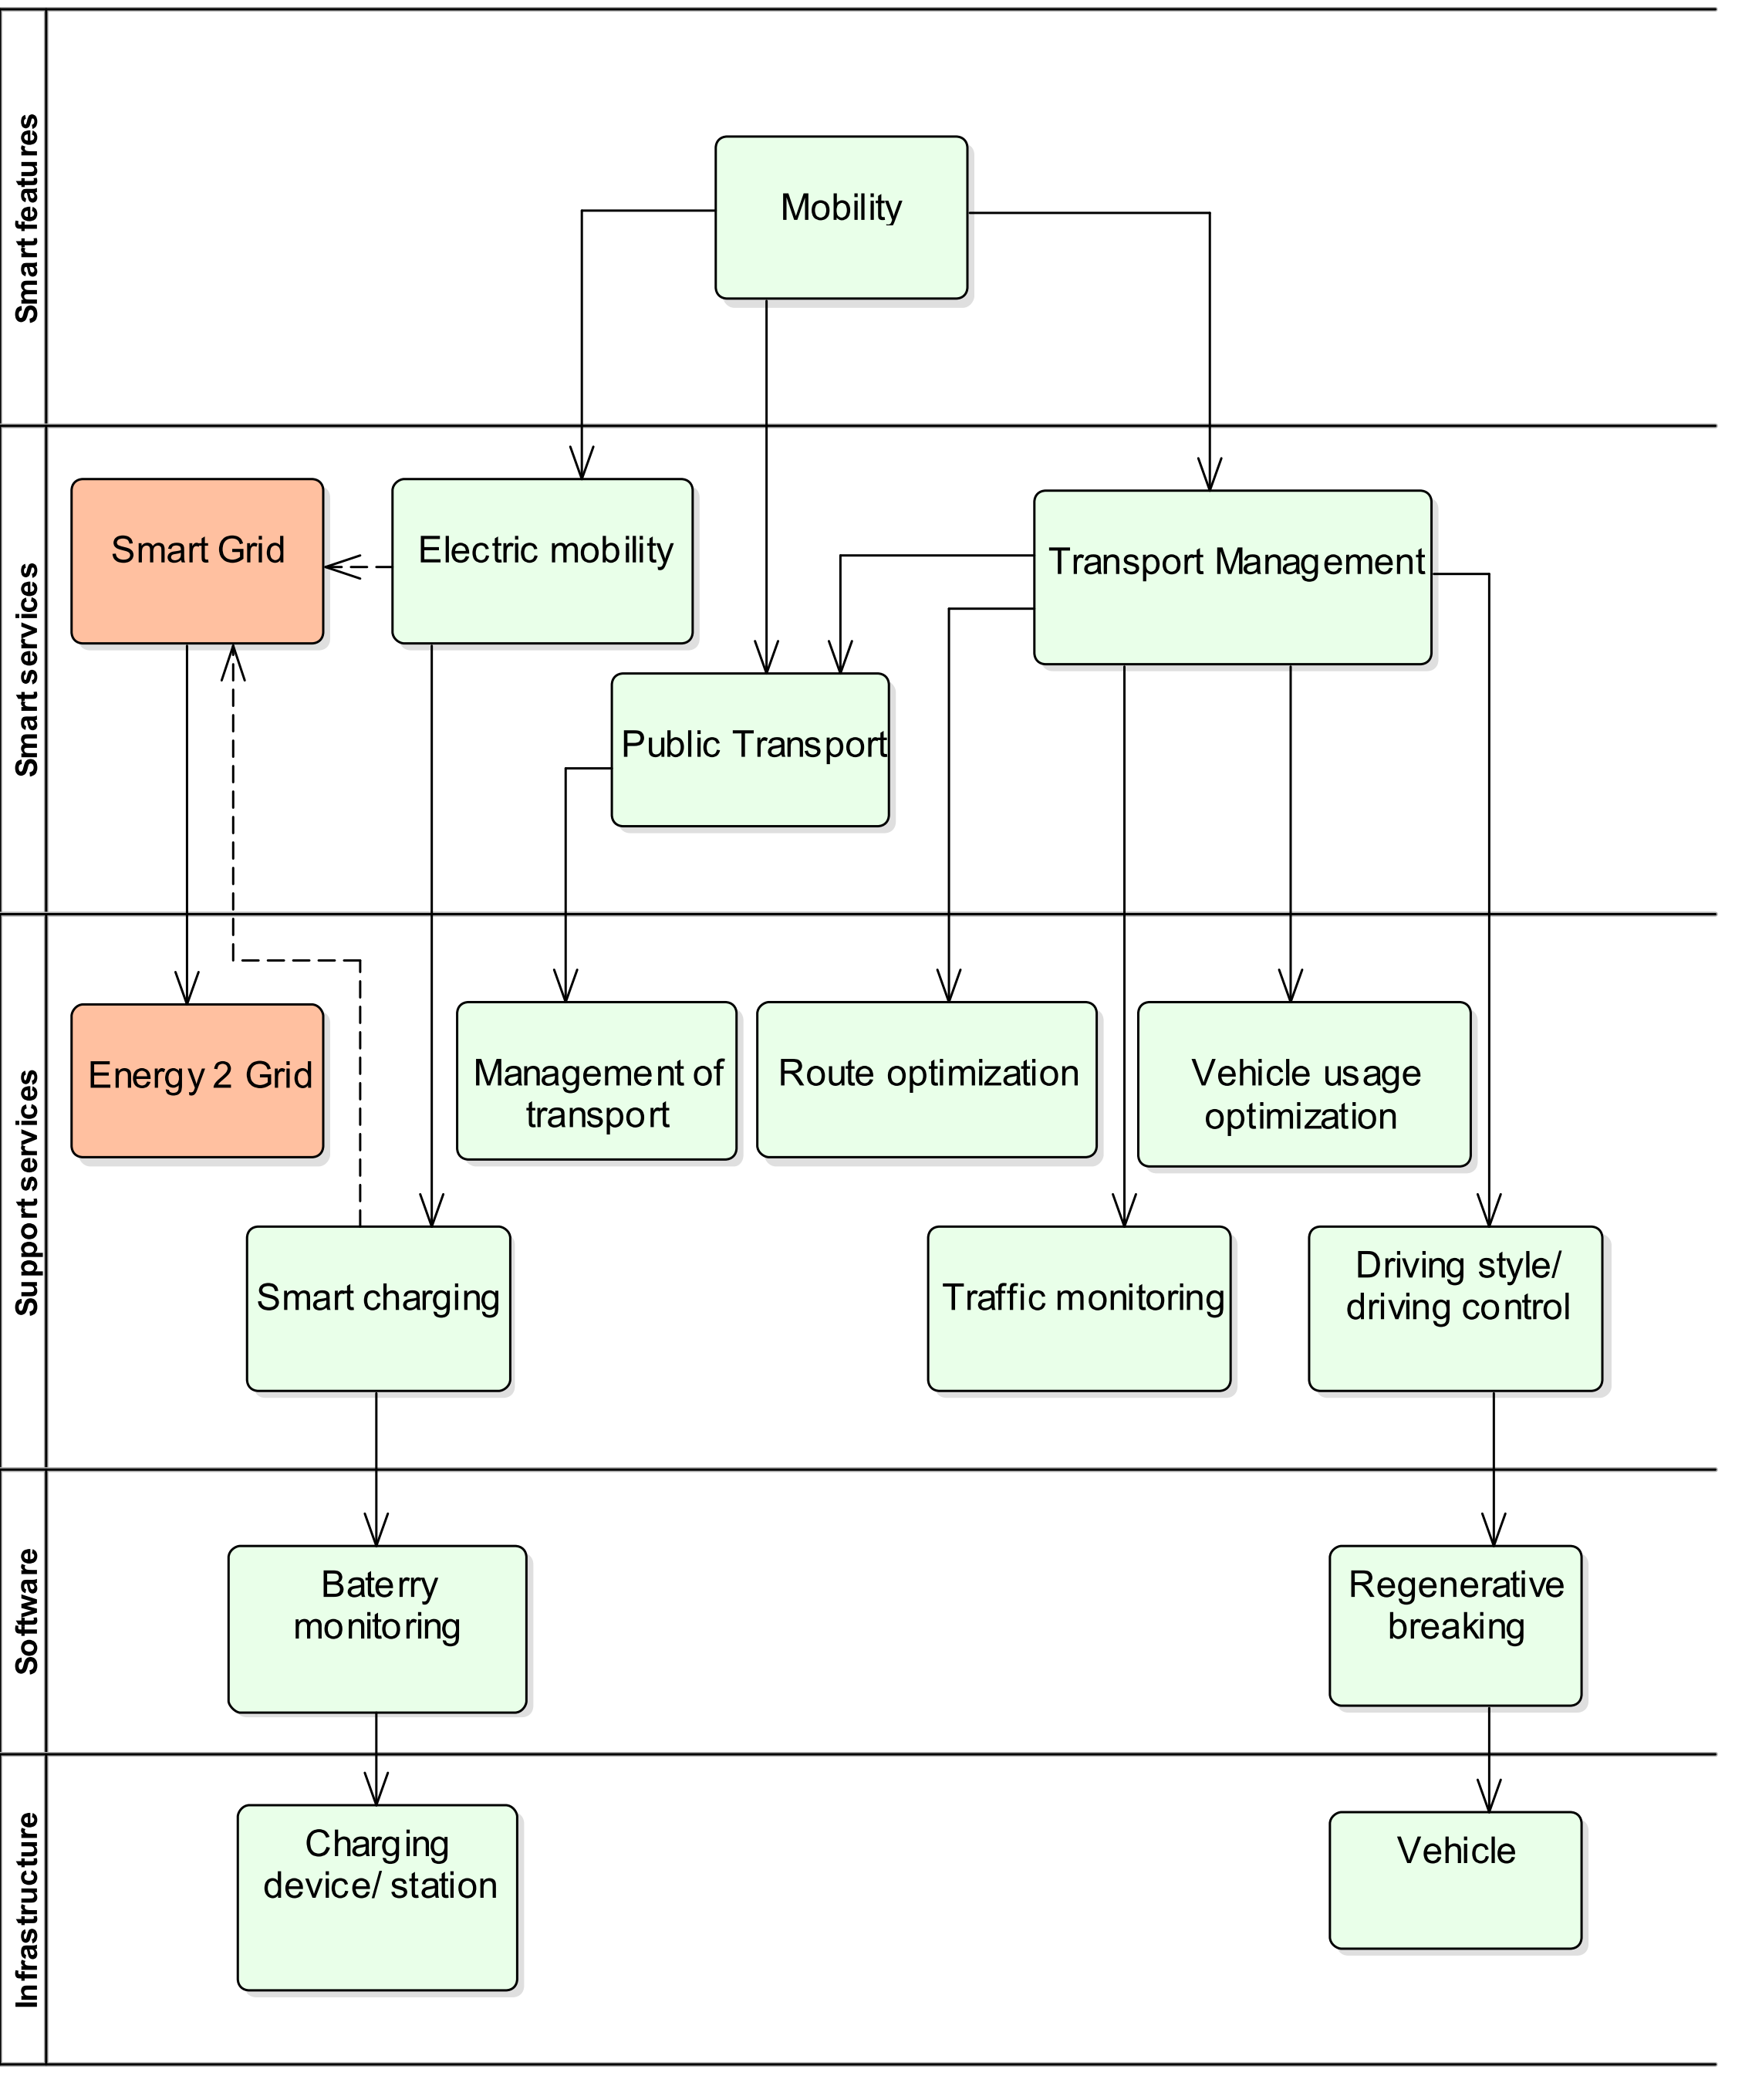
Detailed Layer analysis
Urban planning
Smart Energy
Mobility

Slide 4
Breaking idea
All models are trying to model multicontextual environment as one context
Context is the facets of a situation, fictional or non-fictional, that inspire feelings, thoughts and beliefs of groups and individuals. It is the background information that allows people to make informed decisions. (https://www.studiobinder.com/blog/what-is-context-definition/)
Any change, modification or enlargement means redefinition of the model
We need to find a way how context can be part of the model

Slide 5
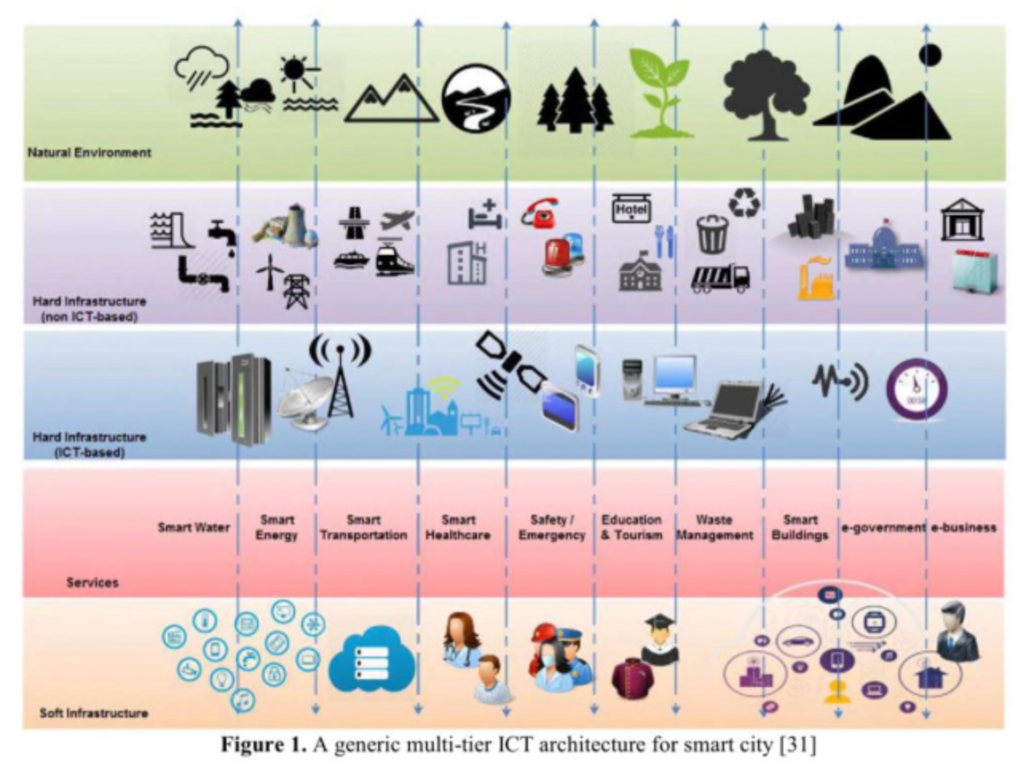
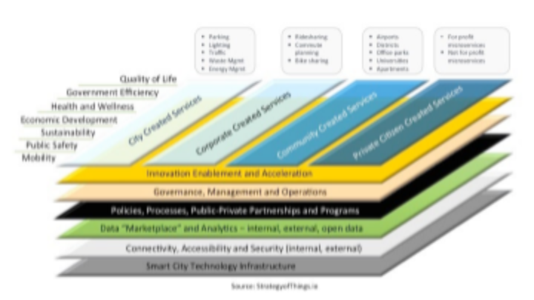
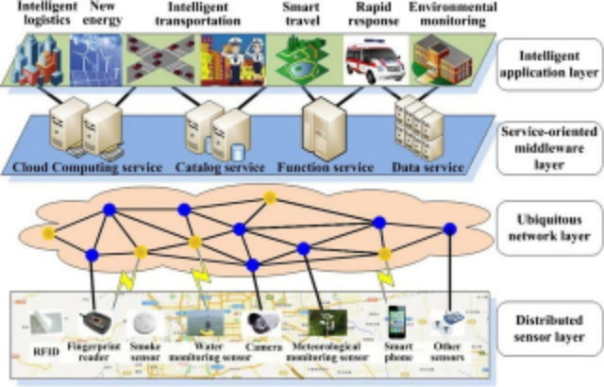
The journey continued…..
The concept of layers was not alone
The same idea was presented by multiple authors
And we have investigated a lot of models…

Slide 6
The main requests to the model
Understandable to the most of actors (common language)
Reflecting the structure and dependencies of the services
Enabling the value analysis
Multicontextual
None of the studied models (including ours) does not fit to all points

Slide 7
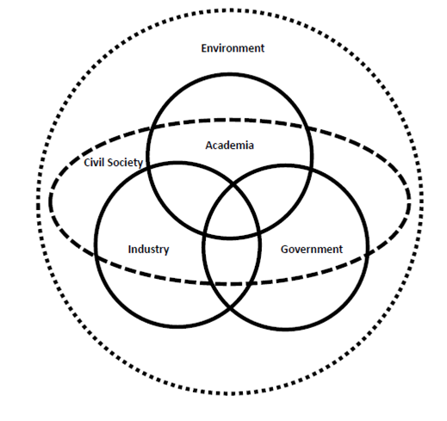
Quadruple Helix

Slide 8
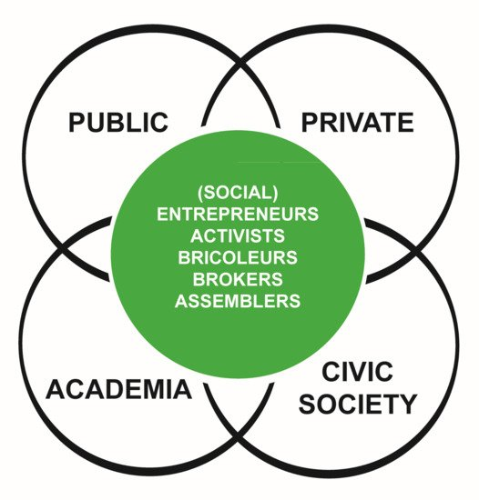
Penta Helix platform

Slide 9
Complexity of Smart City
the environment of Smart City is not truly objective – it is a mix of different contexts, based on the interactions of actors in a stated moment
the main problem is how to merge different perspectives described by the quadruple helix
Government
Wants satisfied citizens
Wants to be elected again
Industry
Wants to have a business opportunity
Expects clear rules of involvement
Academia
Wants to participate on the development
Can act as guarantors of the solution
Society
Expects improving of well being

Slide 10
New developed model
Smart feature and services depend on specific point of view of customer = context
Smart Features
Smart Services
Supporting Services
Infrastructure
Infrastructure and supporting services depend on specific point of view and terminology of experts = context
Customer facing services
Background services

Slide 11
Detailed Layer analysis
Urban planning
Smart Energy
Mobility

Slide 12
How to model such complex environment?
We need to have universal tool to catch multicontextual relations
It should contain
Analysis of perception
Analysis of stakeholders´ motivation
Analysis of service provision
The main questions
Do we really understand the models?
Are the models readable for others?
What if we need to communicate with people from other domains?
And what if we need to achieve understanding across domains?
How we can model in multidisciplinary way?

Slide 13
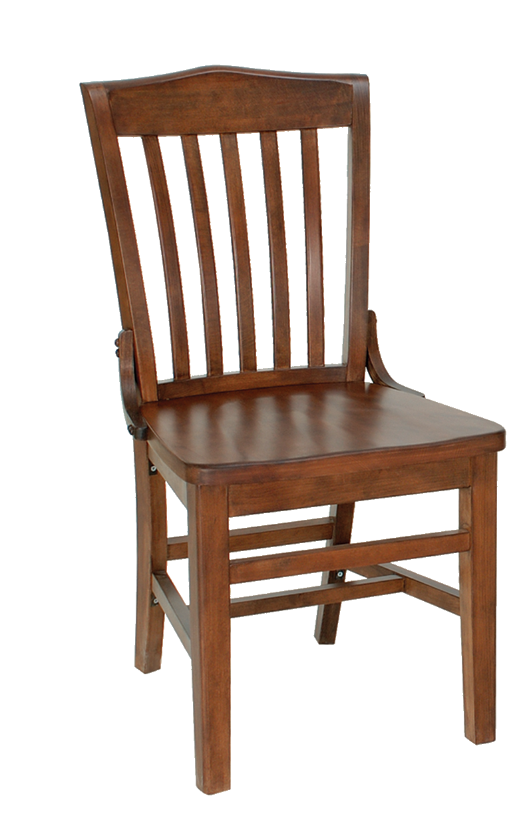
Solution is to go back to our roots and ask
What are we modeling?
The answer is – objects from the real world
How does any person build own mind model?
Where are we modeling?
The answer is - in our mind!

Slide 14
How do we model reality in our heads?
We identify...
Object
-s
...we find interesting

Slide 15
Then, we find...
Relationship
-s
...between our...
Object
-s

Slide 16
Each relationship can connect multiple objects...
Relationship
Relationship
Relationship
Object
Object
Object
...and each object can be present in multiple connections.

Slide 17
Relationship is specifically defined n-dimensional set of objects
Each relationship can connect multiple objects...
Relationship
projection
Object
...and each object can be present in multiple connections.

Slide 18
I can describe anything now!
I know when to perform particular operation
Relationship
Which objects do we find interesting for modelling?
projection
Now I can change the state
Category
Object
Rule
Operation

Slide 19
MENTION – USE duality
I am using category here.
Relationship
R
P
Category
R
Object
R
Rule
I am thinking about category here.
R
Operation

Slide 20
Diamond of Attention Focussing
I am in syntactic part
I can connect relationship with dynamic rule!
Relationship
characteristic
characteristic
R
P
Category
R
Object
R
Rule
I am in dynamic part
I can connect operation with specific categories!
R
characteristic
characteristic
Operation

Slide 21
Diamond of Attention Focussing
Objects and relationships between them
Mention-use duality
Modelling a modelling tool
Referring to itself
Relationship
characteristic
characteristic
R
P
Category
R
Object
R
Rule
characteristic
R
characteristic
Operation

Slide 22
Example – Smart Street

Slide 23
Road (street) - Objects and relationships
Name | Relationship | Name
Car | Is on | Road
Bus | Is on | Road
Bicycle | Is on | Road
Pedestrian way | Is on | Road
Driving lines | Are dividing | Road
All vehicles | Are using | Driving lines
Trafic on the road | contains | All vehicles
Trafic lights | Are managing | Traffic on the road

Slide 24
What do we need to do?
Define categories
To what categories do presented objects belong to?
Define examples of operations that can be performed
Remember they are related to the category, not to the object
Define Rules
they are related to relations, not to categories

Slide 25
Conclusion
Complexity of Smart City, Quadruple Helix
Diamond See
Example of Smart Street

