Slide 1
Complexity and contextuality
Diamonds See and Recognize

Slide 2
Diamond of Attention Focussing
I am in
syntactic part
I can connect
relationship with
dynamic rule!
Relationship
characteristic
characteristic
R
P
Category
R
Object
R
Rule
I am in
dynamic part
I can connect
operation with
specific
categories!
R
characteristic
characteristic
Operation

Slide 3
Diamond of Attention Focussing
Known as See Diamond
Definition of objects and relationaships among them
Mention and use duality
Relationship
characteristic
characteristic
R
P
Category
R
Object
R
Rule
characteristic
R
characteristic
Operation

Slide 4
What to do next
If we want to understand complexity, we need to have holistic approach
What is holistic approach?
  In a medical setting, a holistic approach to problem solving refers to addressing the whole person, including their physical, mental, and emotional health, while taking social factors into consideration.
  In problem solving, a holistic approach starts by first identifying an obstacle, then taking a step back to understand the situation as a whole.
  In service environment, a holistic approach means to understand the value of the service from different perspectives, from the all important stakeholders point of view, to analyze overlaps to the other domains and take them into the consideration

Slide 5
Classification example
killing
killing
Juliet
In love with
Romeo
In love with
killing
Paris

Slide 6
We can see that some connections are somehow similar – they belong to the same category:
killing
killing
Juliet
In love with
Romeo
In love with
killing
Paris

Slide 7
It‘s possible to classify everything we see in the diagram. But how to classify our objects?
killing
killing
Juliet
In love with
Romeo
In love with
killing
Paris

Slide 8
We could certainly divide the objects to men and women:
killing
killing
Juliet
In love with
Romeo
In love with
killing
Paris

Slide 9
But won‘t it be more useful to show, which character belongs to the house of Montague and which one to the house of Capulet?
killing
killing
Juliet
In love with
Romeo
In love with
killing
Paris

Slide 10
It probably depends on a context – a mental model we want to build. Sometimes, both categorizations may be useful:
killing
killing
Juliet
In love with
Romeo
In love with
killing
Paris

Slide 11
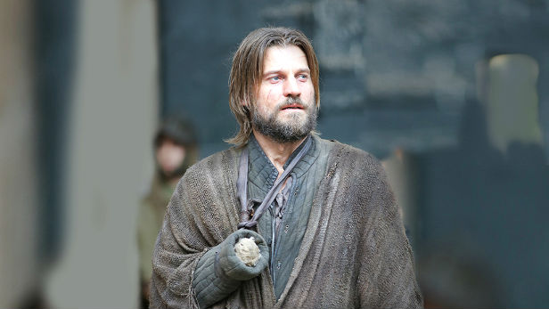
Classifications are blurred
Good or bad?

Slide 12
Certainty
Items (= objects as such, not their constructs) belongs to a category with a given certainty
Item can belong to
more categories!
Category
CI-connection
Item

Slide 13
Attention
The fact is manifested with a certain attention in a given context
Category
CI-connection
Item
Context
And context gives
a design to
the manifestaion.
And here it is about
particular manifestation
of CI connection
Manifestation

Slide 14
R-edges
In some cases, it might be also useful to mention non-trivial concepts – contexts, categories, classifications or manifestations
Romeo killing Romeo
Resulting in
Juliet killing Juliet
Romeo belonging to Monteques
Romeo in love with Juliet
Juliet belonging to Capulets
Fact1
Fact2
Fact3
<fact1> and <fact2> and <fact3>
Story plot
Belonging to

Slide 15
R-edges
Category
R
CI-connection
Item
R
Context
R
R
Manifestation

Slide 16
Context base
Context serves as a model. The base edge defines the set of categories to classify its items to
One category can exist
in more contexts and
vice versa.
Category
base
R
CI-connection
Item
R
Context
R
R
Manifestation

Slide 17

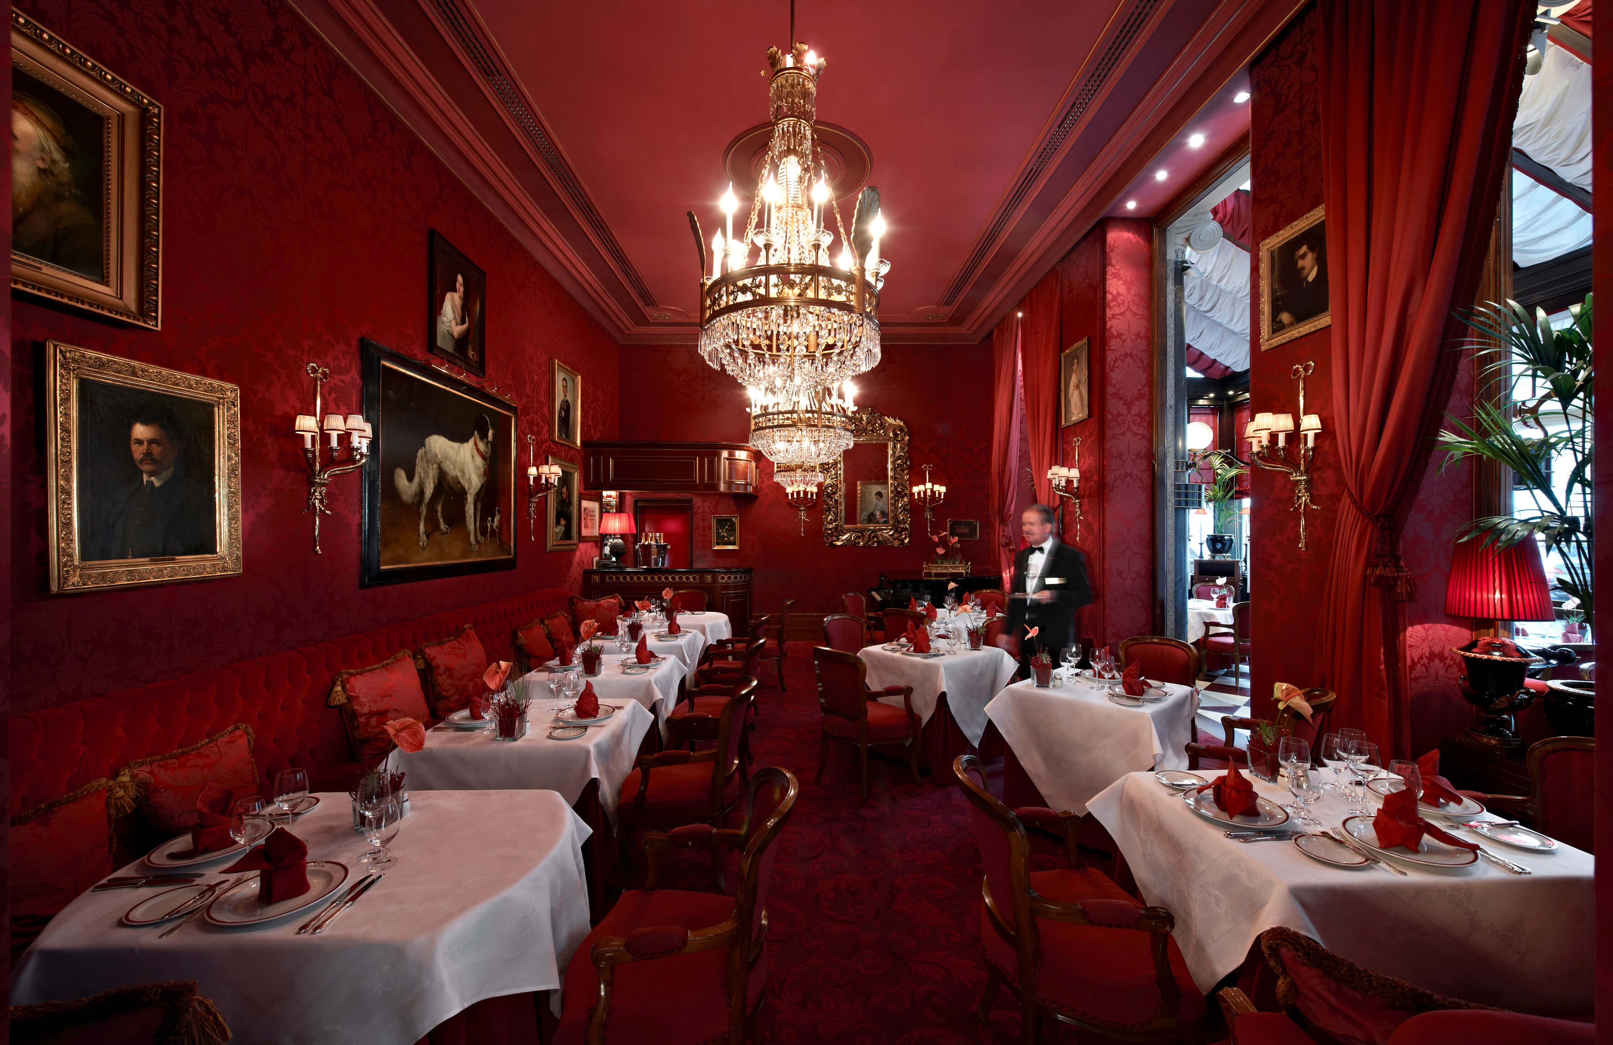
Independent models
Geography
Restaurant
Geography: Context
Restaurant: Context
Sahara: Manifestation
Sacher Cake: Manifestation
Sand desert: CI-connection
Sweet desert: CI-connection
Sand: Category
Desert: Item
Sweet: Category

Slide 18
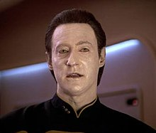
Examples of manifestation of DATA
IT
is any sequence of one or more symbols given meaning by specific act(s) of interpretation
Common understanding
individual units of information.
Star Trek
A character

Slide 19
Why we need it?
In the complex service environment (like Smart City) only one perspective is not enough
Already in a very simple applications we need to work with different manifestation of the same item
If we add the relation to other Services, environments (e.q. contexts) we get very complex model
To understand we need to have the possibility to analyze the manifestation of each item in all contexts

Slide 20
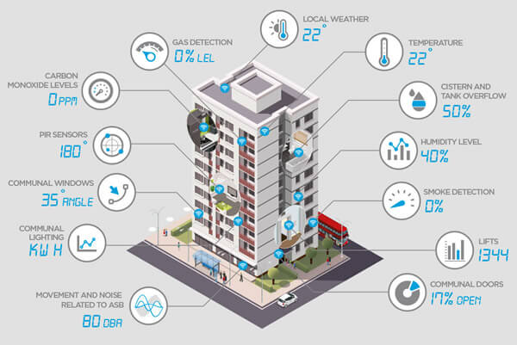
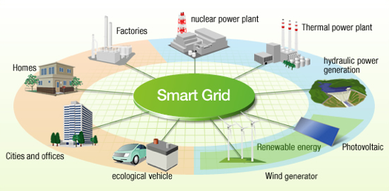
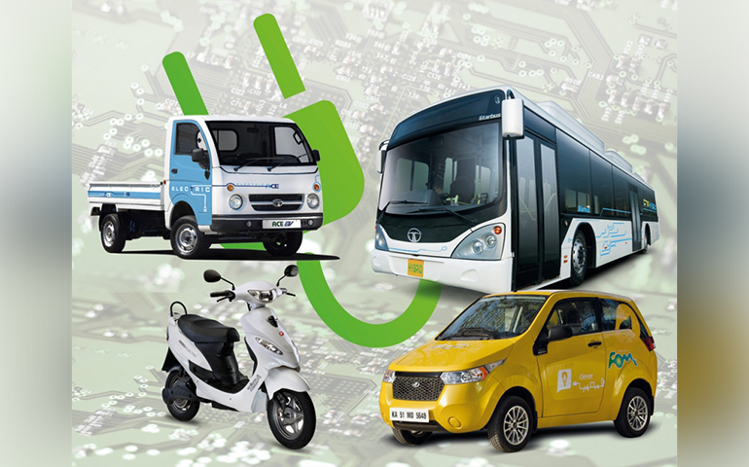
Examples

Slide 21
Example of smart street categories and objects
Street parts
Driving lines
Safety
Cameras
Pedestrian way
Public transport
Bus
Bus stop
All vehicles
Traffic on the road
Traffic lights
Parking slots
Pedestrian blocks
Speed sensor
Ticket machine
Tram line
IT Devices
Cameras
Smart Screen
Traffic lights
Traffic sensor
Pollution sensor
Vehicles
Car
Bicycle
Bus
Tram
Ticket machine
Smart Screen
Smart Screen

Slide 22
Questions
What other categories can we identify?
Can we identify the common domain (context of them)?
What about Security in IT or Transportation context?
What categories appear in more than one context?

Slide 23
Conclusion
Contextuality
Diamond Recognize, its elements and relationships
Examples and differences

