Slide 1
Quality of Service
Josef Spurný
PA181 Services - Systems, Modeling and Execution

Slide 2
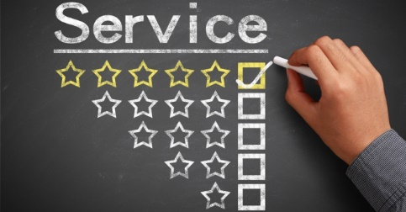
How good your service is?
When there is some service, how good this service is?

Slide 3
Learning Objectives
Recognize the importance of service quality
Describe the five dimensions of service quality
Develop a service measurement survey
Service quality gap identification
Closing the gap to improve service quality

Slide 4
Why is Service Quality Important?
SQ positively correlates with organization‘s financial performance
Dissatisfied customers are likely to share their experience with more than 3 other people
Six times more people hear about negative service experience than about positive one
Customers‘ service expectations are constantly rising, while their tolerance for poor service is declining

Slide 5
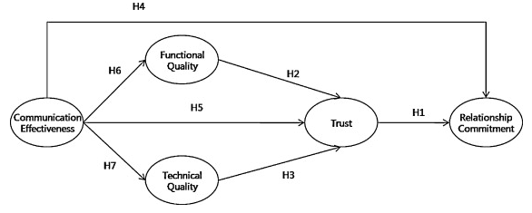
Why is IT Service Quality Important?
Customers often lack specialized knowledge; therefore, it is not easy for them to assess IT service quality, even after delivery
communication with a customer is essential! (T-Shaped profile)
IT Service Quality is a mediating factor between communication and buildup of trust with the customer
Source: Park, Lee, Lee & Truex (2012). Exploring the impact of communication effectiveness on service quality, trust and relationship commitment in IT services.

Slide 6
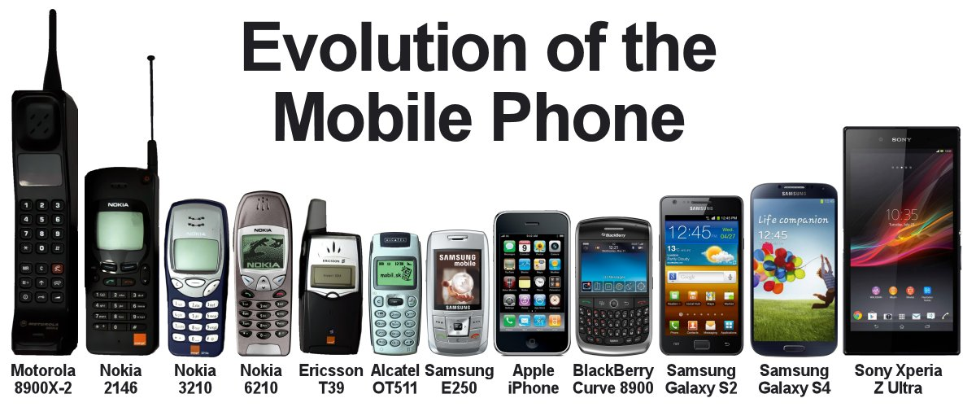
Comparison in real life

Slide 7
Comparison in real life
3rd Party Authority
=
Objective comparison
Own comparison criteria
=
marketing / persuasion

Slide 8
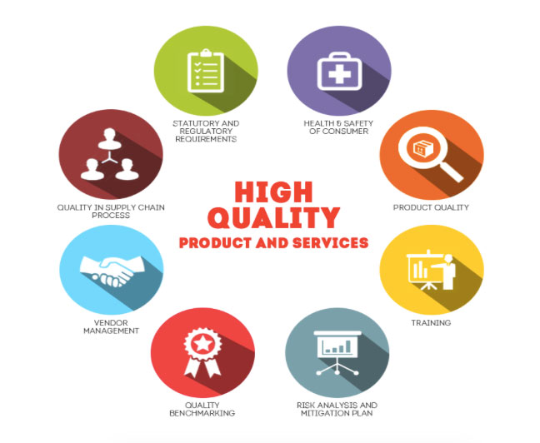
Service Quality or Quality of Service

Slide 9
Scope of Service Quality
View quality from five perspectives
  Content – are standard procedures being followed?
  Process – is the sequence of events in the service process appropriate?
  Structure – are the physical facilities and organizational design adequate for the service?
  Outcome – what change in the status has the service caused? Is the consumer satisfied?
  Impact – what is the long-term effect of the service on the consumer?

Slide 10
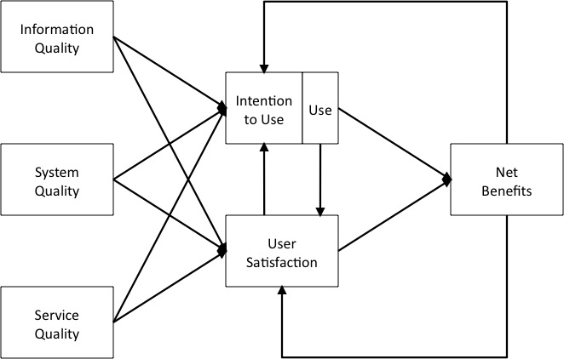
Position of Service Quality
Information Systems Success Theory, DeLone and McLean (2002)
Data quality – format, accuracy, reliability, completeness…
SW engineering
[Focus of this lecture]

Slide 11

Evaluation of Service Quality
Metrics/Criteria/Dimensions

Slide 12
SERVQUAL: The Five Key Service Dimensions
Dimension | No. of Items in Questionnaire | Definition
Reliability | 5 | The ability to perform the promised service dependably and accurately
Assurance | 5 | The knowledge and courtesy of employees and their ability to convey trust and confidence
Tangibles | 4 | The appearance of physical facilities, equipment, personnel and communication materials
Empathy | 5 | The provision of caring, individualized attention to customer
Responsiveness | 4 | The willingness to help customers and to provide prompt service
Source: Based on Parasuraman, A, Ziethaml, V. and Berry, L.L., "SERVQUAL: A Multiple- Item Scale for Measuring Consumer Perceptions of Service Quality' Journal of Retailing, Vol. 62, no. 1, 1988

Slide 13
Service Quality
Reliability
Responsive-ness
Empathy
Tangibles
Assurance
SERVQUAL Model

Slide 14
Dimensions of Service Quality
Reliability:
  Perform promised service dependably and accurately.
  Example: receive mail at same time each day.
Assurance:
  Ability to convey trust and confidence.
  Give a feeling that customer’s best interest is in your heart
  Example: being polite and showing respect for customer.

Slide 15
Dimensions of Service Quality
Tangibles:
  Physical facilities and facilitating goods.
  Example: cleanliness.
Empathy:
  Ability to be approachable, caring, understanding and relating with customer needs.
  Example: being a good listener.
Responsiveness:
  Willingness to help customers promptly.
  Example: avoid keeping customers waiting for no apparent reason.
  Quick recovery if service failure occurs

Slide 16
SERVQUAL Attributes
RELIABILITY
EMPATHY
Providing service as promised
Dependability in handling customers’ service problems
Performing services right the first time
Providing services at the promised time
Maintaining error-free records
Giving customers individual attention
Employees who deal with customers in a caring fashion
Having the customer’s best interest at heart
Employees who understand the needs of their customers
Convenient business hours
RESPONSIVENESS
Keeping customers informed as to when services will be performed
Prompt service to customers
Willingness to help customers
Readiness to respond to customers’ requests
TANGIBLES
Modern equipment
Visually appealing facilities
Employees who have a neat, professional appearance
Visually appealing materials associated with the service
ASSURANCE
Employees who instill confidence in customers
Making customers feel safe in their transactions
Employees who are consistently courteous
Employees who have the knowledge to answer customer questions

Slide 17
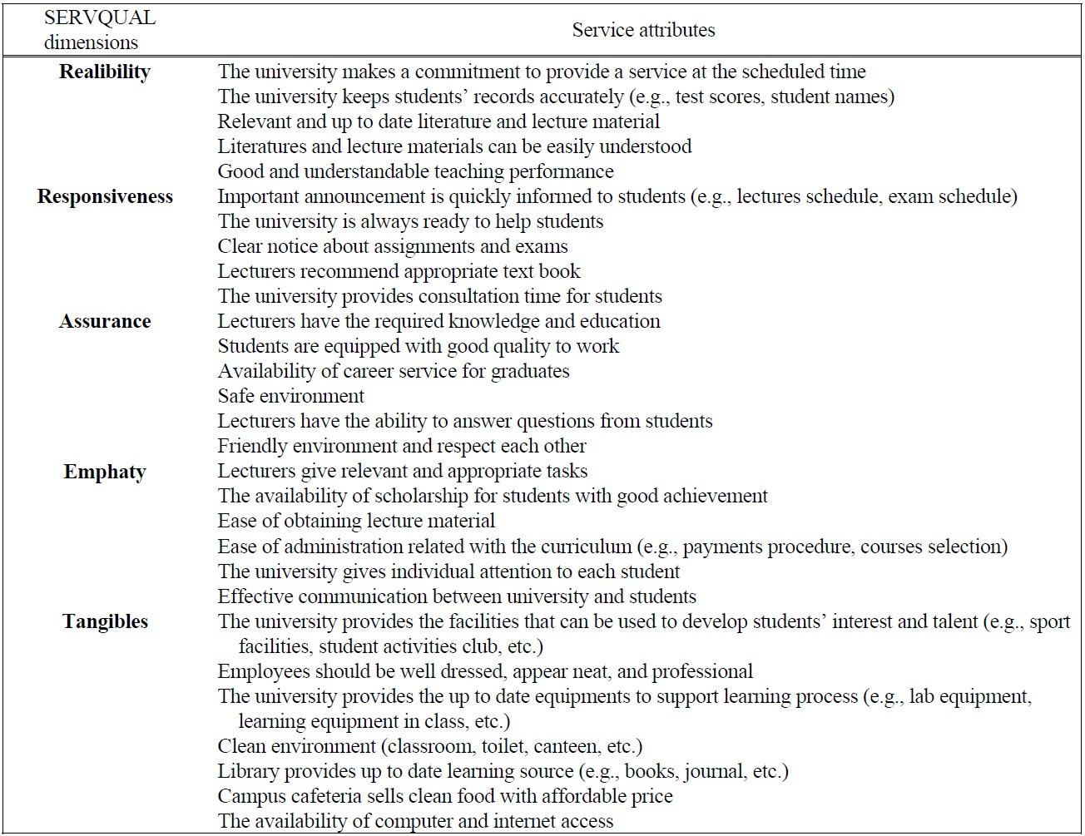
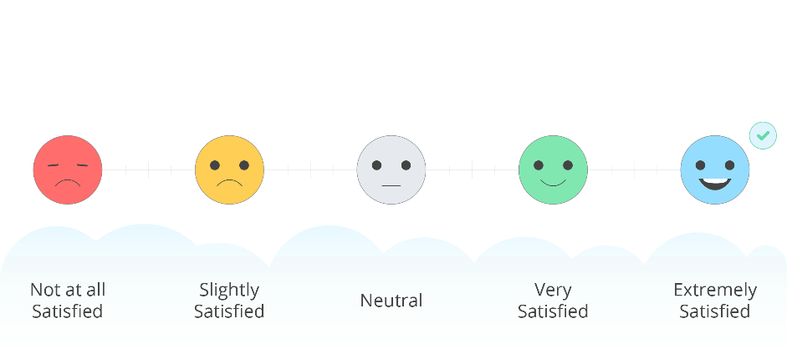
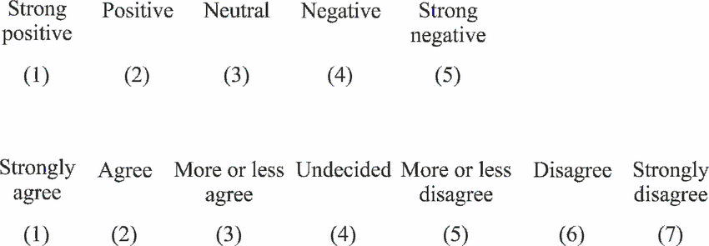
SERVQUAL Example for University Services
Likert scale

Slide 18
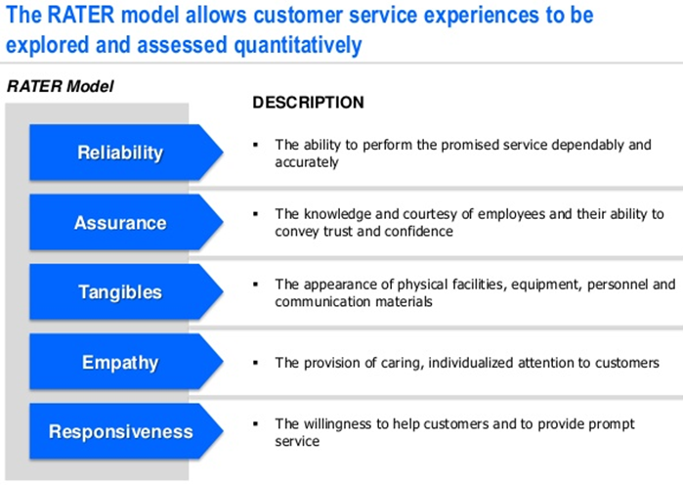
RATER – Tool for SERVQUAL

Slide 19
Remarks for Service Quality
We can assess service quality from the customer’s perspective
We can track customer expectations and perceptions over time and the discrepancies between them
We can compare a set of Servqual scores against those of competitors or best practice examples

Slide 20
Service Quality Assessment
Word of
mouth
Personal
needs
Past
experience
Service Quality
Dimensions
Reliability
Responsiveness
Assurance
Empathy
Tangibles
Expected
service
Service Quality Assessment
1. Expectations exceeded
ES<PS (Quality surprise)
2. Expectations met
ES~PS (Satisfactory quality)
3. Expectations not met
ES>PS (Unacceptable quality)
Perceived
service

Slide 21
Conceptual Model of Service Quality
CUSTOMER
Word-of-mouth
Communications
Personal Needs
Past experience
Expected Service
Gap 5
Perceived Service
PROVIDER
Service
Delivery
External
Communications
To Customers
Gap 4
Gap 3
Gap 1
Service Quality
Specs
Gap 2
Management
Perceptions of
Customer Expectations

Slide 22
What are the Servqual Gaps?
Gap 1: The difference between management perceptions of what customers expect and what customers really expect
Gap 2: The difference between management perceptions and service quality specifications - the standards gap

Slide 23
What are the Servqual Gaps?
Gap 3: The difference between service quality specifications and actual service delivery - are standards consistently met?
Gap 4: The difference between service delivery and what is communicated externally - are promises made consistently fulfilled?

Slide 24
What are the Servqual Gaps?
Gap 5: The difference between what customers expect of a service and what they actually receive
  expectations are made up of past experience, word-of-mouth and needs/wants of customers
  measurement is on the basis of two sets of statements in groups according to the five key service dimensions

Slide 26
Problems with Gaps in Service Quality
Gap1: Market research gap
  Management may not understand how customers formulate their expectations from past experience, advertising, communication with friends
    Improve market research
    Foster better communication between employees and its frontline employees
    Reduce the number of levels of management that distance the customer
Gap 2: Design gap
  Management is unable to formulate target level of service to meet customer expectations and translate them to specifications
    Setting goals and standardizing service delivery tasks can close the gap

Slide 27
Problems with Gaps in Service Quality
Gap 3: Conformance gap
  Actual delivery of service cannot meet the specifications set by management
    Lack of teamwork
    Poor employee selection
    Inadequate training
    Inappropriate job design
Gap 4: Communication gap
  Discrepancy between service delivery and external communication
    Exaggerated promises in advertising
    Lack of information provided to contact personnel to give customers

Slide 28
Problems with Gaps in Service Quality
Gap 5: Customer expectations and perceptions gap
  Customer satisfaction depends on minimizing the four gaps that are associated with service delivery

Slide 29
Monitoring Service Quality
Improvement
A
T
D
I
quality
time
servqual
servqual

Slide 30
Conclusion
Recognize the importance of service quality
Describe the five dimensions of service quality
Develop a service measurement survey
Service quality gap identification
Closing the gap to improve service quality

