Slide 1
Social informatics
PA181 S:SME
Josef Spurný

Slide 2
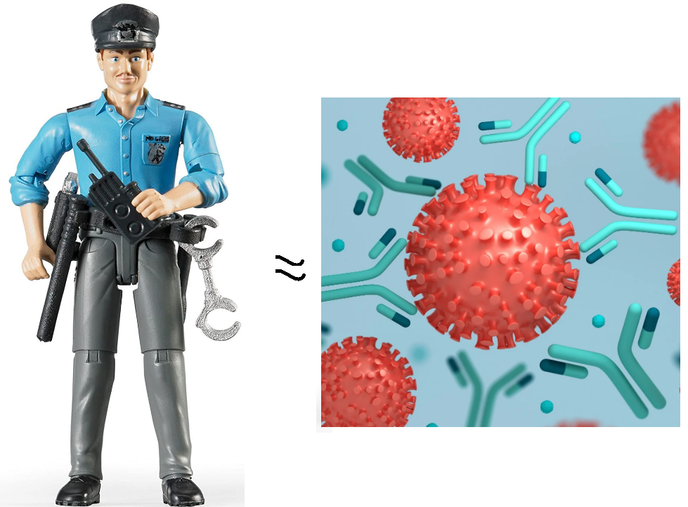
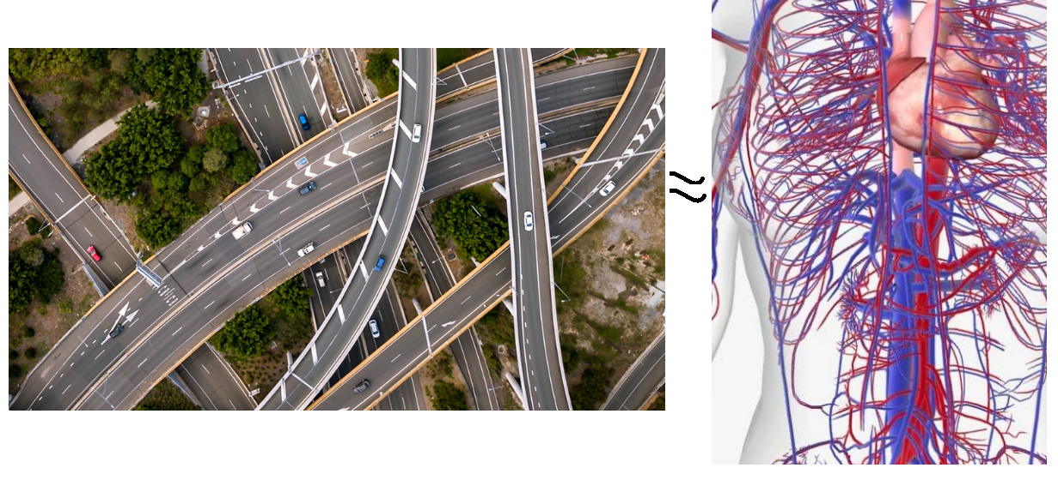
If human society was an organism…

Slide 3


…what would computer science be?

Slide 4
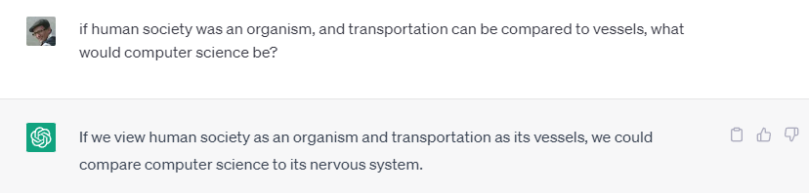
…what would computer science be?
Processing information
Reading data from sensors
Facilitation of response to stimuli, changing environment, etc.

Slide 5
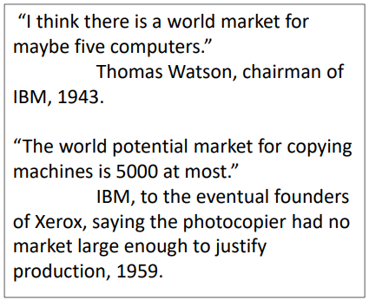
Computers and society
In USA 1960’, people were afraid that computers will take over their jobs
What will be the consequences?
What will people do with their free time??
  Compare: Nowadays vs. ChatGPT
Computers started to be used in more domains in human society (organizations, medicine, education…)

Slide 6
What is social informatics about?
Social informatics refers to the interdisciplinary study of the
  design
  uses
  and consequences
  of information technologies that take into account their interaction with institutional and cultural contexts
    ICT does not exist isolated from social contexts
    People shape the design of ICT
    ICT shapes the way how think and act

Slide 7
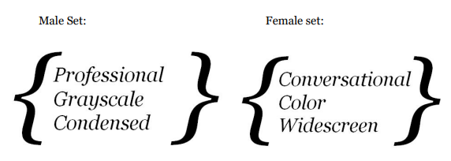
Some challenges with ubiquitous ICT
ICT may be discriminative in terms of social class or gender
  May poor people afford (paid) SW?
  Gender-neutral Design
    IT is male dominated → “masculine” SW design / “male aesthetic”

Slide 8
Some challenges with ubiquitous ICT
Impact on social interaction
Some aspects may be improved, but with some downsides…
  It may be easier to be in touch with friends on-line
    However, we might be less willing to meet in person
  Coordination is easier with shared calendar
    We must keep calendar up-to-date
  New enterprise SW brings better organizational profit
    More stress for employees, procrastination, impact on productivity
  Social media help us to be in touch…
    Idealization vs. reality
    Depression, impact on self-esteem
    Privacy issues

Slide 9
ICT and social transformation?
ICT may change social relationships, but the rate of change is usually slow
ICT usually does not offer new options, but change existing practice
New technologies usually make work more effective, does not change them substantially…
  What about AI?
Transformation towards service-oriented market

Slide 10
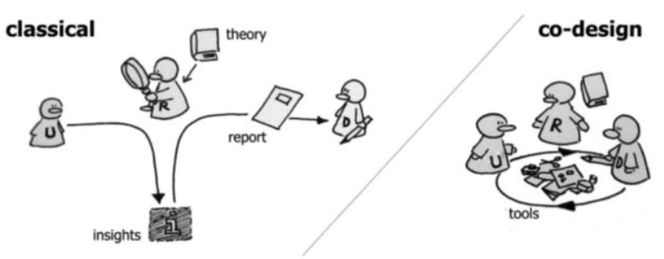
Application of social informatics
ICT shall make things easier, not more complicated
To design a system well, we must understand how people work
Systems are often design without involvement of the typical end-user

Slide 11
Participatory design
Combines IT systems design and ethnographic research
Be part of the (end-user) group, understand their daily tasks, needs and challenges
Reflect that into design, involve end-users in all stages of development

Slide 12
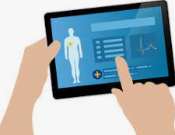




Participatory design – case study
Patient at home
Visiting nurse
Doctor
IT Specialist

Slide 13
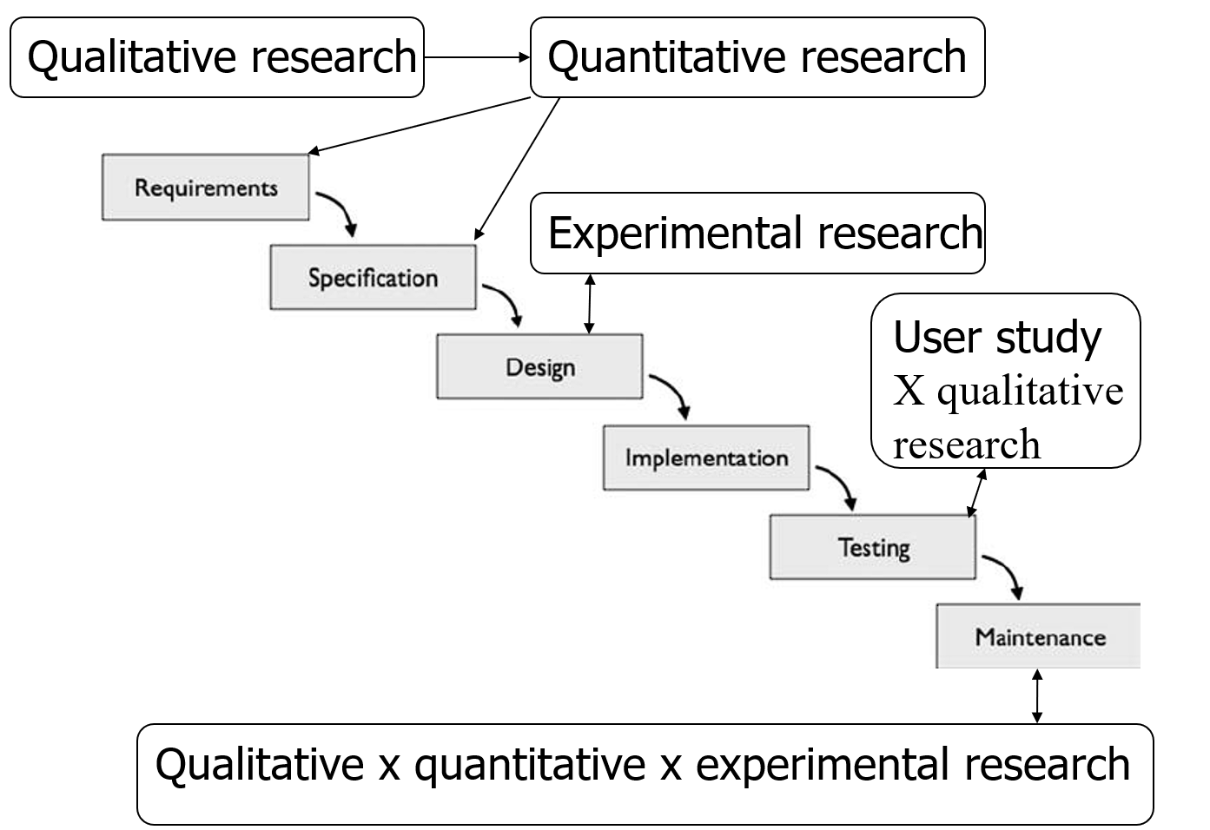
User involvement in SW delivery

Slide 14
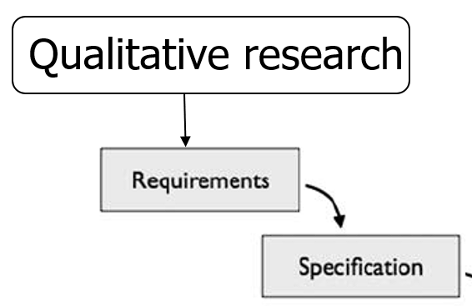
Qualitative research
Small sample of respondents
Typically interviews or focus groups which are recorded, transcribed and analyzed
High amount of information – deep and details
High validity x low reliability
Methods of coding and analyses (thematic analyses etc.)

Slide 15


Qualitative research
Questions (e.g.):
  What are needs and requirements of users?
  Why could they use the SW?
  What could be their motivations?
  What kind of functions they need?
  Are there differences in patterns of needs between different users?

Slide 16
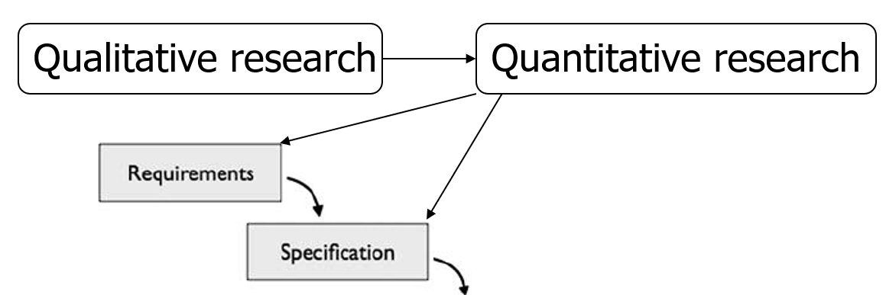
Quantitative research
“Larger” sample of respondents (what is enough?)
Typically a survey (online survey), depends on population
Questions = low and limited amount of information
Low validity x high reliability
Methods of sampling, theory of asking questions, data cleaning, methods of data analyses

Slide 17
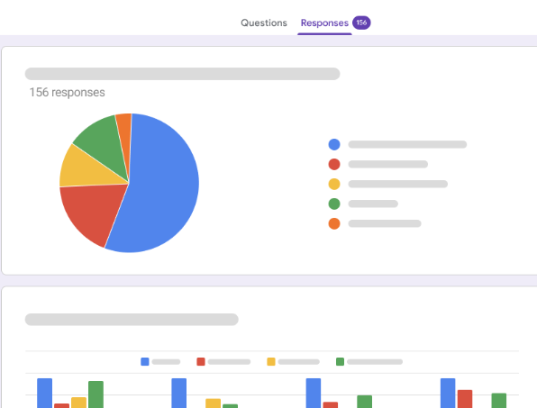
Quantitative research
Questions (e.g.):
  How many people could use the SW?
  What is most important for them?
  Which of functions are highly needed?
  Which functions are needed for which types of users?

Slide 18
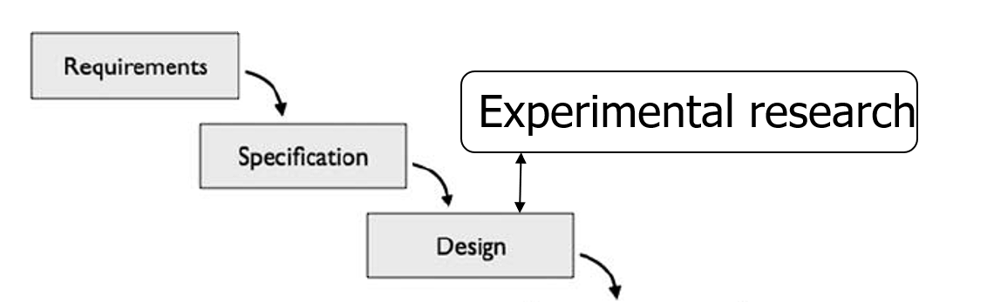
Experimental research
Limited amount of respondents
Experimental design – testing different variants of design (or screens, texts, functions …)
Questions = low and limited amount of information

Slide 19
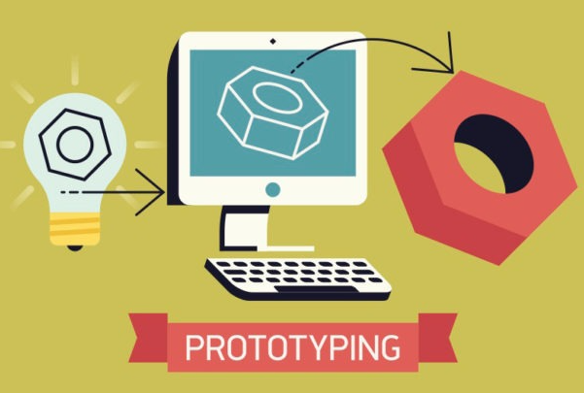
Experimental research
Questions (e.g.):
  What is the best (most user friendly?) design?
  How is the design impacting behavior (decisions) of users within the SW?
  How are different users behaving within different SW designs?

Slide 20



Collaborative systems
allow multiple users to work together on a common task
real-time, regardless of their physical location
designed to facilitate communication, coordination, and teamwork

Slide 21
Collaborative systems - core dimensions
Awareness: individuals working together need to be able to gain some level of shared knowledge about each other's activities
Articulation work: cooperating individuals must be able to partition work into units, divide it amongst themselves and, after the work is performed, reintegrate it
Appropriation (or tailorability): how an individual or group adapts a technology to their own particular situation; the technology may be appropriated in a manner completely unintended by the designers

Slide 22

Collaborative systems – research questions
What are the most effective ways to support collaboration among users in different contexts and domains (business, healthcare…)?
How to accommodate systems to users with different needs or levels of technical expertise?
How to promote knowledge sharing, creativity, or innovativeness through system design?
How can be emerging technologies like AI, VR or blockchain, used to enhance collaboration?

Slide 23

Social computing
Platforms connecting large quantities of users to
  Share knowledge (Wikipedia)
  Share trends or news (social media)
  Solve optimization problems (“swarm intelligence”)
    Navigation (Waze)
    Supply & Demand – “gig economy” (Wolt, Uber, AirBnB…)
    Reviewing products, restaurants, services, sellers …
    Typically, more users = better profit for everyone
vs collaborative systems – smaller teams, task-oriented

Slide 24
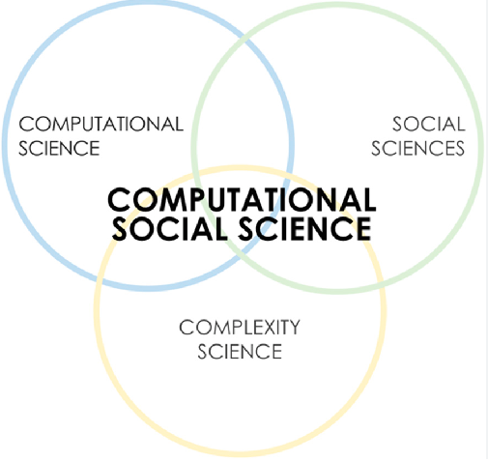
Computational social science
Using computer tools (and knowledge of complex systems) to gain better insight into social problems
  social network analysis
  modeling and simulation

Slide 25
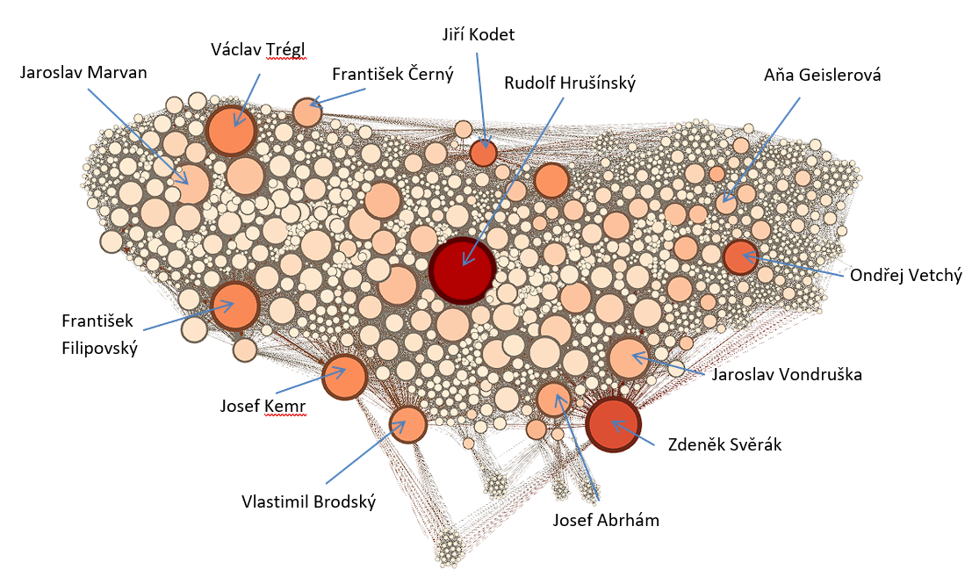
Network analysis of Czech actors' cooperation

Slide 26
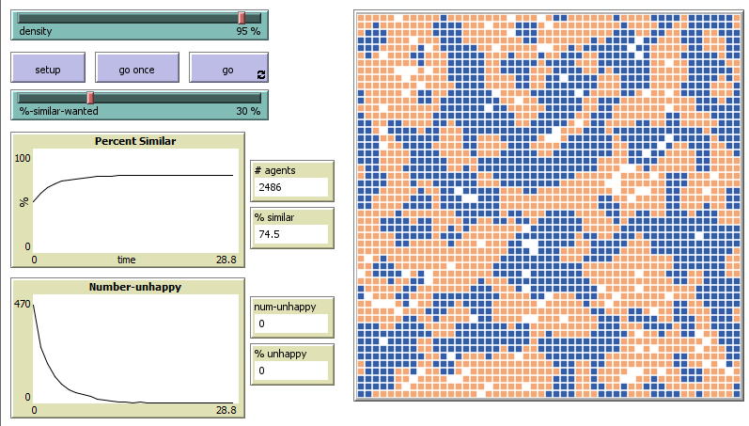
Modeling & Simulations in NetLogo

Slide 27

Assistive technologies
Designing SW/HW solutions to help users with special needs
Hearing / Visual / Movement disabilities
Challenge:
  small target audience for specific SW
  good “market research” + requirements analysis needed
Examples:
  Automatic video captioning
  Read-out-loud features in specific contexts (e.g., ROL + map + gps → pedestrian navigation)
  Speech-to-text

Slide 28

Psychoinformatics
Up to 80 % of population have experienced major depressive episode in their life
Some people do not want to (or can’t afford to) see a therapist
Some people might just want to improve their quality of life

Slide 29
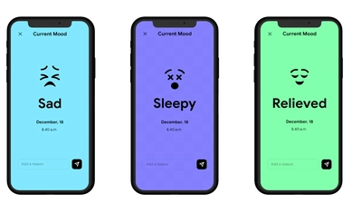
Psychoinformatics
Apps
  Mood tracking
  Personal Journals
  Dream Diary
  Mindfulness / Relaxation & Mediation techniques practice
Using machine learning in (mental) healthcare
  Identification of diagnose from symptoms (might not be even detectable by humans)
  Chatbots

Slide 30

… and numerous other approaches!
Thanks for your attention

