Slide 1
Introduction
Advanced Search Techniques for Large Scale Data Analytics
Pavel Zezula and Jan Sedmidubsky
Masaryk University
http://disa.fi.muni.cz

Slide 2
Course
Teachers:
  prof. Ing. Pavel Zezula, CSc.
  RNDr. Jan Sedmidubsky, Ph.D.
Inspiration:
  Inspired by the book of people from Stanford:
    Jure Leskovec, Anand Rajaraman, Jeff Ullman: Mining of Massive Datasets. Cambridge University Press, 2nd Edition, 476 pages, 2014.
    Additional information: http://mmds.org/

Slide 3
Course Outline
Introduction
Block 1:
  Support for Distributed Processing
  Retrieval Evaluation
  Clustering
  Exercises on topics of Block 1
Block 2:
  Finding Frequent Item Sets
  Finding Similar Items
  Searching in Data Streams
  Exercises on topics of Block 2
Block 3:
  Link Analysis
  Search Applications
  Exercises on topics of Block 3

Slide 4
Course Outline – Block 1
Block 1:
  Support for Distributed Processing
    Distributed file system
    MapReduce, Algorithms using MapReduce
    Cost model and performance evaluation
  Retrieval Evaluation
    Retrieval metrics
  Clustering
    K-means algorithms
    Clustering in non-Euclidean spaces
    Clustering for streams and parallelism

Slide 5
Course Outline – Block 2
Block 2:
  Finding Frequent Item Sets
    Handling large datasets in main memory
    Counting frequent items in a stream
  Finding Similar Items
    Applications of near-neighbor search
    Shingling of documents
    Similarity-preserving summaries of sets
    Locality sensitive hashing
  Searching in Data Streams
    The stream data model
    Filtering streams

Slide 6
Course Outline – Block 3
Block 3:
  Link Analysis
    Page Rank
    Topic sensitive
    Link spam
  Search Applications
    Advertising on the web
    Recommendation systems (collaborative filtering)
    Mining social-network graphs

Slide 7
What is Searching?

Slide 8
Search – The Goals
Goals:
We search to get results
We ask to find answers
We use filters so that the right staff finds us
We browse while wandering and way-finding in restricted space
In reality, we move fluidly between modes of
ask, browse, filter, and search

Slide 9
Search – The Traditional Way
Defined by software
Buy engine, then figure out what it is good for
It often fails because
  It is not easy to use
  It is not able to handle needed content types

Slide 10
Search – Some Quantitative Facts
85% of all web traffic comes from search engines
450+ million searches/day are performed in North America alone
70%+ of all searches are done on Google sites
Search is the most popular application
(second to E-mail??)

Slide 11
Search – The Best First
60% of searchers NEVER go past 1st page of search results
The top three results draw 80% of the attention
The first few results inordinately influence query reformulation

Slide 12
Search – As an Interaction
When we search, our next actions are reactions to the stimuli of a previous search
What we find is changing what we seek
In any case, search must be:
fast, simple, and relevant

Slide 13
Search – Basic Components
Elements of global search:
  Users – goals, psychology, behavior
  Interface – interaction, affordances, language
  Engine – features, technology, algorithms
  Content – indexing structure, metadata
  Creators – tools, process, incentives

Slide 14
Search Changes Our Cognitive Habits
Assuming information continually and instantaneously available on the web:
  We are increasingly handing off the job of remembering to search engines
  When we need answer, we do not think, we go immediately to a nearest Web connection
  When we expect information to be easily found again, we do not remember it well
  Our original memory of facts is changing to a memory of ways to find the facts

Slide 15
Users and Their Intent
Search is subjective and also depends on visual and emotional attributes, e.g. shocking, funny, etc.
Browser
  not clear end-goal; series of unrelated searches; jump across unrelated topics; expects surprises and random search hints
Surfer
  moderate clarity of end-goal; exploratory actions at the beginning; e.g. planning a holiday
Searcher
  very clear about what is searching for; completeness and clarity of results are important
Prevalent strategy
Content
Context

Slide 16
Evolution of Search Engine Strategies
well established
cutting-edge
research
high
Scalability
data volume
number of users (queries)
variety of data types
multi-aspect queries
centralized
parallel
peer-to-peer
grade
distributed
self-organized
Determinism
exact match ► similarity
precise ► approximate
same answer ► variable
fixed infrastr. ► mapping
low

Slide 17
What is Data Mining?
Knowledge discovery from data

Slide 18
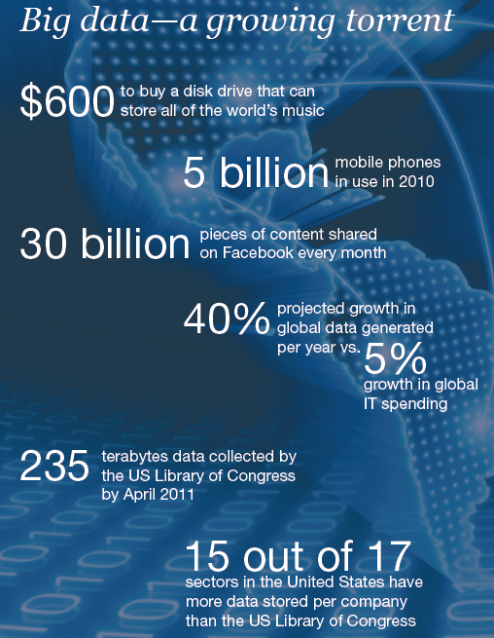
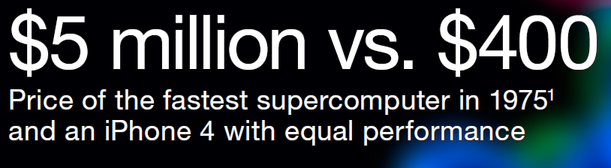

Slide 19

Data contains value and knowledge

Slide 20
Data Mining
But to extract the knowledge
data needs to be
  Stored
  Managed
  And ANALYZED ← this class
Data Mining ≈ Big Data ≈
Predictive Analytics ≈ Data Science

Slide 21
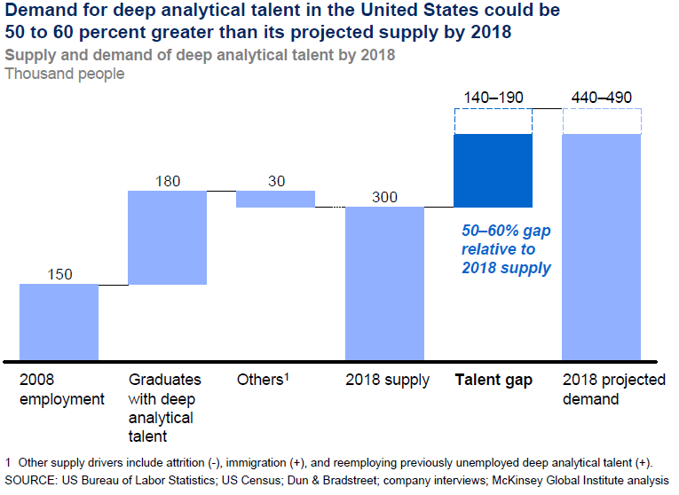
Good news: Demand for Data Mining

Slide 22
What is Data Mining?
Given lots of data
Discover patterns and models that are:
  Valid: hold on new data with some certainty
  Useful: should be possible to act on the item
  Unexpected: non-obvious to the system
  Understandable: humans should be able to
  interpret the pattern

Slide 23
Data Mining Tasks
Descriptive methods
  Find human-interpretable patterns that
  describe the data
    Example: Clustering
Predictive methods
  Use some variables to predict unknown
  or future values of other variables
    Example: Recommender systems

Slide 24
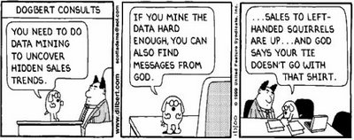
Meaningfulness of Analytic Answers
A risk with “Data mining” is that an analyst can “discover” patterns that are meaningless
Statisticians call it Bonferroni’s principle:
  Roughly, if you look in more places for interesting patterns than your amount of data will support, you are bound to find crap

Slide 25
Meaningfulness of Analytic Answers
Example:
We want to find (unrelated) people who at least twice have stayed at the same hotel on the same day
  10⁹ people being tracked
  1,000 days
  Each person stays in a hotel 1% of time (1 day out of 100)
  Hotels hold 100 people (so 10⁵ hotels)
  If everyone behaves randomly (i.e., no terrorists) will the data mining detect anything suspicious?
Expected number of “suspicious” pairs of people:
  250,000
  … too many combinations to check – we need to have some additional evidence to find “suspicious” pairs of people in some more efficient way

Slide 26
What Matters When Dealing With Data?
Challenges
Usage
Quality
Context
Streaming
Scalability
Collect
Prepare
Text
Data
Modalities
Ontologies
Networks
Signals
Represent
Structured
Multimedia
Model
Reason
Visualize
Data Operators

Slide 27
Data Mining: Cultures
Data mining overlaps with:
  Databases: Large-scale data, simple queries
  Machine learning: Small data, Complex models
  CS Theory: (Randomized) Algorithms
Different cultures:
  To a DB person, data mining is an extreme form of analytic processing – queries that
  examine large amounts of data
    Result is the query answer
  To a ML person, data-mining
  is the inference of models
    Result is the parameters of the model
In this class we will do both!
CS
Theory
Machine
Learning
Data
Mining
Database systems

Slide 28
This Course
This course overlaps with machine learning, statistics, artificial intelligence, databases but more stress on
  Scalability (big data)
  Algorithms
  Computing architectures
  Automation for handling
  large data
Statistics
Machine
Learning
Data Mining
Database systems

Slide 29
What Will We Learn?
We will learn to mine different types of data:
  Data is high dimensional
  Data is a graph
  Data is infinite/never-ending
  Data is labeled
We will learn to use different models of computation:
  MapReduce
  Streams and online algorithms
  Single machine in-memory

Slide 30
What will we learn?
We will learn to solve real-world problems:
  Recommender systems
  Market Basket Analysis
  Spam detection
  Duplicate document detection
We will learn various “tools”:
  Linear algebra (SVD, Rec. Sys., Communities)
  Optimization (stochastic gradient descent)
  Dynamic programming (frequent itemsets)
  Hashing (LSH, Bloom filters)

Slide 31
How It All Fits Together
High dim. data
Locality sensitive hashing
Clustering
Graph
data
PageRank, SimRank
Community Detection
Infinite
data
Filtering data streams
Web advertising
Dimensionality reduction
Spam Detection
Queries on streams
Machine learning
SVM
Decision Trees
Perceptron, kNN
Apps
Recommender systems
Association Rules
Duplicate document detection

Slide 32
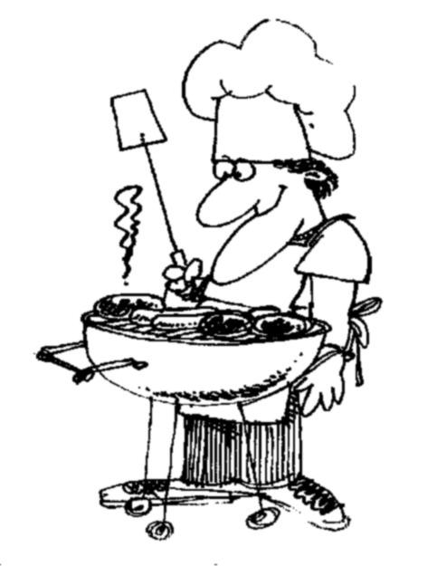
I ♥
data
How do you want that data?

