Slide 1
Windows Forms
Ondřej Pavlica
PV178
Spring 2022

Slide 2
Coming up
Theory
General info
History lesson
Alternatives
Practical use
Setting up Visual Studio
Standard controls
Application logic
Dialogs
Custom controls
Scaling
Asynchronous code
Q&A + Bonuses (if time permits)

Slide 3
General information
Windows only
Event-based
Very beginner-friendly
Drag & Drop
It Just Works™
Very senior-unfriendly
Limited UI scaling
No adaptive font sizes
Very low-level for advanced scenarios
Esoteric bugs

Slide 4
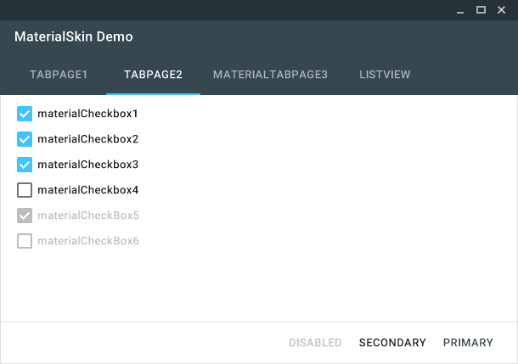
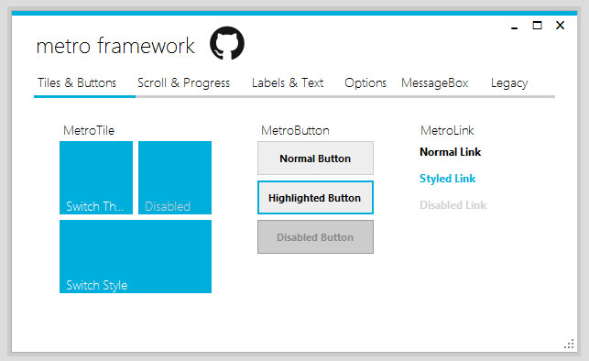
WinForms don‘t need to be ugly
MetroFramework
MaterialSkin

Slide 5
History lesson
Oldest C# UI library (2002, in beta since 2000 - .NET 1.0)
Therefore has a lot of skeletons in its closet (to maintain backwards-compatibility)
Internally uses a lot of Win32 API calls
Rendering native form controls (checkboxes, radio buttons, etc.)
Window management (e.g., moving to foreground)
Uses GDI / GDI+ for rendering
Not maintained anymore by MS
A lot of known bugs
CPU rendering only – no HW acceleration, performance hit

Slide 6
History lesson
Open-source rewrite in .NET Core starting in 2018
More-or-less feature-complete by .NET Core 3.1
DPI scaling
Modern dialog windows
Still Windows-only
API compatibility with the .NET 3 version of WinForms (still pretty bad)
Still rendered by the ancient GDI+ library
No multiplatform port planned (as of yet)
This use case will be (most probably) be covered by MAUI (former Xamarin.Forms)

Slide 7
Real use cases
Quick&Dirty UIs
Prototypes
Internal tools
Software where a UI is an afterthought
Legacy support
Yes, a lot of companies still support Windows XP or even older systems
Student projects ☺

Slide 8
Alternatives - Windows
WPF (Windows Presentation Foundation)
Declarative approach (XML files)
HW acceleration (DirectX)
WinUI (UWP)
Windows 10+
Prettier, but more limited WPF (access to low-level system APIs)
Look up „XAML Controls Gallery“ in Windows Store

Slide 9
Alternatives - Unix
Mono WinForms
A port of .NET 4 WinForms
Not feature-complete
In maintenance mode
Can often run existing WinForms code without modifications

Slide 10
Alternatives - Multiplatform
Avalonia
Open-source multi-platform WPF
Mobile platforms in beta
UNO Platform
Multi-platform UWP
Can run in a web browser (WebAssembly)
MAUI
UNO Platform, but from Microsoft
Faster, less mature

Slide 11
WinForms in practice

Slide 12
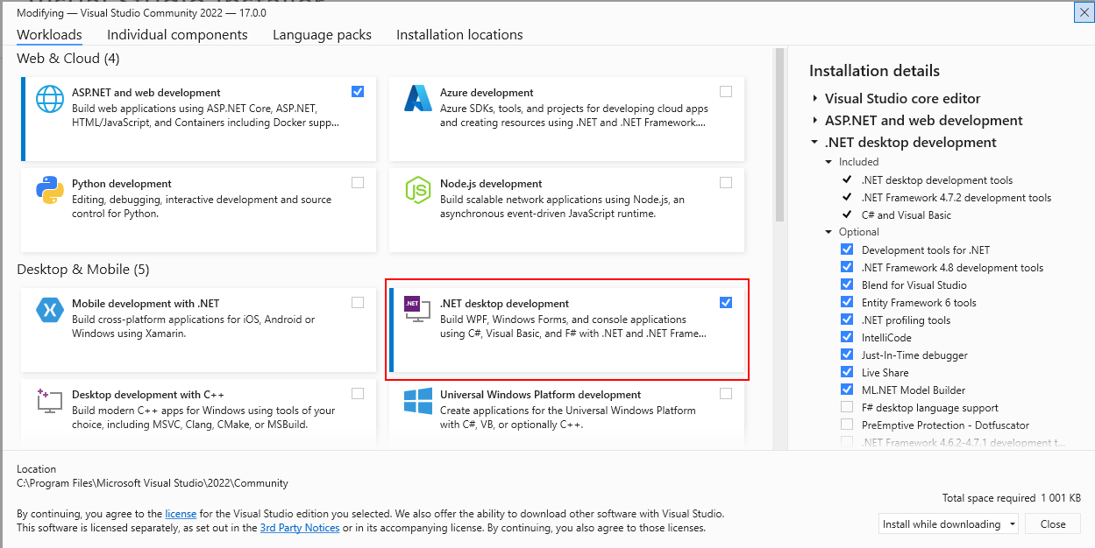
Setting up Visual Studio (Installer)

Slide 13
Visual Studio Tour
Creating a WinForms project
Toolbox
Document outline
Form editor
Control properties & events

Slide 14
VS Tour + Standard Controls

Slide 15
Application Logic
Based on handling events
Switching between UI and code-behind: (Shift +) F7
Don‘t touch the generated code (*.Designer.cs) if you are not sure about what you‘re doing
Don‘t put business logic in the code-behind, interact with business logic classes instead!
This is a common bad practice even in software companies
The code becomes unmaintainable very quickly
There is a high potential of (even unintentionally) storing business data in the UI controls

Slide 16
Application Logic

Slide 17
Dialogs

Slide 18
Custom Controls
Composition
Creating a new UserControl and then drag&dropping existing controls onto it
Quite easy to create, reduces repetition of common UI groupings
Progress bar with status text
Listbox with button controls
Creating an entirely new control
Quite low-level
Extending an existing control
Differently styled button (e.g., material design)
Creating a new control from scratch
OnPaint event + drawing basic shapes (points, lines, rectangles, …)

Slide 19
Creating an Entirely New Control
Out of scope of this lecture
Taught in PB069

Slide 20
Custom Controls - Composition

Slide 21
Scaling
Smart usage of different types of panels combined with:
Docking
Anchoring
Major disadvantage – no sane out-of-the-box font scaling
Has to be implemented at a pretty low level – using Graphics.MeasureString

Slide 22
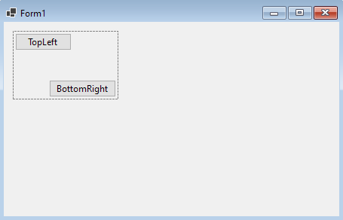
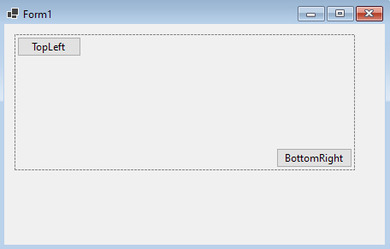
Panel
A container for a group of controls
Primarily used to scale or move this group of controls together

Slide 23
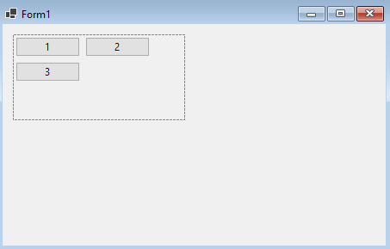
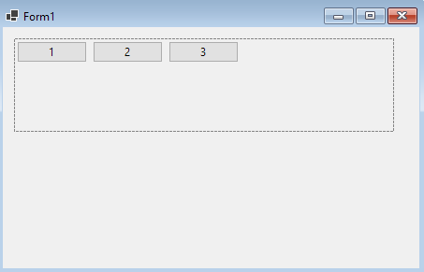
FlowLayoutPanel
Used for stacking controls after each other in a certain direction

Slide 24
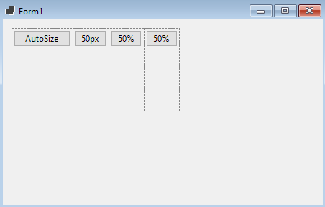
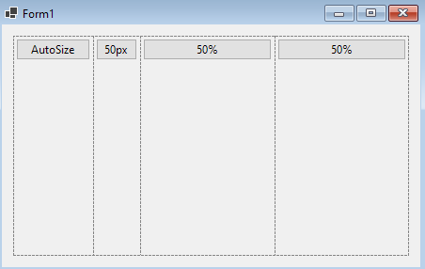
TableLayoutPanel
More fine-tuned control of placements
Columns and rows sized by:
Number of pixels
Percentage of available space
Contents of the given cell

Slide 25
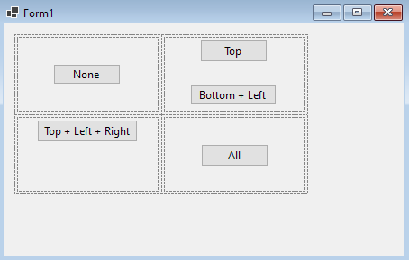
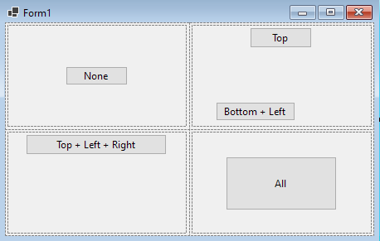
Anchor
Controls‘ position is computed relative to the parent‘s position
This property defines the sides of parent from which the position is computed
Behavior when resizing:
Zero sides – relative position to all sides stays the same (great for centering)
1-2 adjacent sides – the distances (in px) to the chosen sides stay the same
2 non-adjacent, any 3+ sides – the control is stretched, if possible (e.g., AutoSize = true)

Slide 26
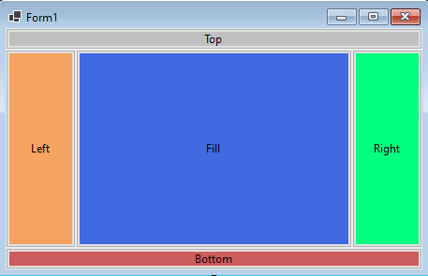
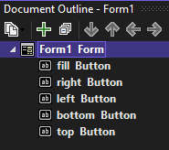
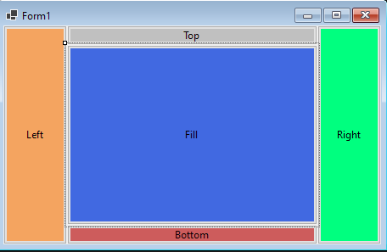
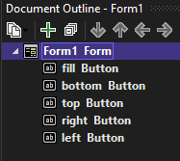
Dock
Dock property - „Sticking“ and stretching a control to fit one of the parent container‘s sides
Does not play nice with non-docked controls in the same container
Docking priority is set by the order of controls in the document tree

Slide 27
Scaling

Slide 28
Asynchronous Code
Problem 1 – You can access UI only from the UI thread
Writing to the UI elements gets more complicated
Solution: control.Invoke() and BeginInvoke()
BeginInvoke() is fire&forget – less deadlock-prone
Problem 2: Events have only synchronous delegates
Therefore async/await parallelism can only be done by void-returning methods
No completion signaling
Exceptions get ignored
Solution: Side channels in the event handler code
Beware using ConfigureAwait(false) -> after awaiting, you must use Invoke() to access UI

Slide 29
Asynchronous Code

Slide 30
Further study
PB069 course
Microsoft docs
CodeProject.com – best resource for obscure parts of WinForms
Experimenting ☺

Slide 31
Q&A

Slide 32
Thank you for attending

