Slide 1
Dynamic black-box analysis of malware
Vít Bukač
PV204 Security Technologies

Slide 2
Dynamic black-box malware analysis – Outline
Lecture
Motivation & Background
Black-box malware analysis principles
Black-box analysis tools
Automatic sandbox analysis
Hands-on lab
Analysis of provided malware samples

Slide 3
Motivation & Background

Slide 4
Cyber Incident Response
Cyber Incident Response
“A well-organized effort by which an organization handles a cyberattack, including analysis, containment, remediation and reduction of future risks.”
Good incident response results in:
Lower costs of ongoing cyber incidents
Fewer future incidents
Cyber Attack Incident
Each incident goes through certain phases
Collecting information about each phase and modifying defenses accordingly helps detect/prevent future incidents

Slide 5
Malware
“Malware is short for malicious software and is typically used as a catch-all term to refer to any software designed to cause damage to a single computer, server, or computer network, whether it's a virus, spyware, et al.”
Robert Moir, Defining Malware: FAQ, 2009. URL: https://technet.microsoft.com/en-us/library/dd632948.aspx

Slide 6
Malware analysis
What is malware analysis?
“Malware Analysis is the study or process of determining the functionality, origin and potential impact of a given malware sample and extracting as much information from it.”
Why is it valuable?
“The information that is extracted helps to understand the functionality and scope of malware, how the system was infected and how to defend against similar attacks in future.”
Soni Madhusudan, Introduction To Malware Analysis, 2020. URL: https://www.geeksforgeeks.org/introduction-to-malware-analysis/

Slide 7
Dynamic black-box malware analysis
Black-box
The analyst has no prior knowledge about internal workings of the sample.
Dynamic
“Dynamic malware analysis executes suspected malicious code in a safe environment called a sandbox. This closed system enables security professionals to watch the malware in action without the risk of letting it infect their system or escape into the enterprise network.”
Kurt Baker, Malware Analysis, URL: https://www.crowdstrike.com/cybersecurity-101/malware/malware-analysis/

Slide 8
Malware types
Ransomware
Trojan
Backdoor
Remote Access Tool (RAT)
Dropper
Downloader
Information stealer
Keylogger
Coinminer
Worm/Self-spreading malware
Spyware
Adware
Botnet
Webshell

Slide 9
Malware infection vectors
Email
Link
Attachment
Link + document download
Unpatched/unsecured hosts
Weak credentials – SSH, RDP
OS vulnerabilities (Petya, Not Petya, WannaCry,…)
App vulnerabilities (Log4j, VPN appliances, web servers, WordPress…)
Malicious website hosting
Drive-by download
USB drives
Cracked software

Slide 10
Case Study: Emotet
Don Ovid Ladores, EMOTET Returns, Starts Spreading via Spam Botnet, 2017. URL: https://www.trendmicro.com/en_us/research/17/i/emotet-returns-starts-spreading-via-spam-botnet.html

Slide 11
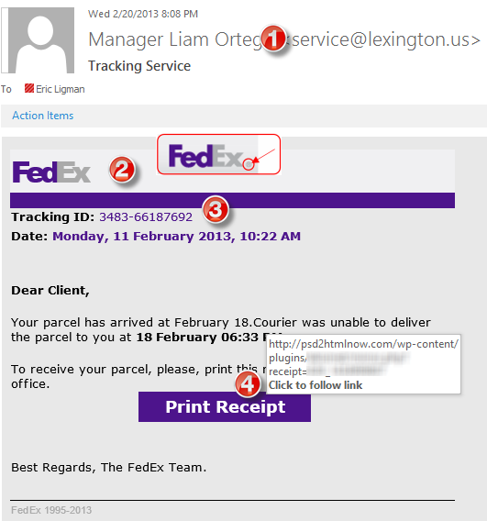
Emotet: Infection vector – Phishing
Subject
“Account blocked”
“Package to be delivered”
“Expiring subscription”
“Invoice” / “Receipt” / “Parchment”
Signs
Unexpected sender address (1)
Graphic errors (2)
Erroneous info (3)
Links to unexpected URL (4)
Links to same URL
Generic salutation
Use of threats, sense of urgency

Slide 12
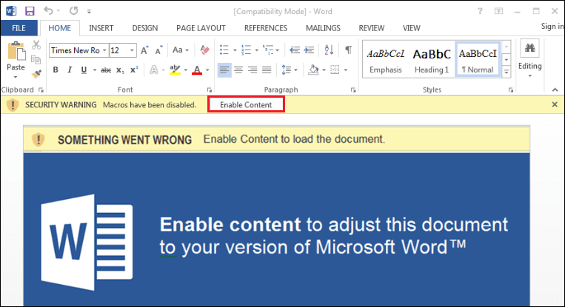
Emotet: Macros and Powershell
Security Magic Blog, July 2018, Emotet Encoded Powershell Observed. URL: https://security5magics.blogspot.com/2018/07/july-emotet-encoded-powershell-observed.html

Slide 13
Emotet: 2nd stage example

Slide 14
Malwareless/Fileless attack
Has no identifiable code or signature that allows typical antivirus tools to detect it.
Lives in your computer's RAM. Thus, it is also known as memory-based malware.
Uses processes that are native to the operating system you are using in order to carry out the attack.
May be paired with other types of malware.
May be able to circumvent application whitelisting, a process that allows only approved applications to be installed on a machine. Fileless malware takes advantage of approved applications that are already on your system.
Ellen Zhang, What is Fileless Malware (or a Non-Malware Attack)? Definition and Best Practices for Fileless Malware Protection, 2018. URL: https://digitalguardian.com/blog/what-fileless-malware-or-non-malware-attack-definition-and-best-practices-fileless-malware

Slide 15
MITRE ATT&CK Framework
Globally accessible knowledge base of adversary tactics and techniques based on real-world observations.
Good learning point about advanced attackers
Community-driven
Allows mapping attack steps
Knowing what is possible in each step facilitates incident analysis and allows planning defenses
Provides info about
Attack tools
Threat actor groups
Protection strategies
https://attack.mitre.org/

Slide 16
MITRE ATT&CK Framework

Slide 17
MITRE ATT&CK example - Emotet
MITRE ATT&CK mapping of an example ransomware attack:
Initial Access – Spearphishing Attachment (T1566.001)
Execution – PowerShell (T1059.001), Service Execution (T1569.002), Rundll32 (T1218.011), Regsvr32 (T1218.010), Remote Access Software (T1219), Exploitation of Remote Services (T1210)
Persistence – Process Injection (T1055)
Defense Evasion – File Deletion (T1070.004), Lateral Tool Transfer (T1570), Domain Account (T1087.002), Domain Groups (T1069.002), Data Encrypted for Impact (T1486)
Credential Access – Valid Accounts (T1078)
Discovery – SMB/Windows Admin Shares (T1021.002), Remote System Discovery (T1018), Process Discovery (T1057), System Information Discovery (T1082), Network Share Discovery (T1135)
Exfiltration – Data from Network Shared Drive (T1039), Web Protocols (T1071.001), Exfiltration to Cloud Storage (T1567.002)
https://thedfirreport.com/2022/11/28/emotet-strikes-again-lnk-file-leads-to-domain-wide-ransomware/

Slide 18
Black box malware analysis principles

Slide 19
Analysis – Ask the right questions
What is the scope of compromise? What are 2nd stage callbacks?
Communication between local file server and an unknown IP address in China has been observed. What process is responsible for the communication?
Malware is creating temporary files. Where are these files located?
Malware executable is created again after system reboot. How is it possible and what is causing it?
A new type of malware has been spreading through internal network. How to quickly assess the malware capabilities? What is its purpose? Is it based on any well-known tool?

Slide 20
Dynamic black-box malware analysis
Dynamic analysis – file is executed
Black-box analysis – without internal knowledge
Observable inputs
Observable outputs
Quick, simple
Common monitoring tools
Collected indicators about
Filenames, process names, process parent/child relationships, temporal relationships, domain names, IP addresses, registry keys, persistence methods, cleanup operations etc.
Can be highly automated

Slide 21
Black box malware analysis – Principle
Prepare analysis environment
Create snapshot
Run monitoring tools
Run malware
Collect and observe interactions between malware and VM
Restore snapshot
Repeat 3-6 as needed

Slide 22
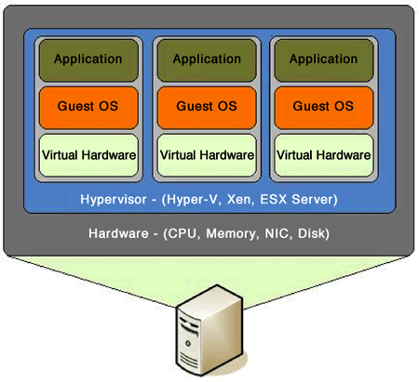
Analysis environment
Virtual Machine
Limited/no connectivity
Virtualized services (DNS, HTTP,…)
Several VMs for various host types
Software
Monitoring tools
Often exploited applications
Snapshots(!)
Risks
VM isolation breach
Malware inactivity in VM

Slide 23
Black-box analysis tools

Slide 24
Network analysis
Capturing sent/received packets
Protocol dissection
Promiscuous mode
Tools
Tcpdump, Wireshark, NetworkMiner
Indicators
Domain names, IP addresses, protocols, ports, HTTP parameters
Q&A
Who is this program communicating with? What reputation does the partner have? What data is exchanged? Is it encrypted or obfuscated?

Slide 25
Network analysis – What to look for
New established connections – HTTP 80/8080
Direct calls for domains without DNS lookup
Random domain names (e.g., rpxiodffd.biz)
Suspicious domain names (e.g., gooogle.org)
Similarly looking domain names (e.g., osinstall.biz, swinstall.biz, swinstall.com)
Outgoing portscans
Ping/DNS request for well known services
Connection availability test
Be aware of background OS/processes activities!

Slide 26
Example – Wireshark

Slide 27
File system
Observing file accesses and modifications
Background file manipulation
Tools
Procmon, Handle
Indicators
File names, folder names, order of actions, compromise spread through local system
Q&A
Where is malware copied after the initial infection? What filenames are used? Where is the collected data stored?

Slide 28
File system – What to look for
New file names & folders
New created files and folders
Batch files (.cmd, .bat, .vbs, .ps1)
Known favorite malware file names (e.g., 1.exe, test.exe, new.exe)
Known file names in uncommon folders (e.g., C:\Temp\svchost.exe)
Recycler
Modifications of system files
Temporary storage files, encrypted archives

Slide 29
Example – Procmon

Slide 30
Registry
Regedit
Windows built-in registry editor
RegRipper
Extracts relevant forensic artifacts from registry
Autoruns
Lists all programs set to start after system boot

Slide 31
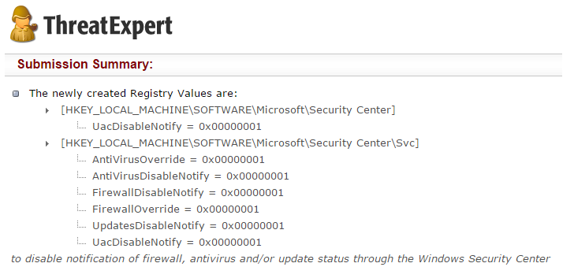
Registry – What to look for
Well-known locations
Autorun locations
Task scheduler
Changes tracking
Keywords fulltext search
Filenames
Processes
Domain names

Slide 32
Registry – Regedit

Slide 33
Processes
Observing initial system compromise
Processes parent/child relationships
Tools
Process Explorer, Procmon
Indicators
Process names, order of execution, dropper activity
Q&A
What processes are run after malware binary is executed? Are batch files involved? Are there watcher processes?

Slide 34
Processes – What to look for
Order of executables
Initial malware
Dropper/downloader
Persistence executable
Final malware
Command line interpreters
cmd.exe
Powershell
Cscript, wscript

Slide 35
Example – Process Explorer

Slide 36
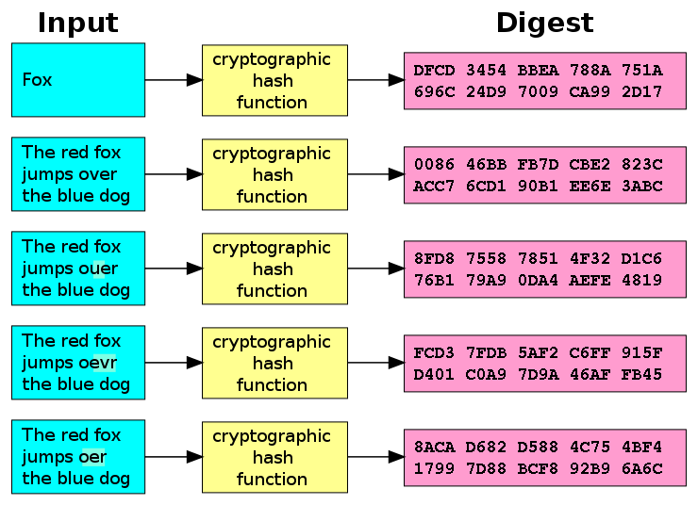
Executable file analysis
Cryptographic hash
Hash function which is considered practically impossible to invert
Unique identification of file
Counter: Polymorphism
MD5, SHA1
Fuzzy hash
Context triggered piecewise hash
Families of files
ssdeep
Strings

Slide 37
Example – Strings
server.exe
AppData
4bcce4de98bcdb4d29f66c0fe1ffe002
hackerhani.no-ip.biz
Software\Microsoft\Windows\CurrentVersion\Run
Software\
yy-MM-dd
??-??-??
Microsoft
Windows
SystemDrive
netsh firewall delete allowedprogram "
Software
cmd.exe /c ping 0 -n 2 & del "
SEE_MASK_NOZONECHECKS
netsh firewall add allowedprogram "
Domain name
Persistence registry key
Commands to be executed
MD5: 5d347384ea978a96bc842ad9f29e95f2

Slide 38
Timeline
Timeline helps understand the logic of malware sample
Temporal order of steps
Intentional waiting
Beaconing intervals
Advanced sandboxes can build timeline from multiple tools

Slide 39
Document analysis – Quick insight
EXIF information
File metadata
Document sandboxing
Document interpretation ambiguity
Practical examples
Double extensions, different content in different viewers, code block obfuscation & hiding

Slide 40
Automated sandbox analysis

Slide 41
Automated sandboxing
Automated
Execute malware in sandbox
Wait 1-2 minutes
Receive summary report
Investigate report
Cuckoo, Norman, Anubis etc.

Slide 42
Example: Cuckoo sandbox
Open-source malware analysis system
Can analyze
Windows executables, DLLs, PDF documents, URLs, HTML files, PHP scripts, Visual Basic scripts, ZIP archives, Python files, etc.
Modular, scriptable
Full memory dump (for Volatility Framework)
Django web interface
Mongo (NoSQL) database
https://github.com/cuckoosandbox/cuckoo

Slide 43
Cuckoo – Architecture

Slide 44
Internet sandbox services
Public service
OpSEC issues
Huge comparison database
Exact match by hash
Similarity search by keywords
Malwr.ee (public Cuckoo sandbox)
Any.run
ThreatExpert.com
Joesandbox.com
Hybrid-Analysis.com
VirusTotal.com

Slide 45
Operational security (OpSec)
Advanced attackers monitor victim’s actions
Unique indicators visible on Google?
Attacker host monitoring for incoming traffic
Keywords search in mails, PDFs…
Basics of OpSec
“Think before you act” mentality
Limited information sharing
Trace removal
PassiveTotal.org

Slide 46
OpSec – Basic rules
No ping
No DNS lookup
No accessing to suspicious domains
No premature remediation steps (reboot, antivirus scan, OS reinstall)
No upload of samples
No indicator validation on external sources
NOT EVEN through 3rd parties

Slide 47
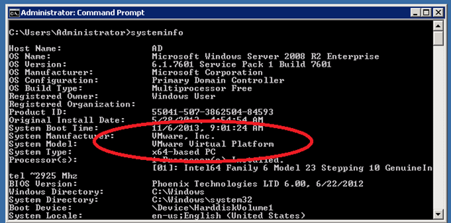
Anti-sandbox techniques
Continuous development – sandbox vs. anti-sandbox
Malware inactive in analysis environment
Tools presence detection (Wireshark, etc.)
Virtualization detection
Registry (key existence, key value)
File system (file existence, drivers)
Processes (syscall response)
Human presence detection
Mouse movement
Keyboard activity
File artefacts

Slide 48
Lab

Slide 49
Lab – Overview
Hands-on experience of manual dynamic black-box analysis
Guided analysis of selected malware samples
Tools
Wireshark – Network activity
Process Monitor – File system activity, process creation
Autoruns – Persistence
Regshot – Registry changes
Process explorer – Process map

Slide 50
Lab – Samples
2-3 samples from different malware families
Commodity malware – Zeus, ZeroAccess, Generic Trojans,…
Students will execute samples in virtual environment
Provided simple analysis virtual machine (Windows)
Indicators collected – network, files, persistence
Discussion about interpretation of facts
Homework
2 samples for analysis independently
Write a cohesive report and present key information to the reader

