Slide 1
A quick look at some other cultural variables

Slide 2
Some other variables
Universalism vs. Particularism
Public vs. Private spheres
Cognitive vs. Affective
Meyer’s “Culture Map”

Slide 3
Universalism vs Particularism: Examples
Note: intro case – Janet Clesca
Germany: the red traffic light
In education: e.g. absence from an exam
Making an exception for a student in difficulty
or
Treating everyone the same
Which is fair?

Slide 4
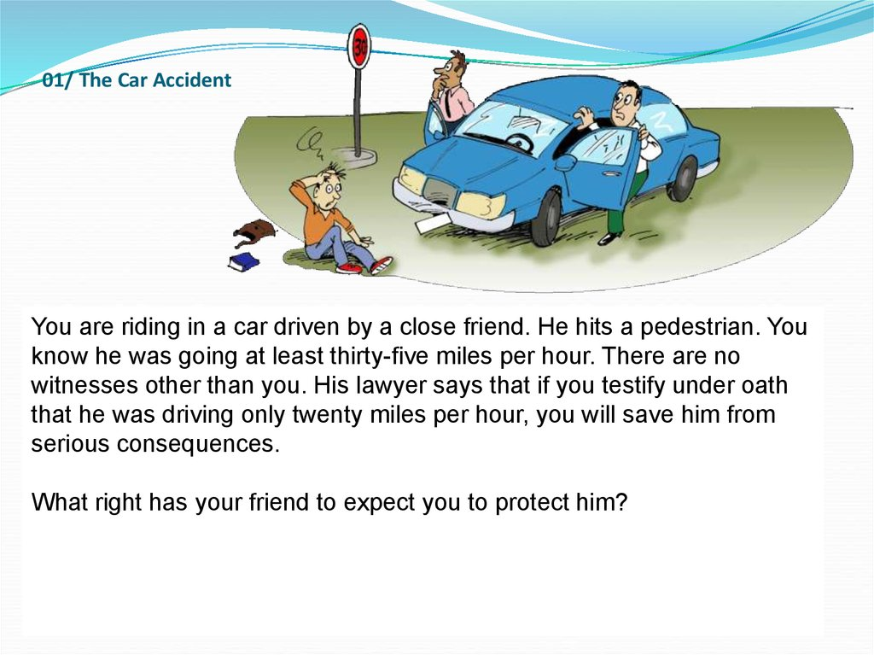
Another example
My friend has no right that I “protect” him by not telling the truth
My friend has some right that I act as a friend to protect him
My friend has every right that I “protect” him by not telling the truth

Slide 5
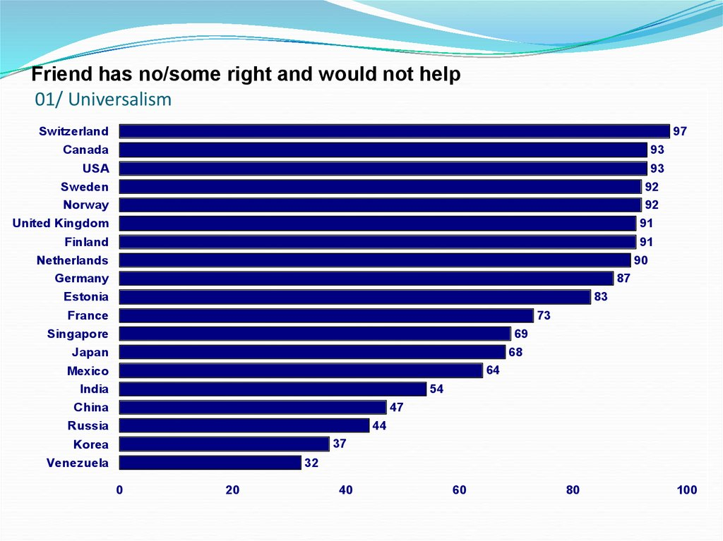
Differences in response
Source: Trompenaars, 1993

Slide 6
Public Versus Private Space - interaction
United States
Many other countries
Notes:
Notice that all the descriptions mentioned friendliness.

Slide 7
Lewin’s circles
Private
US
kitchen
Private
Many other countries
car
Golf club
Fellow
passenger
Many activities in « public » sphere
Many activities in « private » sphere

Slide 8
Public and Private Types
public
private
private
Discomfort Zone!

Slide 9
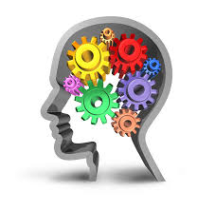
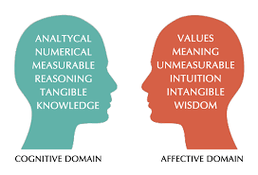
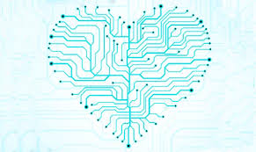
2 types of trust
A number of researchers recognise cognitive trust and affective trust as forms of perception and trust building in businesses and across cultures.
Cognitive trust is based on the others’ work and their abilities, skills and reliability in performing a task and getting the job done
Affective trust means taking the time to get to know others better and establish a connection and emotional proximity in order to develop relationships.

Slide 10
A short video extract
https://hbr.org/video/4631884629001/getting-to-yes-across-cultures
(from 1:01)

Slide 11
Case 1
Chrissie is an American EFL teacher who worked for me for many years. She had an excellent reputation as one of the most dynamic teachers and an expert on preparaing students for the TOEFL test. She is, in many ways a pure product of the « America dream », first generation Filipino-American, her parents had emigrated to California got good jobs, a good standard of living and educated all their children to a high level. Chrissie herself is « typical » Californian – outgoing, friendly, optimistic.
At the end of one semester one of her students came to complain about Chrissie and the mark she had given him. The student said that she had always been « so nice » in class, yet she only gave him 7/20. He didn’t understand.
Obviously, I checked with Chrissie who told me the student hadn’t worked much at all and had got a low score on the TOEFL mock exam.
What has happened here? What types of trust were operating in this situation?

Slide 12
Case/example 2
Micromanagement
What do you understand by this term?
What effect does it have on subordinates?
What is the « role » of trust in causing micromanagement and in preventing it?

Slide 13
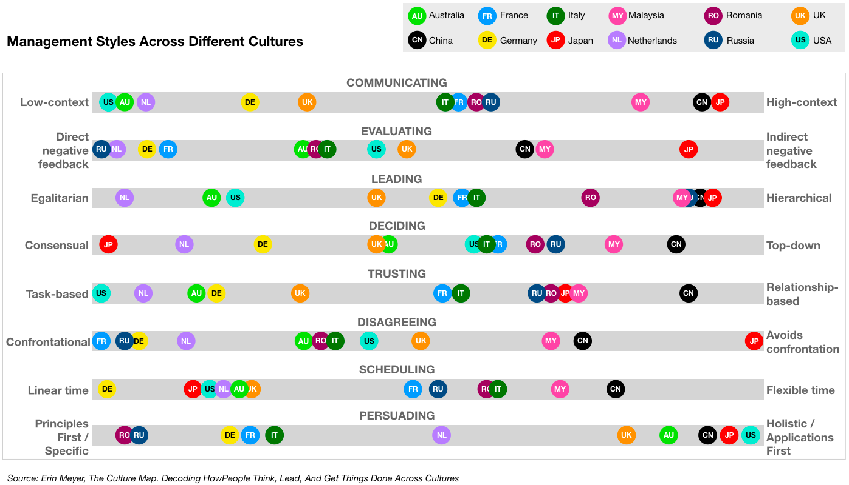
The Culture Map - Erin Meyer (2014) examples

Slide 14
Meyer’s Culture map
8 dimensions
Communication : low / high context
Scheduling: linear / flexible
Trusting: task-based / relationship-based
Leading: egalitarian / hierarchical
Deciding: consensual / top-down
Persuading: principles first / applications first
Evaluating: direct / indirect negative feedback
Disagreeing: confrontational / avoidance

Slide 15
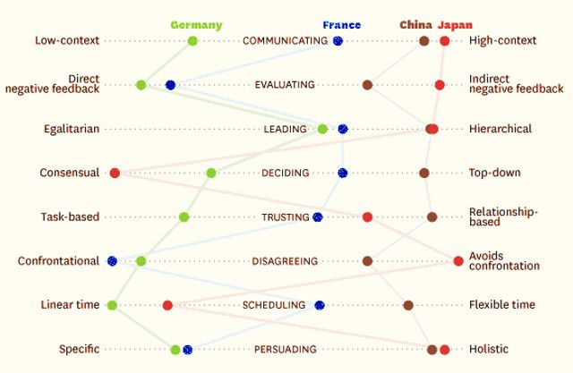
The Culture Map - Erin Mayer
Example 1

Slide 16
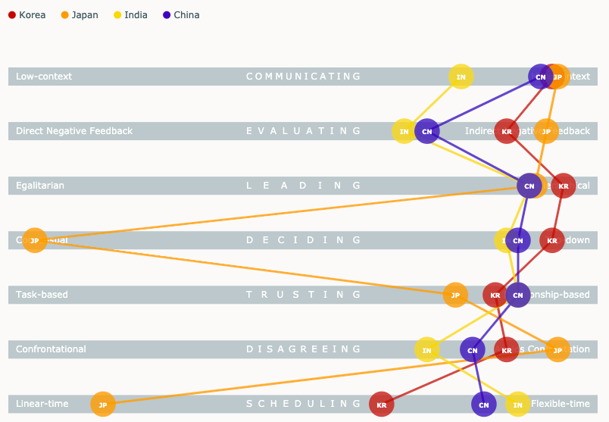
The Culture Map - Erin Mayer
Example 2: Major Asian countries

Slide 17
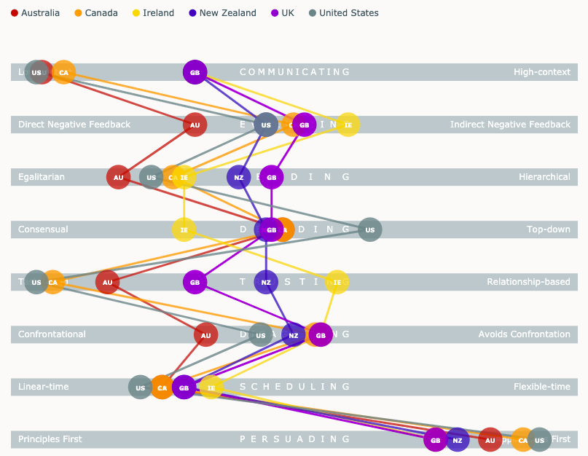
The Culture Map - Erin Mayer
3. English-speaking countries

Slide 18
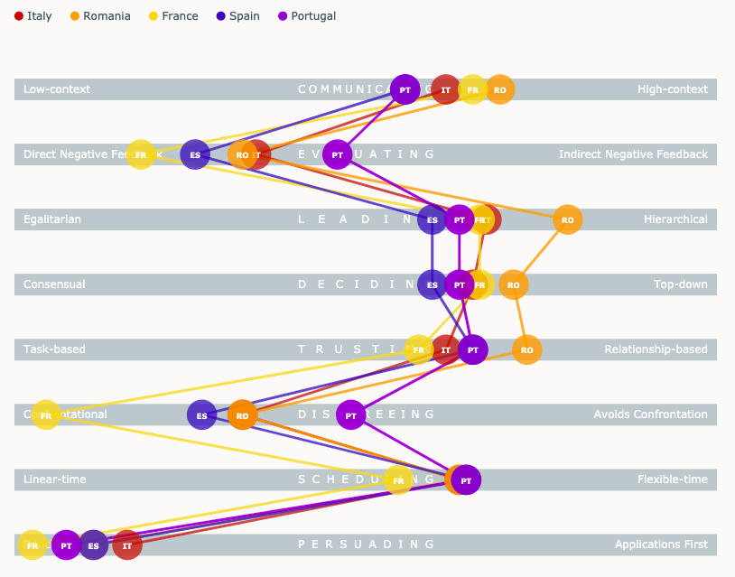
The Culture Map - Erin Mayer 5. Latin countries

Slide 19
Intercultural profiling
Having gathered together lots of different cultural « concepts » you can now start to make intercultural profiles….
……see the next slide….

Slide 20
Intercultural Profiling
The US has the following characteristics:
Low context, monochronic
Future oriented
Inductive approach
Lowish PD, Lowish UA, Hi IND, Hi MAS
Universalist; Specific (small private sphere); Achievement-oriented; somewhat Emotional etc……………So, that gives…

Slide 21

Some Values U.S. Americans Live By
I am important and
have control over my
environment
Task/action orientation
Friendly and informal
relationships
Initiative
Independence
Achievement
Linear time orientation
Present Future
Problem-solving attitude
Change is positive
Rules

Slide 22
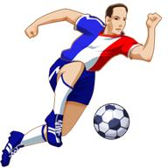
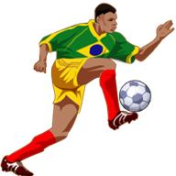
A student-generated example: France vs Brazil
F2
B5
PDI :Power Distance
UAI :Uncertainty Avoidance
MAS :Masculinity
IDV :Individualism
EMO :Emotional
COL :Collectivism
F France
B Brazil
IDV
Individualist society
EMO
They love animals more than their kids
Touch each other
a lot when conversing
F1
Identity conscious
“ French language”
Lively
High UAI
Warm
Conservatives
/Traditional
Metro sexual
“appearance”
Sociable
Change is difficult
Risk - averse
Meritocratic
“Macho”
Hierarchical
High PDI
B3
Common zone
Bureaucracy
Orderly
We not I
Family relationships are very important
football
Bureaucracy
High PDI
Collectivist society
F3
Standardization “formal rules”
COL
Hierarchical
Pro active
Quest for
better life
Risk- averse
B2
Arrogant
Health conscious “food/weight”
Leisure and family live above their professional duty
Very religious
Low MAS
High UAI
F4
B1

Slide 23


