Slide 1
Funding Landscapes
Ladislav Čoček
Research Office, Rectorate
12 November 2024

Slide 2
Funding Landscapes

Slide 3
Funding
Landscapes

Slide 4
Research funding
National
International

Slide 5
Research funding
Public
National
Private
International

Slide 6
Research funding
Public
National
Basic
Research
Private
Innovation
Applied
International
Research

Slide 7
Research funding
Institutional
Support
Public
National
Basic
Research
Private
Grant Projects
Equity,
Guarantees
Tax Deductions
Innovation
Applied
International
Business
Revenues
Research

Slide 8
Scientific Career and Funding

Slide 9










The journey to (non-)academic success
Professorship
Spin-off
ERC AdG /
GA ČR EXPRO
EIC Pathfinder
Senior
researcher
Registration
of IP
ERC CoG /
GA ČR EXPRO
HE clusters /
MSCA DN, SE / Widening
HE clusters
Early
career PI
Applied
research
ERC StG / ERC CZ
GA ČR JS / Standard
Collaborative and networking (COST, Inter-excellence)
Collaborative TAČR
Postdoc
Intersectoral
collaboration
MSCA PF
GA ČR PIF
Other fellowships
SIGMA DC TAČR
Student
Best diploma thesis award
Secondment /
joint PhD
PhD scholarships
Conference grant
Travel grant
Industrial PhD

Slide 10
National funding

Slide 11

GAČR (Czech Science Foundation)
basic research in all disciplines
Standard: 3-years, national panels, incremental research
International: with partner agencies; Lead Agency; WEAVE
EXPRO: 5-years, international panels, frontier research
JUNIOR STAR: 5-years, international panels, independence
POSTDOC INDIVIDUAL FELLOWSHIP: <4 years after PhD
  PIF outgoing: 2(+1)-years, national panels, postdoc abroad
  PIF incoming: 3-years, national panels, incoming from abroad

Slide 12

TAČR (Technology Agency of CZ)
applied research & technological development in all disciplines
primary applicant / beneficiary: company
co-financing
diverse portfolio of programmes
active in international collaboration
taking over „ministry“ applied programmes

Slide 13
TAČR programmes
SIGMA
  DC1: Pre-application research (via CTT)
  DC2: Early-stage researchers
  DC4: International collaboration
TREND
  Technology leadership
  Newcomers

Slide 14

Ministry (departmental) programmes
supporting departmental strategies
Ministry of Education, Youth and Sports (MEYS)
  in charge of institutional funding of universities
  international collaboration based on bilateral and multilateral agreements:
  Mobility projects
  INTER-EXCELLENCE (2) programme
Ministry of Culture: NAKI
Ministry of Health: AZV
Ministry of Interior: OPSEC
some absorbed by TAČR (e.g. environment, transport, industry)

Slide 15
Horizon Europe
(European Union)

Slide 16
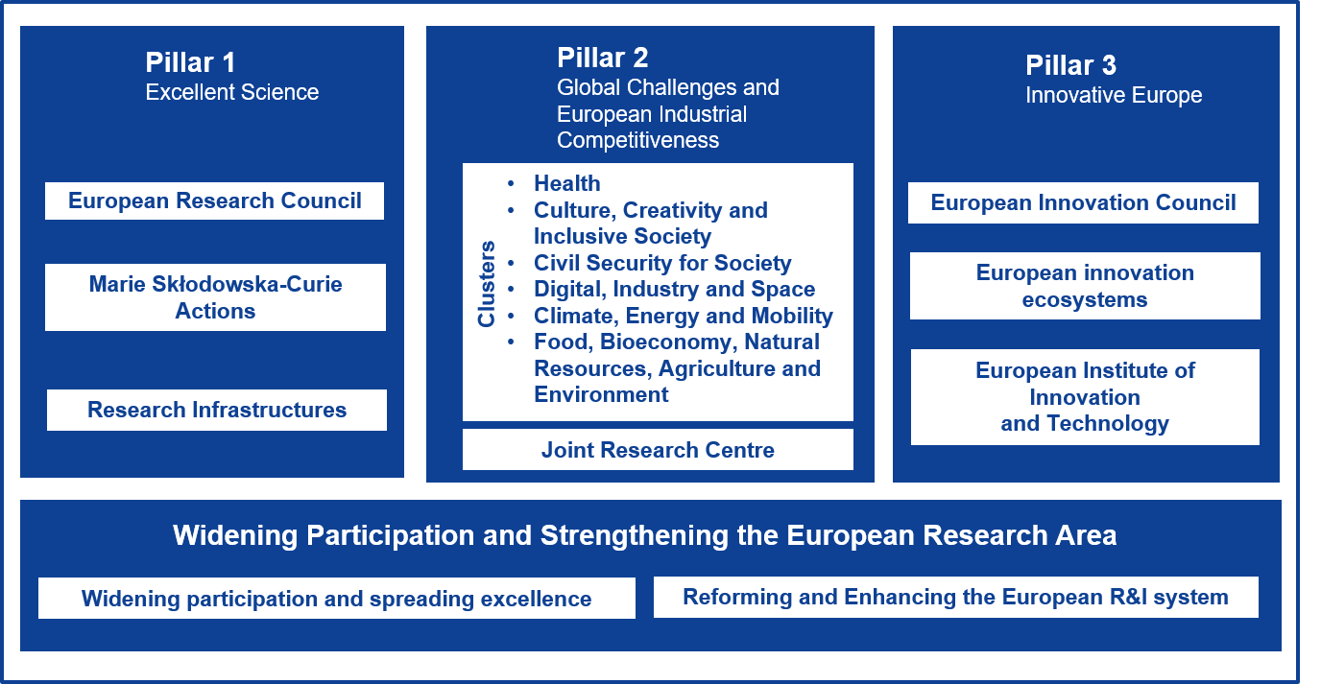
Horizon Europe: structure
2021-2027

Slide 17
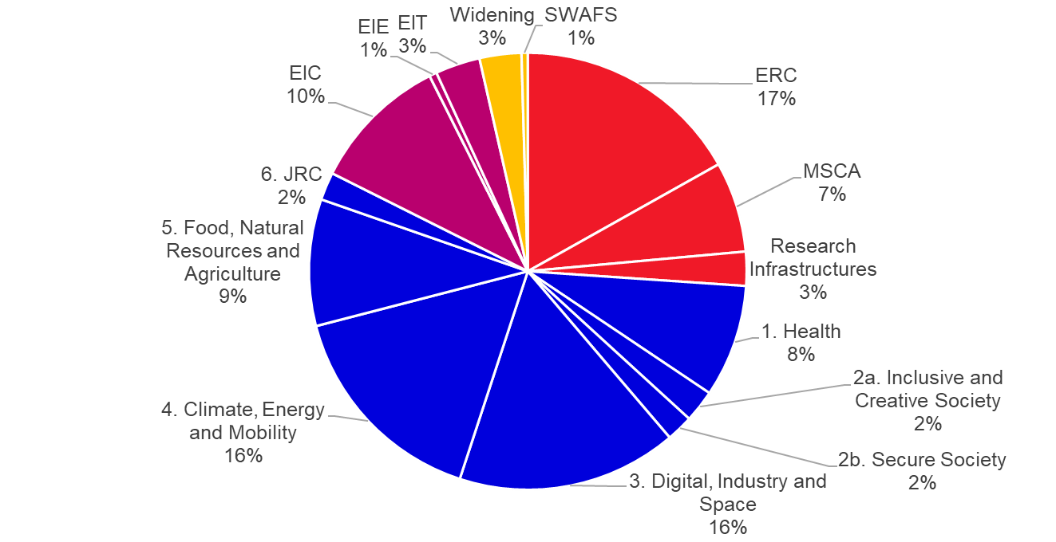
Horizon Europe: budget

Slide 18
Horizon Europe: Pillar 1
European Research Council (ERC)
  Supporting breakthrough research based on excellence only (of the PI and the project)
Marie Skłodowska-Curie Actions (MSCA)
  Mobility of researchers in various career stages
  Individual and collaborative projects
Research Infrastructures
  Strategic support of large infrastructures and their networks
  Clearly targeted calls – need to have a significant role in the community to be able to participate

Slide 19
European Research Council (ERC)
Years after PhD: 2-7 Starting; 8-12 Consolidator; 13+ Advanced
Duration 5 years – 1,5-2,5 million EUR + 1 million EUR top-up
Projects driven by single Principal Investigator (PI)
Breakthrough research; evaluation criterion: Excellence
Synergy grants: 2-4 PIs, 10 (+4) million EUR, 6 years

Slide 20
Support to ERC applicants
TRAINING
Grants Week - Kick-starting a research career with Horizon Europe - 20.11. 2024, UKB
ERC Grant Applications: Strategies, Pitfalls, and Best Practices for Researchers and Project Managers - 5. 2. 2025, UKB
INDIVIDUAL SUPPORT
Assistance with preparation of B1, B2 and A parts of the proposal (ethics,…)
Selection of evaluation panel
Contact with ERC experts (ERC holders, evaluators etc.)
Organisation of mock interviews

Slide 21
Expert group for ERC
Workshops for ERC applicants – interactive training, set of three online meetings focused on:
Day 1 – feedback on 5 min the presentation of project idea and applicant's CV and track record
Day 2 – evaluation of successful proposal from the scientific domain of applicant´s preference
Day 3 – individual presentations of B1 and discussion with members of Expert Group and other ERC evaluators
- Mock interviews - for applicants in 2nd stage of evaluation

Slide 22
MSCA Postdoctoral Fellowships (PF)
Individual: driven by Fellow and Supervisor
Mobility requirement: 2 of 3 last years outside of hosting country
Training action: target is career development, not just research
European: 1-2 years hosting in EU (or associated)
Global: 1-2 years out of EU (or associated) + 1 year back in EU

Slide 23
Support to MSCA PF applicants
TRAINING
Grants Week - Kick-starting a research career with Horizon Europe - 20.11. 2024, UKB
Seminars for Supervisors – February
Workshops for MSCA applicants - March-May
REVISIONS
for proposals prepared in tight collaborations with Supervisor and Faculty

Slide 24
MSCA Doctoral Networks
Network of PhD supervisors
Recruitment of up to 15 PhD students for 3 years
3i: International (mobility of PhD students required); Interdisciplinary; Intersectoral (secondments out of academia, hosting by non-academic institutions)

Slide 25
Horizon Europe: Pillar 2
Destination 5. Unlocking the full potential of new tools, technologies and digital solutions for a healthy society
Destination - Increased Cybersecurity
Thematic „Clusters“:
  Health
  Culture, Creativity and Inclusive Society
  Civil Security for Society
  Digital, Industry and Space
  Climate, Energy and Mobility
  Food, Bioeconomy, Natural Resources, Agriculture and Environment
Collaborative projects
Top-down defined topics
Open calls – for MUNI employees; or on F&T Portal
Destination 3: World-leading Data and Computing Technologies
Destination 4: Digital & Emerging Technologies for Competitiveness and Fit for the Green Deal
Destination 6: A human-centred and ethical development of digital and industrial technologies

Slide 26
Where do the topics come from?
Council of the EU
European Parliament
Main priorities defined for 2021-2027
Strategic plan – destinations for 2021-2024 / 2025-2027
Work Programme – topics for 2021-2022 / 2023-2025 / 2026-2027
Who wrote the topic?
Search for clues: associations, projects, advisory groups, CSAs, forecasting
CZ represented in Programme Committee (can propose or adjust topics; but needs support from other representations)
Politicians
EU Policy
Bureaucrats
programming
Horizon Europe
European Commission
Strategic Plan
advisory
Work Programme
associations
Researchers
advisory groups
(CSA) projects

Slide 27
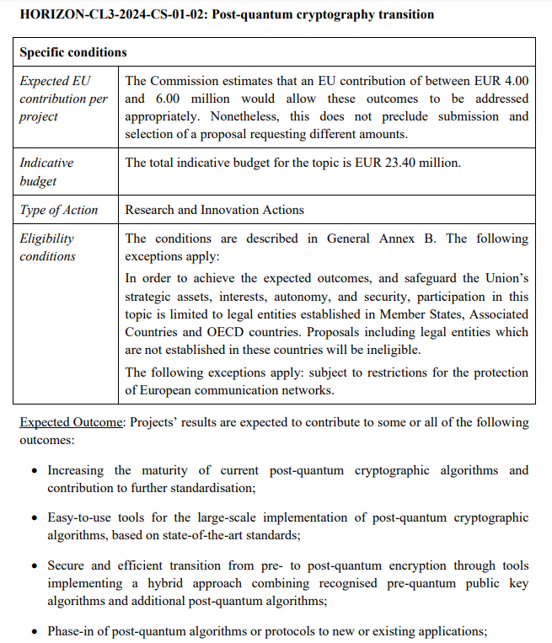
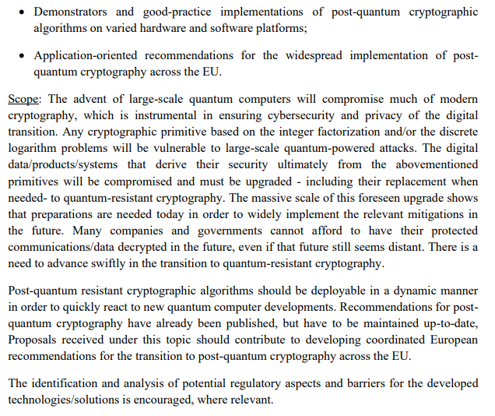
Reading the topics
project budget (indicating
consortium size)
code & title
scope = background,
goals and activities
call budget (indicating
number of proposals to
be financed)
type of action
(research vs. innovation
vs. „chlebíčky“)
expected outcome
RESULTS/IMPACT

Slide 28



European Innovation Council (EIC)
Pathfinder – radically new technology, science-to- technology breakthrough, high-risk high-gain
Transition – preparing investment-ready business plan
Accelerator – patient capital to deep tech SMEs
open & challenge calls
grants (reimbursement of costs) & investments (equity, guarantee)

Slide 29
Horizon Europe: TRLs
1 | 2 | 3 | 4 | 5 | 6 | 7 | 8 | 9
ERC
Proof of Concept (PoC)
EIC
Pathfinder
Transition
Accelerator
Grants
Investment
MSCA
Clusters
Partnerships
Academia
Industry
„Valley of Death“

Slide 30
Funding & Tenders Portal
Horizon Europe – information source
Current calls available here:
  https://ec.europa.eu/info/funding-tenders/opportunities/portal/screen/opportunities/topic-search
One portal for submission of proposals, administration and reporting of running projects, and also selection of evaluators (EXPERT AREA)

