Slide 1
Smart City and Complexity
How to understand complexity of Services
© Leonard Walletzký 2023

Slide 2
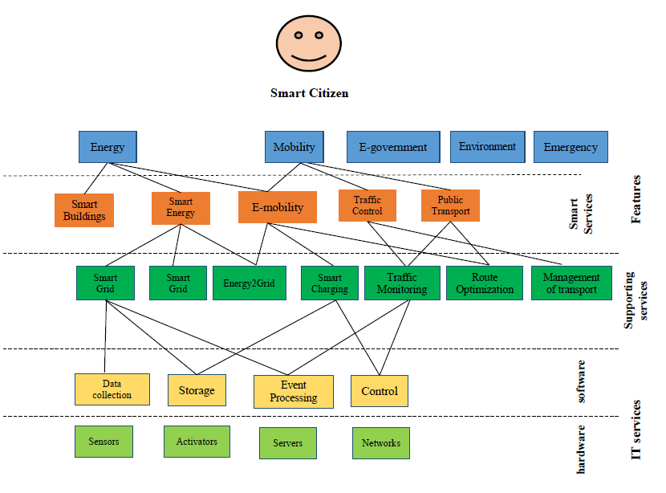
Layer model of Smart City
Walletzky L., Buhnova B., Carrubbo L. (2018) Value-Driven Conceptualization of Services in the Smart City: A Layered Approach. In: Barile S., Pellicano M., Polese F. (eds) Social Dynamics in a Systems Perspective. New Economic Windows. Springer, Cham
Notes:
Předpolkádám, že je nějaký oslí můstek s předchozím slajdem.

Slide 3
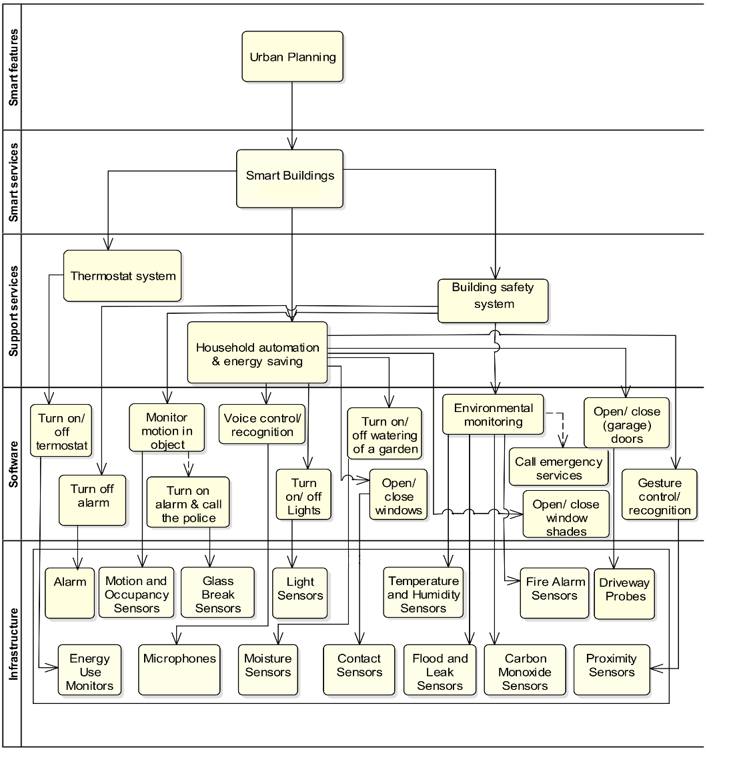
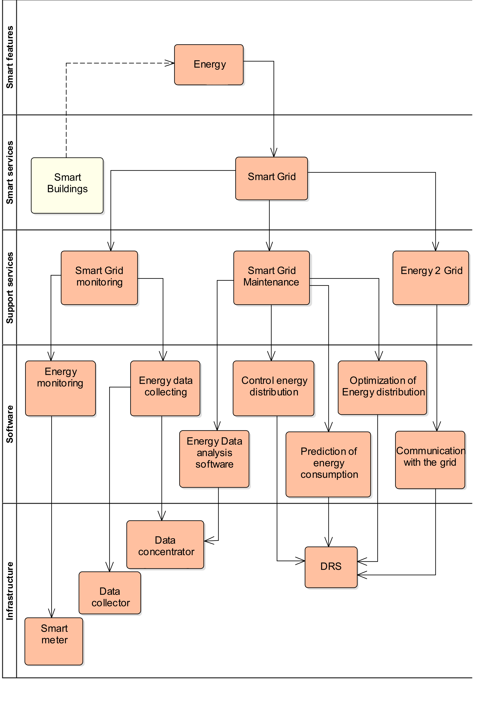
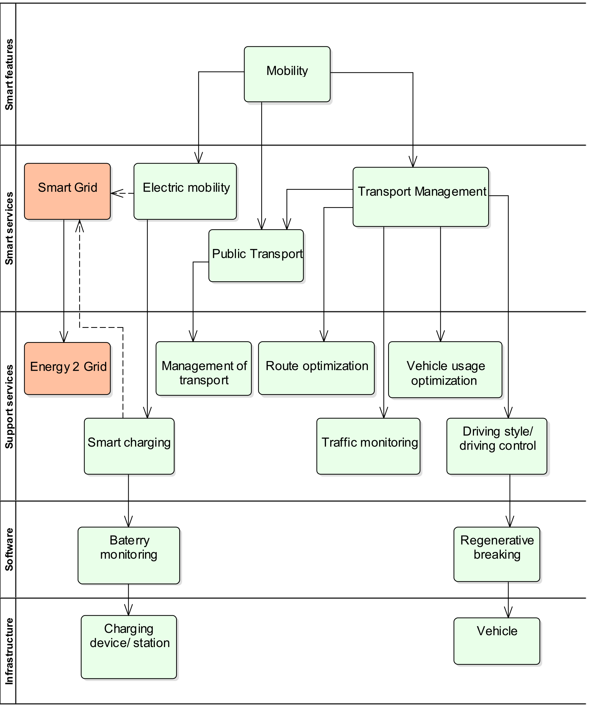
Detailed Layer analysis
Urban planning
Smart Energy
Mobility

Slide 4
Complexity of Smart City
the environment of Smart City is not truly objective – it is a mix of different contexts, based on the interactions of actors in a stated moment
the main problem is how to merge different perspectives described by the quadruple helix
Government
Wants satisfied citizens
Wants to be elected again
Industry
Wants to have a business opportunity
Expects clear rules of involvement
Academia
Wants to participate on the development
Can act as guarantors of the solution
Society
Expects improving of well being

Slide 5
New developed model
Smart feature and services depend on specific point of view of customer = context
Smart Features
Smart Services
Supporting Services
Infrastructure
Infrastructure and supporting services depend on specific point of view and terminology of experts = context
Customer facing services
Background services

Slide 6
Detailed Layer analysis
Urban planning
Smart Energy
Mobility

Slide 7
How to model such complex environment?
We need to have universal tool to catch multicontextual relations
It should contain
Analysis of perception
Analysis of stakeholders´ motivation
Analysis of service provision
The main questions
Do we really understand the models?
Are the models readable for others?
What if we need to communicate with people from other domains?
And what if we need to achieve understanding across domains?
How we can model in multidisciplinary way?

Slide 8
Solution is to go back to our roots and ask
What are we modeling?
The answer is – objects from the real world
How does any person build own mind model?
Where are we modeling?
The answer is - in our mind!

Slide 9
How do we model reality in our heads?
We identify...
Object
-s
...we find interesting

Slide 10
Then, we find...
Relationship
-s
...between our...
Object
-s

Slide 11
Each relationship can connect multiple objects...
Relationship
Relationship
Relationship
Object
Object
Object
...and each object can be present in multiple connections.

Slide 12
Relationship is specifically defined n-dimensional set of objects
Each relationship can connect multiple objects...
Relationship
projection
Object
...and each object can be present in multiple connections.

Slide 13
I can describe anything now!
I know when to perform particular operation
Relationship
Which objects do we find interesting for modelling?
projection
Now I can change the state
Category
Object
Rule
Operation

Slide 14
MENTION – USE duality
I am using category here.
Relationship
R
P
Category
R
Object
R
Rule
I am thinking about category here.
R
Operation

Slide 15
Diamond of Attention Focussing
I am in syntactic part
I can connect relationship with dynamic rule!
Relationship
characteristic
characteristic
R
P
Category
R
Object
R
Rule
I am in dynamic part
I can connect operation with specific categories!
R
characteristic
characteristic
Operation

Slide 16
Diamond of Attention Focussing
Objects and relationships between them
Mention-use duality
Modelling a modelling tool
Referring to itself
Relationship
characteristic
characteristic
R
P
Category
R
Object
R
Rule
characteristic
R
characteristic
Operation

Slide 17
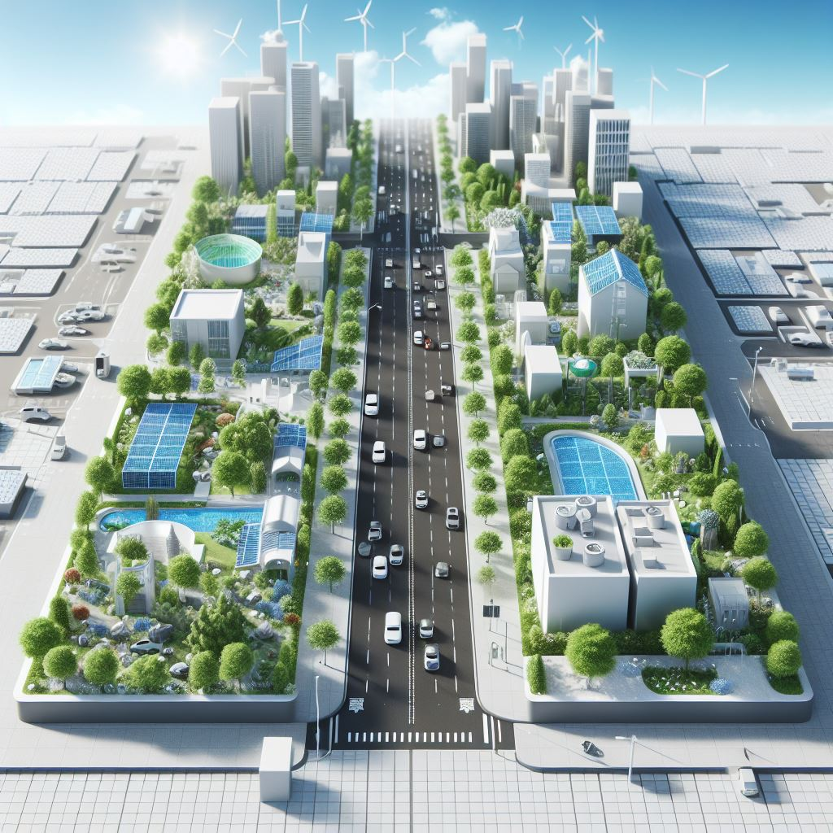
Road (street) - Objects and relationships
Name | Relationship | Name
Car | Is on | Road
Bus | Is on | Road
Bicycle | Is on | Road
Pedestrian way | Is on | Road
Driving lines | Are dividing | Road
All vehicles | Are using | Driving lines
Trafic on the road | contains | All vehicles
Trafic lights | Are managing | Traffic on the road

Slide 18
What to do next
If we want to understand complexity, we need to have holistic approach
What is a holistic approach?
In a medical setting, a holistic approach to problem solving refers to addressing the whole person, including their physical, mental, and emotional health, while taking social factors into consideration.
In problem solving, a holistic approach starts by first identifying an obstacle, then taking a step back to understand the situation as a whole.
In service environment, a holistic approach means to understand the value of the service from different perspectives, from the all important stakeholders point of view, to analyze overlaps to the other domains and take them into the consideration
we are facing to the problem of classification
Interdisciplinary approach

Slide 19
Classification example
killing
killing
Juliet
In love with
Romeo
In love with
killing
Paris

Slide 20
We can see that some connections are somehow similar – they belong to the same category:
killing
killing
Juliet
In love with
Romeo
In love with
killing
Paris

Slide 21
It‘s possible to classify everything we see in the diagram. But how to classify our objects?
killing
killing
Juliet
In love with
Romeo
In love with
killing
Paris

Slide 22
We could certainly divide the objects to men and women:
killing
killing
Juliet
In love with
Romeo
In love with
killing
Paris

Slide 23
But won‘t it be more useful to show, which character belongs to the house of Montague and which one to the house of Capulet?
killing
killing
Juliet
In love with
Romeo
In love with
killing
Paris

Slide 24
It probably depends on a context – a mental model we want to build. Sometimes, both categorizations may be useful:
killing
killing
Juliet
In love with
Romeo
In love with
killing
Paris

Slide 25
Classifications are blurred Good or bad?

Slide 26
Certainty
Items (= objects as such, not their constructs) belongs to a category with a given certainty
Item can belong to more categories!
Category
CI-connection
Item

Slide 27
Attention
The fact is manifested with a certain attention in a given context
Category
CI-connection
Item
Context
And context gives a design to the manifestation.
And here it is about manifestation of CI connection
Manifestation

Slide 28
R-edges
In some cases, it might be also useful to mention non-trivial concepts – contexts, categories, classifications or manifestations
Romeo killing Romeo
Resulting in
Juliet killing Juliet
Romeo belonging to Monteques
Romeo in love with Juliet
Juliet belonging to Capulets
Fact1
Fact2
Fact3
<fact1> and <fact2> and <fact3>
Story plot
Belonging to

Slide 29
R-edges
Category
R
CI-connection
Item
R
Context
R
R
Manifestation

Slide 30
Context base
Context serves as a model. The base edge defines the set of categories to classify its items to
One category can exist in more contexts and vice versa.
Category
base
R
CI-connection
Item
R
Context
R
R
Manifestation

Slide 31
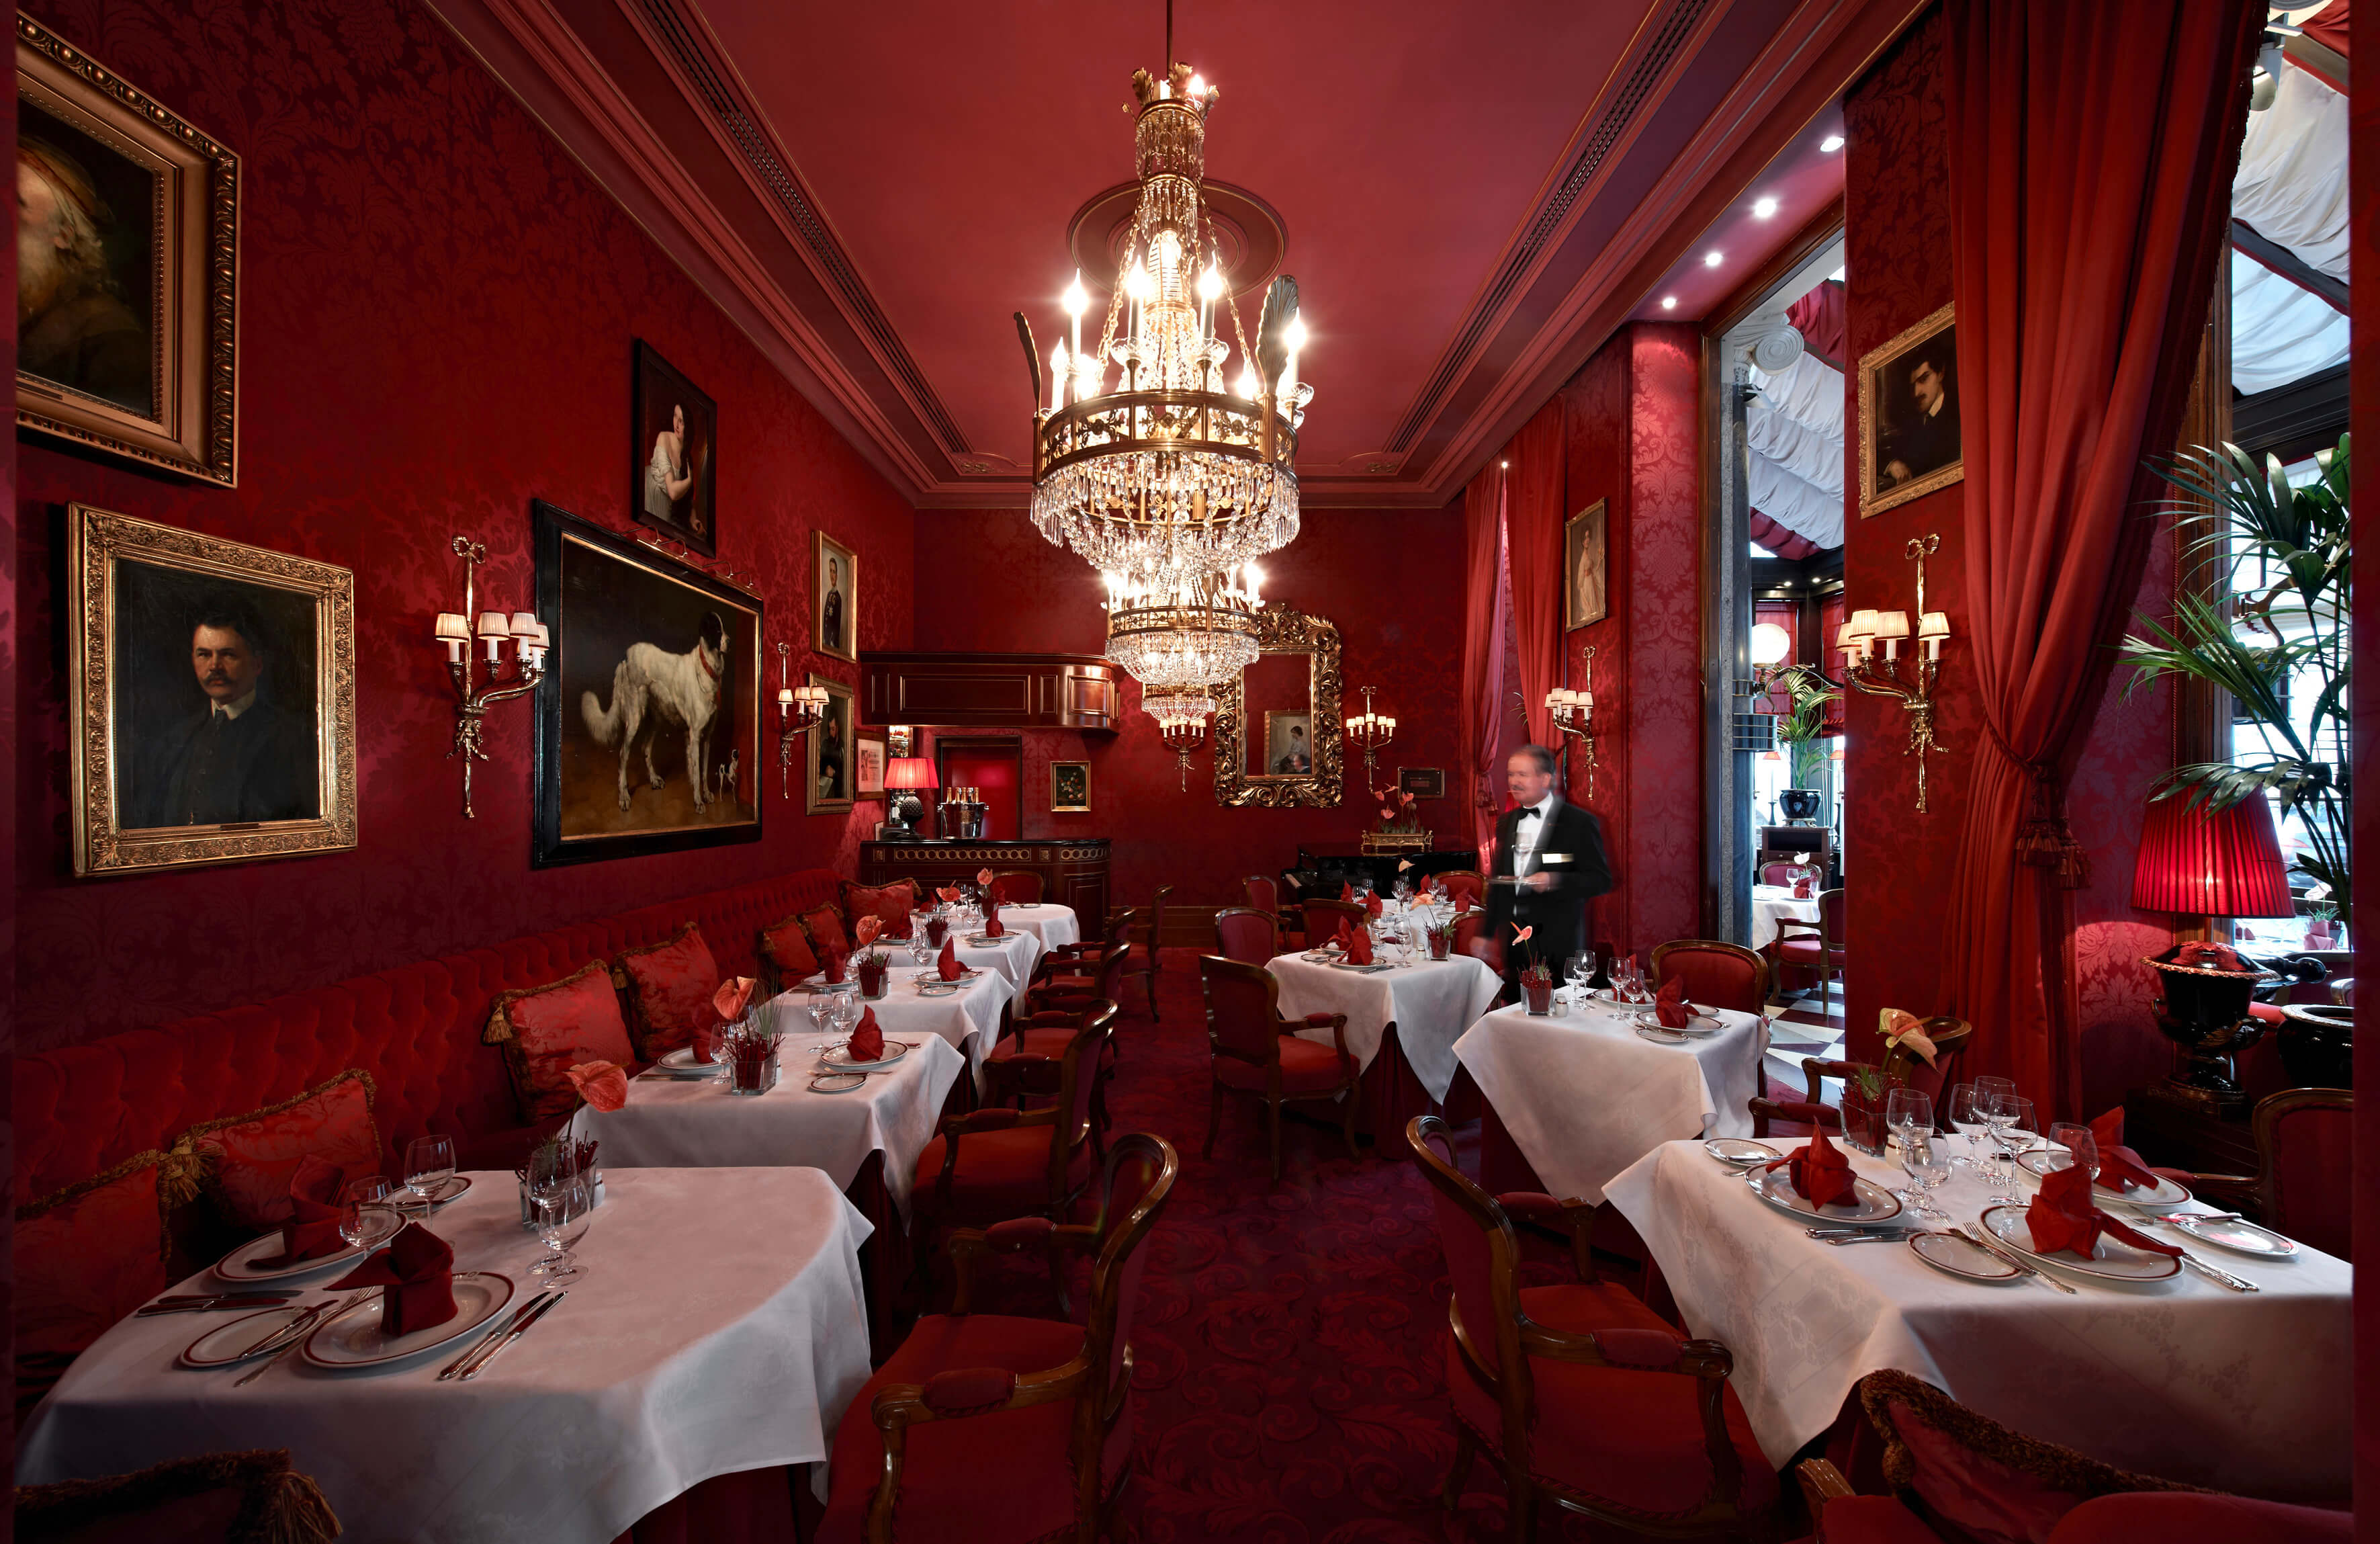
Independent models
Geography
Restaurant
Geography: Context
Restaurant: Context
Sahara: Manifestation
Sacher Cake: Manifestation
Sand desert: CI-connection
Sweet desert: CI-connection
Sand: Category
Desert: Item
Sweet: Category

Slide 32
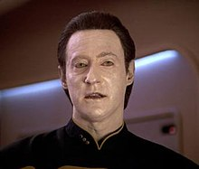
Examples of manifestation of DATA
IT
is any sequence of one or more symbols given meaning by specific act(s) of interpretation
Common understanding
individual units of information.
Star Trek
A character

Slide 33
Why we need it?
In the complex service environment (like Smart City) only one perspective is not enough
Already in a very simple applications we need to work with different manifestation of the same item
If we add the relation to other Services, environments (e.q. contexts) we get very complex model
To understand we need to have the possibility to analyze the manifestation of each item in all contexts

Slide 34
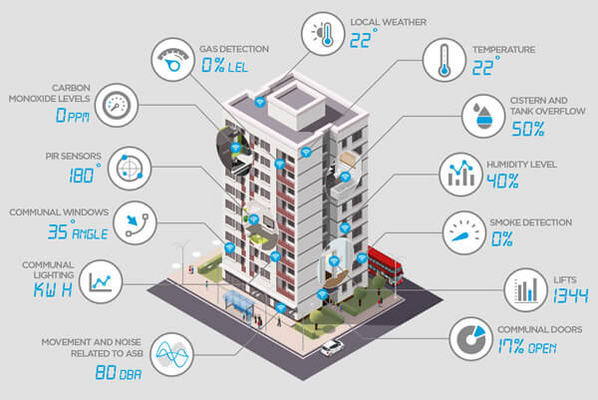
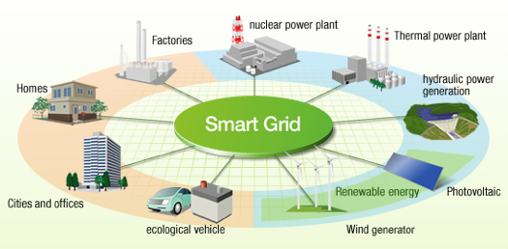
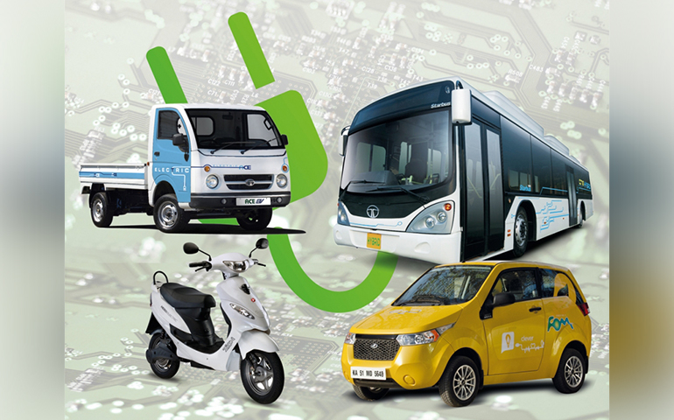
Examples

Slide 35
Example of smart street categories and objects
Street parts
Driving lines
Safety
Cameras
Pedestrian way
Public transport
Bus
Bus stop
All vehicles
Traffic on the road
Traffic lights
Parking slots
Pedestrian blocks
Speed sensor
Ticket machine
Tram line
IT Devices
Cameras
Smart Screen
Traffic lights
Traffic sensor
Pollution sensor
Vehicles
Car
Bicycle
Bus
Tram
Ticket machine
Smart Screen
Smart Screen

Slide 36
Conclusion
Contexts
Diamond See and Recognize, their elements and relationships
Examples and differences
Mention and Use duality
Acknowledgement
This presentation was improved by using Microsoft Copilot

