Slide 1

Diamond Do

Slide 2
Diamond-Path Framework
Paradigm aimed to help understand and act in a service-system environment
Theoretical concept
4 diamond-shaped models
See
Recognize
Organize
Do
Attention
Focusing
Cognitive
Elements
Agent-Team
Organization
Predictive
Behavior

Slide 3
Diamond of Attention Focussing
Objects and relationships between them
Mention-use duality
  Modelling a modelling tool
  Referring to itself
Relationship
characteristic
characteristic
R
P
Category
R
Object
R
Rule
characteristic
R
characteristic
Operation

Slide 4
Diamond of Cognitive Elements
Working within the context
Given level of certainty
Mention-use duality
Each item can apear in more contexts
Category can exist in more contexts (and vice versa)
The level of certainty depends on the expertise of agents
It is never 100%
The only use of R-edges
Category
base
R
CI-connection
Item
R
Context
R
R
Manifestation

Slide 5
Diamond of Agent – Team Organization
Action vs. Flow
Agent Behavior
R-edge
Are stabile during whole service lifecycle
Chnage means the change of the context
It is based on the GBS
Goals are created in the different contexts (enviroments, like school, home, work)
Represents the contextuality
Goal, Agent and Activity can apear in the different context
Action and Flow can be Activity in other context (and vice versa)
GBS
R22
Goal
reaching
reaching
fulfilling
follower
fulfilling
establisher
composite
R11
Action
Agent
Flow
organizer
organizer
member
member
author
learner
covering
superior
collaborator
focusing
R01
Activity
R02
detail
R33

Slide 6
Analysis of the Agent
What can be centred in the agent role?
Agent has requirements
Requirements can be modelled
Agent
Requirement
Model

Slide 7
What is related to requirements?
Goal
Model
fulfilling
recorded in
Use Case
Requirement
Context
forming / formed by
occurring within
addressing
Agent
solved by
Service

Slide 8
What is related to requirements?
Goal
achievable within
achievable by
Model
fulfilling
recorded in
identified within
Use Case
Requirement
Context
forming / formed by
occurring within
addressing
Agent
solved by
Service
creatable within
creatable by

Slide 9
rent a car like rent a bike, pick up the car along the road and go, any time, anywhere
Requirement: we want to solve the transportation issues
Agent: the city or municipality, citizens, tourists
Model: which type of transportation at which time for which group of people
goal: drive green! car sharing! reduce traffic jam and arrange the transportation better
Use case: Smart transportation projects, Car sharing projects
Service: real-time car booking service, service centre, reg. services etc.
Context: Smart City

Slide 10
Two special containers
Goal
achievable within
achievable by
Model
Agent wishes, defines, does.
fulfilling
Model records.
recorded in
identified within
Use Case
Requirement
Context
forming / formed by
occurring within
addressing
Agent
solved by
Service
creatable within
creatable by

Slide 11
Composite edges
GBS
Goal
achievable within
achievable by
M-composite
Model
fulfilling
recorded in
U-composite
identified within
C-composite
Use Case
Requirement
RBS
Context
forming / formed by
occurring within
A-composite
addressing
Agent
solved by
SBS
Service
creatable within
creatable by

Slide 12
R – edges – part 1
GBS
R11
Goal
achievable within
Rnn edges represent
interconnection to
another context (a new
DO diamond)
achievable by
M-composite
Model
fulfilling
recorded in
U-composite
identified within
R22
C-composite
Use Case
RBS
Requirement
Context
forming / formed by
occurring within
A-composite
addressing
Agent
solved by
SBS
R33
Service
creatable within
creatable by

Slide 13
R – edges – part 2
GBS
R11
Goal
achievable within
achievable by
M-composite
Model
R06
fulfilling
R01
recorded in
U-composite
identified within
R22
C-composite
Use Case
R03
RBS
Requirement
occurring within
Context
forming / formed by
R04
R0n enables to create
move the object to
requrement cotainer
R05
A-composite
addressing
Agent
R02
SBS
solved by
R33
Service
creatable within
creatable by

Slide 14
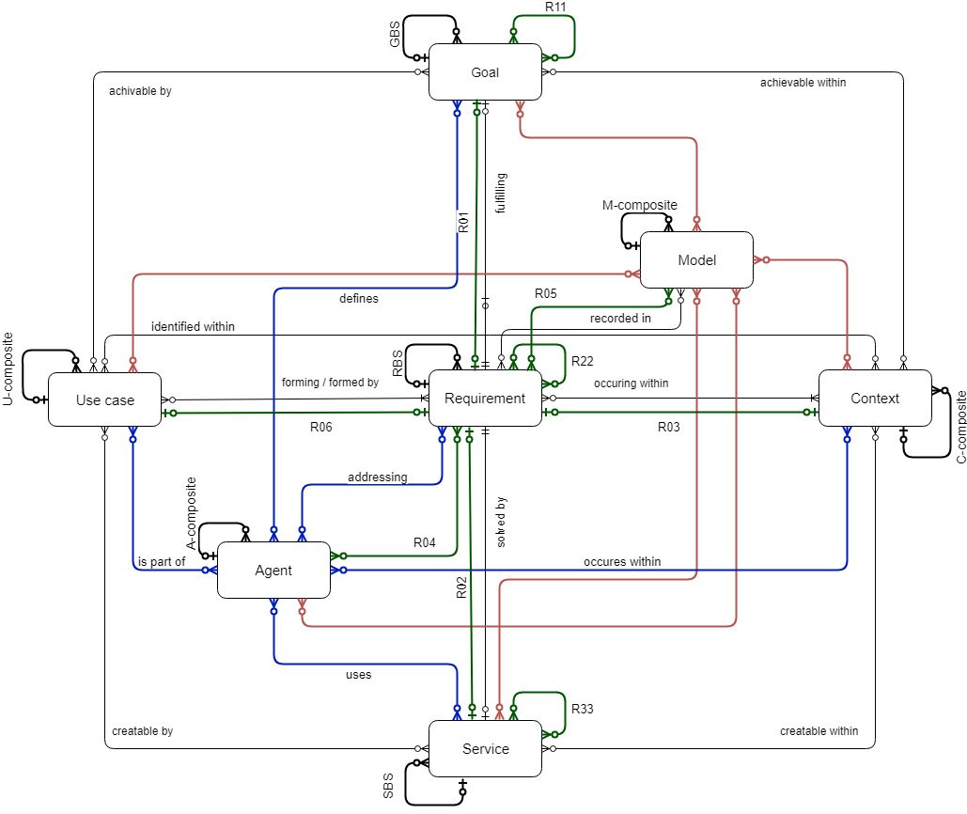
Do diamond – nicer

Slide 15
Diamond of Predictive Behaviour
Depicts the motivation of agents to DO
Everything can be seen as a requirement
Forming and being formed by behavioral patterns
Models as a system memory

Slide 16
Context of the service
Context | Requirement | Service | Agent | Goal | Model | Use Case
Healthy run of the citizen | To find optimal road | Road planner | Citizen | To be healthy | Relaxing roads | Current status of weather and air pollution
Race of the moto bikers | To find optimal road | Road planner | Moto driver | To win the race | Race maps | Weather (rain / sunny), position of other participants
Emergency service | To find optimal road | Road planner | Driver of emergency vehicle | To get to the place of accident | City street map | Current situation of traffic

Slide 17
What are the principles?
Principle of service definition - vertical
Service is not the most important element.
The Requirement is the key to build a successful service environment
The goals are the basement for the set of requirements
Principle of context understanding – horizontal
Context is the part of the model, not the externality
Use case is identified within the context (finding similar solutions)
Requrement is forming and is formed by Use cases
Principle of completeness – z-axis
Agents identification must be done in the relations with other elements
Model must involve all other elements including itself
17

Slide 18
Universal modelling
Accidental
Repeatable
Optimized
Defined
Managed
metrics for process and products quality measurement
CMM
descriptions exists
experience from
the past
capability of
continual
process
improvement
base for process monitoring
comparing of projects
ad hoc,
non-formal
How long does it take for regular ISs to adjust
in order to support newly optimized processes?

Slide 19
Current Modelling Tools
Current CASE tools, BPMT, PMT, … allow to record only such objects and relationships which had their creators in mind at the time when they were developing the tool.
Objects and relationships, which we focus on when modelling various aspects of business, are continually changing.
Problem of effective communication within any IT project lies nearly always on the boundaries of capability of a given modeling tool (… thus, the model doesn’t represent reality appropriately)
Except for some isolated cases, there are only a few ways to extend the used MT by constructs which are needed for current specific requirements.
A problem arises in integrating some partial views into one common view.

Slide 20
Meta-modelling
Generic MT
Domain-specific MT
Domain model
Ability to develop and adjust domain-specific modelling tools
Helps to construct the domain in terms comprehensible to domain experts
Hierarchy of modelling tools

Slide 21
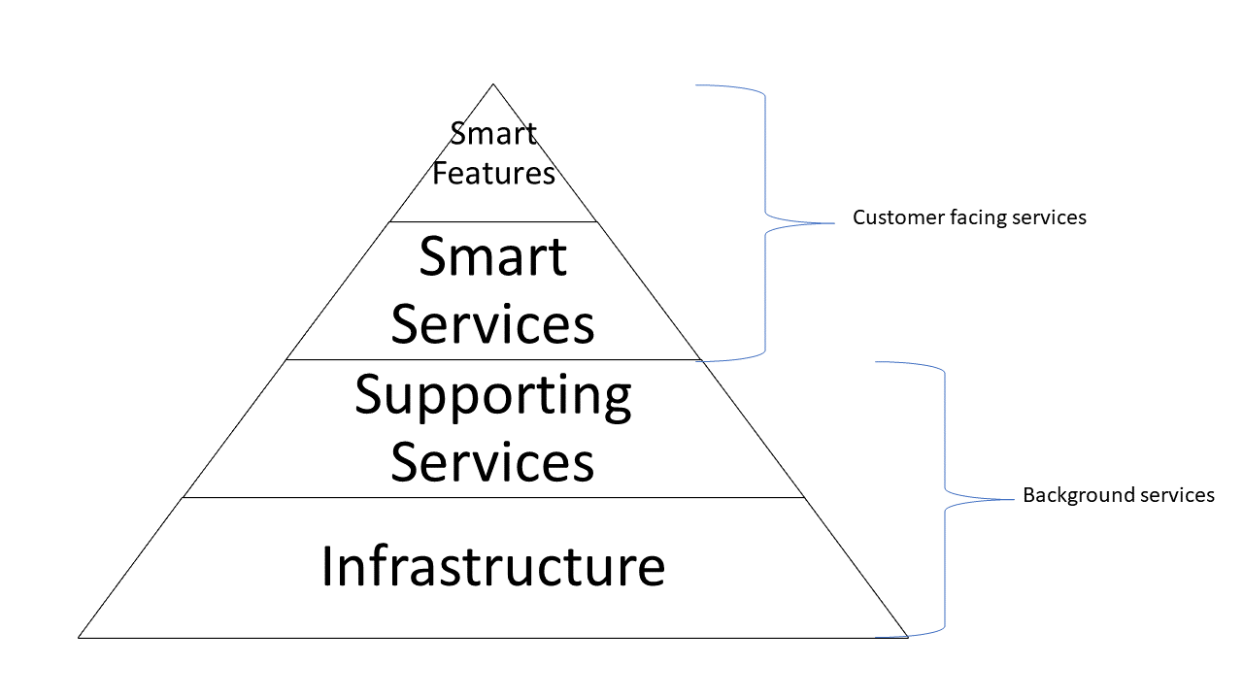
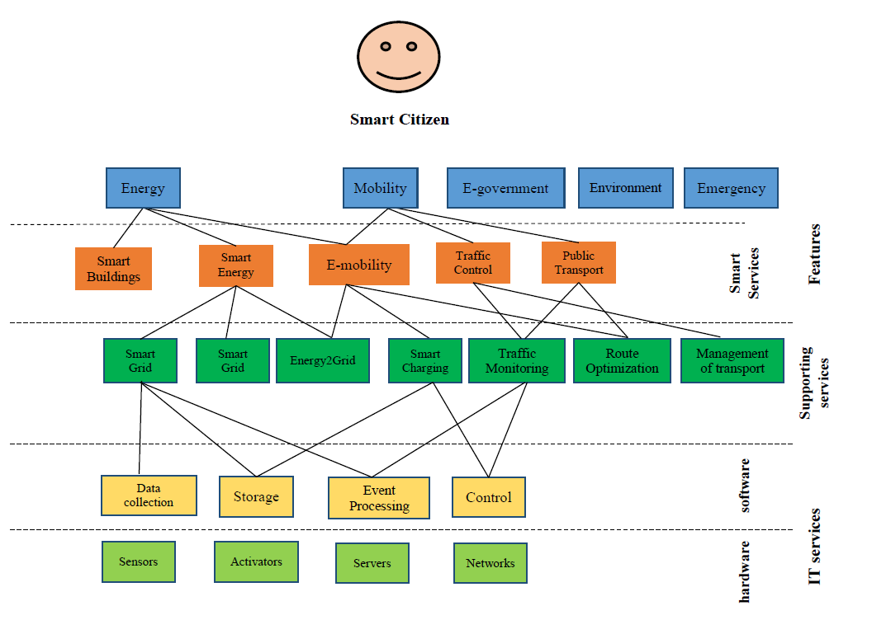
4DocMod – usage in Smart City Models
4DocMod helps to understand the position of each service in the structure of Services
Also, it can analyse the value chain of each Smart Service

Slide 22
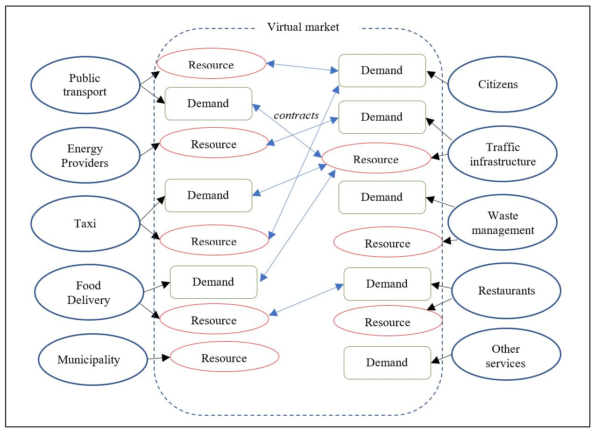
Multi Agent Technology (MAT)

Slide 23
MAT - features
Describe the behaviour and motivation on the virtual market
Each agent has own resources and demand resources of the others to provide/use different Services

Slide 24
MAT – Smart City model
Defines several agents to participate on Smart City development
Government agencies
Private organizations, including technology companies and startups
Citizens are the main stakeholders and end-users of the technologies and services implemented
Non-governmental organizations

Slide 25
Merging 4DocMod and MAT
Using service science and system approach to merge
4DocMod
Recognize contexts
Define value chain
MAT
Focuses on agents and their behavior
In case of change we just need to add new model
Detect overlaps
Can be used separately in each context

Slide 26
Example – Google maps
To find optimal road from Salerno to Ravello

Slide 27
Conclusion
Each modelling tool has its strengths and weaknesses
To understand the problem and to be able to develop new Services we need to explore new ways
The solution is in combining the tools to be able to cover all aspects of the problem (multicontextuality and specific issues)
Service Science matters

