Slide 1
Open Data
Leonard Walletzký
2024

Slide 2
Introduction
Definition of Open Data
Importance and rise of Open Data
Open Data is data that can be freely used, re-used, and redistributed by anyone, subject only, at most, to the requirement to attribute and share alike
The goal of Open Data is to ensure interoperability, which is the ability to intermix different datasets. This interoperability is key to realizing the main practical benefits of openness: the dramatically enhanced ability to combine different datasets together and thereby to develop more and better products and services

Slide 3
What is Open Data?
Explanation of Open Data
Availability and Access: The data must be available as a whole and at no more than a reasonable reproduction cost, preferably by downloading over the internet. The data must also be available in a convenient and modifiable form.
Re-use and Redistribution: The data must be provided under terms that permit re-use and redistribution, including the intermixing with other datasets.
Universal Participation: Everyone must be able to use, reuse, and redistribute. There should be no discrimination against fields of endeavour or persons or groups.
Types of data included in Open Data
Text or numeric data – any data that can be published in standard format (like speed, consumption of power, number of anything, etc.)
Non-textual material: This includes maps, genomes, connectomes, chemical compounds, mathematical and scientific formulae, medical data, and practice, bioscience, and biodiversity
Linked Open Data: Open data can be linked data - referred to as linked open data

Slide 4
Open Data in Cotext of Czech Republic
Defined in the law (no. 106/1999, §3 - §5)
Must be:
Accessible as data files in a machine-readable and open format with the full and current content of the database or aggregated statistics
Provided with non-restrictive conditions of use
Registered in the National Catalogue of Open Data (NKOD) as direct links to data files
Accompanied by documentation
Available for download without technical barriers (registration, limit of accesses, CAPTCHA, etc.)
Prepared with the aim of making machine processing as easy as possible by programmers, etc.
Provided with contact to for feedback (errors, request for extension, etc.)
Every goverment institution or municipality must provide open data (the rule what can be open, must be open)

Slide 5
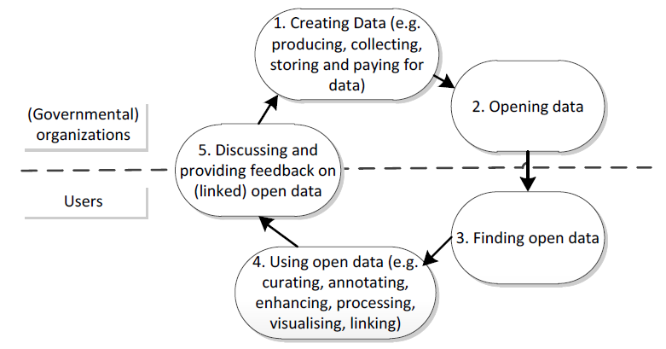
Open Data as a Service

Slide 6

Examples of data portals
Brno - https://data.brno.cz/en/
Prague – http://opendata.praha.eu/
European Data portal - https://www.europeandataportal.eu/en
Rome - https://dati.comune.roma.it/
Naples - http://www.comune.napoli.it/opendata

