Slide 1


PV204 Security technologies
JavaCard - programming secure elements
Petr Švenda svenda@fi.muni.cz @rngsec
Centre for Research on Cryptography and Security, Masaryk University
Please comment on slides with anything unclear, incorrect or suggestions for improvement
https://drive.google.com/file/d/14hI33_RZI8qyvAUI4_FIXlK3Q6iMmHB9/view?usp=sharing

Slide 2
Phase II
Study the selected security technology
Design your project
  Describe the architecture and explain your choices (what attacks is it preventing, …)
Start working on the implementation
  You should have a prototype ready by the end of this phase
Prepare 3-4 page report
  Brief description of the selected security technology
  Project design (architecture, intended use of the selected technology, design choices, …)
  Current progress (+ individual contribution of each team member)
Deadline: 24. 3. 2024
  Submit the report to IS

Slide 3
Prerequisites
Knowledge of basic smartcards technology is assumed (PV079)
If you are not familiar yet, please read slides PV204_03___PV079_2023_smartcards.pdf from IS (uploaded for this course)

Slide 4
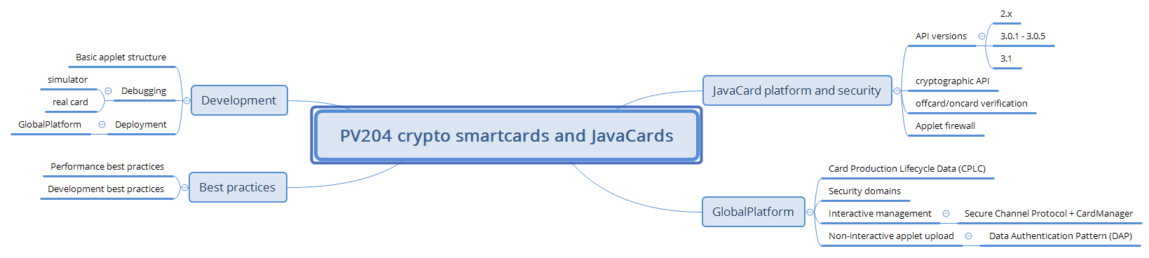
Next week

Slide 5
Motivation
Usage security-relevant scenarios
  Subscriber modules (SIMs), merchant payments, hardware wallets, authentication tokens, electronic IDs…
Why not as another software application on your laptop?
  Laptop not well portable, large trusted code base, many other applications (malware), lack of secure storage for cryptographic keys, user/attacker control platform, expensive to own…
Mobile phone fixes only some of these issues
  Is portable, some have better platform security (but not all!), still somewhat expensive…

Slide 6
Properties of “Ideal” platform Technology
Cheap, portable, no battery
Good support from outer environment
Fast enough for a task
Easy to develop (securely)
Apps portable between platform manufacturers
Secure, even with physical access (keys extraction)
Multiple apps from distrusting providers securely
Secure remote management (new apps, update)
…
crypto smartcards
PC/SC, phones with NFC
main CPU + crypto coprocessors
JavaCard API, tools, best practices
JavaCard bytecode, JCVM
tamper resistant, CC, FIPS140-2/3
Applet firewall, Security Domains
GlobalPlatform, SCP, DAP

Slide 7
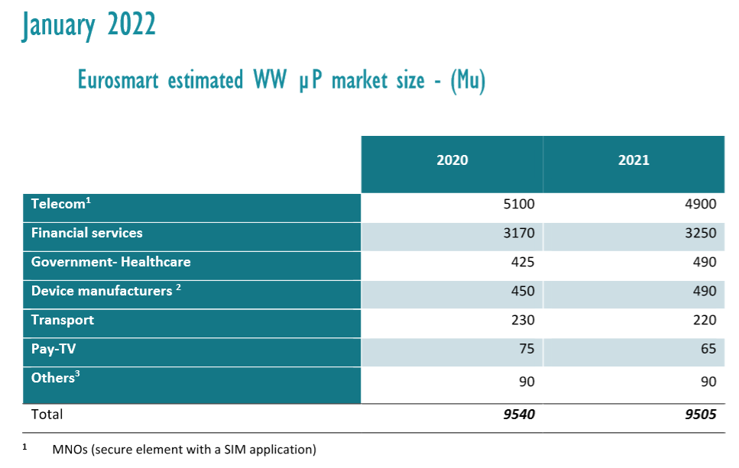
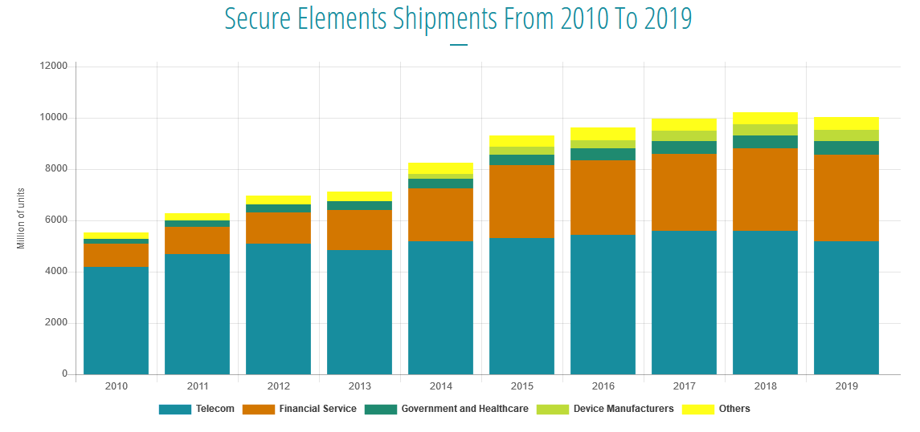
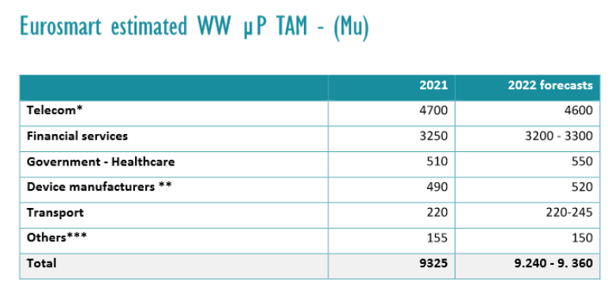
Primary markets for smartcards
Payment
Telco
https://www.eurosmart.com/eurosmarts-secure-elements-market-analysis-and-forecasts/
https://www.eurosmart.com/2021-secure-elements-global-market-and-2022-estimates/

Slide 8
Old vs. current multi-application smart cards
One program only
Stored persistently in ROM or EEPROM
Written in machine code
  Chip specific
Multiple applications at the same time
Stored in EEPROM
Written in higher-level language
  Interpreted from bytecode
  Portable
Application can be later managed (remotely)

Slide 9

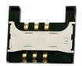


PC application
with direct control:
GnuPG, GPShell
PC application via library:
browser TLS, PDF sign…
Custom app with
direct control
Libraries
PKCS#11, OpenSC, JMRTD
Smartcard control language API
C/C# WinSCard.h, Java java.smartcardio.*, Python pyscard
System smartcard interface: Windows’s PC/SC, Linux’s PC/SC-lite
Manage readers and cards, Transmit ISO7816-4’s APDU
Readers
Contact: ISO7816-2,3 (T=0/1)
Contactless: ISO 14443 (T=CL)
APDU packet
API: EMV, GSM, PIV, OpenPGP, ICAO 9303 (BAC/EAC/SAC)
OpenPlatform, ISO7816-4 cmds, custom APDU
Our focus today
Card application 1
Card application 2
Card application 3
SC app programming:
JavaCard, MultOS, .NET

Slide 10
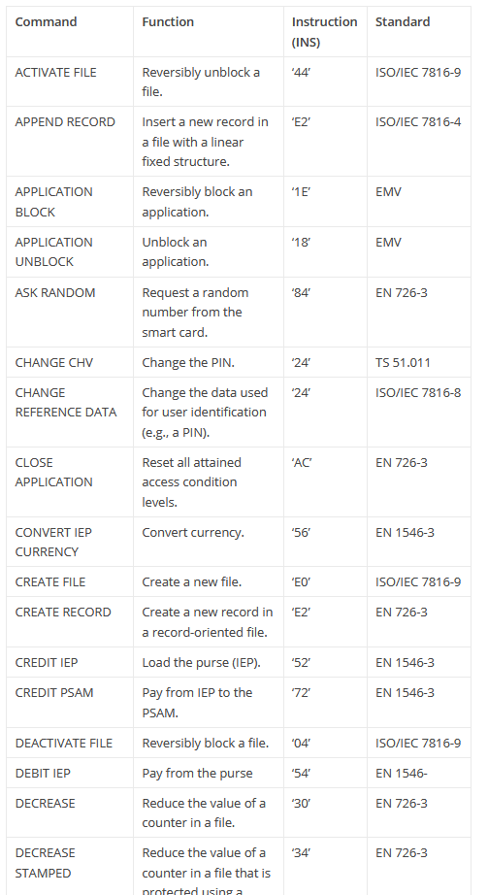
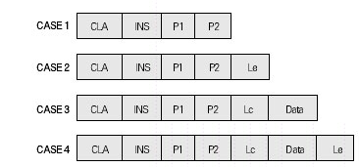
APDU (Application Protocol Data Unit)
APDU is basic logical communication datagram
  header (5 bytes) and up to ~256 bytes of user data
Format specified in ISO7816-4
Header/Data format
  CLA – instruction class
  INS – instruction number
  P1, P2 – optional data
  Lc – length of incoming data
  Data – user data
  Le – length of the expected output data
Some values of CLA/INS/P1/P2 standardized (better interoperability)
  https://web.archive.org/web/20180721010834/http://techmeonline.com/most-used-smart-card-commands-apdu/
Custom values used by application developer (your own API)

Slide 11


JavaCard basics

Slide 12
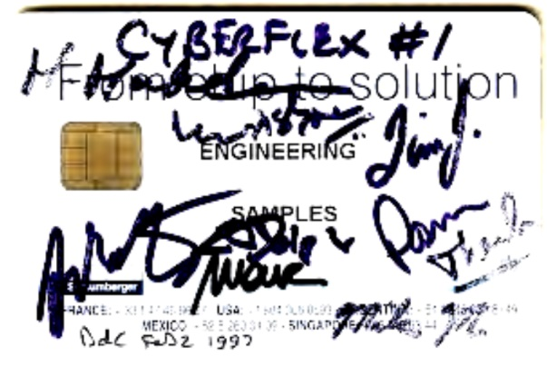
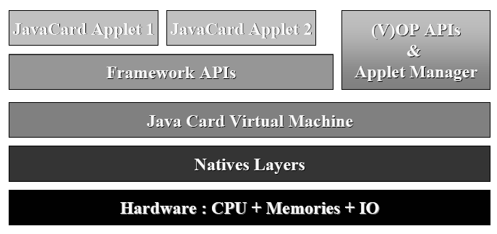
JavaCard
Maintained by Java Card Forum (since 1997)
Cross-platform and cross-vendor applet interoperability
Freely available specifications and development kits
  http://www.oracle.com/technetwork/java/javacard/index.html
JavaCard applet is Java-like application
  uploaded to a smart card
  executed by the JCVM

Slide 13

JavaCard applets
User Application
Written in restricted Java syntax
  byte/short (int) only, missing most of Java objects
Compiled using standard Java compiler
Converted using JavaCard converter
  check bytecode for restrictions
  can be signed, encrypted…
Uploaded and installed into smartcard
  executed in JC Virtual Machine (JCVM)
Communication using APDU commands
  small packets with header
PC/SC library
Applet1
Applet2
JCVM

Slide 14
JavaCard versions
JavaCard 2.1.x/2.2.x (2001-2003)
  widely supported versions
  basic symmetric and asymmetric cryptography algorithms
  PIN, hash functions, random number generation
  transactions, utility functions
JavaCard 2.2.2 (2006)
  last version from 2.x series
  significantly extended support for algorithms and new concepts
    long “extended” APDUs, BigNumber support, biometrics
    external memory usage, fast array manipulation methods…
JavaCard 3.x (2009)
  classic and connected editions, later

Slide 15
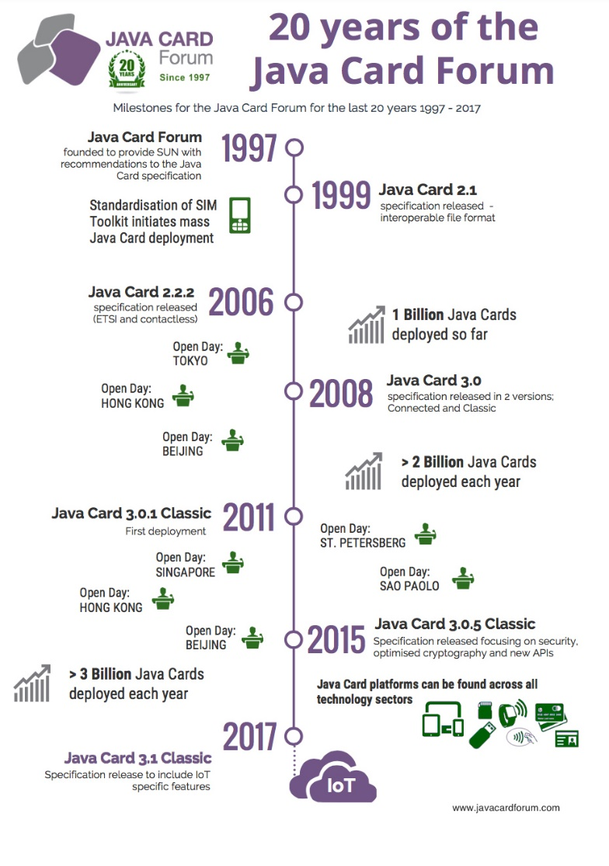
JavaCard 2.x is like Java but not supporting…
No dynamic class loading
No Security manager
No Threads and synchronization
No Object cloning, finalization
No Large primitive data types
  float, double, long and char
  usually not even int (4 bytes) data type by default
    specialized package javacardx.framework.util.intx for support
Most of std. classes missing
  most of java.lang, Object and Throwable in limited form
Limited garbage collection
  Newer cards supports, but slow and not always reliable

Slide 16
JavaCard 2.x supports
Standard benefits of the Java language
  data encapsulation, safe memory management, packages, etc.
Applet isolation based on the JavaCard firewall
  applets cannot directly communicate with each other
  special interface (Shareable) for cross applets interaction
Atomic operations using transaction mode
Transient data (buffer placed in RAM)
  fast and automatically cleared
A rich cryptography API
  accelerated by cryptographic co-processor
Secure (remote) communication with the terminal
  if GlobalPlatform compliant (secure messaging, security domains)

Slide 17
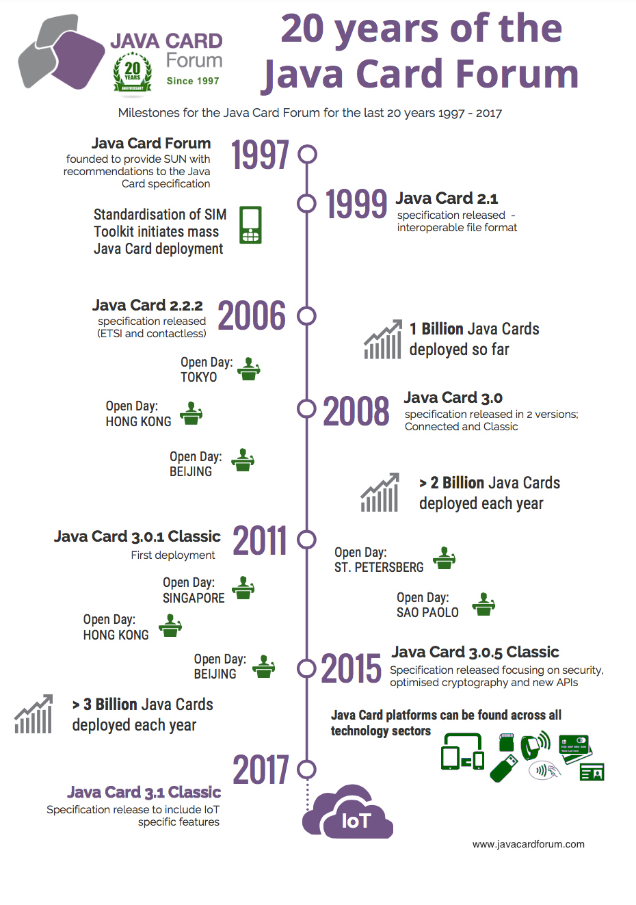
JavaCard 3.0.x (most recent 3.0.5 from 2015)
Major release of JavaCard specification
  significant changes in development logic
  two separate branches – Classic and Connected edition
JavaCard 3.x Classic Edition
  legacy version, extended JC 2.x
  APDU-oriented communication
JavaCard 3.x Connected Edition
  smart card perceived as web server (Servlet API)
  TCP/IP network capability, HTTP(s), TLS
  supports Java 6 language features (generics, annotations…)
  move towards more powerful target devices
  focused on different segment then classic smart cards
Connected edition is not used so far (likely dead)

Slide 18
JavaCard 3.1 (2018) and 3.2 (2023)
JavaCard 3.1
  Focus on IoT
  Additional cryptographic algorithms, named curves
  Not much experience yet (no devices available)
    Some certified end of 2022
JavaCard 3.2
  Ext. EdDSA (edwards25519, edwards448 curves)
  TLS1.3 and DTLS1.3 key schedule operations
  Configuration for RSA-OAEP/PSS
Conservative development
  Only what is “widely” requested
  Lacking behind state of the art

Slide 19
How to analyze real-world usage of technology X?
Collect representative sample of users / projects (ideally “all”)
  E.g., all open-source JavaCard projects on GitHub
Establish significance of projects
  E.g., Number of developers/forks/stars, search trends on Google, sales stats…
Analyze projects for the level and style of use of technology X
  E.g., static code analysis of JavaCard keywords and constants
  Ideally trends in time if possible (e.g., code state in time via git commits)
“The adoption rate of JavaCard features by certified products and open-source projects”, L. Zaoral, A. Dufka, P.Svenda, CARDIS’23 https://link.springer.com/chapter/10.1007/978-3-031-54409-5_9

Slide 20
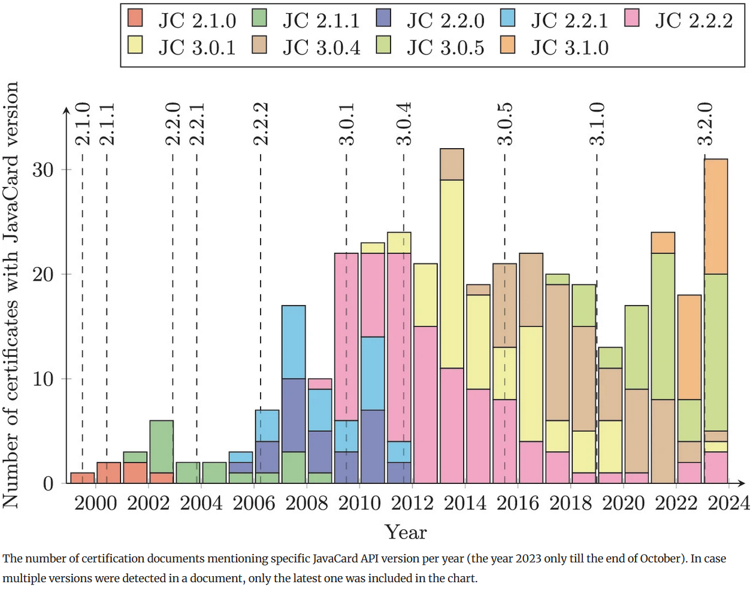
Certified smartcards and JavaCard-related projects
Number of (expensively) certified JavaCard devices is increasing

Slide 21
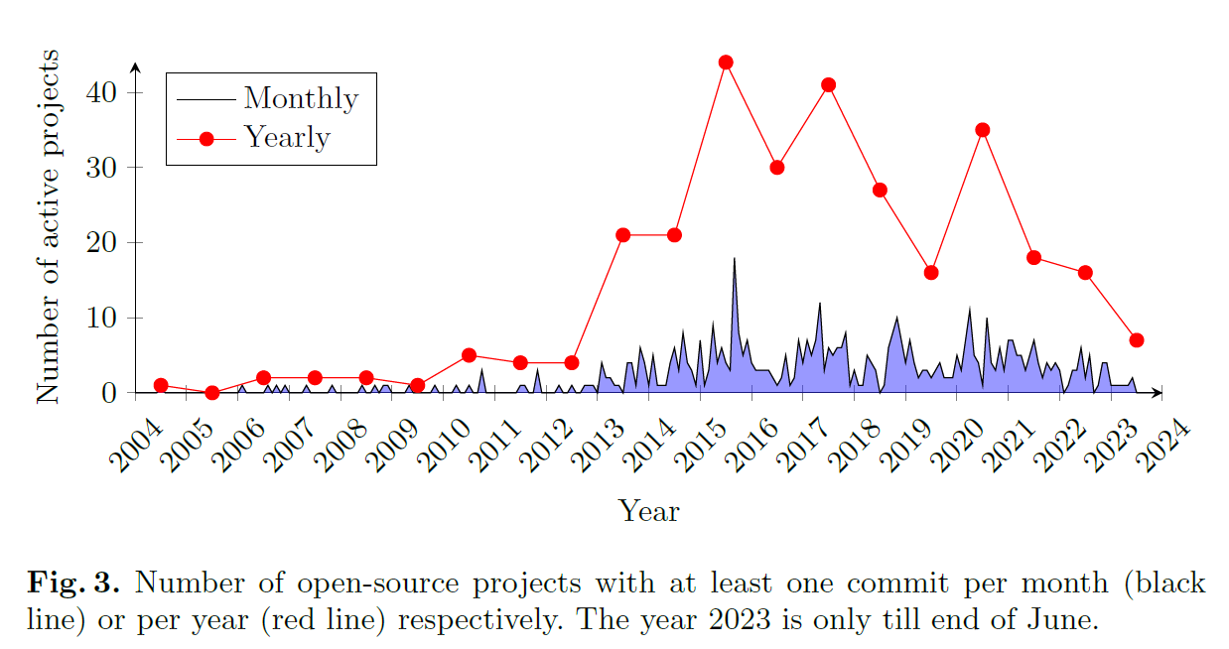
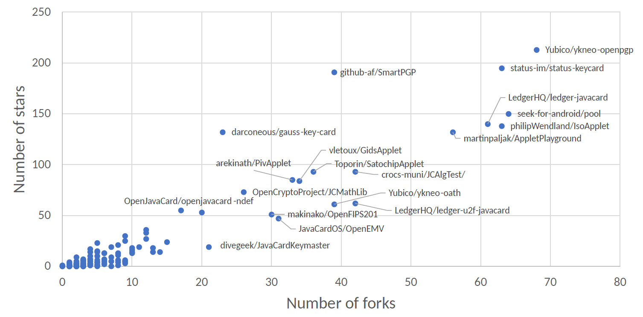
Activity of open-source JavaCard applets in time
Is open-source ecosystem representative of the whole domain?
  Likely two orders of magnitude more developers in non-open source domain
  Proprietary applets with access to proprietary API may be different

Slide 22
Version support
Need to know supported version for your card
  convertor adds version identification of packages used to binary cap file
  If converted with unsupported version, upload to card fails
Supported version can be (somewhat) obtained from card
  JCSystem.getVersion() → [Major.Minor]
  https://github.com/petrs/jcAIDScan
  See https://www.fi.muni.cz/~xsvenda/jcsupport.html
Available cards supports mostly 2.x specification or 3.0.x (newer cards)

Slide 23
JavaCard applet firewall – runtime checks
Applet1
Applet2
Applet3
Access to other applet’s methods and attributes prevented
  Even if public
Applets can access specific JCRE objects
JCRE can access all applets (no restriction)
Static attributes of package accessible by all its applets!
Cap file 1
Cap file 2
Static data
JavaCard runtime environment (JCRE)
JCRE = JCVM + API
APDU
SmartCard hardware
Inspired by http://ekladata.com/IHWNXUB-yernblD2sdiK1zxxQco/5_javacard.pdf

Slide 24
Desktop vs. smart card
Following slides will be marked with icon based on where it is executed
Process executed on host (PC/NTB…)
Process executed inside smart card

Slide 25
On-card, off-card code verification
How to upload only “correct” applets?
Off-card verification
  Basic JavaCard constraints
  Possibly additional checks (e.g., type consistency when using Shareable interface)
  Full-blown static analysis possible
  Applet can be digitally signed (and enforced by DAP – shown later)
On-card verification
  Limited resources available
  Proprietary checks by JC platform implementation

Slide 26
Developing JavaCard appS

Slide 27
package example;
import javacard.framework.*;
public class HelloWorld extends Applet {
protected HelloWorld() {
register();
}
public static void install(byte[] bArray, short bOffset, byte bLength) {
new HelloWorld();
}
public boolean select() {
return true;
}
public void process(APDU apdu) {
// get the APDU buffer
byte[] apduBuffer = apdu.getBuffer();
// ignore the applet select command dispached to the process
if (selectingApplet()) return;
// APDU instruction parser
if (apduBuffer[ISO7816.OFFSET_CLA] == CLA_MYCLASS) &&
apduBuffer[ISO7816.OFFSET_INS] == INS_MYINS)) {
MyMethod(apdu);
}
else ISOException.throwIt( ISO7816.SW_INS_NOT_SUPPORTED);
}
public void MyMethod(APDU apdu) { /* ... */ }
}
include packages from javacard.*
extends Applet
Called only once, do all allocations&init HERE
Called repeatedly on application select, do all temporaries preparation HERE
Called repeatedly for every incoming APDU, parse and call your code HERE

Slide 28
JC development process
6. Write user Java app
(javax.smartcardio.*)
Extends
javacard.framework.Applet
7. Use applet on
smart card (APDU)
2. Compile Java→*.class
(Java 1.3 binary format)
3. Convert *.class→*.jar/cap
(JavaCard Convertor)
5. Install applet
(GPPro/GPShell)
4. Upload *.jar/cap
→ smart card (GPPro/GPShell)

Slide 29
JavaCard application running model
Uploaded package – application binary
Installed applet from package – running application
Applet is “running” until deleted from card
Applet is suspended when power is lost
  Transient data inside RAM are erased
  Persistent data inside EEPROM remain
  Currently executed method is interrupted
When power is resumed
  Unfinished transactions are rolled back
  Applet continues to run with the same persistent state
  Applet waits for new command (does not continue with interrupted method)
Applet is deleted by service command

Slide 30

Globalplatform
Managing applets on card

Slide 31

Motivation: Fix bug in electronic IDs for half of population
Problem: how to remotely manage administrative access to token?
  Smartcards, TEE (TrustZone) - same basic issues, but also some specifics
Local/remote upload, configuration and removal of applications
Authentication of manager, online vs. offline operations

Slide 32
GlobalPlatform
Specification of API for card administration
  Upload/install/delete applications
  Card lifecycle management
  Card security management
  Security mechanisms and protocols
Newest is GlobalPlatform Card Specification v2.3.1
  March 2018
  Previous versions also frequently used
  http://www.globalplatform.org/specificationscard.asp
Primary open API for Trusted Execution Environment (TEE)
  ARM TrustZone…

Slide 33

GlobalPlatform – main terms
Card Manager
Security
Domain 1
Security
Domain 2
Smart card life cycle
  OP_READY, INITIALIZED (prepared for personalization)
  SECURED (issued to user, use phase)
  CARD_LOCKED (temporarily locked (attack), unlock to SECURED)
  TERMINATED (logically destroyed)
Card Manager (CM)
  Special card component responsible for administration and card system service functions (cannot be removed)
Security Domain (SD)
  Logically separated area on card with own access control
  Enforced by different authentication keys

Slide 34
GlobalPlatform – main terms
Card Manager
Security
Domain 1
Security
Domain 2
Card Content (apps,data) Management
  Content verification, loading, installation, removal
Security Management
  Security Domain locking, Application locking
  Card locking, Card termination
  Application privilege usage, Security Domain privileges
  Tracing and event logging
Command Dispatch
  Application selection
  (Optional) Logical channel management
Applet 2
Applet 3
Applet 1

Slide 35
Smart card life cycles
The smart card passes various logical life cycle states between manufacture and final destruction
Life cycle states define which operations can be performed with the card
The card Life Cycle States OP_READY and INITIALIZED are intended for use during the Pre-Issuance phases of the card’s life.
The states SECURED, CARD_LOCKED and TERMINATED are intended for use during the Post-Issuance phase of the card although it is possible to terminate the card at any point during its life.

Slide 36
Smart card life cycles
OP_READY – card is ready for uploading of key diversification data, any application and issuer specific structures.
INITIALIZED – card is fully prepared but not yet issued to card holder.
SECURED – card is issued to card holder. Card management is possible only through Security domain (installation of signed applets etc.).
CARD_LOCKED – card is locked due to some security policy and no data management can be performed. Card can be locked by Security domain and later unlocked as well (switch back to SECURED state).
TERMINATED – card is logically “destroyed“ due to card expiration or detection of the severe security thread.

Slide 37
Global Platform APDU commands
DELETE – delete uniquely identifiable object (e.g. JavaCard applet)
STORE_DATA – upload content of single data object
GET_DATA - used to retrieve a single data object
SET_STATUS – set Life Cycle status
GET_STATUS – return Life Cycle status
INSTALL – initiate installation, typically (JavaCard) applet
LOAD – upload file from PC to smart card, e.g. JavaCard cap file
PUT_KEY – update value of specified key

Slide 38
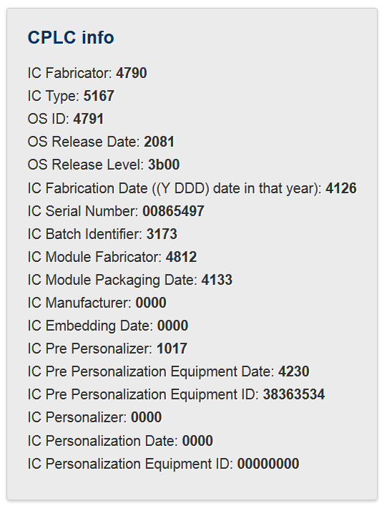
Card Production Life Cycle (CPLC)
Manufacturing metadata
Dates (OS, chip)
Circuit serial number
(not mandatory)
GlobalPlatform APDU
  80 CA 9F 7F 00
  gppro --info
ISO7816 APDU
  00 CA 9F 7F 00

Slide 39
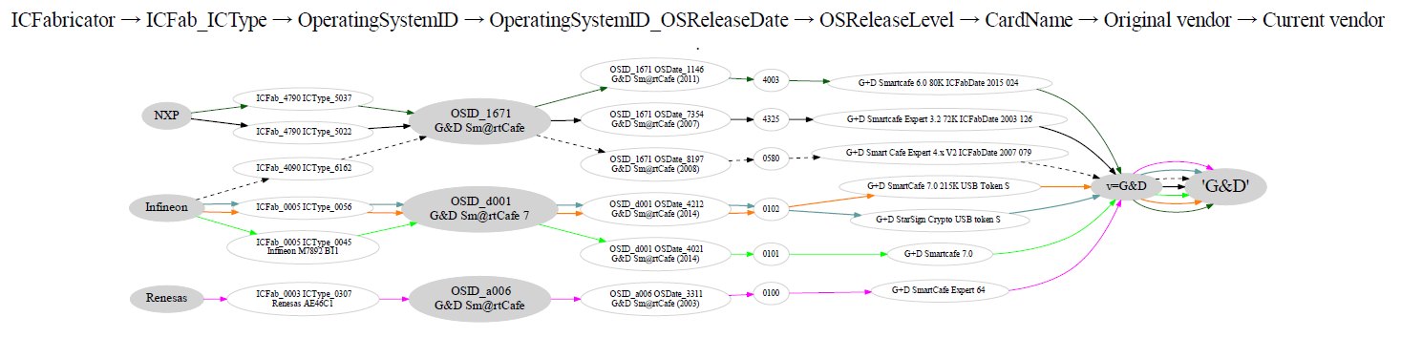
Example CPLC results from several G&D cards

Slide 40
GlobalPlatform package/applet upload - SCP
Security domain selection
Secure channel establishment (SCP) – security domain
Package (cap file) upload
  Local upload in trusted environment
  Remote upload with relayed secure channel
Applet installation
  Separate instance from package binary with unique AID
  Applet privileges and other parameters passed
  Applet specific installation data passed
gp --install file_with_applet.cap

Slide 41
GlobalPlatform package/applet upload - Data Authentication Pattern (DAP)
Generate cap signing keypair (RSA, OpenSSL)
Sign applet (file with cap, capfile tool)
Create policy domain (SSD) with MandatedDAPVerification
Set personalization keys for the SSD (secret symmetric crypto keys)
Upload verification key for this domain (key version 0x73, public key of your signing keypair)
Verify that SSD is prepared (DOM, DAPVerification privilage)
Upload signed applet (*.cap file)
https://github.com/martinpaljak/GlobalPlatformPro/blob/next/tests/sce70.sh

Slide 42
GlobalPlatformPro – DAP example
Warning: Once created,
policy domain cannot
be removed
// Sign cap file
java -jar capfile.jar -s priv.pem file.cap
// Create policy domain with dap verification (DAPVerification) - will contain public key and will be used to authorize cap loading
set DOM5=050505050505
gp -key default -domain %DOM5% -privs MandatedDAPVerification
// Lock with visa2 KDF
gp -connect %DOM5% -key default -lock emv:default
// Put pub key
gp -connect %DOM5% --put-key pub.pem --new-keyver 0x73 -key emv:default
// Try to install unsigned cap files (shall fail)
gp -key default --sha256 --install file_unsigned.cap
// Load applet into ISD with DAP policy domain used
gp -key default --sha256 --install file.cap --dap-domain %DOM5%

Slide 43
Developing simple applet

Slide 44
JavaCard – My first applet
Desktop Java vs. JavaCard
  PHP vs. C ☺
No modern programming features
  No threads, no generics, no iterators…
Limited type system
  Usually no ints (short int and byte only), no floats, no Strings
Fun with signed 16-bits values
  JavaCard is usually 16-bit platform (short)
  (short) typecast must be performed on intermediate results
  Shorts are signed => to obtain unsigned byte
    Convert to short with & 0x00ff

Slide 45
Necessary tools
Several tool chains available
  both commercial (RADIII, JCOPTools, G&D JCS Suite)
  and free (Sun JC SDK, AppletPlayground…)
We will use:
  Java Standard Edition Development Kit 1.3 or later
  ant-javacard ant task for building JC applets
    Apache Ant 1.7 or later, JavaCard Development Kit 2.2.2
  NetBeans 6.8 or later as IDE
  GlobalPlatformPro for applets management

Slide 46
package example;
import javacard.framework.*;
public class HelloWorld extends Applet {
protected HelloWorld() {
register();
}
public static void install(byte[] bArray, short bOffset, byte bLength) {
new HelloWorld();
}
public boolean select() {
return true;
}
public void process(APDU apdu) {
// get the APDU buffer
byte[] apduBuffer = apdu.getBuffer();
// ignore the applet select command dispached to the process
if (selectingApplet()) return;
// APDU instruction parser
if (apduBuffer[ISO7816.OFFSET_CLA] == CLA_MYCLASS) &&
apduBuffer[ISO7816.OFFSET_INS] == INS_MYINS)) {
MyMethod(apdu);
}
else ISOException.throwIt( ISO7816.SW_INS_NOT_SUPPORTED);
}
public void MyMethod(APDU apdu) { /* ... */ }
}
include packages from javacard.*
extends Applet
Called only once, do all allocations&init HERE
Called repeatedly on application select, do all temporaries preparation HERE
Called repeatedly for every incoming APDU, parse and call your code HERE

Slide 47
Simple JavaCard applet - code
Subclass javacard.framework.Applet
Allocate all necessary resources in constructor
Select suitable CLA and INS for your method
Parse incoming APDU in Applet.process() method
Call your method when your CLA and INS are set
Get incoming data from APDU object (getBuffer(), setIncomingAndReceive())
Use/modify data
Send response (setOutgoingAndSend())

Slide 48
select() method
Method called when applet is set as active
  for subsequent APDU commands
  begin of the session
  use for session data init (clear keys, reset state…)
deselect()
  similar, but when applet usage finish
  may not be called (sudden power drop) => clear in select
public void select() { // CLEAR ALL SESSION DATA
chv1.reset(); // Reset OwnerPIN verification status
remainingDataLength = 0; // Set states etc.
// If card is not blocked, return true.
// If false is returned, applet is not selectable
if (!blocked) return true;
else return false;
}

Slide 49
Sending and receiving data
javacard.framework.APDU
  incoming and outgoing data in APDU object
Obtaining just apdu header
  APDU.getBuffer()
Receive data from terminal
  APDU.setIncomingAndReceive()
Send outgoing data
  APDU.setOutgoingAndSend()

Slide 50
Sending and receiving data – source code
private void ReceiveSendData(APDU apdu) {
byte[] apdubuf = apdu.getBuffer(); // Get just APDU header (5 bytes)
short dataLen = apdu.setIncomingAndReceive(); // Get all incoming data
// DO SOMETHING WITH INPUT DATA
// STARTING FROM apdubuf[ISO7816.OFFSET_CDATA]
// ...
// FILL SOMETHING TO OUTPUT (apdubuf again)
Util.arrayFillNonAtomic(apdubuf, ISO7816.OFFSET_CDATA, 10, (byte) 1);
// SEND OUTGOING BUFFER
apdu.setOutgoingAndSend(ISO7816.OFFSET_CDATA, 10);
}

Slide 51
Communication with smart card

Slide 52
JavaCard communication lifecycle
(Applet is already installed, APPLET_AID)
PC: Reset card (plug smart card in, software reset)
PC: Send SELECT command (00 a4 04 00 APPLET_AID)
  received by Card Manager application
  SC: sets our applet active, select() method is always called
PC: Send any APDU command (any of your choice)
  SC: received by process() method
SC: Process incoming data on card, prepare outgoing data
  encryption, signature…
PC: Receive any outgoing data
  additional special readout APDU might be required
PC: Repeat again from step 4
PC: (Send DESELECT command)
  SC: deselect() method might be called

Slide 53

Java javax.smartcardio.* API
List readers available in system
  TerminalFactory.terminals()
  identified by index CardTerminal.get(index)
  readable string (Gemplus GemPC Card Reader 0)
Connect to target card
  Check for card (CardTerminal.isCardPresent())
  connect to Card (CardTerminal.connect("*"))
  get channel (Card.getBasicChannel())
  reset card and get ATR (Card.getATR())
Already used in labs last week – SimpleAPDU project

Slide 54
Java javax.smartcardio.* API (2)
Select applet on card
  send APDU with header 00 a4 04 00 LC APPLET_AID
Send APDU to invoke method
  prepare APDU buffer (byte array)
  create CommandAPDU from byte array
  send CommandAPDU via CardChannel.transmit()
  check for response data (getSW1() == 0x61)
  read available response data by 00 C0 00 00 SW2
Process response
  status should be ResponseAPDU.getSW() == 0x9000
  returned data ResponseAPDU.getData()

Slide 55
Response APDU (R-APDU)
Response data + status word (2 bytes)
  0x9000 - SW_NO_ERROR, OK
  0x61** - SW_BYTES_REMAINING_**
  see javacard.framework.ISO7816 interface
  other status possible (GlobalPlatform, user defined)
May require special command to read out
  first response is just status word (0x61**)
  00 C0 00 00 ** or C0 C0 00 00 ** APDU
    ** is number of bytes to read out

Slide 56
Debugging applet

Slide 57
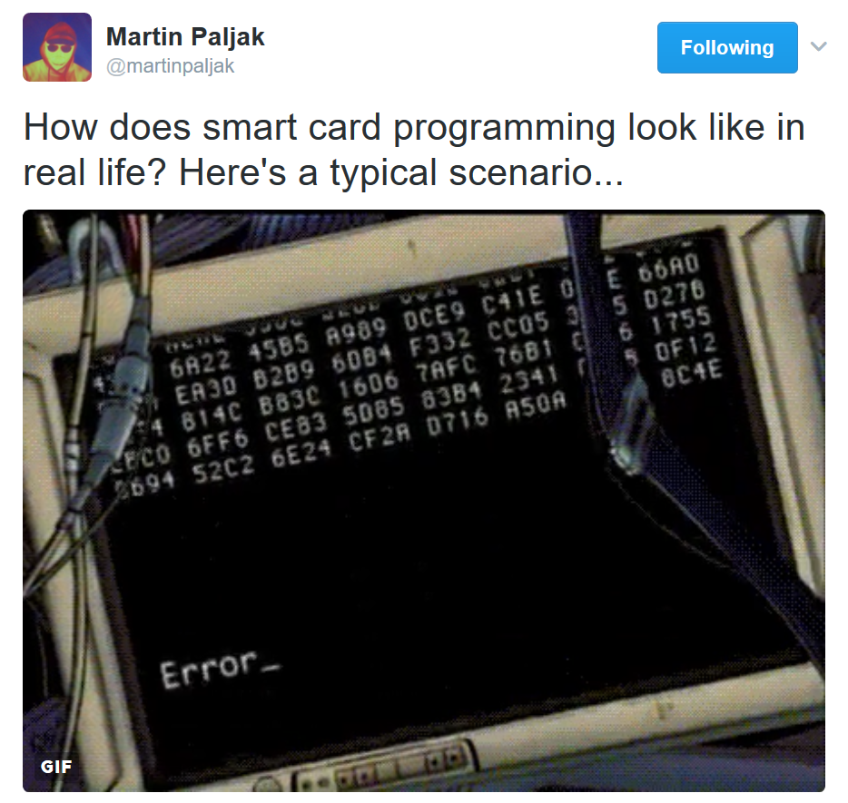
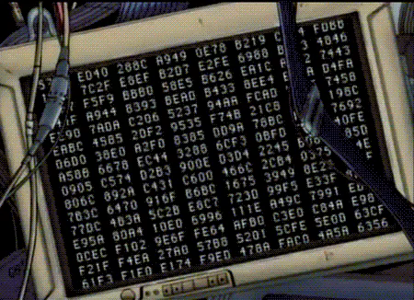

Slide 58
1. Debugging applets: simulator
The smartcard is designed to protect application
  Debugger cannot be connected to running application
Option 1: use card simulator (jcardsim.org)
  Simulation of JavaCard 3.0.5 (based on BouncyCastle)
  Very helpful, allows for direct debugging (will be covered in labs)
  Catch of logical flaws etc.
  Allows to write automated unit and integration tests!
Problem: Real limitations of cards are missing
  supported algorithms, memory, execution speed…

Slide 59
2. Debugging applets: real cards
Option 2: use real cards
  Cannot directly connect debugger, no logging strings…
Debugging based on error messages
  Use multiple custom errors rather than ISO7816 errors
  Distinct errors tell you where problem (might) happened
Problem: operation may end with unspecific 0x6f00
  Any uncaught exception on card (other than ISOException)
  Solution1: Capture on card, translate to ISOException
  Solution2: Locate problematic command by insertion of ISOException.throwIt(0x666); and recompile

Slide 60
Possible causes for exception on card
Writing behind allocated array
Using Key that was Key.clear() before
Insufficient memory to complete operation
Cipher.init() with uninitialized Key
Import of RSA key into real card generated by software outside card (e.g., getP() len == 64 vs. 65B for RSA1024)
Storing reference of APDU object localAPDU = origAPDU;
Decryption of value stored in byte[] array with raw RSA with most significant bit == 1 (set first byte of array to 0xff to verify)
Set CRT RSA key using invalid values for given part - e.g. setDP1()
Too many nested calls, no free space on stack for arguments
… and many more ☺

Slide 61
Getting more than 0x6f00
public void process(javacard.framework.APDU apdu) {
// ignore the applet select command dispatched to the process
if (selectingApplet()) return;
try {
//
// … Standard APDU command dispatching...
//
} catch (ISOException e) {
throw e; // Our exception from code, just re-emit
} catch (ArrayIndexOutOfBoundsException e) {
ISOException.throwIt(SW_ArrayIndexOutOfBoundsException);
} catch (ArithmeticException e) {
ISOException.throwIt(SW_ArithmeticException);
} catch (ArrayStoreException e) {
ISOException.throwIt(SW_ArrayStoreException);
} catch (NullPointerException e) {
ISOException.throwIt(SW_NullPointerException);
} catch (NegativeArraySizeException e) {
ISOException.throwIt(SW_NegativeArraySizeException);
} catch (CryptoException e) {
ISOException.throwIt((short) (SW_CryptoException_prefix | e.getReason()));
} catch (SystemException e) {
ISOException.throwIt((short) (SW_SystemException_prefix | e.getReason()));
} catch (PINException e) {
ISOException.throwIt((short) (SW_PINException_prefix | e.getReason()));
} catch (TransactionException e) {
ISOException.throwIt((short) (SW_TransactionException_prefix | e.getReason()));
} catch (CardRuntimeException e) {
ISOException.throwIt((short) (SW_CardRuntimeException_prefix | e.getReason()));
} catch (Exception e) {
ISOException.throwIt(Consts.SW_Exception);
}
}
Our exception, just re-emit
Some exceptions provide additional information (code). Propagate it further
final short SW_Exception = (short) 0xff01;
final short SW_ArrayIndexOutOfBoundsException = (short) 0xff02;
final short SW_ArithmeticException = (short) 0xff03;
final short SW_ArrayStoreException = (short) 0xff04;
final short SW_NullPointerException = (short) 0xff05;
final short SW_NegativeArraySizeException = (short) 0xff06;
final short SW_CryptoException_prefix = (short) 0xf100;
final short SW_SystemException_prefix = (short) 0xf200;
final short SW_PINException_prefix = (short) 0xf300;
final short SW_TransactionException_prefix = (short) 0xf400;
final short SW_CardRuntimeException_prefix = (short) 0xf500;

Slide 62
Debugging using custom commands
Addition of custom commands to “dump” interesting parts of data
  Intermediate values of internal arrays, unwrapped keys…
Should obey to Secure by default principle
  Debugging possibility should be enabled only on intention
  E.g., specific flag in installation data which cannot be enabled later (by an attacker)
  Don’t let debugging code into release!

Slide 64
Next week:
Best practices for JavaCard
(secure multiparty computation)

Slide 65
Summary
Smart cards are programmable (JavaCard)
  reasonable cryptographic API
  coprocessor for fast cryptographic operations
  multiple applications coexist securely on single card
  Secure execution environment
Standard Java 6 API for communication exists
PKI applet can be developed with free tools
  PIN protection, on-card key generation, signature…
JavaCard is not full Java – optimizations, security

Slide 66
Mandatory reading
Mandatory
  IS, Gemalto_JavaCard_DevelGuide.pdf
Optional
  Java Card lecture, Erik Poll, Radboud Uni
    http://ekladata.com/IHWNXUB-yernblD2sdiK1zxxQco/5_javacard.pdf

Slide 67
Best practices (for applet developers)

Slide 68
Quiz
Expect that your device is leaking in time/power channel. Which option will you use?
  AES from hw coprocessor or software re-implementation?
  Short-term sensitive data stored in EEPROM or RAM?
  Persistent sensitive data in EEPROM or encrypted object?
  Conditional jumps on sensitive value?
Expect that attacker can successfully induct faults (random change of bit(s) in device memory).
  Suggest defensive options for applet’s source code
  Change in RAM, EEPROM, instruction pointer, CPU flags…

Slide 69
Security hints (1)
Use API algorithms/modes rather than your own
  API algorithms fast and protected in cryptographic hardware
  general-purpose processor leaks more information (side-channels)
Store session data in RAM
  faster and more secure against power analysis
  EEPROM has limited number of rewrites (10⁵ - 10⁶ writes)
Never store keys, PINs or sensitive data in primitive arrays
  use specialized objects like OwnerPIN and Key
  better protected against power, fault and memory read-out attacks
  If not possible, generate random key in Key object, encrypt large data with this key and store only encrypted data
Make checksum on stored sensitive data (=> detect fault)

Slide 70
Security hints (2)
Erase unused keys and sensitive arrays
  use specialized method if exists (Key.clearKey())
  or overwrite with random data (Random.generate())
  Perform always before start of new session
Use transactions to ensure atomic operations
  power supply can be interrupted inside code execution
  be aware of attacks by interrupted transactions - rollback attack
Do not use conditional jumps with sensitive data
  branching after condition is recognizable with power analysis => timing/power leakage

Slide 71
Security hints (3)
Allocate all necessary resources in constructor
  applet installation usually in trusted environment
  prevent attacks based on limiting available resources
Don’t use static attributes (except constants)
  Static attribute is shared between multiple instances of applet (bypass applet firewall)
  Static ptr to array/engine filled by dynamic allocation cannot be removed until package is removed from card (memory “leak”)
Use automata-based programming model
  well defined states (e.g., user PIN verified)
  well defined transitions and allowed method calls

Slide 72
Security hints (4)
Treat exceptions properly
  Do not let uncaught native exceptions to propagate from the card
  Do not let your code to cause basic exceptions like OutOfBoundsException or NullPointerExceptions…

Slide 73
Security hints: fault induction (1)
Secure Application Programming in the presence of Side Channel Attacks, Riscure
Cryptographic algorithms are sensitive to fault induction
  Single signature with fault from RSA-CRT may leak the private key
  Perform operation twice and compare results
  Perform reverse operation and compare (e.g., verify after sign)
Use constants with large hamming distance
  Induced fault in variable will likely cause unknown value
  Use 0xA5 and 0x5A instead of 0 and 1 (correspondingly for more)
  Don’t use values 0x00 and 0xff (easier to force all bits to 0 or 1)
Check that all sub-functions were executed [Fault.Flow]
  Fault may force program stack or stack to skip some code
  Idea: Add defined value to flow counter inside target sub-function, check later for expected sum. Add also in branches.

Slide 74
Security hints: fault induction (2)
Secure Application Programming in the presence of Side Channel Attacks, Riscure
Replace single condition check by complementary check
  conditionalValue is sensitive value
  Do not use boolean values for sensitive decisions
Verify number of actually performed loop iterations
if (conditionalValue == 0x3CA5965A) { // enter critical path
// . . .
if (~conditionalValue != 0xC35A69A5) {
faultDetect(); // fail if complement not equal to 0xC35A69A5
}
// . . .
}
int i;
for ( i = 0; i < n; i++ ) { // important loop that must be completed
//. . .
}
if (i != n) { // loop not completed
faultDetect();
}

Slide 75
Security hints: fault induction (3)
Secure Application Programming in the presence of Side Channel Attacks, Riscure
Insert random delays around sensitive operations
  Randomization makes targeted faults more difficult
  for loop with random number of iterations (for every run)
Monitor and respond to detected induced faults
  If fault is detected (using previous methods), increase fault counter.
  Erase keys / lock card after reaching some threshold (~10)
    Natural causes may occasionally cause fault => > 1

Slide 76
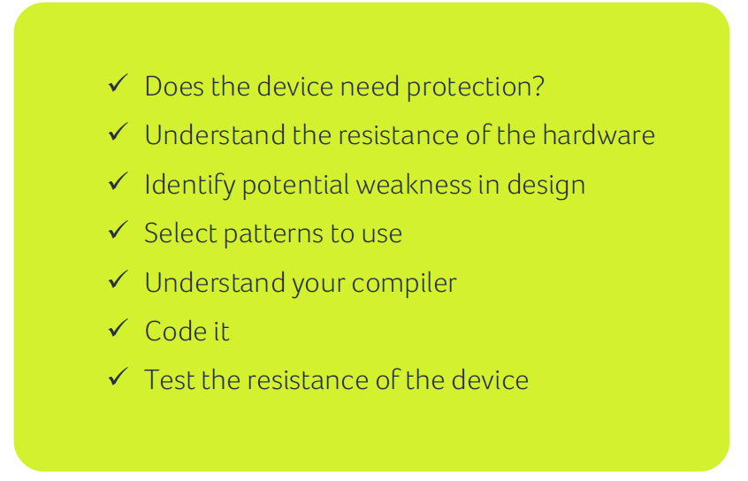
How and when to apply protections
Riscure

Slide 77
Execution speed hints (1)
Big difference between RAM and EEPROM memory
  new allocates in EEPROM (persistent, but slow)
    do not use EEPROM for temporary data
    do not use for sensitive data (keys)
  JCSystem.getTransientByteArray() for RAM buffer
  local variables automatically in RAM
Use algorithms from JavaCard API and utility methods
  much faster, cryptographic co-processor
Allocate all necessary resources in constructor
  executed during installation (only once)
  either you get everything you want or not install at all

Slide 78
Execution speed hints (2)
Garbage collection limited or not available
  do not use new except in constructor
Use copy-free style of methods
  foo(byte[] buffer, short start_offset, short length)
Do not use recursion or frequent function calls
  slow, function context overhead
Do not use OO design extensively (slow)
Keep Cipher or Signature objects initialized
  if possible (e.g., fixed master key for subsequent derivation)
  initialization with key takes non-trivial time

Slide 79
JCprofilerNext – performance profiling, non-constant time detection

Slide 80
JCProfilerNext: on-card performance profiler
Open-source on-card performance profiler (L. Zaoral)
  https://github.com/lzaoral/JCProfilerNext
Automatically instrumentation of provided JavaCard code
  Conditional exception emitted on defined line of code
  Spoon tool used https://spoon.gforge.inria.fr/
Measures time to reach specific line (measured on client-side)
Fully automatic, no need for special setup (only JavaCard + reader)
Goals:
  Help developer to identify parts for performance optimizations
  Help to detect (significant) timing leakages
  Insert “triggers” visible on side-channel analysis
  Insert conditional breakpoints…

Slide 81
Instrumented code (Spoon)
// if m_perfStop equals to stopCondition, exception is thrown (trap hit)
public static void check(short stopCondition) {
if (PM.m_perfStop == stopCondition) {
ISOException.throwIt(stopCondition);
}
}
private void example(APDU apdu) {
short count = Util.getShort(apdu.getBuffer(), ISO7816.OFFSET_CDATA);
for (short i = 0; i < count; i++) {
short tmp = 0;
for (short k = 0; k < 50; k++) {
tmp++;
}
}
}
PM.check(PMC.TRAP_example_Example_example_argb_javacard_framework_APDU_arge_1);
PM.check(PMC.TRAP_example_Example_example_argb_javacard_framework_APDU_arge_2);
PM.check(PMC.TRAP_example_Example_example_argb_javacard_framework_APDU_arge_3);
PM.check(PMC.TRAP_example_Example_example_argb_javacard_framework_APDU_arge_4);
PM.check(PMC.TRAP_example_Example_example_argb_javacard_framework_APDU_arge_5);
PM.check(PMC.TRAP_example_Example_example_argb_javacard_framework_APDU_arge_6);
PM.check(PMC.TRAP_example_Example_example_argb_javacard_framework_APDU_arge_7);
PM.check(PMC.TRAP_example_Example_example_argb_javacard_framework_APDU_arge_8);

Slide 82
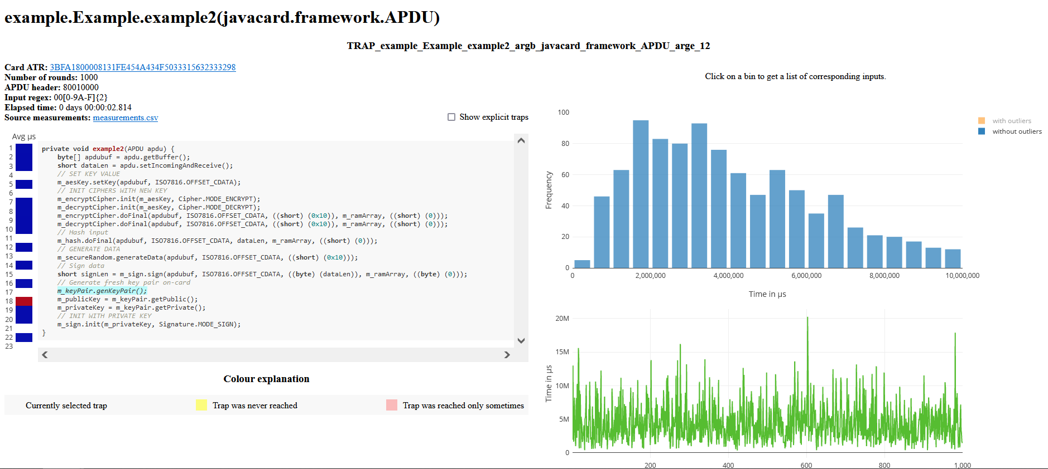
JCProfilerNext – timing profile of target line of code

Slide 83
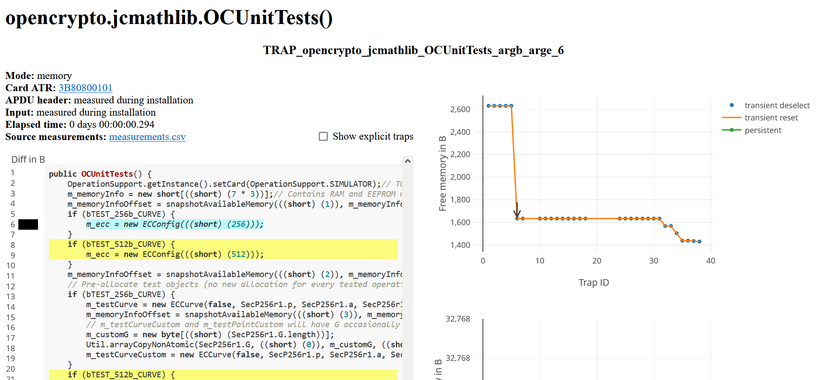
JCProfilerNext – memory consumption

Slide 84
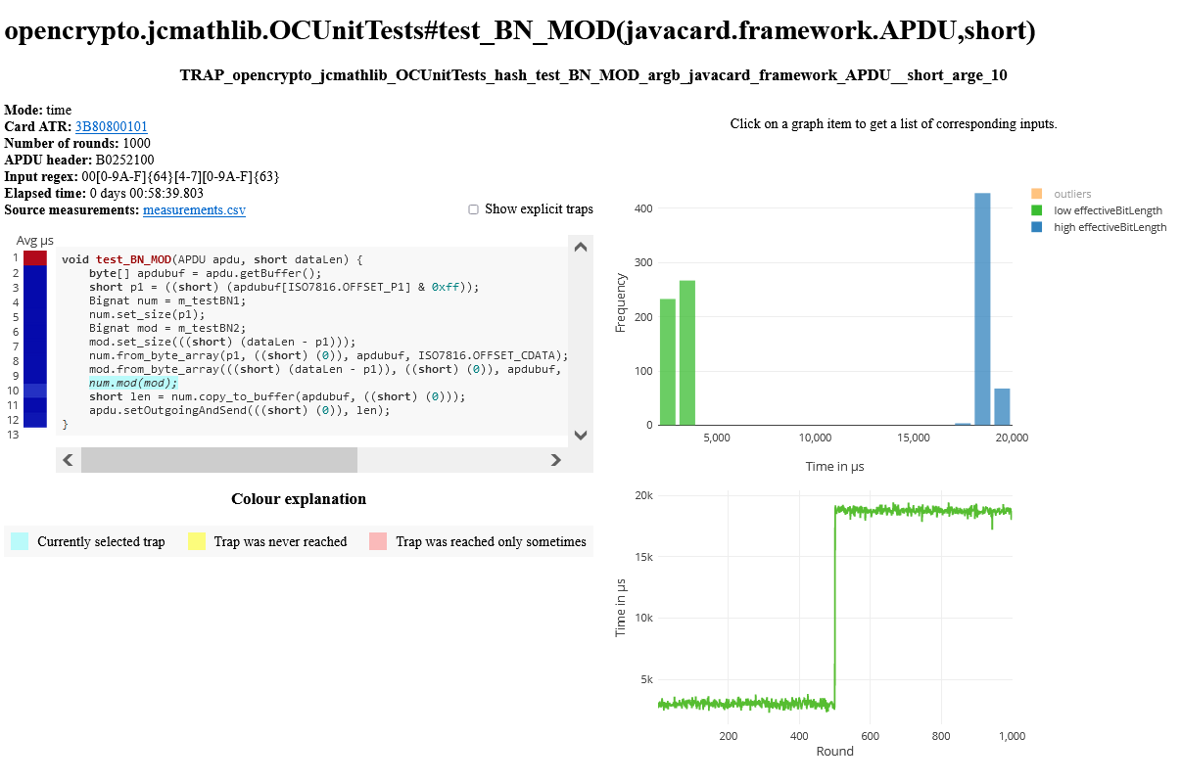
JCProfilerNext – checking for non-constant behavior

Slide 85
JCProfilerNext – profiling via power measurement
The default measurement option is host-based timer => imprecise
  Exception thrown after every line of code, measured with whole roundtrip
Idea: insert distinct operation visible in powertrace after every line
  Original code is instrumented with 3xRNG.generateData() instead of exception
  Powertrace of whole method is captured
  RNG operations are detected and used as separators
  Precise timing of operation is obtained
  Visualization is performed using standard JCProfilerNext pipeline
More elaborate setup (oscilloscope), but very precise measurement
  better detection of non-constant-time operations

Slide 86
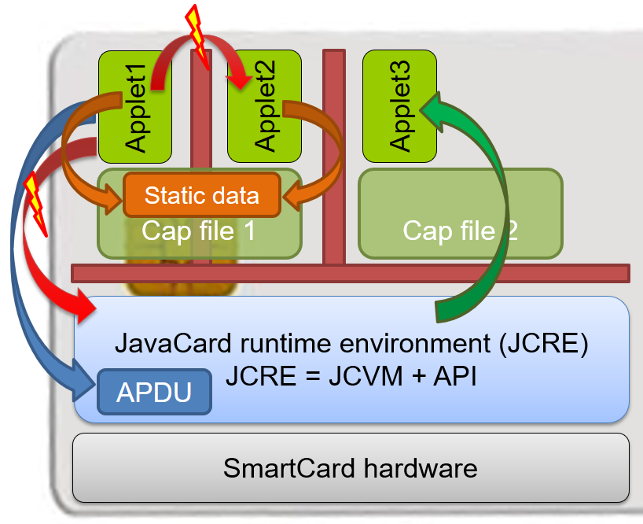
JavaCard applet firewall issues
short[] array1, array2; // persistent variables short[] localArray = null; // local array JCSystem.beginTransaction(); array1 = new short[1]; array2 = localArray = array1; // dangling reference! JCSystem.abortTransaction();
Main defense for separation of multiple applets
Platform implementations differ
  Usually due to the unclear and complex specification
If problem exists then is out of developer’s control
Firewall Tester project (W. Mostowski)
  Open and free, the goal is to test the platform
  http://www.sos.cs.ru.nl/applications/smartcards/firewalltester/

Slide 87
Relevant open-source projects
Easy building of applets
  https://github.com/martinpaljak/ant-javacard
  https://github.com/ph4r05/javacard-gradle-template
AppletPlayground (ready to “fiddle” with applets)
  https://github.com/martinpaljak/AppletPlayground
Card simulator https://jcardsim.org
Profiling performance
  https://github.com/crocs-muni/JCAlgTest
  https://github.com/OpenCryptoProject/JCProfiler
Curated list of JavaCard applets
  https://github.com/crocs-muni/javacard-curated-list
Low-level ECPoint library
  https://github.com/OpenCryptoProject/JCMathLib

Slide 88
Summary
Smart cards are programmable (JavaCard)
  reasonable cryptographic API
  coprocessor for fast cryptographic operations
  multiple applications coexist securely on single card
  Secure execution environment
Standard Java 6 API for communication exists
PKI applet can be developed with free tools
  PIN protection, on-card key generation, signature…
JavaCard is not full Java – optimizations, security

Slide 90
Supplementary materials

Slide 91
Quick and dirty start

Slide 92
Quick and dirty start – OpenPGP applet
Get JavaCard smart card and reader
Install Java SDK and ant build environment
  Don’t forget to set proper paths (javac, ant)
Download AppletPlayground project
  https://github.com/martinpaljak/AppletPlayground
Download GlobalPlatformPro uploader
  https://github.com/martinpaljak/GlobalPlatformPro

Slide 93
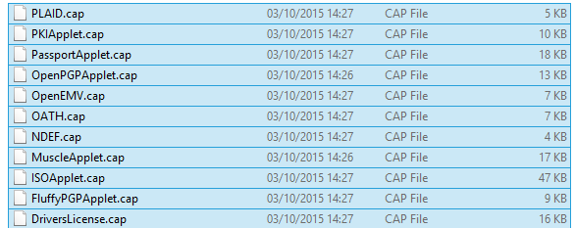
1. Compile and convert applets
> ant toys
  ‘toys’ is ant build target inside build.xml
  Compiles source with Java compiler (javac)
  Convert with javacard convertor
(use > ant simpleapplet to build only our applet)

Slide 94
2. Manage applets on smart card
GlobalPlatformPro tool
  Authenticates against CardManager
  Establish secure channel with CM
  Manage applets (list/upload/delete)
Auto-detected ISD AID: A000000003000000
Host challenge: BD525E5585006202
Card challenge: 05211C9591C58232
Card reports SCP02 with version 255 keys
Master keys:
Version 0
ENC: Ver:0 ID:0 Type:DES3 Len:16 Value:404142434445464748494A4B4C4D4E4F
MAC: Ver:0 ID:0 Type:DES3 Len:16 Value:404142434445464748494A4B4C4D4E4F
KEK: Ver:0 ID:0 Type:DES3 Len:16 Value:404142434445464748494A4B4C4D4E4F
Sequence counter: 0521

Slide 95
>gp -list –verbose
Reader: Gemplus USB SmartCard Reader 0
ATR: 3BF81300008131FE454A434F5076323431B7
More information about your card:
http://smartcard-atr.appspot.com/parse?ATR=3BF81300008131FE454A434F507632343
1B7
Auto-detected ISD AID: A000000003000000
Host challenge: 10FFA96848D9EB62
Card challenge: 0520E372F35B4818
Card reports SCP02 with version 255 keys
Master keys:
Version 0
ENC: Ver:0 ID:0 Type:DES3 Len:16 Value:404142434445464748494A4B4C4D4E4F
MAC: Ver:0 ID:0 Type:DES3 Len:16 Value:404142434445464748494A4B4C4D4E4F
KEK: Ver:0 ID:0 Type:DES3 Len:16 Value:404142434445464748494A4B4C4D4E4F
Sequnce counter: 0520
Derived session keys:
Version 0
ENC: Ver:0 ID:0 Type:DES3 Len:16 Value:654E72AAADA31F0A7B5567160DE4C5A7
MAC: Ver:0 ID:0 Type:DES3 Len:16 Value:C6883A00AB6E56384B845A5A6F68CA6C
KEK: Ver:0 ID:0 Type:DES3 Len:16 Value:3875213C9F2123EB01AA420DC83C18F0
Verified card cryptogram: 62CBE443B3F4FB80
Calculated host cryptogram: 9AAC671F9B1E0630
AID: A000000003000000 (|........|)
ISD OP_READY: Security Domain, Card lock, Card terminate, Default selected, CVM (PIN) management
AID: A0000000035350 (|.....SP|)
ExM LOADED: (none)
A000000003535041 (|.....SPA|)

Slide 96
3. Upload applet to smart card
(already converted applet *.cap is assumed)
> gp --instal OpenPGPApplet.cap –verbose
Hint: test with gpg --card-edit
CAP file (v2.1) generated on Sat Oct 03 15:13:58 CEST 2015
By Sun Microsystems Inc. converter 1.3 with JDK 1.8.0_60 (Oracle Corporation)
Package: openpgpcard v0.0 with AID D27600012401
Applet: OpenPGPApplet with AID D2760001240102000000000000010000
Import: A0000000620101 v1.3
Import: A0000000620201 v1.3
Import: A0000000620102 v1.3
Import: A0000000620001 v1.0
Cap loaded

Slide 97
OpenPlatform Package/applet upload
Security domain selection
Secure channel establishment – security domain
Package upload
  Local upload in trusted environment
  Remote upload with relayed secure channel
Applet installation
  Separate instance from package binary with unique AID
  Applet privileges and other parameters passed
  Applet specific installation data passed

Slide 98
4. Communicate with smart card
> gp --apdu apdu_in_hex --debug
Example for SimpleApplet.java
  gp –-apdu B0541000 -d (generate random numbers)
>gp --apdu B0541000 -d
[*] Gemplus USB SmartCard Reader 0
SCardConnect("Gemplus USB SmartCard Reader 0", T=*) -> T=1, 3BF81300008131FE454A
434F5076323431B7
SCardBeginTransaction("Gemplus USB SmartCard Reader 0")
A>> T=1 (4+0000) B0541000
A<< (0016+2) (32ms) 801D52307393AC0AB1CC242F6905B7C5 9000

Slide 99
5. Delete applet
> gp --delete D27600012401 --deletedeps
(Verify that applet was deleted by gp –list)

Slide 100
Developing simple PKI applet

Slide 101
PKI-relevant JavaCard API
Access controlled by PIN
  javacard.security.OwnerPIN
Asymmetric cryptography keys
  javacard.security.KeyPair, PublicKey, PrivateKey
Digital signatures
  javacard.security.Signature
Asymmetric encryption
  javacard.security.Cipher

Slide 102
PIN verification functionality
javacard.framework.OwnerPIN
Management functions (available for “admin”)
  Create PIN (new OwnerPIN())
  Set initial PIN value (OwnerPIN.update())
  Unblock PIN (OwnerPIN. resetAndUnblock())
Common usage functions (available to user)
  Verify supplied PIN (OwnerPIN.check())
  Check if was verified (OwnerPIN.isValidated())
  Get remaining tries (OwnerPIN.getTriesRemaining())
  Set new value (OwnerPIN.update())

Slide 103
PIN code
// CREATE PIN OBJECT (try limit == 5, max. PIN length == 4)
OwnerPIN m_pin = new OwnerPIN((byte) 5, (byte) 4);
// SET CORRECT PIN VALUE
m_pin.update(INIT_PIN, (short) 0, (byte) INIT_PIN.length);
// VERIFY CORRECTNESS OF SUPPLIED PIN
boolean correct = m_pin.check(array_with_pin, (short) 0, (byte) array_with_pin.length);
// GET REMAING PIN TRIES
byte j = m_pin.getTriesRemaining();
// RESET PIN RETRY COUNTER AND UNBLOCK IF BLOCKED
m_pin.resetAndUnblock();

Slide 104
Digital signature
Management functions
  Generate new key pair (KeyPair().genKeyPair())
  Export public key (KeyPair().getPublic())
  (export private key) (KeyPair().getPrivate())
  create Signature object (Signature.getInstance())
  init with public/private key (Signature.init())
Common usage functions
  sign message (Signature.update(), Signature.sign())
  verify signature (Signature.update(),verify())

Slide 105
On-card asymmetric key generation
javacard.security.KeyPair
Key pair is generated directly on smart card
  very good entropy source (TRNG)
  private key never leaves the card (unless you allow in code)
  fast sign/verify operation
But who is sending data to sign/decrypt?
  protect signature method by PIN.isValidated() check
  use secure channel to prevent injection of attacker’s message
  terminal still must be trustworthy

Slide 106
Key generation - source code
// CREATE RSA KEYS AND PAIR
m_keyPair = new KeyPair(KeyPair.ALG_RSA_CRT, KeyBuilder.LENGTH_RSA_1024);
// STARTS ON-CARD KEY GENERATION PROCESS
m_keyPair.genKeyPair();
// OBTAIN REFERENCES TO PRIVATE AND PUBLIC KEY OBJECT
m_publicKey = m_keyPair.getPublic();
m_privateKey = m_keyPair.getPrivate();
Example shows RSA 1024b – not recommended
Use KeyBuilder.LENGTH_RSA_2048 instead
(But 2 APDUs are required to transmit signature back)

Slide 107
Public (private) key export/import
Obtain algorithm-specific key object from KeyPair
  e.g., RSAPublicKey pubKey = keyPair.getPublic();
  get exponent and modulus
    getExponent() & getModulus() methods
  send it back to terminal via APDU
Similar situation with key import
  setExponent() & setModulus() methods
Private key export
  It is up to you if your code will allow private key export (usually not)
  Otherwise similar as for RSAPublicKey
  more parameters with RSAPrivateCrtKey (CRT mode)

Slide 108
javacard.security.Signature
Both symmetric and asymmetric crypto signatures
  RSA_SHA_PKCS1 (always), ECDSA_SHA, DSA (less common)
  DES_MAC8_NOPAD (always), ISO9797 (common), AES (common)
  check in advance what your card supports (JCAlgTester)
Message hashing done on card (asymmetric sign)
  message received in single or multiple APDUs
  Signature.update(), Signature.sign()
If you need just sign of message hash
  use Cipher object to perform asymmetric crypto operation

Slide 109
Signature – source code
// CREATE SIGNATURE OBJECT
Signature m_sign = Signature.getInstance(Signature.ALG_RSA_SHA_PKCS1, false);
// INIT WITH PRIVATE KEY
m_sign.init(m_privateKey, Signature.MODE_SIGN);
// SIGN INCOMING BUFFER
signLen = m_sign.sign(apdubuf, ISO7816.OFFSET_CDATA, (byte) dataLen,
m_ramArray, (byte) 0);

Slide 110
Asymmetric encryption
javacardx.crypto.Cipher
Usage similar to Signature object
  generate key pair
  export/import public key
  initialize Key and set mode (MODE_ENCRYPT/DECRYPT)
  process incoming data (Cipher.update(), doFinal())
Supported algorithms
  RSA_NOPAD (always), RSA_PKCS1 (almost always)

Slide 111
Demo - symmetric cryptography applet

Slide 112
Random numbers
javacard.security.RandomData
Two versions of random generator
  ALG_SECURE_RANDOM (truly random)
  ALG_PSEUDO_RANDOM (deterministic from seed)
Generate random block
  RandomData.generateData()
Very fast and high quality output
  bottleneck is usually card-to-terminal link

Slide 113
RandomData – source code
private RandomData m_rngRandom = null;
// CREATE RNG OBJECT
m_rngRandom = RandomData.getInstance(RandomData.ALG_SECURE_RANDOM);
// GENERATE RANDOM BLOCK WITH 16 BYTES
m_rngRandom.generateData(array, (short) 0, ARRAY_ONE_BLOCK_16B);

Slide 114
Key generation and initialization
Allocation and initialization of the key object (KeyBuilder.buildKey())
Receive (or generate random) key value
Set key value (AESKey.setKey())
// …. INICIALIZATION SOMEWHERE (IN CONSTRUCT)
// CREATE AES KEY OBJECT
AESKey m_desKey = (AESKey) KeyBuilder.buildKey(KeyBuilder.TYPE_AES,
KeyBuilder.LENGTH_AES_256, false);
// Generate random data to be used as key
m_rngRandom.generateData(array, (short) 0,
(short) KeyBuilder. KeyBuilder.LENGTH_AES_256/8);
// SET KEY VALUE
m_aesKey.setKey(array, (short) 0);

Slide 115
Symmetric cryptography encryption
javacard.security.Cipher
Allocate and initialize cipher object
  Cipher.getInstance(), Cipher.init()
Encrypt or decrypt data
  Cipher.update(), Cipher.doFinal()

Slide 116
Encryption with 3DES – source code
// INIT CIPHER WITH KEY FOR ENCRYPT DIRECTION
m_encryptCipher.init(m_desKey, Cipher.MODE_ENCRYPT);
//….
// ENCRYPT INCOMING BUFFER
void Encrypt(APDU apdu) {
byte[] apdubuf = apdu.getBuffer();
short dataLen = apdu.setIncomingAndReceive();
// CHECK EXPECTED LENGTH (MULTIPLY OF 64 bites)
if ((dataLen % 8) != 0) ISOException.throwIt(SW_CIPHER_DATA_LENGTH_BAD);
// ENCRYPT INCOMING BUFFER
m_encryptCipher.doFinal(apdubuf, ISO7816.OFFSET_CDATA, dataLen, m_ramArray, (short) 0);
// COPY ENCRYPTED DATA INTO OUTGOING BUFFER
Util.arrayCopyNonAtomic(m_ramArray, (short) 0, apdubuf, ISO7816.OFFSET_CDATA, dataLen);
// SEND OUTGOING BUFFER
apdu.setOutgoingAndSend(ISO7816.OFFSET_CDATA, dataLen);
}

Slide 117
Message authentication code (MAC)
javacard.security.Signature
Usage similar to asymmetric signatures
Create signature object for target MAC algorithm
Initialize with symmetric cryptography key
Supported algorithms
  DES_MAC8 (always), AES_MAC8 (increasingly common)

Slide 118
MAC – source code
Example based on 3DES, can be AES as well
private Signature m_sessionCBCMAC = null;
private DESKey m_session3DesKey = null;
// CREATE SIGNATURE OBJECT
m_sessionCBCMAC = Signature.getInstance(Signature.ALG_DES_MAC8_NOPAD, false);
// CREATE KEY USED IN MAC
m_session3DesKey = (DESKey) KeyBuilder.buildKey(KeyBuilder.TYPE_DES, KeyBuilder.LENGTH_DES3_3KEY, false);
// INITIALIZE SIGNATURE DES KEY
m_session3DesKey.setKey(m_ram, (short) 0);
// SET KEY INTO SIGNATURE OBJECT
m_sessionCBCMAC.init(m_session3DesKey, Signature.MODE_SIGN);
// GENERATE SIGNATURE OF buff ARRAY, STORE INTO m_ram ARRAY
m_sessionCBCMAC.sign(buff, ISO7816.OFFSET_CDATA, length, m_ram, (short) 0);

Slide 119
Data hashing
javacard.security.MessageDigest
Create hashing object for target algorithm
  MessageDigest.getInstance()
Reset internal state of hash object
  MessageDigest.reset()
Process all parts of data
  MessageDigest.update()
Compute final hash digest
  MessageDigest.doFinal()
Supported algorithms
  MD5, SHA-1 (always), SHA-256 (increasingly common)
  related to supported Signature algorithms

Slide 120
Data hashing – source code
// CREATE SHA-1 OBJECT
MessageDigest m_sha1 = MessageDigest.getInstance(
MessageDigest.ALG_SHA, false);
// RESET HASH ENGINE
m_sha1.reset();
// PROCESS ALL PARTS OF DATA
while (next_part_to_hash_available) {
m_sha1.update(array_to_hash, (short) 0, (short) array_to_hash.length);
}
// FINALIZE HASH VALUE (WHEN LAST PART OF DATA IS AVAILABLE)
// AND OBTAIN RESULTING HASH VALUE
m_sha1.doFinal(array_to_hash, (short) 0, (short) array_to_hash.length,
out_hash_array, (short) 0);

Slide 121
GPPro – M. Paljak
gp.exe -install applet.cap -verbose
Reader: OMNIKEY AG Smart Card Reader USB 0
ATR: 3BF81800008031FE450073C8401300900092
More information about your card:
http://smartcard-atr.appspot.com/parse?ATR=3BF81800008031FE450073C8401300900092
Auto-detected ISD AID: A000000003000000
Host challenge: 764D6A0982DC5E17
Card challenge: 0005112D5C02E152
Card reports SCP02 with version 1 keys
Master keys:
Version 0
ENC: Ver:0 ID:0 Type:DES3 Len:16 Value:404142434445464748494A4B4C4D4E4F
MAC: Ver:0 ID:0 Type:DES3 Len:16 Value:404142434445464748494A4B4C4D4E4F
KEK: Ver:0 ID:0 Type:DES3 Len:16 Value:404142434445464748494A4B4C4D4E4F
Diversififed master keys:
Version 0
ENC: Ver:0 ID:0 Type:DES3 Len:16 Value:8D16CDB90D9A1BCB9C3B208FB491DFF6
MAC: Ver:0 ID:0 Type:DES3 Len:16 Value:D3A3DD0DB2C1F84F79E3BC0EF4B0A78E
KEK: Ver:0 ID:0 Type:DES3 Len:16 Value:F80C3E807D4C57293B651693ED999448
Sequnce counter: 0005
Derived session keys:
Version 0
ENC: Ver:0 ID:0 Type:DES3 Len:16 Value:6BCC8856C64D5A6090A603C5FFBA7F4F
MAC: Ver:0 ID:0 Type:DES3 Len:16 Value:3BDCE52AE932EFF43E506C498BAC9F21
KEK: Ver:0 ID:0 Type:DES3 Len:16 Value:FFC30797EFA7EC37A28E4485052EA21D
Verified card cryptogram: 37C4139407A2F0DD
Calculated host cryptogram: A9376B4721194AFA
CAP file (v2.1) generated on Tue Aug 04 14:34:51 CEST 2015
By Sun Microsystems Inc. converter 1.3 with JDK 1.8.0_31 (Oracle Corporation)
Package: AlgTest v1.0 with AID 6D797061636B616731
Applet: JCAlgTestApplet with AID 6D7970616330303031
Import: A0000000620001 v1.0
Import: A0000000620102 v1.2
Import: A0000000620101 v1.2
CAP loaded

Slide 122
GPShell script – another tool for upload
# Install & configure script for Gemalto TOP IM GX4, mother key
mode_201
gemXpressoPro
enable_trace
establish_context
card_connect
select -AID A000000018434D00
open_sc -security 3 -keyind 0 -keyver 0 -key 47454d5850524553534f53414d504c45
delete -AID ${jc.applet.AID_GPShell}
delete -AID ${jc.package.AID_GPShell}
install -file ${jc.package.shortName}.cap -sdAID A000000018434D00
-nvCodeLimit 4000 -priv 0
# test selection
select -AID ${jc.applet.AID_GPShell}
card_disconnect
release_context
Connect to reader and card
Select Card Manager application
Authenticate and establish secure channel (OpenPlatform)
Delete previous version of our applet (instance first, package second)
Upload and install file *.cap with applet
Try to select newly installed applet

Slide 123
Demo: OpenPGP applet

Slide 124
OpenPGP
Standard for PGP/GPG compliant applications
Includes specification for card with private key(s)
  openpgp-card-1.0.pdf
Supported (to some extend) in GnuPG
Pre-personalized OpenPGP cards available
  http://www.g10code.de/p-card.html
Open source Java Card applet available
  JOpenPGPCard
  http://sourceforge.net/projects/jopenpgpcard/
  our card can be used

Slide 125
JOpenPGPCard applet
Main parts
  two level of PIN protection
  on-card keys generation, public key export
  on-card encryption/signature
Compilation and upload
  Project settings (preconfigured)
  AID (given in OpenPGP specification)
  GPShell script
Compile and upload applet to card

Slide 126
Compilation and upload
gpg --card-edit
Command> admin
Command> help
Command> generate
  follow the instructions (default PINs)
  signature, decryption and authentication key
  private keys generated directly on the card
  public keys exported to GPG keyring
Change your PIN by Command> passwd

Slide 127
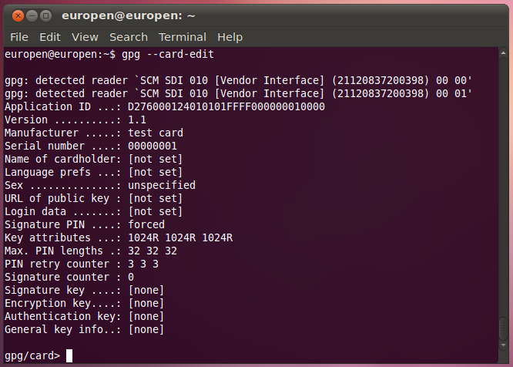
GPG --card-edit
No keys generated yet

Slide 128
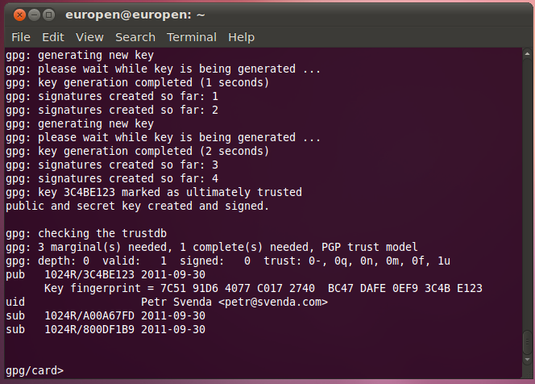
GPG – keys generation finished

Slide 129
What we have…
Card with OpenPGP-compliant applet
GPG generated private&public keypairs
  sign, enc, auth
Public keys exported from card and imported to local keyring
Can be used to sign, encrypt message on command line
Can be further integrated into applications
  Thunderbird + Enigmail + GPG

Slide 130
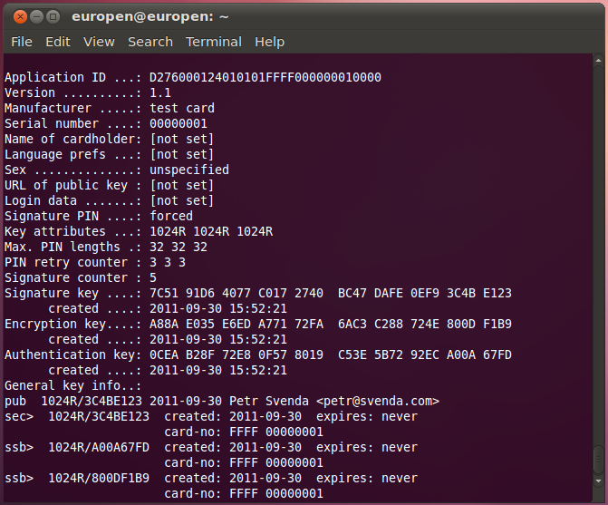
(gpg –card-edit) Command> list

Slide 131
Using GPG with smart card
gpg --clearsign --output myfile.sig --sign myfile
  our public key is already imported to keyring
  PIN is required to sign (notice signature count so far)
  --clearsign causes output in BASE64
gpg --verify myfile.sig
  smart card not required, public key in keyring
gpg --output gpshell.log.gpg --recipient petr@svenda.com --encrypt gpshell.log
  smart card not required, public key in keyring
gpg --decrypt gpshell.log.gpg

Slide 132
More details about JavaCard

Slide 133
JavaCard – more to be discovered
function f(…) { byte a[] = new byte[10]; byte b[] = JCSystem.makeTransientByteArray(...); byte c; }
Recursion is slooow...
Memory allocation issues
  EEPROM vs. RAM allocations, new operator
  No (real-time) garbage collector!
Persistent objects
Transactions, atomic operations
JavaCard applet firewall

Slide 134
GPShell upload&install
Upload and install converted *.cap file
  GPShell tool with script specific for target card
  GP SCP channel version (mode_201, mode_211)
  select CardManager by AID (various AIDs)
  authenticate and open secure channel (open_sc)
  delete previous applet version (1. applet, 2. package)
  load and install (install command, many params)
  install may pass personalization data (master key…)
Check applet functionality
  from GPShell script, no need for secure channel
  select your applet by AID (select –AID xxx)
  send test APDU (send_apdu -APDU xxx)

Slide 135
JavaCard – PIN verification
public class OwnerPIN implements PIN { byte triesLeft; // persistent counter boolean check(...) { ... triesLeft--; ... } }
Image/code for PIN verification
  Vulnerable to transaction rollback

Slide 136
JavaCard – PIN verification done better
public class OwnerPIN implements PIN { byte[] triesLeft = new byte[1]; // persistent counter byte[] temps = JCSystem.makeTransientByteArray(1, JCSystem.CLEAR_ON_RESET); boolean check(...) { ... temps[0] = triesLeft[0] - 1; // update the try counter non-atomically: Util.arrayCopyNonAtomic(temps, 0, triesLeft, 0, 1); ... } }
Non-atomic operations

Slide 137
JavaCard – Atomic vs. Non-Atomic
Persistent memory updates
  Two ways of updating
  FillArrayNonAtomic, CopyArrayNonAtomic
Code refactoring
  Original short/byte values have to be converted to arrays[1]

Slide 138
JavaCard – Atomic vs. Non-Atomic
a[0] = 0 beginTransaction() a[0] = 1; arrayFillNonAtomic(a,0,1,2); // a[0] = 2; abortTransaction() | a[0] = 0; beginTransaction(); arrayFillNonAtomic(a,0,1,2); // a[0] = 2; a[0] = 1; abortTransaction();
Non-deterministic variable rollback
Result dependency on the commands order
  a[0] == 0 vs. a[0] == 2

