Slide 1


PV204 Security technologies
Please comment on slides with anything unclear, incorrect or suggestions for improvement
https://drive.google.com/file/d/1DD5tgyaS8Nk_Wze97_IJpVBRQhXuwgT8/view?usp=drive_link
JavaCard optimizations, Secure Multiparty Computation and Trhreshold signatures
Petr Švenda svenda@fi.muni.cz @rngsec
Centre for Research on Cryptography and Security, Masaryk University
(part of MPC slides done by Antonín Dufka)

Slide 2
Best practices (for applet developers)

Slide 3
Quiz
Expect that your device is leaking in time/power channel. Which option will you use?
  AES from hw coprocessor or software re-implementation?
  Short-term sensitive data stored in EEPROM or RAM?
  Persistent sensitive data in EEPROM or encrypted object?
  Conditional jumps on sensitive value?
Expect that attacker can successfully induct faults (random change of bit(s) in device memory).
  Suggest defensive options for applet’s source code
  Change in RAM, EEPROM, instruction pointer, CPU flags…

Slide 4
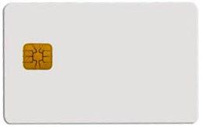
Security hints (1)
Use algorithms/modes from JC API rather than your own implementation
  JC API algorithms fast and protected in cryptographic hardware
  general-purpose processor leaks more information (side-channels)
Store session data in RAM
  faster and more secure against power analysis
  EEPROM has limited number of rewrites (10^5 – 10^6 writes)
Never store keys, PINs or sensitive data in primitive arrays
  use specialized objects like OwnerPIN and Key
  better protected against power, fault and memory read-out attacks
  If not possible, generate random key in Key object, encrypt large data with this key and store only encrypted data
Make checksum on stored sensitive data (=> detect faults)
  check during applet selection (do not continue if data are corrupted)
  possibly check also before sensitive operation with the data (but performance penalty)

Slide 5
Security hints (2)
Erase unused keys and sensitive arrays
  use specialized method if exists (Key.clearKey())
  or overwrite with random data (Random.generate())
  Perform always before and after start of new session (new select, new device…)
Use transactions to ensure atomic operations
  power supply can be interrupted inside code execution
  be aware of attacks by interrupted transactions - rollback attack
Do not use conditional jumps with sensitive data
  branching after condition is recognizable with power analysis => timing/power leakage

Slide 6
Security hints (3)
Allocate all necessary resources in constructor
  applet installation usually in trusted environment
  prevents attacks based on limited available resources later during applet use
Don’t use static attributes (except constants)
  Static attribute is shared between multiple instances of applet (bypasses applet firewall)
  Static pointer to array/engine filled by dynamic allocation cannot be removed until package is removed from card (memory “leak”)
Use automata-based programming model
  well defined states (e.g., user PIN verified)
  well defined transitions and allowed method calls

Slide 7
Security hints (4)
Treat exceptions properly
  Do not let uncaught native exceptions to propagate away from the card
    0x6f00 emitted – unclear what caused it from the terminal side
    Your applet is unaware of the exception (fault induction attack in progress?)
  Do not let your code to cause basic exceptions like OutOfBoundsException or NullPointerExceptions…
    Slow handling of exceptions in general
    Code shall not depend on triggering lower-layer defense (like memory protection)

Slide 8
Security hints: fault induction (1)
Secure Application Programming in the presence of Side Channel Attacks, Riscure
Cryptographic algorithms are sensitive to fault induction
  Single signature with fault from RSA-CRT may leak the private key
  Perform operation twice and compare results
  Perform reverse operation and compare (e.g., verify after sign)
Use constants with large hamming distance
  Induced fault in variable will likely cause unknown value
  Use 0xA5 and 0x5A instead of 0 and 1 (correspondingly for more)
  Don’t use values 0x00 and 0xff (easier to force all bits to 0 or 1)
Check that all sub-functions were executed [Fault.Flow]
  Fault may force program stack or stack to skip some code
  Idea: Add defined value to flow counter inside target sub-function, check later for expected sum. Add also in branches.

Slide 9
Security hints: fault induction (2)
Secure Application Programming in the presence of Side Channel Attacks, Riscure
Replace single condition check by complementary check
  conditionalValue is sensitive value
  Do not use boolean values for sensitive decisions
Verify number of actually performed loop iterations
if (conditionalValue == 0x3CA5965A) { // enter critical path
// . . .
if (~conditionalValue != 0xC35A69A5) {
faultDetect(); // fail if complement not equal to 0xC35A69A5
}
// . . .
}
int i;
for ( i = 0; i < n; i++ ) { // important loop that must be completed
//. . .
}
if (i != n) { // loop not completed
faultDetect();
}

Slide 10
Security hints: fault induction (3)
Secure Application Programming in the presence of Side Channel Attacks, Riscure
Insert random delays around sensitive operations
  Randomization makes targeted faults more difficult
  for loop with random number of iterations (for every run)
Monitor and respond to detected induced faults
  If fault is detected (using previous methods), increase fault counter.
  Erase keys / lock card after reaching some threshold (~10)
    Natural causes may occasionally cause fault => > 1

Slide 11
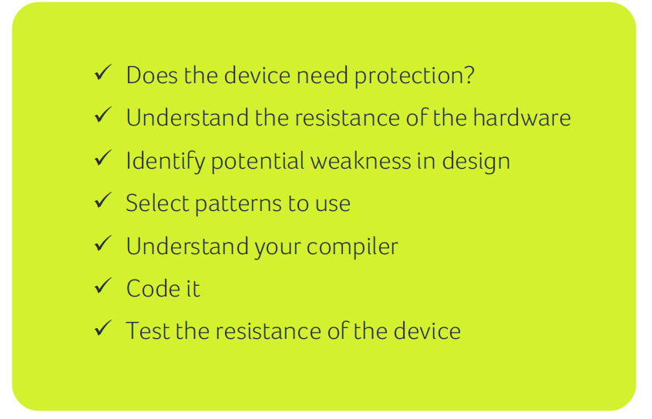
How and when to apply protections
Riscure

Slide 12
Execution speed hints (1)
Big difference between RAM and EEPROM memory
  new allocates in EEPROM (persistent, but slow)
    do not use EEPROM for temporary data
    do not use for sensitive data (keys)
  JCSystem.getTransientByteArray() for RAM buffer
  local variables automatically in RAM
Use algorithms from JavaCard API and utility methods
  much faster, cryptographic co-processor
Allocate all necessary resources in constructor
  executed during installation (only once)
  either you get everything you want or not install at all

Slide 13
Execution speed hints (2)
Garbage collection limited or not available
  do not use new except in constructor
Use copy-free style of methods
  foo(byte[] buffer, short start_offset, short length)
Do not use recursion or frequent function calls
  slow, function context overhead
Do not use OO design extensively (slow)
Keep Cipher or Signature objects initialized
  if possible (e.g., fixed master key for subsequent derivation)
  initialization with key takes non-trivial time

Slide 14
JCprofilerNext – performance profiling, non-constant time detection

Slide 15
JCProfilerNext: on-card performance profiler
Open-source on-card performance profiler (L. Zaoral)
  https://github.com/lzaoral/JCProfilerNext
Automatically instrumentation of provided JavaCard code
  Conditional exception emitted on defined line of code
  Spoon tool used https://spoon.gforge.inria.fr/
Measures time to reach specific line (measured on client-side)
Fully automatic, no need for special setup (only JavaCard + reader)
Goals:
  Help developer to identify parts for performance optimizations
  Help to detect (significant) timing leakages
  Insert “triggers” visible on side-channel analysis
  Insert conditional breakpoints…

Slide 16
Instrumented code (Spoon)
// if m_perfStop equals to stopCondition, exception is thrown (trap hit)
public static void check(short stopCondition) {
if (PM.m_perfStop == stopCondition) {
ISOException.throwIt(stopCondition);
}
}
private void example(APDU apdu) {
short count = Util.getShort(apdu.getBuffer(), ISO7816.OFFSET_CDATA);
for (short i = 0; i < count; i++) {
short tmp = 0;
for (short k = 0; k < 50; k++) {
tmp++;
}
}
}
PM.check(PMC.TRAP_example_Example_example_argb_javacard_framework_APDU_arge_1);
PM.check(PMC.TRAP_example_Example_example_argb_javacard_framework_APDU_arge_2);
PM.check(PMC.TRAP_example_Example_example_argb_javacard_framework_APDU_arge_3);
PM.check(PMC.TRAP_example_Example_example_argb_javacard_framework_APDU_arge_4);
PM.check(PMC.TRAP_example_Example_example_argb_javacard_framework_APDU_arge_5);
PM.check(PMC.TRAP_example_Example_example_argb_javacard_framework_APDU_arge_6);
PM.check(PMC.TRAP_example_Example_example_argb_javacard_framework_APDU_arge_7);
PM.check(PMC.TRAP_example_Example_example_argb_javacard_framework_APDU_arge_8);

Slide 17
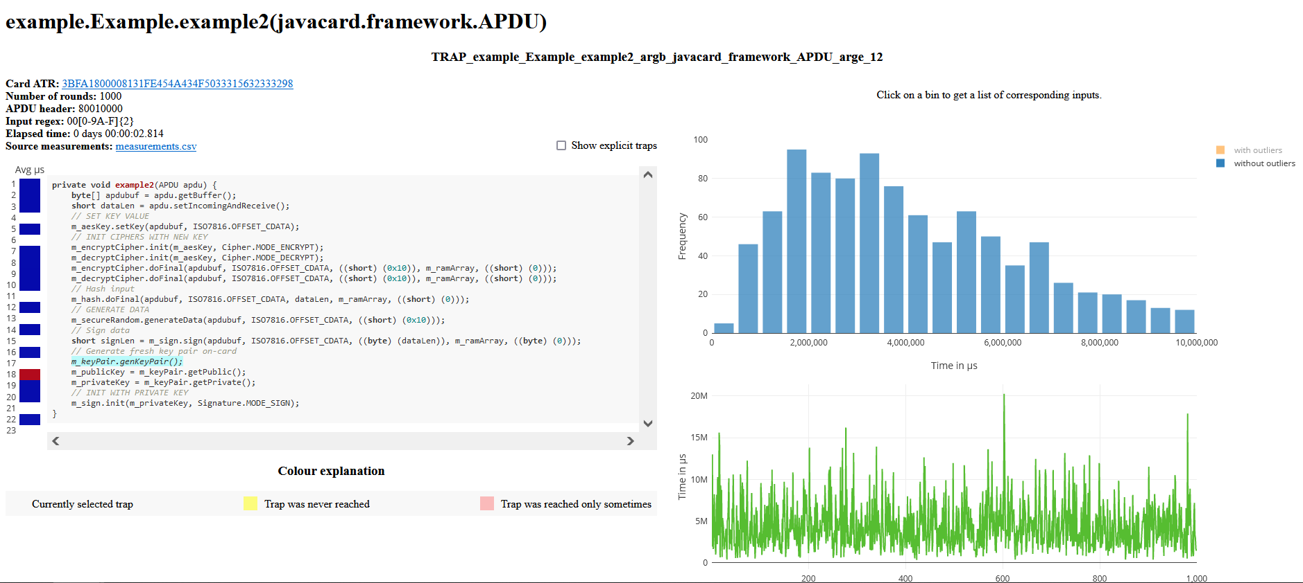
JCProfilerNext – timing profile of target line of code

Slide 18
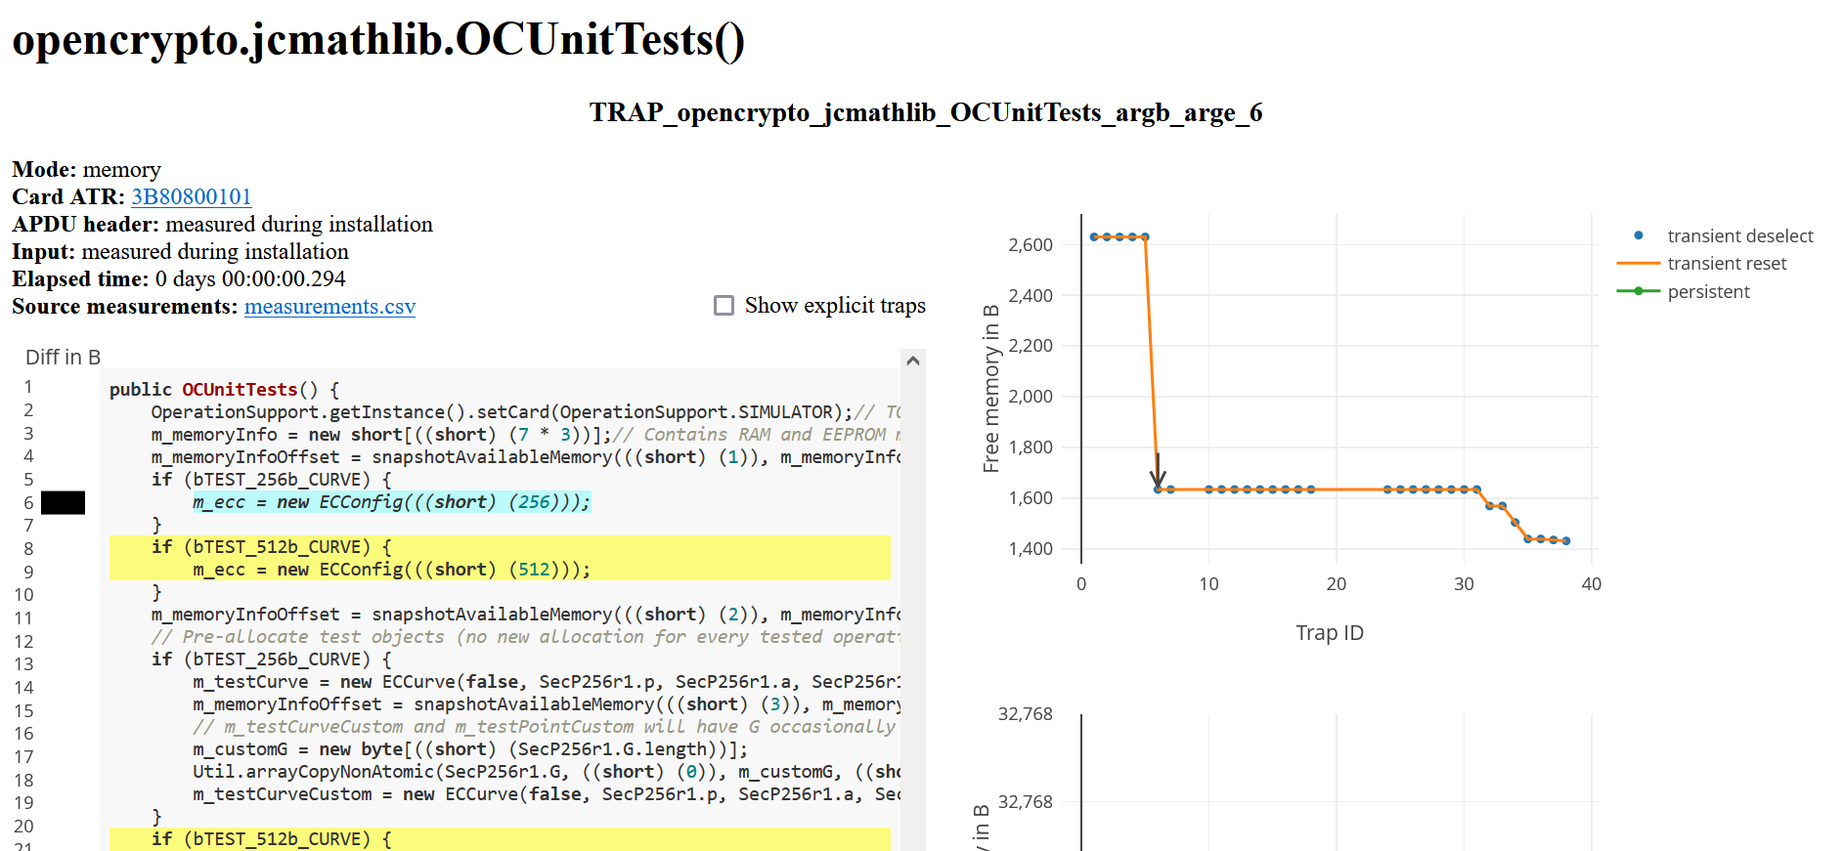
JCProfilerNext – memory consumption

Slide 19
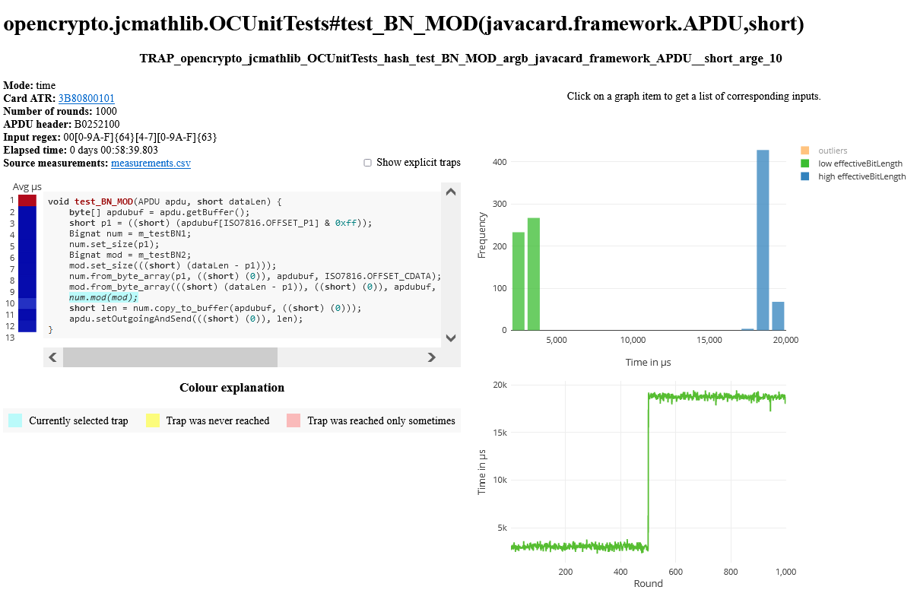
Checking for non-constant time execution

Slide 20
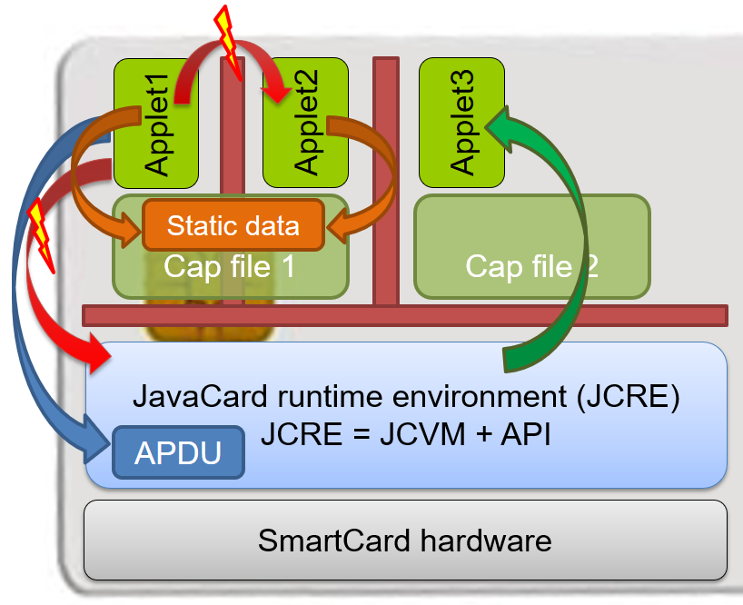
JavaCard applet firewall issues
short[] array1, array2; // persistent variables short[] localArray = null; // local array JCSystem.beginTransaction(); array1 = new short[1]; array2 = localArray = array1; // dangling reference! JCSystem.abortTransaction();
Main defense for separation of multiple applets
Platform implementations differ
  Usually due to the unclear and complex specification
If problem exists, then is out of developer’s control
Firewall Tester project (W. Mostowski)
  Open and free, the goal is to test the platform
  http://www.sos.cs.ru.nl/applications/smartcards/firewalltester/

Slide 21
Relevant open-source projects
Easy building of applets
  https://github.com/martinpaljak/ant-javacard
  https://github.com/ph4r05/javacard-gradle-template
AppletPlayground (ready to “fiddle” with applets)
  https://github.com/martinpaljak/AppletPlayground
Card simulator https://jcardsim.org
Profiling performance
  https://github.com/crocs-muni/JCAlgTest
  https://github.com/lzaoral/JCProfilerNext
Curated list of JavaCard applets
  https://github.com/crocs-muni/javacard-curated-list
Low-level ECPoint library
  https://github.com/OpenCryptoProject/JCMathLib

Slide 23
Threshold cryptography
(to remove single point of failure)

Slide 24
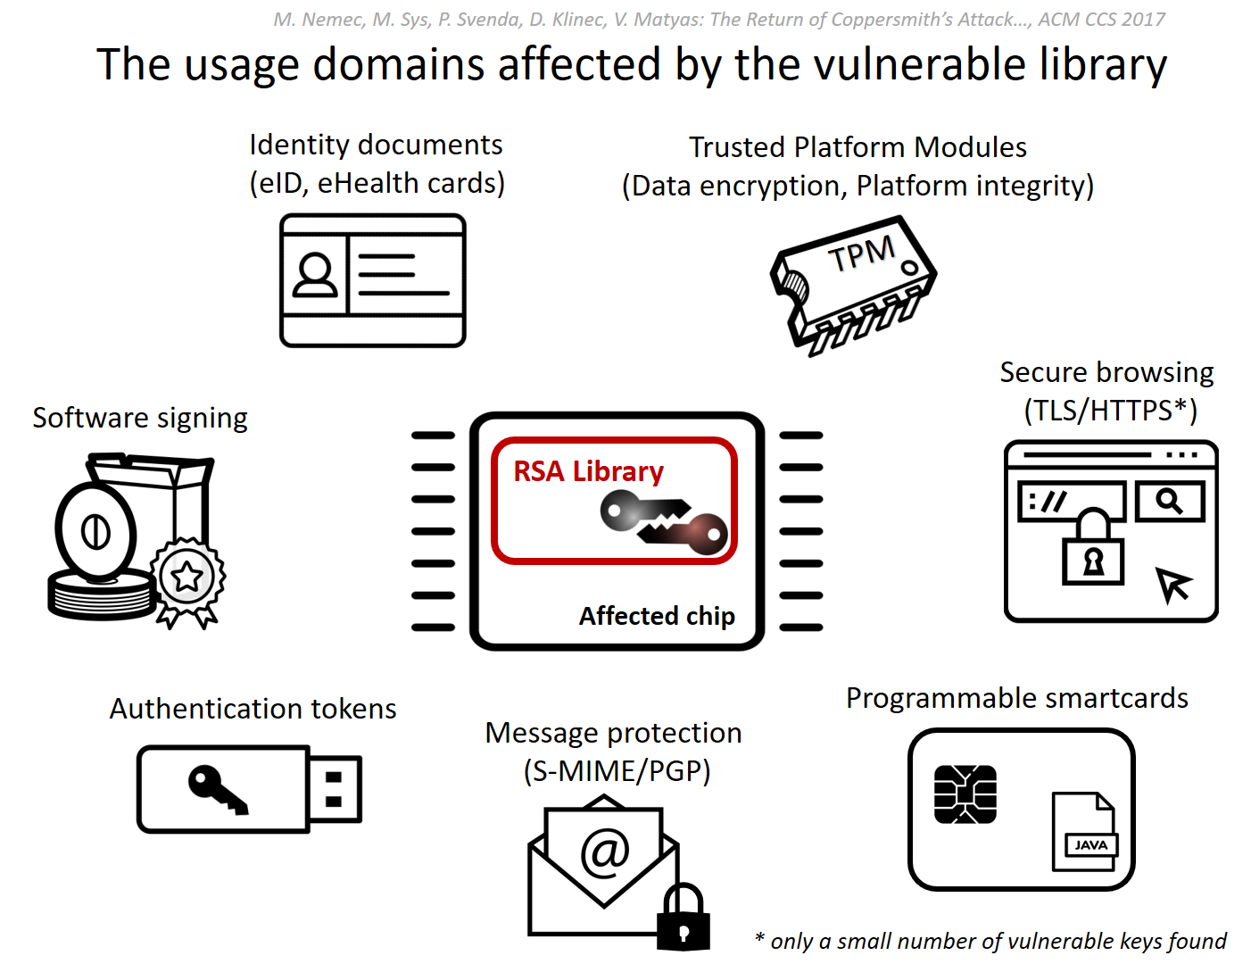
Possibly heard of ROCA vulnerability CVE-2017-15361
https://roca.crocs.fi.muni.cz
25-30% TPMs worldwide, BitLocker, ChromeOS…
Firmware update available
Austria, Estonia, Slovakia, Spain…
Very few keys, but all tied to SCADA management
Commit signing,
Application signing
GitHub, Maven…
Single point of failure: Prime generation of RSA keygen in widely used chip (1-2 billion chips)
Gemalto .NET
Yubikey 4…
Yubikey 4…

Slide 25
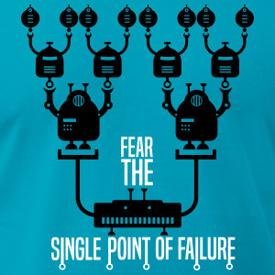
Single point of failure
We already try to avoid single point of failure at many places
  Personal: dual control, people from different backgrounds…
  Technical: Load-balancing web servers, RAID, periodic backups…
  Supply chain: no reliance on single supplier…
Problems: Appropriate trade-off between security, cost and usability
Systems without single point of failure tend to be:
  More complex
  More expensive
  Less performant
  Backward incompatible
  (not really without single point of failure)
zerodayclothing.com

Slide 26
Removing single point of failure in cryptographic signatures

Slide 27
Secure Multi-Party Computation
“Offload heavy computation to untrusted party while not leaking info”
“Distribute critical cryptographic operation among N parties”
Example:
Amazon evaluates trained neural network on medical image (on behalf of user)
Amazon learns neither the trained NN, nor the processed image
Technology: Homomorphic encryption, garbled circuits (slow, but getting better)
Focus of this lecture (threshold cryptography)
Example:
3 devices collaboratively compute digital ECC signature
Private key never at single place, secure unless all devices are compromised
Technology: purpose tailored schemes (efficient, provably secure)

Slide 28
Goals of threshold cryptography
Remove single point of failure
  Reduce trust requirements (no single party can fail you)
  Better protect against attacks like malware (no single device with full key)
  Provide resiliency against subset compromise (k-of-n)
Provide fault tolerance (n-of-n vs. k-of-n)
  Perform operation with some parties not available
Enable different signing/decryption policies to be enforced (each party)
  Regulatory requirements (e.g., “four eyes principle”)

Slide 29

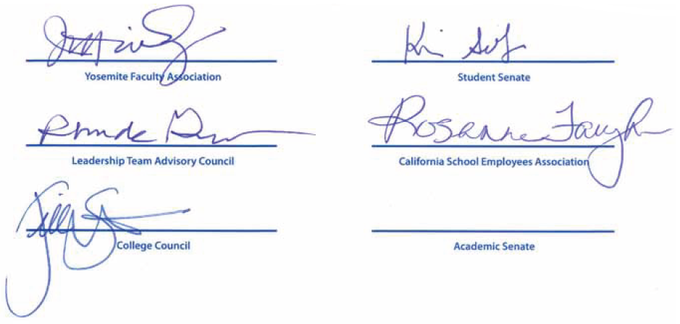

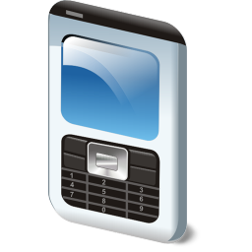



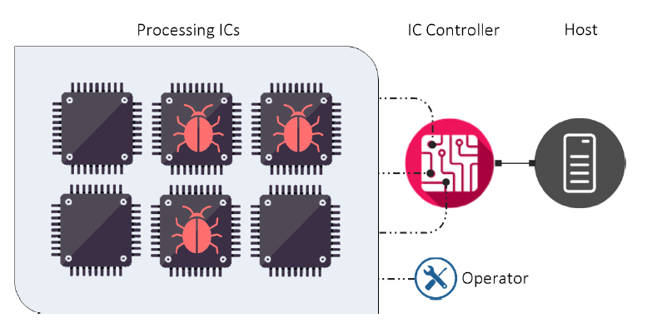

Single signature
Analogically for decryption (single person decrypts, multiple people, k-of-n)
Threshold
Signature (MPC)
Multiple signatures
Shamir TSS
Share 1
Share 2
Share 3
Signature
Signature
Signature
Signature
Signature

Slide 30
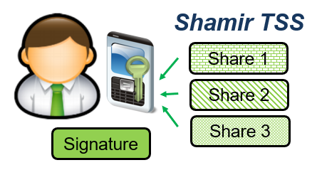
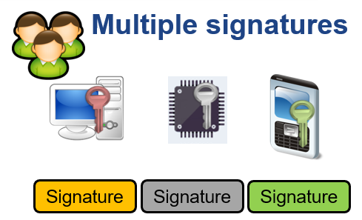
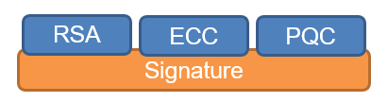
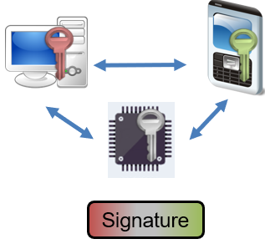
How to “split” key for threshold cryptography?
(Shamir threshold secret sharing)
Multiple separate signatures (same algorithm)
Cryptographic “garden” (multiple keys, different keys)
n-of-n MPC signature (multiple keys, all must contribute)
  k-of-n MPC threshold signature (multiple keys, k must contribute)

Slide 31

Option: Cryptographic “garden”
Electronic signature == sign_RSA(SHA256(message))
  Failure in RSA or SHA256 algorithm or its implementation => forgery of signatures
Signature using cryptographic “garden”
  Differently computed (algorithm) signatures over same message
  Signature = sign_RSA+ sign_ECC + sign_PostQuantumAlg
  Mitigate design problems of particular algorithm
Disadvantages: backward (in-)compatibility, larger storage space…
RSA
Signature
RSA
ECC
PQC
Signature

Slide 32
Threshold cryptography
Proposed already in 1987 by Y. Desmedt
Principle
  Private key split into multiple parts (“shares”)
  Shares used (independently) by separate parties during a protocol to perform desired cryptographic operation
  If enough shares are available, operation is finished successfully
Properties
  Better protection of private key (single point of failure removed)
  Key shares can be distributed to multiple parties (independent usage condition)
  Resulting signature may be indistinguishable from a standard one (e.g., ECDSA)
Significant research progress made in the cryptocurrency context
PV204 | Secure Multiparty Computation

Slide 33
Threshold cryptography protocols
Typically, distributed key generation is also included
  Private key is not generated on a single device
Output signatures can be indistinguishable from single party signatures
  ECDSA ([GGN16], [LN18], [GG18], [GG20], [Can+20], …)
  Schnorr (MuSig, MuSig2, FROST…)
  RSA ([DF91], [Gen+97], [DK01], Smart-ID…)
Various designs with different properties
  Supported setups (n-of-n / k-of-n)
  Number of communication rounds
  Computation complexity
  Security assumptions…

Slide 34
Practical examples of MPC

Slide 35
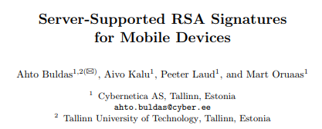


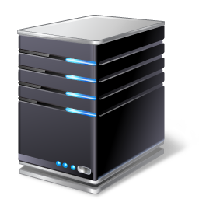
Smart-ID signature system
Banks in Baltic states, >4M users
  Qualified Signature Creation Device (QSCD)!
Collaborative computation of signature using:
  User’s mobile device (3072b RSA)
  Smart-ID service provider (3072b RSA)
Two-party RSA signatures, threshold signature scheme
  Whole signature key never present at a single place
  Smart-ID service provider cannot alone compute valid signature
Final signature is 6144b RSA => compatible with existing systems
  Assumed security level is equivalent to 3072b RSA (as if one party compromised)
Sign 3k RSA
Sign 3k RSA
6k RSA Signature

Slide 36
MPC wallets (software, hardware)
Number of cryptocurrencies uses ECDSA/EdDSA/Schnorr algorithm to authorize TX
  Funds are lost if private key is stolen/lost
Multiple separate signatures by separate private keys possible (so called multisignature)
  More costly (more onchain space => higher fee)
  Privacy leaking (structure of approval)
  Not always (directly) supported (Bitcoin has IP_CHECKMULTISIG, Ethereum needs special contract)
MPC to compute threshold multiparty signature
  Interaction between multiple entities, single signature as a result
  Not recognizable from standard transactions on-chain
ECDSA
  Several end-user wallets like ZenGo, Binance, Coinbase… as well as institutional custodians
  Usually one share by user, second by server
Schnorr-based signatures easier to compute (e.g., Musig-2, FROST)
  Available in Bitcoin after Taproot

Slide 37
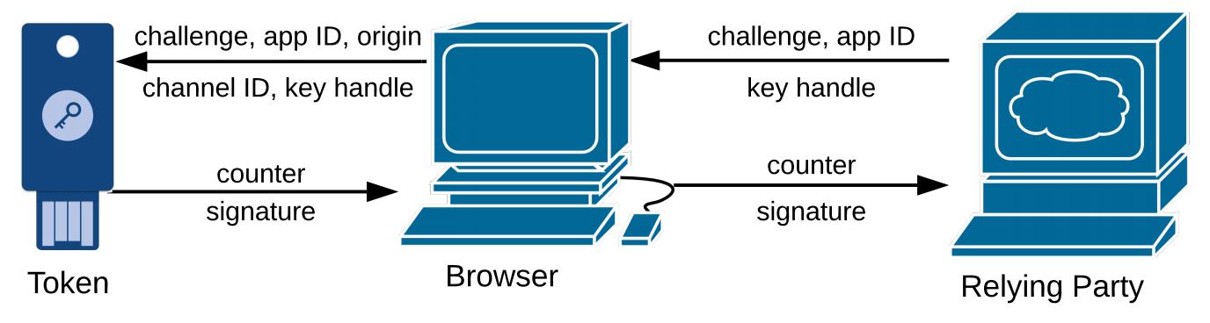
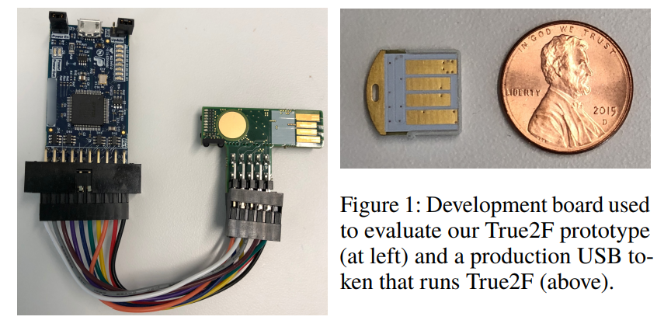
True2F FIDO U2F token
https://arxiv.org/pdf/1810.04660.pdf
Yubikey 4 has single master key
  To efficiently derive keypairs for separate Relying parties (Google, GitHub…)
  Inserted during manufacturing phase (what if compromised?)
Additional two MPC protocols (as protection against backdoored token)
  Verifiable insertion of browser randomness into final keypairs
  Prevention of private key leakage via ECDSA padding
Backward-compatible (Relying party, HW)
Efficient: 57ms vs. 23ms to authenticate

Slide 38




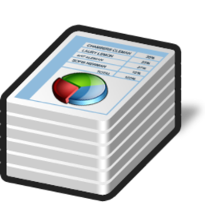



Cryptography as a Service (CaaS)
Hardware Security
Module (HSM)
WS API: JSON
CaaS creates single point of failure (SPoF)
  More risk to server
Typically solved by HSM
HSM becomes SPoF!

Slide 39
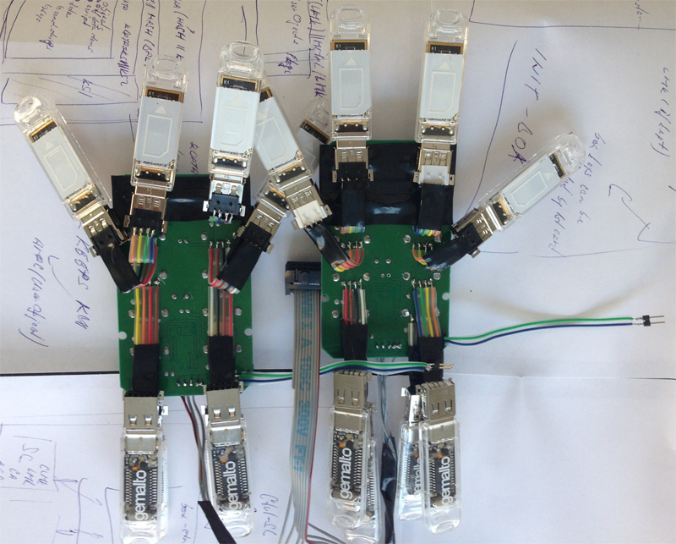
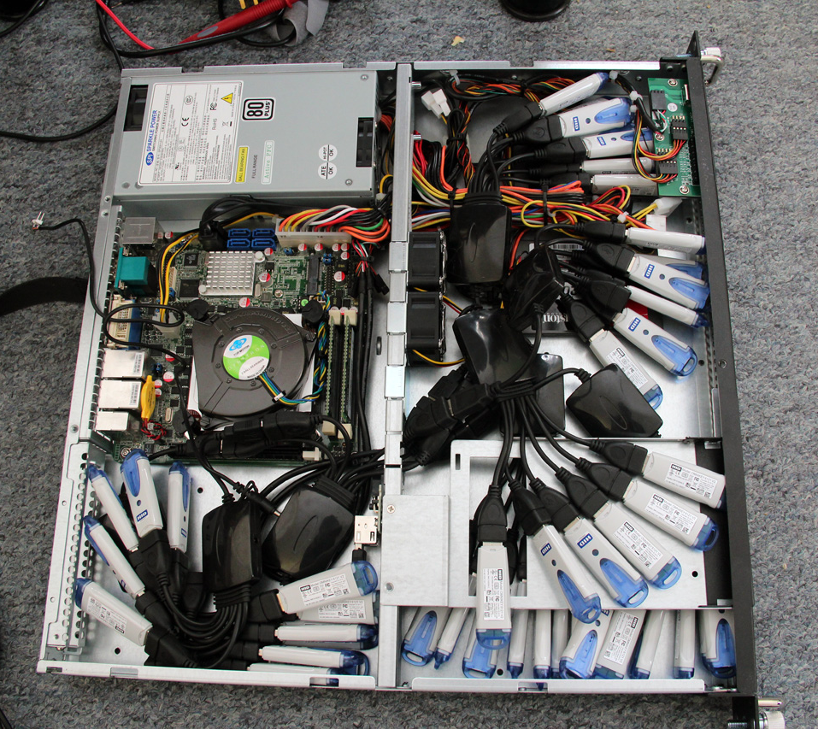
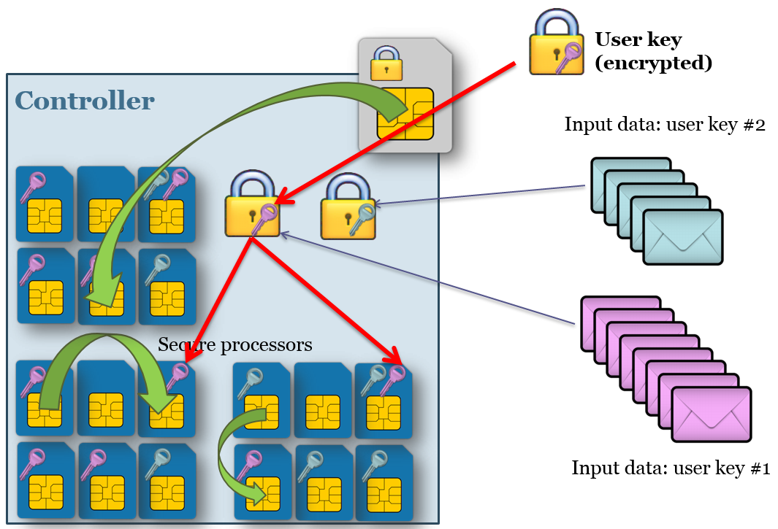
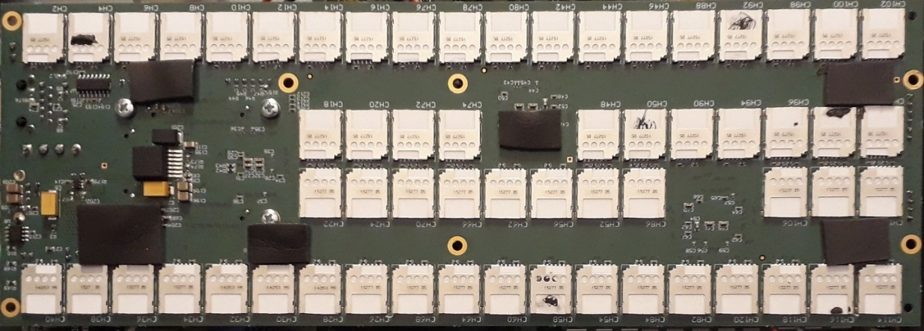
CryptoHive
https://crocs.fi.muni.cz/papers/space2015
First prototype:
12+2 configuration
1U prototype:
43+2 configuration
Dedicated board:
110+10 cards configuration
  Performance:
  ~600 RSA-1024 signs/sec
  ~1200 HMAC/sec

Slide 40

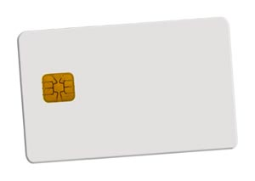

Problem: buggy or subverted chip
https://crocs.fi.muni.cz/papers/mpc_ccs17
https://crocs.fi.muni.cz/papers/mpc_ccs17
Prevention of supply chain compromise or buggy chip
Suite of ECC-based multi-party protocols proposed
  Distributed key generation, ElGamal decryption, Schnorr signing
Efficient implementation on JavaCards + high-speed box
Combination with non-smartcard devices possible

Slide 41
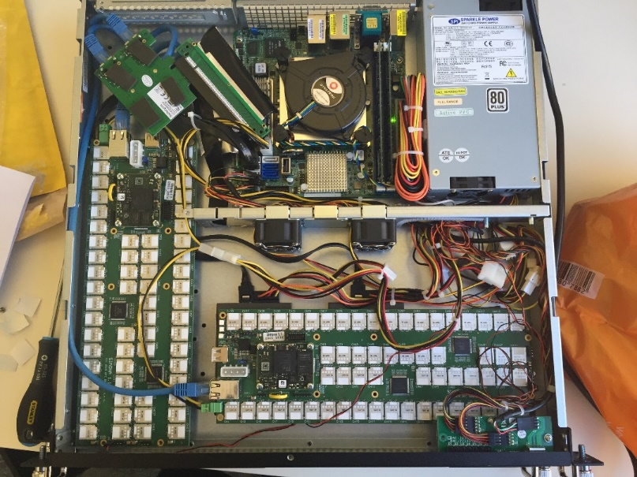
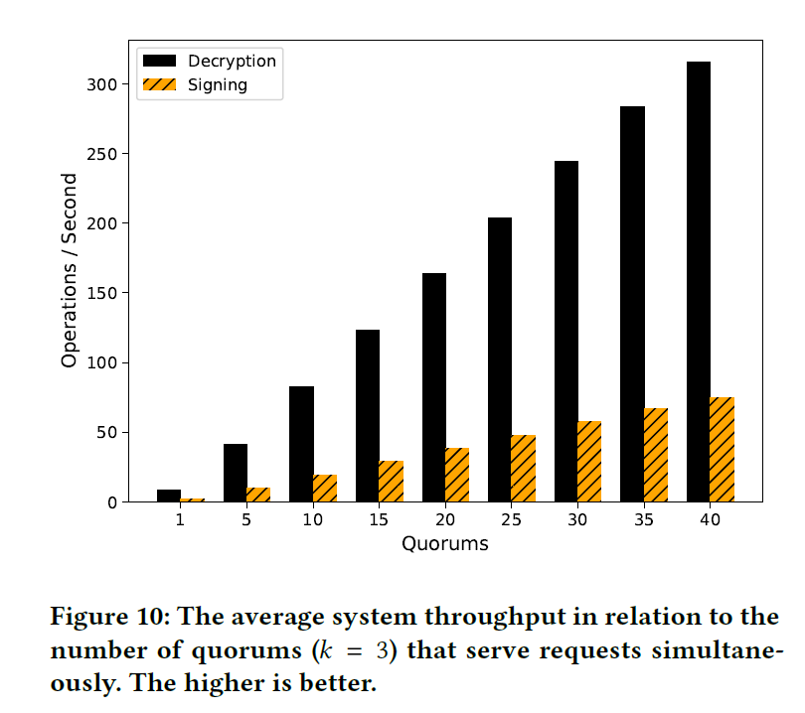
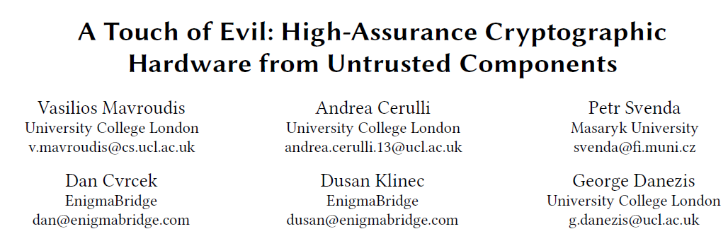
SmartHSM for multiparty (120 smartcards, 3 cards/quorum)
https://crocs.fi.muni.cz/papers/mpc_ccs17
…
120 cards => 40 quorums
=> 300+ decrypt / second
=> 80+ signatures / second

Slide 42

How to run MPC on JavaCards
https://github.com/OpenCryptoProject/JCMathLib
MPC applets: https://github.com/OpenCryptoProject/Myst, https://github.com/crocs-muni/JCFROST
Schnorr-based MPC protocols requires low-level curve operations
  Supported by card, but not exposed by standard JavaCard API
JCMathLib https://github.com/OpenCryptoProject/JCMathLib
  Adds support for low-level classes/methods like ECPoint and Integer
    Which are otherwise not supported by public JavaCard API
    (available via proprietary extensions, but requires NDA)
  Main goals
    Expose helpful functions for research/FOSS usage (e.g., Schnorr MPC sigs)
    Allow for publication of functional applets originally based on proprietary API
  Low-level methods build (mis)using existing JC API
    E.g., ECPoint.multiply() using ECDH KeyAgreement + additional computation
  Optimized for low RAM memory footprint and performance

Slide 43
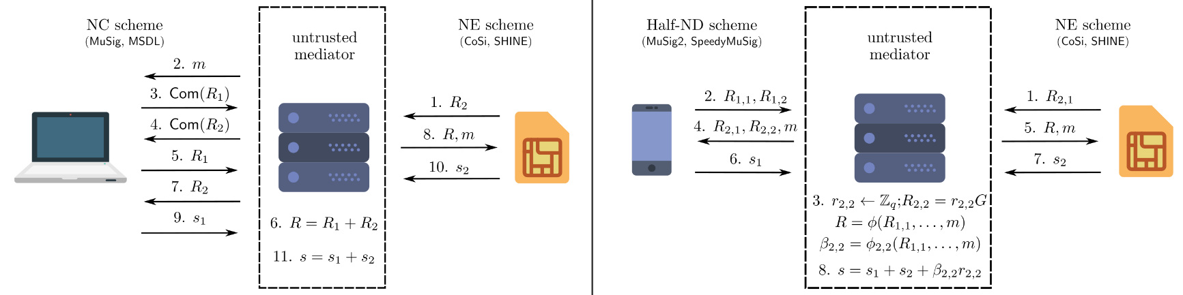
SHINE: Interoperability of MPC signatures
SHINE: Resilience via Practical Interoperability of Multi-party Schnorr Signature Schemes,
Antonin Dufka, Vladimir Sedlacek, Petr Svenda, SECRYPT , 2022.
Idea: make existing Schnorr-based MPC protocols interoperable via untrusted mediator
  NE-based schemes (CoSi, Myst)
  NC-based schemes (MuSig, MSDL)
  Half-ND-based schemes (MuSig2, SpeedyMuSig)
Additional multi-signature protocol optimized for smartcards (SHINE)
  JCMathLib used

Slide 44
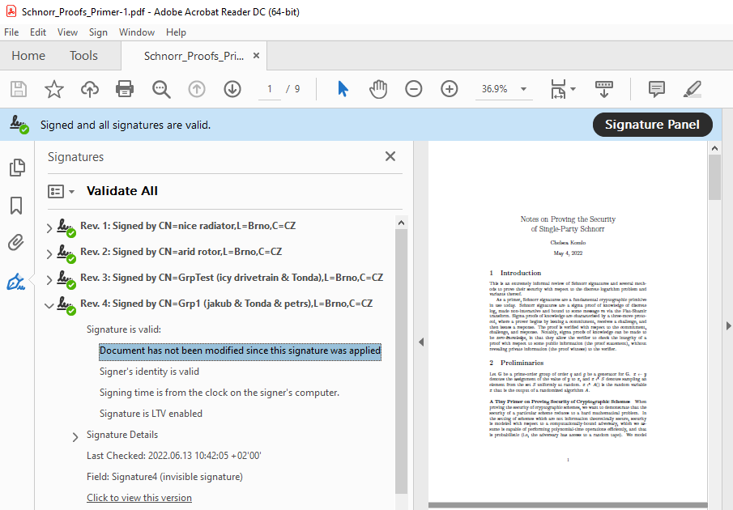
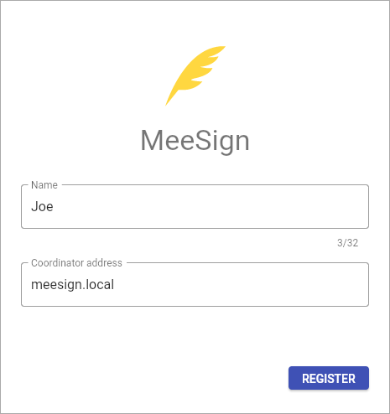
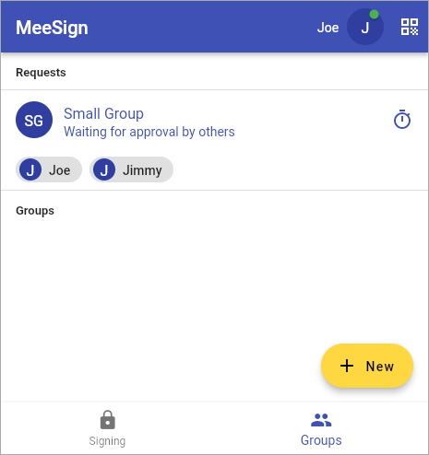
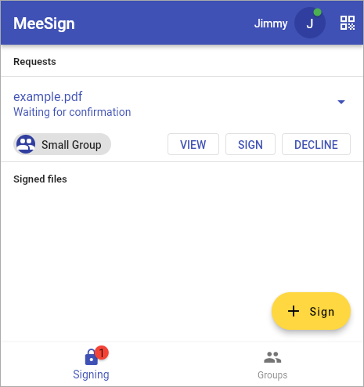
MeeSign (k-of-n ECDSA)
Platform for multi-party document signing
  MPC utilized for group signing and backward compatibility
  Outputs valid PDF signatures by multiple parties
MeeSign: Threshold signing for electronic evidence management. Antonin Dufka, Jakub Janku, Jiri Gavenda,
Petr Svenda. EurOpen 2022. Also available on https://meesign.crocs.fi.muni.cz/.

Slide 45
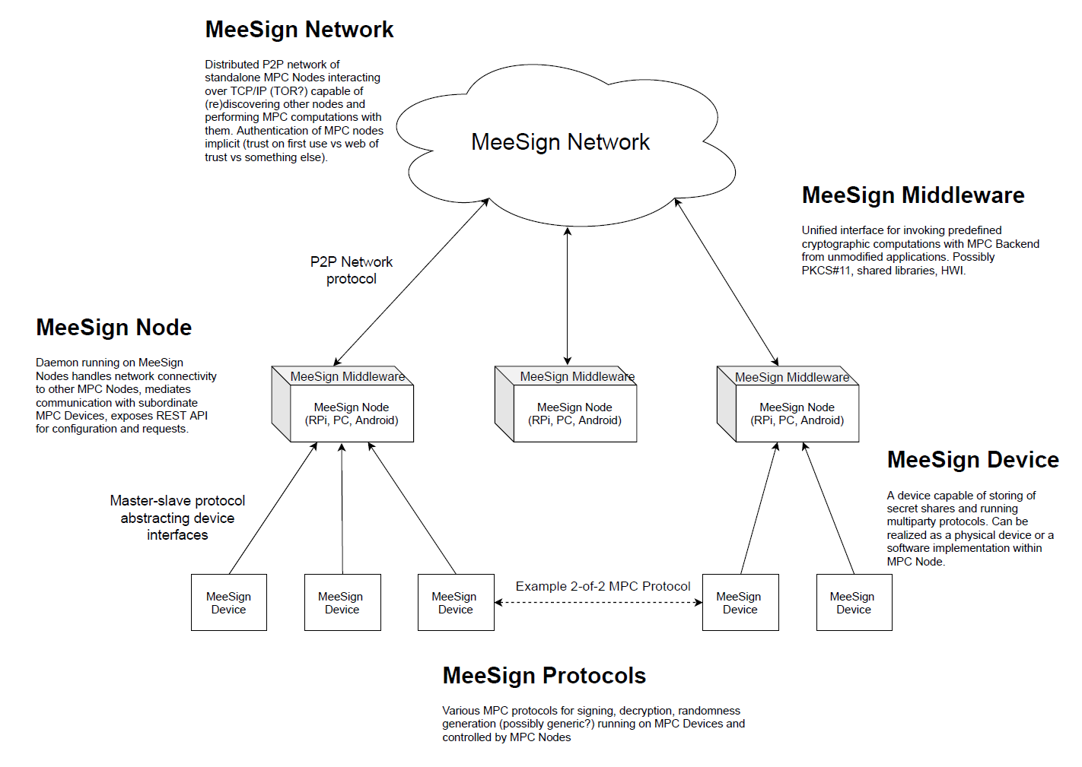

Slide 46
Use-case scenarios

Slide 47
High-level usage scenarios
Digital signature
User authentication
Data decryption
Key / randomness generation
Notes:
Díky zpětně kompatibilnímu MPC lze zvýšit bezpečnost i tam, kde to teď není možné bez přechodu na nový systém (více podepisujících, lepší kontrola autentizace, lepší kontrola přístupu k datům)

Slide 48
Multiparty signatures – configurations and use-cases
2-out-of-2 (two signers, both required)
  One share on mobile phone, second on server (Smart-ID, eIDAS compliant)
  One share on US smartcard, second on Chinese smartcard (backdoor resistance)
2-out-of-3 (three signers total, at least two required)
  Two shares user, one share backup server (backup if user lose one share)
  One share lender, one share lendee, one share arbiter (for disputes)
1-out-of-3 (very robust backup against key loss)
3-out-of-5 (shares distribution voting)
  CEO has 2 shares, all other have only single one
11-out-of-15 (Liquid consortium signing blocks on Liquid sidechain)

Slide 49

Multiparty signatures with additional policy
Signers can also enforce specific signing policy
  Only during certain time, documents, type of operations, certain amount…
2-out-of-2 with policy
  One person, second automatic signer only during office hours
2-out-of-3 with policy (two people, one automated device with policy)
  Two people together can always sign/transfer, one person alone only up to limit)
3-out-of-3 (two people, one automated device with policy)
  Automated device signs only when previous two already signed and additionally impose 1-month delay (timelock)

Slide 50










MPC for authentication – configurations
2-of-2: one user, two devices
  (higher security against device compromise)
2-of-2: one user, one server-side automatic process
  (check time interval when authentication is allowed)
2-of-2: two users (user, approving controller)
  (access must be approved by controller)
2-of-3: three users (user, redundant approvers)
  (one user, two controllers – one approval is enough)
Bonus: Independent log of authentication attempt

Slide 51
Multiparty decryption and Shamir threshold scheme
Combination of MPC and Shamir
  2-of-2 multiparty decryption for every person to decrypt Shamir share
  Shamir shares combined later (standard procedure)
  Usable to enable easy removal of person from share (by deletion of second key for 2-of-2)

Slide 52
Threshold crypto protocols – tradeoffs and limitations
Security vs. usability
More difficult to finalize signature (more parties, communication)
More complex software (bugs more likely)
Number of rounds, interaction
Amount of data exchanged
Active research field => possibility for new attacks against whole schemes

Slide 53
Backward compatibility
Existing systems already use some crypto algorithm (RSA, ECDSA…)
  Difficult to switch all information systems to new algorithm
Threshold algorithm is backward compatible, if verification is unchanged
  Only signer needs to update its software (to create threshold MPC signature)
  Verification software stay unchanged
  Allows for gradual opt-in (improve signing security of people who upgrade)
  (similarly for decryption – if encryption is unchanged)
Backward-compatible signatures exists for commonly used algorithms
  RSA, ECDSA, EdDSA, Schnorr…

Slide 54
Summary
JavaCard programming
  Optimizations need to consider underlaying hardware (RAM, co-processors…)
  Programs shall anticipate faults during computation (injected by an attacker)
Secure Multiparty Computation
  Exciting domain, active research, many practical uses
  Collaborative computation of signatures, decryption, keygen…
  Can be backward compatible (k-ECDSA, k-RSA, k-Schnorr…)
  Usually more computational demanding (common CPU is enough)
  Some protocols efficient enough to run on smartcards (Schnorr-based sigs…)
Split to multiple parties provides:
  Better protection of private key against bugs and compromise
  Possibility of additional policy before party participation

Slide 56
Additional slides for generic multiparty computation and whitebox cryptography construction (for interested, not mandatory part of PV204 course)

Slide 57
Secure Multiparty Computation (MPC)
Enables multiple parties to jointly compute a function, but keeps their inputs private
Different types of protocols:
Secret sharing protocols (e.g., Shamir)
  Jointly hold secret, but split in shares, can be reconstructed only when sufficient number of shares are available
Garbled circuit protocol
  One party creates Boolean circuit (2-input gates) from the specification and transforms it (XOR, AND)
  Other party evaluates without learning original specification and/or data
Partial/Somewhat/Fully Homomorphic Encryption (PHE, SHE, FHE)
Oblivious Transfer, Secure Function Evaluation

Slide 58
How to protect
Protections Against Reverse Engineering

Slide 59

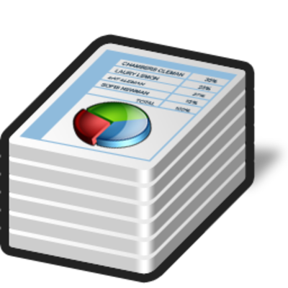



Standard vs. whitebox attacker model
(symmetric crypto example)

Slide 60
Whitebox attacker model
The attacker is able to:
  inspect and disassemble binary (static strings, code...)
  observe/modify all executed instructions (OllyDbg...)
  observe/modify used memory (OllyDbg, memory dump...)
How to still protect value of cryptographic key?
Who might be whitebox attacker?
  Mathematician (for fun)
  Security researcher / Malware analyst (for work)
  DRM cracker (for fun&profit)
  ...

Slide 61
Classical obfuscation and its limits
Provides only time-limited protection
Obfuscation is mostly based on obscurity
  add bogus jumps
  reorder related memory blocks
  transform code into equivalent one, but less readable
  pack binary into randomized virtual machine...
Barak’s (im)possibility result (2001)
  family of functions that will always leak some information
  but practical implementation may exist for others
Cannetti et. al. positive results for point functions
Goldwasser et. al. negative result for auxiliary inputs

Slide 62
CEF&CED
Computation with Encrypted Data and Encrypted Function

Slide 63
Scenario
We’d like to compute function F over data D
  secret algorithm F or sensitive data D (or both)
Solution with trusted environment
  my trusted PC, trusted server, trusted cloud…
Problem: can be cloud or client really trusted?
  server hack, DRM, malware...
Whitebox attacker model
  controls execution environment (debugging)
  sees all instructions and data executed

Slide 64



CEF
Computation with Encrypted Function (CEF)
  A provides function F in form of P(F)
  P(F) can be executed on B’s machine with B’s data D
  B will not learn function F during its computation (except D_{i} to F(D_{i}) mapping)
A
B

Slide 65

CED
Computation with Encrypted Data (CED)
  B provides encrypted data D as E(D) to A
  A is able to compute its F as F(E(D)) to produce E(F(D))
    result of F over D, but encrypted
  A will not learn data D
  E(F(D)) is returned back to B and decrypted
A
B

Slide 66
CED via homomorphism
Convert your function into Boolean circuit with additions (xor) and multiplications (and)
Compute addition and/or multiplication “securely”
  an attacker can compute E(D1+D2) = E(D1)+E(D2)
  but can learn neither D1 nor D2
Execute whole circuit over encrypted data

Slide 67
Types of homomorphic schemes
Partial homomorphic scheme
  either addition or multiplication is possible, but not both; any number of times
Somewhat homomorphic scheme
  Both operations possible, but only limited number of times
Fully homomorphic scheme
  both addition and multiplication; unlimited number of times (any computable function)

Slide 68
Partial homomorphic schemes
Example with RSA (multiplication)
  E(d₁).E(d₂) = d₁e . d₂e mod m = (d₁d₂)^{e} mod m = E(d₁d₂)
Example Goldwasser-Micali (addition)
  E(d₁).E(d₂) = x^{d1}r₁^{2 .} X^{d2}r₂² = x^{d1+d2}(r₁r₂)² = E(d₁⊕d₂)
Limited to polynomial and rational functions
Limited to only one type of operation (mult or add)
  or one type and very limited number of other type
Slow – based on modular mult or exponentiation
  every operation equivalent to whole RSA operation

Slide 69
Somewhat Homomorphic Encryption
Both operations (mult and add) possible, but only limited number of times
BGV (Barrat, Gentry and Vaikuntanathan) scheme
GSW (Gentry-Sahai-Waters) scheme

Slide 70
Fully homomorphic scheme (FHE)
Holy grail - idea proposed in 1978 (Rivest et al.)
  both addition and multiplication securely
But no scheme until 2009 (Gentry)!
Fully homomorphic encryption
  based on lattices over integers
  noisy somewhat homomorphic encryption usable only for few operations
  combined with repair operation (enable to use it for more operations again)

Slide 71
Fully homomorphic scheme - usages
Outsourced cloud computing and storage
  FHE search, Private Database Queries
  protection of the query content
Secure voting protocols
  yes/no vote, resulting decision
Protection of proprietary info - MRI machines
  expensive algorithm analyzing MR data, HW protected
  central processing restricted due to private patient’s data
…

Slide 72
Fully homomorphic scheme - practicality
Not very practical (yet ☺) (Gentry, 2009)
  2.7GB key & 2h computation for every repair operation
  repair needed every ~10 multiplication
FHE-AES implementation (Gentry, 2012)
  standard PC ⇒ 37 minutes/block (but 256GB RAM)
Gentry-Halevi FHE accelerated in HW (2014)
  GPU / ASICS, many blocks in parallel => 5 minutes/block
Replacing AES with other cipher (Simon) (2014)
  2 seconds/block
Very active research area!

Slide 73
Partial/Fully Homomorphic Encryption libraries
Homomorphic encryption libraries: HElib, FV-NFLlib, SEAL
Comparison of features and performance
  https://arxiv.org/pdf/1812.02428v1.pdf
  https://link.springer.com/chapter/10.1007/978-3-030-12942-2_32

Slide 74
Whitebox cryptography

Slide 75
White-box attack resistant cryptography
How to protect symmetric cryptography cipher?
  protects used cryptographic key (and data)
Special implementation fully compatible with standard AES/DES… 2002 (Chow et al.)
  series of lookups into pre-computed tables
Implementation of AES which takes only data
  key is already embedded inside
  hard for an attacker to extract embedded key
  Distinction between key and implementation of algorithm (AES) is removed

Slide 76


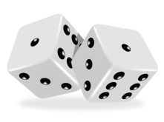
Whitebox transform

Slide 77
Impractical solution
Input block
Output block = AES(input, key_{X})
Secure, but 2¹²⁸ x 16B memory storage
00…00…00
10…01…11
Precomputed table
00…00…01
10…11…01
…
…
2¹²⁸
used as index into table
01…11…11
00…01…11
2¹²⁸
…
…
01…11…11
01…10…00
11…11…11
10…00…10

Slide 78
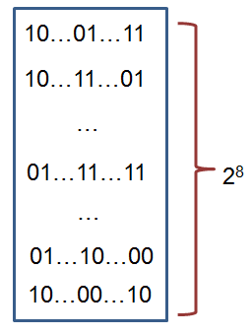
WBACR AES – some techniques
Pre-compute table for all possible inputs
  practical for one 16bits or two 8bits arguments table with up to 2¹⁶ rows (~64KB)
  AddRoundKey: data ⊕ key
    8bit argument data, key fixed
Pack several operations together
  AddRoundKey+SubBytes: T[i] = S[i ⊕ key];
Protect intermediate values by random bijections
  removed automatically by next lookup
  X = F⁻¹(F(X))
  T[i] = S[F⁻¹(i) ⊕ key];

Slide 79
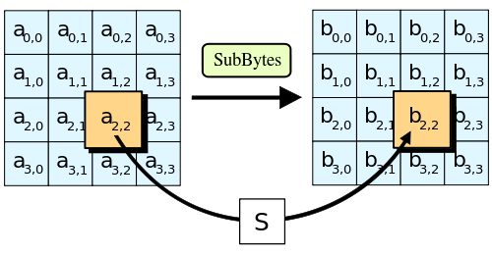
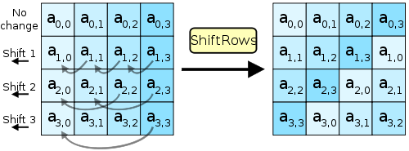
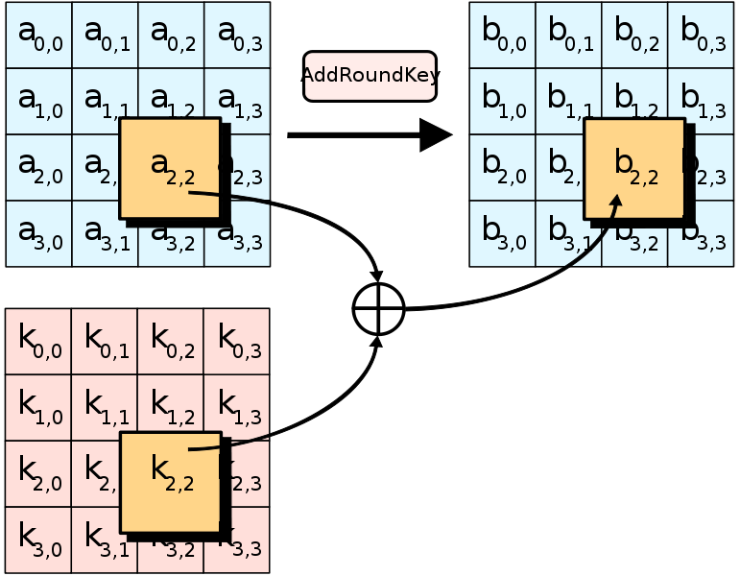
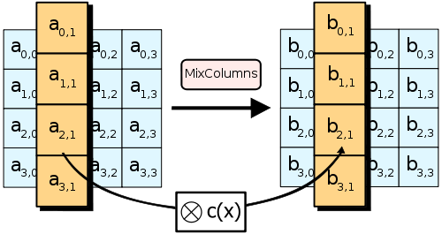
AES – short remainder (used ops)
Pictures taken from http://en.wikipedia.org/wiki/Advanced_Encryption_Standard

Slide 80
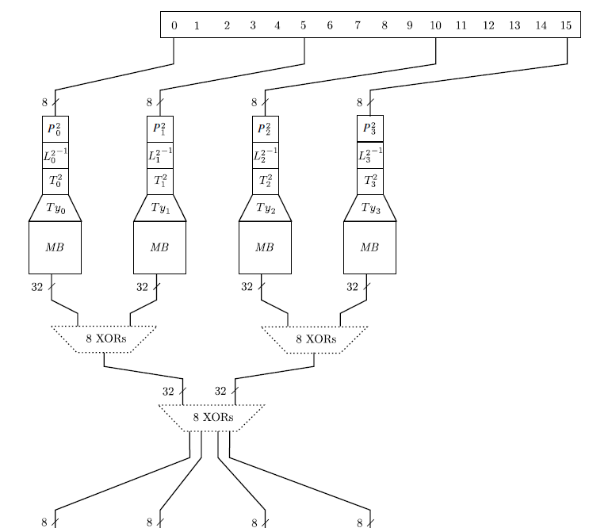
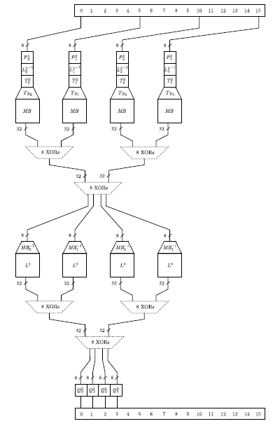
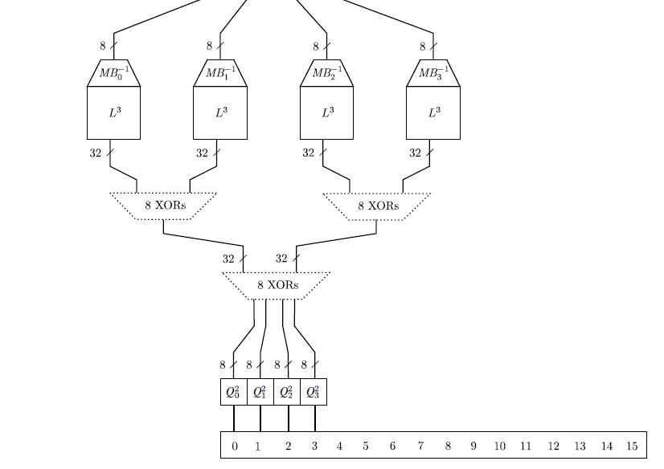

Slide 81
Whitebox cryptography lifecycle
[Secure environment]
  Generate required key (random, database...)
  Generate WAES tables (in secure environment)
[Potential insecure environment]
  Compile WAES tables into target application
[Insecure environment (User PC)]
  Run application and use WAES as usual (with fixed key)

Slide 82
AES
key
Environment outside control
of an attacker
makeTable()
precompTable
Environment under control
of an attacker
data
encrypted data
encrypt(data)

Slide 83
Resulting implementation
More difficult to detect that crypto was used
  no fixed constants in the code
  precomputed tables change for every new AES instance
    even two tables for same key are different
  (but can still be detected)
Resistant even when precomputed tables are found
  when debugged, only table lookups are seen
  key value is never manipulated in plaintext
  transformation techniques should provide protection to key embedded inside tables

Slide 84
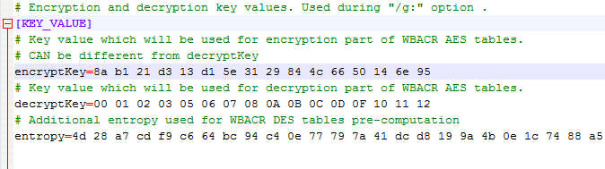
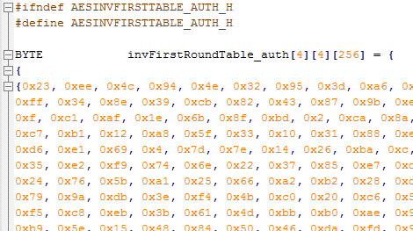
Demo – WAES
WAES tables generator
  configuration options
  *.h files with pre-computed tables
WAES cipher implementation
  compile-in tables
  tables as memory blob

Slide 85
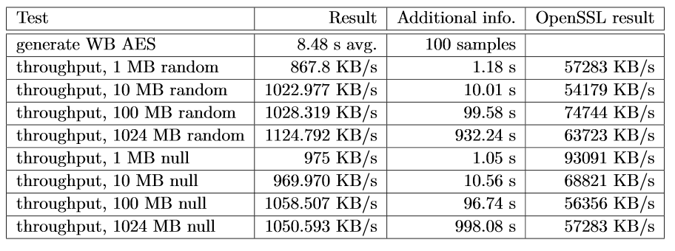
WAES performance
Intel Core i5 M560@2.67GHz
L. Bacinska, https://is.muni.cz//th/373854/fi_m/

Slide 86
WBACR Ciphers - pros
Practically usable (size/speed)
  implementation size ~800KB (WBACR AES tables)
  speed ~MBs/sec (WBACRAES ~6.5MB/s vs. 220MB/s)
Hard to extract embedded key
  Complexity semi-formally guaranteed (if scheme is secure)
  AES shown unsuitable (all WBARC AESes are broken)
One can simulate asymmetric cryptography!
  implementation contains only encryption part of cipher
  until attacker extracts key, decryption is not possible

Slide 87
WBACR Ciphers - cons
Implementation can be used as oracle (black box)
  attacker can supply inputs and obtain outputs
  even if she cannot extract the key
  (can be partially solved by I/O encodings)
Problem of secure input/output
  protected is only cipher (e.g., AES), not code around
Key is fixed and cannot be easily changed
Successful cryptanalysis for several schemes ☹
  several former schemes broken
  new techniques being proposed

Slide 88
Space-Hard Ciphers
Space-hard notion of WBACR ciphers
  How much can be fnc compressed after key extraction?
    WBACR AES=>16B key=>extreme compression (bad)
  Amount of code to extract to maintain functionality
SPACE suite of space-hard ciphers
  Combination of l-line target heavy Feistel network and precomputed lookup tables (e.g., by AES)
  Variable code size to exec time tradeoffs

Slide 89
Can whitebox transform replace secure hardware (e.g., smart card)?
Only to limited extent
Limitation of arguments size
Operation atomicity
  one cannot execute only half of card’s operations
No secure memory storage
  no secure update of state (counter)
Both can be used as black-box
  smart card can use PIN to limit usage
But still some reasonable usages remain

Slide 90
List of proposals and attacks
(2002) First WB AES implementation by Chow et. al. [Chow02]
  IO bijections, linear mixing bijections, external coding
  broken by BGE cryptanalysis [Bill04]
    algebraic attack, recovering symmetric key by modelling round function by system of algebraic equations
(2006) White Box Cryptography: A New Attempt [Bri06]
  attempt to randomize whitebox primitives, perturbation & random equations added, S-boxes are enc. keys. 4 AES ciphers, major voting for result
  broken by Mulder et. al. [Mul10]
    removes perturbations and random equations, attacking on final round removing perturbations, structural decomposition. 2¹⁷ steps
(2009) A Secure Implementation of White-box AES [Xia09]
  broken by Mulder et. al. [Mul12]
    linear equivalence algorithm used (backward AES-128 compatibility => linear protection has to be inverted in next round), 2³² steps
(2011) Protecting white-box AES with dual ciphers [Kar11]
  broken by our work [Kli13]
    protection shown to be ineffective
Fault induction especially devastating

Slide 91
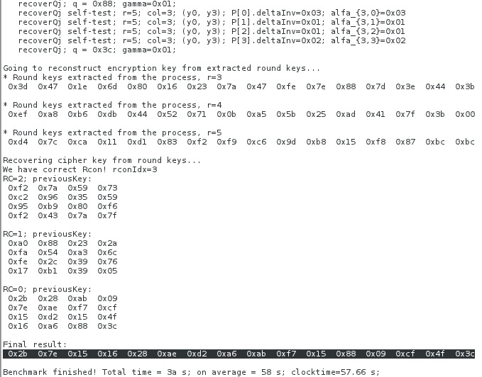
BGE attack in progress

Slide 92
More resources
Overviews, links
  http://whiteboxcrypto.com/research.php
  https://minotaur.fi.muni.cz:8443/~xsvenda/docuwiki/doku.php?id=public:mobilecrypto
Crackme challenges
  http://www.phrack.org/issues.html?issue=68&id=8
Whitebox crypto in DRM
  http://whiteboxcrypto.com/files/2012_MISC_DRM.pdf

Slide 93
Whitebox transform IS used in the wild
Proprietary DRM systems
  details are usually not published
  AES-based functions, keyed hash functions, RSA, ECC...
  interconnection with surrounding code
Chow at al. (2002) proposal made at Cloakware
  firmware protection solution
  Apple’s FairPlay & Brahms attack
    http://whiteboxcrypto.com/files/2012_MISC_DRM.pdf
  ...

