Slide 1


PV204 Security technologies
Trusted Boot, TPM, SGX
Petr Švenda svenda@fi.muni.cz @rngsec
Centre for Research on Cryptography and Security, Masaryk University
Please comment on slides with anything unclear, incorrect or suggestions for improvement
https://drive.google.com/file/d/1i8K1d8JpIesLnMbf8S4QUNs3UEXhLbUr/view?usp=sharing

Slide 2
Overview
Booting chain of programs
BIOS as root of trust
Verified and Measured boot
Trusted boot in the wild
  Trusted Platform Module
  Chromium, Windows 8/10/11, UEFI…
Dynamic root of trust
  Intel’s TXT, SGX

Slide 3

Motivation – untrusted host platform
Traditional role of operating system
  Isolate processed
  Manage privileges, authorize operations
But how to deal with
  Debugger, disassembler
  Intercepted multimedia output
  Malware run along with banking app
  Keyloggers, Evil maid
  System administrators, Service providers
  …

Slide 4
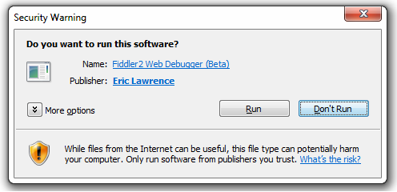
Solution?
Code signing (e.g., Microsoft AuthentiCode)
  Application binary is signed, PKI used to verify certificate
  If not signed, user is notified
  Mandatory signing for selected applications (drivers…)
Signed == Secure?

Slide 5
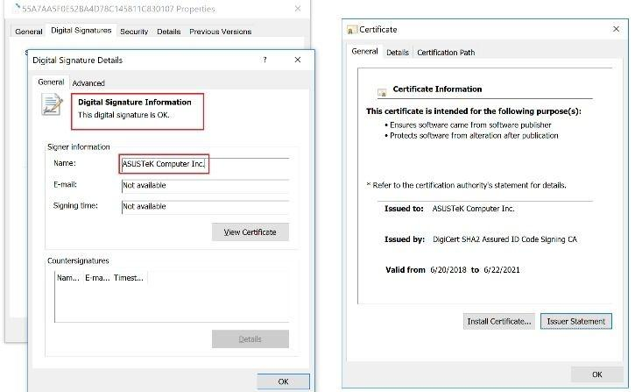
Signed == Secure?

Slide 6
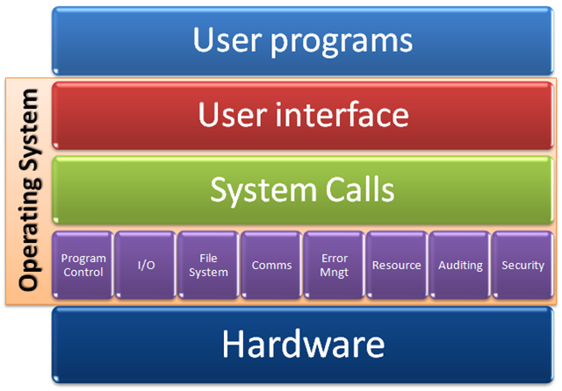
Trust in program’s functionality
Trust in a program code?
  Signed code may still contain bugs and vulnerabilities
Trust only in a program code?
  Underlying OS layers
  Underlying firmware
  Underlying hardware
  Memory used by the program
  Other code with access to the program’s memory/code
  …
The program is almost never executed “alone”

Slide 7
Problem statement
How to make sure that valid programs run only within valid environment?
Is it possible to start valid “clean” environment on previously compromised machine?
Is it possible to prevent tampering of apps against an attacker with physical access?
How to prove what apps are running on local machine to a remote party?

Slide 8
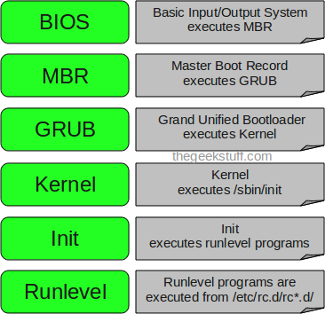
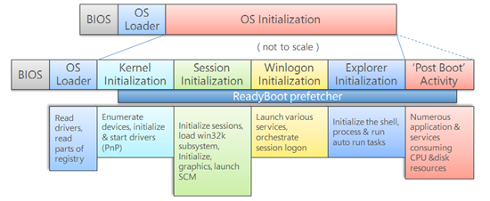
Classical boot chain
Linux
Windows
How to detect that BIOS or
OS Loader was modified?
(evil maid, bootkit…)
http://www.thegeekstuff.com/2011/02/linux-boot-process/
http://social.technet.microsoft.com/wiki/contents/articles/11341.the-windows-7-boot-process-sbsl.aspx

Slide 9
How to arrive at the expected chain of apps?
Just trust the whole boot process
Make all applications in protected read-only memory
  If read-only => cannot be (maliciously) modified. But is it really what is running?
Signature-based approach: Verified boot
  Before next app is executed, its signature is verified
  Requires valid (unforged) public key (integrity)
  Requires trust to owner of private key (signs only valid applications)
  (but which particular apps were executed is not known, only that they were signed)
Create un-spoofable log what executed: Measured boot
  Before next app is executed, its hash (“measurement”) is added to un-spoofable log (TPM’s PCR)
  Will NOT prevent run of unwanted app, but environment cannot lie about what was executed
  Requires (protected) log storage (Trusted Platform Module)
  May require authentication of log (Remote attestation)

Slide 10
“Verified” boot
(signatures)
Trusted boot
“Measured” boot
(cumulative hash)

Slide 11

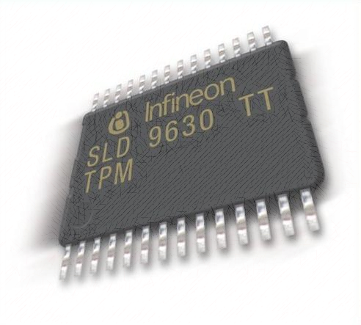
“Verified” boot
Verified and measured approaches can be combined
“Measured” boot
TPMLog.txt
User app
Kernel
GRUB
MBR
BIOS
PCR = H(…H(H(0|H(MBR))|H(GRUB)…H(User app))
User app
=>
VERIFY (RSA)
MEASURE: PCR = H(PCR | H(User app))
…
Kernel
VERIFY (RSA)
MEASURE: PCR = H(PCR | H(Kernel))
GRUB
VERIFY (RSA)
MEASURE: PCR = H(PCR | H(GRUB))
MBR
VERIFY (RSA)
BIOS
MEASURE: PCR = H(PCR | H(MBR))
What verifies or
measures BIOS?
RESET: PCR = 0
Nothing => BIOS is Root of Trust

Slide 12
Root of trust (for verified/measured boot)
Verified and Measured boot need some root of trust
  Initial piece of code that nobody verifies/measures
Static root of trust
  Start building trusted chain after reset of whole device
Dynamic root of trust
  Start building trusted chain without reset of device (faster)
What can be root of trust?
  static root of trust: BIOS, UEFI firmware, Intel Boot Guard, AMD Platform Security Processor
  dynamic root of trust: Intel TXT, Intel SGX, Pluton
Root of trust requires special protection
  As nobody verifies than nobody will detect eventual modification of it

Slide 13
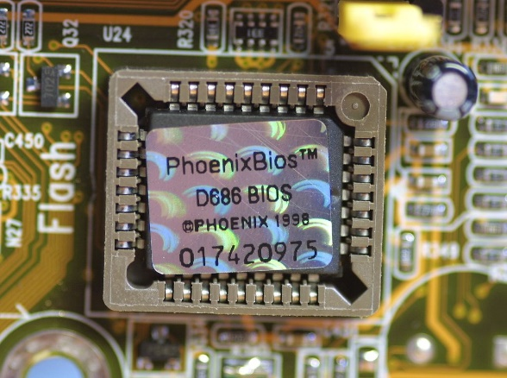
BIOS as root of trust
First code executed on CPU of target machine
Privileged access to hardware
  E.g., can write into memory of OS code via DMA
Provides code for System Management Mode (SMM)
  Routines executed during the whole platform runtime
  x86 feature since 386, all normal execution is suspended
  Used for power management, memory errors, hardware-assisted debugger…
  Very powerful mode (=> also target of “ring -2” rootkits)

Slide 14
BIOS – security considerations
How BIOS verifies integrity of next module to run?
Where public key(s) for verification are stored?
How to handle updates of signing keys?
How BIOS checks signatures on its own updates?
How BIOS can be compromised?

Slide 15
How BIOS can be compromised?
Maliciously written by BIOS vendor (backdoor)
Replacement of genuine BIOS by malicious one
  By physical flash (SPI programmer) of BIOS code
  By lack of flashing protection mechanism by original BIOS
  By code logic flaws in BIOS locking mechanisms
Modification of other code/data used by BIOS
  Bug in parsing unsigned data…
Currently used protections:
  Chipset-enforced protection of flash memory with BIOS
  BIOS signature verification before new version is written
  Hardware-aided check of executed code (TPM, TXT, SGX)
  Check of BIOS signature before execution by CPU (IBG)

Slide 16
BIOS write locking – “locks”
Prevent unauthorized BIOS flash (from host OS)
Allow for authorized BIOS changes
  BIOS upgrade, signing keys update
  Change of persistent configurations (boot device…)
Locking mechanism (locks) for BIOS memory write
  Locks are unlocked after reboot
  Signature on new BIOS version is verified by old BIOS, and new is flashed eventually (before locking locks)
  BIOS configuration (boot device priority) is written before locking locks
  Locks locked before handling execution to other code

Slide 17
Attacks against BIOS locks
Attacks typically via BIOS code vulnerability
  BIOS usually does not takes (much) user input, but may parse BIOS update blob with some parts unsigned (logo)
  Buffer overflow in logo parsing => Locks are not locked yet => write own BIOS
  http://invisiblethingslab.com/resources/bh09usa/Attacking%20Intel%20BIOS.pdf
Write into flash memory by SPI programmer
Which one is more serious? Different attacker models
1. Is remote, but patchable
2. Is local attacker, but requires design changes to prevent

Slide 18

Impact: Attack against Tails live-CD distro
Tails is live-CD Linux distribution
Designed to provide security even on previously compromised computer
  Boot complete fresh OS from live-CD + security tools
Attack 1: Physical BIOS modification
  Modified BIOS inserts malicious code into Tails during boot time
  Known thread, physical access to computer assumed
Attack 2: SMM rootkit (LightEater)
  Bug in BIOS exploited by remote party to modify SMM routines
Main issue: Tails tries to start with clean erased computer, but some elements still persist erase (BIOS modifications)

Slide 19
Intel Boot Guard (IBG)

Slide 20
Intel Boot Guard (IBG)
Feature to protect BIOS
  Piece of trusted processor-provided, ROM-based code
  Runs first after reset, verifies Initial Boot Block (IBB)
“Measured” boot mode (TPM-based)
  Passively extends TPM’s PCRs by hash of IBB
“Verified” boot mode (digital signature)
  OEM vendor hardcodes public key via fuses into CPU
  Intel Boot Guard checks signature of IBB by OEM’s key
  Only vendor-approved IBB=>BIOS=>OS is executed
Combination of measured and verified mode

Slide 21
Intel Boot Guard – new root of trust
AMD Platform Security Processor (PSP) provides same functionality as IBG
User app
VERIFY (RSA)
MEASURE: PCR = H(PCR | H(User app))
…
Kernel
VERIFY (RSA)
MEASURE: PCR = H(PCR | H(Kernel))
GRUB
VERIFY (RSA)
MEASURE: PCR = H(PCR | H(GRUB))
MBR
VERIFY (RSA)
BIOS
MEASURE: PCR = H(PCR | H(MBR))
BIOS
VERIFY (RSA)
Intel Boot Guard (CPU)
MEASURE: PCR = H(BIOS-IBB)
IBG: Verified mode
IBG: Measured mode

Slide 22
Intel Boot Guard – security improvements
What attacks are mitigated by Intel Boot Guard?
Direct BIOS flash by SPI programmer
  Mitigated, signature/measurement mismatch
Remote change of BIOS / BIOS data
  Mitigated, signature/measurement mismatch
Other bug(s) in BIOS code
  Not mitigated, signed code still contains bug
Any new attacks opened by IBG?

Slide 23
How hard is to incorporate backdoor?
OEM vendor can sign backdoored BIOS
  But multiple OEM vendors exist, open-source bootloaders (coreboot)
Intel Boot Guard is written by Intel only
  But OEM fuses own verification public key, right?
  But it is the IBG code that actually verifies a signature!
Trivial (potential) backdoor (inside IBG code inside CPU)
  if (IBB[SOME_OFFSET] == BACKDOOR_MAGIC) then always load provided BIOS (no signature check)
  Or possibly verify by some other public key (secure even when BACKDOOR_MAGIC is leaked)

Slide 24
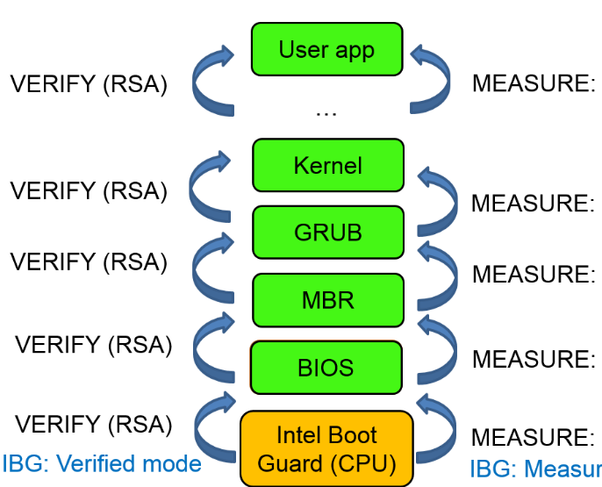
Short summary
Signature-based “verified” boot approach
  Whitelisting approach – run only what is signed
  Robust signature process needed (trust in private key owner)
  Integrity of verification public key is critical
  Key management is necessary (multiple keys, key updates)
“Measured” boot approach
  Un-spoofable log of hashes of executed code
  Can be remotely verified (remote attestation, explained later)
Root of trust needs to be protected
  Historically was BIOS (+ update signatures + write locks)
  Intel Boot Guard/AMD Platform Security Processor inside CPU (signature of BIOS)

Slide 25
Trusted platform module

Slide 26
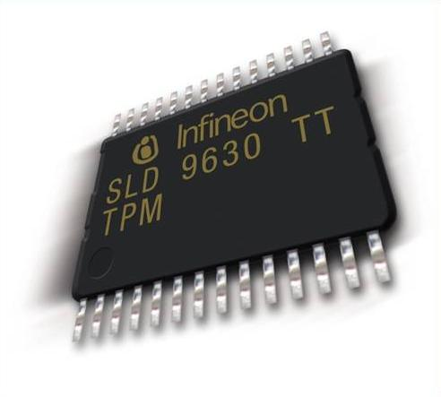
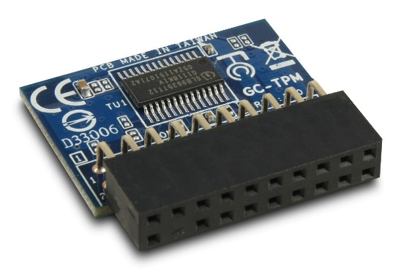
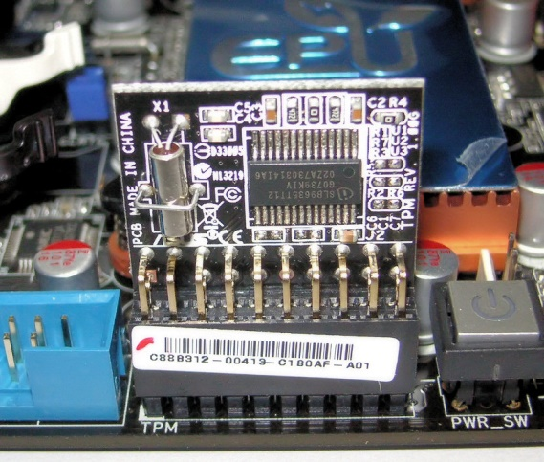
TPM hardware
Cryptographic smart card connected/inside to device
  Secure storage, cryptographic operations…
  (But not programmable JavaCard ☺)
Physical placement
  Additional chip on motherboard (discrete dTPM: Infineon, STM, Nuvoton)
  Firmware module inside CPU (firmware fTPM: Intel, AMD)
  Incorporated in CPU/peripheral (integrated iTPM: Pluton)
  (Software TPM – for development and debugging)
Accessed during boot time
  “Measured” boot (TPM’s PCR registers)
  BitLocker encrypted drive keys
Accessed later (private key operation)

Slide 27
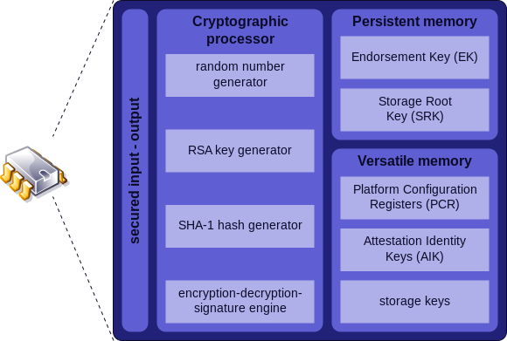
Trusted platform module
Author: Guillaume Piolle

Slide 28
Trusted Platform Module (TPM)
ISO/IEC 11889 standard for secure crypto-processor
Versions published by Trusted Computing Group
  https://trustedcomputinggroup.org
  TPM 1.2 (2003-2011)
  TPM 2.0 (2013-now, not compatible with 1.2, but downgrade switch in BIOS)
Tools to communicate with TPM
  Windows: Microsoft PCPTool, TSS.MSR, Windows API
  Linux: tpm_tools, tpm2_tools, GUI TPMManager

Slide 29
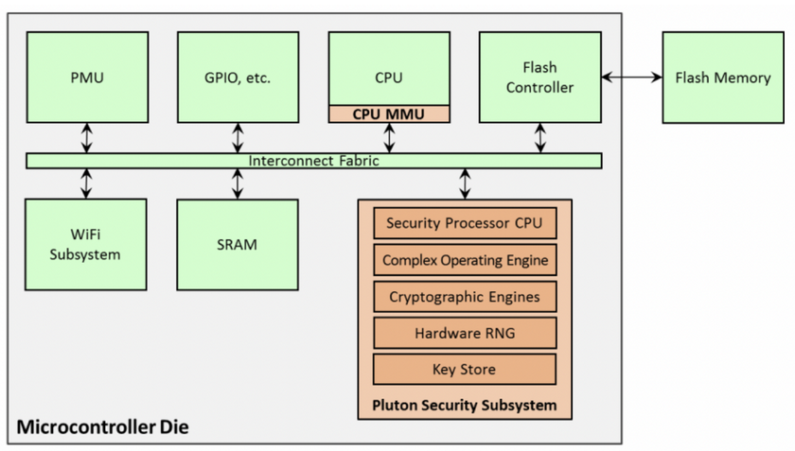
Pluton chip (iTPM)
https://www.microsoft.com/en-us/research/wp-content/uploads/2017/03/SevenPropertiesofHighlySecureDevices.pdf
Hardware chip inside AMD and Qualcomm CPU/SoC silicon die
  Co-developed by Microsoft, AMD and Qualcomm (Intel not yet)
  Similar functionality like Secure Enclave or ARM TrustZone
    own on-chip RAM, ROM, RNG, cryptographic co-processors…
    Only Microsoft signed firmware (Windows Update), downgrade protection
  On non-Windows systems provides only generic TPM 2.0 (iTPM)
Used to implement TPM 2.0 functionality (integrated TPM => iTPM)
  But also more, design originally from Microsoft Xbox (DRM) and Azure Sphere
  SHACK (Secure Hardware Cryptography Key) implementation
  DICE (Device Identifier Composition Engine) implementation
  Robust Internet of Things (RIoT) specification compliance

Slide 30
TPMAlgTest project

Slide 31
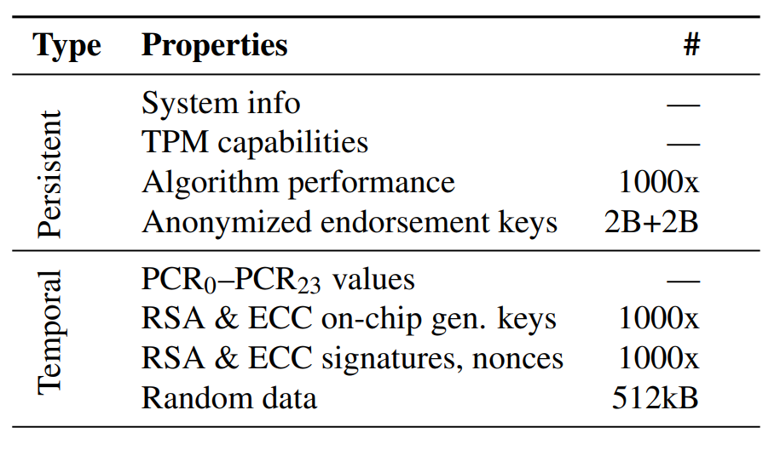
TPM analysis (TPMAlgTest project)
TPMAlgTest data collection tools
  AMD, Intel, Infineon, Nuvoton, STM (total 80 TPM versions)
  FI MU computers, compatibility testing cluster, community submissions
  https://github.com/crocs-muni/tpm2-algtest
Algorithmic and performance support
Properties of cryptographic material (RSA and ECC keypairs)
  Frequency of changes in cryptographic library
Properties of Endorsement keys (on-chip or injected)
Analysis of randomness data (GetRandom(), ECC keys and nonces…)

Slide 32
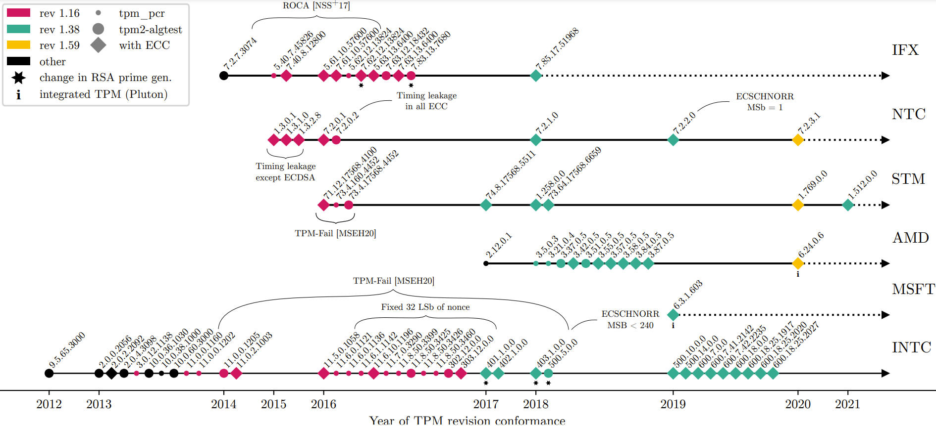

Slide 33
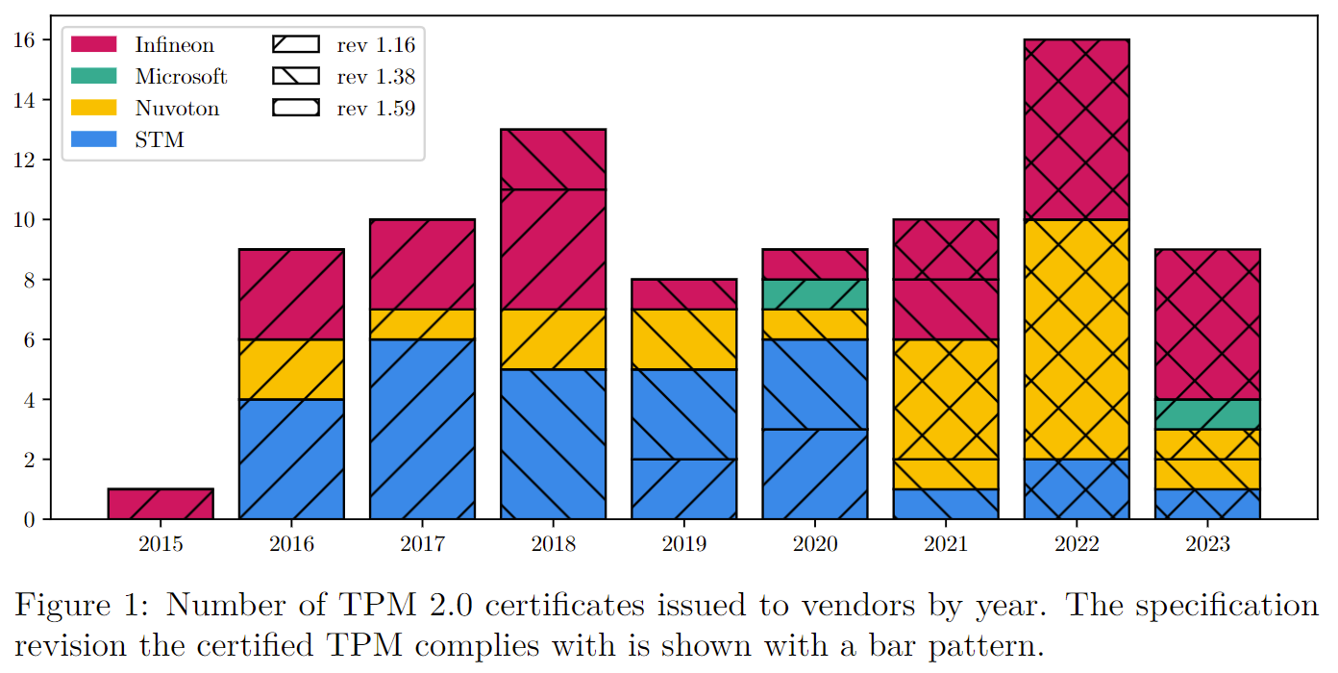

Slide 34
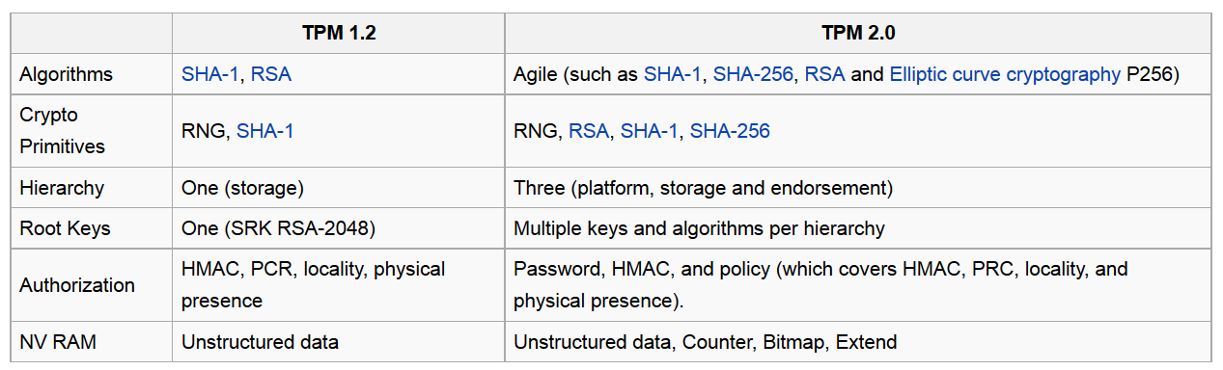
TPM 1.2 vs. TPM 2.0
TPM 2.0 introduced algorithm flexibility (no longer fixed SHA-1)
  If (some) algorithm is broken, no need to create “TPM 3.0”
TPM 2.0 often supports legacy API 1.2 (switch in BIOS)
TPM 2.0 seems to focus on IoT-like devices (support TLS)
https://en.wikipedia.org/wiki/Trusted_Platform_Module

Slide 35
Security functions provided by TPM-based systems
“Measured” boot with remote attestation
  Provide signed log of what executed on platform (PCR)
Storage of keys (disk encryption, private keys…)
  Can be additionally password protected
Binding and Sealing of data
  Encryption key wrapped by concrete TPM’s public key
Platform integrity
  Software will not start if current PCR value is not right

Slide 36
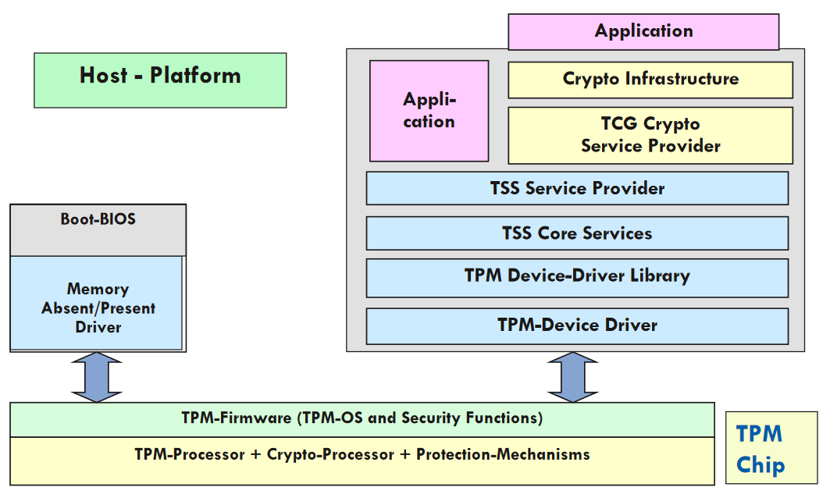
TPM Trusted Software Stack stack
Infineon, http://www.cs.unh.edu/~it666/reading_list/Hardware/tpm_fundamentals.pdf

Slide 37
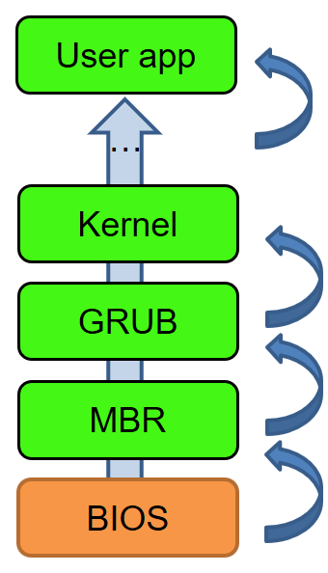
TPM PCR
Platform Configuration Register (PCR)
Measurement cumulatively stored in PCR
  measurement = SHA1(next block to execute)
  PCR[i] = SHA1(PCR[i] | new_measurement)
  Current block measure & store next before passing control
PCR cannot be erased until reboot
  Every part that was executed is stored
  Possible to perform after-the-fact verification what executed
Idea: boot what you want, but PCR will hold trace
Multiple PCRs to support finer grained reporting

Slide 38
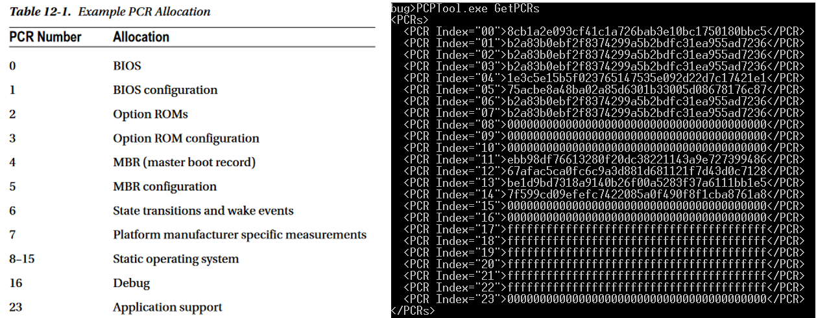
Platform attestation – PCR registers
W: PCPTool.exe GetPCRs
L: cat `find /sys/class/ -name "tpm0"`/device/pcrs

Slide 39
Remote attestation of platform state
So you measured your boot. How to prove your state to remote party?
Idea:
  Take current PCR values (stored inside TPM)
  Sign it by TPM’s attestation private key (AIK), (all inside TPM)
  Send signed PCR values + TPMLog from computer to remote party
  Remote party holds public key and can verify signature => trust in authenticity of PCR values

Slide 40
Remote attestation of platform state
Apps running on your computer measured in PCRs
Your TPM contains unique Endorsement key
You can generate Attestation key inside TPM (AIK)
  And sign AIK by Endorsement key (inside TPM)
You can sign your PCRs by AIK (inside TPM)
Remote party can verify signature on AIK key
  Using public key of Endorsement key
Remote party can verify signature on PCRs
  Using public key of AIK key
Remote party now knows “what” you are running

Slide 41
Remote attestation
Multiple PCRs to support finer grained reporting
  not just single cumulative value
Multiple PCRs available
  BIOS, ROM, Memory Block Register [index 0-4]
  OS loaders [5-7], Operating System [8-15]
  Debug [16], Localities, Trusted OS [17-22]
  Application specific [23]
What is PCR measurement good for?
  PCR content can be signed by TPM’s private key and exported
  List of applications claimed to be executed (=> PCR expected value can be recomputed by remote party)
  => Remote attestation

Slide 42
Platform attestation – PCR registers
<PlatformAttestation size="30591">
<Magic>PADS<!-- 0x53444150 --></Magic>
<Platform>TPM_VERSION_12</Platform>
<HeaderSize>28</HeaderSize>
<PcrValues size="480">
<PCR Index="0">8cb1a2e093cf41c1a726bab3e10bc1750180bbc5</PCR>
<PCR Index="1">b2a83b0ebf2f8374299a5b2bdfc31ea955ad7236</PCR>
<PCR Index="2">b2a83b0ebf2f8374299a5b2bdfc31ea955ad7236</PCR>
<PCR Index="3">b2a83b0ebf2f8374299a5b2bdfc31ea955ad7236</PCR>
<PCR Index="4">68fffb7e5c5f6e6461b3527a0694f41ebd07e4e1</PCR>
<PCR Index="5">8e33d52190def152c9939e9dd9b0ea84da25d29b</PCR>
<PCR Index="6">b2a83b0ebf2f8374299a5b2bdfc31ea955ad7236</PCR>
<PCR Index="7">b2a83b0ebf2f8374299a5b2bdfc31ea955ad7236</PCR>
<PCR Index="8">0000000000000000000000000000000000000000</PCR>
<PCR Index="9">0000000000000000000000000000000000000000</PCR>
<PCR Index="10">0000000000000000000000000000000000000000</PCR>
<PCR Index="11">b2a83b0ebf2f8374299a5b2bdfc31ea955ad7236</PCR>
<PCR Index="12">7c84e69cd581eefd7ebe1406666711fd4fda8aa8</PCR>
<PCR Index="13">01788a8a31f2dafcd9fe58c5a11701e187687d49</PCR>
<PCR Index="14">26cda47f1db41bedc2c2b1e6c91311c98b4e2246</PCR>
<PCR Index="15">0000000000000000000000000000000000000000</PCR>
<PCR Index="16">0000000000000000000000000000000000000000</PCR>
<PCR Index="17">ffffffffffffffffffffffffffffffffffffffff</PCR>
<PCR Index="18">ffffffffffffffffffffffffffffffffffffffff</PCR>
<PCR Index="19">ffffffffffffffffffffffffffffffffffffffff</PCR>
<PCR Index="20">ffffffffffffffffffffffffffffffffffffffff</PCR>
<PCR Index="21">ffffffffffffffffffffffffffffffffffffffff</PCR>
<PCR Index="22">ffffffffffffffffffffffffffffffffffffffff</PCR>
<PCR Index="23">0000000000000000000000000000000000000000</PCR>
</PcrValues>
…

Slide 43
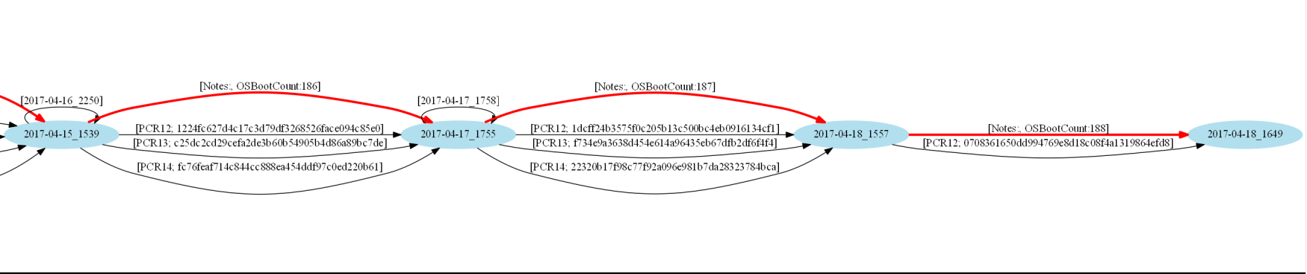
TPM platform info
Provides information about your platform state
Included in PCR12 (Operating System information)
Reboot =>
<PlatformCounters>
<OsBootCount>44</OsBootCount>
<OsResumeCount>2</OsResumeCount>
<CurrentBootCount>0</CurrentBootCount>
<CurrentEventCount>66</CurrentEventCount>
<CurrentCounterId>179136858</CurrentCounterId>
<InitialBootCount>0</InitialBootCount>
<InitialEventCount>64</InitialEventCount>
<InitialCounterId>179136858</InitialCounterId>
</PlatformAttestation>
<PlatformCounters>
<OsBootCount>45</OsBootCount>
<OsResumeCount>0</OsResumeCount>
<CurrentBootCount>0</CurrentBootCount>
<CurrentEventCount>67</CurrentEventCount>
<CurrentCounterId>179136858</CurrentCounterId>
<InitialBootCount>0</InitialBootCount>
<InitialEventCount>67</InitialEventCount>
<InitialCounterId>179136858</InitialCounterId>
</PlatformAttestation>

Slide 44
Trusted boot – real implementations

Slide 45

Verified boot - Chromium OS
Starts with read-only part of firmware/BIOS (root of trust)
  Cannot be forged, but also cannot be not updated
  Contains permanently stored root RSA public key
“Verified” boot strategy is used
  Verifies that all executed code is from Chromium OS source tree
  Code signatures verified by (shorter) keys signed by root key
    speed tradeoff + possibility to update compromised keys
Does not completely prevent user to boot other OSes
  Developer mode turned on => signature on kernel not checked
  TPM is used to provide mode reporting (normal/devel/recovery)
https://www.chromium.org/chromium-os/chromiumos-design-docs/verified-boot
https://www.chromium.org/chromium-os/chromiumos-design-docs/verified-boot-crypto

Slide 46
Chromium OS uses of TPM
Limited remote attestation (PCR[0] used)
  to store developer and recovery mode switches
Prevent rollback attack
  Prevented by strictly increasing version of key & firmware
  Version is written in TPM’s NV RAM location, only read-only firmware can update this location
  Key version prevents update to older (compromised) key
  Firmware version prevents update to vulnerable firmware
Store selected user’s private keys (secure storage)
Wrap selected disk encryption keys by TPM’s system key
https://www.chromium.org/developers/design-documents/tpm-usage

Slide 47
UEFI secure boot
Secured and Trusted Boot

Slide 48
UEFI secure boot principles
Platform key (RSA 2048b, PK) for authentication of platform owner
Key exchange keys (KEKs) for authentication of other components (drivers, OS components…)
“Setup" mode – platform key (PK) is not loaded yet
  Everybody can write its own platform key (become owner)
  Once PK is written, switch to “user” mode
“User” mode
  New keys (PKs, KEKs) can be written only if signed by PK
  New software components loaded only if signed by KEKs

Slide 49
Microsoft, Secured Boot and Measured Boot: Hardening Early Boot Components Against Malware

Slide 51
Windows 8/10/11 trusted boot
Secured and Trusted Boot

Slide 52
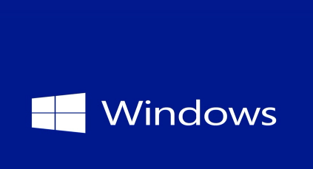

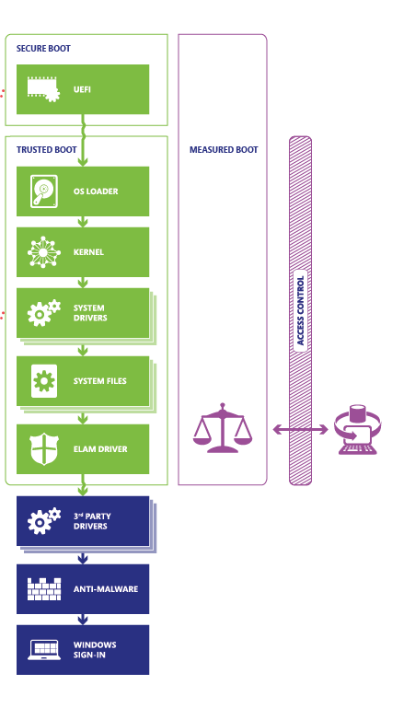
Windows 8/10 trusted boot
Certified Windows 8/10/11 devices have trusted boot by default
  “Verified” boot used (UEFI+OS sign)
  “Measured” boot used (TPM)
TPM PCRs used for measurements
TPM used for keys protection
  BitLocker disk encryption key
  ROCA CVE-2017-15361 is relevant
    If Infineon TPM used, patch!
http://technet.microsoft.com/en-US/windows/dn168167.aspx

Slide 53
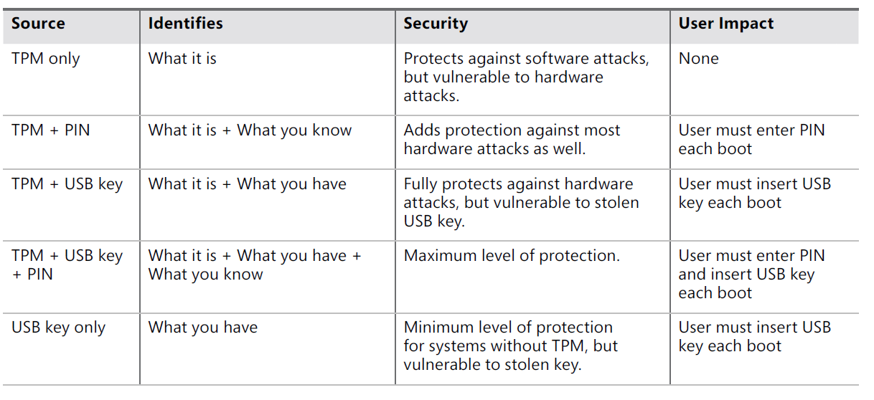
Usage of TPM in BitLocker (disk encryption)
Source of Volume Master Key (VMK)
M. Russinovich et. al., Windows Internals Part 2, 6th Edition

Slide 55
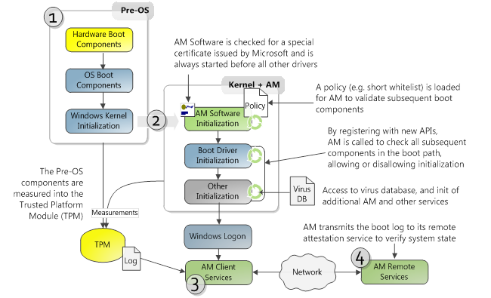
Windows 8/10 – secure boot process
Certified Windows 8/10 devices must have secure boot enabled by default
Microsoft, Secured Boot and Measured Boot: Hardening Early Boot Components Against Malware

Slide 56
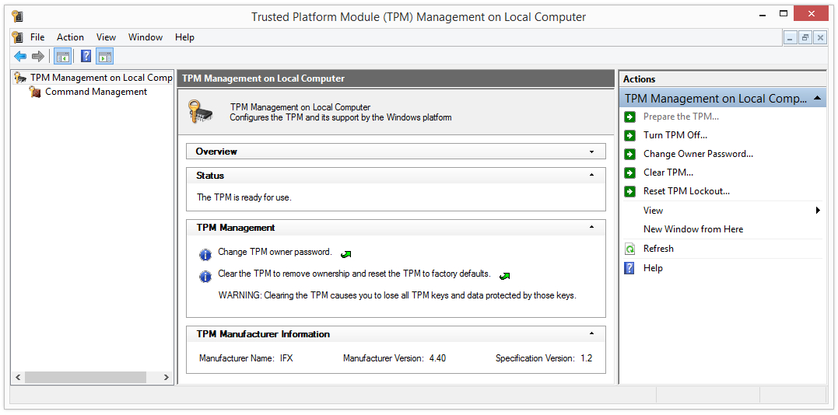
TPM owner password
You “own” TPM if you can set owner password
  One owner password per single TPM
Password set during TPM initialization phase
  can be repeated, but content is erased
Password protected storage of keys (Bitlocker…)
Run tpm.msc

Slide 57
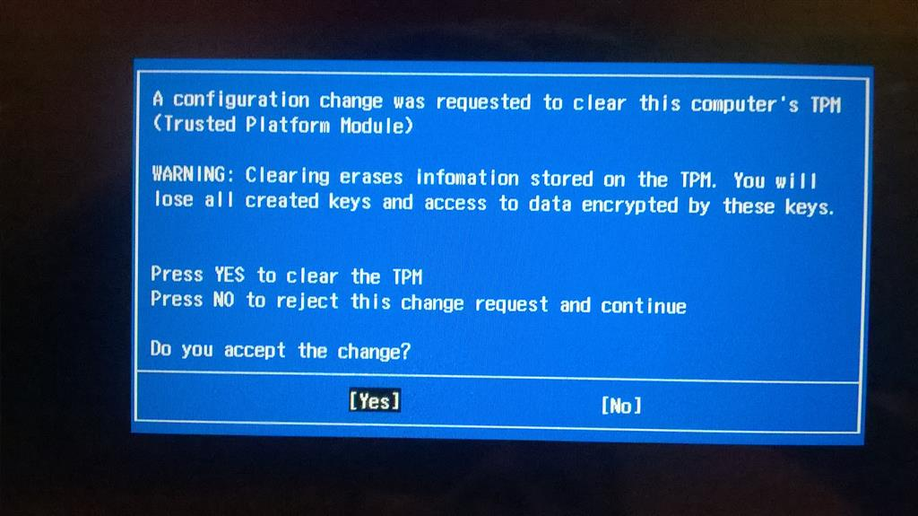

Slide 58
Attacks against TPM

Slide 59
Attacks against systems with TPM
Physical attacks
  Sniffing, side-channels, fault induction…
Design/reference implementation weaknesses
  Buffer overflow in packet handling [2023], updated specification January 2024
    “Revision 98 Added parameter to MemoryMove(), MemoryCopy(), and MemoryConcat() to make sure that the data being moved will fix into the receiving buffer.”
Attacks against cryptographic implementations
  ROCA [2017, CRoCS], RSA factorization (Infineon)
  TPM-Fail vulnerability [2020], ECDSA nonce timing dependency (STM, Intel)
  TPMScan vulnerabilities [2024, CRoCS]
    Fixed low 4 bytes of ECDSA nonce, (older Intel fTPM)
    TPM-Fail-like nonce timing in other algorithm than ECDSA (Nuvoton)

Slide 61
Research paper
Paper written by CROCS and NUKIB [CHES’24]
  https://crocs.fi.muni.cz/papers/tpm_ches2024
Several ECC nonce-related vulnerabilities discovered
  Known vulnerabilities by TPM-Fail (2019) – Intel, STM, Nuvoton
    Few topmost bits leaked via timing, ~1000s signatures to recover key
  Previously unreported vulnerabilities in ECSCHNORR and ECDAA
    inconsistent testing and reporting
New serious vulnerability in older Intel fTPMs 11.5.0.1058-303.12.0.0
  Lowest bytes of nonces of ECDSA and ECSCHNORR fixed to 0x00000001
  Only nine signatures required to extract private key, no need for active observation
  Fixed in 400.x versions, but not publicly disclosed

Slide 62
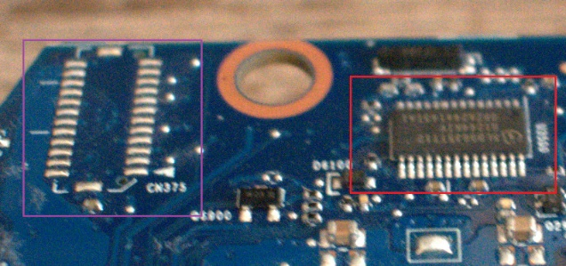
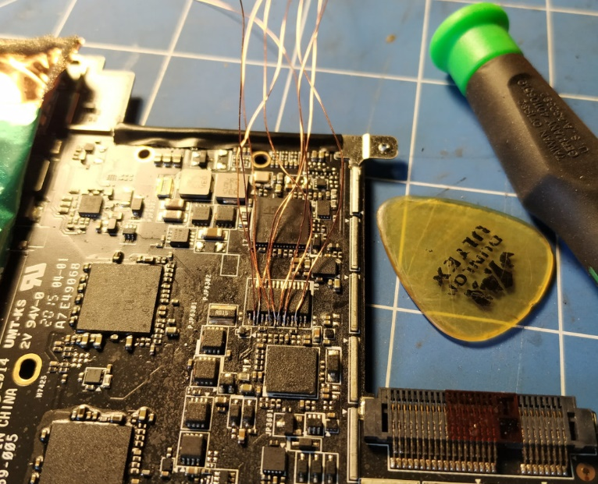
Attack: Sniffing commands/keys for BitLocker
Nice writeup how to sniff BitLocker key when send from TPM to OS, then decrypt disk image
  https://pulsesecurity.co.nz/articles/TPM-sniffing
fTPM and iTPM does not have exposed bus

Slide 63
Basic components

Slide 64
TPM keys
Endorsement key (EK)
  Generated during manufacturing, permanent
  Remain in TPM device during whole chip lifetime
TPM Storage Root Key (SRK)
  Generated by use after taking ownership
  New Storage root key can be generated after TPM clear
  Used to protect TPM keys created by application
Various delegate keys
  Separate keys signed/wrapped by EK, SRK…
  Application can generate and store own keys
  Good practice: do not have single key for everything

Slide 65
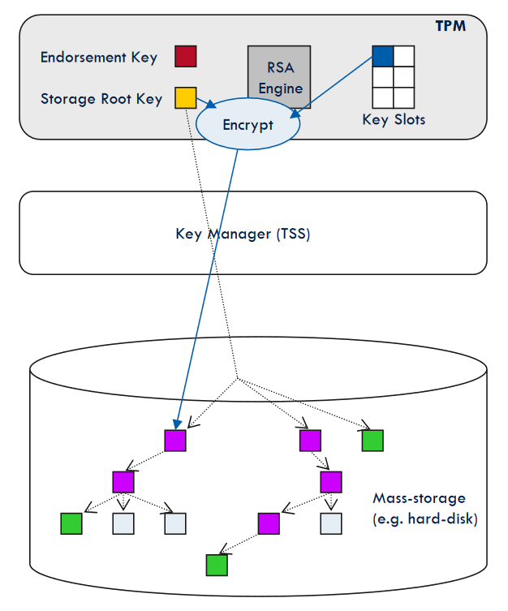
TPM storage keys
Application keys encrypted under SRK
Exported as protected blob
Stored on mass-storage
If needed, decrypted back and placed into slot
Key usable until removed
http://www.cs.unh.edu/~it666/reading_list/Hardware/tpm_fundamentals.pdf

Slide 66
TPM policy
TPM releases secret only when PCR contains particular value
Enforcement even in measured-only mode
  Key is not released if unexpected component was started (started => is included in measurements)
Conditions can use ANDs and ORs
How to handle policy updates?
  Change policy of state only from already valid state

Slide 67
Programming with TPM
The TPM Software Stack from Microsoft Research (C++, Java, C#, Python)
  https://github.com/Microsoft/TSS.MSR
tpm2-tools
  Open-source TPM stack for Linux and Windows
  https://github.com/tpm2-software/tpm2-tools

Slide 68
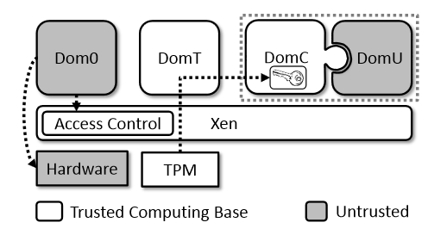
Usage of TPM in cloud-computing
Combination of virtualization and trusted computing
  Modified Xen hypervisor used to make standard TPM available for secret-less virtual machine
  Results in significant decrease in the size of trusted computational base (TCB)
Several different implementations
  E.g., Red Hat keylime https://github.com/keylime/
http://bleikertz.com/research/acns2013.pdf

Slide 69
Dynamic root of trust

Slide 70
Static Root of Trust Measurement (SRTM)
Start trusted immutable piece of firmware
  E.g., BIOS loader or Intel Boot Guard
Initiates measurement process
  Integrity of every next component is added to TPM’s PCRs
  Start → BIOS → PCI EEPROM → MBR → OS …
But do we need to start (trusted boot) only after reboot?
  Takes relatively long time
  Can we execute the same process, but dynamically?
  Can we exclude long chain (BIOS, PCI…)?
    Long chain => large Trusted Computing Base (TCB)!

Slide 71
Dynamic Root Trust Measurement (DRTM)
Launch of measured environment at any time
  “Late lunch” option
  No need to reset whole platform
  Can be also terminated after some time
Measurement process similar to static root of trust
  Application trust chain executed from dynamic root
Implementation of DRTM
  Intel’s TXT (not used much in practice, server CPUs typically)
  Intel’s SGX (all Skylake processors and newer, from 2015)

Slide 72
Intel’s Trusted Execution Technology
Intel’s TXT uses a processor-based root of trust
  Option given in TCG specifications
Goal: shorten chain of trust
  Run specific program in verified/trusted chain without restart
Goal: provide independent root of trust (CPU-based)
  Processor isolates memory of Measured Launched Environment (MLE) from other processes
Intel’s TXT still uses TPM to store measurements
http://www.intel.com/content/dam/www/public/us/en/documents/guides/intel-txt-software-development-guide.pdf
Outdated, abounded in favor of SGX

Slide 73
Intel’s TXT issues
TXT still relies on BIOS provided code (SMM)
  TXT-started chain can be compromised by forged BIOS
  Hard to patch (design decision, not implementation bug)
  Proposed defence by hardening and sandboxing SMM
Bugs in TXT implementation
  Memory corruption, misconfiguring VT-d …
  Can be fixed after discovery
Bugs in processing residual state of pre-TXT lunch
  Maliciously modified ACPI tables
  Can be fixed after discovery

Slide 74
tboot – open-source implementation
Pre-kernel/VMM module
Based on Intel’s Trusted Execution Technology
Performs a measured and verified launch of an OS kernel/VMM
http://sourceforge.net/projects/tboot/

Slide 75
Intel’s SGX : Security enclave
Intel’s Software Guard Extension (SGX)
  New set of CPU instructions intended for future cloud server CPUs
Protection against privileged attacker
  Server admin with physical access, privileged malware
Application requests private region of code and data
  Security enclave (4KB for heap, stack, code)
  Encrypted enclave is stored in main RAM memory, decrypted only inside CPU
  Access from outside enclave is prevented on CPU level
  Code for enclave is distributed as part of application
Trusted Computing Base significantly limited! ☺
  But proprietary Intel code inside CPU ☹

Slide 76
Intel’s SGX – some details
EGETKEY instruction generates new enclave key
  SGX security version numbers
  Device ID (unique number of CPU)
  Owner epoch – additional entropy from user
EREPORT instruction generates signed report
  Local/remote attestation of target platform
Debugging possible if application opt in
Enclave cannot be emulated by VM

Slide 77
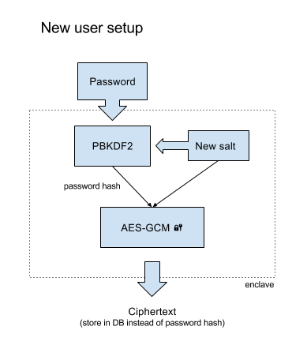
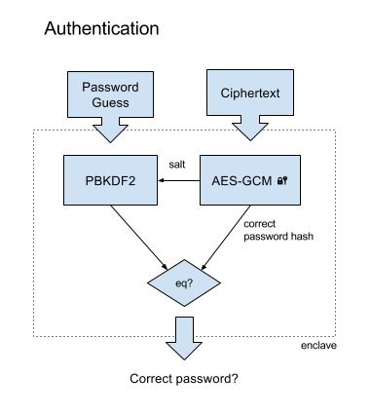
SGX hardened password verification
https://jbp.io/2016/01/17/using-sgx-to-hash-passwords/

Slide 78
Intel SGX is/was very active research area
Many small enclaves to cover whole program
  User-annotated code split into many enclaves (“microns”)
    Secure interaction between microns (attest, auth. encryption)
  Tor, H2O, FreeTDS and OpenSSL successfully transformed
    2685, 154, 473 and 307 LOC changes required respectively
    TCB only 20KLOC, PANOPLY specific overhead 24%
Memory randomization of code inside enclave
  SGX program modified with custom LLVM compiler
  Added in-enclave loader for ASLR & swDEP (2703 LOC)
  Code&data split into 32/64B units randomized separately
Full library OS based on SGX (Haven, Graphene-SGX)

Slide 79
Recent attacks against SGX
SGX is not a silver bullet
Vulnerable to side-channels
  Attacker with physical access explicitly excluded from attacker model
  Impacted by Spectre attack (2017)
    https://github.com/lsds/spectre-attack-sgx
    https://github.com/osusecLab/SgxPectre
  Impacted by Foreshadow attack (CVE-2018-3615) https://foreshadowattack.eu/
    Reading out attestation private key
Bugs of enclave code are still problem (developer)
Not everything is running inside enclave (other code, user input…)

Slide 80
Programming with Intel’s SGX
Intel SGX SDK
  https://software.intel.com/en-us/sgx-sdk
  6th generation core processor (or later) based platform with SGX enabled BIOS support
Example: Hardened password hashing
  https://jbp.io/2016/01/17/using-sgx-to-hash-passwords/
  https://github.com/ctz/sgx-pwenclave
More SGX info
  http://theinvisiblethings.blogspot.cz/2013/08/thoughts-on-intels-upcoming-software.html
  http://theinvisiblethings.blogspot.cz/2013/09/thoughts-on-intels-upcoming-software.html

Slide 81
Intel SGX deprecated on non-server CPUs (end 2021)
Intel deprecated technology for the newest non-server CPUs
  Still present in server CPUs, utilized by Azure confidential computing…
Not completely clear reasons so far
  Possibly mix of many past attacks which cannot be fixed without changing the architecture significantly (and breaking compatibility)
https://community.intel.com/t5/Intel-Software-Guard-Extensions/Intel-SGX-deprecated-in-11th-Gen-processors/m-p/1351848
https://edc.intel.com/content/www/us/en/design/ipla/software-development-platforms/client/platforms/alder-lake-desktop/12th-generation-intel-core-processors-datasheet-volume-1-of-2/001/deprecated-technologies/

Slide 82
Trusted computing - Critique

Slide 83
Trusted Computing (TC) - controversy
For whom is your computed trusted?
  Secure against you as an owner?
Is TC preventing users to run code of their choice?
  Custom OS distribution?
  Open OEM system – locked on first installation
  Physical switch to unlock later
Why some people from Trusted Computing consortium think that Trustworthy Computing might be better title?

Slide 84
Trusted computing - controversy
R. Anderson, `Trusted Computing' FAQ (2003)
  http://www.cl.cam.ac.uk/~rja14/tcpa-faq.html
J. Edge, UEFI and "secure boot“
  http://lwn.net/Articles/447381/
R. Stallman, Can You Trust Your Computer?
  https://www.gnu.org/philosophy/can-you-trust.html
Selected problems addressed in current designs

Slide 85
Quo Vadis, TPM?
~2004: Started with primarily aim at DRM enforcement (TPM 1.2)
  Some adoption, but also controversy, unclear future
~2013: TPM 2.0 significantly renewed interest and scope of use
  Wide hardware support via certified dTPMs (Infineon, Nuvoton, STM) and non-certified fTPMs (Intel, AMD)
  Microsoft Windows 11 requires TPM presence (measured boot, Bitlocker)
  Linux systemd rapidly adds measured boot https://systemd.io/TPM2_PCR_MEASUREMENTS/
~2017: Support for TPM-based functions more common
~2022: Pluton chip (Microsoft + AMD & Qualcomm), iTPM
  iTPM implementation (certification in progress), difficult to sniff TPM bus
  Directly updatable via Windows Update

Slide 86
Summary
Two principal solutions for trusted boot
  Verified boot (signatures) and Measured boot (PCR+RA)
Start from clean (and trusted) point
  Allow only intended software to run
  Or prove what actually executed
Additional hardware inside motherboard / CPU provides wide range of new possibilities (TPM)
Size of Trusted Computing Base matters (TPM/SGX)
Controversy about implication of trusted boot
  Who owns and control target platform

