Slide 1


PV204 Security technologies
Please comment on slides with anything unclear, incorrect or suggestions for improvement
https://drive.google.com/file/d/16zVbDqjxpEgUEAweWTCrijpjvTsONW8h/view?usp=sharing
Bitcoin basics I.
Petr Švenda svenda@fi.muni.cz @rngsec
Centre for Research on Cryptography and Security, Masaryk University

Slide 2
Why bitcoin?
Especially if you are not interested in Bitcoin.

Slide 3
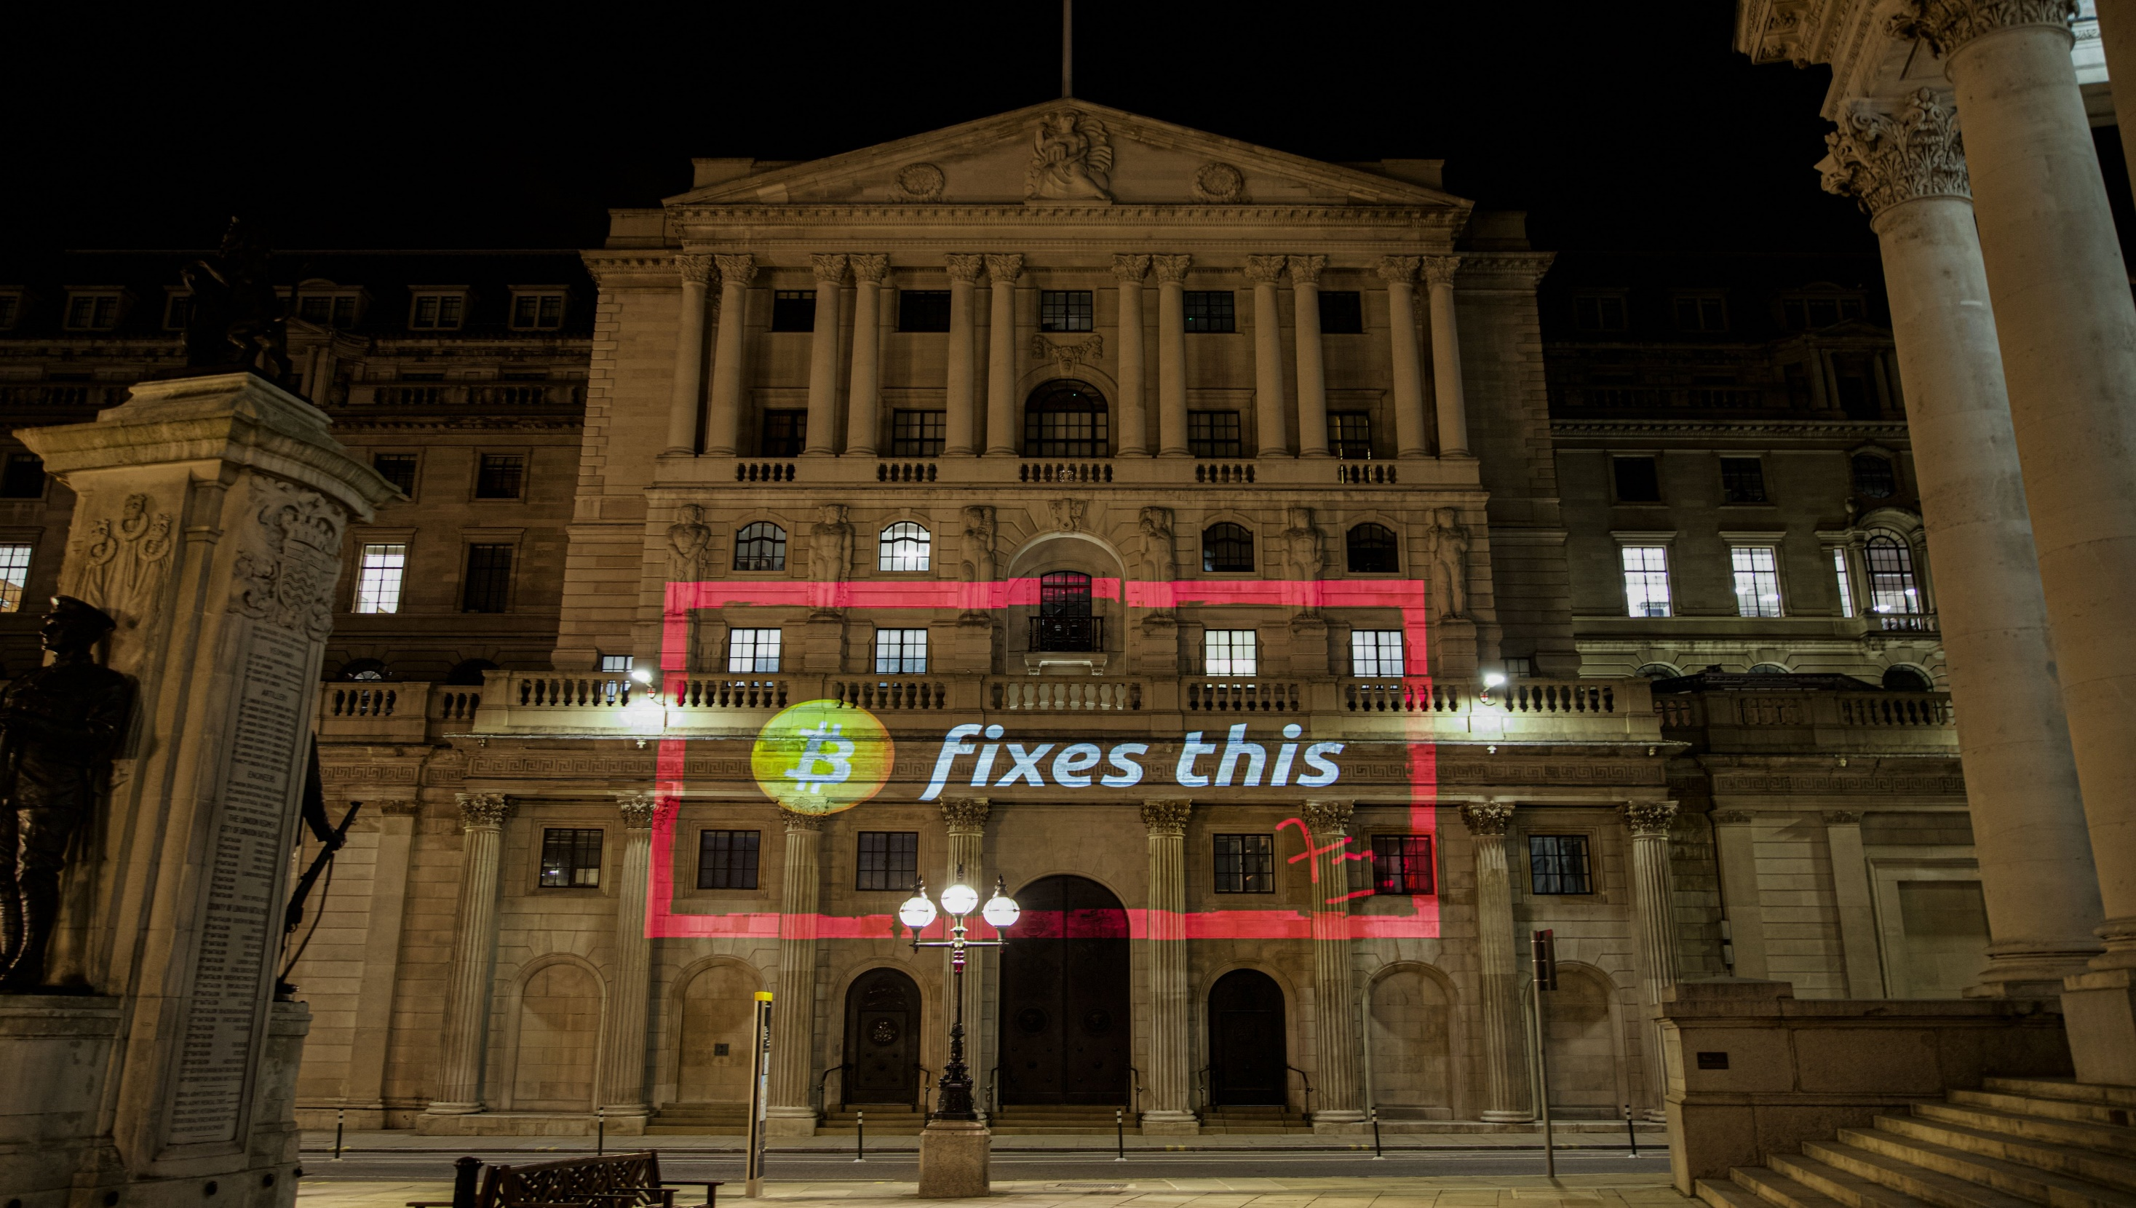
“Bitcoin fixes everything” meme
“Bitcoin fixes everything!”
https://twitter.com/DominicFrisby/status/1388448025970884609

Slide 4
Goals for the lecture
Bitcoin does not fix everything, but is on a frontline
  No safety net, no chargeback, attacker anonymous => security technique must really work, great for battle-testing security ideas, natural “bug bounty program”
6 main tech pieces we will cover (also usable outside Bitcoin world)
  How to backup key(s) (single seed, BIP39, Shamir)
  How to make always fresh keys (derivation via BIP32, also address privacy)
  How to protect signing key against malware
    (multisig, hardware wallet, airgap pc + tx broadcast, mpc sig)
  How to introduce restricted signing policy (time, limit… lockscript/multisig)
  How to protect your financial privacy (CoinJoin, Tor)
  How to use hardware wallet with secure element

Slide 5
Motivation example – what are limitations of this example?
I have PayPal/Visa/Venmo… why something else, slower, energy intensive…
  Scenario: Bank ledger, user accounts after KYC (ID), transfers between users
  Complicated
Problems:
  Central point of failure (maintenance, server compromise, transaction censorship, no ID, money freeze…)
  Increasing number of “coins” in system (inflation)
  Difficult auditability of complete current supply (Eurodollar system, dollar-denominated deposits at foreign banks, limited/no reserve requirements…)

Slide 6


What is your previous exposure to the cryptocurrencies? Please check all items which applies to you.
ⓘ Start presenting to display the poll results on this slide.

Slide 7
Basics

Slide 8
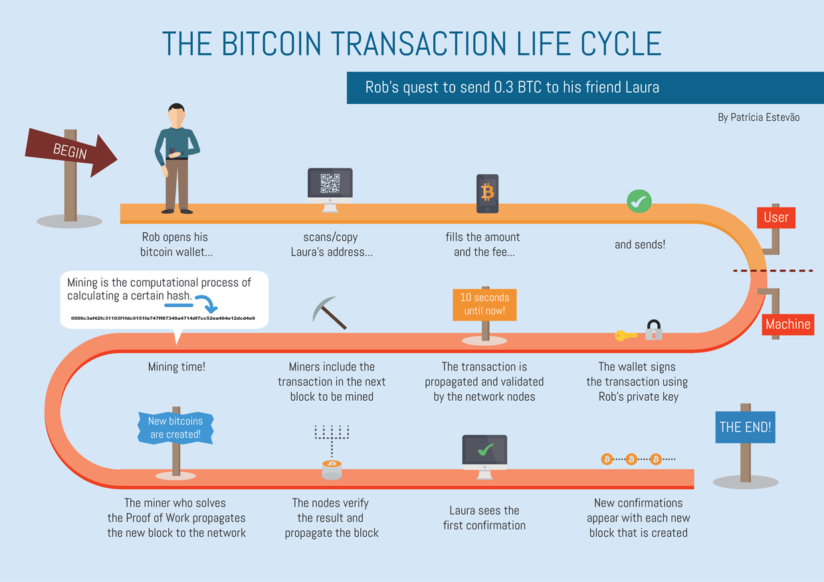
https://livebitnews.com/wp-content/uploads/2017/09/bitcoin-transaction-life-cycle-high-resolution-1.png
Wallet
Address
Fee
Transaction
Signing
Network nodes
Block
Mining
Proof of Work
Verification
Block reward
Tx confirmation
And many more…

Slide 9
Main design goals of the Bitcoin
Decentralization
  No central authority or intermediary (=> no single point of failure), possibility of self-custody
  No limitation on network participants (no permission to join is required)
  Applies to executing a transaction, but also development, infrastructure, mining…
Transparency
  All transactions recorded on public ledger; validity of every “bitcoin” easy to verify
  Total number of bitcoins in circulation easy to assess (monetary policy, fixed supply)
Security based on cryptography (mainly signature, hash functions)
  Ownership of bitcoins proved only cryptographically (no “chargeback” based on human decision)
  Protection of bitcoins reduced to protection of private key(s)
Pseudonymity of participants
  bitcoins connected to public keys, not usernames (does not automatically mean anonymity!)

Slide 10
Problems to tackle
How to prevent double spending?
How to allow for permissionless participation?
Who will store authoritative copy of public ledger?
How to prevent modification of ledger history?
Who will include next block in blockchain?
How to maintain decentralization in distant future?
…

Slide 11
Double-spending problem and Bitcoin’s solution
Digital data are inherently easy to copy perfectly
  If used as monetary coins, how to prevent double/triple… spending the same coin?
  Previous proposals (eCash, B-money, Bit Gold..) required central party for prevention
Digital coin X is “spent” by a transaction between users A and B
  Double spend is another transaction from A to C using same coin X
If all transactions are ordered strictly in time, double spend is not possible
  Later transaction with same coin X is invalid
  Decentralized ordering is costly as all participants need to agree on global state
If ordered after every transaction => costly and slow
Bitcoin orders in batches of transaction every 10 minutes on average
  User needs to wait one (or more blocks) for ordering (longer => higher certainty)

Slide 12
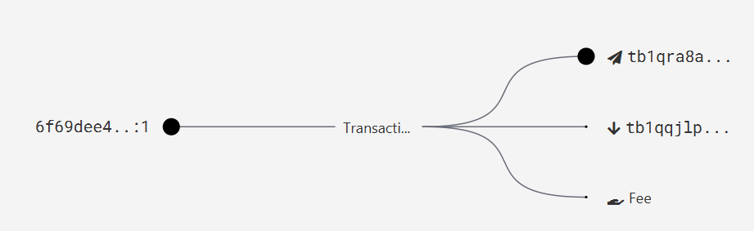
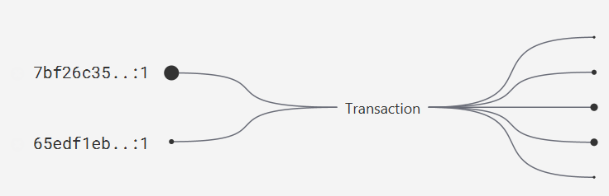
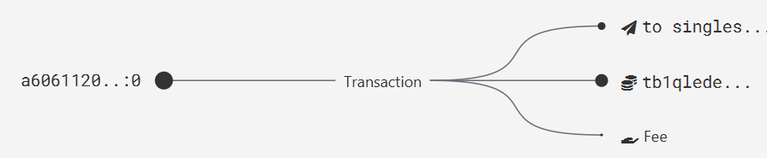
Where are my bitcoins?
Public ledger of all transactions (blockchain)
  Replicated between all Bitcoin fullnodes (P2P network)
“Bitcoin holdings” - sum of values of not-yet-spent transactions control
  Unspent Transaction Output (UTXO)
“Bitcoin receive” operation – generate variable part of lockscript (public) and share with sender + monitor blockchain for my transaction
“Bitcoin send” operation – take “your” UTXO and use it as input to new one
  Specify recipient by script specifying what must be done int future send (lockscript)
  Typical lockscript is “prove that you can sign with private key corresponding to THIS public key”
Protection and handling of private keys is paramount
  “Not your keys, not your bitcoin!“

Slide 13
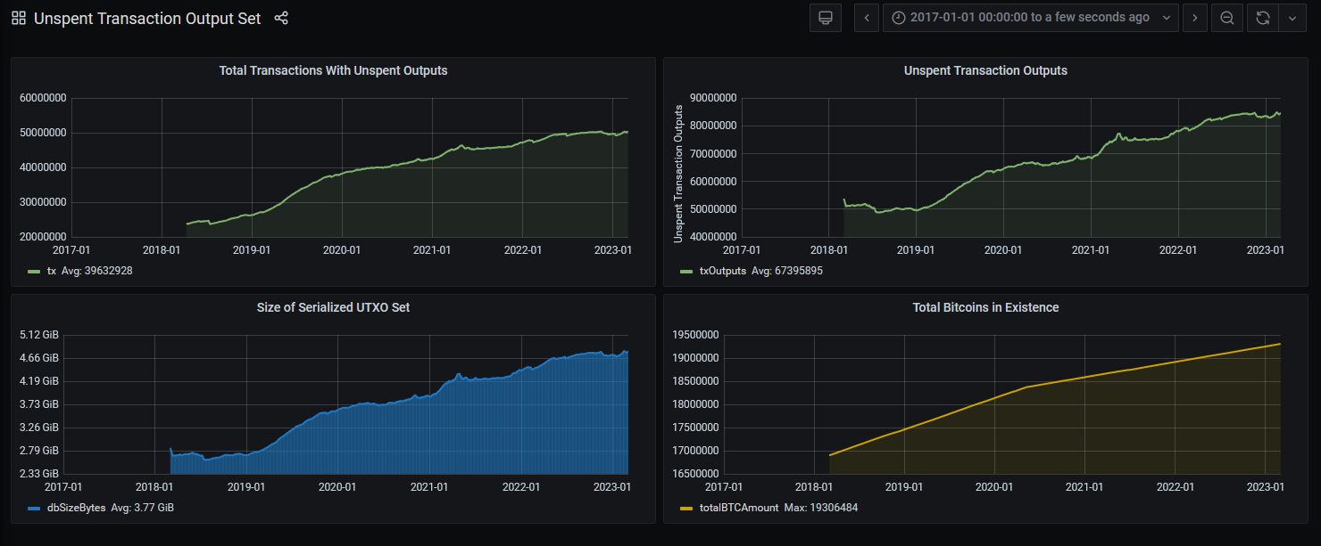
UTXO set = all currently valid “bitcoins”
https://statoshi.info/d/000000009/unspent-transaction-output-set?orgId=1&refresh=10m&from=1483225200000&to=now

Slide 14
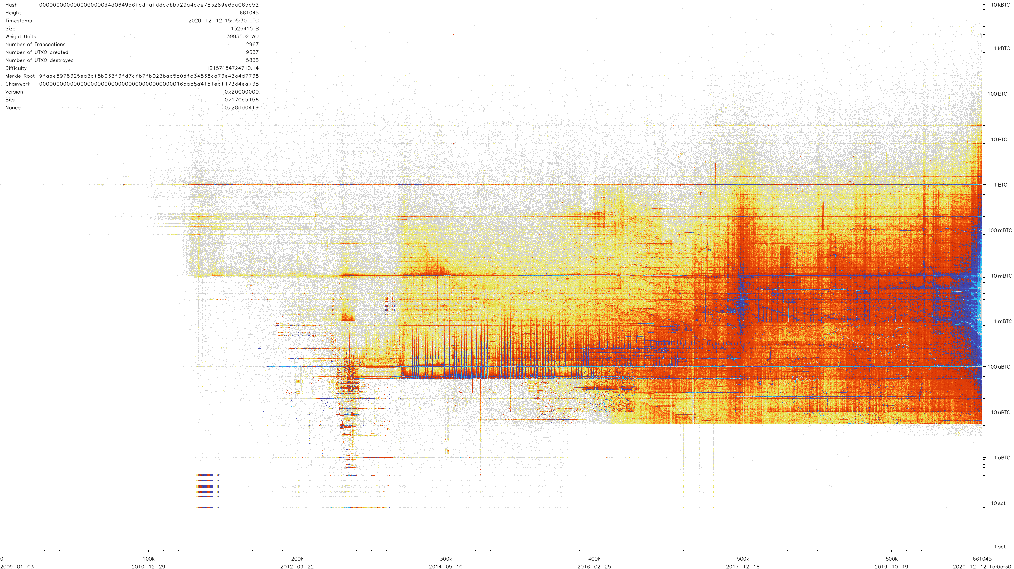
Heatmap distribution of UTXOs in time and value
https://utxo.live/
https://github.com/martinus/BitcoinUtxoVisualizer

Slide 15
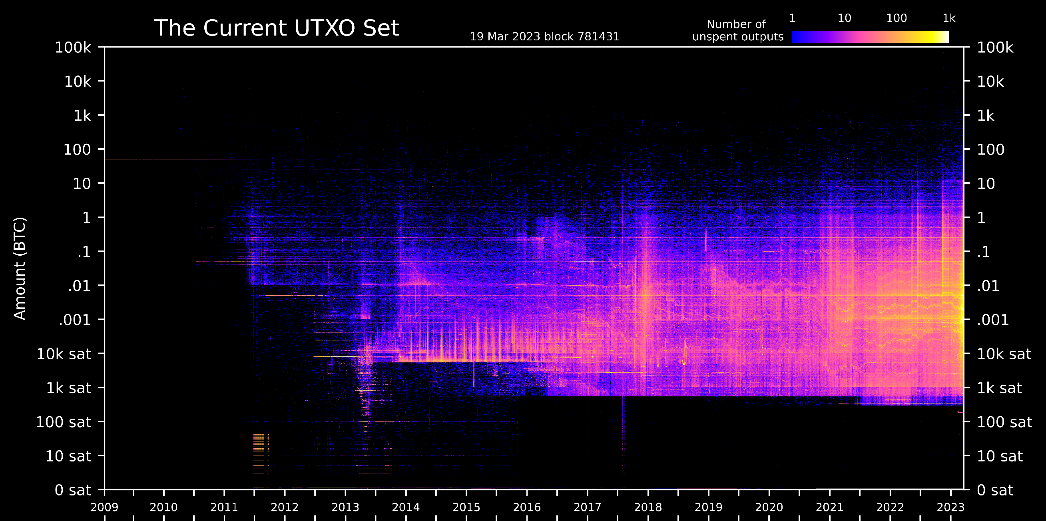
Heatmap distribution of UTXOs in time and value
https://utxo.live/
https://github.com/martinus/BitcoinUtxoVisualizer

Slide 16
Bitcoin network
Problem: How to allow for permissionless participation?

Slide 17
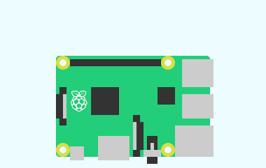
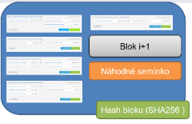
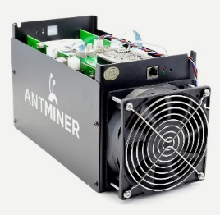

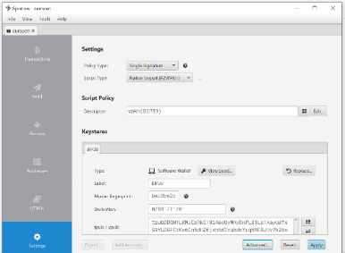

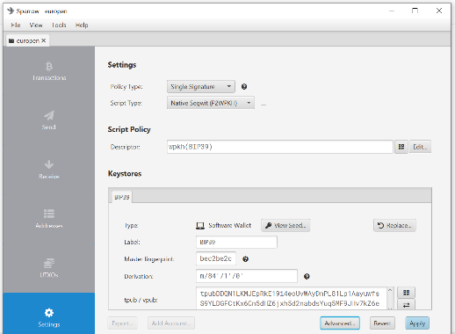

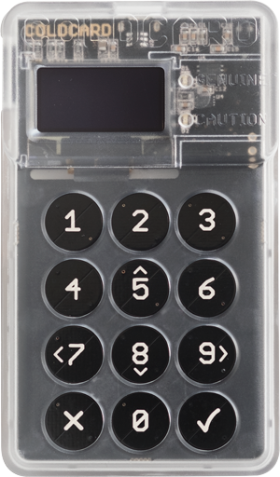
Bitcoin
P2P network
fullnode
Blockchain
fullnode
SW-only wallet
With hardware wallet

Slide 18
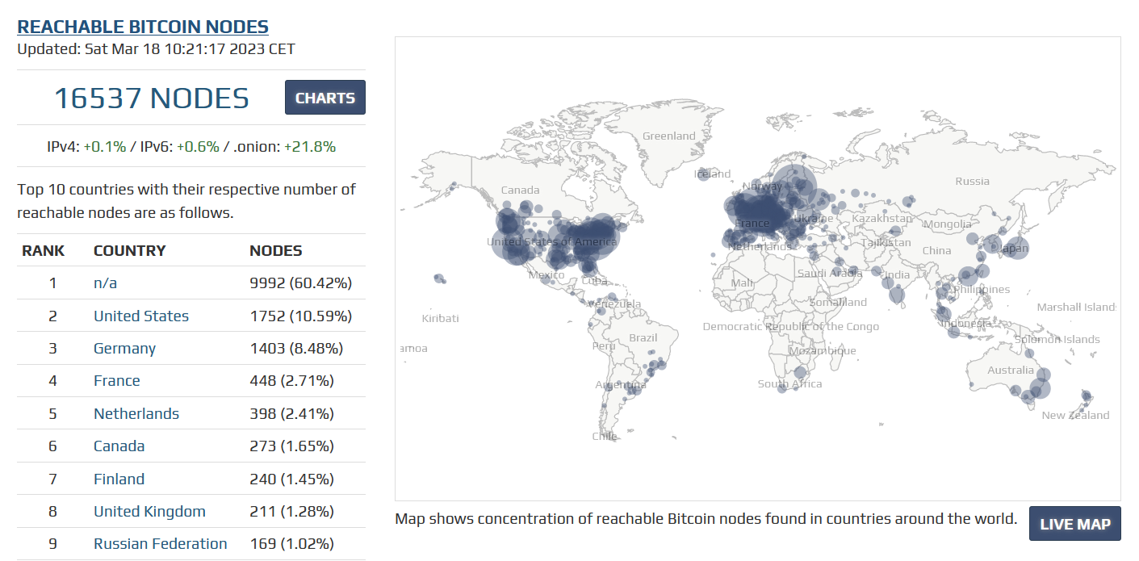
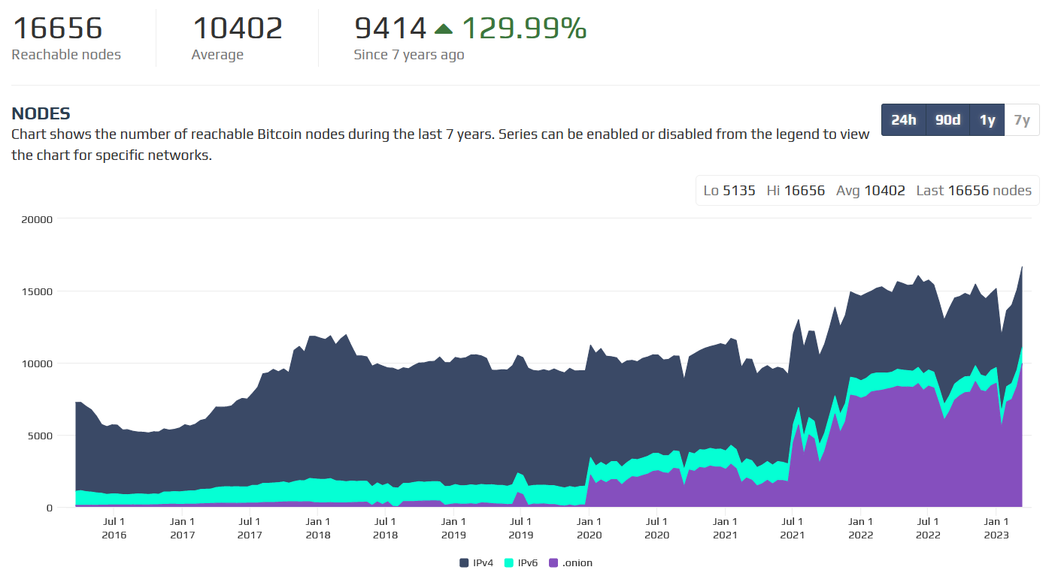
P2P Bitcoin network map https://bitnodes.io/

Slide 19
What is Bitcoin “fullnode”
Software capable to connect and interact with P2P network
Downloads whole blockchain, fully verifies all blocks (PoW) and transactions starting from the Genesis block (or trusted checkpoint)
  Dynamically builds own UTXO set (unspent txs) and Mempool (unconfirmed txs)
Propagates new incoming blocks and transactions
No formal specification of Bitcoin consensus exists
  Bitcoin Core software is defacto specification (https://github.com/bitcoin/bitcoin)
  Other implementations also exists (but large majority of nodes are Bitcoin Core)
Currently several days to fully synchronize (CPU/bandwith), ~465GB
Can be run over Tor to protect user privacy
Bitcoin wallet needs to connect to some fullnode (your = better privacy)

Slide 20
Networks in Bitcoin (Mainnet, Testnet, Regtest, Signet)
Mainnet – main, global production network (“real” bitcoins)
Testnet – testing network (global, some mining happens…)
  Restarted from time to time, contains many different types and versions of TXs
Regtest – local instance of Bitcoin network
  Used for local testing (integration, regression,debugging)
  Blockchain started from block 0, you are the only miner
  (mined bitcoins unusable on Mainnet)
  You can insert own transactions, decide on mining new blocks, debug…
Signet – testing network like Testnet, but with features not yet active on Mainnet
  Initially for testing Taproot, now for future possible softforks
(Lighting – second layer network of payment channels atop of mainnet)
  Practically instant and very low fees independently from mainnet

Slide 21
Mempool – unconfirmed transactions
Every fullnode maintains own list of unconfirmed transactions (mempool)
  No single global mempool! But local mempools tend to synchronize quickly
Miners construct next block from transactions maximizing profit (mostly)
What if tx is in a mempool, but with too low fee (not getting confirmed)?
  Child pays for parent –additional transaction spending output of previous (high fee)
  Replace By Fee (RBF) flag – new tx, but with higher fee, replaced by nodes
  (Wait for purge, pay miner out of band…)
If too many unconfirmed txs present, some existing are purged (removed)
  Default size of mempool (for Bitcoin Core) is ~300MB
  Selection depends on configuration (low-fee tx, large tx, old tx)
  If discarded, it can be re-inserted later from other nodes or resubmitted (by owner)

Slide 22
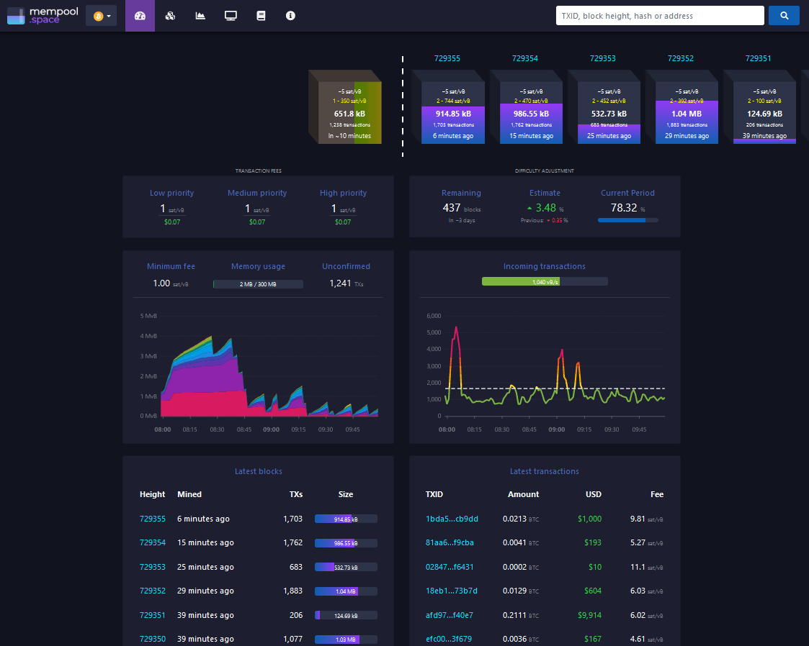
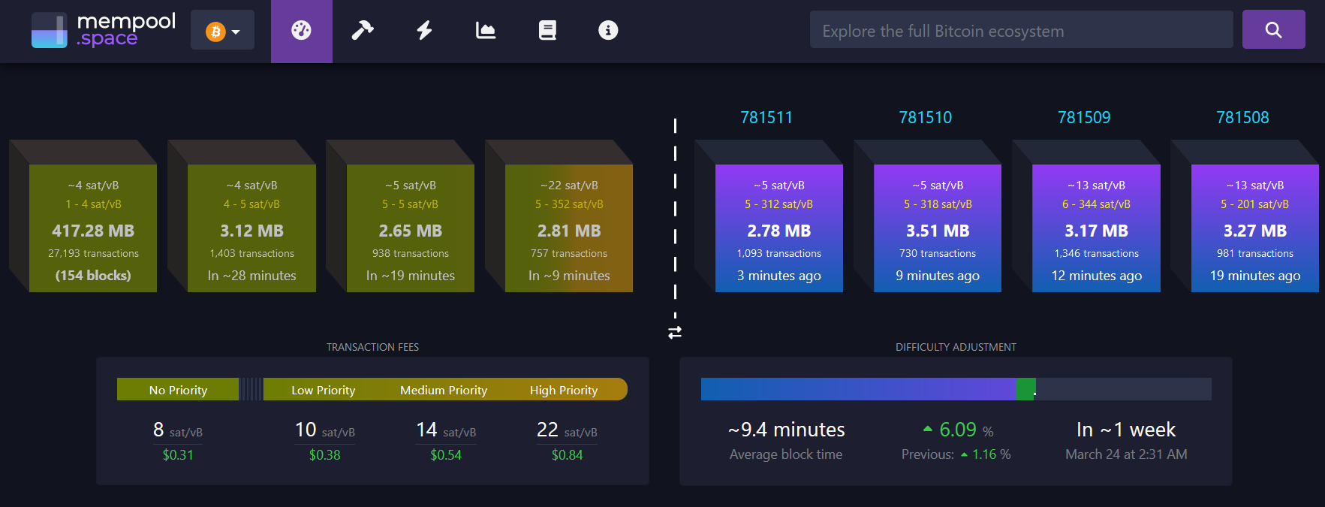
Popular mempool explorer – https://mempool.space
Can be run on your own fullnode (privacy improvement)
Testnet version https://mempool.space/testnet

Slide 23
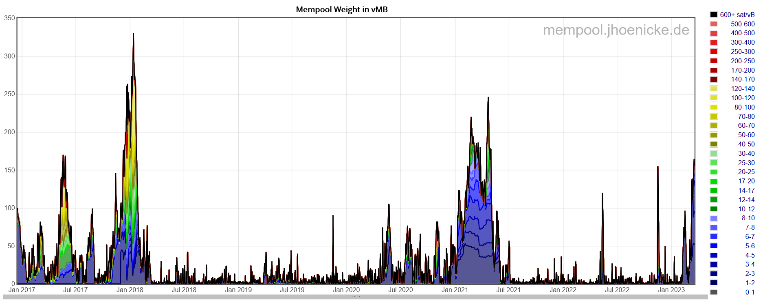
Mempool size in time
Blocksize wars in 2017, blockchain “spamming”, bullrun Dec 2017 (~$20k)
Bullrun towards May 2021 (~$69k)
Ordinals/Inscription Feb 2023

Slide 24
Demo: look and comment the current mempool state

Slide 25
Transaction

Slide 26
Transaction components
Binary structure optimized for small size (further decreased over time)
  Version
  Inputs (bitcoins spent, points to some previous tx outpt + unlock script)
  Outputs (bitcoins received, description of lock script)
  Locktime (when starts to be valid, absolute or relative, time or block height)
Can be created offline, broadcasted immediately or later (Lighting)
Version, Locktime
Inputs
Outputs

Slide 27
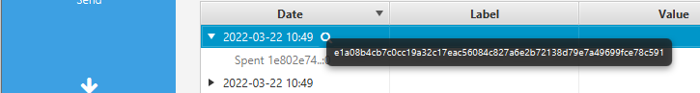
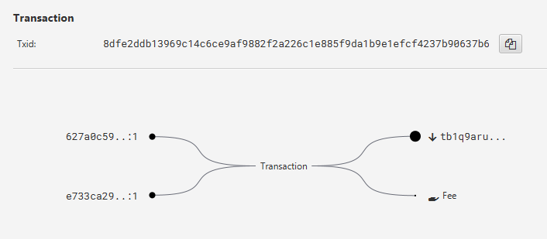
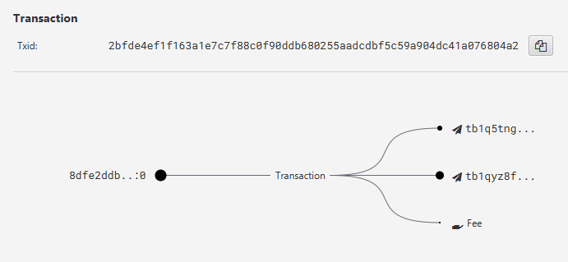
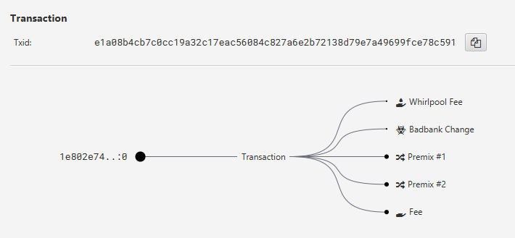
Various transactions can be created
Two inputs, one output + fee (possibly consolidation)
One input, two outputs + fee (possibly classic pay)
One input, many outputs, fee (CoinJoin premixing)
Many inputs, many outputs, fee…

Slide 28
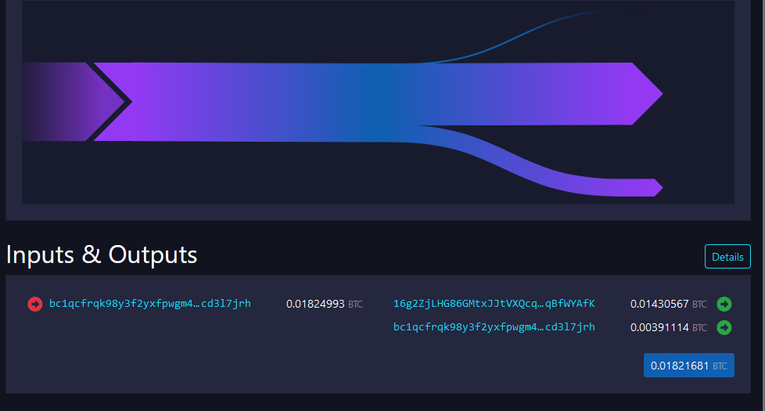
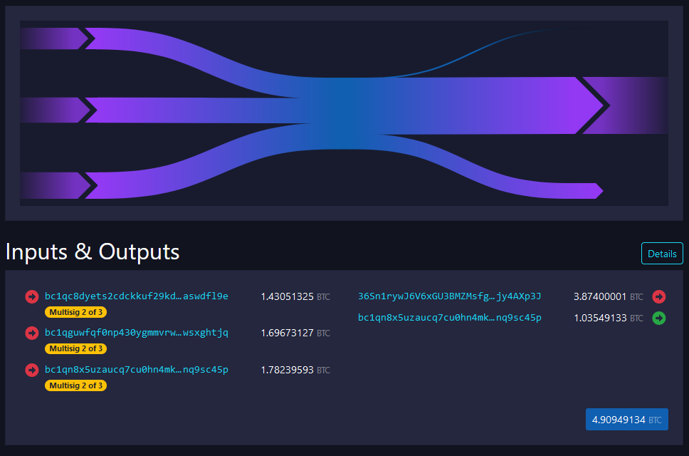
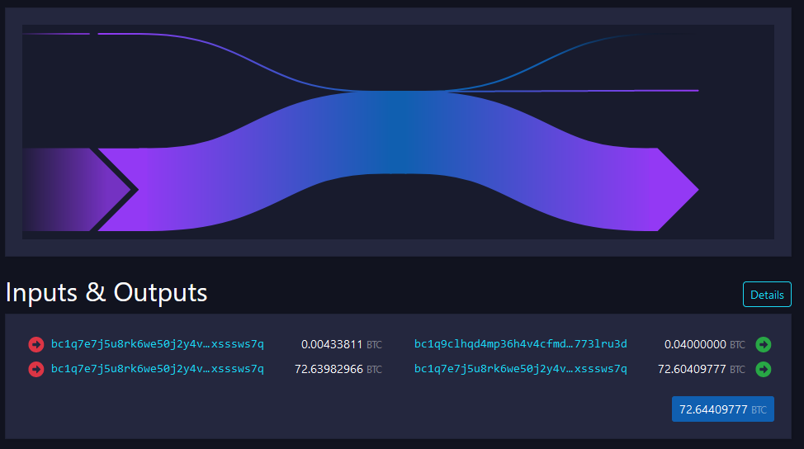
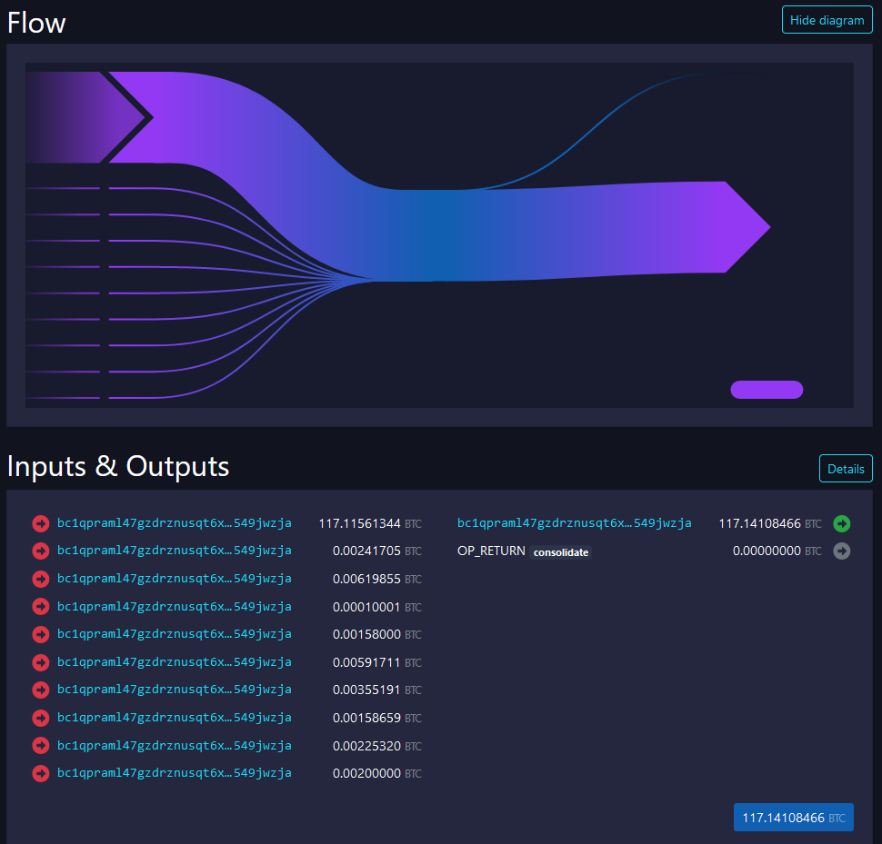
Standard pay (change likely bc1)
Multisig pay (3.87) from multiple inputs
Standard pay (0.04) with consolidation
Consolidation (even annotated OP_RETURN)

Slide 29
Demo: look AT current mempool transactions (confirmed, uncorfirmed)

Slide 30
Lock and unlock scripts
Version, Locktime
Inputs
Outputs

Slide 31
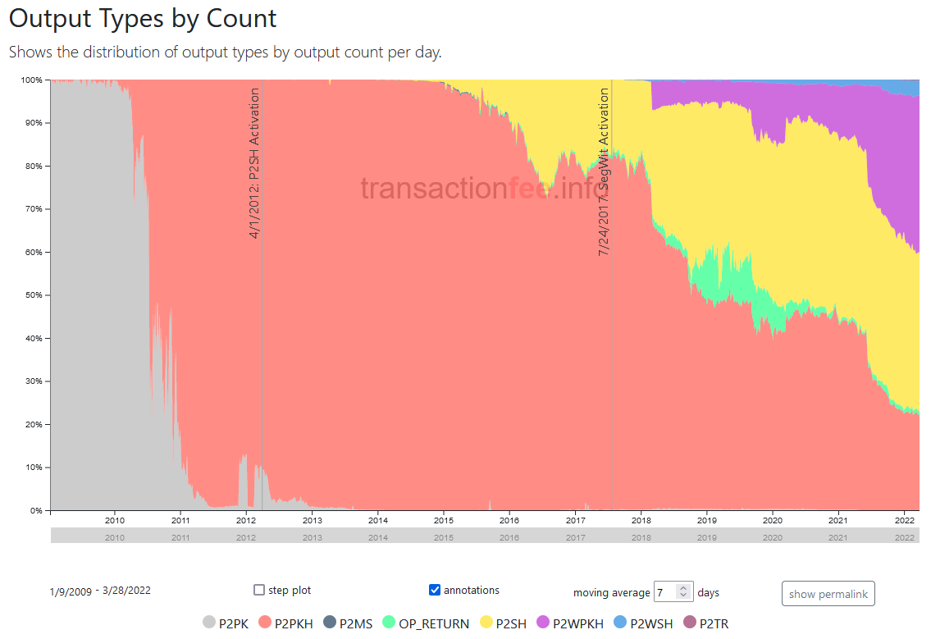
Types of receiving “addresses”
https://transactionfee.info/charts/output-type-distribution-count/
Inputs
Outputs
There is no ”address” defined in Bitcoin network
Standard patterns how to construct lock script emerged over the time
  e.g., unlock if signature is verifiable with the public key stored in lock script (P2PK)
  “Address” is the variable part of the lock script differing between (different receivers / transactions)
Notation warning: scriptSig (script + signature), scriptPubKey (initial meaning script + public key == P2PK)
Well-known standard types of lock scripts
  Pay-to-public-key (P2PK)
  Pay-to-public-key-hash (P2PKH, starts with 1)
  Pay-to-script-hash (P2SH, BIP16)
  OP_RETURN (any data 40B)
  Native Pay-to-witness-script-hash (P2WSH, starts with 3)
  P2WSH-nested-in-P2SH
  P2SH-P2WPKH, P2SH-P2WSH
  Native P2WPK, P2WSH (Bech32, starts with bc1)
  Pay-to-Taproot (P2TR, Schnorr signature, starts bc1p)

Slide 32
Pay-to-public-key (P2PK), Pay-to-public-key-hash (P2PKH)
Pay-to-public-key (P2PK)
  Lock script contains direct value of public key and instructions to push signature and verify with the public key
  Used initially by Satoshi and others, now infrequent
  Disadvantage: if practical dlog attack against secp256k1 is found, private key can be computed
Pay-to-public-key-hash (P2PKH), starts with ‘1’
  Lock script contains hash of public key later used for signature verification
  Advantage: smaller lockscript, attacker does not know public key until spent

Slide 33
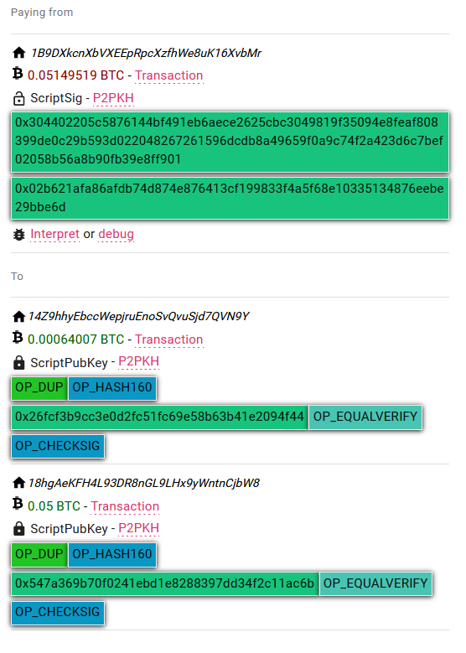
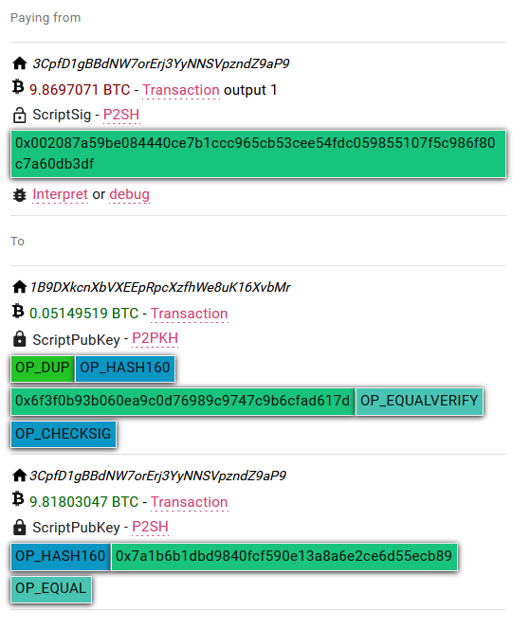
P2PKH - script execution (https://nioctib.tech/)
  https://nioctib.tech/#/transaction/f2f398dace996dab12e0cfb02fb0b59de0ef0398be393d90ebc8ab397550370b
  https://nioctib.tech/#/transaction/feff813f13340060f641c11ab1307bb1b8cabcdcc3af1aed8a089e38c8407aef

Slide 34
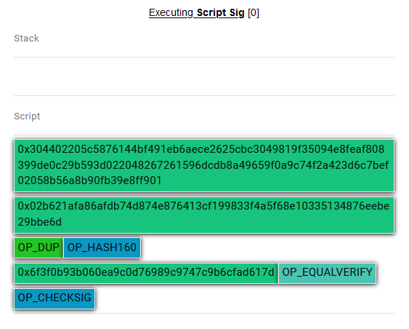
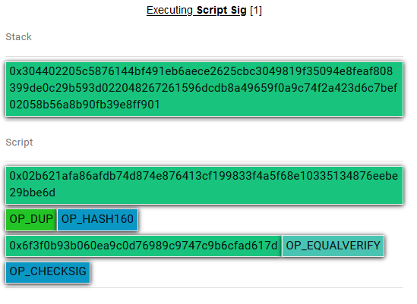
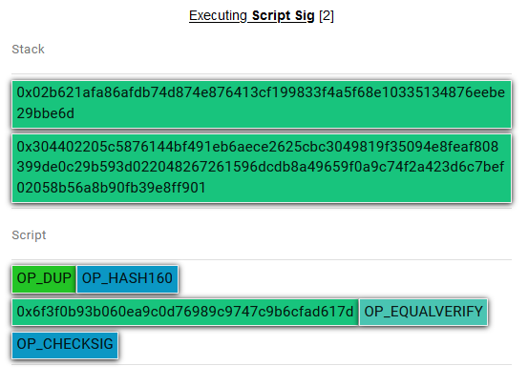
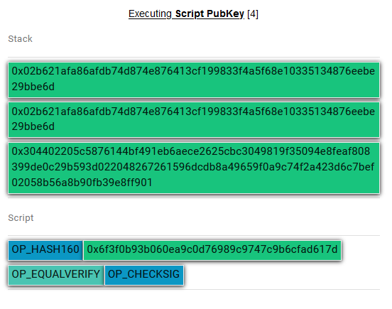
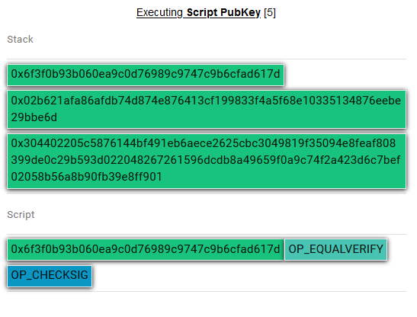
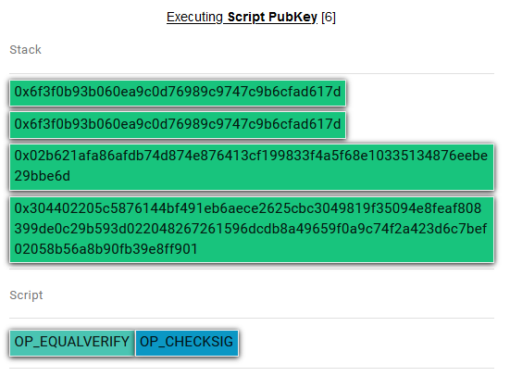
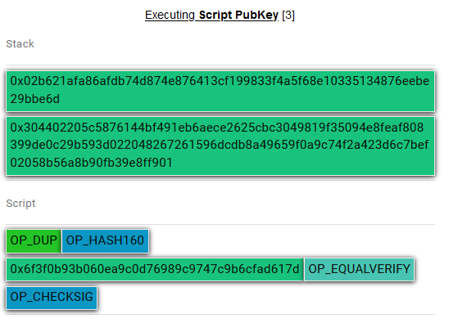
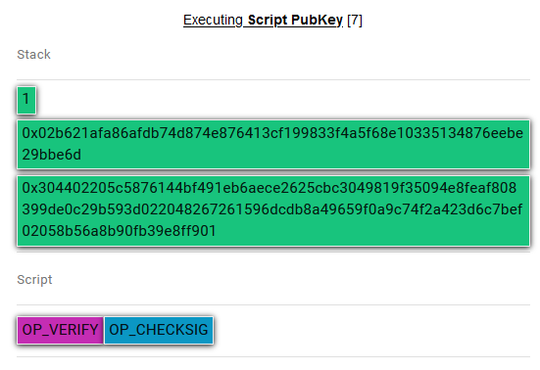
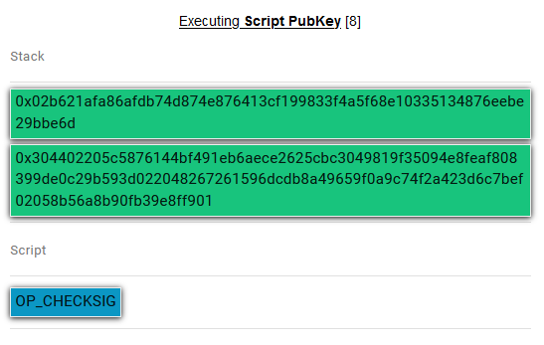
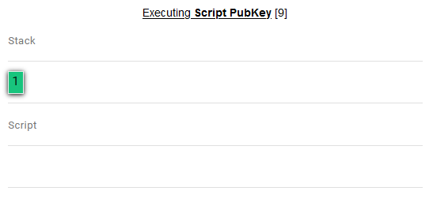
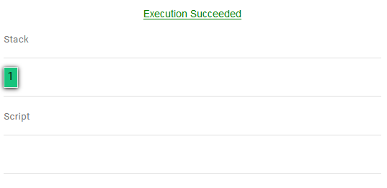

Slide 35
Pay to script hash (P2SH), BIP16, starts with ‘3’
Lock script separated into two parts
  1) commitment to the script (hash value, checked later)
  2) actual lock script (hash value must match the commitment)
Sending tx sets output’s ScriptPub to the commitment
  Shorter as only hash is posted, not whole lock script
  Lock script is provided only later when spending (privacy, fee to be paid)
  Lock script can have multiple spending paths (Merkle tree) and only the one used is posted (better for privacy)
Redeeming tx provides actual lock script + unlock script

Slide 36
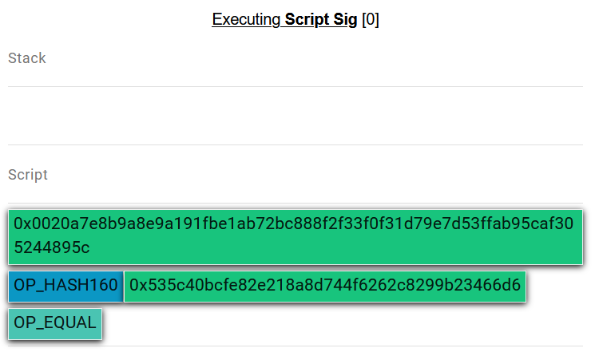
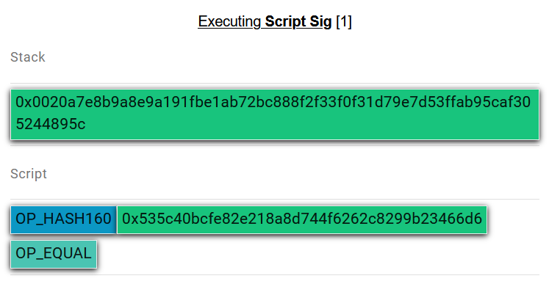
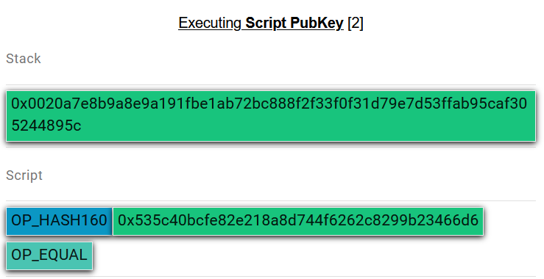
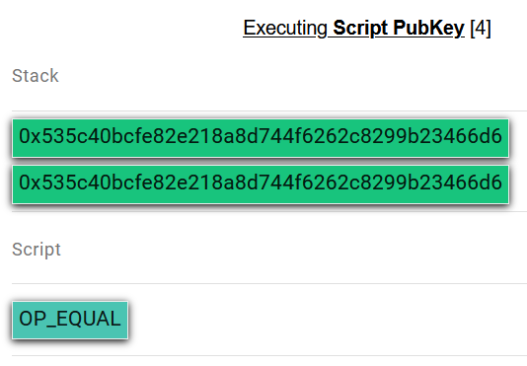
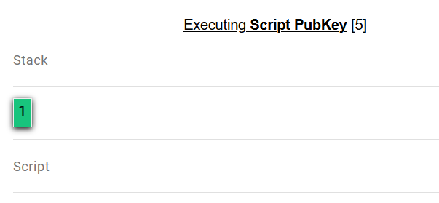
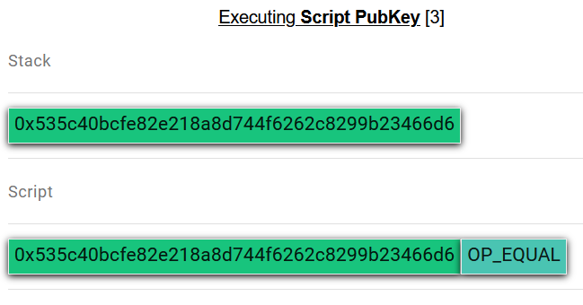
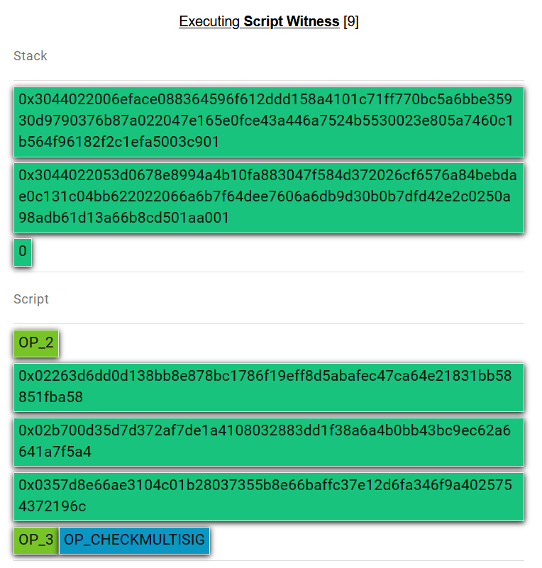
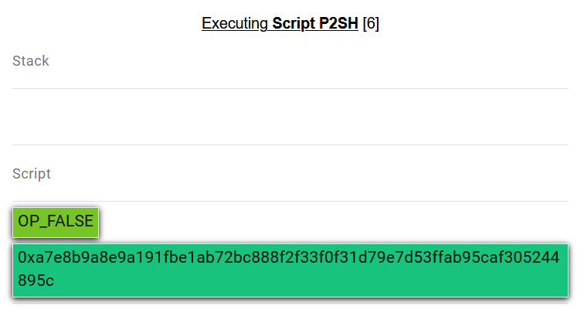
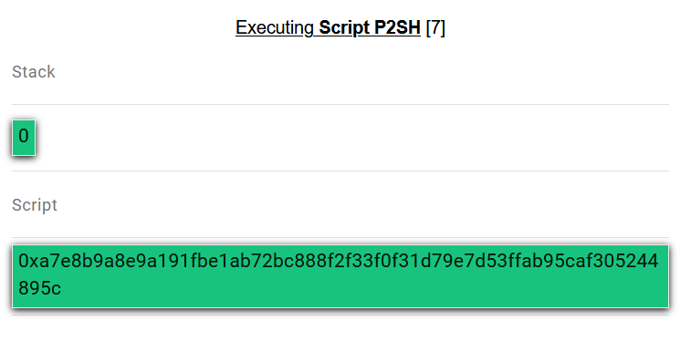

Commitment to script
Script
If initial script structure was commitment and value on stack is true, special code branch of code is executed, using original witness script
Check script hash
Witness script is executed (here 2-of-3 multisig)
OP_FALSE is used to push 0 on stack (multisig bug)
…

Slide 37
Interesting, non-standard scripts
SHA1 collision bounty
  Bitcoins locked to script requiring two different inputs hashed to same SHA1 hash
  Redeemed shortly after Google published SHA1 collision blocks
    https://blockstream.info/tx/8d31992805518fd62daa3bdd2a5c4fd2cd3054c9b3dca1d78055e9528cff6adc
    https://nioctib.tech/#/transaction/f2f398dace996dab12e0cfb02fb0b59de0ef0398be393d90ebc8ab397550370b
  More details: https://bitcoinjs-guide.bitcoin-studio.com/bitcoinjs-guide/v5/part-three-pay-to-script-hash/puzzles/computational_puzzle_sha1_collision_p2sh.html
  Similar bounties for

Slide 38


OP_RETURN
If OP_RETURN is encountered during execution of unlock+lock script, it is FALSE
  Such output is provably unspendable
Somewhat controversial instruction
  Some feels, that blockchain shall not be used for non-financial data (USDT was initially on Bitcoin via OP_RETURN)
  But there were already ways how to store arbitrary data into blockchain anyway (e.g., bytes of value, invalid address)
Analysis of OP_RETURN data
  https://www.blockchainresearchlab.org/2020/03/13/how-do-op-return-transactions-impact-bitcoin/
  https://opreturn.org/
charley loves heidi
https://nioctib.tech/#/transaction/f2f398dace996dab12e0cfb02fb0b59de0ef0398be393d90ebc8ab397550370b

Slide 39

Miniscript (A. Poelstra, P. Wuille, S. Kanjalkar, 2019)
Language for easier and error-prone creation of Bitcoin scripts
  Subset of Bitcoin script language
  Human-readable, easy to express complex locking conditions
  https://bitcoin.sipa.be/miniscript/
Simple building blocks (policies)
  Single-key, Multi-key,
  Time-locks, Check-sequence,
  Hash-lock…
Compiler creates optimal script
  And cost analysis

Slide 40




Miniscript examples
A 3-of-3 that turns into a 2-of-3 after 90 days
A single key

Slide 41
Interesting stats about mined transactions
https://forkmonitor.info/nodes/btc
https://transactionfee.info/
https://cryptobriefing.com/unpacking-bitcoins-recent-double-spend-event

Slide 42

Warning: Why not put “blockchain” everywhere?
“Blockchain not Bitcoin”, “Blockchainize everything”… claims
Permissionless distributed consensus on global state is very expensive
  Confirmation time, storage space, energy expenditure (PoW)…
  Most applications does not need it!
  Especially when other components of application are centralized (development, governance decisions, data storage…)

Slide 43
Study materials
Mandatory reading
  Bitcoin's academic pedigree (Arvind Narayanan, Jeremy Clark)
    https://dl.acm.org/doi/10.1145/3132259 (copy in IS)
    Explanation of roots of Bitcoin key components
If you were not familiar with basics of Bitcoin before
  Watch ‘But how does bitcoin actually work?’ by 3Blue1Brown (26min)
    https://www.youtube.com/watch?v=bBC-nXj3Ng4
  Read slides Hello Bitcoin (including notes under every slide)
    From https://www.hellobitco.in/, copy of slides in IS

Slide 44


Further reading
Mastering Bitcoin (Andreas M. Antonopoulos and others)
  https://github.com/bitcoinbook/bitcoinbook
Programming Bitcoin (Jimmy Song)
  https://github.com/jimmysong/programmingbitcoin
List of interesting resources
  https://blockonomi.com/bitcoin-educational-resources/
  https://learnmeabitcoin.com/, https://learnmeabitcoin.com/technical/

Slide 45
Thank you for coming, see you next Week

