Slide 1

Neural Document Retrieval
Martin Fajčík
MUNI PV211 2024
Last edited: 15.04.2024

Slide 2
Outline
Dense retrieval vs Sparse retrieval
Dense Retrieval – Dense Passage Encoder
Dense Retrieval – Contriever
Sparse Retrieval – SPLADE
Dense Retrieval – ColBERT
Neural Reranking – Cross-Encoder

Slide 3
Dense Retrieval vs Sparse Retrieval
|1.1|16.3|7.8|-14.1|1.1|-4.3|-0.4|9.2|
Model
PV211 final term
may ask about this
or
|0|0|0|0|-3.1|0|0|2.8|-4.1|0|-4.3|0|14.1|1.2|0|0|0|0|0

Slide 4
Dense Retrieval vs Sparse Retrieval
Dense Vector
|1.1|16.3|7.8|-14.1|1.1|-4.3|-0.4|9.2|
Model
PV211 final term
may ask about this
or
Sparse Vector (majority elements has the same value)
|0|0|0|0|-3.1|0|0|2.8|-4.1|0|-4.3|0|14.1|1.2|0|0|0|0|0

Slide 5
Dense Passage Retrieval
Question Encoder
Passage Encoder
What will the PV211 ask about?
The 2022 test contained skip-lists, explanation of
posting lists, and BM25
Karpukhin, Vladimir, et al. "Dense Passage Retrieval for Open-Domain Question Answering." Proceedings of the 2020 Conference on Empirical Methods in Natural Language Processing (EMNLP). 2020.

Slide 6
Dense Passage Retrieval
The similarity function between two representations
Assume dataset with m training instances
Each instance contains one question and one relevant (positive) passage
along with n irrelevant (negative) passages
Karpukhin, Vladimir, et al. "Dense Passage Retrieval for Open-Domain Question Answering." Proceedings of the 2020 Conference on Empirical Methods in Natural Language Processing (EMNLP). 2020.

Slide 7
Dense Passage Retrieval Training
Cross-Entropy Contrastive Loss
Hyperparameters and Model choices
  Encoder and Decoder are both based on BERT pre-trained models
  21M of 100 words passages of Wikipedia were indexed
  Each passage is also prepended with the title of the Wikipedia article where the passage is from, separated with a [SEP] token
  batch size 128
  Learning rate 1e-5, using Adam optimizer, linear scheduling with warmup rate 0.1, and dropout 0.1
  Training sets of each dataset had around ~60k samples
Karpukhin, Vladimir, et al. "Dense Passage Retrieval for Open-Domain Question Answering." Proceedings of the 2020 Conference on Empirical Methods in Natural Language Processing (EMNLP). 2020.

Slide 8
Dense Passage Retrieval Inference
Index Construction
  Create embeddings for all (21M) passages, using passage encoder.
  This takes a lot of memory (fp16 of 21M 768 dimensional embeddings ~ 32 GB)
Query Time
  Use query encoder to encode question.
  Find nearest neighbor doing full dot-product (O(n)) with 21M embeddings.
  Then compute arg top-K, to find K nearest values.
  (Optional) use approximate nearest neighbor methods, with logarithmic expected computational complexity, such as HNSW.
Karpukhin, Vladimir, et al. "Dense Passage Retrieval for Open-Domain Question Answering." Proceedings of the 2020 Conference on Empirical Methods in Natural Language Processing (EMNLP). 2020.

Slide 9

Dense Passage Retrieval Negative Sample Mining
Top BM25 passage that does not contain answer string (original DPR was made on open-domain QA)
In-batch negatives
Pros and Cons of both? (discussion)
This Photo by Unknown Author is licensed under CC BY
Karpukhin, Vladimir, et al. "Dense Passage Retrieval for Open-Domain Question Answering." Proceedings of the 2020 Conference on Empirical Methods in Natural Language Processing (EMNLP). 2020.

Slide 10
Dense Passage Retrieval Negative Sample Mining
Top BM25 passage that does not contain answer string (original DPR was made on open-domain QA)
  C: Answer list is non-exhaustive, possibility of False negatives
  C: Unclear how to mine for non-QA applications
  P: BM25 is unsupervised
  P: BM25 provides near-to-relevant negatives
In-batch negatives
  P: Cheaply obtained, no need for extra encoding
  C: Requires large batch size
This Photo by Unknown Author is licensed under CC BY
Karpukhin, Vladimir, et al. "Dense Passage Retrieval for Open-Domain Question Answering." Proceedings of the 2020 Conference on Empirical Methods in Natural Language Processing (EMNLP). 2020.

Slide 11
Cross-Encoder
Reranking
Cross-Encoder tends to work better then Bi-Encoder
Cross-Encoder can’t be used for (First stage) Retrieval
Question
Candidate Passage
How much plastic Coca-cola produces globally?
…3.43 million metric tons in 2022.
BERT
Binary Cross-Entropy
How much plastic Coca-cola produces globally?
…admits it produces 3m tonnes of plastic packaging a year.
How much plastic Coca-cola produces globally?
Coca Cola and PepsiCo responsible for 25% of packaging pollution found on UK beaches.
How much plastic Coca-cola produces globally?
…25 per cent of its packaging globally to be reusable by 2030
Each Passage Classified Independently
Concatenate
Nogueira, Rodrigo, and Kyunghyun Cho. "Passage Re-ranking with BERT." arXiv preprint arXiv:1901.04085 (2019).

Slide 12
Cross-Encoder
Reranking
Question
Candidate Passage
How much plastic Coca-cola produces globally?
…3.43 million metric tons in 2022.
BERT
Binary Cross-Entropy
How much plastic Coca-cola produces globally?
…admits it produces 3m tonnes of plastic packaging a year.
How much plastic Coca-cola produces globally?
Coca Cola and PepsiCo responsible for 25% of packaging pollution found on UK beaches.
How much plastic Coca-cola produces globally?
…25 per cent of its packaging globally to be reusable by 2030
Each Passage Classified Independently
Concatenate
Reranking dataset (from the original paper)
  Positives: relevant passage from dataset.
  Negatives: top-1000 non-relevant passages.
Nogueira, Rodrigo, and Kyunghyun Cho. "Passage Re-ranking with BERT." arXiv preprint arXiv:1901.04085 (2019).

Slide 13
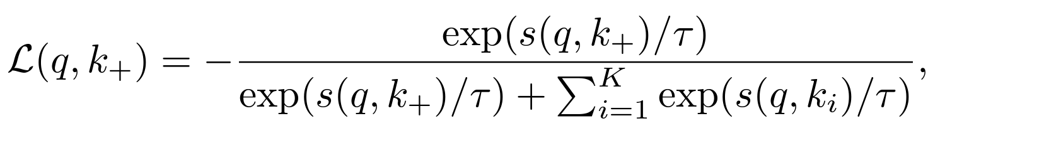
Contriever Parallels with DPR
Cross-Entropy Loss similar to DPR
  is a temperature hyperparameter (0.05, in pretraining and finetuning)
Based on bi-encoder BERT architecture (same as DPR), but encoder is shared
Inference is the same as with DPR
Gautier Izacard, Mathilde Caron, Lucas Hosseini, Sebastian Riedel, Piotr Bojanowski, Armand Joulin, and Edouard Grave. 2022. Unsupervised dense information retrieval with contrastive learning. TMLR.

Slide 14
Contriever Unsupervised Pretraining
Pretraining with Independent cropping
  Positive samples are random subsequences of the same document in pre-training corpus.
  “We use the random cropping data augmentation, with documents of 256 tokens and span sizes sampled between 5% and 50% of the document length. Documents are simply random piece of text sampled from a mix between Wikipedia and CCNet data, where half the batches are sampled from each source. We also apply token deletion with a probability of 10%.”
Gautier Izacard, Mathilde Caron, Lucas Hosseini, Sebastian Riedel, Piotr Bojanowski, Armand Joulin, and Edouard Grave. 2022. Unsupervised dense information retrieval with contrastive learning. TMLR.

Slide 15
Contriever Unsupervised Pretraining
Pretraining with Independent cropping
  Negative samples come from
    In-batch negatives (with very large batch 2048)
    MoCo algorithm (He et al., 2020)
Gautier Izacard, Mathilde Caron, Lucas Hosseini, Sebastian Riedel, Piotr Bojanowski, Armand Joulin, and Edouard Grave. 2022. Unsupervised dense information retrieval with contrastive learning. TMLR.
Kaiming He, Haoqi Fan, Yuxin Wu, Saining Xie, and Ross Girshick. Momentum contrast for unsupervised visual representation learning. In Proceedings of the IEEE/CVF Conference on Computer Vision and Pattern Recognition, pp. 9729–9738, 2020

Slide 16
Contriever Unsupervised Pretraining
MoCo algorithm
  Store representations from last N previous batches in a queue and
  use them as (cheap) negative examples in the loss.
  The gradients for similarity with these representations is only computed w.r.t. parameters of the “query” encoder.
  As the model might sometimes change rapidly, reusing the old representations might lead to a drop of performance when the network rapidly changes during training.
    Hence authors define document encoder is an exponential average of query encoder.
    At every training update step:
      Query network is updated via gradient computed from SGD-like optimizer.
      Document network is updated from the new parameters of query network .
      Authors use m=0.9995
Gautier Izacard, Mathilde Caron, Lucas Hosseini, Sebastian Riedel, Piotr Bojanowski, Armand Joulin, and Edouard Grave. 2022. Unsupervised dense information retrieval with contrastive learning. TMLR.
Kaiming He, Haoqi Fan, Yuxin Wu, Saining Xie, and Ross Girshick. Momentum contrast for unsupervised visual representation learning. In Proceedings of the IEEE/CVF Conference on Computer Vision and Pattern Recognition, pp. 9729–9738, 2020

Slide 17
Contriever Unsupervised Pretraining Hyperparameters
Optimizer: AdamW
Learning rate: 5e-5
Batch size: 2048
Steps: 500,000
Queue: 131,072 (representations from last 64 batches were considered)
Gautier Izacard, Mathilde Caron, Lucas Hosseini, Sebastian Riedel, Piotr Bojanowski, Armand Joulin, and Edouard Grave. 2022. Unsupervised dense information retrieval with contrastive learning. TMLR.
Kaiming He, Haoqi Fan, Yuxin Wu, Saining Xie, and Ross Girshick. Momentum contrast for unsupervised visual representation learning. In Proceedings of the IEEE/CVF Conference on Computer Vision and Pattern Recognition, pp. 9729–9738, 2020

Slide 18
Contriever Supervised Finetuning
Batch size 1024
Learning rate 1e-5
Negatives:
  First phase: 20k steps only with in-batch negatives
  Second phase: in-batch negatives in 90% of cases, 10% of cases are hard negatives mined from the model trained in phase 1 (how many is not documented)
Gautier Izacard, Mathilde Caron, Lucas Hosseini, Sebastian Riedel, Piotr Bojanowski, Armand Joulin, and Edouard Grave. 2022. Unsupervised dense information retrieval with contrastive learning. TMLR.

Slide 19
SPLADE (V2)
Learning sparse vectors for retrieval using BERT-based model.
Formal, Thibault et al. “SPLADE v2: Sparse Lexical and Expansion Model for Information Retrieval.” ArXiv abs/2109.10086 (2021)

Slide 20
SPLADE (V2)
Learning sparse vectors for retrieval using BERT-based model.
A sequence of tokens from volabulary V set
for question / passage:
A sequence of contextualized representations extracted as
Formal, Thibault et al. “SPLADE v2: Sparse Lexical and Expansion Model for Information Retrieval.” ArXiv abs/2109.10086 (2021)

Slide 21
SPLADE (V2)
A sequence of contextualized representations extracted as
Next, let’s reuse BERT-pretraining “head” to compute importance scores of
  i-th position representation to the
  j-th vocabulary token
Formal, Thibault et al. “SPLADE v2: Sparse Lexical and Expansion Model for Information Retrieval.” ArXiv abs/2109.10086 (2021)

Slide 22
SPLADE (V2)
Next, let’s reuse BERT-pretraining “head” to compute importance scores of
  i-th position representation to the
  j-th vocabulary token
E_{j} is a token-embedding matrix of BERT
b_{j} is a token-embedding bias
transform is a non-linear function
both learned during BERT pretraining
Formal, Thibault et al. “SPLADE v2: Sparse Lexical and Expansion Model for Information Retrieval.” ArXiv abs/2109.10086 (2021)

Slide 23
SPLADE (V2)
E_{j} is a token-embedding matrix of BERT
b_{j} is a token-embedding bias
transform is a non-linear function
both learned during BERT pretraining
w_{ij} are actually pre-softmax scores of i-th representation h_{i} during pretraining
Formal, Thibault et al. “SPLADE v2: Sparse Lexical and Expansion Model for Information Retrieval.” ArXiv abs/2109.10086 (2021)

Slide 24
SPLADE (V2)
Formal, Thibault et al. “SPLADE v2: Sparse Lexical and Expansion Model for Information Retrieval.” ArXiv abs/2109.10086 (2021)

Slide 25
SPLADE (V2)
Sanity check: What is the size of vector w?
Formal, Thibault et al. “SPLADE v2: Sparse Lexical and Expansion Model for Information Retrieval.” ArXiv abs/2109.10086 (2021)

Slide 26
SPLADE (V2)
Sanity check: What is the size of vector w?
|w| = |V| (same as size of vocabulary)
Formal, Thibault et al. “SPLADE v2: Sparse Lexical and Expansion Model for Information Retrieval.” ArXiv abs/2109.10086 (2021)

Slide 27
SPLADE Training
Uses the same style contrastive loss as DPR
Formal, Thibault et al. “SPLADE v2: Sparse Lexical and Expansion Model for Information Retrieval.” ArXiv abs/2109.10086 (2021)

Slide 28
SPLADE Training
Uses the same style contrastive loss as DPR
Combined with sparsity losses for query and passage representations
Formal, Thibault et al. “SPLADE v2: Sparse Lexical and Expansion Model for Information Retrieval.” ArXiv abs/2109.10086 (2021)

Slide 29
SPLADE Training
Uses the same style contrastive loss as DPR
Combined with sparsity losses for query and passage representations
Tuneable hyperparameters that
control sparsity strength
Formal, Thibault et al. “SPLADE v2: Sparse Lexical and Expansion Model for Information Retrieval.” ArXiv abs/2109.10086 (2021)

Slide 30
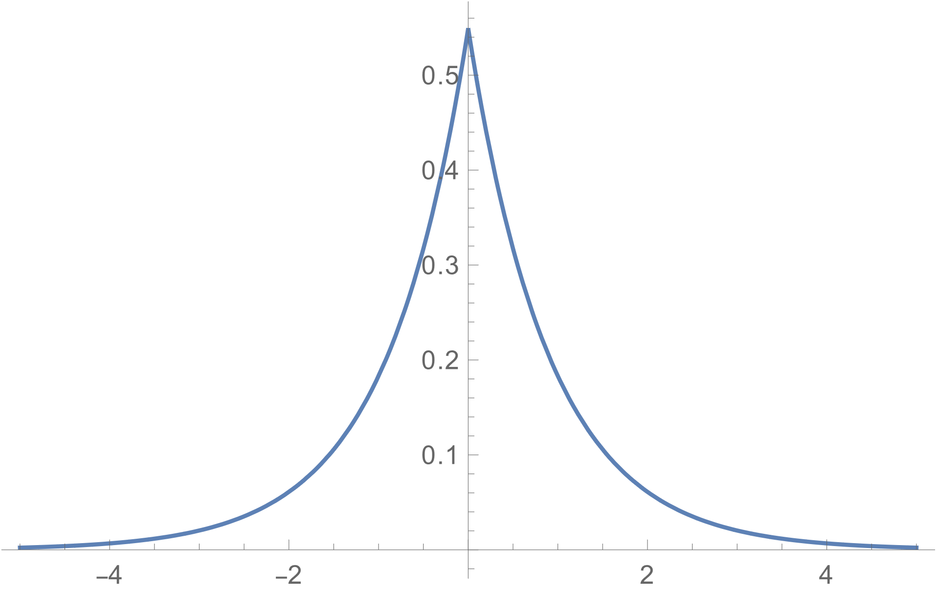
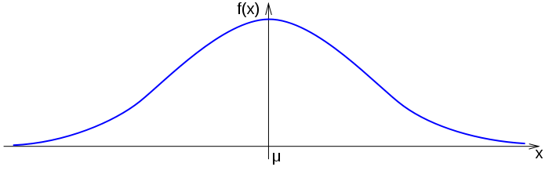
Sparsity Loss (vanilla)
Common sparsity losses are L1/L2 regularization loss

Slide 31
Sparsity Loss (vanilla)
Common sparsity losses are L1/L2 regularization loss

Slide 32
Sparsity Loss (vanilla)
Common sparsity losses are L1/L2 regularization loss
Offsetting loss won’t affect the optimization (argmax [f(x)] = argmax [f(x)+c])

Slide 33
Sparsity Loss (complexity analysis)
However, different representations might have same representations not sparse
  L* losses only care about sparsity across vector dimension
  Expected # of FLOPS for sim(w_{q},w_{p}) is d/p,
  where d is |w| dimensionality (V) and
  1/p is average proportion of non-0 elements in w
p1
0
2
0
0
0
3
p2
0
4
0
0
0
8
p3
0
1
0
0
0
2
Biswajit Paria, Chih-Kuan Yeh, Ian E. H. Yen, Ning Xu, Pradeep Ravikumar, and Barnabás Póczos. 2020. Minimizing FLOPs to Learn Efficient Sparse Representations. arXiv:2004.05665

Slide 34
Sparsity Loss (complexity analysis)
However, different representations might have same representations not sparse
  L* losses only care about sparsity across vector dimension
p1
0
2
0
0
0
3
p2
0
4
0
0
0
8
p3
0
1
0
0
0
2
How to enforce sparsity across vectors?
Biswajit Paria, Chih-Kuan Yeh, Ian E. H. Yen, Ning Xu, Pradeep Ravikumar, and Barnabás Póczos. 2020. Minimizing FLOPs to Learn Efficient Sparse Representations. arXiv:2004.05665

Slide 35
FLOPS Sparsity Loss
Estimate expected w_{j} across minibatch of M elements
(p₁, p₂, …, p_{M})
Enforce sparsity of such estimate
Expected # of FLOPS for sim(w_{q},w_{p}) is d/p^2,
where d is |w| dimensionality (V) and
1/p is average proportion of non-0 elements in w
The probability that n-th element is sparse is the same for all n
Biswajit Paria, Chih-Kuan Yeh, Ian E. H. Yen, Ning Xu, Pradeep Ravikumar, and Barnabás Póczos. 2020. Minimizing FLOPs to Learn Efficient Sparse Representations. arXiv:2004.05665

Slide 36
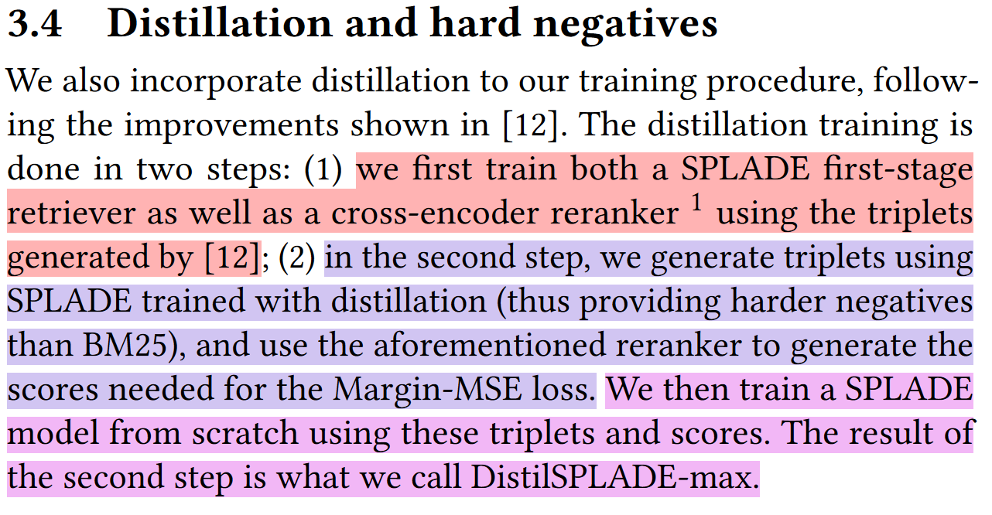
SPLADE Training
From the paper
Formal, Thibault et al. “SPLADE v2: Sparse Lexical and Expansion Model for Information Retrieval.” ArXiv abs/2109.10086 (2021)

Slide 37
DistilSPLADE-max Training
Get triples for MS-MARCO from traditional system, picking negatives at random from top-1000 ranked passages. Construct first dataset of triplets (D#1)
Train Cross-Encoder on D#1 (CE#1).
Train SPLADE#1 on D#1 using distillation from CE#1.
Generate new negatives from SPLADE #1 top-K retrieved; construct new dataset of triplets (D#2).
Train Cross-Encoder on D#2 (CE#2).
Train SPLADE#2 on D#2 using distillation from CE#2.
Formal, Thibault et al. “SPLADE v2: Sparse Lexical and Expansion Model for Information Retrieval.” ArXiv abs/2109.10086 (2021)

Slide 38
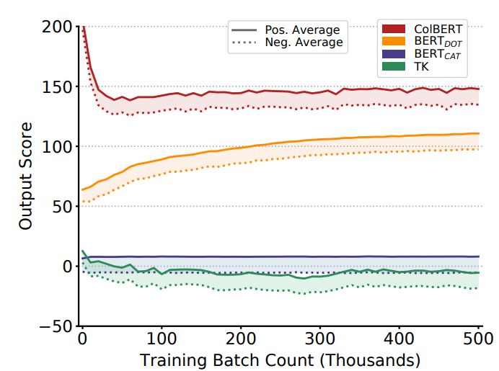
Distillation via Margin-MSE
Margin Mean Squared Error Loss
Assume Teacher Model score function M_{T}.
  E.g. BERT output projected to a scalar, as in Cross-Encoder.
And Student Model score function M_{S}.
  E.g., DPR/Contriever/SPLADE model’s dot-product.
To avoid enforcing specific scores from M_{T} to M_{S} only margins can be distilled from Teacher into Student.
Notes:
- Model Distillation = Transferring information between two models,
training Student Model from Teacher Model.
- Score function = Similarity function
Hofstätter, Sebastian, et al. "Improving efficient neural ranking models with cross-architecture knowledge distillation." arXiv preprint arXiv:2010.02666 (2020).

Slide 39
Distillation via Margin-MSE
Margin Mean Squared Error Loss
Assume Teacher Model score function M_{T}.
  E.g. BERT output projected to a scalar, as in Cross-Encoder.
And Student Model score function M_{S}.
  E.g., DPR/Contriever/SPLADE model’s dot-product.
Loss function for triples of queries Q, positive passages P⁺, negative passages P⁻.
Teacher’s error margin
Student’s error margin
Hofstätter, Sebastian, et al. "Improving efficient neural ranking models with cross-architecture knowledge distillation." arXiv preprint arXiv:2010.02666 (2020).

Slide 40
SPLADE Inference
Similar to DPR/Contriever.
Sparse-vector products, are efficiently implemented in Numba/Numpy.
Formal, Thibault et al. “SPLADE v2: Sparse Lexical and Expansion Model for Information Retrieval.” ArXiv abs/2109.10086 (2021)

Slide 41
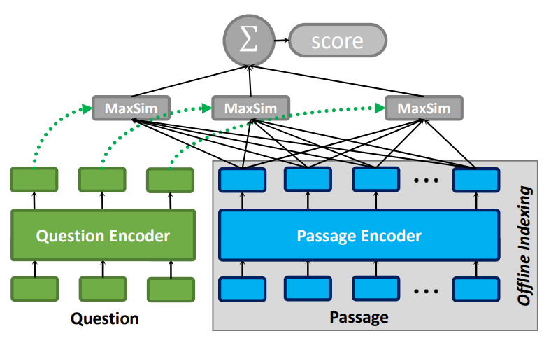
COLBERT V2
Multi-vector query/document representations.
Middle ground between cross-encoder and bi-encoder.
Can be used for (first-stage) retrieval.
However, it’s large passage index makes it suited for smaller collections.
Santhanam, Keshav, et al. "PLAID: an efficient engine for late interaction retrieval." Proceedings of the 31st ACM International Conference on Information & Knowledge Management. 2022.

Slide 42
COLBERT V2
Punctuation symbol embeddings are removed.
Query is always represented with N_{q}(=32) tokens. Shorter queries are padded.
Documents are split so that they contain N_{d}(=300 on BEIR ) representations.
Representations are low-domensional
  (Each DPR vector has 768d, each of COLBERT’s vectors is 128d).
Each vector representation is L2 normalized (= unit vectors)
Santhanam, Keshav, et al. "PLAID: an efficient engine for late interaction retrieval." Proceedings of the 31st ACM International Conference on Information & Knowledge Management. 2022.

Slide 43
COLBERT MaxSim
Each token in Question/Passage is encoded into vector using BERT.
Similarity between query and passage is computed between two matrices Q and P.
Max-pooled over document representations.
Santhanam, Keshav, et al. "PLAID: an efficient engine for late interaction retrieval." Proceedings of the 31st ACM International Conference on Information & Knowledge Management. 2022.

Slide 44
COLBERT MaxSim
Each token in Question/Passage is encoded into vector using BERT.
Similarity between query and passage is computed between two matrices Q and P.
Max-pooled over document representations.
Cosine Similarity

Slide 45
COLBERT Training
Similar to previous methods.
V2 uses hard negatives, cross-encoder distillation, in-batch negatives.
Santhanam, Keshav, et al. "PLAID: an efficient engine for late interaction retrieval." Proceedings of the 31st ACM International Conference on Information & Knowledge Management. 2022.

Slide 46
COLBERT Inference (PLAID)
Tomorrow practical

Slide 47
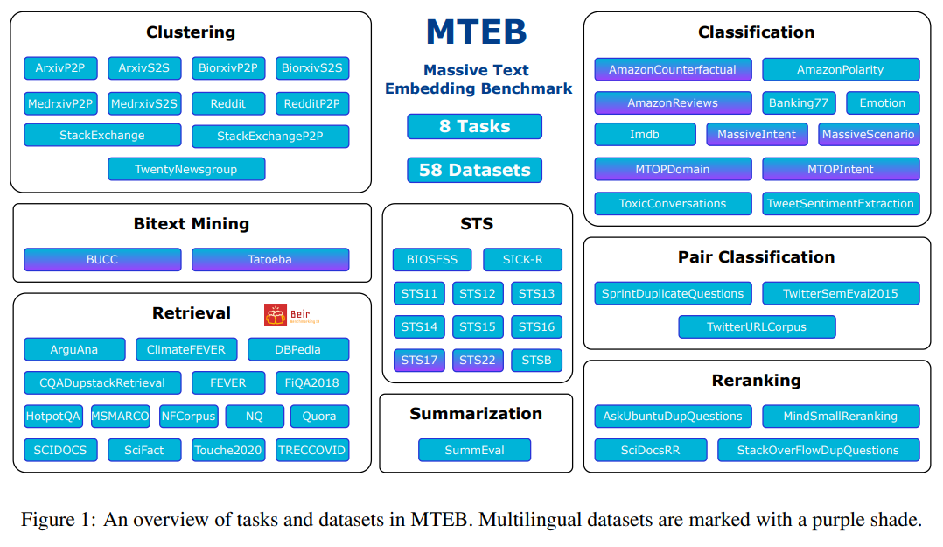
MTEB Massive Text Embedding Benchmark
https://huggingface.co/spaces/mteb/leaderboard
Muennighoff, Niklas, et al. "MTEB: Massive Text Embedding Benchmark." Proceedings of the 17th Conference of the European Chapter of the Association for Computational Linguistics. 2023.

