Slide 1
Spatial sharpening of thermal images

Slide 2
Remote sensing
Way to acquire land surface information without direct contact
Different kind of vehicles
Satellites
UAV
Different kind of sensors
Short/long wavelengths, visible/not visible by human eye
Thermal sensors

Slide 3
Satellite missions
Landsat
1972, USGS/NASA
Thermal imagery on Landsat 8-9
High resolution – 30x30m per pixel
Low revisit time – 16 days per image
Sentinel
2014, ESA
Thermal imagery on Sentinel-3
Low resolution – 1kmx1km per pixel
High revisit time – 1 day per image

Slide 4
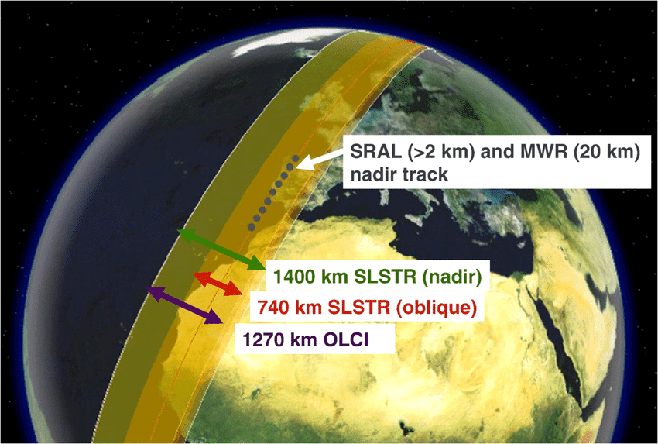
Spatial/temporal trade-off
Higher resolution = Orbiting closer to earth = Lower Swath width

Slide 5
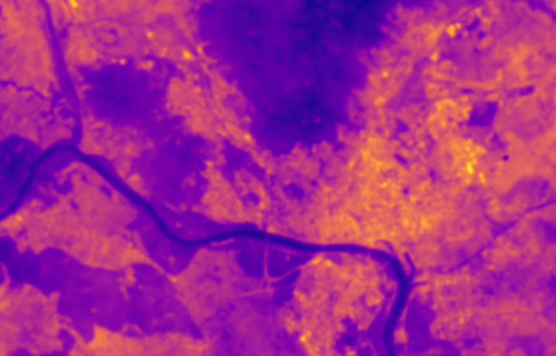
Motivation

Slide 6
Motivation

Slide 7
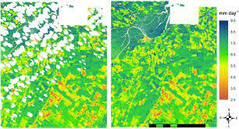
Problematic images

Slide 8
Related work
Mostly using NDVI and other spectral indices to model LST
Linear approaches: TsHARP, DisRad (Mukherjee et al. 2014)
Non-linear models: RFR, SVR (Bonafoni et al., 2016), (Bartkowiak et al. 2019)
Deep-Learning: Encoder-decoder architecture, self-attention (Mukherjee et al., 2022)
Global vs. local approach
Heterogenity of land cover

Slide 9
Related work
Lack of modelling anthropogenic heat flux in sharpening studies
Jin et al. 2019
Qf = Qi + Qp + Qc + C
Qi = Heat generated by industrial activity
Qp = Heat generated by everyday human activity (Cars, AC, basically living)
Qc = Heat generated by commercial activity – retail centers, business centers

Slide 10
Research goals
Evaluate the accuracy of existing models for the spatial thermal sharpening
Test the hypothesis: Predictors that model anthropogenic heat flux will improve the accuracy of the sharpening model
Choose subset of predictors that work best for the task

Slide 11
Study area
Bratislava
Heterogenous land cover
Forests, Water, Industrial, Residential
Mild climate

Slide 12
Data
Low resolution LST:
Sentinel 3
ESA
Python sentinelsat
High resolution LST:
Landsat-8
Earth explorer
Python landsatxplore

Slide 13
Environmental variables
NDVI
(NIR – GREEN)/(NIR+GREEN)
NDBI
(SWIR - NIR)/(SWIR + NIR)
Building density, Landcover (OSM)
Elevation (Lidar images)

Slide 14
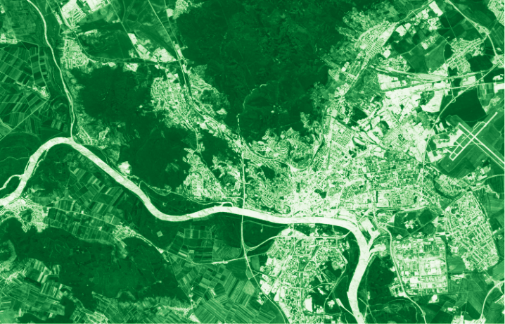

Slide 15
Predictors for AHF
Gridded dataset for energy consumption, GDP (Jin et al. 2019)
Approximated to a finer resolution
Human density
Night light satellites

Slide 17
Selected models
TsHARP
RFR
SVR

Slide 18
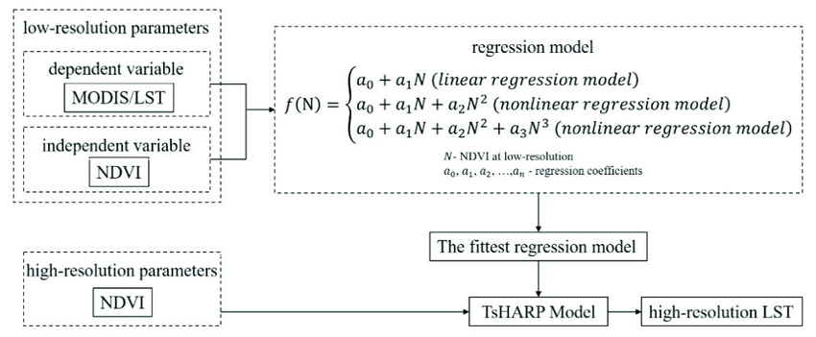
Baseline model

Slide 19
Baseline results so far
Best subset of environmental predictors – (NDVI, NDBI, elevation)
MAE: 4 K
Best subset combined with AHF predictors (NDVI, NDBI, Energy consumption, Building density)
MAE : 3.6 K
T-test – p = 0.02

