Slide 1
Contrastive Language-Image Pre-training & Latent Diffusion
David Valecký

Slide 2
CLIP
Learning method from natural language supervision
Dataset of 400 million (image, text) pairs
Perform a wide set of tasks during pre-training
OCR
geo-localization
action recognition

Slide 3
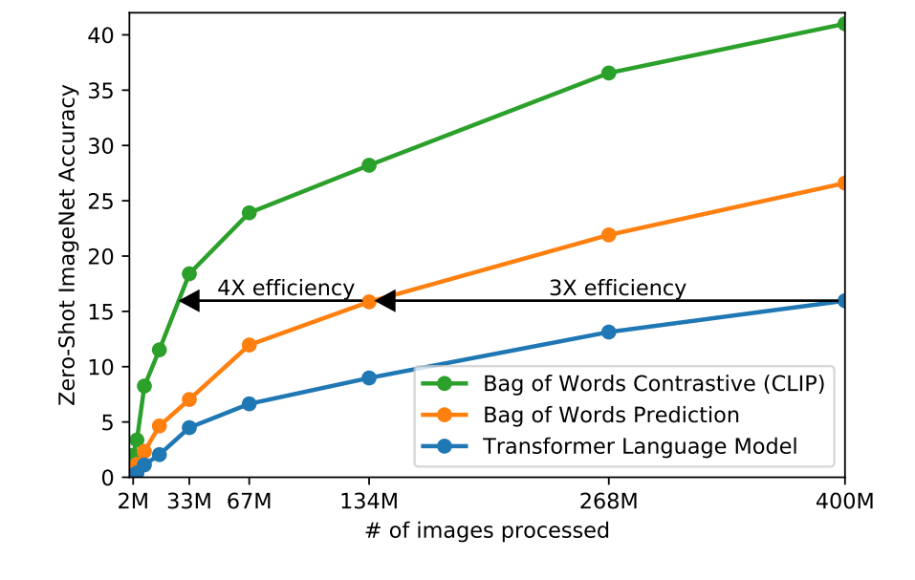
Comparison with other methods
Benchmark on 30 existing datasets
Strong at zero-shot classification
Better than public ImageNet models

Slide 4
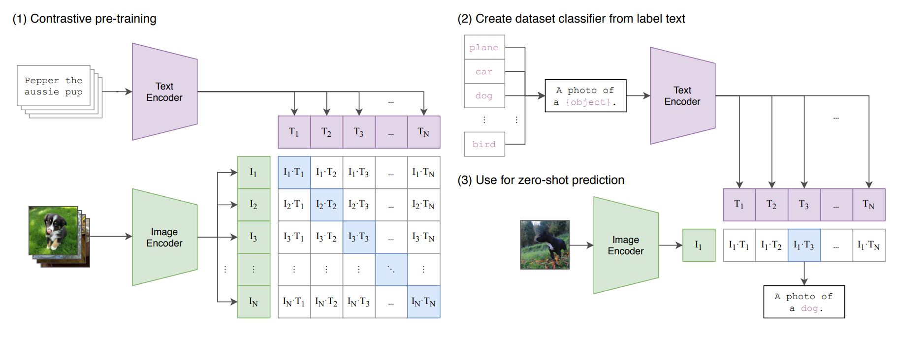
Dual-Input model architecture
Two types of inputs: an image and a text prompt
Vision encoder for images
Language encoder for text

Slide 5
Image Encoder
Variant of Vision Transformer (ViT)
Based on CNN
Originally designed for natural language processing tasks
Employs self-attention mechanisms
High-dimensional vector representations - CLIP image embeddings
Space where images and text are jointly represented
3 vectors - Query (Q), Key (K), Value (V)
Self-attention - can run in parallel

Slide 6
Text encoder
Transformer-based architecture
No pre-trained weights
Linear projection to map from each encoder’s representation to the multi-modal embedding space
Simplified because many CLIP’s pre-training dataset are only a single sentence

Slide 7
Performance
The largest ResNet model
Model name - RN50x64
18 days to train on 592 V100 GPUs
Largest Vision Transformer
12 days on 256 V100 GPUs
Model name - ViT-L/14

Slide 8
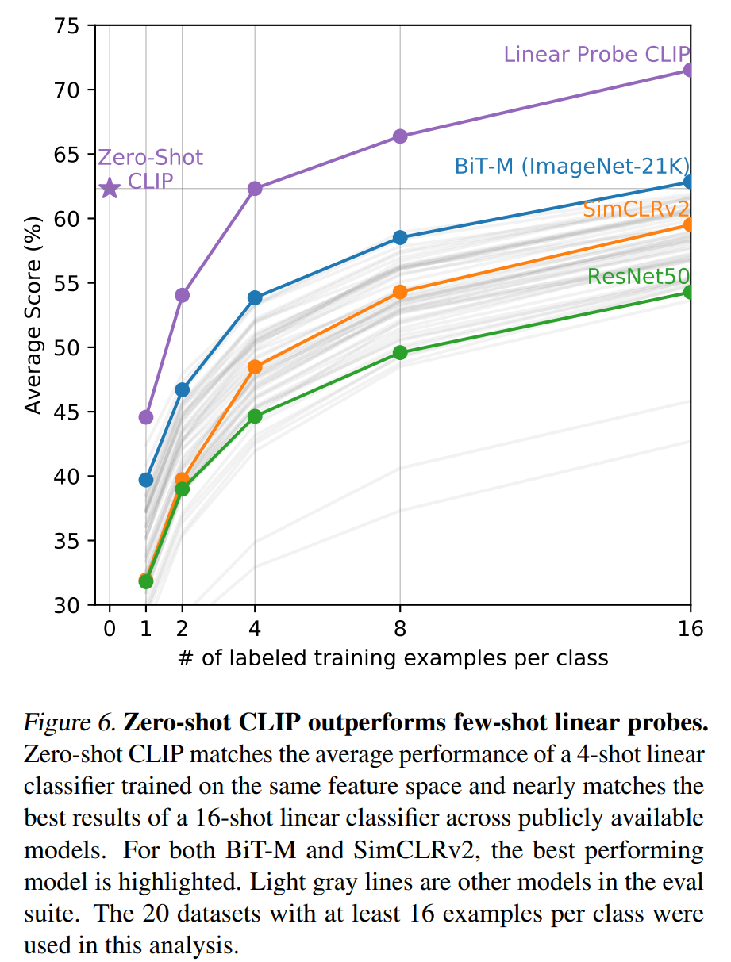
Zero-Shot Transfer
Performing unseen tasks
Standard image classification datasets using a generically pre-trained model
Second study zero-shot transfer to existing image classification datasets at the time of publishing paper

Slide 9
Applications and Use Cases
Image Classification
Text-to-Image Retrieval
An ability to generalize to a wide array of task

Slide 10
Latent Diffusion
Autoencoder (VAE)
U-Net
Text Encoder - CLIP, pre-trained

Slide 11
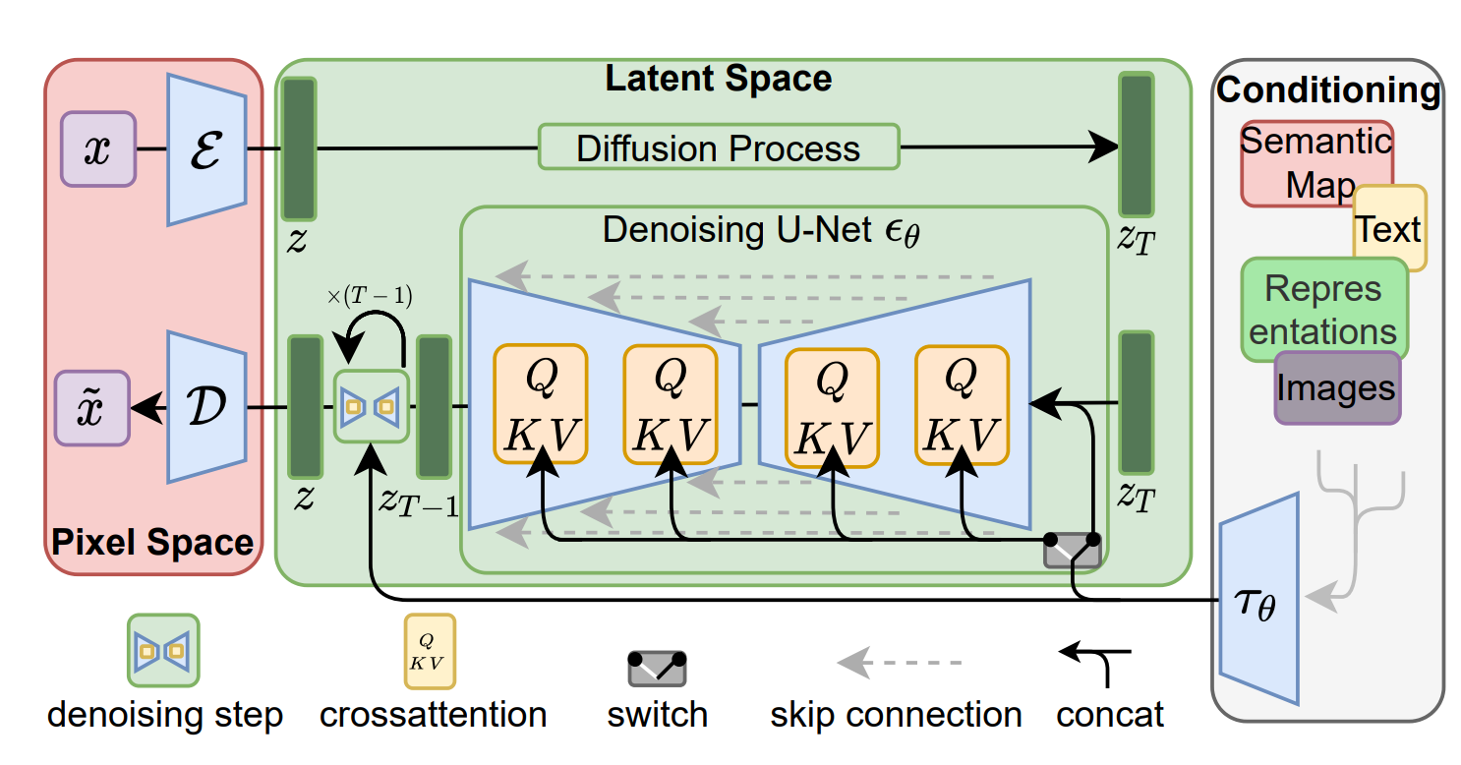
Latent diffusion model

Slide 12
Autoencoder (VAE)
Transforms a high-dimensional image (512x512x3) into a compact latent representation (64x64x4)
"Latents" serve as input to the U-Net
Conversion significantly reduces memory requirements (48 times less) compared to pixel-space diffusion models
The decoder reconstructs the original image from the latent representation
Only the decoder is needed to convert denoised latents into actual images
Isotropic Gaussian distribution

Slide 13
U-Net
Predicts denoised image representations from noisy latents
By subtracting this noise from the noisy latents, actual latents are obtained
Contains:
Encoder (12 blocks)
Middle block
Skipconnected Decoder (12 blocks)
Totally 25 blocks
8 blocks handle down-sampling or up-sampling convolution layers
17 blocks containing four ResNet layers and two Vision Transformers (ViTs)

Slide 14
Text Encoder
Stable Diffusion uses a pre-trained text encoder CLIP
Latent space can be used to train multiple generative models
Downstream application single-image CLIP-guided synthesis

Slide 15
Odkazy
https://arxiv.org/pdf/2112.10752.pdf
https://cdn.openai.com/papers/dall-e-2.pdf
https://arxiv.org/pdf/2103.00020.pdf

