Slide 1
Management by Competencies
Strategic frame

Slide 2
Previously on MbC
Leaders
Managers
Workers

Slide 3

Roles and People
Leader, manager, worker are roles
Roles have not to be confused with persons
  as well as human resources
Leadership context
Management context
Performance context
member of the board
managing director
market analyst
Key Roles in Enterprise

Slide 4
Company management
It is about synergy among leaders, managers and workers
To lead well is about doing right things
To manage well is about doing things in right way
Key Roles in Enterprise
Notes:
str 55 a dal

Slide 5
Development of managerial style
liberal
mngmnt
team mngmnt
company led by ideas
people
dynamics
stability
processes
results
effectiveness
usefulness
formal
mngmnt
directive
mngmnt
company led by people
me (manager)
Development of man. style
(C) J. Plamínek
Notes:
Good leadership of people and their resource management is on the borders of science, craft, and art. There is a plenty of factors affecting the right choice of managerial style. These factors may involve resources of led people, character of tasks to be done, qualities of managers,... The intuition and nature is usually the most effective tool. There is no optimal or universal managerial style.
However, experience shows us that successful managers can be found on the right of this matrix. Why?

Slide 6
System of Corporate Ideas
Strategic Frame
Goals & Objectives
Products, Services, Processes & Projects, Resources, Tasks, Competencies, Feedbacks, Feedforwards, HR development, ...
Strategic Frame
Notes:
Philosophical core of MbC is to continually approximate the corporate requirements and possibilities of people who work there. Therefore the System of Corporate Ideas (SCI) has to be a logical unit which starts by general thoughts and considerations, but ends by specific tasks to be performed by particular people.

Slide 7





Strategy: Theory of vitality
crisis
Stability
Effectivity
Usefulness
Dynamics
Integration
Synergetization
Habilitation
Motivation
Orientation
Definition
eqi.
activity
stability
acceptation
structures
resources
processes
tasks
products
needs
subjects
(C) J. Plamínek

Slide 8
Purpose of Strategic Frame
Defines company and its business
Instrument of strategic management
Defines only boundary which delimits space for free activity of management
Submission for company management
Strategic frame ought to be an eternal source of inspiration, orientation and motivation for people working for company, for suppliers, investors, ...
Absence of strategic frame is often reason of chaos in companies which leads to their failure
Strategic frame is the seed the company ideas grow from

Slide 9

Context of Strategic Frame
Stability
Effectiveness
Usefulness
Dynamics
Integration
Synergetization
Habilitation
Motivation
Orientation
Definition
Leaders

Slide 10

Role of Manager
Manager has to continuously
  understand and accept the strategic frame
  define consequent requirements
  explore and develop possibilities
  effectively communicate with monitoring system
strategic frame
external
suppliers
Management
monitoring
goals
ways
tasks
evaluation
internal
resources
Key Roles in Enterprise
Notes:
Leader defines strategic goals, principles and rules to be obeyed. Manager has to achieve these goals by satisfaction of all rules and principles. The role of manager is the most sophisticated and complex role in any company.

Slide 11
Creation of Strategic Frame
Emotional perspective
Rational perspective
wishes, intuition, instincts
unconsciousness
consciousness
measurable parameters
Environment understanding
trends, challenges, opportunities
“The future belongs to people who see possibilities before they become obvious.”
--Ted Levitt

Slide 12
The Elements of Strategic Frame
Strategic frame
Business hypothesis
Mission
Strategy
Vision
Values and Rules
(C) J. Plamínek

Slide 13
Business Hypothesis
Strategic frame
Business hypothesis
Vision
Mission
Values and Rules
Strategy
Gains trust of investors, owners, managers, workers
Identifies business opportunities in surrounding environment
Clarifies why intended business will generate sufficient income to sustain itself in the future
Includes trend estimations of target customers behavior and other subjects considering development in environment
Delimits a space where the company will operate and describes the position which company want to fill
business, market, political, technological, economical, ecological and social

Slide 14
Mission
Strategic frame
Business hypothesis
Mission
Values and Rules
Vision
Strategy
Indicates the benefits for customers, suppliers, employees
Offers products and services to satisfy needs of the subjects
Appeals to wider customer groups
Attracts attention rather than explain usefulness exactly

Slide 15
Mission Examples
Strategic frame
Business hypothesis
Mission
Values and Rules
Vision
Strategy
Google
to organize the world's information and make it universally accessible and useful.
Kofola
Kofola's mission is to enthusiastically create an attractive brand of beverages, which will offer consumers a functional and emotional value that they become an important part of their life.

Slide 16
Vision
Strategic frame
Business hypothesis
Mission
Values and Rules
Vision
Strategy
Answers the question: What the business and company will look like in a distant future?
Reflects feelings and ideas of leaders
(emotional perspective)
Includes measurable parameters and its values indicating achievement of vision
(rational perspective)

Slide 17
Vision Examples
Strategic frame
Business hypothesis
Mission
Values and Rules
Vision
Strategy
Google
to develop a perfect search engine.
Kofola
Kofola group's vision to be the preferred choice for customers, employees and shareholders. By 2012 we want to be an overall "number two" in the soft drinks market in the Czech Republic, Slovak Republic and Poland. In each of these countries, our goal is to have in the segments of cola drinks and water brands that will be 1 or 2 place in these segments. In other categories to be imaginary third place.

Slide 18
Strategy
Strategic frame
Business hypothesis
Mission
Values and Rules
Vision
Strategy
Defines specific business activities which enable to sustain success of company both in the presence and in the future
markets to operate on, customers and clients to serve, competitive advantage to gain
The parts of the strategy focused on the presence and on the future have to be clearly distinguished
to avoid confusion of managers
to prepare step changes to surprise both clients and competitors

Slide 19
Values and Rules
Strategic frame
Business hypothesis
Mission
Values and Rules
Vision
Strategy
Focus on potential ways leading to achievement of goals outlined in vision
Emotionally, it is a set of shared and felt values which company ought to obey when realizing the vision
examples: Give-Take Matrix compliance, exploit any flaw in law at all costs
Shared values are rationalized into the set of clear rules which observance is measurable
example: every contract must be revised by XY from the perspective of Give-Take Matrix compliance

Slide 20
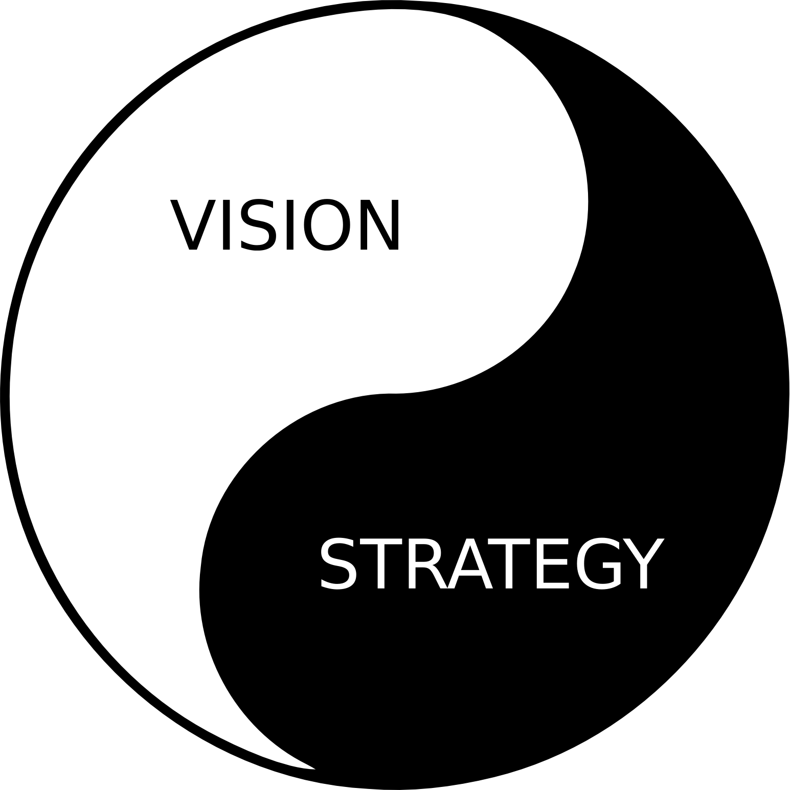
Vision and Strategy
Strategic frame
Business hypothesis
Mission
Values and Rules
Vision
Strategy
A vision without a plan
is just a dream.
A plan without a vision
is just a drudgery.
But a vision with a plan can change the world.

Slide 21
Summary
System of Corporate Ideas
Strategic Frame
  business hypothesis
  vision
  mission
  values and rules
  strategy

