Slide 1
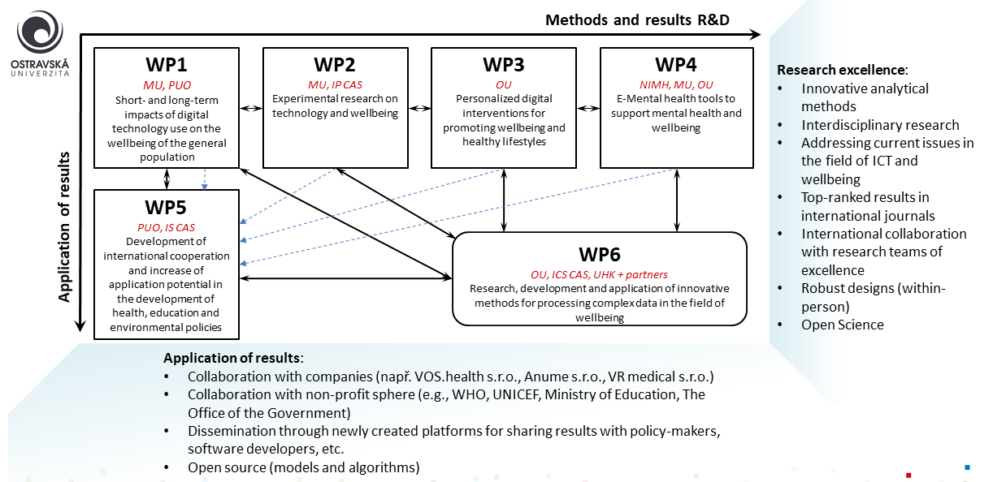
DigiWELL

Slide 2
WP1: Short- and long-term impacts of the use of digital technologies on the wellbeing of the general population
Leader: Prof. David Šmahel

Slide 3
WP1: Objectives
Understanding the short- and long-term impacts of ICT use on the psychological, social, and physical wellbeing of children, adults, and older people (WP1.1, WP1.2, WP1.3)
Research on populations vulnerable to the risks of ICT use, which will enable a deeper understanding of the factors related to the risks of ICT use for specific groups (WP1.1 – WP1.4).
Development of innovative methods and analytical procedures. We will develop research tools that enable real-time collection of objective data using mobile phones. We will also develop innovative analytical procedures, enabling objective data processing (WP1.3, WP1.4).

Slide 4
WP1.1: Analysis of existing data regarding the impact of ICT use on wellbeing and online risks
Research activity leader: Dr. Lenka Dědková
Based on the analysis of existing data, we will focus on illuminating the links between ICT use, wellbeing, and online risks (such as problematic internet use, risky online communication, cyberbullying, hateful online content, online health information seeking etc.)
Data: FUTURE project, EU Kids Online, HBSC, ISSC, SHARE
Work timeline: predominantly during the first two years (2024-25)
Deliverables: 26 publications

Slide 5
WP1.2: Long-term effects of ICT use on the wellbeing of children, adults, and older people: Longitudinal research
Research activity leader: doc. Anna Ševčíková
Two independent longitudinal studies:
1. study will cover the adult population (18-59 in the first wave) in one sub-panel and the older population (60+ in the first wave) in the other sub-panel (3 waves, spaced one year apart)
2. longitudinal study will focus on adolescents (12-17 in the first wave), surveying the dyads of one adolescent and one parent (5 waves, six months apart).
both surveys will cover the patterns of ICT use and wellbeing (physical, psychological, social, e.g., stress, sleep, loneliness). Each will also have a dedicated section on developmentally specific topics (e.g., coping with aging among older adults, use of ICT for socialization among adolescents, occupational wellbeing among adults).

Slide 6
WP1.3: Short-term impacts of ICT use on adult wellbeing: The “Ecological Momentary Assessment (EMA)” study
Research activity leader: Prof. David Šmahel
the short-term impacts of ICT use on wellbeing among adults, i.e., the so-called momentary effects within the day (using intensive data, objective data from mobile phones and other available digital technologies)
1. phase: pilot research, survey of the adult population (min N = 600), testing the measurement tools and examine (between-person) relationships between selected variables. Furthermore, pilot studies (EMA1-2 on students, min N = 50) will be conducted to validate the measurement tools from the within-person perspective.
2. phase: three EMA studies (minimum N = 600)
The EMA3 study will focus on assessing the impact of the use of ICT, especially mobile phones, on the wellbeing of adults
The EMA4 study will focus on how ICT can be used to improve adults’ wellbeing in their work environments
The EMA5 study will focus on assessing the effectiveness of selected types of digital interventions used in mobile applications designed to optimize “digital wellbeing.”

Slide 7
WP1.3: Short-term impacts of ICT use on adult wellbeing: The “Ecological Momentary Assessment (EMA)” study
Work timeline:
pilot research by Q1-2025 (cross-sectional, EMA1-2)
EMA3 study: preparation from 1-2024 to 3-2025, data collection 4/5-2025
EMA4 study: preparation from 6-2025 to 3-2026, data collection 5/6-2026
EMA5 study: preparation from 6-2026 to 3-2027, data collection 5/6-2027.
Data analysis will always start immediately after data collection and cleaning.
Deliverables: 3 publications in WP2 (Indicator 214 021) and 3 more publications based on EMA data declared in WP6

Slide 8
WP1.4: Research on population vulnerable to risks of ICT use: Qualitative study and investigation of physiological and biological correlates
Research activity leader: dr. Klára Maliňáková
This activity will investigate populations that are vulnerable in relation to the use of ICT. We aim to provide a deep understanding of the factors and mechanisms that may contribute to the vulnerability of a given population to ICT risks.
The activity will build on the analysis of existing data and the results of the first wave of longitudinal research. These results will be used to determine which populations are at risk (e.g., children by socioeconomic status, the population of lonely older adults).
We will carry out the following sub-studies:
(1) focus groups and interviews with people from each population will be conducted.
(2) smaller studies focused on physiological and other biological correlates related to risky ICT use in vulnerable populations (e.g., hormone analysis, EEG, galvanic skin response, and other relevant indicators).
From 9/2025

Slide 9
WP2: Experimental research on technology and wellbeing
Leader: Doc. Martina Hřebíčková

Slide 10
WP2: Objectives
Providing strong evidence of causality in the relationship between ICT factors, aspects associated with ICT use, and wellbeing, which is still lacking in the literature, through experimental studies using state-of-the-art methodological and analytical approaches.
The focus will be on relevant mechanisms (mediators) through which digital technologies influence wellbeing, specifically the role of selected ICT factors, individual characteristics or emotions associated with ICT use.
Identification of conditions (moderators) specifying when and for which individuals the influence of digital technologies on wellbeing is manifested.
The results obtained in the controlled experimental design of WP2 will enable the design of effective interventions to promote wellbeing as well as to prevent and counteract social pathologies in the context of ICT.

Slide 11
WP2.1: Experimental research of positive aspects of ICT – promoting wellbeing
Research activity leader: doc. Hana Macháčková
focus on the dimension of physical wellbeing and address selected topics and processes that are linked to the use of eHealth/mHealth
research on factors enabling an increase in the effectiveness and applicability of eHealth/mHealth (e.g. trust in services, satisfaction with the quality of communication). This will include the use of the latest technologies, specifically eye-tracker.
An offline experiment using eye-tracking technology to obtain data on attention and response to specific aspects of eHealth will allow inferences to be made about cognitive processes associated with exposure to different types of stimuli based on accurate data.
Work timeline: first year: preparation and pretesting, second to fourth year: data collection, fifth year: preparation of articles
Deliverables: 4 publication, three more publications will be produced in collaboration with WP6 and WP2.2 (Sylvie Graf)

Slide 12
WP5: Development of international cooperation and increasing the application potential in the development of health, education, and environmental policies
Leader: Dr. Petr Baďura

Slide 13
WP5.2: International comparison aiming to identify the role of technology use, digital skills, online risks, and selected characteristics with regard to wellbeing in children and adolescents (9–17 years)
Research activity leader: doc. Hana Macháčková / Dr. Marie Jaroň Bedrošová
Data from the international EU Kids Online (EUKO) project will be used. The next wave of this project in Czechia (2026) will be collected in WP5.2. The international nature of the data will allow comparison across European countries and capture the specificities of Czech children and adolescents
data will be collected from children and their parents or caregivers by a trained administrator in the child's home
Work timeline: preparation of the data collection (1-2024 to 3-2026), EUKO data collection (3-4 - 2026), analysis (2027)
Deliverables: 2 publications

Slide 14
International collaboration with high quality foreign universities and research centers
University of Amsterdam – Prof. Patti Valkenburg and Prof. Jochen Peter
In WP2, we will consult on the design of selected upcoming experiments, and on the use of mHealth and eHealth tools
Mobility is planned
KU Leuven - Prof. Steven Eggermont, Assoc. Prof. Kathleen Beullens
In WP1, we will collaborate to produce publications from longitudinal investigations, specifically in the area of psychological wellbeing
Mobility of Dr. Dědková is planned for 2026
University of Vienna – Prof. Jörg Matthes
We plan to consult on the design of these research studies and plan joint publications in the field of cyberhate

