Slide 1
Drawing 4.12. 2024
What and How

Slide 2
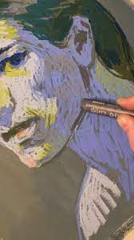
Stylized Portrait on Large Format
The task for today is to draw portrait of the model. BUT you have a lot of freedom.
Based on observation you create a variation – we did a caricature so you already have this experience.
Also, you can use any of the approaches we did last week.

Slide 3
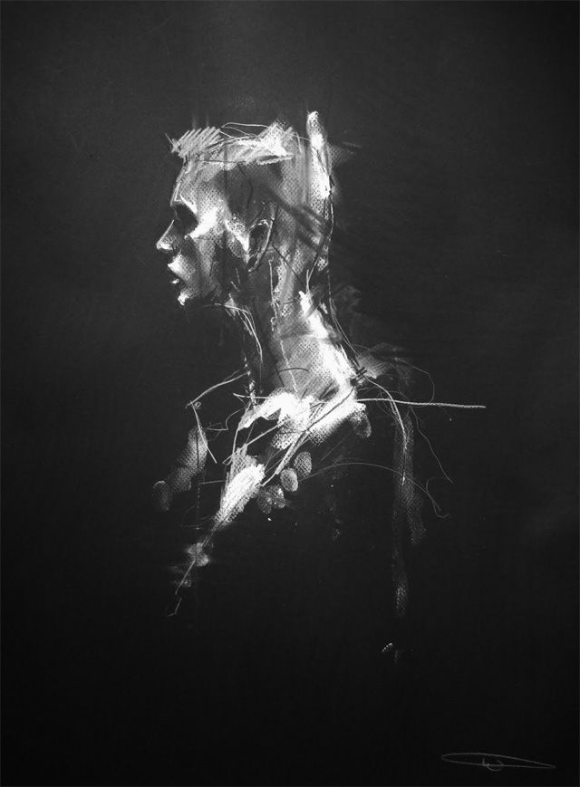
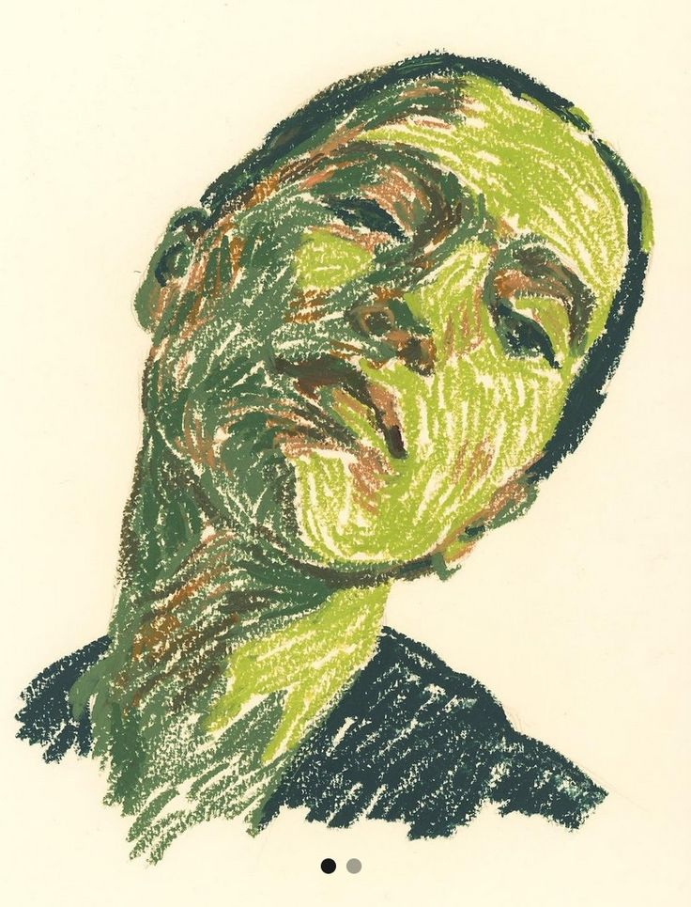
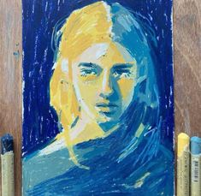
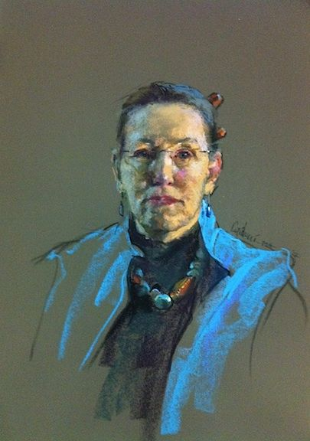
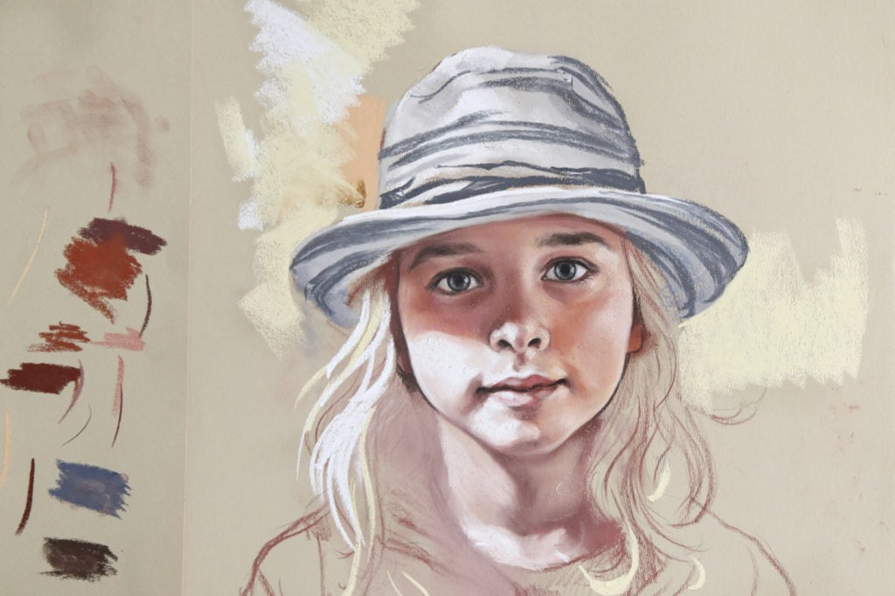
Select the right paper for your technique and color scheme idea

Slide 4
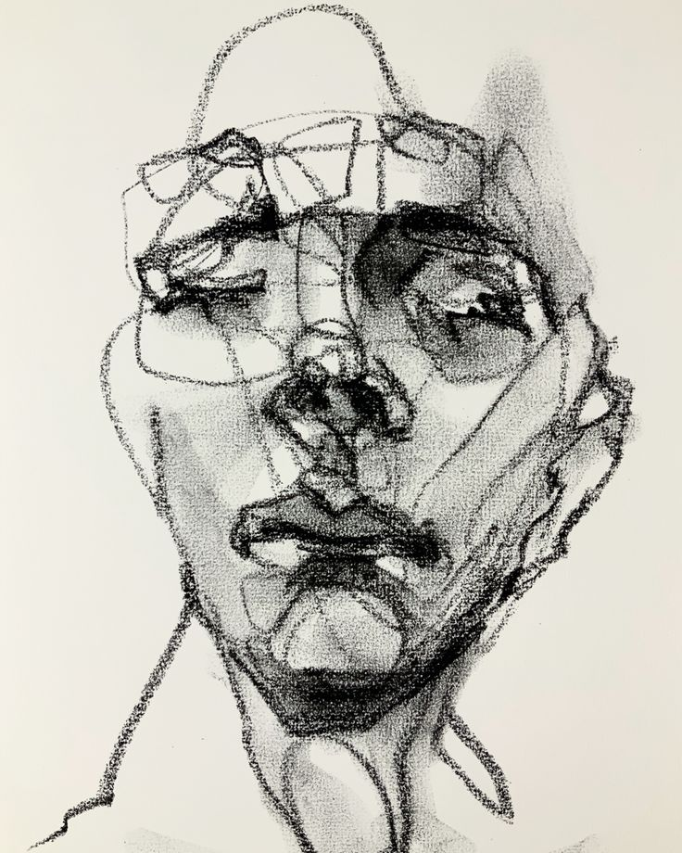
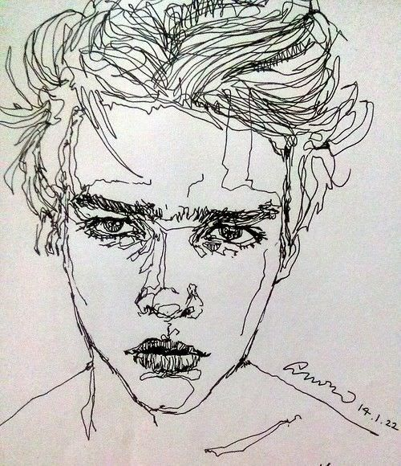
Also, you can use any of the approaches we did last week.
Not the one with closed eyes, that would not work ☺
You can use a technique of drawing in one line for example…

Slide 5
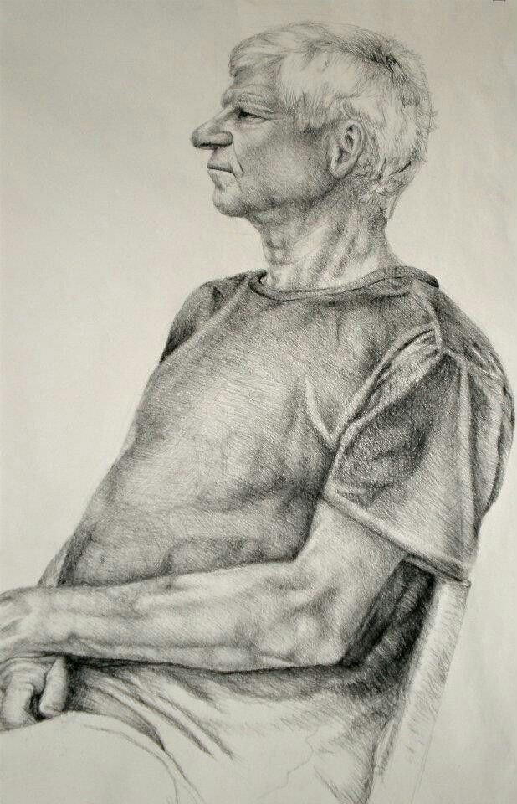
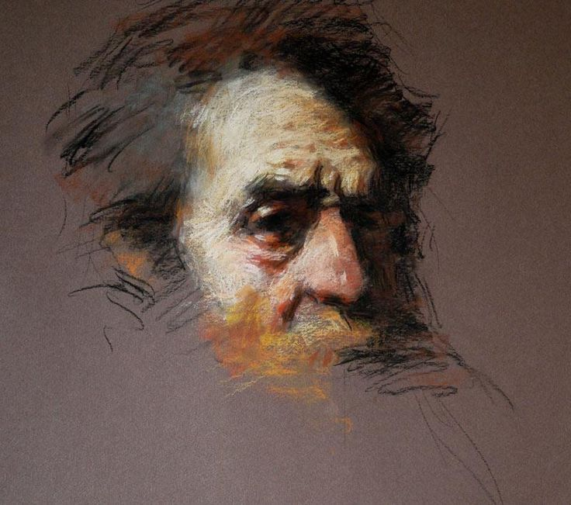
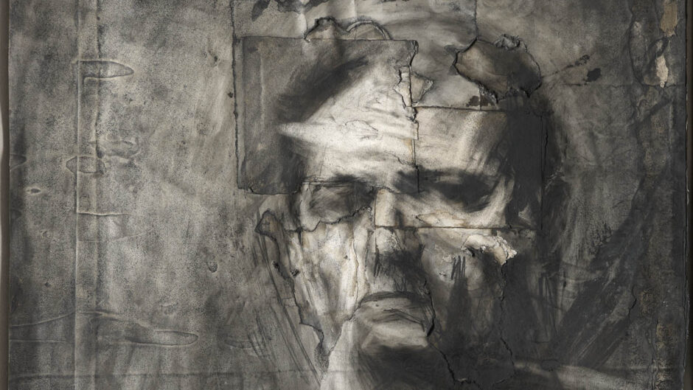
Make sure you know what exactly will be part of your drawing,
Where you plan to crop the figure – think about the composition.

Slide 6
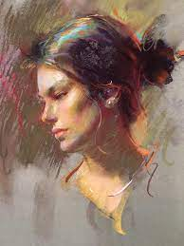
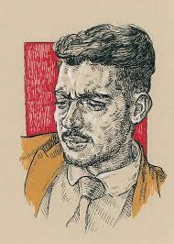
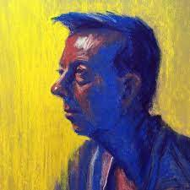
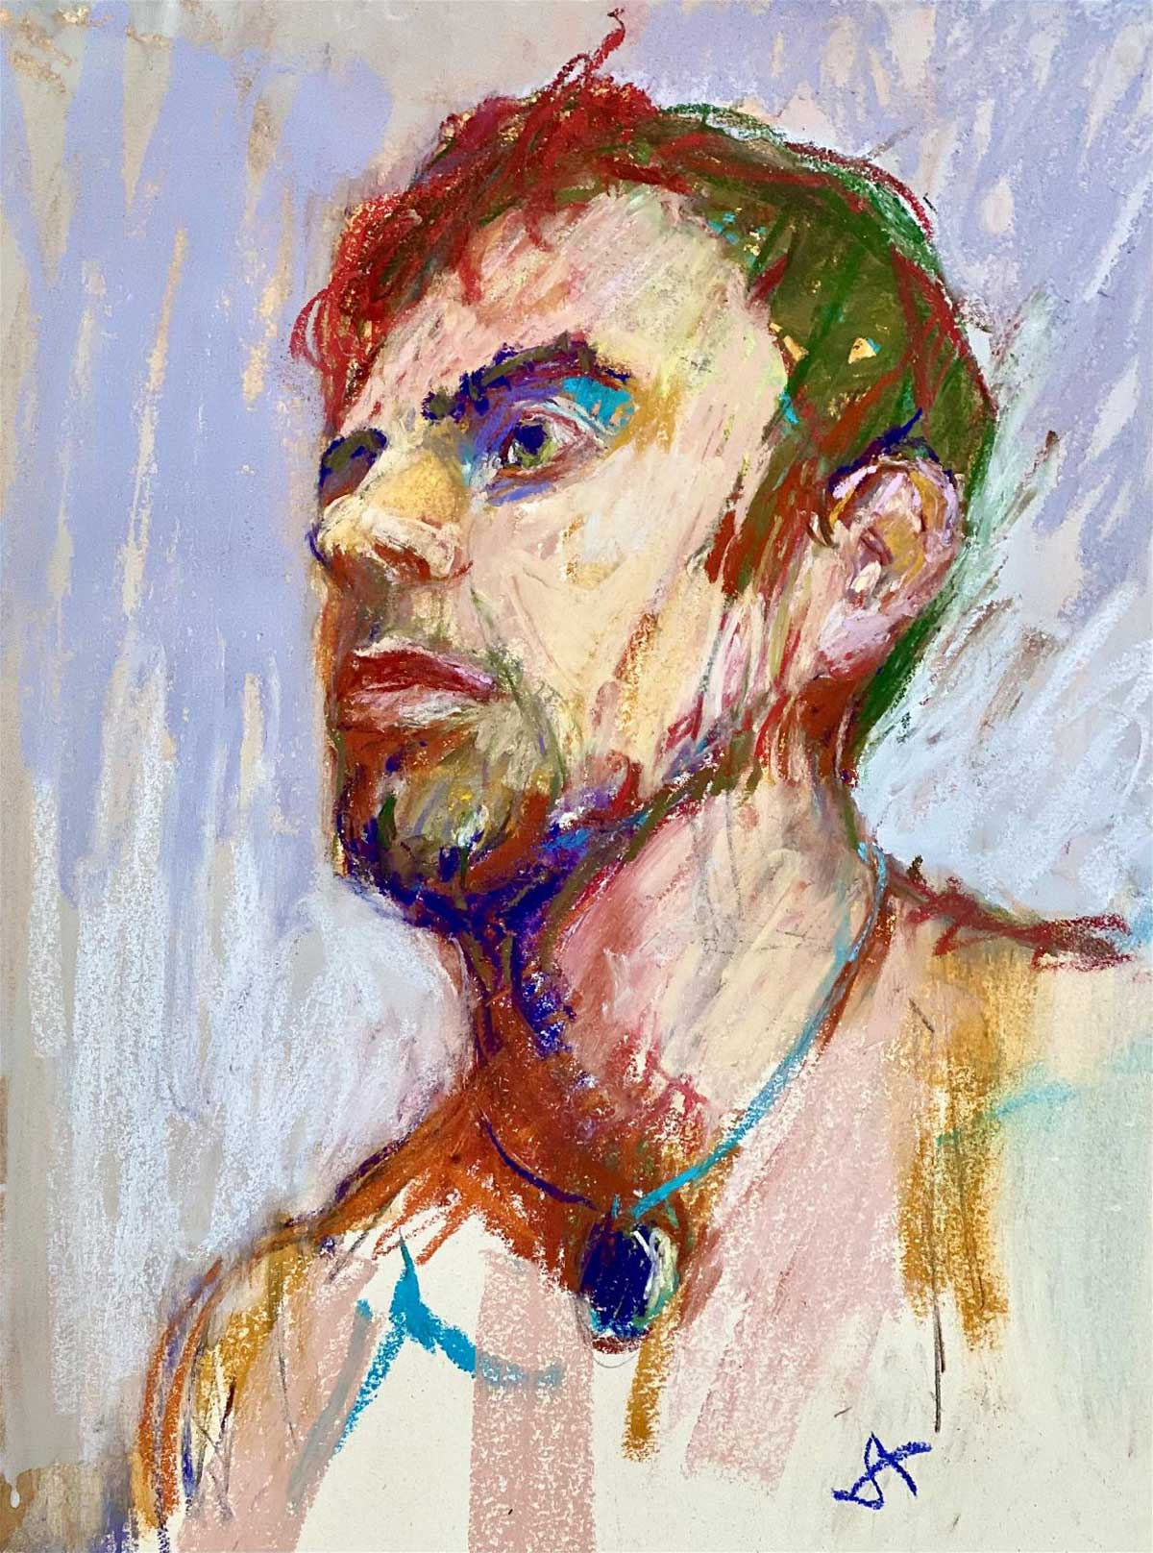
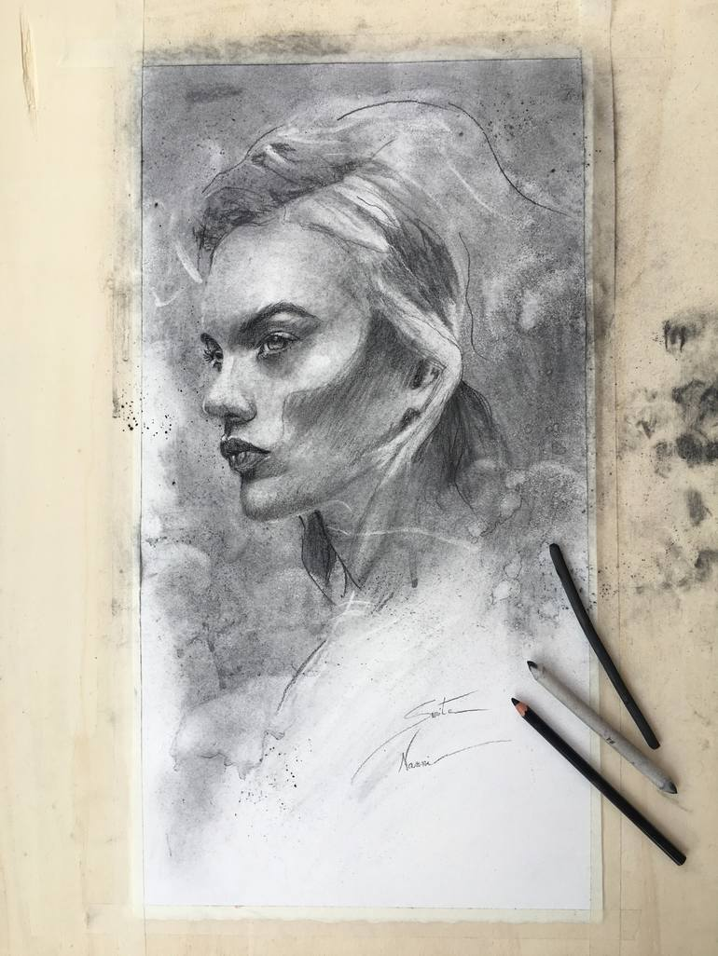
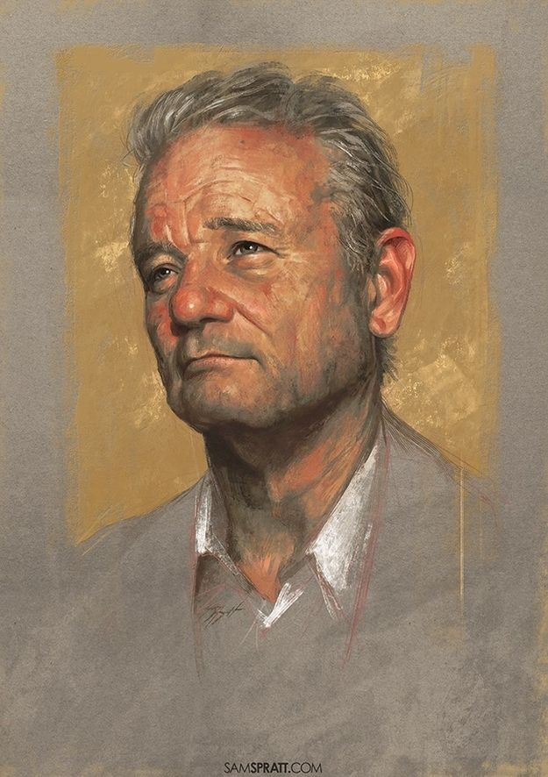
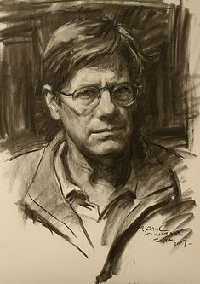
Dont be afraid to work with the background.

Slide 7
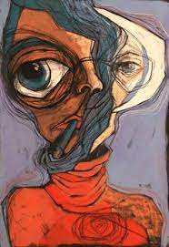
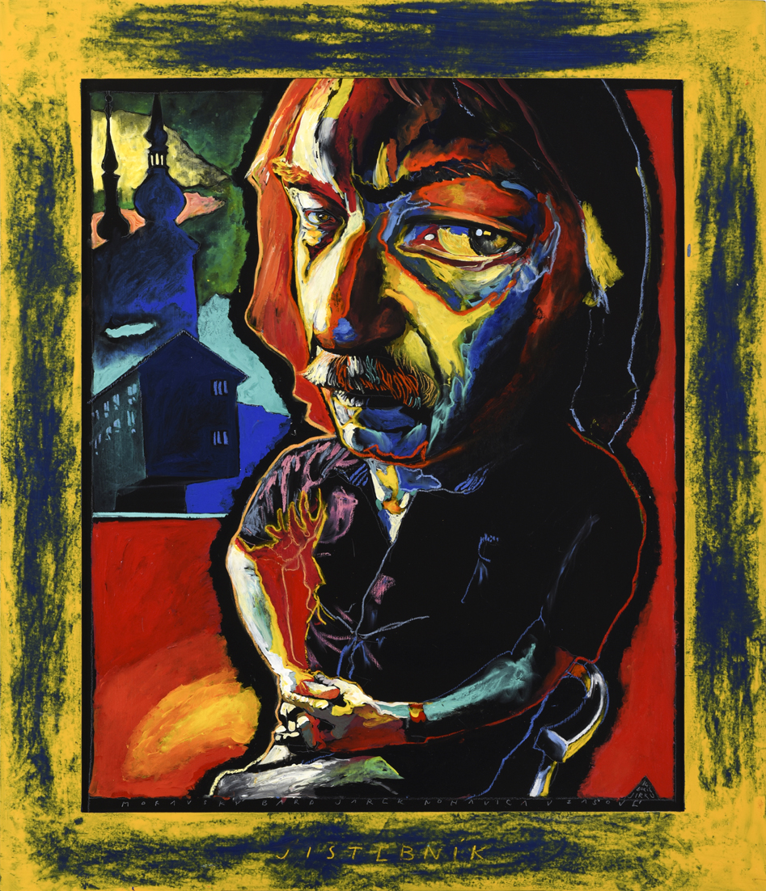
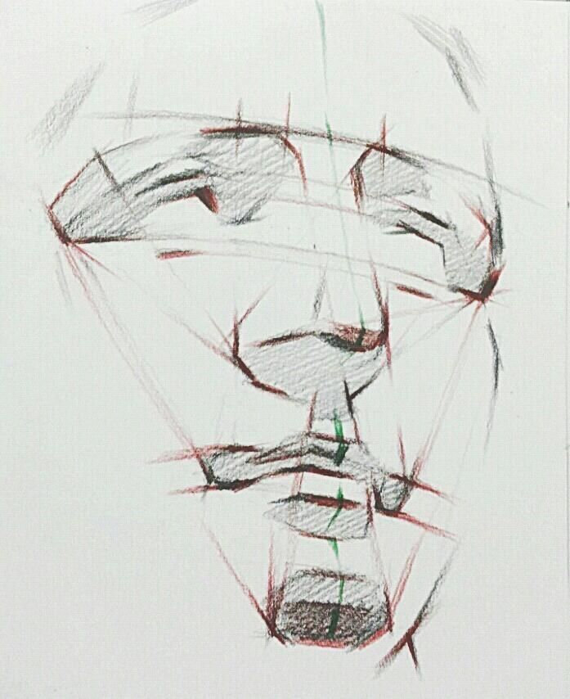
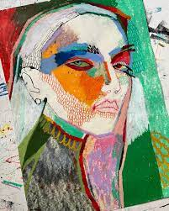
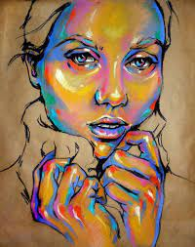
Think about a stylization – anything works:
Work in linear drawing and color some fields,
Work in color planes
Select complementary colors and use those
Use gradient colors
It is up to you to decide how much stylized portrait you want to do.
But always there is the anatomy – which has to be there (even if it is deformed).

Slide 8
Think about a stylization – anything works:
Work in linear drawing and color some fields,
Work in color planes
Select complementary colors and use those
Use gradient colors
It is up to you to decide how much stylized portrait you want to do.
But always there is the anatomy – which has to be there (even if it is deformed).

