Slide 1

COLBERT
Retrieval
(Practical)
Martin Fajčík
MUNI PV211 2024
Last edited: 16.04.2024

Slide 2
COLBERT Inference (PLAID)
Indexing
  Storing all vectors for all documents in fp16 has unrealistic memory requirements.
    For example, 100k documents, 124 tokens on average, fp16 index only for embeddings would take 100,000 x 124 x2 x128 ~ 3,17 GB.
Santhanam, Keshav, et al. "PLAID: an efficient engine for late interaction retrieval." Proceedings of the 31st ACM International Conference on Information & Knowledge Management. 2022.

Slide 3
COLBERT Inference (PLAID)
Indexing
  Storing all vectors for all documents in fp16 has unrealistic memory requirements.
    For example, 100k documents, 124 tokens on average, fp16 index only for embeddings would take 100,000 x 124 x2 x128 ~ 3,17 GB.
Approximate Retrieval
  Exact retrieval is too slow
    32 products on matrix with 100,000 x 124 ~ 12,400,000 embeddings
Santhanam, Keshav, et al. "PLAID: an efficient engine for late interaction retrieval." Proceedings of the 31st ACM International Conference on Information & Knowledge Management. 2022.

Slide 4
COLBERT PLAID Indexing
Centroids:
  Find a set of centroids using K-means on random subsample of corpus C.
    Subsample size ~ square root of # of documents.
    K ~ rounded down to nearest power of 2 for
    16 x square root of (# of embeddings).
Santhanam, Keshav, et al. "PLAID: an efficient engine for late interaction retrieval." Proceedings of the 31st ACM International Conference on Information & Knowledge Management. 2022.

Slide 5
COLBERT PLAID Indexing – CASE STUDY
Assume ColBERTv2 model with each passage having at most 300 tokens.
Next, assume there is
- 100,000 passages in corpus (<=300 tokens).
- 124 tokens per passage on average.
- model with 128 dimensional vectors.
- 16-bit float type precision used.
Exercise 1
How much memory will centroid vectors cost.
Santhanam, Keshav, et al. "PLAID: an efficient engine for late interaction retrieval." Proceedings of the 31st ACM International Conference on Information & Knowledge Management. 2022.

Slide 6
COLBERT PLAID Indexing – CASE STUDY
Assume ColBERT model with each passage having at most 300 tokens.
Next, assume there is
- 100,000 passages in corpus (<=300 tokens).
- 124 tokens per passage on average.
- model with 128 dimensional vectors.
- 16-bit float type precision used.
Exercise 1
How much memory will centroid vectors cost.
Solution
We have 124 tokens per passage, and 100k passages, this leads to 12 400 000 raw embeddings. K is rounded down to nearest power of 2 for 16 x square root of (# of embeddings). That is K is rounded down to the nearest power of 2 of ~56,000, that is 32 768. Each embedding is save if float 16 type, so the total size in bytes is:
2 bytes x 128 dimensions x 32 768 centroids = 8388608 bytes ~ 8.4 MB.
Santhanam, Keshav, et al. "PLAID: an efficient engine for late interaction retrieval." Proceedings of the 31st ACM International Conference on Information & Knowledge Management. 2022.

Slide 7
COLBERT PLAID Indexing
2. Compressed Representations:
  Each passage is encoded into matrix P.
  Embeddings in P are compressed.

Slide 8
COLBERT PLAID Indexing – Compression Mechanism
2. Compressed Representations:
  Each vector is stored as
    index of its nearest centroid , and
    a residual vector
  Each dimension of residual vectors are further quantized into 2 bits.
    How to quantize?
  Theoretical space requirements for 1 representation (b=2, n=128)
Santhanam, Keshav, et al. "PLAID: an efficient engine for late interaction retrieval." Proceedings of the 31st ACM International Conference on Information & Knowledge Management. 2022.

Slide 9
COLBERT PLAID Indexing – Compression Mechanism
2. Compressed Representations:
  Each vector is stored as
    index of its nearest centroid , and
    a residual vector
  Each dimension of residual vectors are further quantized into 2 bits.
    Simple quantization = perform K-means on each dimension, assign its fp32 intervals into 4 clusters.
  Theoretical space requirements for 1 representation (b=2, n=128)
Santhanam, Keshav, et al. "PLAID: an efficient engine for late interaction retrieval." Proceedings of the 31st ACM International Conference on Information & Knowledge Management. 2022.

Slide 10
COLBERT PLAID Indexing – Compression Mechanism
2. Compressed Representations:
  Theoretical space requirements for 1 representation (b=2, n=128)
  In practice, authors assume there are up to 2^32 centroids, so
    How many bytes will each vector representation consume?
Santhanam, Keshav, et al. "PLAID: an efficient engine for late interaction retrieval." Proceedings of the 31st ACM International Conference on Information & Knowledge Management. 2022.

Slide 11
COLBERT PLAID Indexing – Compression Mechanism
2. Compressed Representations:
  Theoretical space requirements for 1 representation (b=2, n=128)
  In practice, authors assume there are up to 2^32 centroids, so
    32 + 2x128 = 288 bits = 36 bytes
  How much memory it saves from naïve fp16 implementation?
Santhanam, Keshav, et al. "PLAID: an efficient engine for late interaction retrieval." Proceedings of the 31st ACM International Conference on Information & Knowledge Management. 2022.

Slide 12
COLBERT PLAID Indexing – Compression Mechanism
2. Compressed Representations:
  Theoretical space requirements for 1 representation (b=2, n=128)
  In practice, authors assume there are up to 2^32 centroids, so
    32 + 2x128 = 288 bits = 36 bytes
  How much memory it saves from naïve fp16 implementation?
    Naïve = 2 bytes x 128 = 256 bytes (7.1x less)
Santhanam, Keshav, et al. "PLAID: an efficient engine for late interaction retrieval." Proceedings of the 31st ACM International Conference on Information & Knowledge Management. 2022.

Slide 13
COLBERT PLAID Indexing – CASE STUDY
Exercise 2:
Assume ColBERT model with each passage having at most 300 tokens.
Next, assume there is
- 100,000 passages in corpus (<=300 tokens).
- 124 tokens per passage on average.
- model with 128 dimensional vectors.
- 16-bit float type precision used.
Estimate the size of saved compressed vectors.
Santhanam, Keshav, et al. "PLAID: an efficient engine for late interaction retrieval." Proceedings of the 31st ACM International Conference on Information & Knowledge Management. 2022.

Slide 14
COLBERT PLAID Indexing – CASE STUDY
Exercise 2:
Assume ColBERT model with each passage having at most 300 tokens.
Next, assume there is
- 100,000 passages in corpus (<=300 tokens).
- 124 tokens per passage on average.
- model with 128 dimensional vectors.
- 16-bit float type precision used.
- 2 bits per dimension quantization.
Estimate the size of saved compressed vectors.
Solution:
We have 124 tokens per passage, and 100k passages, this leads to 12 400 000 raw embeddings. Each is indexed with centroid index (int32)
and residual vector (128x 2 bits) = 32 bytes). To find out, how much embeddings belong to each passage, we further need to save passage lengths (int16 will suffice to passages <300),
So the result is:
32 bytes x 12 400 000 + 4 bytes x 12 400 000 + 2 bytes x 100 000= 446 600 000 bytes = 446,6 MB.
Santhanam, Keshav, et al. "PLAID: an efficient engine for late interaction retrieval." Proceedings of the 31st ACM International Conference on Information & Knowledge Management. 2022.

Slide 15
COLBERT PLAID Indexing
3. Inverted list of passages
  For each embedding, add passage to an inverted list mapping centroids to their nearest unique passage ID.
    If 1st embedding in P is nearest to centroid C₁, and 2nd embedding in P is nearest to centroid C₂, both centroids will be mapped to this passage.
  In default implementation, each passage is indexed using uint32.
    Q: How much passages this allows to index?
.
C
.
.
LEGEND
. → passage a
x → passage b
C → centroid location
C
x
x
x
x
.
C

Slide 16
COLBERT PLAID Indexing
3. Inverted list of passages
  For each embedding, add passage to an inverted list mapping centroids to their nearest unique passage ID.
    If 1st embedding in P is nearest to centroid C₁, and 2nd embedding in P is nearest to centroid C₂, both centroids will be mapped to this passage.
  In default implementation, each passage is indexed using uint32.
    Q: How much passages this allows to index? A: ~4 billion
.
C
.
.
LEGEND
. → passage a
x → passage b
C → centroid location
C
x
x
x
x
.
C

Slide 17
COLBERT PLAID Indexing – CASE STUDY
Exercise 3:
Assume ColBERT model with each passage having at most 300 tokens.
Next, assume there is
- 100,000 passages in corpus (<=300 tokens).
- 124 tokens per passage on average.
- Assume each index of each passage is encoded in uint32.
- Assume each cluster is mapped to 198 passages on average.
How much memory will such an inverted index take?

Slide 18
COLBERT PLAID Indexing – CASE STUDY
Exercise 3:
Assume ColBERT model with each passage having at most 300 tokens.
Next, assume there is
- 100,000 passages in corpus (<=300 tokens).
- 124 tokens per passage on average.
- Assume each index of each passage is encoded in uint32.
- Assume each cluster is mapped to 198 passages on average.
How much memory will such an inverted index take?
Solution:
There is 32 768 total clusters (from Exercise 1), so 32 768 x 198 = 6 488 064 mapped passages in total.
These can be saved in a list, if we also separately save a length offset for each cluster.
In this case 32 bits will suffice (using standard dtypes) to encode # of passages mapped to each cluster
(remember, there can be the case when almost all passages are mapped to single cluster!).
So in total we have 6 488 064 x 4 bytes + 32768 x 4 bytes = 26 083 328 bytes ~ 26 MB in total.

Slide 19
COLBERT PLAID Indexing – CASE STUDY
Index Summary
Centroids 8.4 MB
Embeddings 446,6 MB
Inverted Index 26 MB
In total 481 MB
  down from 3,17 GB!
  ONLY ~15% OF THE ORIGINAL SIZE*.
* - original size didn’t counted in passage lengths, but that is negligible in terms of size

Slide 20
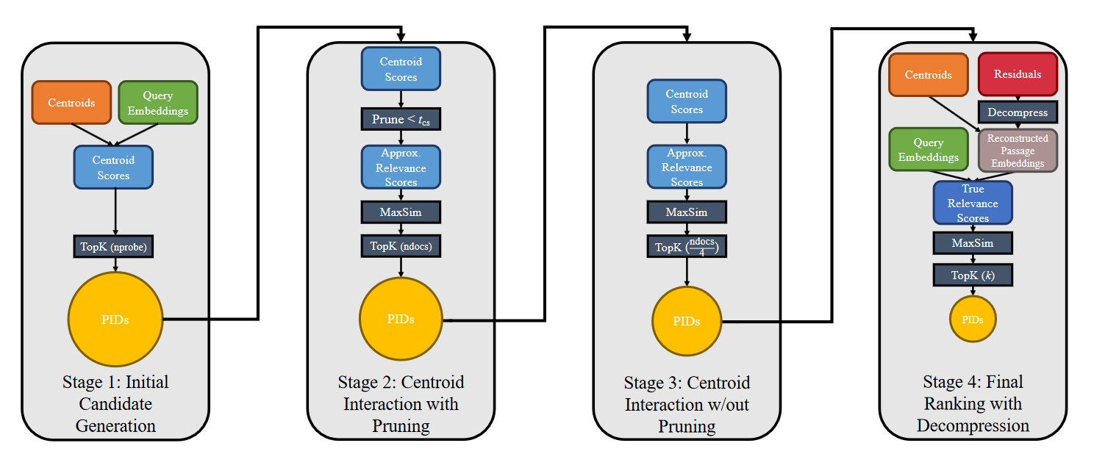
COLBERT Retrieval
Santhanam, Keshav, et al. "PLAID: an efficient engine for late interaction retrieval." Proceedings of the 31st ACM International Conference on Information & Knowledge Management. 2022.

Slide 21
COLBERT Retrieval
Stage 1
  Let C be the matrix of all centroid embeddings.
  Let Q be the query embeddings, obtained after encoding query.
  Compute similarities between each
  the passages “close” to the top-nprobe centroids per query token are the initial candidate set
Santhanam, Keshav, et al. "PLAID: an efficient engine for late interaction retrieval." Proceedings of the 31st ACM International Conference on Information & Knowledge Management. 2022.

Slide 22
COLBERT Retrieval
Stage 2: Representational Composition
  Suppose I is the list of the centroid indices mapped to each of the tokens in the candidate set
  Compute approximate similarity, where each token is represented by its nearest centroid embedding
Santhanam, Keshav, et al. "PLAID: an efficient engine for late interaction retrieval." Proceedings of the 31st ACM International Conference on Information & Knowledge Management. 2022.

Slide 23
COLBERT Retrieval
Stage 2: Representational Composition
  Suppose I is the list of the centroid indices mapped to each of the tokens in the candidate set
I = [x,3,y,z,…]
|C|
S[3]
I₂
S[3]
|P|
|Q|
|Q|
Santhanam, Keshav, et al. "PLAID: an efficient engine for late interaction retrieval." Proceedings of the 31st ACM International Conference on Information & Knowledge Management. 2022.

Slide 24
COLBERT Retrieval
Stage 2: Pruning
  To make matrix even smaller, only tokens, whose corresponding centroid i has max similarity to query higher then threshold are considered
    In implementation,
    these rows can be actually pre-flagged in S
S[3]
|P| - (# of filtered by threshold)
|Q|
Santhanam, Keshav, et al. "PLAID: an efficient engine for late interaction retrieval." Proceedings of the 31st ACM International Conference on Information & Knowledge Management. 2022.

Slide 25
COLBERT Retrieval
Stage 2
  Top-ndocs scoring documents are selected into
  passage IDs (PIDs) candidate set for stage 3
Santhanam, Keshav, et al. "PLAID: an efficient engine for late interaction retrieval." Proceedings of the 31st ACM International Conference on Information & Knowledge Management. 2022.

Slide 26
COLBERT Retrieval
Stage 3
  Same as stage 2, but without filtering, considering all rows of S.
  Top-(ndocs/4) passages are selected for final processing (Stage 4).
Santhanam, Keshav, et al. "PLAID: an efficient engine for late interaction retrieval." Proceedings of the 31st ACM International Conference on Information & Knowledge Management. 2022.

Slide 27
COLBERT Retrieval
Stage 4
  Final set of candidates is decompressed, and
  exact max-sim operation is computed for these in FP32.
  All steps are done to minimize
    candidate index lookup (looking for cluster/residual of particular passage)
    decompressed of candidates (both steps are very slow).
    Board: How to do dequantization?
  Final top-k results are returned, along with similarities.
Santhanam, Keshav, et al. "PLAID: an efficient engine for late interaction retrieval." Proceedings of the 31st ACM International Conference on Information & Knowledge Management. 2022.

Slide 28
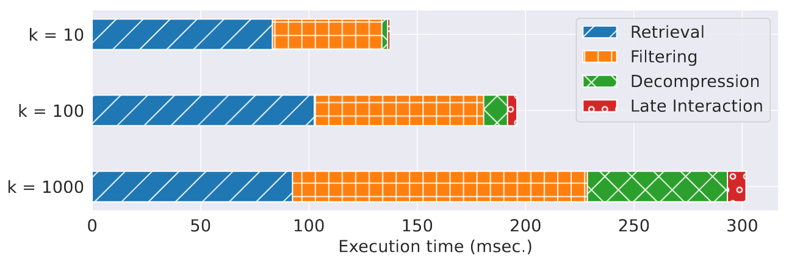
COLBERT Retrieval Speed on MS-MARCO
Nardini, Franco Maria, Cosimo Rulli, and Rossano Venturini. "Efficient Multi-vector Dense Retrieval with Bit Vectors." European Conference on Information Retrieval. Cham: Springer Nature Switzerland, 2024.

