Slide 1
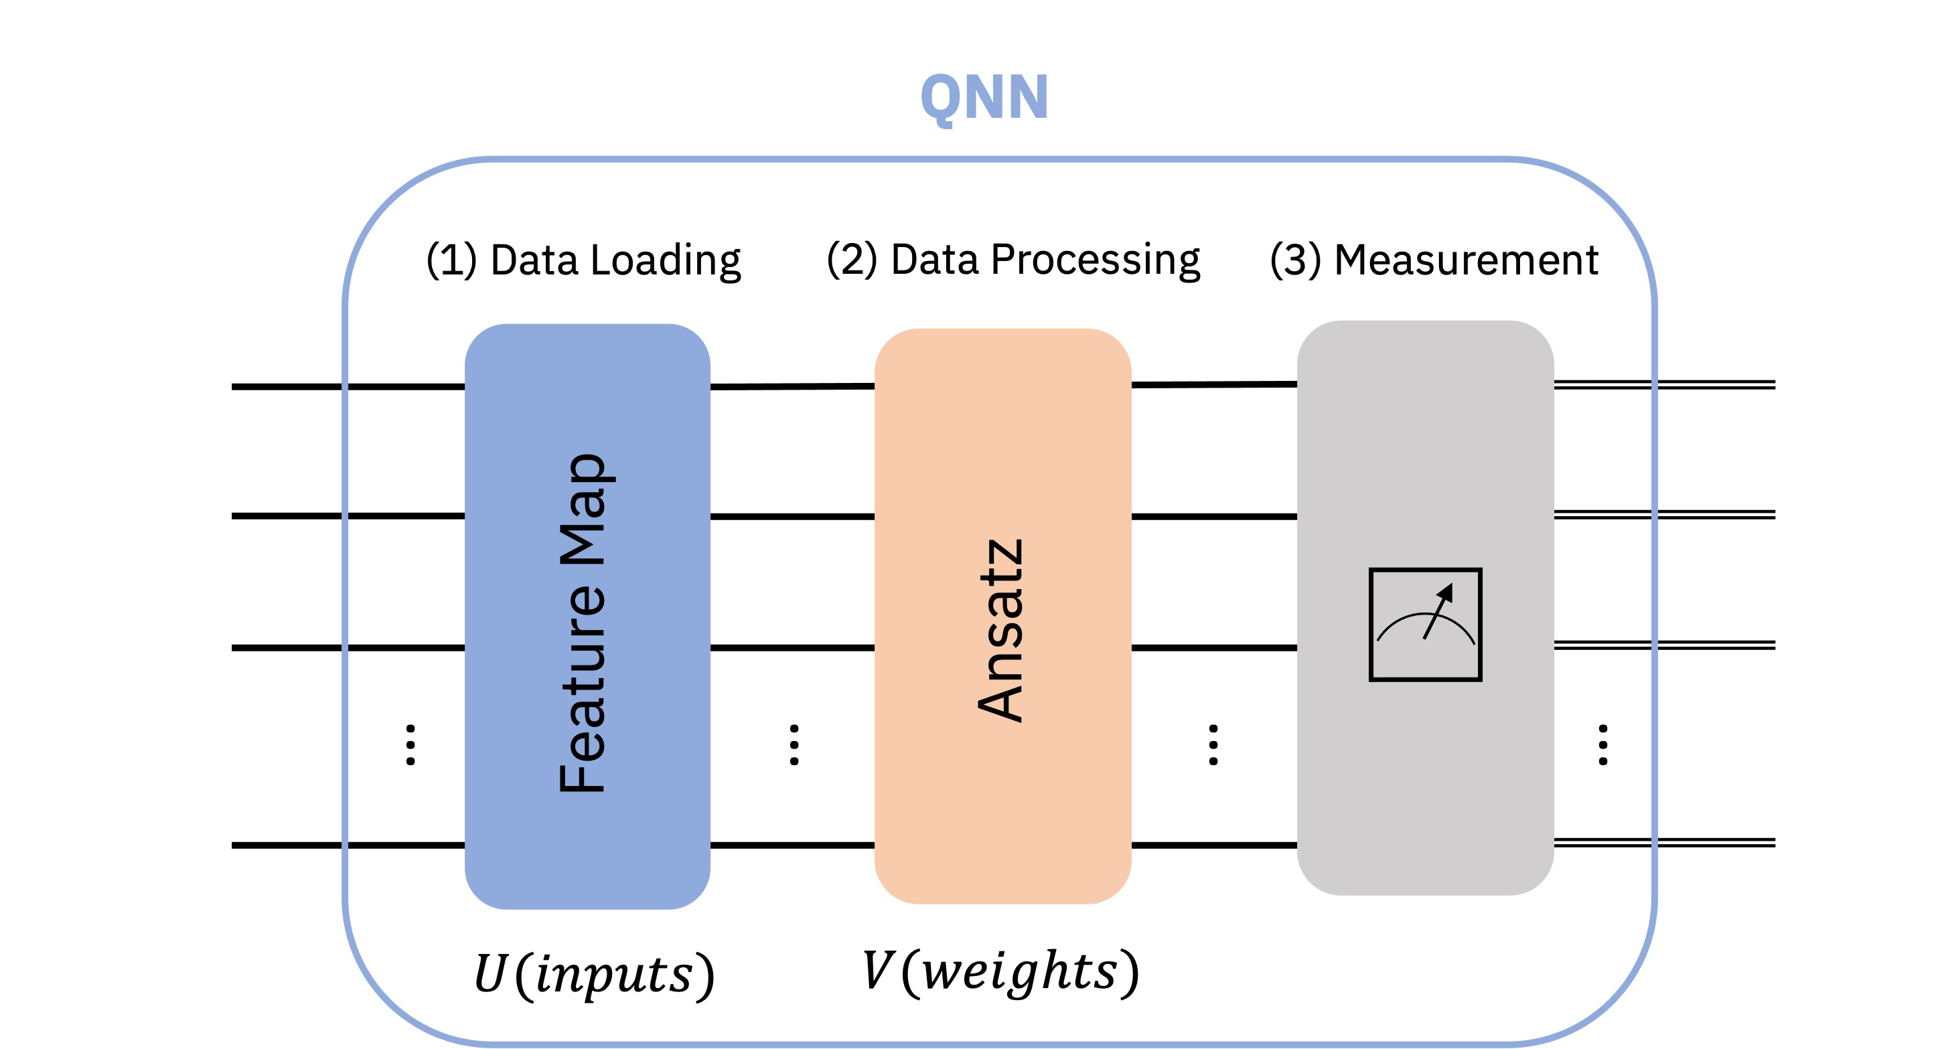
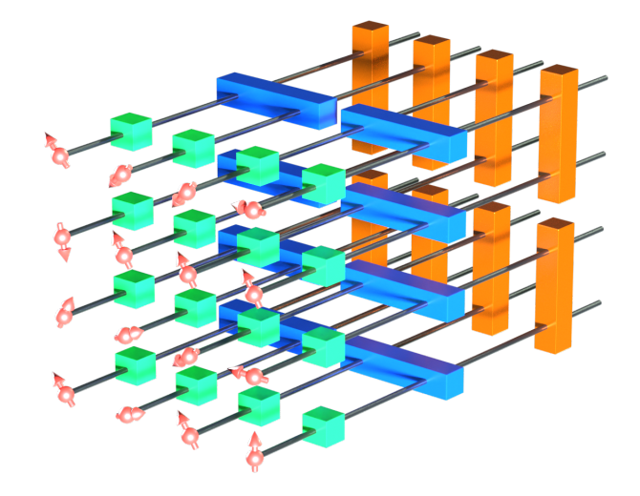
Quantum Neural Networks: What are they good for?
How do they work?
What are the potential advantages/disadvantages?
How does the state-of-art compare to traditional ANNs?
I aim to tame the complexity of the topic

