Slide 1
VB036 Session 3

Slide 2
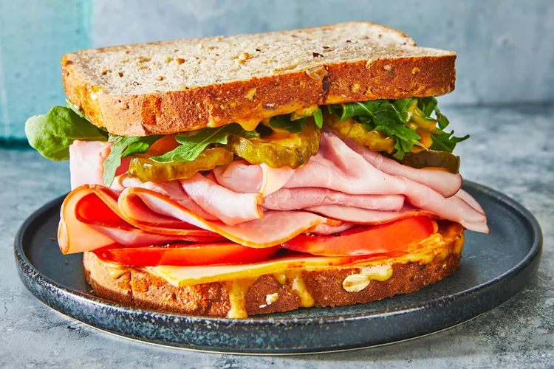
You might have heard of the sandwich feedback approach. What do you think it means? Would you like to be given feedback this way? Why? Why not?
1. ____________________
2_____________________
3._____________________

Slide 3
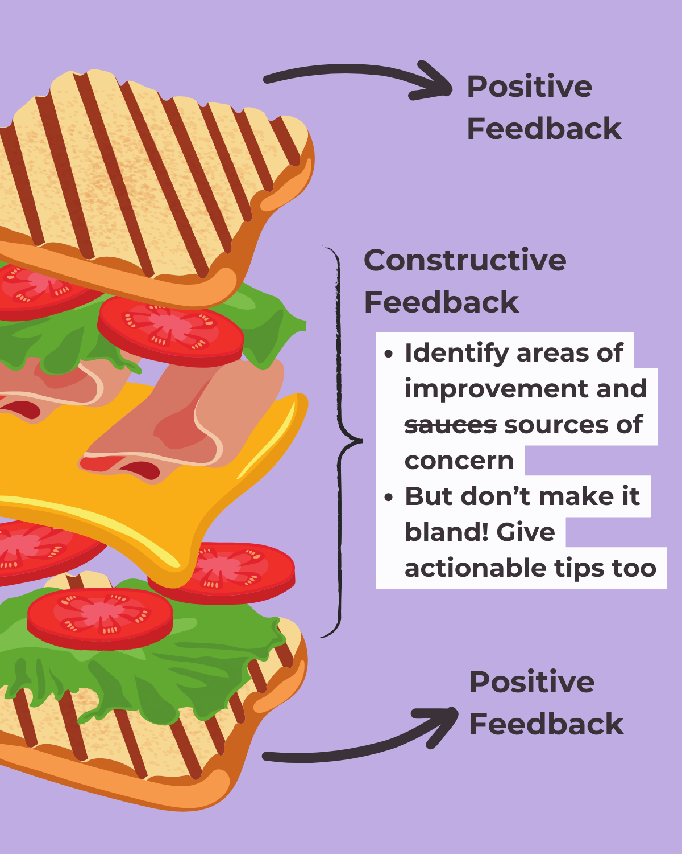

Slide 4
Strategies to give feedback
Provide both positive and negative aspects of a performance
Language to praise: I appreciate how you…
I was impressed by… You did well with… Great job on…
Language to express criticism and suggestion: You could … I would like to see more … I think you should… One area to work on …. One suggestion is… It might help to…

Slide 5
“Something I really appreciate about you is...." ..
“I think you did a great job when you… ...
“I would love to see you do more of X as it relates to Y” ...
“One of the things I admire about you is…”

Slide 6
1) Describe what your peer did rather than pass judgment
ie. Instead of saying “it’s good”, say something like “you used a wide variety of sentence structures that made it more interesting to listen to you”
2) Praise
Tell your peer what they did well!
I think you used a lot of good details
I liked when you used the word ______
My favorite part was ________ because…

Slide 7
Take-aways
Be specific
Stay positive
Your goal is to help your peer improve
Feedback is not about correcting mistakes and editing
Feedback is providing guidance

