Slide 1
Flooding Denial of Service attacks detection on the source client hosts
Vít Bukač

Slide 2
Definitions
Denial of service attack (DoS)
  An attempt to make a computer resource unavailable to its intended users
Flooding DoS
  Flooding attacks are performed by initiating a vast amount of seemingly legitimate transactions.

Slide 3
Aim of the thesis
Design a new flooding denial-of-service attacks detection method for client hosts
Measure its effectiveness

Slide 4
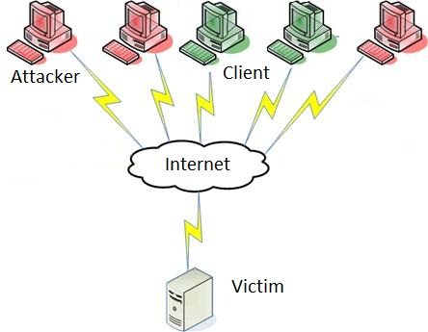

Slide 5
State of the Art – source network
D-WARD: A Source-End Defense against Flooding Denial-of-Service Attacks
  Sending rate/response rate packet ratio
Filtering spoofed traffic at source end for defending against DoS / DDoS attacks
  Simultaneous connections
  Learning period + attack period

Slide 6
State of the Art – source host
DDoSniffer: Detecting DDOS Attack at the Source Agents
  Low packet connections, number of new connections, IP spoofing
  Limited class of attacks, fixed thresholds
A P2P-Based Distributed Detection Scheme against DDoS Attack
  Packet count, traffic volume
  Collaborative

Slide 7
Why source client hosts?
Advantages
Disadvantages
Congestion avoidance
Small collateral damage
Easy traceback
Sophisticated algorithms
Forensics data
Access encrypted payload
Effectiveness
Deployment incentive
Hidden traffic
Agent shutdown

Slide 8
Detection method
Input: Host’s network traffic features
What: standalone detection engine, 2 stages
  Exclude demonstrably benign traffic
  Anomalies forward to second stage
  Verify anomalies with complex algorithms
Output: DoS attack Y/N, process ID

Slide 9
Research outcome
Papers
  Study of usability of existing methods for source host detection
  Description of the method incl. evaluation
  Extension for low-rate and pulsing DoS attacks
A prototype tool implementing the method

Slide 10
Conclusion
Research a new Denial of service attacks detection method for source client hosts
  2-stage architecture with multiple processing algorithms
Compare with existing solutions
So far unpopular, rarely explored

