Slide 1
Identifying aboutgrams in engineering texts

Slide 2
Introduction
n-grams, bundles, chunks, clusters
“idiom principle”
Phraseological studies - concgraming
Clusters -> as an alternative to KW -> phraseology

Slide 3
Concgrams
N-grams – contiguous
e.g. take part
Skipgrams
AB, A*B e.g. take no part, take an active part
Not positional variation (AB, BA)
“phrase-frames”
Concgrams
Irrespective of any constituency and/or positional variation
Starting point for quantifying the extend of phraseology

Slide 4
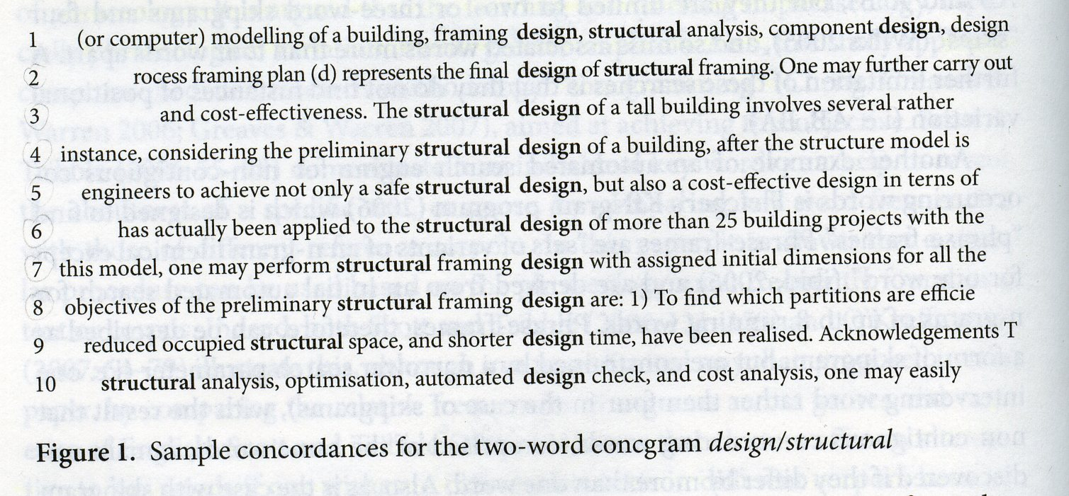
Concgrams

Slide 5
Aboutgrams
Aboutness is a product of the global patternings of a text = “macrostructure”
“aboutgrams” = word associations which are specific to a text
Aboutness
Highest freq. occuring lexical phrases comprise provisional aboutgram list
Equally or more freq. in corpus are removed
Specialized (HKEC) and general corpus (BNC)

Slide 6
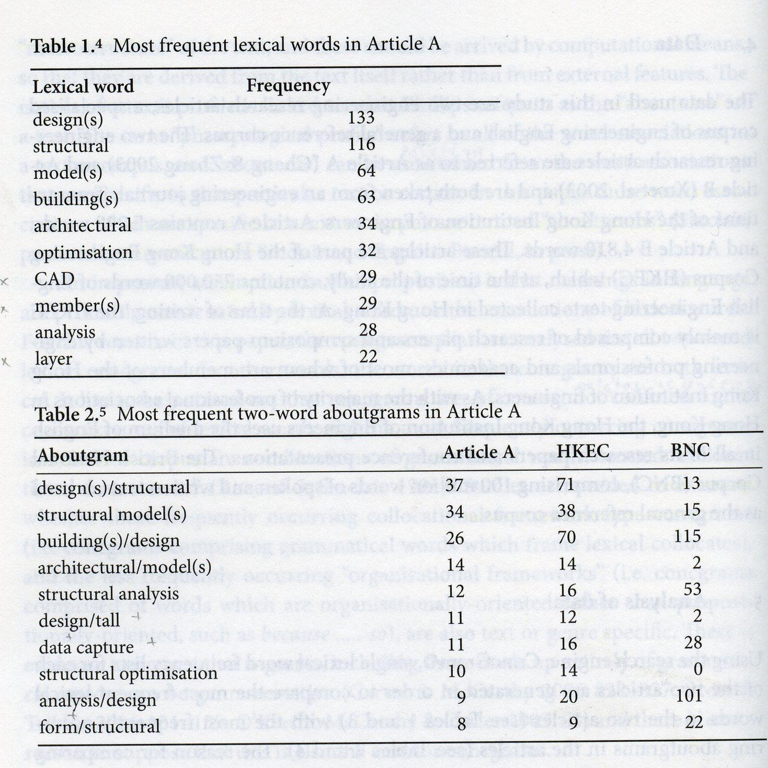
Analysis of data

Slide 7
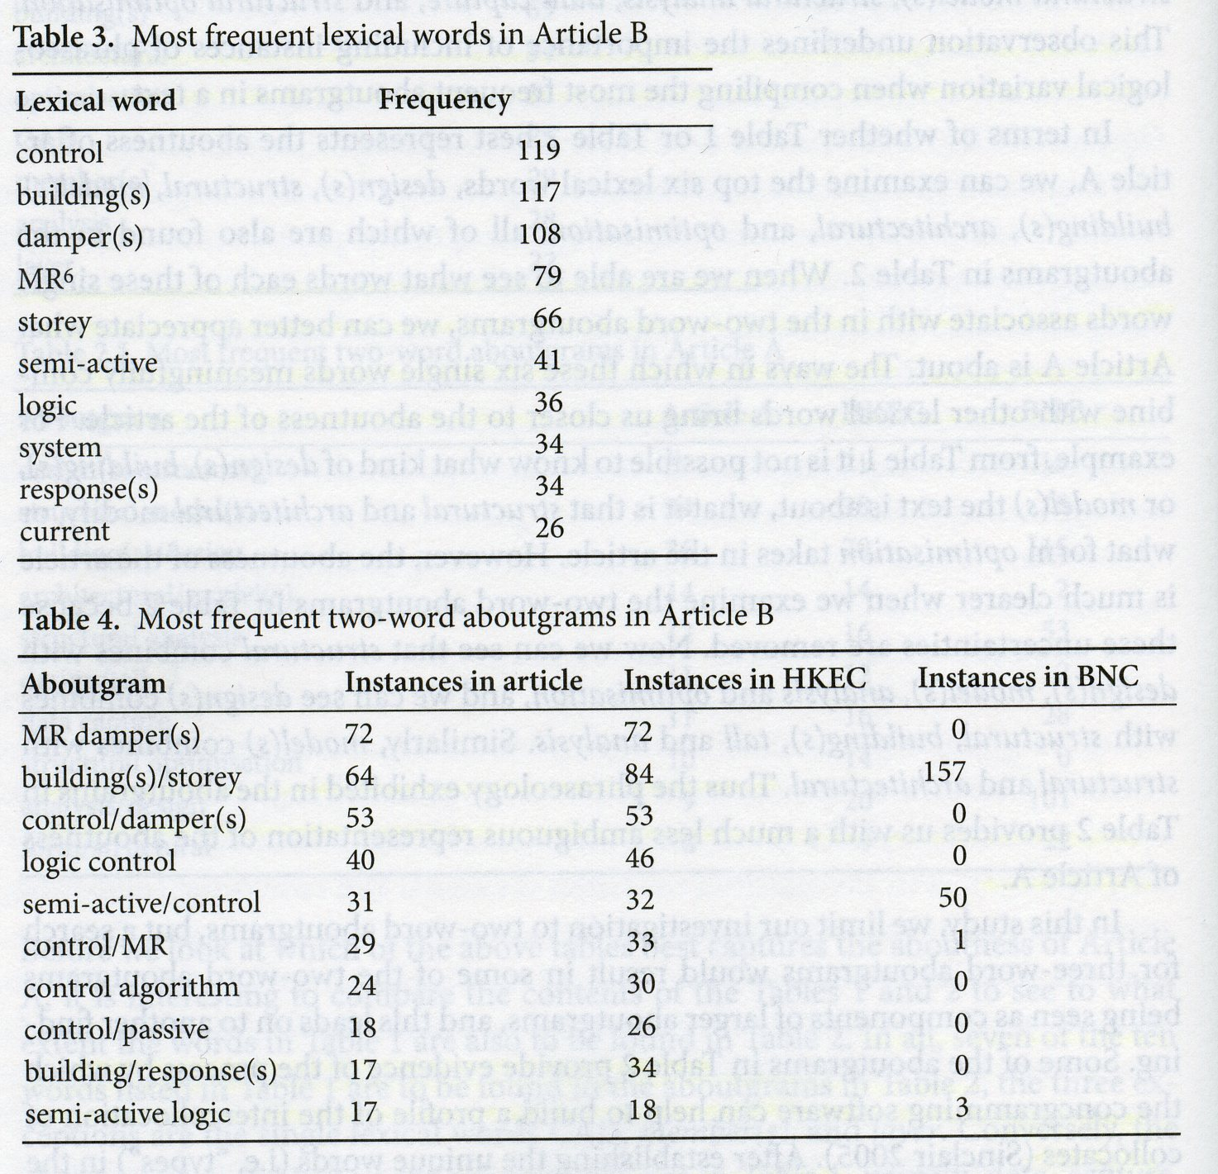
Analysis of data

Slide 8
Analysis of data
Intercollocation of collocates
Establish unique words ( i.e. “types”)
Search for word associated with them -> 2 word concgrams
2 word concgrams then become new origin
This process disambiguates words and a group gives a strong sense of the content, scope and argument of the document (design [of a] [for] tall building(s) – 11 instances)

Slide 9
Conclusion
Meaning arise from words in particular combination
Not rely entirely on KW
Aboutness, phraseology is not utilized
Create tentative aboutgrams
Confirmed with reference to both, spec. and general reference corpus
Human intervention in creating concgrams
Can be used in learning and teaching context with students of English to raise their awareness of the centrality of phraseology

