Slide 1
A contrastive analysis of keywords in newspaper articles on “Kyoto Protocol“
Erica Bassi
Presentation by Petr Dluhoš

Slide 2
Outline
Introduction
Data corpora
Semantic fields
Alarm/disaster meaning
Environment, gas collocations
Conclusions

Slide 3
Introduction
Kyoto protocol (1997)
Two newspapers
  Italian La Repubblica
  American The New York Times
Contrastive analyses of keywords

Slide 4
Data
La Repubblica
  832 texts
  500,000 words
The New York Times
  657 texts
  650,000 words
Articles from 1997 – 2006
Selected manually according to the theme

Slide 5
Reference corpora
The New York Times portion of the American National Corpus (4148 articles, 3.6 mil. words
La Reppublica corpus (380 mil. words)
Tools used:
  TreeTagger
  WordSmith Tools 4.0

Slide 6
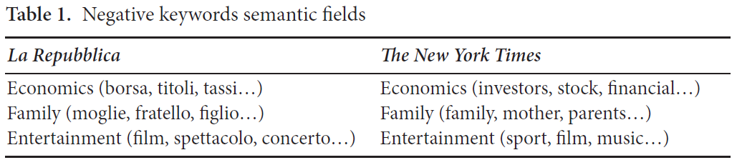
Extracting keywords
Positive and negative keywords
Manually grouped into semantic fields (economics, family, entertainment)

Slide 7
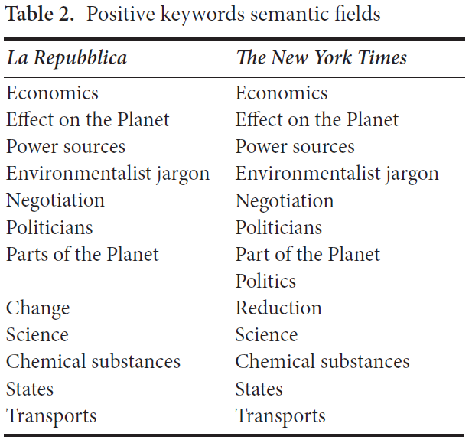
Positive keywords semantic fields

Slide 8
Differences among keywords in one semantic group - negotiation
Mainly in negotiation, change, effect on the planet
Negotiation
  NYT - disussing two different positions: talks, debate, negotiators
  LR – reaching an agreement: accords, targets, ratification

Slide 9
semantic group – change
NYT – privation and deficiency:
  reduction, cut, limits
LR – also other changes:
  reduction, increase, development

Slide 10
semantic group – effect on the planet
NYT – general effect, indirect :
  warming, greenhouse, pollution
LR – distaters, direct consequencies:
  hurricane, floods, drought

Slide 11
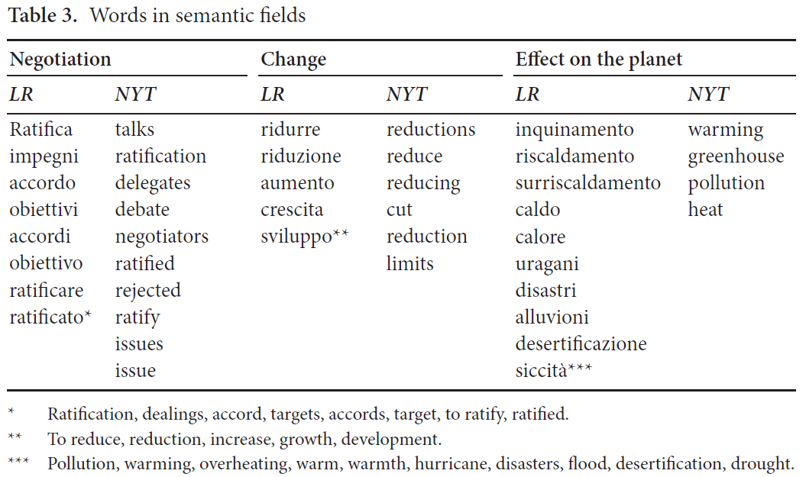
Detailed table

Slide 12
Alarm sub-corpora
To explain the last divergence
Articles selected manually
Reference corpora - whole Kyoto corpora
NYT - remote, distatnt problems:
  Ice melting, sea rising, birds, bears
LR – natural calamities:
  Disastre, hurricane, uragane

Slide 13
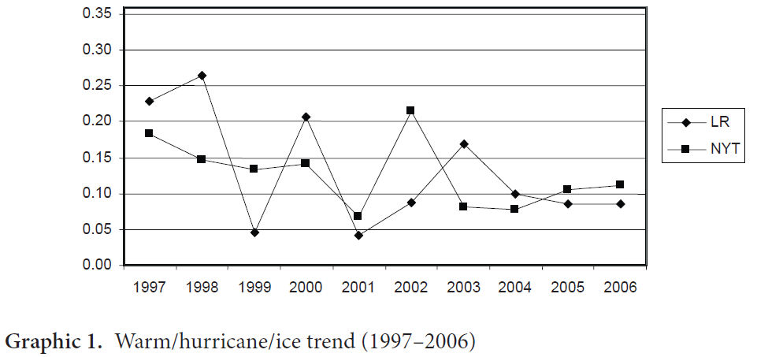
Time evolution of selected words (natural events)
According to whole Kyoto corpora

Slide 14
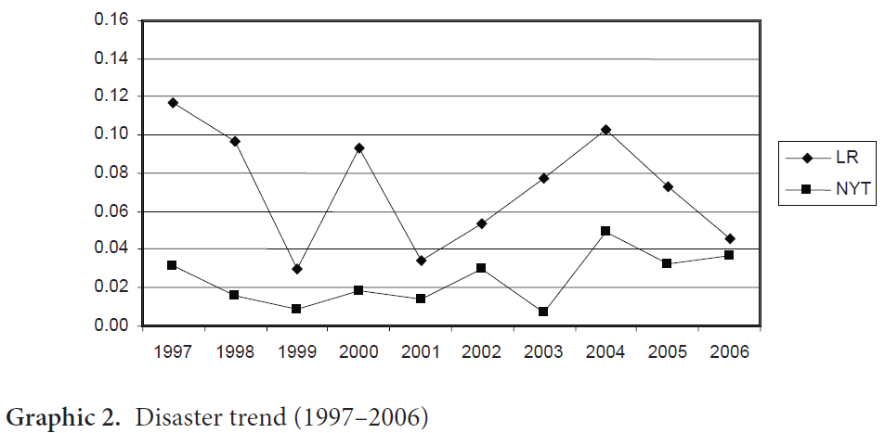
Time evolution of selected words
In the semantic field of “disaster”

Slide 15
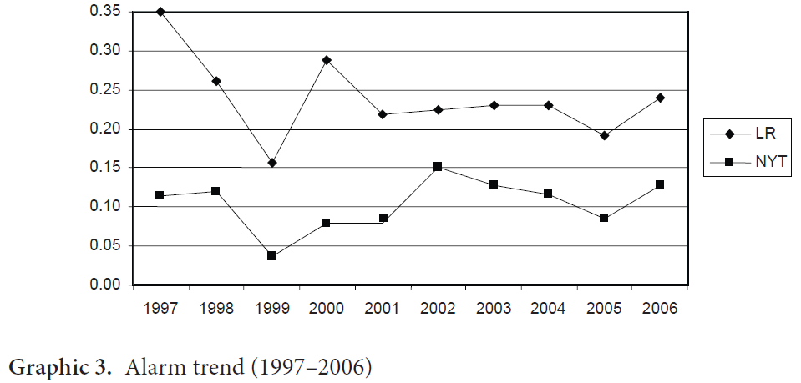
Time evolution of selected words
In the semantic field of “alarm”

Slide 16
Concordance of “environment” and “gas”
Environment –
  1st positive in LR,
  35th in NYT
Gas –
  LR – judgement, negative attitude (harmful, toxic, cause, responsible)
  NYT – uncertainity, doubts (contribute, believed, linked, scientists)

Slide 17
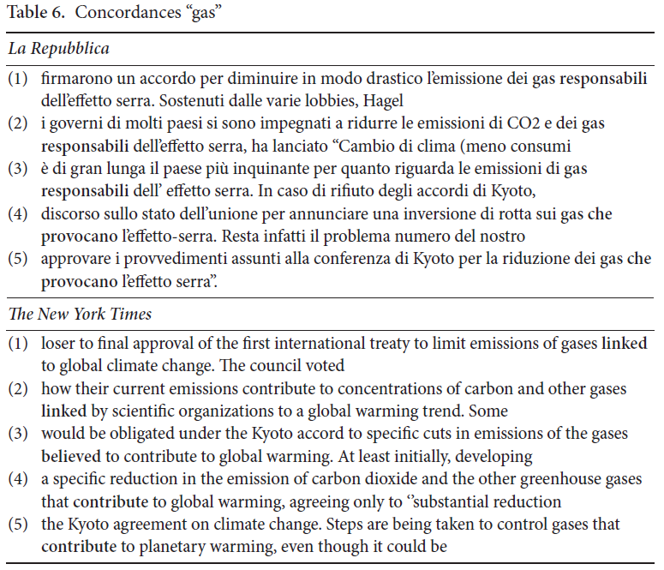
Concordance of “gas”

Slide 18
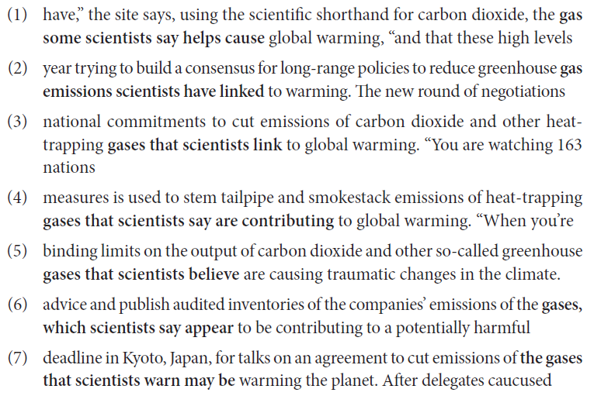
Concordance of “gas” – uncertainity in NYT

Slide 19
Conclusions
Same semantic fields, different meanings
USA – negotiations, difficulty of change
Italy – agreement, awareness of negative consequencies
Which approach is better?
  USA – unrealistic difficulties, ignoring Kyoto protocol as a solution
  Italy – myth of an easy redemptive solution

